Slide 1
A Testbed for Quantum Error Correcting Codes
Team : 'Fault Intolerant' (Tom O'Leary)
Email: thomas.oleary@lmh.ox.ac.uk

Slide 2
The source material
'Decoding Quantum Errors With Subspace Expansions'
Jarrod R. McClean, Zhang Jiang, Nicholas C. Rubin, Ryan Babbush & Hartmut Neven.
Nature Communications, (2020)11:636, https://doi.org/10.1038/s41467-020-14341-w

Slide 3
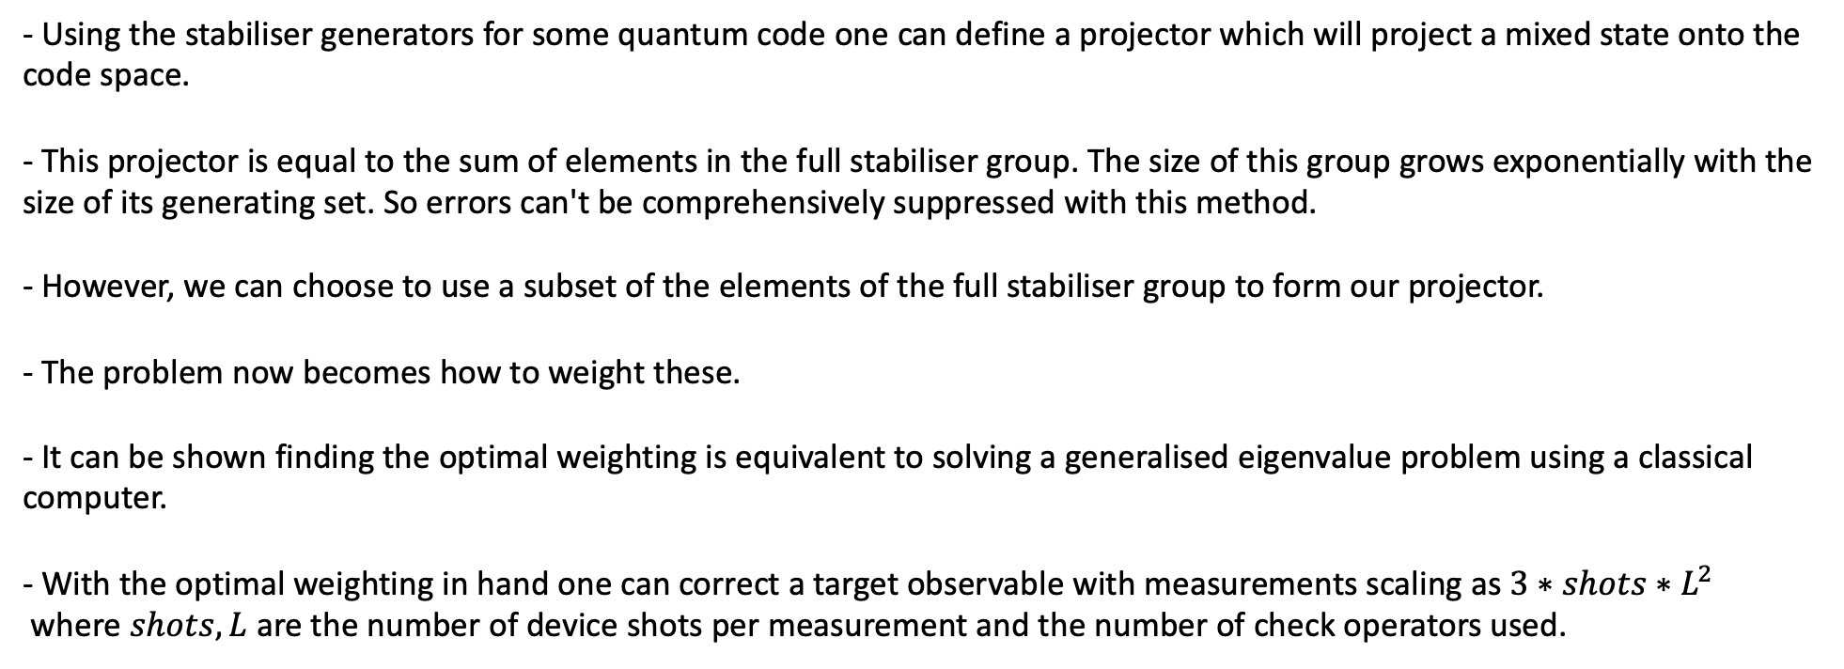
The method in a slide
- Using the stabiliser generators for some quantum code one can define a projector which will project a mixed state onto the code space.
- This projector is equal to the sum of elements in the full stabiliser group. The size of this group grows exponentially with the size of its generating set. So errors can't be comprehensively suppressed with this method.
- However, we can choose to use a subset of the elements of the full stabiliser group to form our projector.
- The problem now becomes how to weight these.
- It can be shown finding the optimal weighting is equivalent to solving a generalised eigenvalue problem using a classical computer.
- With the optimal weighting in hand one can correct a target observable with measurements scaling as $3∗shots∗L^{2}$
where $shots, L$ are the number of device shots per measurement and the number of check operators used.

Slide 4
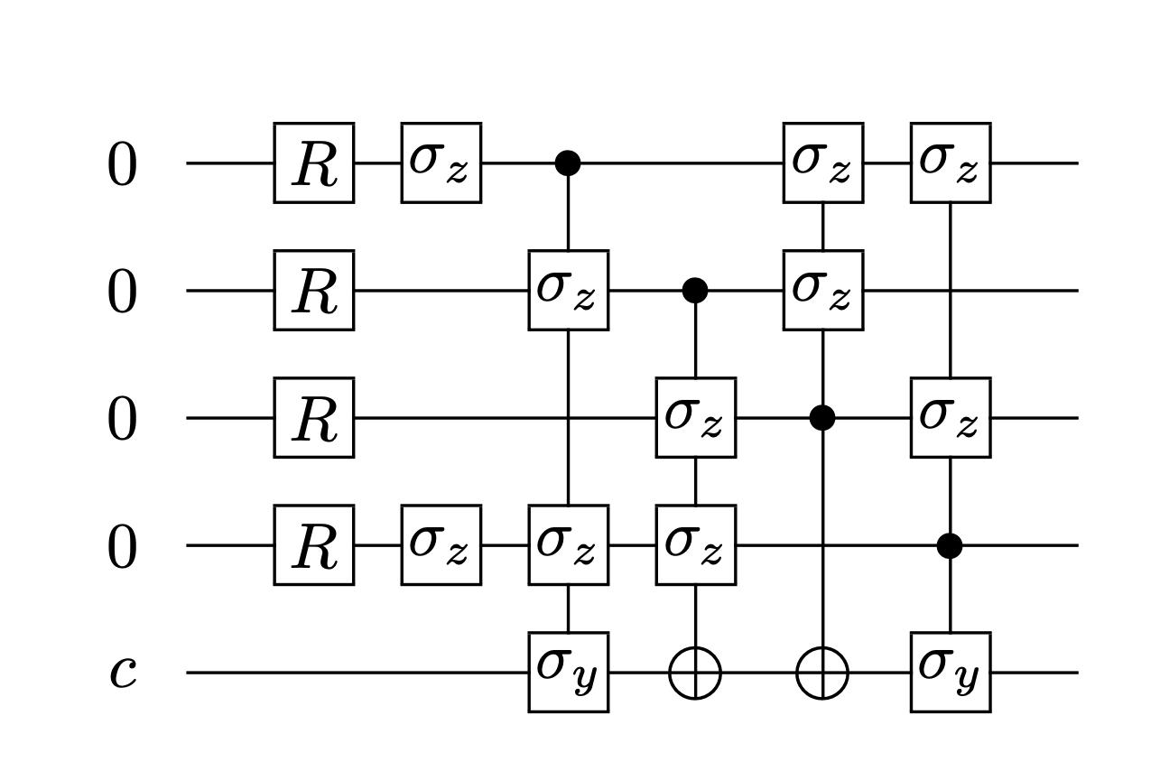
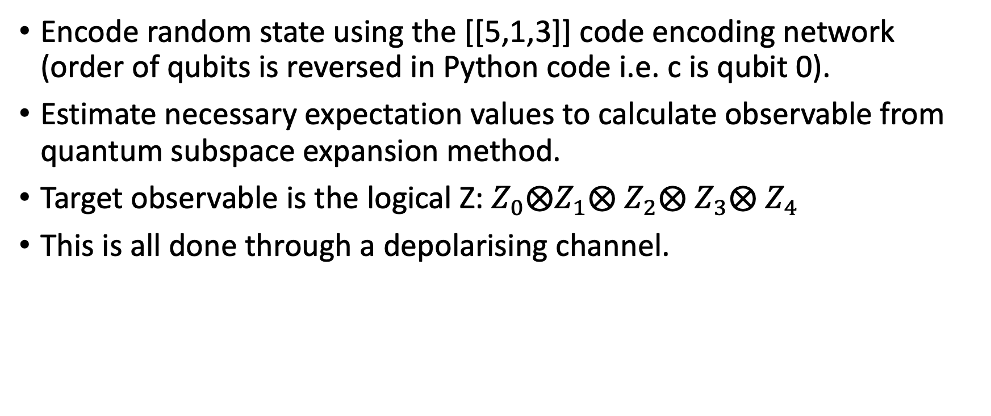
The Toy Problem
Encode random state using the [[5,1,3]] code encoding network (order of qubits is reversed in Python code i.e. c is qubit 0).
Estimate necessary expectation values to calculate observable from quantum subspace expansion method.
Target observable is the logical Z: $Z_{0}⨂Z_{1}⨂$ $Z_{2}⨂$ $Z_{3}⨂$ $Z_{4}$
This is all done through a depolarising channel.
Gottesman - 1997 - Stabilizer Codes and Quantum Error Correction

Slide 5
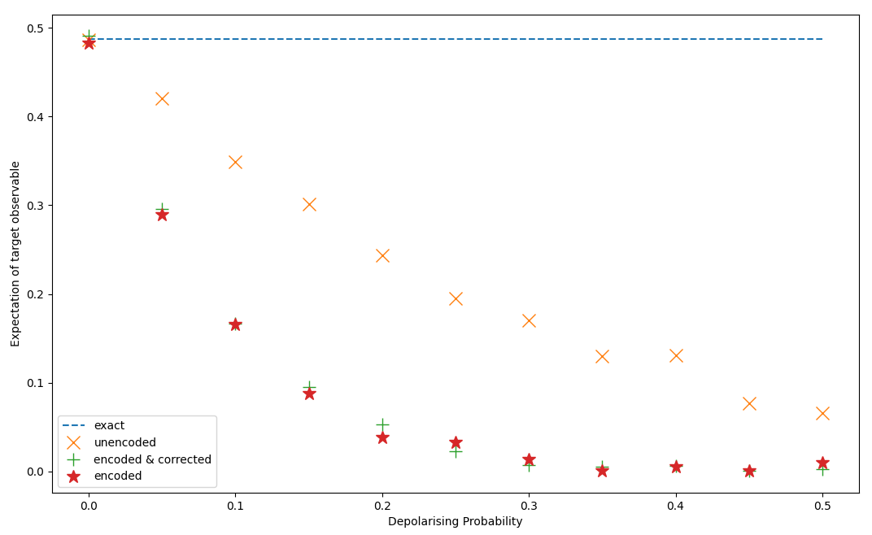
Results
Estimate of expectation of logical Z for a randomly chosen single qubit state. 'Exact' is expectation of single qubit Pauli Z with no noise. 'Unencoded' is expectation for single qubit Pauli Z with noise. 'Encoded & corrected' is expectation of logical Z for 5 qubit code with encoded single qubit state and with QSE correction applied. 'Encoded' is with no QSE correction applied.

Slide 6
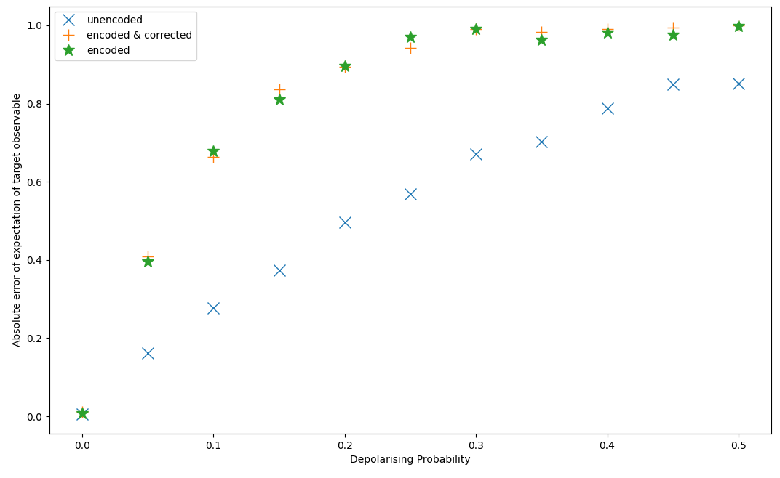
Results
Absolute error with exact expectation of target observable. Labels correspond to same cases as on previous slide.

Slide 7
If I had two more weeks (or if my laptop charger didn't break!)
Understand if presence of noise in encoding network contributed to lack of efficacy of the encoding and correction.
Use as a pedagogical tool to observe the relationship between the optimal weighting of check operators and the choice of noise model .
How does the choice of check operators affect the numerical stability of the generalised eigenvalue problem

Slide 8
If I had two more weeks (or if my laptop charger didn't break!) [cont].
Observe the effects for more target observables which can't be efficiently classically simulated.
Observe the effects for different noise models & real device noise. Control noise on real device by adding layers of redundant operations of increasing depth.

Slide 9
Contributions
Open source implementation using Qiskit. (While for the purposes of this hackathon an artificial parameterised noise model was chosen, this could be removed in favour of a backend of choice)
Observing the accuracy of estimation of a Pauli observable.
Generic code structure intended to be easily adapted to other choices of quantum codes and elements of stabiliser group for the expansion.

