Slide 1
Kaplan-Meier Analysis using caIntegrator, and the Generation of Prognosis-predicting Gene Sets: Identification of 14 Biomarkers Associated with Dire Outcomes in Brain Cancer.
Thomas R. Boal, PhD.
NARTech, Inc.
Bethesda, MD.
boalt@mail.nih.gov
Presented at the 2009 caBIG Annual Meeting

Slide 2
The caBIG caIntegrator tools allow one to perform Kaplan-Meier (K-M) analysis on large clinical datasets.
For example, the "Kaplan-Meier survival plot for Gene Expression Data" tool in the Rembrandt web application allows one to enter a HUGO gene name and compare K-M survival plots for up-regulated gene expression vs. down-regulated gene expression patient subsets.

Slide 3
caIntegrator
A caBIG set of tools for analyzing data
Data warehouse for large clinical datasets: (1) demographic and patient information (age, date of cancer occurrence, date of death, etc)
Web Applications that serve as front ends to the data warehouse backends (Rembrandt, CGEMS, CMA, etc)
Non-GUI interfaces are partially implemented (Java API, Grid Services, etc)
Includes both public data (no log-in required) and private data (password protected)

Slide 4
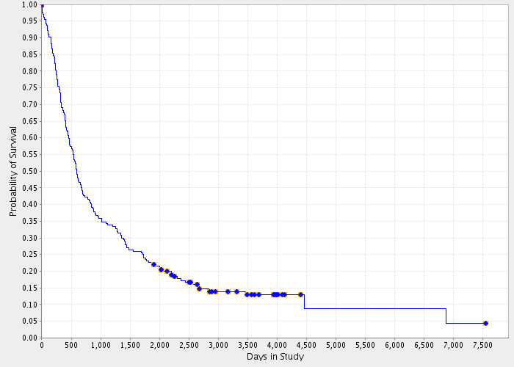
Kaplan-Meier Analysis
Plots probability of survival vs. time
Typically resembles exponential decay (see K-M plot of all Rembrandt patients at right).
A rough gauge of survivability is the “half-life”: the point where the K-M plot crosses P = 0.5 on the Y-axis. For instance, on the K-M plot below, the half-life is around 600 days.
Kaplan-Meier Survival Plot for All Public Rembrandt Samples

Slide 5
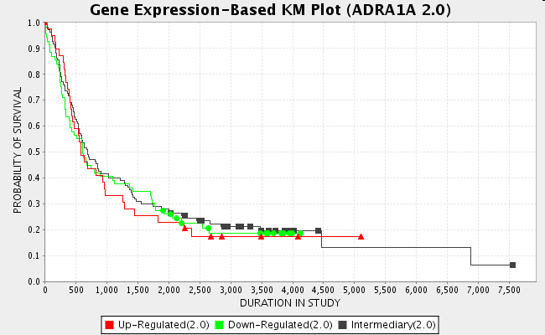
Kaplan-Meier Analysis
One can compare two superimposed Kaplan-Meier curves that represent two conditions (male vs. female, Caucasian vs. Black, etc).
The extent that two superimposed K-M plots are significantly separated is reflected in a probability (“p-value”). A p-value of near 1.0 (e.g., 0.99) shows essentially no difference: the curves are often nearly 100 % superimposible (see K-M plot at right).
The smaller the p-value, the more statistically significant the result. Generally, p < 0.001is required.
Up-Regulated(2.0): 39 samples
Down-Regulated(2.0): 69 samples
Intermediary(2.0): 110 samples
Log-rank p-value (for significance of difference of survival between group of samples)
Up-Regulated(2.0) vs. Down-Regulated(2.0) =0.99
Kaplan-Meier plot with superimposible subgroups.

Slide 6
Rembrandt
Repository for Molecular Brain Neoplasia Data
Clinical database of more over 900 study participants
https://caintegrator.nci.nih.gov/rembrandt/
Both public and password-protected datasets
Managed by the Lab of Dr. Howard Fine (NCI/CCR)

Slide 7
METHODS
An updated list of 28,165 current HUGO gene symbols was downloaded from http://www.genenames.org/ , resulting in genome-wide coverage.
Each HUGO gene symbol was sequentially fed into the Public CMA Rembrandt caIntegrator Gene Expression Kaplan-Meier engine( https://cma.nci.nih.gov/cma-rembrandt/geneView/index ) with the default settings (ALL_PATIENTS), using an IE automation tool written in Visual Basic (WebBrowser ActiveX Control http://msdn.microsoft.com/en-us/library/aa752040(VS.85).aspx).
The Statistical Report for each HUGO symbol (number of samples in each group and Log-rank p-values) was automatically written to a database (MS Access).

Slide 8
Out of 28,165 HUGO gene symbols, valid K-M data was returned for 14,842 genes.
11,706 genes returned “No reporters for this gene and platform”.
1617 HUGO genes (e.g., CUL3 )returned an invalid K-M report: “Up-Regulated(2.0) vs. Down-Regulated(2.0) =-100.0” (BUG).

Slide 9
The total number of genes that returned data, 16,459, was around 700 less than expected for the HG-U133_Plus_2 platform.
For instance, A2LD1gives “No reporters for this gene and platform” even though caBIO shows it has 2 reporters (232422_at and 237869_at) (BUG).

Slide 10
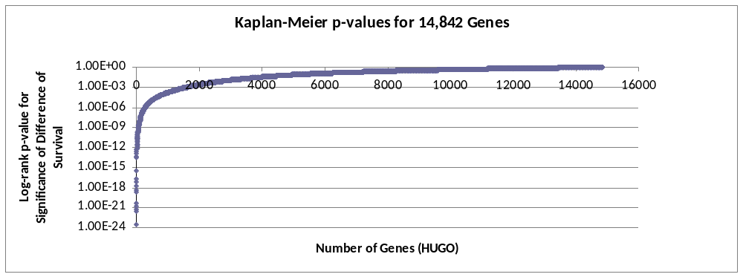
The distribution of the 14,842 K-M p-values are plotted above. They widely range from 3.35 E-24 to 0.999. Most have non-significant p-values (>0.01).

Slide 11
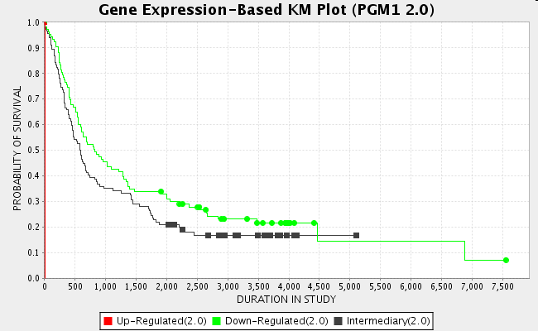
Those K-M plots with extremely small p-values appear to be artifacts of the algorithm (e.g., see PGM1, below).
Up-Regulated(2.0): 1 sample
Down-Regulated(2.0): 103 samples
Intermediary(2.0): 114 samples
Log-rank p-value (for significance of difference of survival between group of samples)
Up-Regulated(2.0) vs. Down-Regulated(2.0) =3.35 E-24
Kaplan-Meier plot of the gene with the smallest p-value

Slide 12
482 genes had highly significant p-values (<E-05) and were investigated further.
GSEA analysis (http://www.broadinstitute.org/gsea/ ) of the 482 candidate genes gave suggestive but inconclusive results. Gene Ontology analysis of the 482 genes using GoMiner (http://discover.nci.nih.gov/gominer/ ) showed several GO categories significantly enriched (e.g., GO:0030295_protein_kinase_activator_activity was enriched 13-fold with FDR = 0.070000).

Slide 13
14 genes were further selected as candidate prognosis biomarkers (see table and data below). They all showed extremely poor prognosis for patients who over-expressed the gene, as shown by their all reaching a premature 0.0 probability of survival. All had overall highly significant P-values (range of E-12 to E -06).

Slide 14
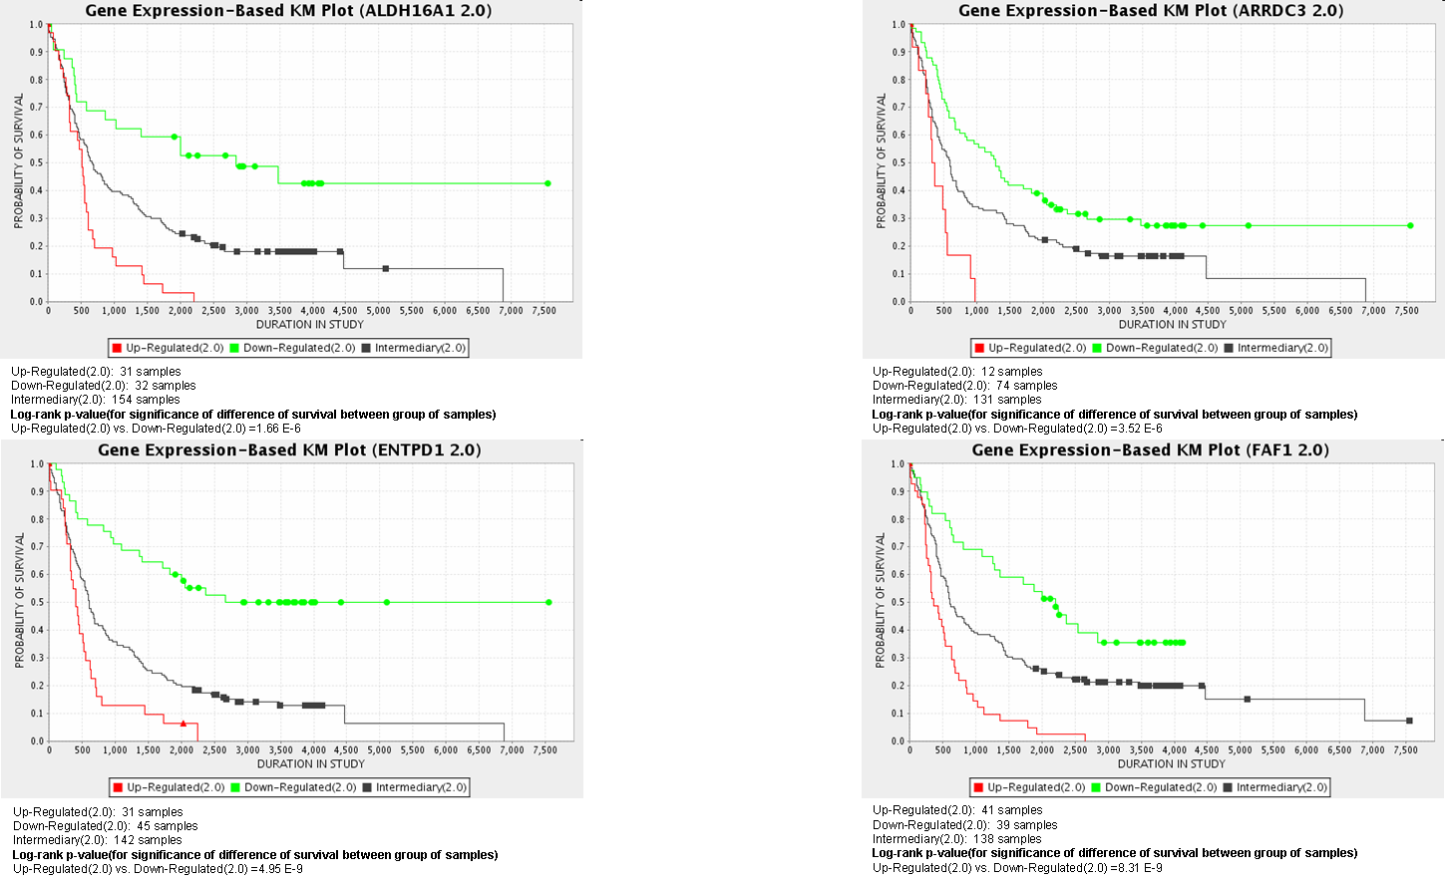
PROGNOSIS BIOMARKERS

Slide 15
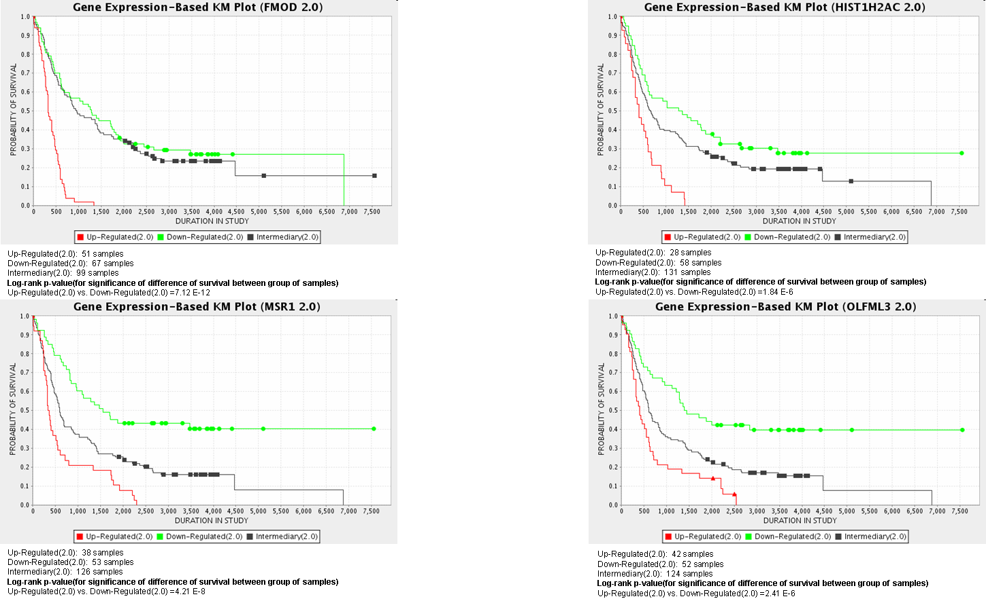
PROGNOSIS BIOMARKERS

Slide 16
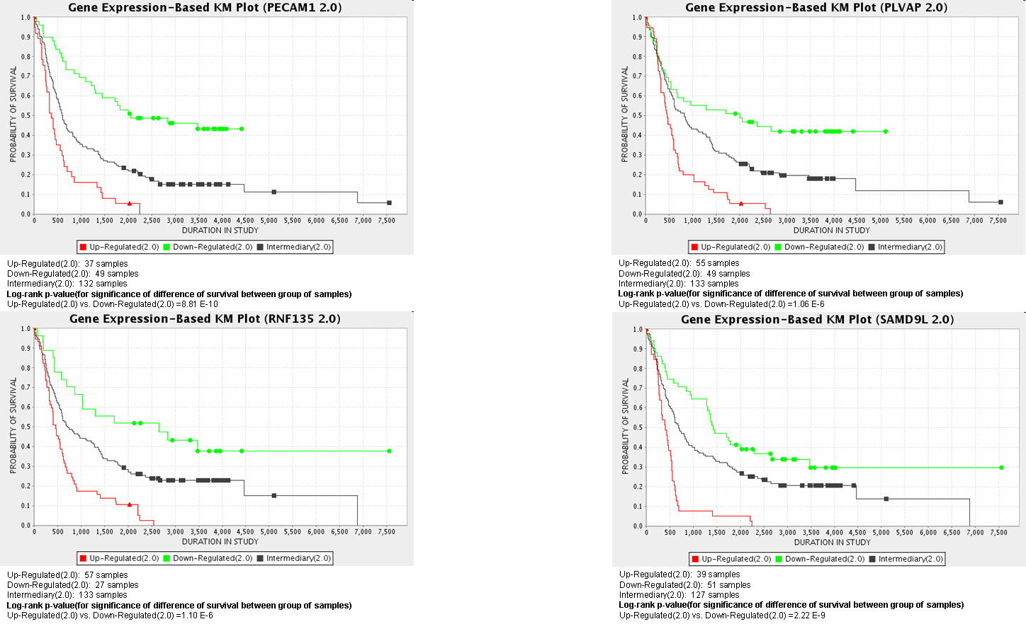
PROGNOSIS BIOMARKERS

Slide 17
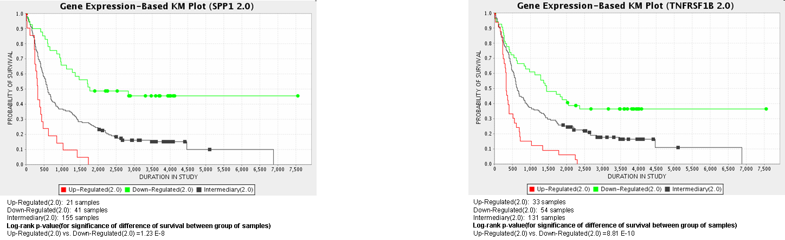
PROGNOSIS BIOMARKERS

Slide 18
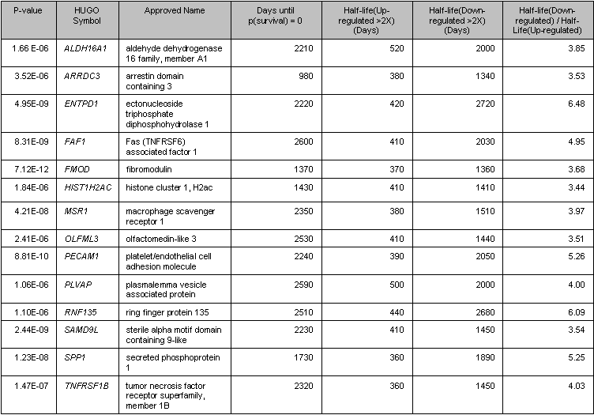
PROGNOSIS BIOMARKERS

Slide 19
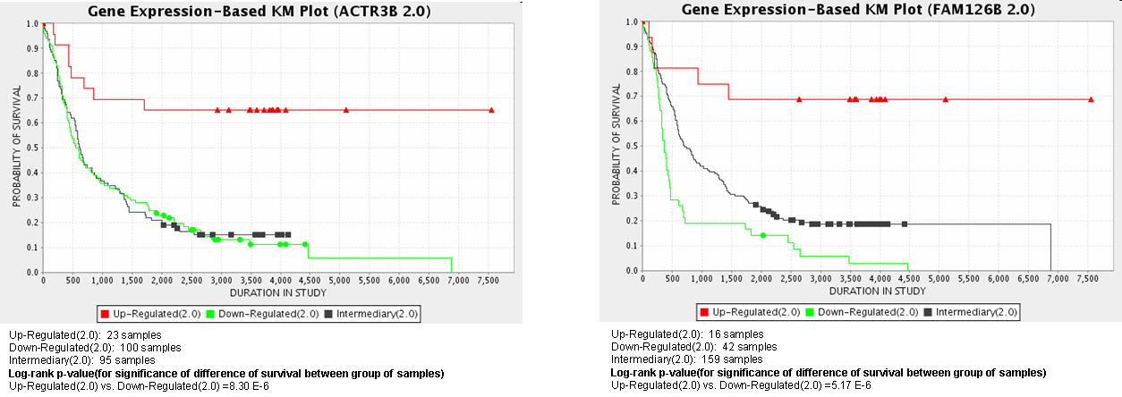
  Two additional genes (see ACTR3B and FAM126B above) seem to show good prognosis for over-expressers:
  the K-M plots never reach the p = 0.5 value, even after 20 years.

Slide 20
  There appears to be a dose-response effect of level of gene expression and poor prognosis. Thus, small molecules that inhibit these proteins (e.g., the enzymes ALDH16A and ENTPD1) might be attractive candidates for drug development. Poor prognosis could also potentially be reversed by antisense or siRNA inhibition.
  These results need to be replicated with an independent brain cancer dataset. A good candidate would be TCGA Glioma, which is also hosted on the CMA application.
  14 gene expression biomarkers have been identified that show potential for identifying post-surgery brain cancer patients with poor prognosis (100% of those with the phenotype die).
  If validated, e.g., by the FDA, these biomarkers could be a valuable tool in Personalized Medicine for brain cancer patients, and show the power of in-silico research.

