Slide 2

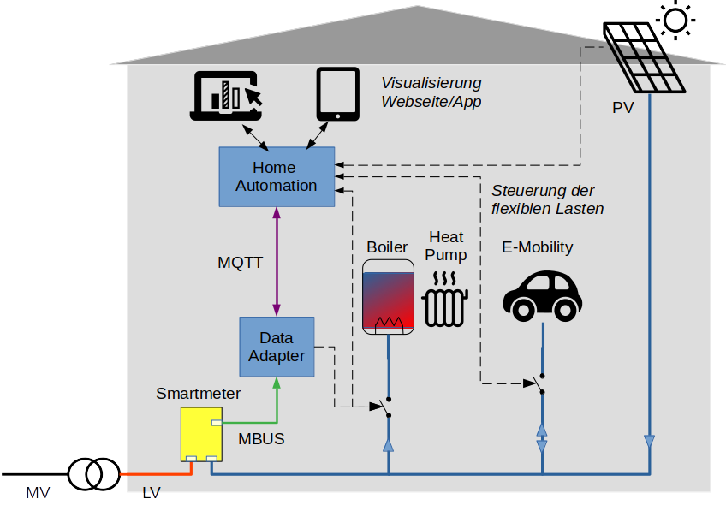
18
Empower citizens to use their own energy data. Using the smartmeter’s local interface for visualization and automation
Intro
Smart Meters rollout in Switzerland hardly deliver the promised energy savings because they do not yet provide customers with easy access to their data by a local interface CII.
Interfaces are not implemented uniformly by the manufacturers and are rolled out by distribution system operators (DSO) in different configurations.
Motivation
The easy and free access of consumption data is a crucial step in the energy transition and CO2 reduction and shall help to provide the following contribution
give customers transparency about their consumption in real time
change customer behavior in a sustainable way to save energy
create innovations that help customers to optimize their own consumption with self-generation (PV) and controllable consumers (car charging station, heat pump)

Slide 3
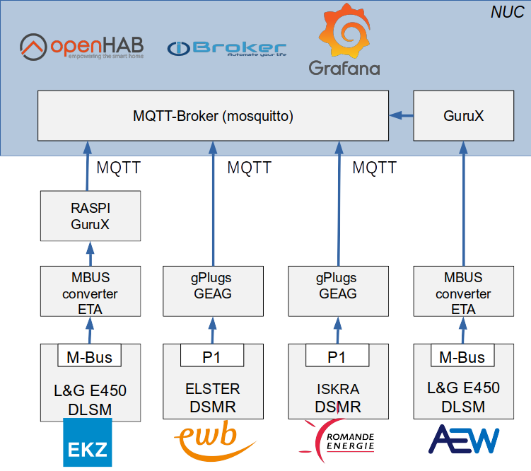
18
Empower citizens to use their own energy data. Using the smartmeter’s local interface for visualization and automation
Idea
Reading of data fro smart meter CII (DLMS, IDIS CII, DSMR-P1, MBUS), from different DSO (EKZ, AEW, EWB, Romande Energie)
Harmonized MQTT profile The MQTT topics should be standardized to provide interoperability between different smart meters and various applications.
Data
The data from the different meters are sent via MBUS or DSMR to a adapter which converts the data into MQTT. Different meters are provided by the DSO. The MQTT stream is then integrated into OpenHab and ioBroker.
Tasks
Setup of the different metering systems
Conversion of MBUS-DLMS/COSEM data into MQTT using the open-source library from gurux.fi and Adaption of the DSMR-P1 Protocol to MQTT
Integration of the smart meter data into ioBroker and OpenHab
Documentation of the interoperable MQTT interface
Interoperability test setup

Slide 4
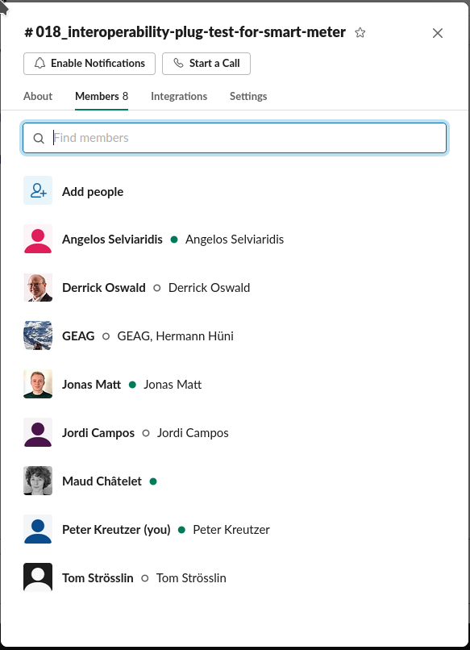
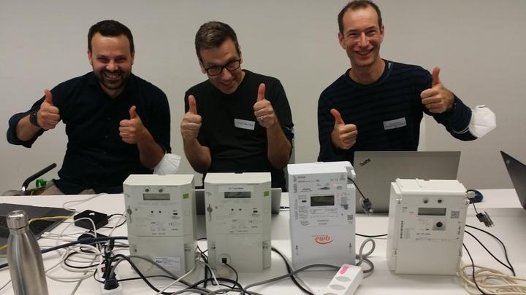
18
Empower citizens to use their own energy data. Using the smartmeter’s local interface for visualization and automation
All meters up and running !!!!

Slide 5
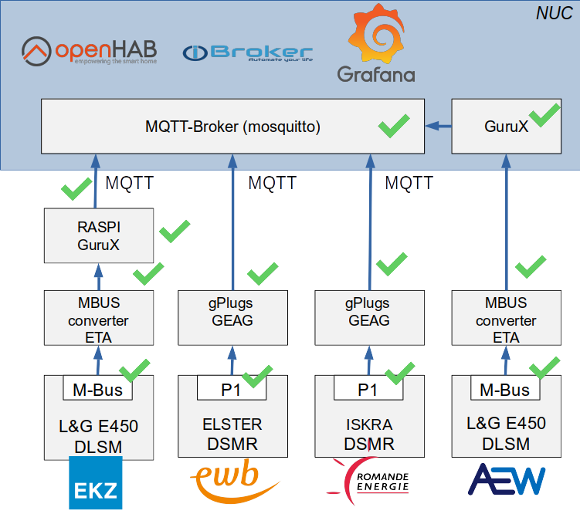
18
Empower citizens to use their own energy data. Using the smartmeter’s local interface for visualization and automation
Interoperability test setup
All data are flowing from the smart meters up to the central MQTT broker
The EKZ open source library is now able to read data from different smart meters !
MQTT transformation adapter implemented

Slide 6
18
Empower citizens to use their own energy data. Using the smartmeter’s local interface for visualization and automation
Central brocker shows all data from smart meter
different MQTT messages:
EKZ: smartmeter/LGZ1030655933512/ACTIVE_POWER_P {"value": 0.0, "timestamp": 1629055611}
Romande Energie: tele/gPlug11/SENSOR {"Time":"2021-09-24T17:56:38","z":{"Pi":0}}
AEW: smartmeter/12345/ACTIVE_POWER_P {"value": 71.0, "timestamp": 1632499152}
EWB: tele/gPlug10/SENSOR {"Time":"2021-09-24T17:03:45","z":{"Pi":0}}
Visualization to be done as next step – today
Tomorrow we can start analyzing the common profile and start implementing it into the setup

Slide 7
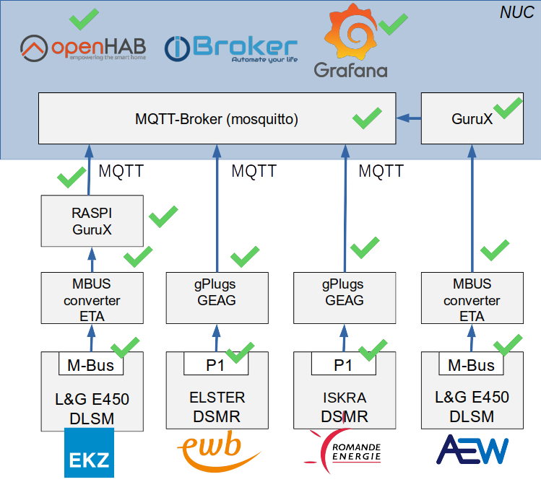
18
Empower citizens to use their own energy data. Using the smartmeter’s local interface for visualization and automation
Interoperability test setup
All data are read from the meter and connect to grafana and openhab
MQTT transformation adapter implemented and publishes a common profile for all meter

Slide 8
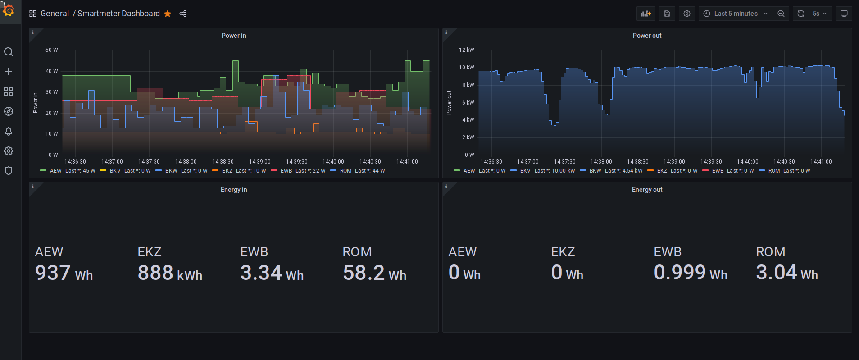
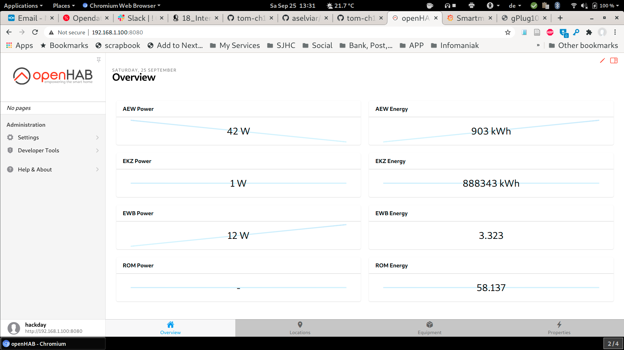
18
Empower citizens to use their own energy data. Using the smartmeter’s local interface for visualization and automation

Slide 9
18
Empower citizens to use their own energy data. Using the smartmeter’s local interface for visualization and automation
What is required to address the interoperability issue?
Establish a taskforce on VSE involving all DSO in switzerland to get harmonized publishing of OBIS data from the meter,
e.g.: Profile for consumer, prosumer ...
Embrace the open software project from EKZ to make the MQTT profile publishing publicly available → https://github.com/scs/smartmeter-datacollector
Start a open hardware project to have a plug and play device that implements the reading of the meter profile and publishes the MQTT profile
Build a community of users that actively maintains the projects

