Slide 1
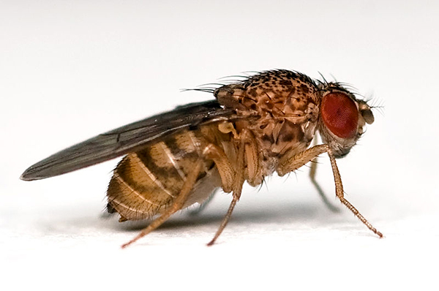


Quantitative measurements of olfactory perceptual thresholds in Drosophila
Allie Hexley
8/18/16
Allie Hexley | ahexley@mit.edu

Slide 2
Overview
1
Motivation
Constructing the behavior chamber
Preliminary data
Next steps

Slide 3
Overview
1
Motivation
Constructing the behavior chamber
Preliminary data
Next steps

Slide 4
Why quantify perceptual thresholds in Drosophila?
2
We want to quantitatively determine how differences in neural activity lead to differences in perceptual discrimination
Determine minimum concentration difference flies can detect and how that difference relates to a difference in number of neural spikes
Produce curves for behavior vs concentration and neural activity vs concentration

Slide 5
Why Drosophila?
3
Numerically compact brain and a sophisticated genetic toolbox for manipulating circuit functions
Olfactory neurons are stereotyped, so it is easy to find neurons with the same connectivity and physiology in every individual
Genetic labels for specific neurons and these labels can be used to target specific neurons for electrophysiological measurements

Slide 6
Why train the flies?
4
Previous work has shown that we can train flies via Pavlovian conditioning
Pairing an odor with electric shock causes learned aversion of that odor
Odors used in previous work and our work: 4-methylcyclohexanol (MCH) and 3-octanol (OCT)
We want to condition the animals so that we can push the perceptual thresholds to the limits and make sure we are calculating the minimum difference the flies can discriminate

Slide 7
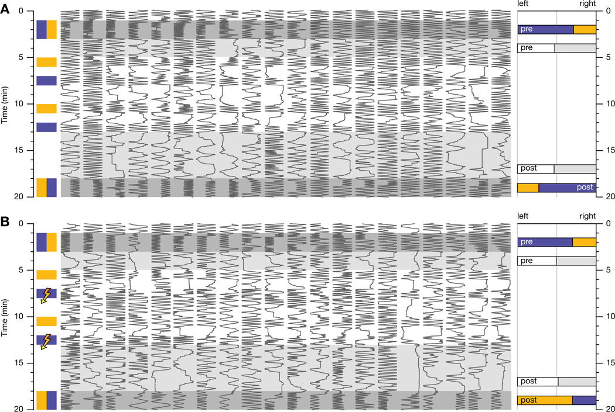
Pavlovian olfactory conditioning causes learned aversion
5
Claridge-Chang et al., 2009

Slide 8
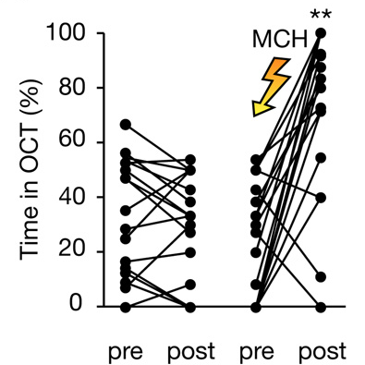
Individual flies show learned aversion
6
Claridge-Chang et al., 2009

Slide 9
Investigating behavior across concentration
7
Previous work has not tested varying concentrations of odor and looked at performance limits
What is the minimum concentration difference that the flies can distinguish?
How does this minimum concentration difference relate to a difference in neural activity?

Slide 10
Overview
8
Motivation
Constructing the behavior chamber
Preliminary data
Next steps

Slide 11
Overview
8
Motivation
Constructing the behavior chamber
Preliminary data
Next steps

Slide 12
Specifications
9
Allow for individual fly movements to be tracked
Allow for Pavlovian conditioning via electric shock
Allow two odors to be presented simultaneously on separate halves of the chamber
Be fully-automated

Slide 13
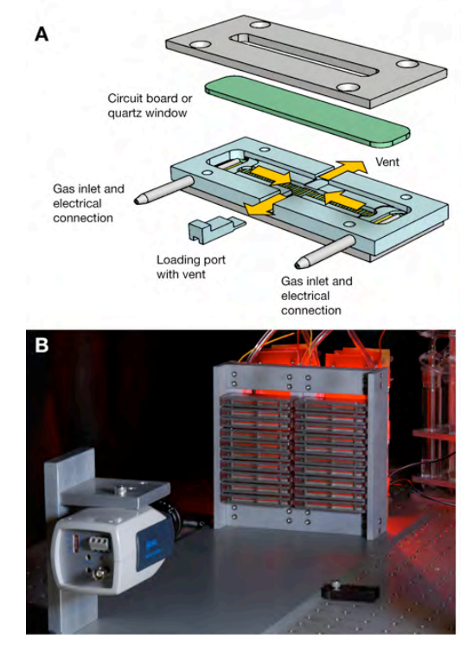
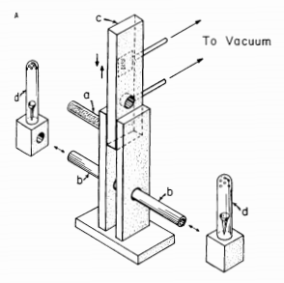
Previous Designs
10
Tully and Quinn, 1985
Claridge-Chang et al., 2009

Slide 14
Schematic of the chamber
11
Odor
in LHS
Odor
in RHS

Slide 15
Schematic of input odor line
12
Valve 1
off
Valve 2
off
Odor
line
MFC
on
on
Odor A
Odor B
Paraffin
Oil
Carrier
MFC
To LHS
of chamber
HPA
through
regulator
Charcoal
Filter
Carrier
MFC
To RHS
of chamber
Odor A
Odor B
Paraffin
Oil
Odor
line
MFC
on
on
Valve 3
Valve 4
off
off

Slide 16
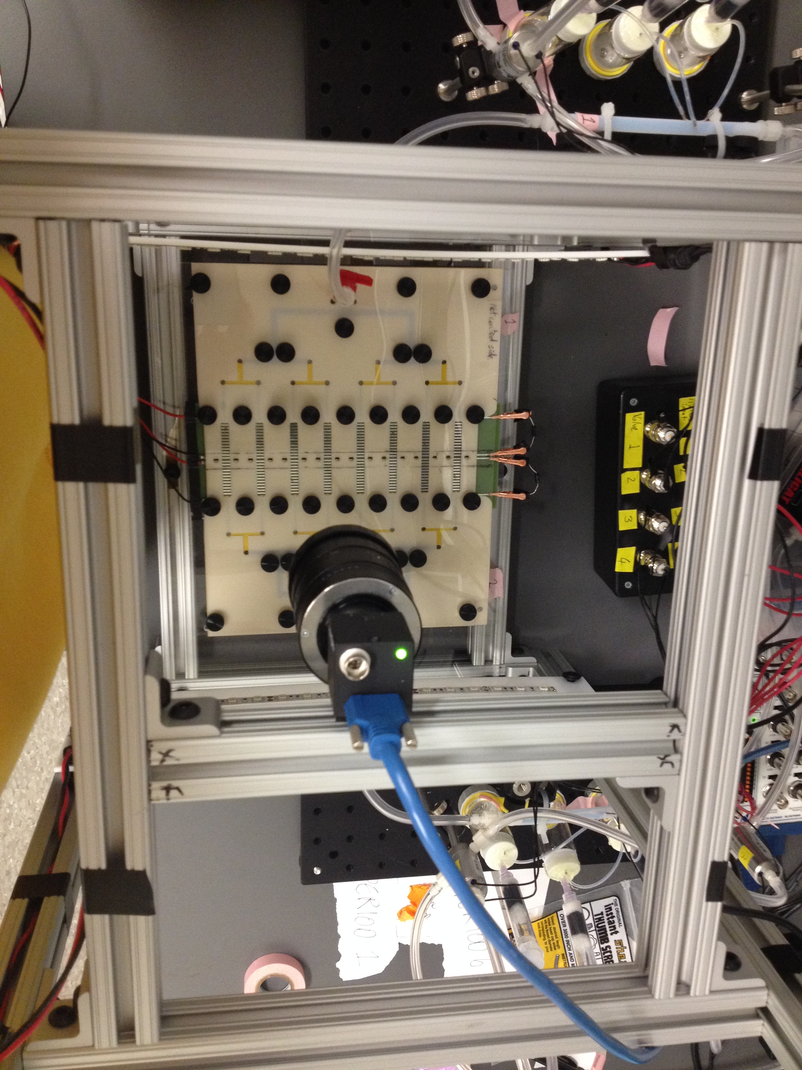
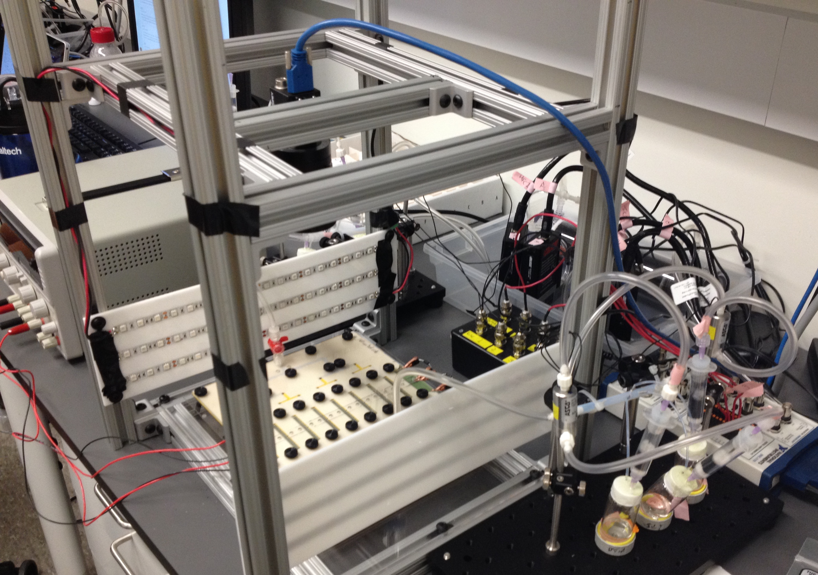
The behavior chamber
13

Slide 17
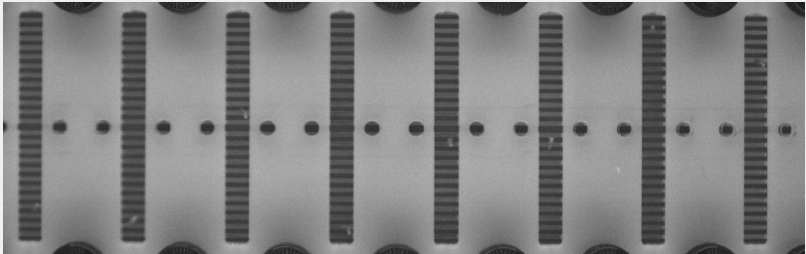
Image acquisition
14

Slide 18
Image acquisition
14

Slide 19
Overview
15
Motivation
Constructing the behavior chamber
Preliminary data
Next steps

Slide 20
Overview
15
Motivation
Constructing the behavior chamber
Preliminary data
Next steps

Slide 21
Mock conditioning
16
Innate preference is maintained after mock conditioning.

Slide 22
Flies learn aversion to MCH
17
When presentation of MCH is paired with electric shocks, flies learn aversion to MCH.

Slide 23
Flies learn aversion to MCH
17
pre
pre
post
post
Conditioning Trial
Mock Trial

Slide 24
Maintaining learned aversion along concentration curve
18
Training Against 5% MCH
Learned aversion to 5% MCH, but learned aversion not maintained when tested at 3% MCH

Slide 25
Maintaining learned aversion along concentration curve
19
Training against 3% MCH

Slide 26
Maintaining learned aversion along concentration curve
19
Training against 3% MCH
pre
post

Slide 27
Can Drosophila distinguish
5% MCH from 3% MCH?
20
Training against 5% MCH, no obvious aversion learned to 5% MCH

Slide 28
Can Drosophila distinguish
5% MCH from 3% MCH?
21
Training against 3% MCH, no obvious aversion learned to 3% MCH

Slide 29
Conclusions
22
None of these results are statistically significant because the sample size is too small
However the results are suggestive that the flies cannot learn aversion to 5% MCH vs 3% MCH
Possible hypotheses:
  Flies cannot disciminate between 5% and 3% MCH (concentrations are near saturation point for discrimination)
  Flies are generalizing learned aversion to all concentrations of MCH, so perceiving 5% and 3% to be equally aversive regardless of the concentration trained against

Slide 30
Overview
23
Motivation
Constructing the behavior chamber
Preliminary data
Next steps

Slide 31
Overview
23
Motivation
Constructing the behavior chamber
Preliminary data
Next steps

Slide 32
Next steps
24
Repeat experiments with a much larger population of flies (n=50)
Repeat experiments with a much larger range/number of concentrations (n=6)
This will allow us to see if this data is statistically significant
Produce behavior vs concentration curve to see how behavior varies across concentration

Slide 33
Looking ahead
25
Record neuron spiking in flies showing behavior change after conditioning and produce spike rate vs concentration curve to see how neural activity depends on odor concentration
Test with a variety of odors and see if generalization along concentration is the same for all odors or if it differs depending on the odor used

Slide 34
Thank you!
Acknowledgements
Elizabeth Hong
The Hong Lab
SURF & NSF
Allie Hexley | ahexley@mit.edu

Slide 35
Questions?
Allie Hexley | ahexley@mit.edu

Slide 36
Back-up Slides
Allie Hexley | ahexley@mit.edu

Slide 37
Maintaining learned aversion along concentration curve
Training against 8% OCT

Slide 38
Maintaining learned aversion along concentration curve
Training against 4% OCT

Slide 39
References
10
Adam Claridge-Chang, Robert D. Roorda, Eleftheria Vrontou, Lucas Sjulson, Haiyan Li, Jay Hirsh, & Gero Misenbock. Writing Memories with Light-Addressable Reinforcement Circuitry. Cell. 2009.
T. Tully and W.G. Quinn. Classical Conditioning and retention in normal and mutant Drosophila melanogaster. J Comp Physiol. 1985.

