Slide 1
Training Against 5% MCH vs 12% OCT

Slide 2
Training Against 5% MCH vs 12% OCT

Slide 3
Training Against 5% MCH vs 12% OCT

Slide 4
Training Against 8% OCT vs 10% MCH

Slide 5
Training Against 3% MCH vs 12% OCT

Slide 6
Training Against 4% OCT vs 10% MCH

Slide 7
Comparing Training Against 5% MCH vs Against 3% MCH

Slide 8
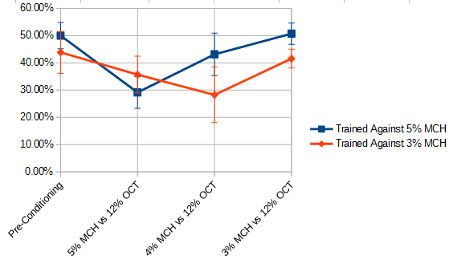
Comparing Training Against 5% MCH vs Against 3% MCH

Slide 9
Training Against 3% MCH vs 5% MCH

Slide 10
Training Against 5% MCH vs 3% MCH

Slide 11
Training Against 5% MCH vs 3% MCH

