Slide 1
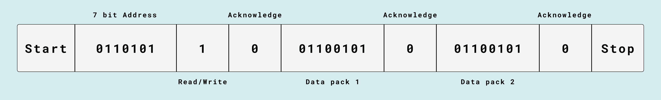
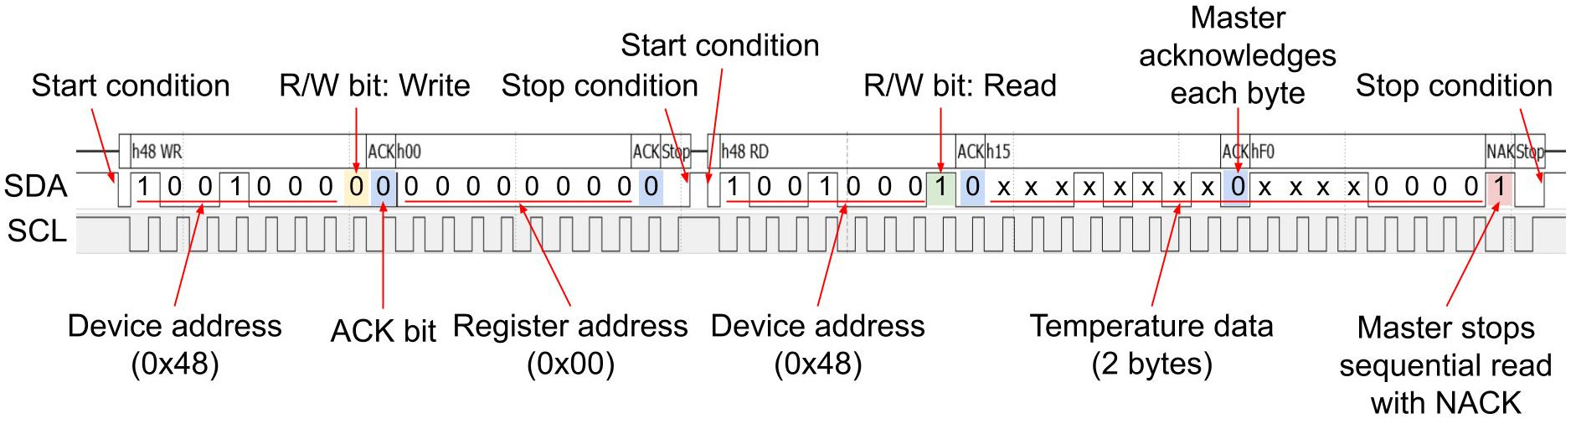
Device address (0x48) write
Register address (0x00)
Device address (0x48)
read
Data 1
Data 2
For some reason this library takes 2 measurements
https://www.digikey.com/en/maker/projects/getting-started-with-stm32-i2c-example/ba8c2bfef2024654b5dd10012425fa23

Slide 2
Device address (0x48) write
Register address (0x00)
Device address (0x48)
read
Data 1
Data 2
For some reason this library takes 2 measurements

