Slide 1




OpenRiverCam in Indonesia
What the pilot taught us, and the path forward Response to the PMI / IPB / BHLK meeting, Sukabumi, 21 August 2026
Palang Merah Indonesia · Institut Pertanian Bogor · Balai Hidrologi dan Lingkungan Keairan · American Red Cross
2026-08-31 · Draft for internal review — not yet circulated

Slide 2
Thank you
None of this exists without the people who built it and looked after it.
PMI volunteers and staff at Sukabumi and Jakarta gave their time to a system that was new to them and that did not always work.
IPB re-surveyed the site with a total station after our own survey failed twice. That survey is what the station runs on today.
BHLK brought the standards knowledge, and the offer of server capacity, that make a pilot possible at all.
What follows is largely a list of things we would do differently. Every one was learned because someone did the work that made it visible.
2 / 24

Slide 3
The pilot, and what we think comes next
The pilot has been a good experience. A station in the water, four months of behaviour to learn from, and a working relationship between PMI, IPB and BHLK that did not exist before.
Our recommendation is that the next step is yours.
Not because the partnership has run its course, but because of what the pilot produced: knowledge, not a body of measurements.
Knowledge is worth more to you as an input to your own approach than as a set of parts to copy.
We would rather help you start your own design than hand you ours to maintain.
3 / 24

Slide 4
What this briefing covers, and what it leaves to you
The technology only: the station as built, what four months in the field revealed, and what we would change before more units are constructed.
Not in scope: what the data is fit to support, or what accuracy any application requires.
Those judgements belong with IPB, BHLK and their federal partners.
Measurement requirements shown here are recorded from you, not proposed by us.
Written to give an accurate basis for your decision rather than an encouraging one.
4 / 24

Slide 5
Three offers were made on 21 August. We welcome all three.
Build one to three stations as a pilot.
Supported. What follows is what we would change first.
Provide server capacity for the data.
Well matched to the pilot, and holding the data in Indonesia carries a clear benefit.
Move the present site to open ground.
Supported, and the field record adds independent evidence for it.
5 / 24

Slide 6
Why a low-cost station is worth studying
A river gauge is only useful if there are enough of them. How many an agency can afford decides how much of a catchment it can observe.
This station: USD 1,340 in materials — electronics and enclosure only. Sukabumi already had its panel and battery, so a new solar site would add an array. A mains site would not.
Lowest-cost automatic water-level station on the government e-catalogue: about USD 3,600 before VAT, measuring stage only.
Not like for like — that is a supported commercial instrument, this is a pilot-stage assembly.
At this price a basin authority can consider a network where it might otherwise consider a single gauge. That possibility is the whole of the argument.
6 / 24

Slide 7
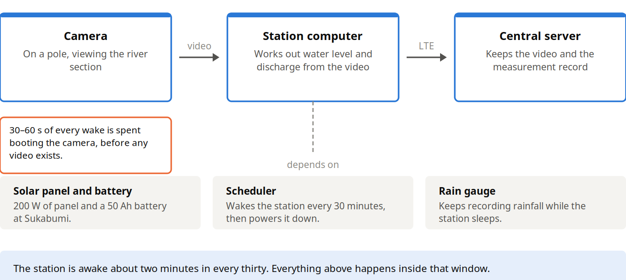
What is being offered for study
7 / 24

Slide 8
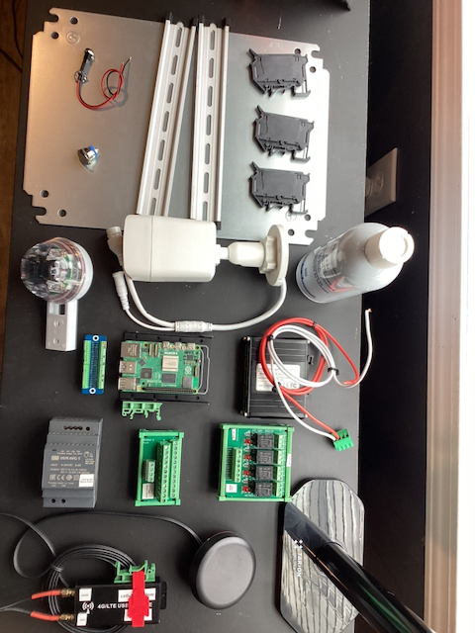
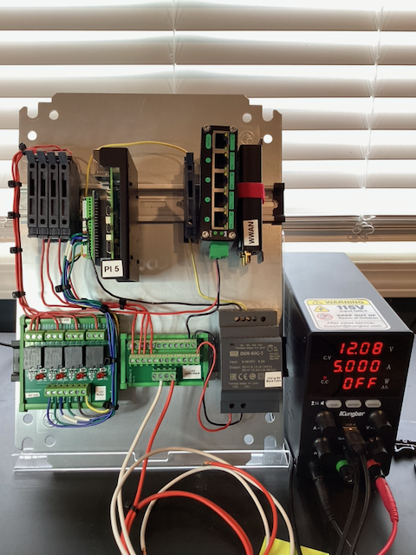
Built from commodity parts, so it can be repaired locally
The parts for one station, before assembly.
The same parts wired onto the plate, under bench power.
No soldering, no fabrication, nothing single-source.
8 / 24

Slide 9
The evidence is thin, and we ask you to treat it as thin
One station, on one river, watched across part of one season — 16 April to 28 August 2026.
A second station was built but never installed.
What the deployment has produced so far is knowledge about the design, not a body of measurements.
It is a volunteer pilot and should be read as one.
Never built to production standards of availability or record continuity. Measuring it against an industrial instrument would be the wrong test, and unfair to the people who kept it running.
The useful question is narrower: what does this design make hard, and what should be built differently.
9 / 24

Slide 10
Three design gaps, and what we would build instead
The station cannot report its own condition. When it stopped, it stopped quietly.
Instead: report state on every waking, and make any mode that suppresses data expire on its own and raise an alert. R4, R5.
Nothing reconciles what was recorded against what arrived.
Instead: compare the station's record against the server's on a schedule. Small piece of software; should have been in version one. R7.
Water level is read from the image, and daylight defeats it.
Instead: an independent water-level reference, so the measurement does not rest on one optical method succeeding. R1.
10 / 24

Slide 11
A twenty-five dollar decision caused most of the outages
No single step in the chain looks like a mistake.
The USB storage drive caused a driver fault at boot, so it was removed rather than fixed.
That left the SD card as the only volume — small enough to sit at the level where it deletes old recordings.
That caused processing to fail on 43% of videos.
The station shuts down after processing finishes, so a failed run never shut down: awake to a 25-minute backstop instead of two minutes, about twelve times the energy.
Repeated across a night, that flattened the battery. A missed wake then left the next-startup alarm in the past.
Two lessons: shutdown and startup are split across two systems and neither owns the cycle; and cheap parts can carry expensive operating costs.
A common root: the computer's own clock battery connector broke on both boards. Losing it is why a separate scheduling board was fitted, which is what split the cycle. R37
11 / 24

Slide 12
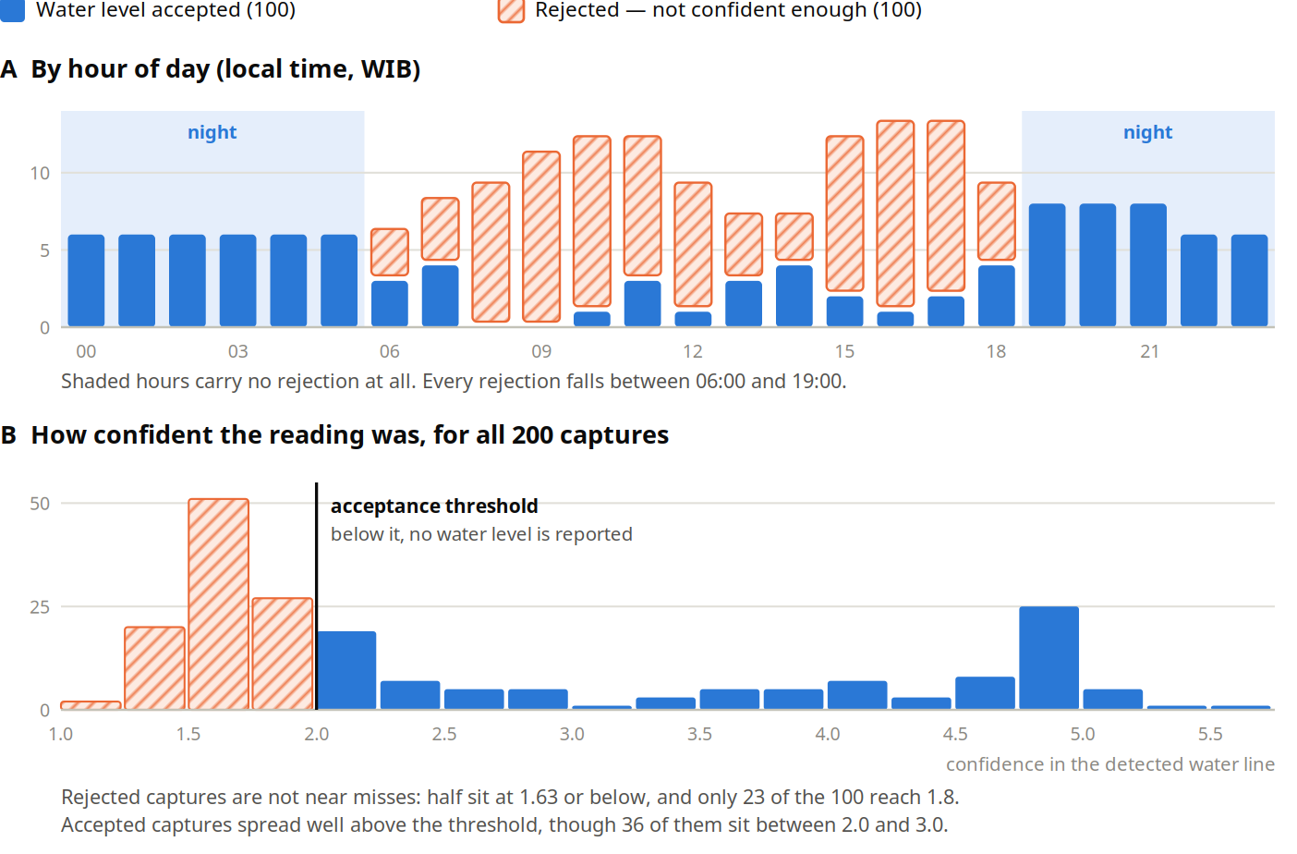
The station measures water level reliably only at night
The two peaks and the early-afternoon dip are the pattern a sun-angle effect produces.
12 / 24

Slide 13
What we recommend
Group | Recommendations
What is worth keeping | R30, R31, R32, R33, R34, R35
Keep a station you can break | R36
Choose the site before anything else | R16, R17, R18
Improve measurement accuracy | R1, R2, R19, R20
Improve monitoring | R4, R5, R6, R21, R7
Give one process control of the sleep and wake cycle | R10, R12
Improve the server and the processing chain | R13, R14, R15, R22, R23, R24
Choose parts for operating cost, not just purchase price | R37, R9, R25, R26
Choose the architecture to suit the site | R11, R8, R27
Support local construction and maintenance | R3, R28
Divide responsibilities | R29
Full text in the working list; the report carries an index of all of them. 37 recommendations in 11 groups.
13 / 24

Slide 14
The changes with the greatest effect
Use an industrial Pi carrier with NVMe, a protected clock and an integrated UPS. Most of the failures above meet at one place, and this removes them in a single part. R37
Build the test station first, so a fault can be reproduced and a fix tried before it goes to a river. R36
Build monitoring for a fleet, not for one station. This is the highest-value work on the list. R4–R7
Fit an independent water-level reference, and plan the survey as skilled work from the start. R1, R2, R19, R20
Give one process control of the whole sleep and wake cycle, and make shutdown happen on a timer. R10, R12
Make mains power the default; use solar only where mains is not available. R11
Choose the site before anything else, and confirm permission in writing before building for it. R16–R18
14 / 24

Slide 15
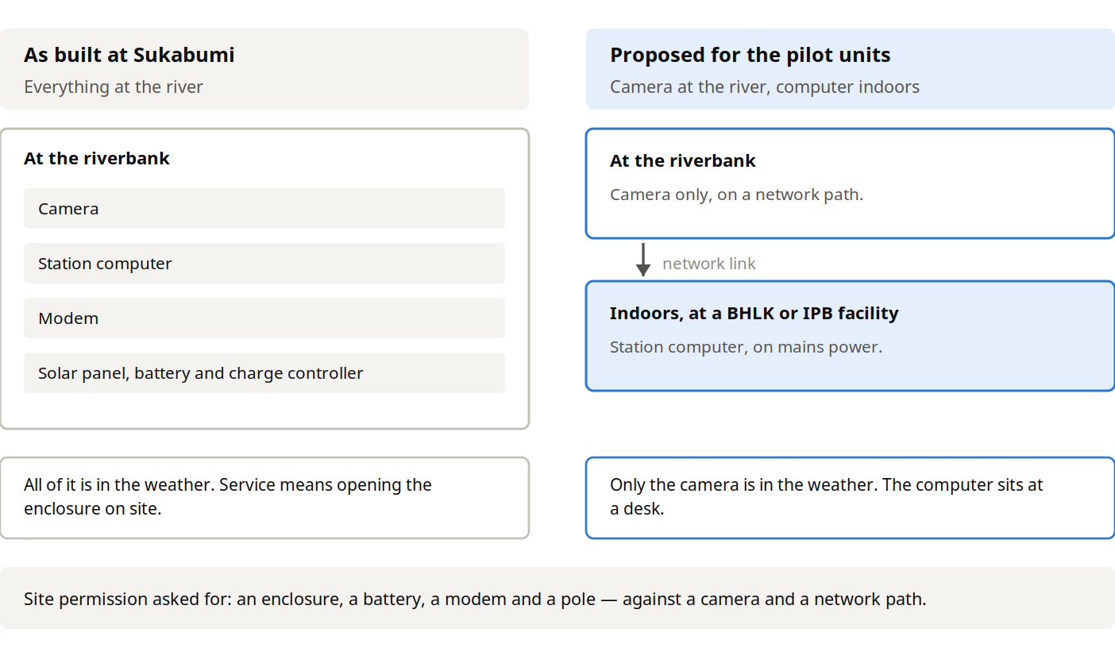
Camera at the river, computer indoors (R8)
Designed and not yet field tested — the pilot's first experiment, not a proven alternative.
15 / 24

Slide 16
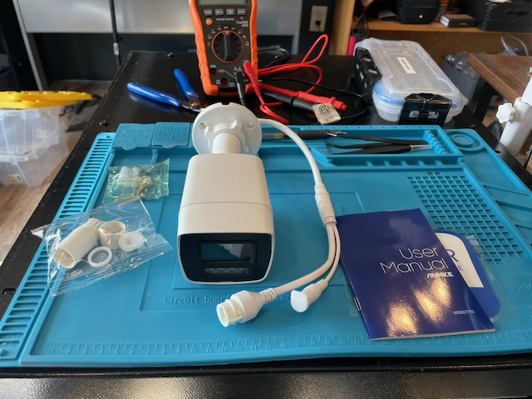
One lesson about method
The budget was applied part by part: the cheapest item meeting each requirement.
It prices each part against its specification sheet, not against what that part's limits cost the rest of the system.
The camera meets every line of its specification, and still costs a fifth of the video quality and 30–60 s of battery on every waking.
Its light fires whenever it starts and cannot be turned off — 48 flashes a day at the present site.
Capable hardware, running a reseller's version of the manufacturer's software.
16 / 24

Slide 17
Build the test station first
Everything we know about the failures was diagnosed on a solar station, on a river, awake for tens of seconds, that we could not touch.
We could not reproduce a fault, test a fix before committing it remotely, or tell a working change from a quiet week. Several diagnoses took months for that reason alone.
The Jakarta station was meant to be that test station and never became one. Its absence cost more than the site it was built for.
A test station is not a spare: mains-powered, always on, somewhere someone can watch it, open it and break it deliberately.
We would treat it as the first station a pilot builds, not the last.
17 / 24

Slide 18
What is worth keeping
The five constraints: commodity parts, no soldering, no specialist skills, common tools, five-minute replacement.
The spare switched outputs. The relay module has four channels; one drives the camera and three are deliberately left free, wired and ready.
That is what lets a station drive a siren, a beacon or an alerting relay without reopening the design — and what turns a measurement station into something a community can act on.
We would ask that any replication keeps that spare capacity rather than removing it to save a few dollars.
The factory-sealed camera, which removed the humidity failure that killed the previous unit.
The recovery kit, documentation in both languages, and spares at the local PMI chapter.
18 / 24

Slide 19
Building and looking after the units in Indonesia
The design was made to be built by people who are not electronics specialists, with tools they already own.
That intent only becomes real if the parts can be bought locally and the documentation supports substitution — R3.
Spares held at the local PMI chapter turn a failure into a part swap rather than a shipment.
Where the field unit is a standard security camera, support falls within a supply chain that already exists across Indonesia.
We would rather help build the capacity to maintain these stations than remain the place they are sent when they break.
19 / 24

Slide 20
Hosting the data in Indonesia
BHLK's offer suits the pilot, and holding the data in Indonesia carries a clear benefit for a government-partnered deployment.
Two constraints to design for rather than discover:
The video store and the database must share one filesystem. Plan storage as a single volume.
Server and station software versions are tied together, and a remote station cannot be upgraded on demand.
We would suggest running both instances in parallel until the new one has completed a full operating cycle, including an upgrade.
Worth agreeing in writing: where the authoritative copy sits, who administers it, who has access, and the retention policy.
20 / 24

Slide 21
Choosing the sites
An open site helps with three problems at once: satellite positioning, the sun-water-camera angle, and the view across the section.
A move costs a fresh survey and a fresh calibration, not only a relocation. The survey is the expensive part.
Site permission should be settled before a unit is built for a particular site.
A complete station was built and tested for an intended Jakarta site. Permission fell through during the April visit.
That station is still available. We suggest it serves best as a study and test unit.
Open it, trace it, power it up, take it apart — and install it somewhere convenient and local if that is useful, so it can be exercised against real water.
Not as an operational station with expectations of availability and consistent data. It carries the design this briefing recommends changing.
We would not build to a site again before you tell us the permission is in place.
21 / 24

Slide 22
Working together
BHLK — data processing, conformance with standards, and the route to acceptance within PUPR data systems. Offers server capacity.
IPB — design, calibration methodology, training material, and the development path for future sensor types.
PMI — user of the information, and the operational side: installation, maintenance, siting, response, and spares.
Offered for your consideration: write the split into the collaboration agreement so it survives staff changes, and keep a light joint forum for what does not sort into one role.
The commitments this implies for PMI have not been discussed with PMI National Headquarters.
22 / 24

Slide 23
Questions for consideration
Who should hold the Jakarta station as a study and test unit? It was to transfer to IPB for deployment. Whether IPB or BHLK is better placed to hold it is for the two of you.
Can a staff gauge be read from the camera image accurately enough? If it can, R1 needs no separate sensor.
Two of the thirteen interruptions remain unexplained.
Does the recovery-voltage threshold bound how long an interruption lasts, or hold the station off?
How does the velocity measurement perform across the surface conditions the pilot sites present?
Absolute discharge accuracy at Sukabumi, unresolved pending the survey.
We expect your work to change some of what is written here. That is the point of handing it over rather than handing it down.
23 / 24

Slide 24
What we can offer from here
We are not proposing to build your stations.
What we can offer is the record: this briefing and its report, the appendix, the operator and assembly documentation in English and Bahasa Indonesia, the software, and the built station at Wisma PMI to take apart.
Beyond that, whatever is useful — reviewing a design, answering a question about something that surprised us, looking at data that does not behave.
Sukabumi will keep running, and we will keep reporting what it does, including the parts that go wrong.
The pilot found the problems while they were still cheap, and it introduced three organisations to one another. The next station in this story should be one you designed.
24 / 24

