Slide 1


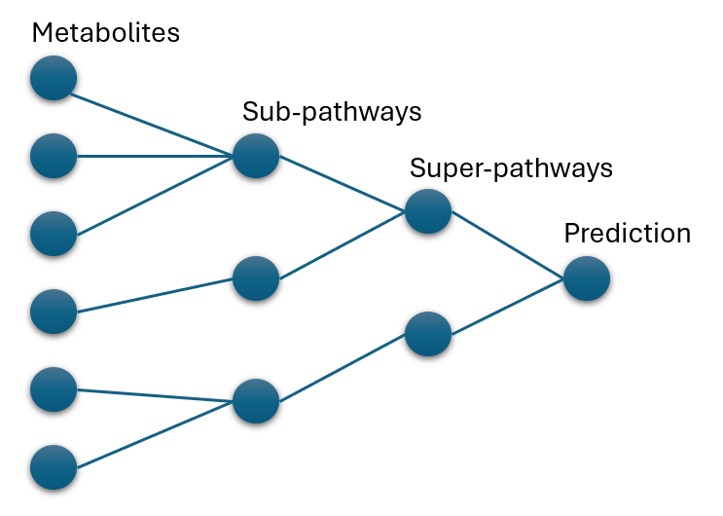
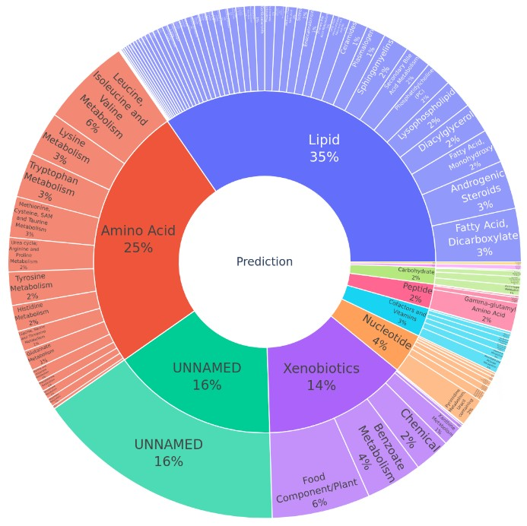
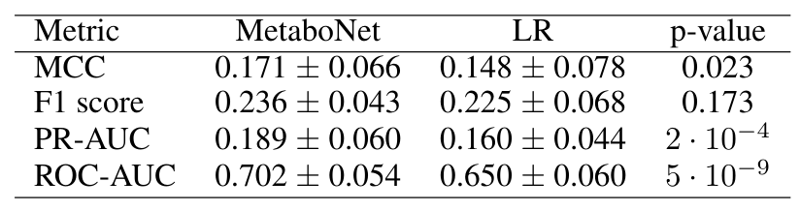
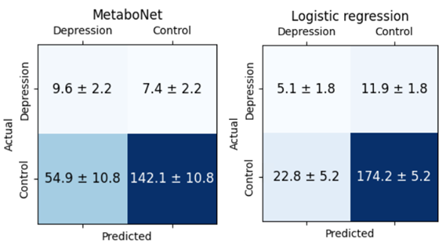

Biologically Interpretable Deep Learning for Metabolomics
Predicting Depression with Biological Insight
1. Introduction
2. Research Questions
3. Methodology
Depression, a leading cause of disability[1], lacks objective diagnostic tools [2]. Metabolomics, which analyzes small molecules, holds promise for improving diagnosis and understanding [2]. Despite the complexity of metabolomics data, deep learning methods have not been extensively explored due to issues with interpretability [3].
Q1: How well can biologically interpretable deep learning model, MetaboNet, trained on metabolomics predict depression?
Q2: Can MetaboNet identify biologically relevant metabolites and pathways associated with depression?
Baseline machine learning model used is logistic regression (LR).
Dataset: 86 individuals with depression and 982 healthy controls.
1. 2. 3. 4. 5.
Data
analysis
Model optimization
Performance evaluation
Model interpretation
Literature cross-validation
4. Results Q1
5. Results Q2
Figure 1: MetaboNet constructed using prior biological knowledge about biochemical sub-pathways and super-pathways. This architecture makes the network inherently interpretable and lightweight.
Metabolite level not validated
Top sub-pathways validated by literature:
1. Food component/plant [4]
2. Leucine, isoleucine and valine [5]
3. Benzoate metabolism [6]
4. Fatty acid dicarboxylate [7]
Top super-pathway, lipids, also validated by literature [8]
Limited research in metabolomics and depression to validate our findings.
Biomarker elicitation
6. Future research
Table 1: Classification performance metrics with paired t-test p-values. Random baselines are: 0 for MCC, 0.08 for F1 score and PR-AUC, and 0.5 for ROC-AUC.
Need for unbiased, diverse, and large datasets for studying depression.
MetaboNet can suggest important factors, but experimental validation is necessary to confirm.
7. Conclusions
Q1: MetaboNet outperforms LR, though the overall classification performance remains modest.
Q2: Findings do not support the capability of MetaboNet to identify biologically relevant individual metabolites.
However, MetaboNet shows
promise in identifying relevant
biochemical sub-pathways
and super-pathways.
MetaboNet statistically significantly outperforms LR in key metrics.
Classification results revealed sex-related differences, with better performance observed in females.
Figure 3: MetaboNet biochemical pathways relative importance sunburst. The outer ring is sub-pathways and the inner ring is super-pathways.
References
Figure 2: Averaged confusion matrix. MetaboNet shows better identification of depressed individuals.
Author: Tom Kitak, t.kitak@student.tudelft.nl | Supervisor: Dr. Gennady V. Roshchupkin | Responsible professor: Dr. Marcel J.T. Reinders
Notes:
Dataset: 1000 samples and 1000 features.
8% being depression
5-fold cross validation with Matthews correlation coefficient as optimization metric
Metrics
Matthews Correlation Coefficient: Measures the quality of binary classifications, considering all four confusion matrix categories
Trade-off between precision and recall
precision and recall for different thresholds
recall and specificity
Do they perform better than random?
MCC: 0
F1: 0.08
AUC-PR: 0.08
AUC-ROC: 0.5 The rest of the 5 weeks:
Paper writing
Trying to further improve the models performance
Second research question focus, so analyzing metabolites that have predictive power in out models and determining if the literature also validates them

