Slide 1
IODD Viewer
Synopsis

Slide 2

Technology Stack

Slide 3
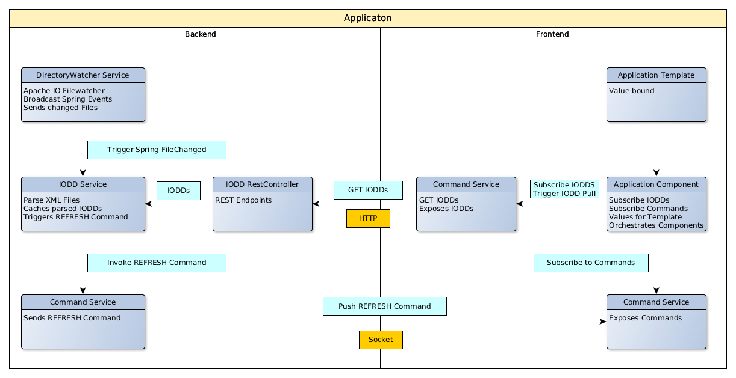
Architecture

Slide 4
Libraries Backend
Spring Boot
Jackson (databind / XML)
SB Websocket / Stomp
SB Web MVC (REST)
Gradle

Slide 5
Libraries Frontend
Angular
Materialize SASS
SockJS / StompJS
RxJS
NPM / Angular CLI

Slide 6
Demo

Slide 7
Questions ?

