Slide 1
Digital exclusion, adolescent mental health and COVID-19
Child Development Forum
14/12/2021
Tom Metherell, Fitzwilliam College

Slide 2
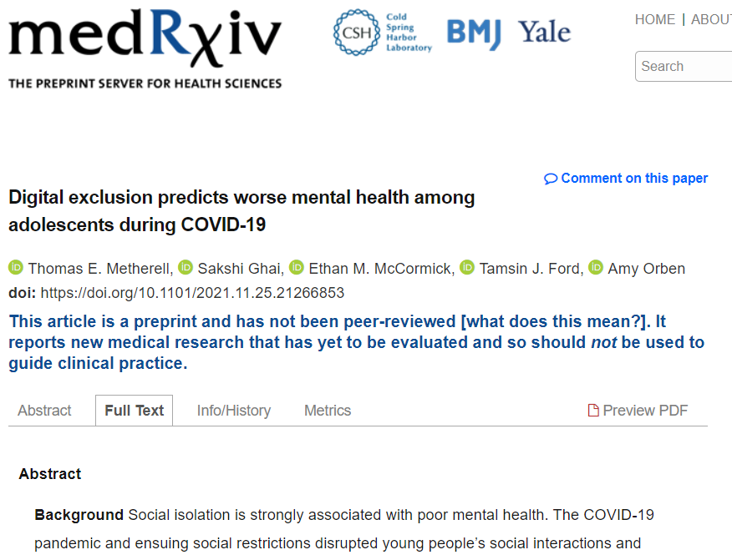
Metherell et al. (2021)

Slide 3
Overall state of adolescent mental health
“In 2020, one in six (16.0%) children aged 5 to 16 years were identified as having a probable mental disorder, increasing from one in nine (10.8%) in 2017.”
— Vizard et al. (2020)

Slide 4
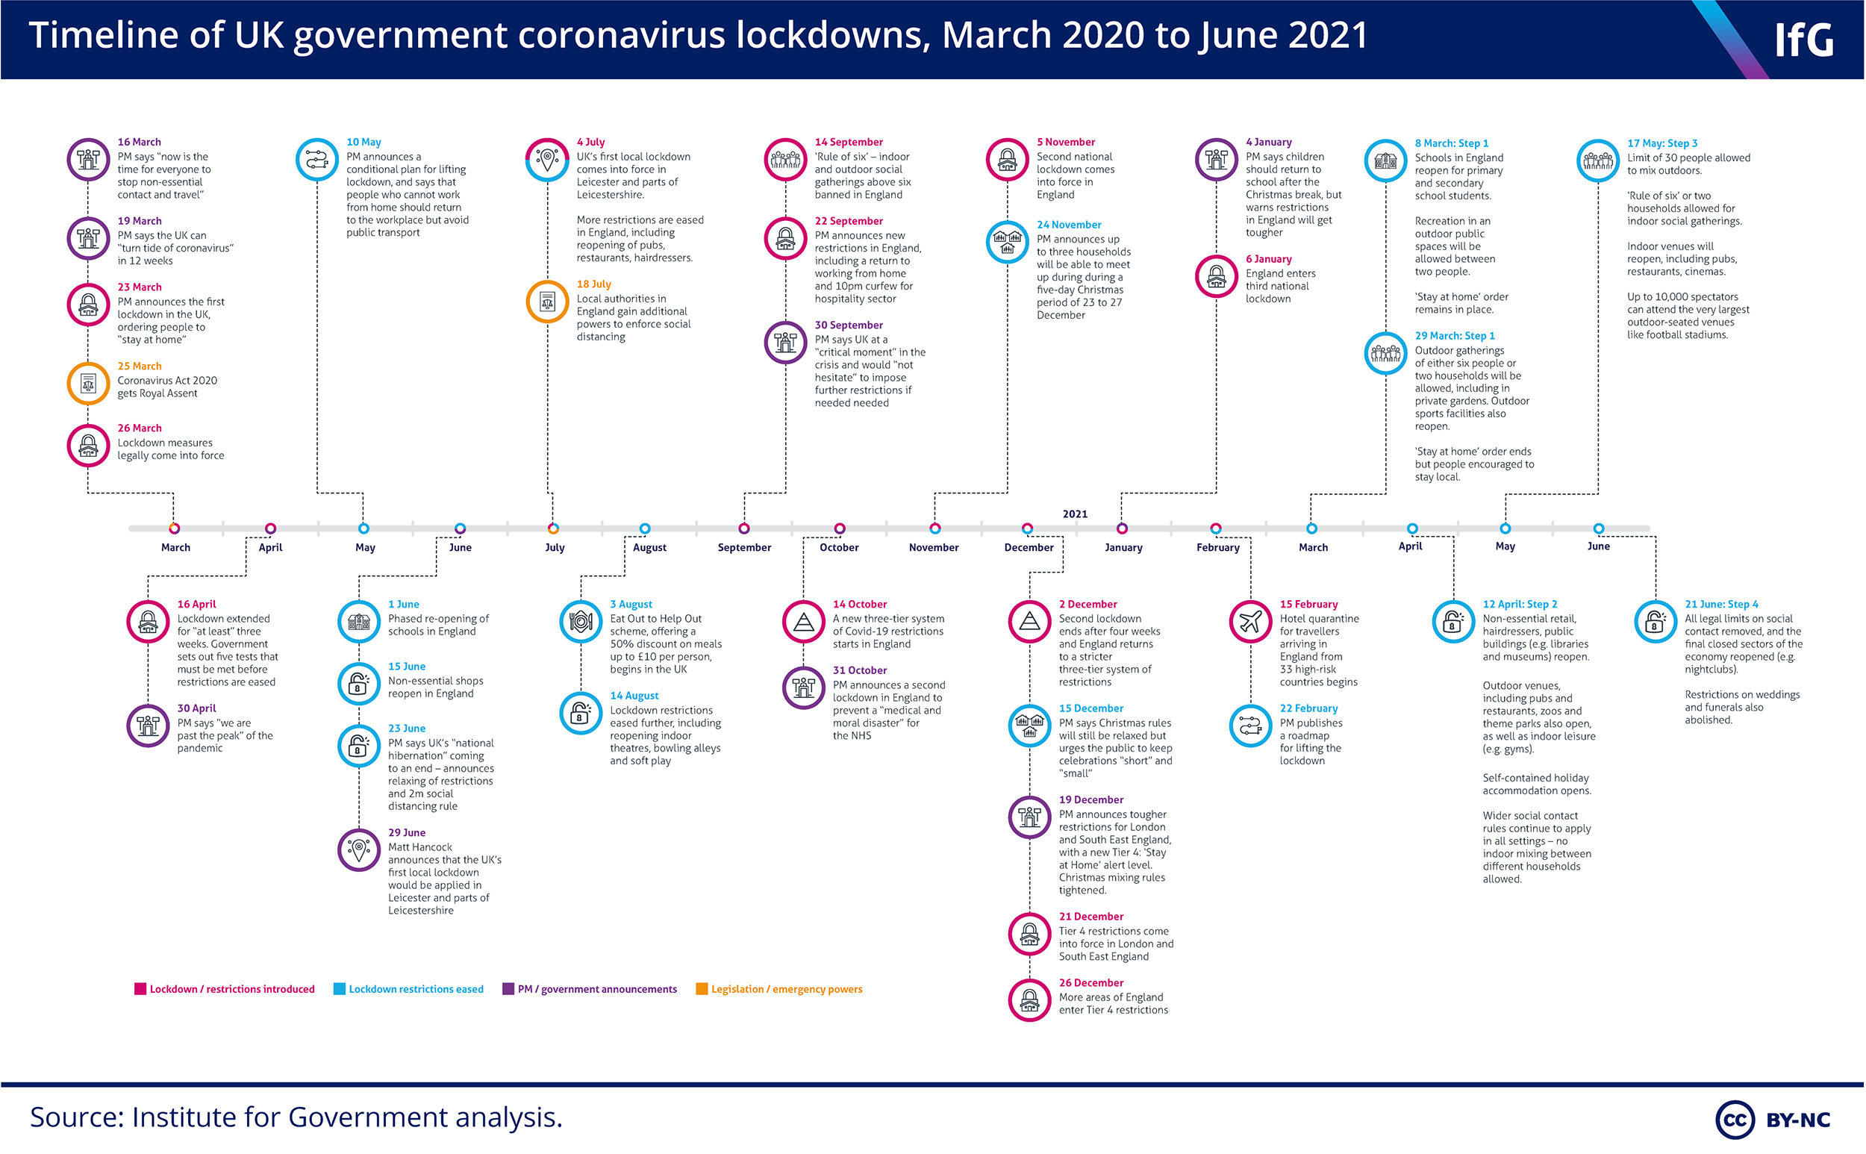
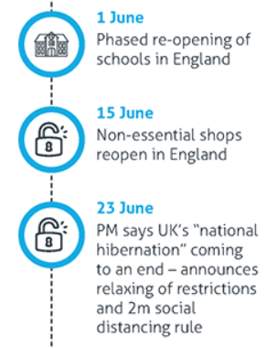
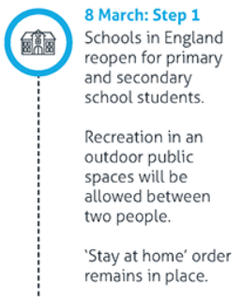
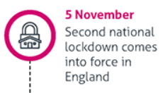
Institute for Government (2021) licensed under CC BY-NC 2.0

Slide 5
Risks from COVID-19 measures
“Adolescents' use of digital technologies and social media might mitigate some of the negative effects of physical distancing”
— Orben, Tomova, & Blakemore (2020)

Slide 6
Understanding Society data
Wave | Dates | N
Main survey wave 9 | 2017-19 | 2,821
COVID-19 wave 4 | July 2020 | 1,411
COVID-19 wave 6 | November 2020 | 1,432
COVID-19 wave 8 | March 2021 | 1,388
University of Essex (2021a, 2021b)

Slide 7
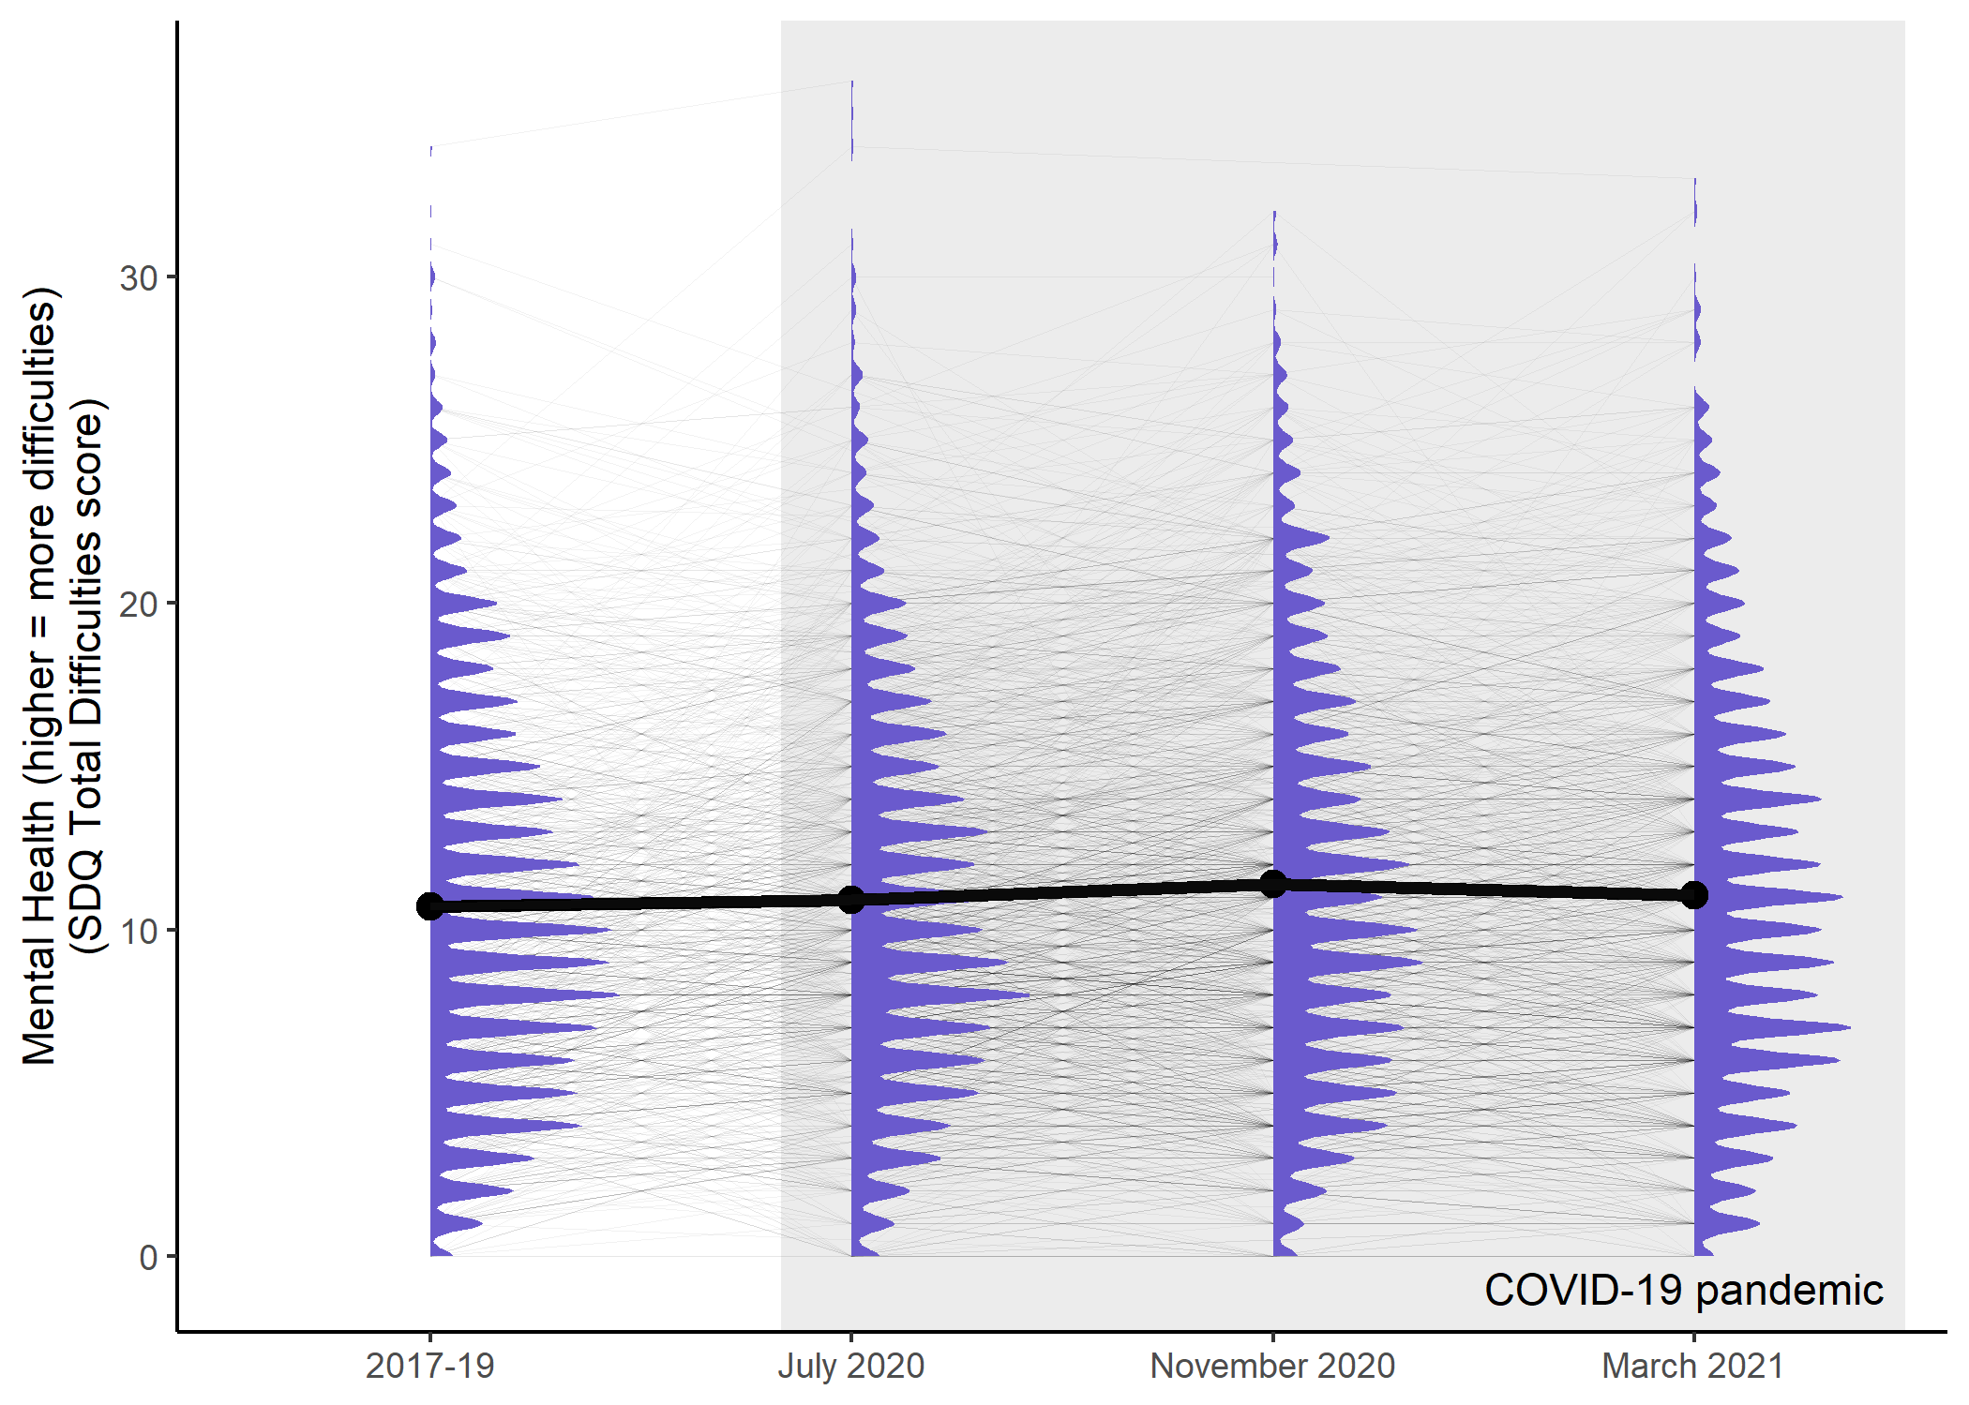
Adolescent mental health during COVID-19
Institute for Government (2021); Metherell et al. (2021)

Slide 8
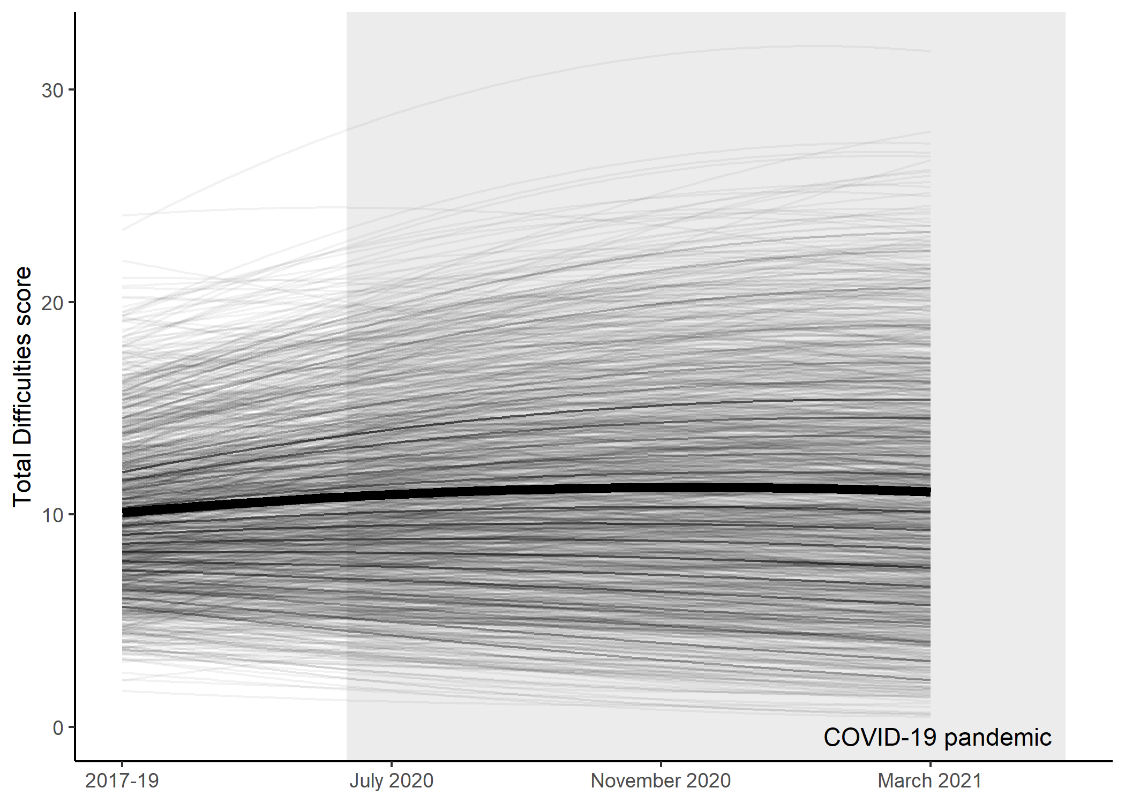
Longitudinal (latent growth curve) model
Metherell et al. (2021)

Slide 9
Grouping by digital inclusion
Two key variables:
Having access to a computer
Having access to a good internet connection
… for schoolwork
University of Essex (2021b)

Slide 10
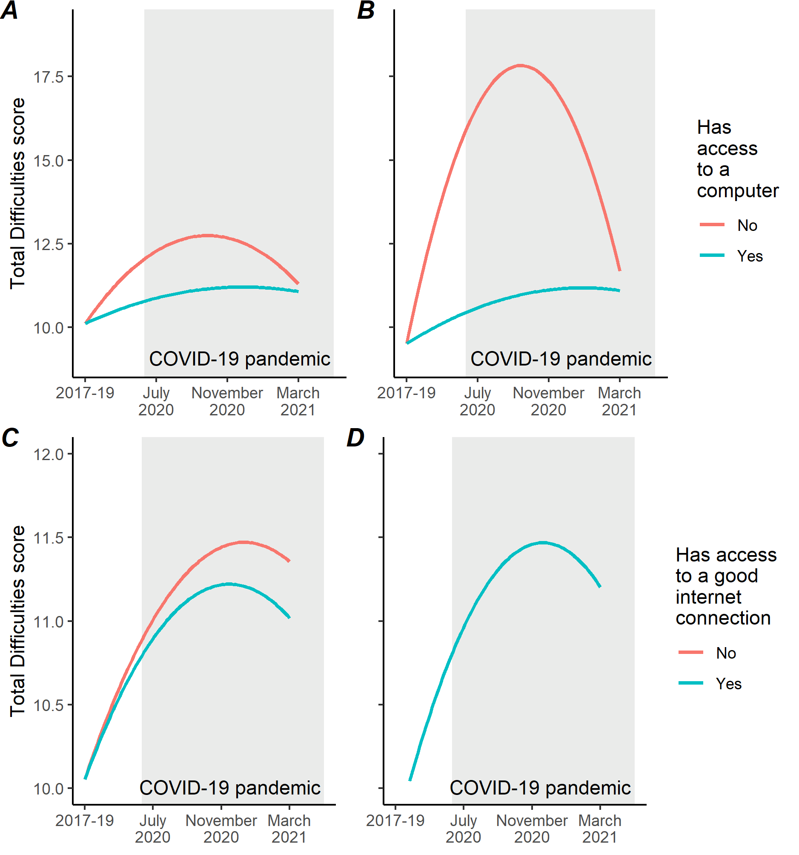
Access to a computer
A no control covariates, survey weights applied
B control covariates:
Sex
Birth year
Ethnicity (white vs. non-white)
Mean household income across waves
Weights not applied
Metherell et al. (2021)

Slide 11
Access to a good internet connection
C no control covariates, survey weights applied
D control covariates:
Sex
Birth year
Ethnicity (white vs. non-white)
Mean household income across waves
Weights not applied
Metherell et al. (2021)

Slide 12
Caveats
Not yet fully generalisable to the adolescent population of the UK
Narrow operationalisation of digital exclusion
Dichotomisation of ethnicity
Averaging of income across waves
Metherell et al. (2021)

Slide 13
Implications
“Digital exclusion, as indicated by lack of access to a computer, is a tractable risk factor that likely compounds other adversities facing children and young people during periods of social isolation.”
— Metherell et al. (2021)

Slide 14
Implications
“… the importance of obtaining basic levels of digital access as a way of supporting adolescent mental health needs to be emphasised more regularly and taken more seriously.”
— Metherell et al. (2021)

Slide 15
References
Metherell, T.E., Ghai, S., McCormick, E.M., Ford, T.J., & Orben, A. (2021). Digital exclusion predicts worse mental health among adolescents during COVID-19. medRxiv. https://doi.org/10.1101/2021.11.25.21266853
Institute for Government. (2021).Timeline of UK government coronavirus lockdowns. https://www.instituteforgovernment.org.uk/charts/uk-government-coronavirus-lockdowns
Orben, A., Tomova, L., & Blakemore, S.-J. (2020). The effects of social deprivation on adolescent development and mental health. The Lancet Child & Adolescent Health, 4(8), 634–640. https://doi.org/10.1016/S2352-4642(20)30186-3
University of Essex, Institute for Social and Economic Research. (2021a). Understanding Society: Waves 1-10, 2009-2019 and Harmonised BHPS: Waves 1-18, 1991-2009. [data collection]. 13th Edition. UK Data Service. SN: 6614, https://doi.org/10.5255/UKDA-SN-6614-14
University of Essex, Institute for Social and Economic Research. (2021b). Understanding Society: COVID-19 Study, 2020-2021. [data collection]. 10th Edition. UK Data Service. SN: 8644, https://doi.org/10.5255/UKDA-SN-8644-10
Vizard, T., Sadler, K., Ford, T., Newlove-Delgado, T., McManus, S., Marcheselli, F., Davis, J., Williams, T., Leach, C., Mandalia, D., & Cartwright, C. (2020). Mental Health of Children and Young People in England, 2020. Health and Social Care Information Centre. https://files.digital.nhs.uk/CB/C41981/mhcyp_2020_rep.pdf

