Slide 1


Digital exclusion predicts worse mental health among adolescents during COVID-19
SPSP Annual Convention
19/02/2022
Thomas E. Metherell, Sakshi Ghai & Amy Orben
digitalmentalhealth.group
@tom_metherell

Slide 2


Overall state of adolescent mental health in the UK
2017
2020
Has a probable mental disorder
Vizard et al. (2020)

Slide 3
Understanding Society data
Wave | Dates | N
(Pre-COVID) | 2017-19 | 2,821
(COVID-19) | July 2020 | 1,411
(COVID-19) | November 2020 | 1,432
(COVID-19) | March 2021 | 1,388
University of Essex (2021a, 2021b)

Slide 4
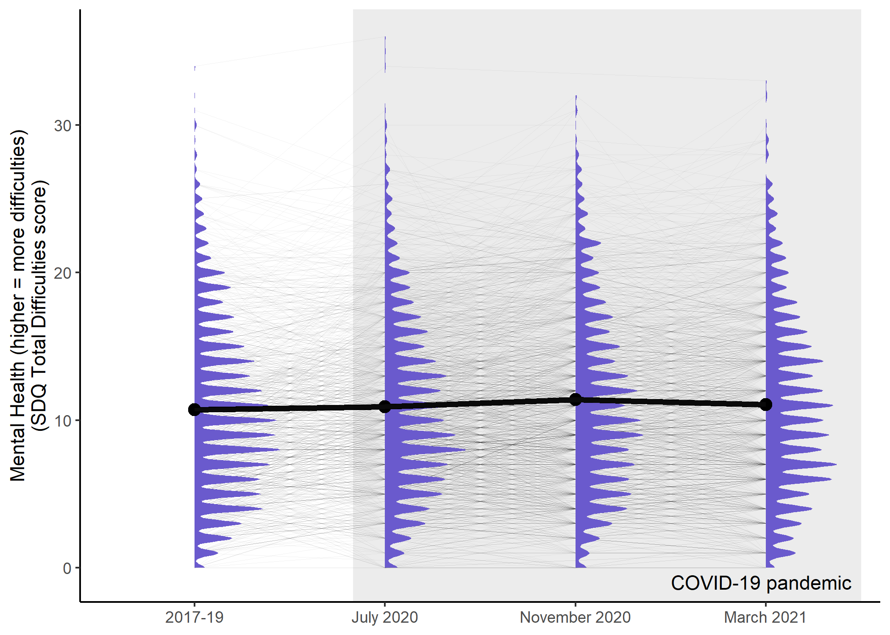
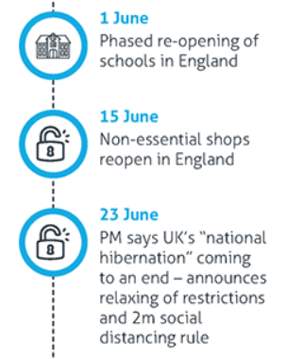
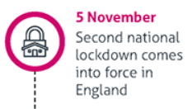
Adolescent MH during COVID-19
Institute for Government (2021); Metherell et al. (2021)

Slide 5
Might digital exclusion affect mental health during COVID-19?

Slide 6
Grouping by digital inclusion
We operationalised using key variables:
Having access to a computer
Having access to a good internet connection
… for schoolwork
University of Essex (2021b)

Slide 7
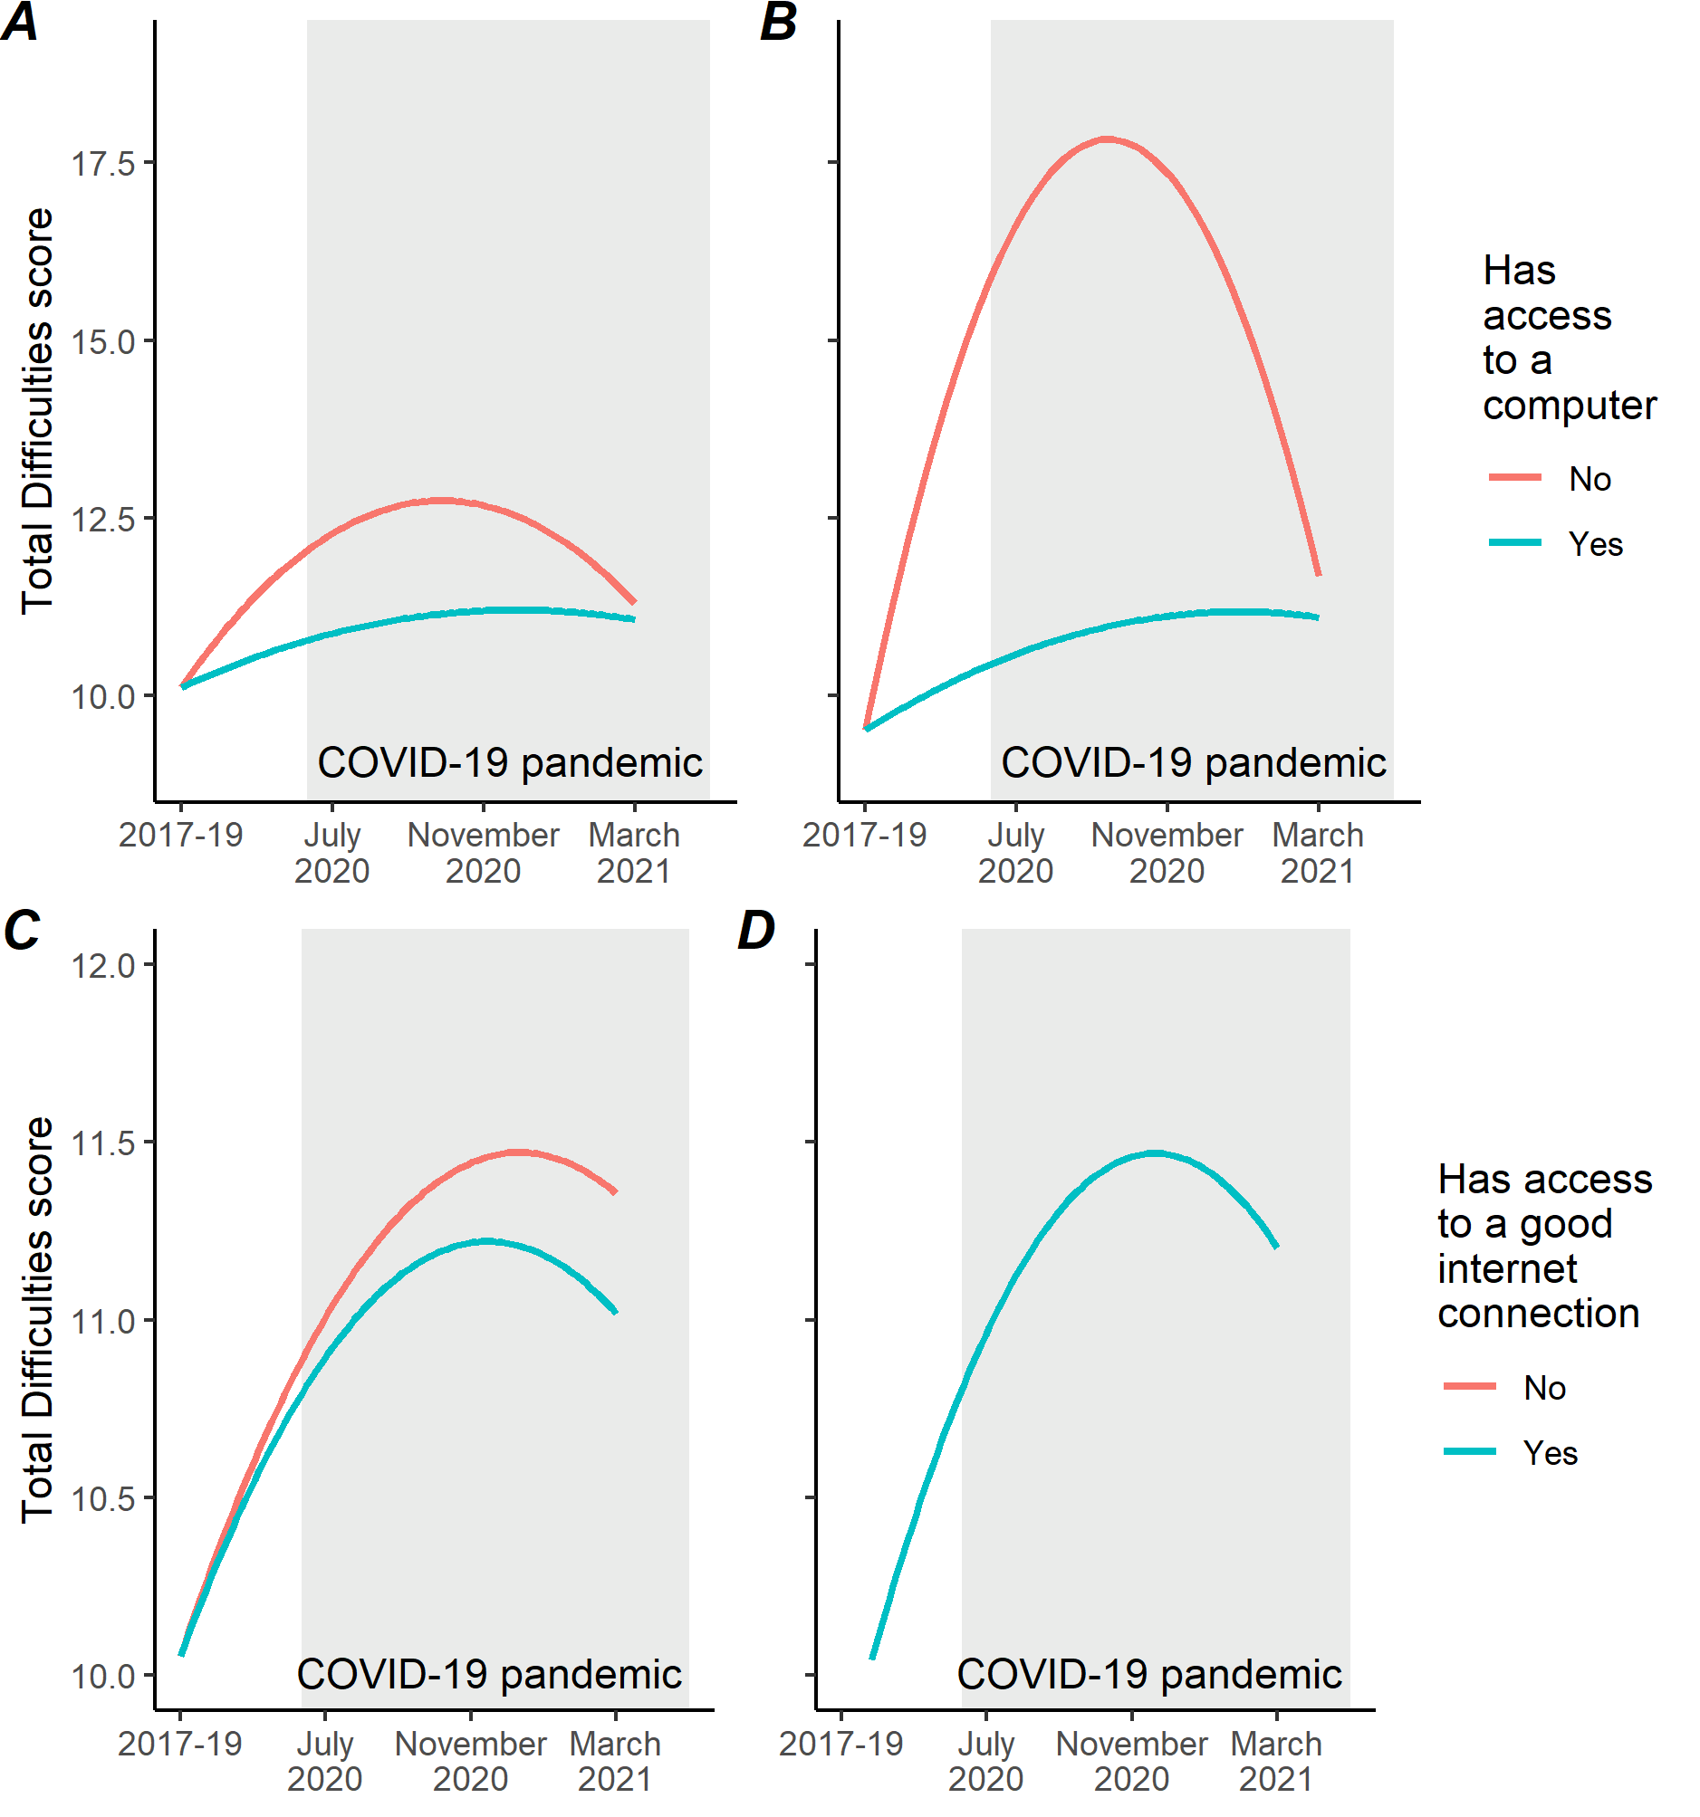
Access to a computer
A no control covariates, survey weights applied
B control covariates:
Sex
Birth year
Ethnicity (white vs. non-white)
Mean household income across waves
Weights not applied
Metherell et al. (2021)

Slide 8
Access to good internet connection
C no control covariates, survey weights applied
D control covariates:
Sex
Birth year
Ethnicity (white vs. non-white)
Mean household income across waves
Weights not applied
Metherell et al. (2021)

Slide 9
Implications
“Digital exclusion, as indicated by lack of access to a computer, is a tractable risk factor that likely compounds other adversities facing children and young people during periods of social isolation.”
— Metherell et al. (2021)

Slide 10
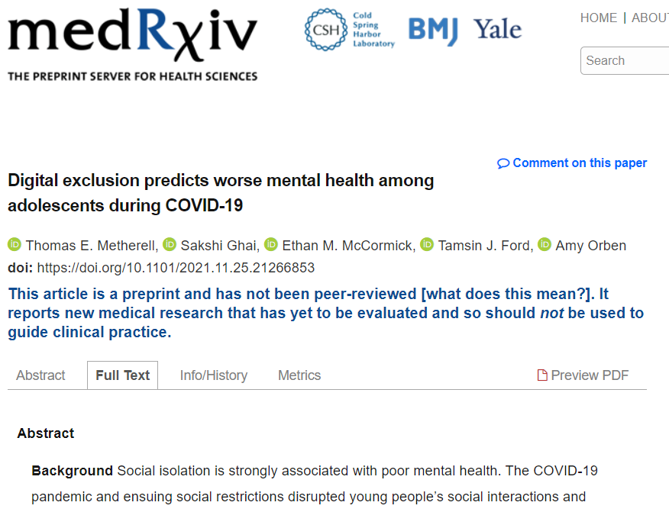
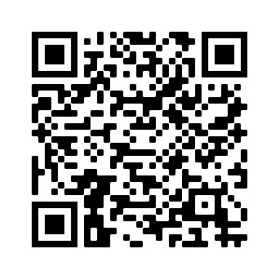

Slide 11
References
Metherell, T.E., Ghai, S., McCormick, E.M., Ford, T.J., & Orben, A. (2021). Digital exclusion predicts worse mental health among adolescents during COVID-19. medRxiv. https://doi.org/10.1101/2021.11.25.21266853
Institute for Government. (2021).Timeline of UK government coronavirus lockdowns. https://www.instituteforgovernment.org.uk/charts/uk-government-coronavirus-lockdowns
University of Essex, Institute for Social and Economic Research. (2021a). Understanding Society: Waves 1-10, 2009-2019 and Harmonised BHPS: Waves 1-18, 1991-2009. [data collection]. 13th Edition. UK Data Service. SN: 6614, https://doi.org/10.5255/UKDA-SN-6614-14
University of Essex, Institute for Social and Economic Research. (2021b). Understanding Society: COVID-19 Study, 2020-2021. [data collection]. 10th Edition. UK Data Service. SN: 8644, https://doi.org/10.5255/UKDA-SN-8644-10
Vizard, T., Sadler, K., Ford, T., Newlove-Delgado, T., McManus, S., Marcheselli, F., Davis, J., Williams, T., Leach, C., Mandalia, D., & Cartwright, C. (2020). Mental Health of Children and Young People in England, 2020. Health and Social Care Information Centre. https://files.digital.nhs.uk/CB/C41981/mhcyp_2020_rep.pdf

