Slide 1



Digital access constraints predict worse mental health among adolescents during COVID-19
Tom Metherell // University of Cambridge ➔ University College London
11th July 2023
@tom_metherell
thomas.metherell.22@ucl.ac.uk
Notes:
Introduction (linger!). QR code links to paper.

Slide 2
Outline
1
2
3
4
5
Overall state of adolescent mental health
Changes during COVID-19 pandemic
Mental health associations of lack of digital access
Discussion of findings
Significance in an increasingly digitalised world
Notes:
Self-explanatory. Linger on this slide! Lay out roadmap.

Slide 3


Overall state of UK adolescent mental health
2017
2020
Has a probable mental disorder
2022
data from NHS Digital
Notes:
Key points: - Data is from national NHS survey of Mental Health in Children & Young People. 1 in 9 had a probable mental health disorder in 2017, up to 1 in 6 in 2020 and 1 in 5 in 2022. Context is therefore of a significantly increased incidence of mental health symptoms in (and after) the COVID-19 pandemic. The time period of this study ends in March 2021; will be interesting to see how things develop in this “post-crisis” phase of the pandemic.

Slide 4
Understanding Society youth survey (ages 10‒15)
​ | Fieldwork dates | N
Pre-pandemic | 2017–19 | 2 821
During COVID-19 pandemic | July 2020​ | 1 411​
Q3 | November 2020 | 1 432
Q4 | March 2021 | 1 388
Notes:
We can further assess the overall state of adolescent mental health before & during the pandemic using data from Understanding Society. US uses the Strengths & Difficulties Questionnaire to assess the levels of mental health symptoms. Here are the waves for which US collected adolescent mental health data…

Slide 5
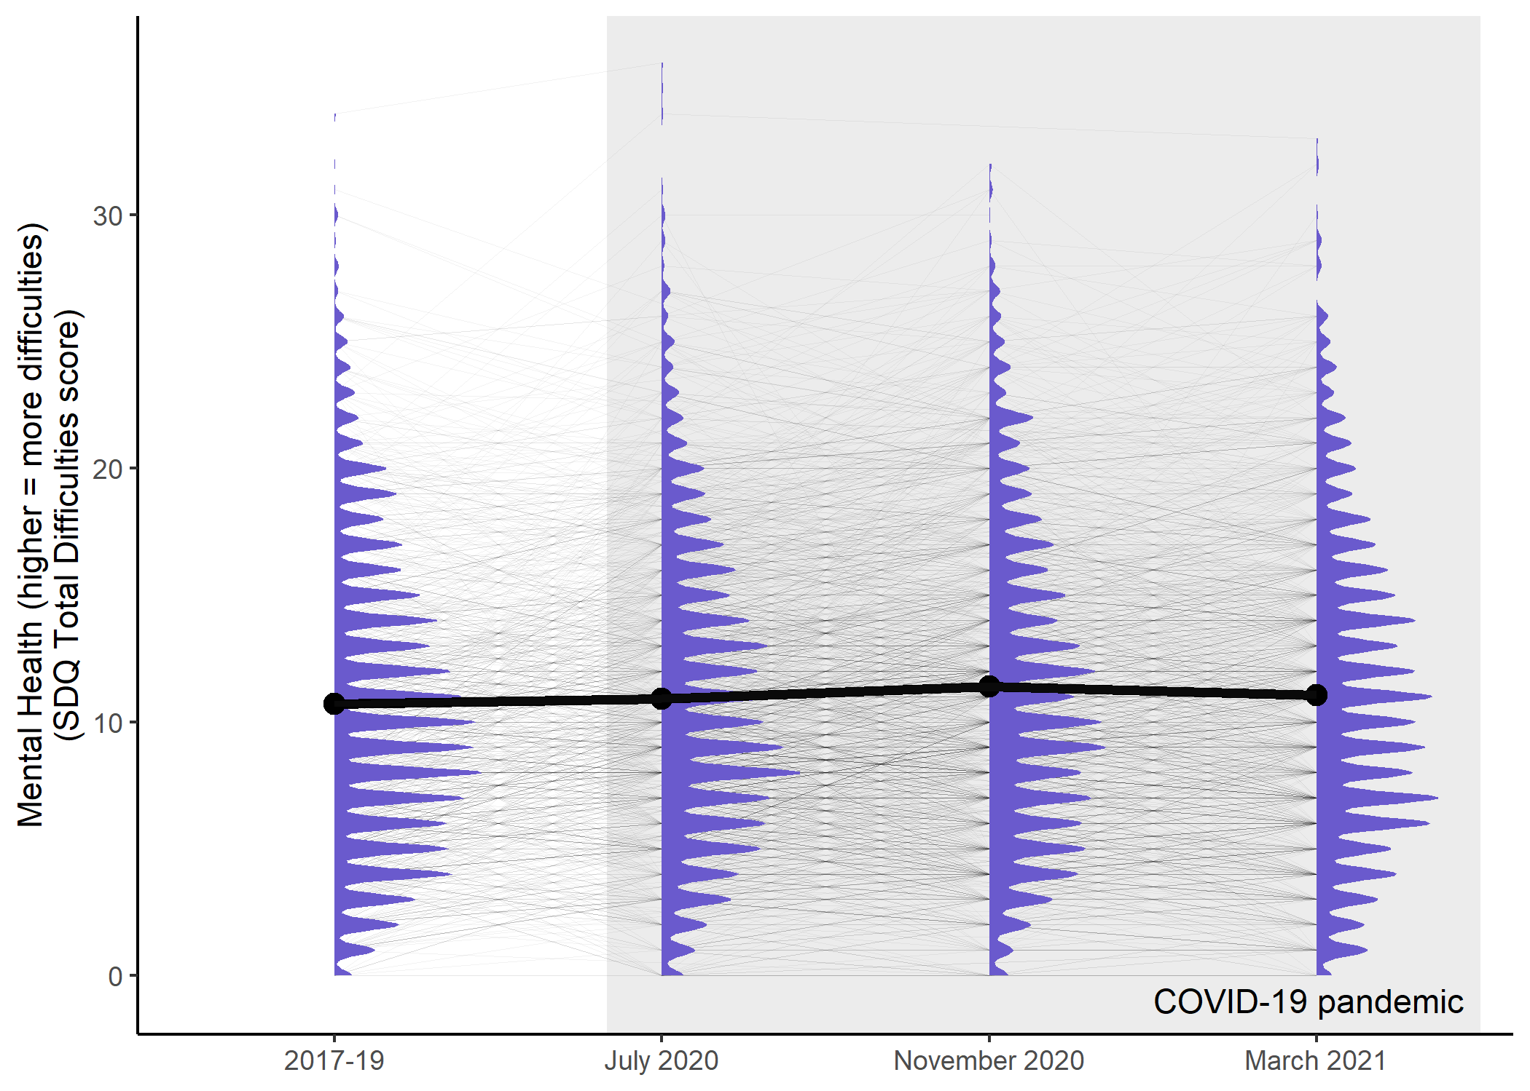
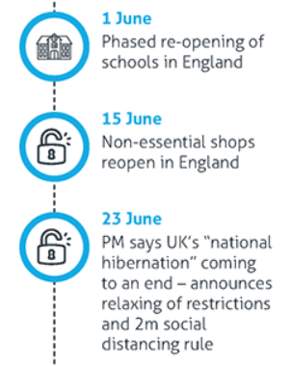

Institute for Government (2021); Metherell et al. (2022)
Notes:
Describe features of graph in painstaking detail (black line is mean SDQ score). Note in particular: July 2020 coincides with relaxing of first wave of restrictions in England (vast majority of UK population); November 2020 coincides with introduction of second lockdown in England. These features might explain the worse MH in November cf. July – these data are quite coarse.

Slide 6

Many adolescents are well positioned to mitigate… social shortfalls using digital means of connection. — Orben et al. (2020)
Notes:
If the COVID-19 pandemic had happened 25 years earlier, young people would have been faced with communicating only via telephone/SMS and maybe email. However, with the advent of instant messaging and social media, many adolescents arguably had a better chance of mitigating the social isolation resulting from lockdown.

Slide 7
Around 1.5 million homes [in the UK] remain offline. — Ofcom (2021)
Notes:
However, around 1.5 million homes in the UK remain offline, and that means some young people won’t have had access to the digital social platforms that most were using to communicate with their friends.

Slide 8






COVID-19 pandemic for adolescents
Social restrictions
Online schooling
Mental health consequences for digitally excluded?
Orben et al. (2020)
Notes:
*** FIVE MINUTES *** In addition, with the introduction of restrictions on face-to-face interaction, schooling moved mostly online. This not only has the potential to impact education but might also interfere with general social interactions (and in cases where individual MH support is needed, this tends to take place in a schooling context and is therefore also disrupted by students being sent home).

Slide 9
Digital exclusion during lockdown is likely to be more disempowering than ever. — Ofcom (2021)
Notes:
As a result, we hypothesised that being digitally excluded during lockdown would lead adolescents along a path of worse mental health during the pandemic than those who had access to digital devices would have.

Slide 10


Digital access measures
Having access to a computer
Having access to a good internet connection
Notes:
We operationalised digital access using two key variables present in the Understanding Society dataset: having access to a computer and having access to a good internet connection, both for schoolwork.

Slide 11
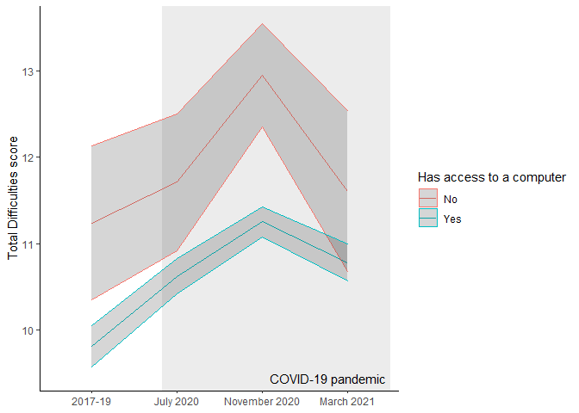
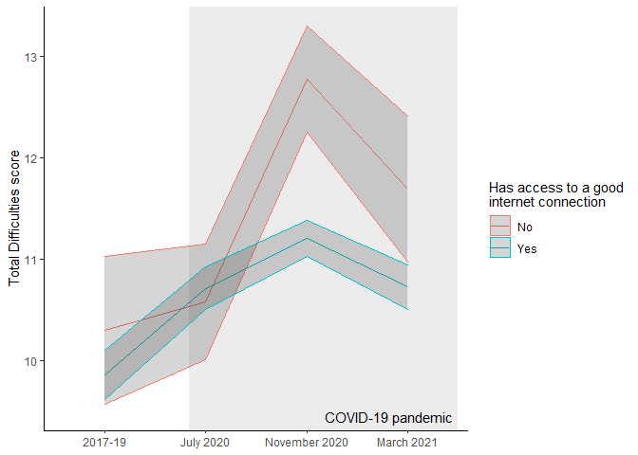
Cross-sectional data
Metherell et al. (2022)
Notes:
These are cross-sectional data from Understanding Society (i.e. lines display mean SDQ score +/- standard error). Notice again ‘inverted U’ shape of mean SDQ scores, but note also that this is greatly pronounced in those who don’t have access to a computer (left) or good internet connection (right).

Slide 12
Step 1: establish general form of mental health trajectories
Notes:
Cross-sectional data are not good at telling us about the mean *trajectories* of individuals’ MH over the relevant time period. So we turn to longitudinal latent growth curve modelling to better assess this. We started by establishing the general form of mental health trajectories…

Slide 13
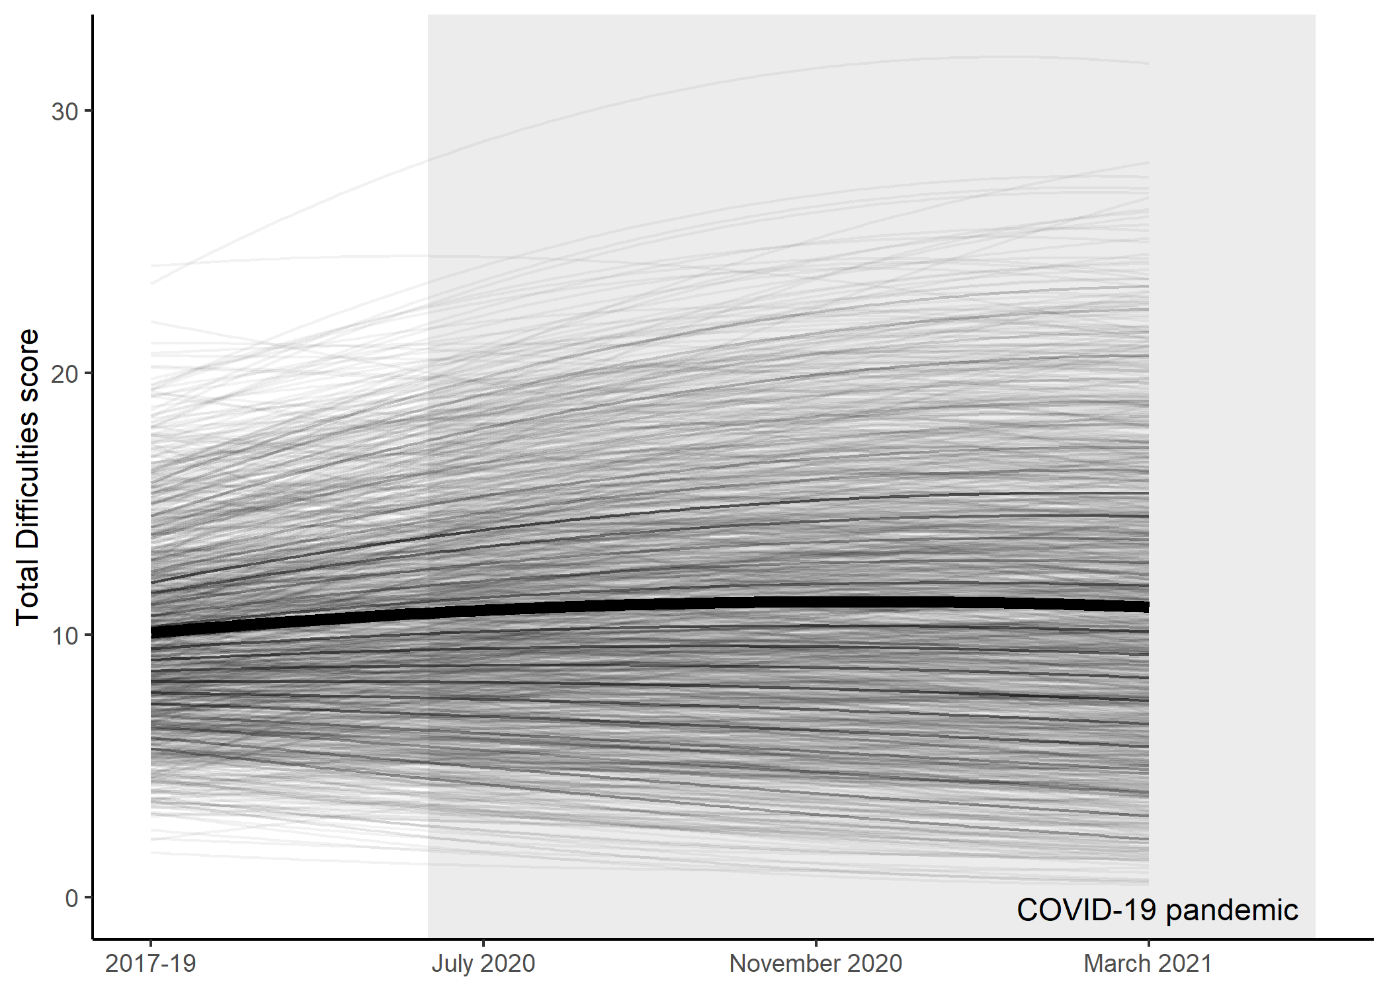
Metherell et al. (2022)
Notes:
I first fitted a model where adolescent mental health, then compared this to one where mental health changes linearly. These models fit significantly worse than the model shown in this figure, where the trend in mental health is quadratic (i.e. has the ‘inverted U’ shape). The peak of the trend is approximately in December 2020.

Slide 14
Step 2: does allowing parameters to differ between groups make model fit significantly better?
Notes:
Now we have the general form of the adolescent MH trajectories, we can start to consider those with and without access to digital devices separately. Once we have a trajectory for each group modelled, we can start to constrain the parameters of the model in turn so that they are the same across groups, and see whether this makes the fit of the model substantially worse. By trying this with all of the model parameters, variances and covariances (using likelihood ratio tests), we arrive at the best possible model for the data.

Slide 15
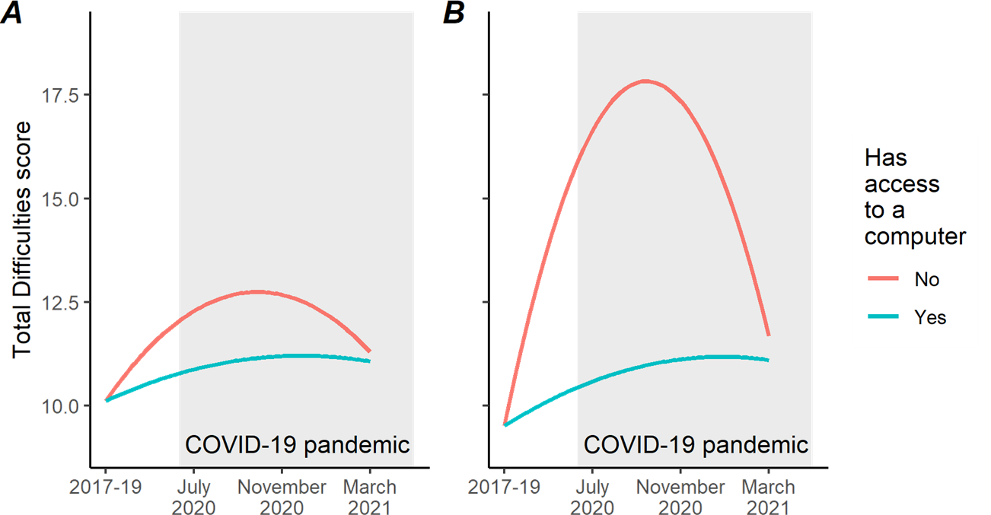
Metherell et al. (2022)
Notes:
Here is the end of that process. On the left you can see the best model of the data JUST for having access to a computer. BUT this model does not consider variables that might covary with mental health that are also available in the dataset (sex, age, ethnicity, income). Once we take these into account… (advance slide)

Slide 16
Control covariates:
Sex
Birth year
Ethnicity (white / ethnic minority)
Mean household income across waves
Metherell et al. (2022)
Notes:
*** TEN MINUTES *** In We arrive at the model on the right. Notice that, contrary to what we might expect, controlling for these variables actually increases the size of the effect. So it looks like lack of access to a computer might be causative of worse mental health among adolescents during the pandemic, but not beforehand.

Slide 17
“High” symptoms (≥ 18):
24%
14%
“Very high” (≥ 20)
16%
8%
Metherell et al. (2022)
Notes:
In terms of clinical cutoffs, note also here that the proportion of modelled adolescent trajectories entering the “high” or “very high” ranges of SDQ scores is 24% in the group without computer access cf. 14%, and the proportion entering “very high” is 16% cf. 8%.

Slide 18
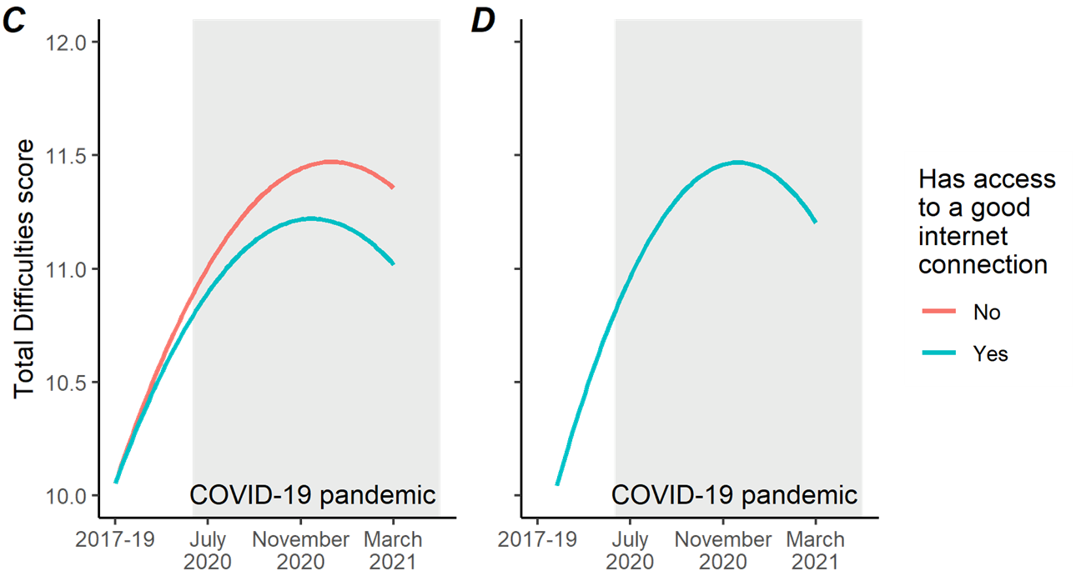
Metherell et al. (2022)
Notes:
Repeating the same process for access to a good internet connection, on the left you can see the model without control variables taken into account. On the right is with controls, and now you can see that the two lines are actually on top of one another. This is because the data do not support any difference between the modelled trajectories once we take control variables into account. So it would appear that access to a good internet connection is not predictive of worse adolescent MH. Potential reasons for this: the smaller effect size for this (what is a good internet connection?) combined with a small sample size for the digitally excluded group leads to the difference being insignificant.

Slide 19
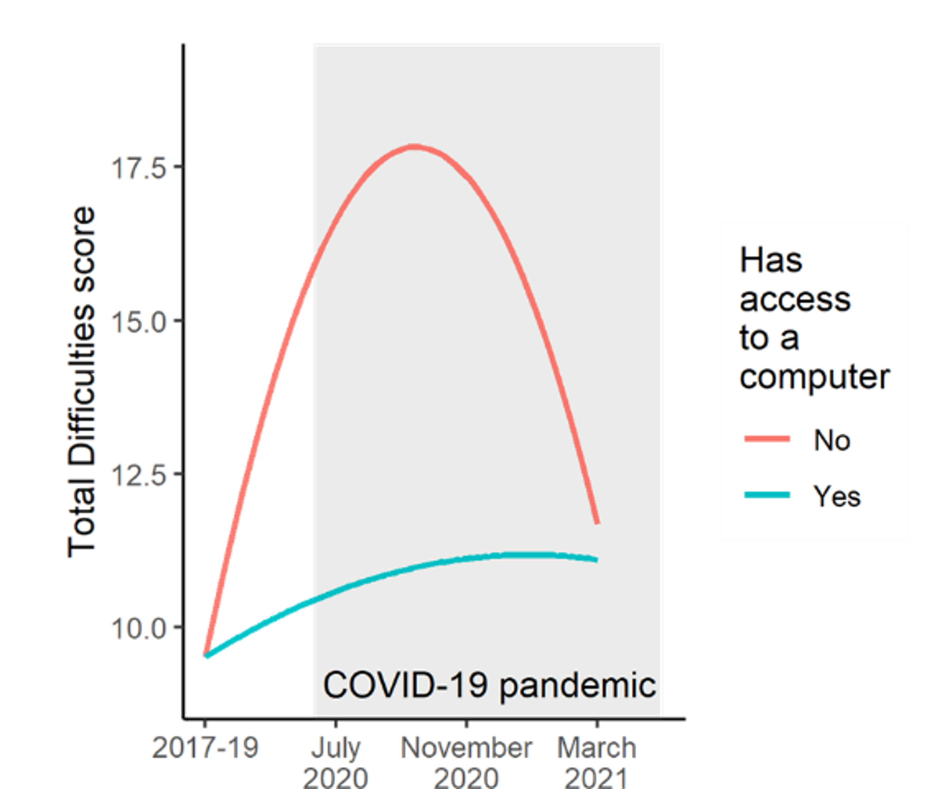
Discussion: COVID-19 pandemic for adolescents
Social restrictions
Online schooling
Mental health consequences for digitally excluded(?)
Orben et al. (2020); Metherell et al. (2022)
Notes:
So returning to our hypothesis, we have provided some evidence that not having access to digital devices (in this case, a computer) might have adverse mental health consequences among adolescents during COVID.

Slide 20



Caveats
Limited number of digitally excluded adolescents
Unequal spacing of survey waves
Could not apply sample weights
Metherell et al. (2022)
Notes:
There are some caveats to this: firstly, in the UK, the number of adolescents without access to digital devices is quite low, so the sample sizes for the digitally excluded groups are quite small (5-10% of total). Also, the survey waves are not equally spaced, which might influence the validity of the models we fit. Finally, because of the small size of the excluded groups it was not possible to validly apply survey weights, so the results are not yet fully generalisable to the UK population – e.g. ethnic minorities are oversampled in the dataset to account for higher dropout rates.

Slide 21



Significance
Technology brings risks and benefits for youth mental health
Digital exclusion is a risk factor during social isolation
In a “digital first” world, equitable access is needed
Metherell et al. (2022)
Notes:
Finally: the significance of these findings. Our results combined with the findings of others indicate that digital technologies don’t just bring risks, but also potential benefits for adolescent mental health, particularly during times of elevated social isolation such as the COVID-19 pandemic. Digital exclusion may be a risk factor for adolescent mental health during these times, and it is therefore important to prioritise equitable digital access. Finally, as we move towards a more digitalised world, equitable digital access must become a priority in order to protect the mental health of adolescents in the future.

Slide 22
Paper (including references)
Thomas E. Metherell, Sakshi Ghai, Ethan M. McCormick, Tamsin J. Ford & Amy Orben
Digital access constraints predict worse mental health among adolescents during COVID-19.
Scientific Reports 12;19088
Notes:
QR code for paper again; all of the references from this presentation are also found there. Brief acknowledgement to co-authors and funders, plug Twitter and invite conversation over email.

Slide 23






THANK YOU!
@tom_metherell
thomas.metherell.22@ucl.ac.uk
supported by:

