Slide 1

Final Viva
User behavior analysis based on Deep Packet Inspection
Speaker：Cheng Qian

Slide 2


contents
1
Purpose and Background
Achievements: nDPI platform
Achievements: Front-end system
Demonstration

Slide 3


1
Purpose and Background
Contents 1
Contents 2
Contents 3
Contents 4
All the user behavior data go to Internet service company.
User behavior analysis
User tastes and habits analysis
More accurate ads and push notifications
Intelligent recommendation; Increase DAU (Daily Active User)
01
What if we adopt it for network carrier?
02
03
Based on Application Layer
Read the load content inside of IP packets (traditional technique only read headers)
Identify protocol type through specific feature; Reliable
Deliver the tube; comprehensive data
More secure and robust
Deep Packet Inspection
Idea
Service Company
Network
Carrier

Slide 4

contents
2
Purpose and Background
Achievements: nDPI platform
Achievements: Front-end system
Demonstration

Slide 5



















2
nDPI platform
Contents 1
Contents 2
Contents 3
Contents 4
Deployment
Video
1
Video
2
User
1
Device
Website
1
Video
3
User
2
Device
Website
2
Switch deployed
with nDPI
User
3
Device
Website
3
nDPI1.6
Ubuntu system
User
4
Device
Website
4
Figure 2.1 Deployment

Slide 6
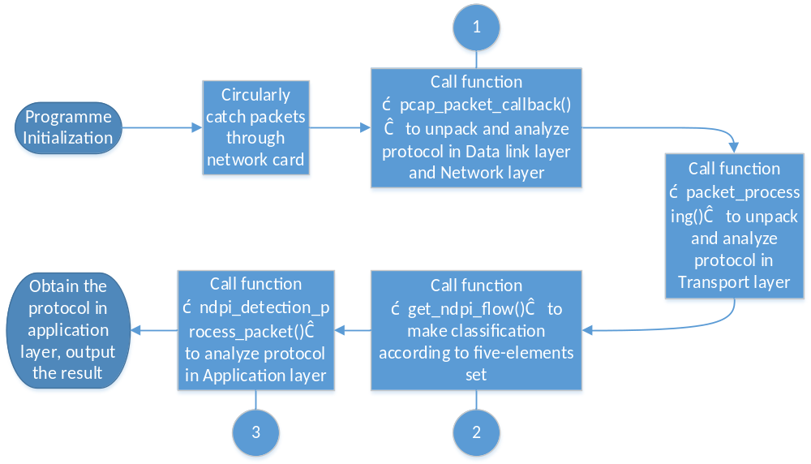
2
nDPI platform
Contents 1
Contents 2
Contents 3
Contents 4
Protocol analysis
From lower layer to upper layer, which conclude Data link layer, Network layer, Transport layer and Application layer
Specific principles for each layer
Figure 2.2 Entire execution flow
Notes:
第一步是程序的初始化，调用setupDetection()函数
接下来会开启线程调用libpcap库函数对通过电脑网卡的数据包进行抓取，或者读取传入的.pcap文件
然后从lower到upper。。。
最后obtain

Slide 7
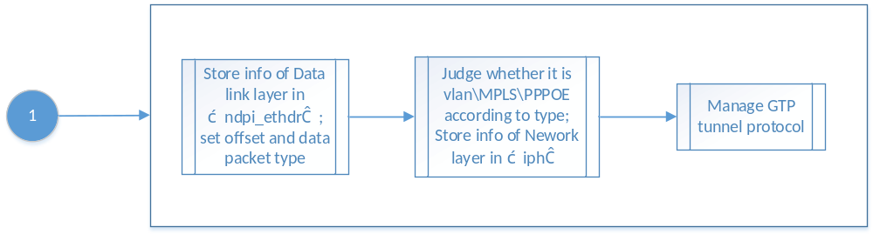
2
nDPI platform
Contents 1
Contents 2
Contents 3
Contents 4
Protocol Analysis
Data link layer and Network layer
Figure 2.3 Data link layer and Network layer Analysis
Call function “pcap_packet_callback()” to unpack and analyze protocol in Data link layer and Network layer, judge whether it is based on IP or other protocols, and obtain source and destination IP address, protocol type etc.
Notes:
接下来对每一个数据包,首先对其数据链路层和IP层进行拆包分析pcap_packet_callback()函数，判断是否为基于IP协议等，并获得其源目的IP、协议类型等。
具体是将数据链路层信息存储在ndpi_ethdr中，然后设置片偏移和数据包类型
接着根据类型判断是否属于vlan、mpls或者pppoe。并将网络层信息存储在 iph 中
最后检查是否存在gtp隧道协议，最终获得完整的数据链路层和网络层协议

Slide 8
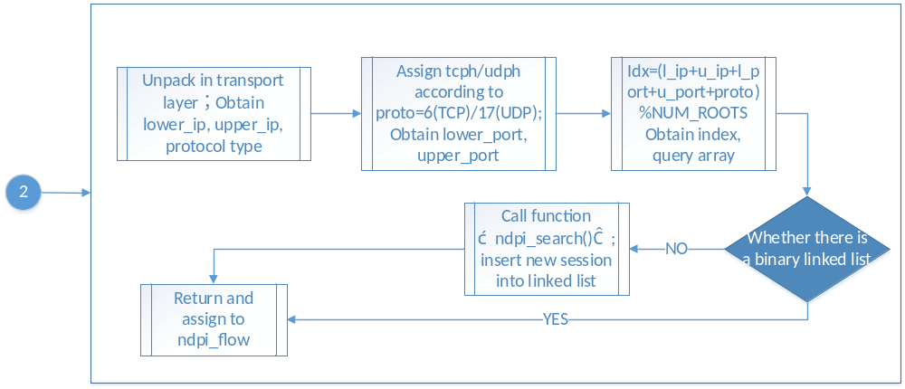
2
nDPI platform
Contents 1
Contents 2
Contents 3
Contents 4
Protocol Analysis
Transport layer
Figure 2.4 Transport layer Analysis
Call function “packet_processing()” to unpack and analyze protocol in Transport layer
Notes:
在接下来调用packet_processing()函数，进行传输层分析。
首先对传输层进行拆包得到lower ip，upper ip 和协议类型，然后根据proto数值设置tcph/udph并得到上下端口号，
在进行传输层分析时调用了get_ndpi_flow()函数，该函数返回ndpi_flow这个结构体。在get_ndpi_flow()函数中获取传输层的信息如源目的端口等信息。然后根据（源目的IP、源目的端口、协议类型(tcp\udp)）这五个元素计算出idx。
根据此idx处是否存在二叉链表决定是否调用search函数插入新的链表，最终得到传输层信息

Slide 9
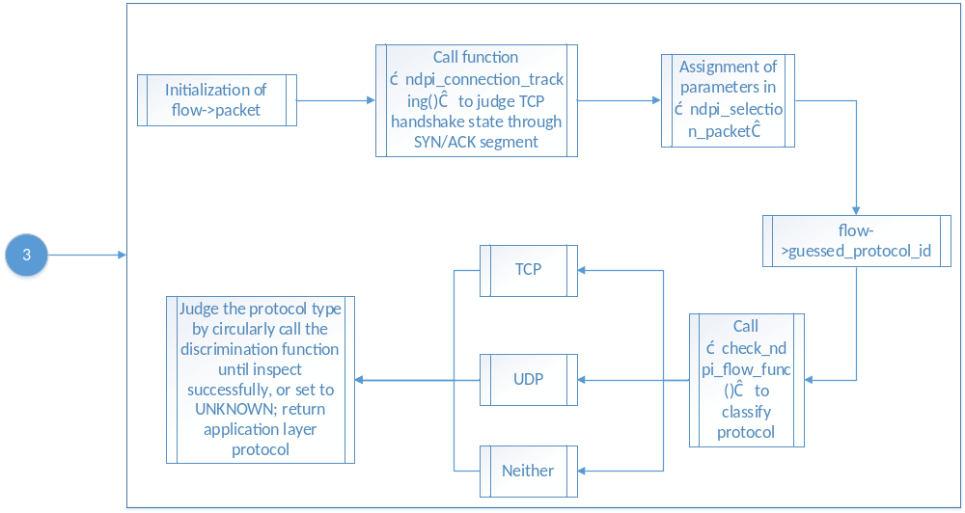
2
nDPI platform
Contents 1
Contents 2
Contents 3
Contents 4
Protocol Analysis
Application layer
Call“ndpi_detection_process_packet()” to analyze protocol in Application layer, which is the most important function in protocol analysis
Figure 2.5 Application layer Analysis
Notes:
接下来函数会调用ndpi_detection_process_packet()这个函数进行应用层分析。这也是应用协议分析的主体函数。函数首先会对flow->packet即对packet这个结构体进行初始化。
接下来会调用ndpi_connection_tracking()函数，这个函数的主要作用是判断这个包的‘位置’，，一个tcp经过三次握手建立连接
接下来会对ndpi_selection_packet进行设置，这个变量主要记录每个数据包的下四层信息。
最后，调用check_ndpi_flow_func()函数进行具体应用协议的检测，这里会根据tcp\udp\二者都不进入不同的接口。经过这个函数之后如果仍然没有检测出协议类型，那么就继续检测下一个数据包直到检测出该数据流的协议类型为止。

Slide 10
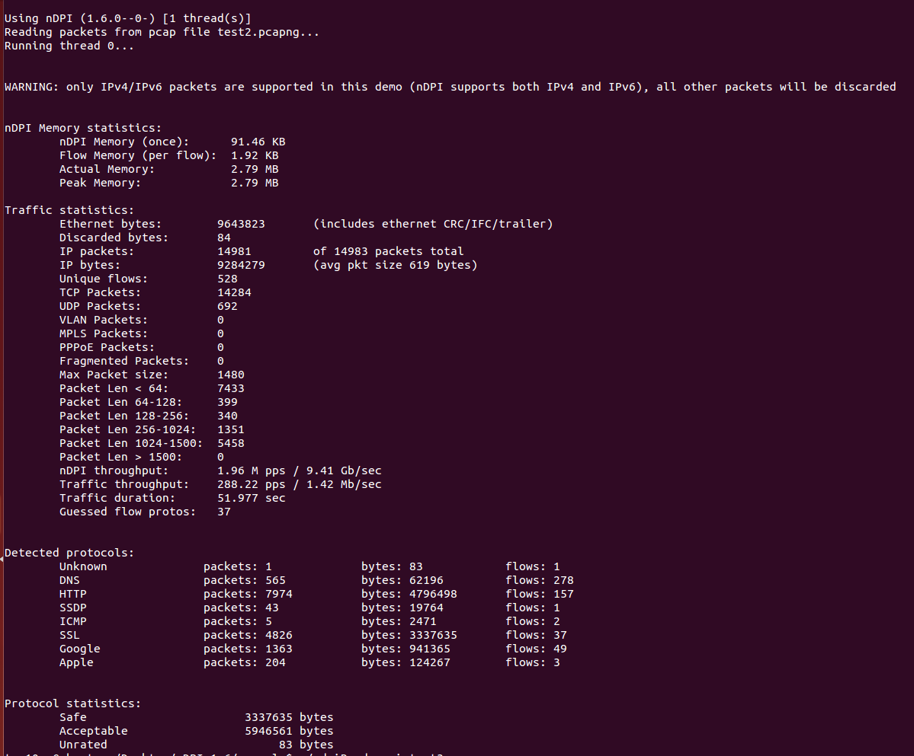
2
nDPI platform
Contents 1
Contents 2
Contents 3
Contents 4
Analysis
Real-time grasp the Internet packets.
Return statistical result of the packets in this pcap file.
Figure 2.6 Statistical Result

Slide 11
contents
3
Purpose and Background
Achievements: nDPI platform
Achievements: Front-end system
Demonstration

Slide 12
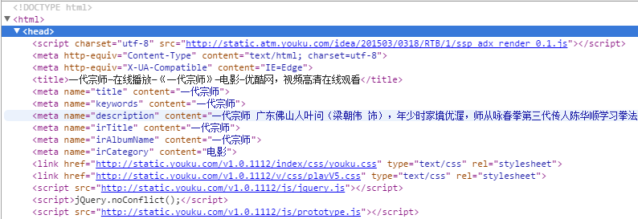
3
Front-end system
Contents 1
Contents 2
Contents 3
Contents 4
HTML title: <title>一代宗师—在线播放—《一代宗师》—电影—优酷网，视频高清在线观看</title> Subtitle: <meta name="title" content="一代宗师"> Keyword: <meta name="keywords" content="一代宗师"> Story and feature: <meta name="description" content="一代宗师 广东佛山人叶问（梁朝伟 饰），年少时家境优渥，师从咏春拳第三代传人陈华顺学习拳法，师傅“一条腰带一口气”的告诫，支持他走过兵荒马乱、朝代更迭的混乱年代。妻子张永..."> Subheading or episode name: <meta name="irTitle" content="一代宗师"> Album name: <meta name="irAlbumName" content="一代宗师"> Category(movie or TV series): <meta name="irCategory" content="电影">
Regular expression
Figure 3.2 Summarized format
Figure 3.1 Original HTML header
Extract title： <title>[\u4e00-\u9fa5]+—在线播放—《[\u4e00-\u9fa5]+》—[\u4e00-\u9fa5]+—优酷网，视频高清在线观看</title> Extract subtitle or episode name: "irTitle.*[\u4e00-\u9fa5]+ " Extract album name: "irAlbumName.*[\u4e00-\u9fa5]+" Extract category: "irCategory.*[\u4e00-\u9fa5]+"
Regular expression is a series of characters that define a search sequence pattern. It is mainly used for pattern matching string.
Figure 3.3 Regular expression

Slide 13
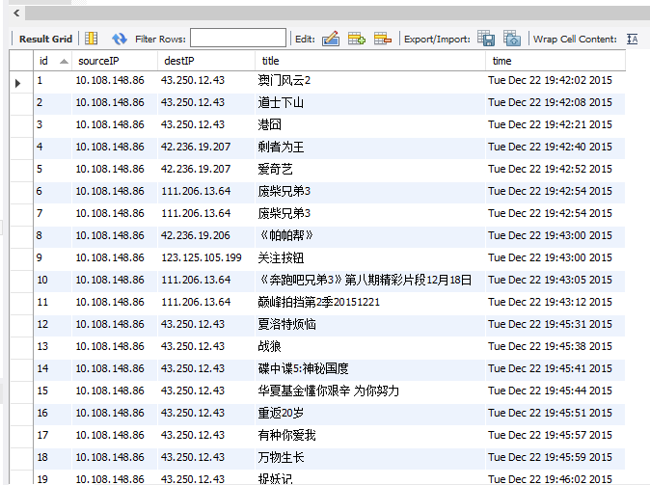
3
Front-end system
Contents 1
Contents 2
Contents 3
Contents 4
Database
Focused on video information.
Summarize six dominating video website HTML header format into regular expression.
Filter and store behavior-related factors (Source IP, Dest IP, Title, Timestamp) in to a database.
Figure 3.4 MySQL database

Slide 14
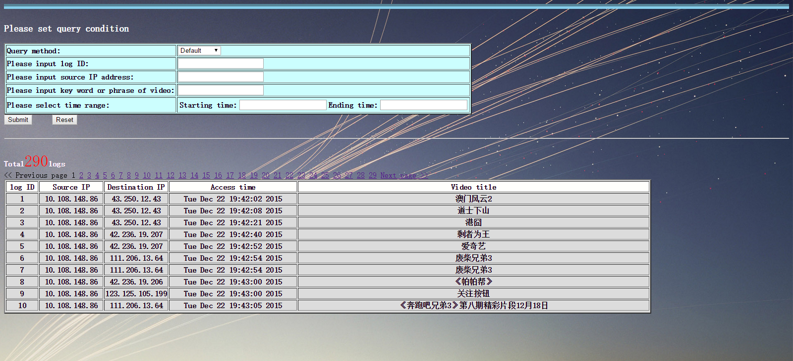
3
Front-end system
Contents 1
Contents 2
Contents 3
Contents 4
Front-end query system
Deploy on Tomcat 8.0
The upper part is used to let the user set any conditions while querying
The lower part is used to display the query result and statistical number of eligible logs
Three query method
“Default”, “Find user” and “Find video”
Details in demonstration part
Figure 3.4 Front-end query system

Slide 15


3
Front-end system
Contents 1
Contents 2
Contents 3
Contents 4
Step 1
Step 2
Step 3
Understand the principle of DPI
Deployment; Analysis of the open source code of nDPI
Grasp and analyze Internet packets; Extract user-related info (focused on video info)
Step 6
Step 5
Step 4
Organize result and finish report
Program a front-end user query system
Store user information into MySQL database
Figure 3.5 Milestones of the project

Slide 16
contents
4
Purpose and Background
Achievements: nDPI platform
Achievements: Front-end system
Demonstration

Slide 17
A
H
K
N
T
S

