Slide 1
TPQ – predicting intraday stock index futures swings
Tom Preston
Novemeber 15, 2019

Slide 2
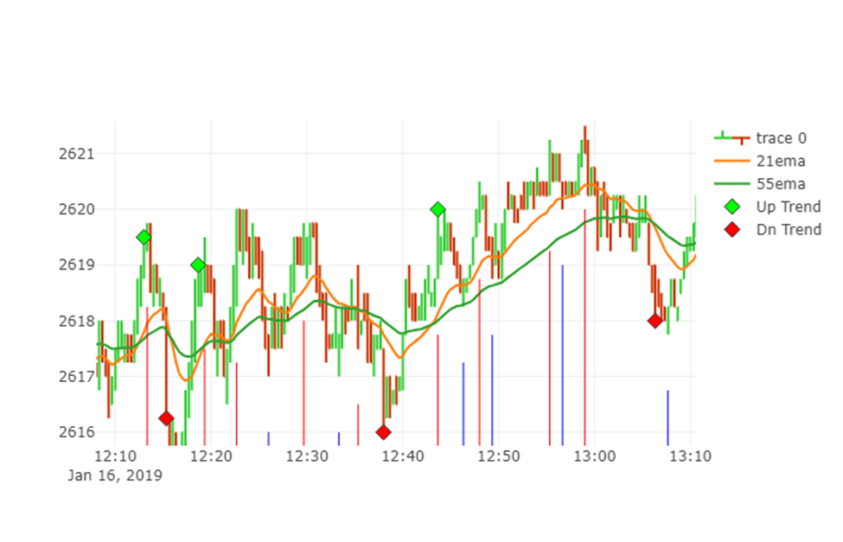
Agenda
Problem Statement
The Data
Exploration
Random Forest Model
Results
Insights

Slide 3
Problem Statement
SP500 e-Mini volatility has increased over the past few years
Day trading the e-Mini has increased in popularity
Several day trading approaches recommend trading short term (1 min) charts for 3 ticks ($37.50 @$12.50 per tick profit) while risking 6 ticks ($75.00) per contract on each trade
Can we use data science to improve on this day trading approach ?

Slide 4
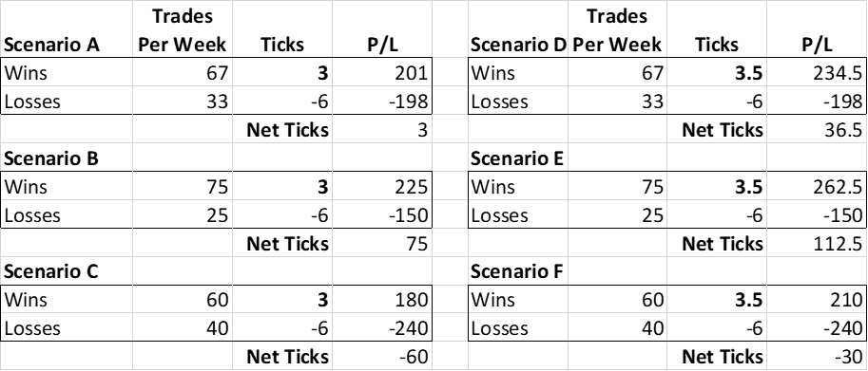
Day trading basic calculations
Scenarios A – F compare profit / loss assuming 3 ticks ($37.50) profit & 6 ticks ($75.00) loss over 100 potential trades
Scenario A – 67% profitability is breakeven approach (before commissions)
Scenario B - C: 8 more wins or losses greatly impacts profitability
Scenario D – F: Averaging .5 points more profit per trades improves all scenarios

Slide 5
The data
SP500 e-Mini trading data for January 2019
Tick data (1M + ticks)
Data converted using pandas resampling int Open, High, Low and Close data
20 second bar chart (mimics the 687 ticks bar chart for day trading)
Additional Data:
21 bar EMA (exponential moving average) – pd.Series calculation
55 bar EMA (exponential moving average) – pd.Series calculation
Custom Developed calculations:
Swing (up or down)
The size of the swing (in points) from the beginning to the end of the swing
The number of total bars in a swing
Trend (up or down) – Trend is up when price closes 1.5 point above 55 EMA and vice versa
Trend Move (up or down)
The MFE (most favorable excursion) – maximum open profit for a trend move
The MAE (most adverse excursion) – maximum drawdown for a trend move
The number of bars to hit the MFE and MAE
55 bar EMA (exponential moving average) – pd.Series calculation

Slide 6
E-Mini Price chart example
Trend Change Flags
20 second Price Bars
Price Swing Start (Blue is upswing, Red is down swing)

Slide 7
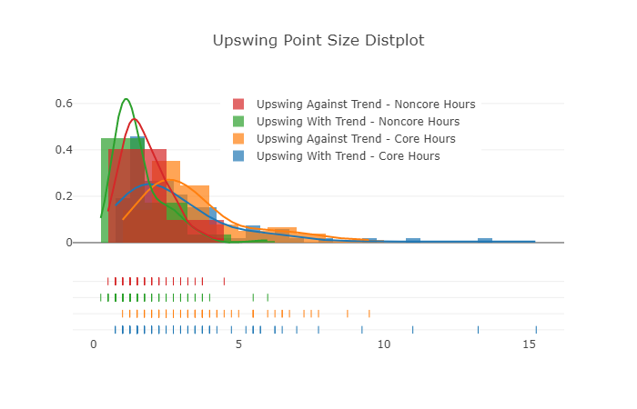
E-Mini EDA
EDA for price swings and trend moves
Move size in points and move length in number of bars
Data separated into core hours (9 am – 3 pm EST) and non core hours (4 pm – 8 am EST)
Swings with and against the trend analyzed

Slide 8
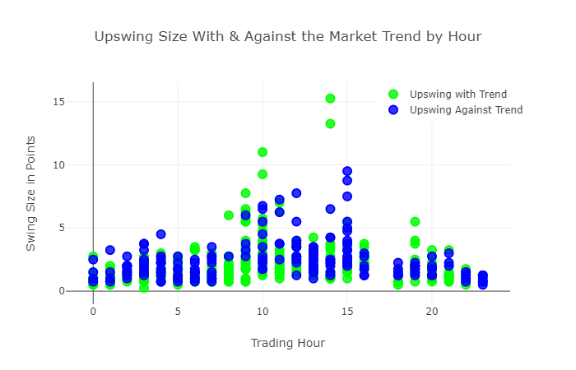
E-Mini core trading hours
EDA for price swings and trend moves
Core trading hours (9 am – 3 pm EST) shows larger size and longer length moves
Trading with the trend are typically larger

Slide 9
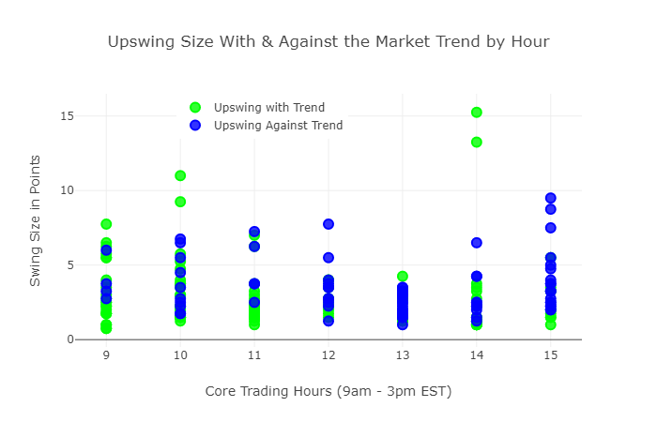
E-Mini core trading hours CONT.
EDA for price swings and trend moves
Core trading hours average 5 point moves
10 am and 2 pm EST often have larger moves

Slide 10
Summary swing analysis
EDA for price swings (956 observations)
50% of all swings are 1.75 points or larger therefore .75 pt profit target is reasonable
Core trading hours 50% leverage for all swings average 2.5 points
Swing length are similar across all swing types – marker keeps same swing structure

Slide 11
Summary trend move analysis
EDA for trend moves (93 observations) – Multiple swings make up a trend move
MFE – trend move potential profit 50% level is 2.0 points
Length of trend is much larger during non-core hours meaning price is not as volatile
MAE – trend move drawdown 50% level is (1.0) points
Data supports using limit entry approach for entering trend trades (i.e. enter on price pullback

Slide 12
Random forest application
Price swing analysis provides reasonable ranges for swing size and length
Predicting if the price swing will exceed previous swing high / low establishes trading targets
The goal is to predict if the swings will exceed previous swing extrement (i.e. A and B high points) for all swings
Random Forest will be used to determine the most valuable features for this prediction

Slide 13
Random forest model
Our data is reduced to these columns:
Breakout (our target variable) – 1 or 0
21 EMA & 55 EMA
Retrace = the percentage retracement of the previous swing
Swing (-1 = downswing, 1 = upswing)
Swing_len – number of 20 second bars in swing
Swing_type (4 types of swings – Long and Short, with and against the trend)
Trend (1 = up trend, -1 = down trend)
Hour = trading hour (24 hour scale)
Hour_type (9 am – 3 pm = 1 (“core” hours) and 4 pm – 8am = 0 (“noncore” hours)
Sample Data below:
 | 21EMA | 55E | Brkout | retrace | swing | swing_len | swing_type | trend | hour | hour_type
0 | 2614.33 | 2614.14 | 1.0 | 1.00 | -1 | 2 | 4 | 1.0 | 3 | 0
1 | 2614.33 | 2614.15 | 1.0 | 2.00 | 1 | 2 | 1 | 1.0 | 3 | 0
2 | 2614.28 | 2614.14 | 1.0 | 1.50 | -1 | 4 | 4 | 1.0 | 3 | 0
3 | 2613.97 | 2614.03 | 0.0 | 2.33 | 1 | 7 | 1 | 1.0 | 3 | 0
4 | 2614.03 | 2614.04 | 0.0 | 0.86 | -1 | 4 | 4 | 1.0 | 3 | 0

Slide 14
Random forest results
80 % train and 20% test data
Accuracy: 0.65, Precision: .66, Recall 0.69
Predicted Result | 0.0 | 1.0
Actual Result
0.0 | 53 | 36
1.0 | 32 | 71
Feature Importance (top 3 marked)
('21EMA', 0.16784893965323588), <<<<<<<<<<<<
('55E', 0.1474478287573294),
('retrace', 0.29807399850023714), <<<<<<<<<<<<
('swing', 0.015242575697336433),
('swing_len', 0.19725555099071168), <<<<<<<<<<<
('swing_type', 0.03437945102718543),
('trend', 0.015427164478980612),
('hour', 0.11245784433977743),
('hour_type', 0.011866646555205956)]

Slide 15
Results / Final Insights
Random Forest Model:
66% accuracy is solid start but more features are needed to improve model
Top 3 features (21 EMA, retracement, and swing length)
Need to add decision tree to understand how each feature is being used
Retracement feature assumed to mean smaller pullbacks signal market strength therefore predicting previous swing peak to be exceeded
Swing Length should be removed – the length of the swing ies only know after the swing is completed
SP500 eMimi Final Insights:
Core trading hours have more volatility
Approximately 10 – 1 ratio of trading swings to trend moves – while trend moves go longer, proper filtering of trade swings provides more opportunities
Trading with trend makes sense but intraday swings can be traded with and against the trend
Trend swing analysis supports limit entries, additional study needed on price swings
Additional analysis around price retracement is next areas to study

