Slide 1

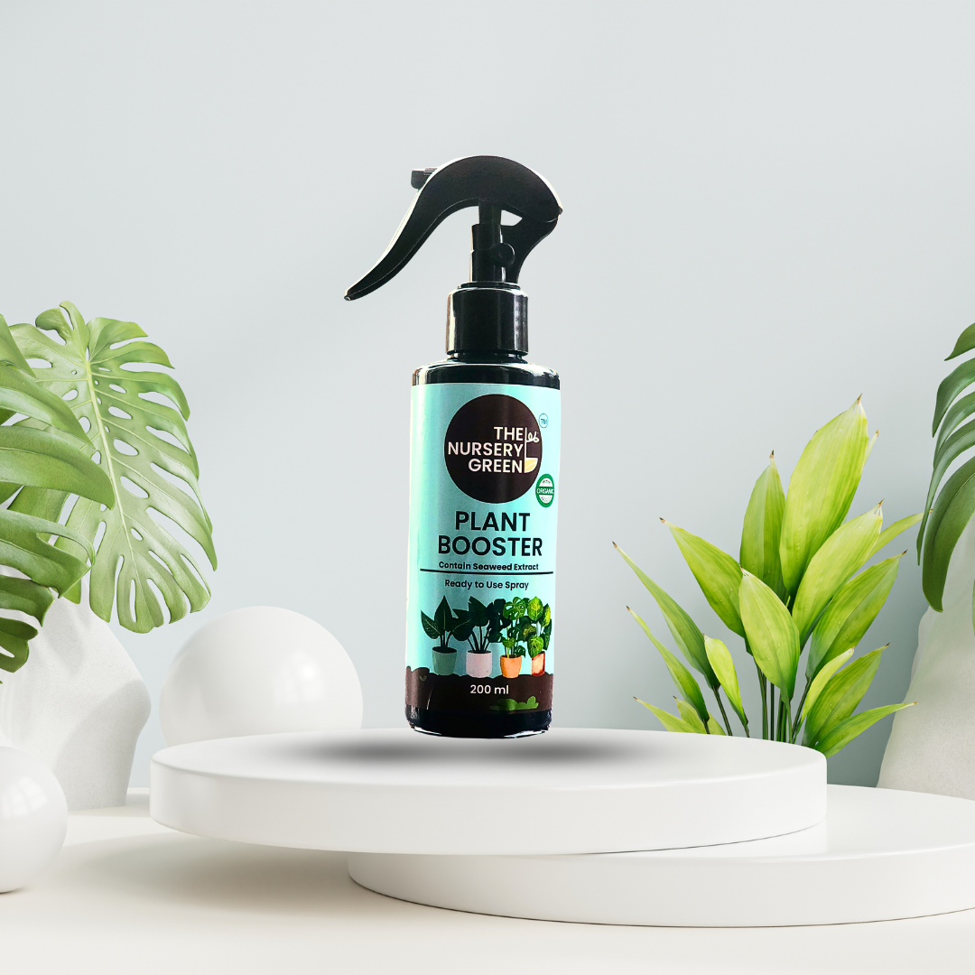

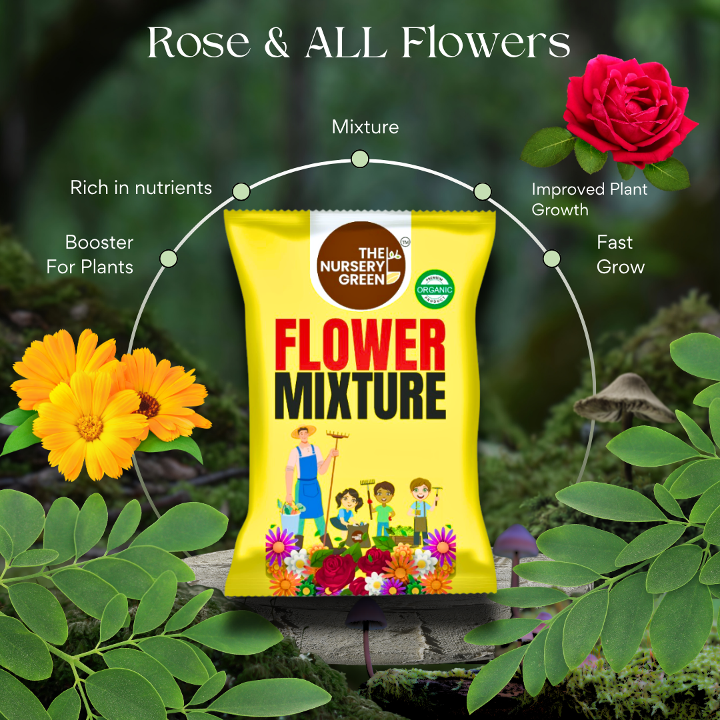
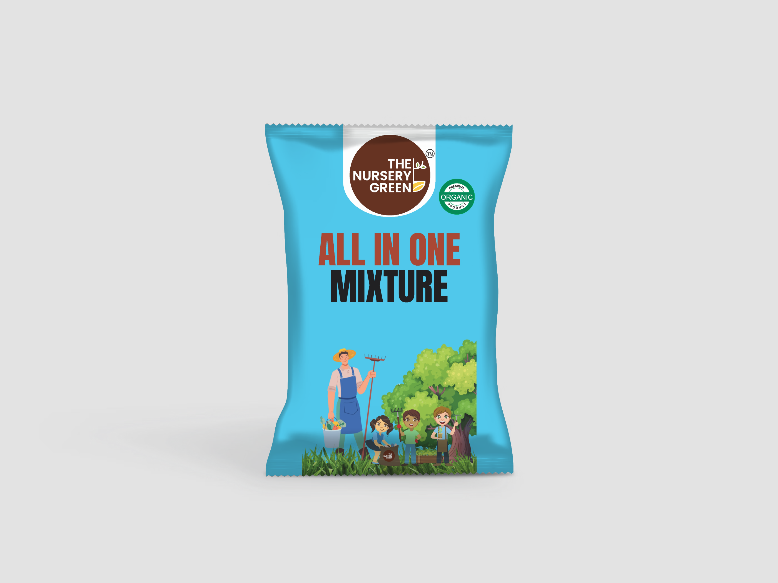
THE NURSERY GREEN
India's First Integrated
Plant Health + Commerce Platform
Investor Deck • February 2026 • Confidential

Slide 2
The Problem
01
₹18,000 Crore of silent plant deaths — fragmented diagnosis, no trust
🔍
🧩
🚫
Misdiagnosis
Fragmented
No Verification
60%+ wrong treatment from generic Google searches
YouTube + Amazon + WhatsApp = no single source of truth
Advice given without leaf, soil, or environment check
💸
🔄
TAM
₹6K–₹18K Cr
Trust Deficit
No Feedback Loop
30M+ urban plant-owning
households × ₹2K–₹6K
annual spend
Users can't tell if a ₹200 spray will actually work
Brands sell but never learn if treatments actually worked
Growing 15–20% annually — urban gardening, balcony farming, wellness green living

Slide 3
Our Solution
02
Verified diagnosis + treatment + commerce + community — one app
📷
🧠
💬
Plant Scanner
Knowledge DB
Smart Chatbot
50+ diseases
100+ Indian remedies
Pixel-level analysis
Hybrid online/offline
Auto-refreshing MongoDB
Verification pipeline
6 categories
Audit trail
Chat → order flow
Plant-care routing
Order tracking
Knowledge integration
👥
🛒
📱
Community
Commerce
Mobile App
Show & Tell
Tips & Tricks
Help & Advice
Before/after photos
100% organic products
Razorpay (UPI + Card)
Free shipping ₹1999+
30-day guarantee
Expo + React Native
iOS + Android
Google/FB OAuth
Deep-link support
All features live & deployed — Railway backend, Razorpay payments, OAuth, admin tooling

Slide 4
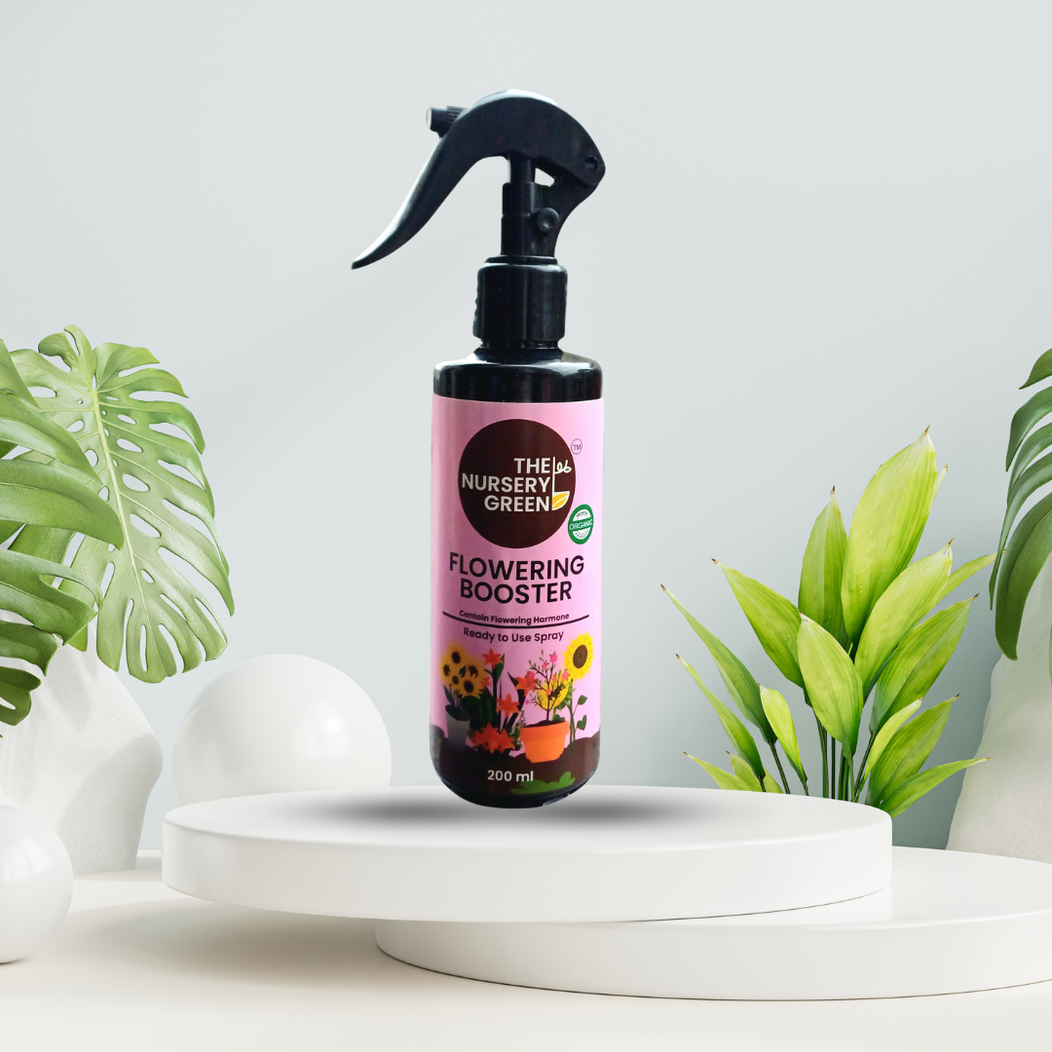
Product Catalog
03
100% organic plant care — made for Indian conditions
Plant Booster Spray
Neem Oil
Flower Mixture
All-in-One Mixture
Flower Booster
₹180
₹150
₹230
₹199
₹180
Free shipping above ₹1,999 • 30-day replacement guarantee • Desi remedies included

Slide 5
Why Now — India's Moment
04
UPI + mobile + D2C momentum = perfect convergence
21.7B
₹28.3L Cr
$163B
900M+
UPI txns (Jan 2026)
UPI value (Jan 2026)
E-commerce 2026
Smartphones
$60B
40%
$170B
691
D2C by 2027
D2C CAGR
E-retail 2030
Banks on UPI
What this means for us
• UPI removes friction (₹130 spray = one-tap purchase)
• Mobile-first discovery → diagnosis → purchase in-app
• D2C trust > marketplace listings = higher repeat
• Content + commerce convergence → diagnosis-led flywheel
Sources: IBEF, NPCI, Statista

Slide 6
Competitive Landscape
05
No one in India combines all four layers
Capability
E-commerce
Content Sites
Plant ID Apps
Nursery Green
Commerce
✅
❌
❌
✅
Verified diagnosis
❌
❌
Partial
✅
Auto-refresh knowledge DB
❌
❌
❌
✅
Community + social proof
❌
Partial
❌
✅
India-specific remedies
❌
Partial
❌
✅
Chat → Order
❌
❌
❌
✅
Leaf + soil + env verification
❌
❌
❌
✅
Diagnosis audit trail
❌
❌
❌
✅
🔑 Key: Verification-first diagnosis • 100+ desi remedies • Closed-loop data flywheel • Chat-to-cart
The Nursery Green — Only platform with all 8 capabilities

Slide 7
The Data Flywheel
06
Scan / Ask
Every interaction makes the platform smarter
📷
100K+ cases
Knowledge
Improves
Verify
(leaf/soil/env)
After 100K diagnosis logs, our India-specific plant health dataset will be unmatched.
🔄
✅
TRUST
→
REPEAT
Compounding
Better accuracy → higher conversion → more data → lower CAC.
📊
🧠
Defensible
Log Case
+ Outcome
Diagnosis
+ Plan
Integration depth + data flywheel is impossible to clone quickly.
🛒
Powered by verification-first inputs — leaf + soil + environment
Buy
Treatment

Slide 8
Business Model
07
Subscription layered over repeat D2C commerce
D2C Products
Subscription
B2B / B2B2C
GM: 45–55%
Live
GM: 80–90%
Q3 2026
GM: 60–70%
2027
Marketplace
Affiliate
Data & Insights
GM: 15–25%
2027
GM: 70–80%
2027
GM: 90%+
2028
Unit Economics (Target)
Revenue Mix Evolution
AOV: ₹650–₹1,200 • Repeat: 4–8×/yr • CAC: ₹150–₹400
Payback: <6 mo • Blended GM: 55–62% • LTV:CAC > 4:1
Y1: 90% commerce → Y5: 55% commerce + 30% subscription + 15% B2B
Subscription is the margin accelerator
All targets are planning assumptions; replace with cohort data as collected

Slide 9
Go-to-Market (India)
08
Scanner acquisition → community retention → repeat commerce
🏙️ Phase 1: Metro (0–12 mo)
🌍 Phase 2: Tier-2 (12–24 mo)
🏢 Phase 3: B2B (24–36 mo)
Mumbai, Delhi, Bangalore, Pune, Hyderabad, Chennai
• Scanner viral loops (₹50–100 CAC)
• 500 community seeders
• WhatsApp referrals (₹100–150)
• 50 micro-influencers
• Meta/Google retargeting
Hindi, Tamil, Telugu, Bengali, Marathi
• Voice-based diagnosis
• ₹299 monthly bundles
• City cohorts ("Plant Circles")
• College/school programs
• Non-typing user support
Institutional & enterprise layer
• RWA managed care contracts
• Nursery partnerships
• Corporate green buildings
• Smart City initiatives
• White-label scanner
North Star Metric → monthly diagnosis-to-purchase conversions

Slide 10
Financial Projections
09
Revenue growth with improving margins as subscription mix rises
Revenue (USD millions)
$420M
EBITDA Margin
Y1: -60%
0%
Y4: +5%
$265M
5%
Y7: +21%
21%
$160M
Y8: +24%
24%
$82M
$38M
Active Users
$0.9M
$4.2M
$15M
Y1: 25K
2%
Y1
Y2
Y3
Y4
Y5
Y6
Y7
Y8
Y7: 8.5M
65%
Scenario-based planning — not guaranteed forecast. ₹83 = $1 exchange rate.

Slide 11
$1 Billion Valuation Path
10
Achievable in Year 6–7 with disciplined execution
$1.9B
$1.3B
Indian Comparables
Mamaearth: $1.2B (IPO 2023)
Lenskart: $4.5B (2023)
PharmEasy: $5.6B (peak)
Country Delight: $1.5B (2024)
D2C + vertical AI + subscription = premium multiples
$950M
$575M
$285M
$128M
$42M
$12M
Y1
Y2
Y3
Y4
Y5
Y6
Y7
Y8
Revenue multiples calibrated against Indian D2C and vertical SaaS comparables

Slide 12
Future Features
11
Customer attraction + moat expansion
🗣️
📡
📅
📈
Voice Plant Doctor
Sensor Fusion
Care Calendar
Outcome Tracker
Hindi + 5 languages
Voice symptom capture
3–5× TAM expansion
BT soil sensors
Photo + data diagnosis
Premium tier unlock
Weather + lifecycle
Push notifications
2–3× weekly usage
Before/after photos
Recovery trajectory
Efficacy dataset
HIGH PRIORITY
HIGH PRIORITY
HIGH PRIORITY
MED PRIORITY
🏪
🎮
🤖
🌐
Marketplace
Gamification
AI Prediction
IoT Garden
Local nurseries
Service providers
15–25% take rate
Leaderboards
Care streaks
K-factor > 1.2
Growth models
Recovery timeline
Patent-worthy IP
Auto-watering
Climate control
Smart home integration
MED PRIORITY
MED PRIORITY
LATER PRIORITY
LATER PRIORITY

Slide 13
Defensibility — Why We Win
12
6 compounding moats
💾
📡
🔁
Data Moat
Distribution
Behavior
Every diagnosis logged
India-specific dataset
2–3yr to replicate
Scanner → chatbot → shop → community
4 touchpoints in 1 funnel
Care cycles = monthly habit
Not one-time transactions
🛡️
🌐
🇮🇳
Trust
Network Effects
Localization
Reference-backed solutions
Verification-first diagnosis
More users = better data
= better diagnosis = more users
100+ desi remedies
Indian plants & climates
12–18mo to replicate
Integration depth + data flywheel = hard to clone

Slide 14
24-Month Roadmap
13
Stage-gated by retention & unit economics milestones
0–6 mo
D30 retention loops
Subscription alpha ₹99/mo
Scanner UX upgrade
Community seeding (5 cities)
Referral engine
6–12 mo
Hindi + regional voice
Care calendar + push
3-tier subscription
Outcome tracker v1
Expand 15 cities
12–18 mo
Nursery marketplace
Soil sensor bundle
B2B pilot (10 societies)
500+ knowledge entries
ML model v1
18–24 mo
Expand 50+ cities
Corporate green packages
IoT pilot
AI growth prediction
Series A ready
Each phase unlocked only when retention & payback milestones are met

Slide 15
The Ask
14
Seed round to scale what already works
$500K – $800K
Use of Funds
🟢 35% — Product + AI + Data (scanner ML, knowledge DB, vernacular voice)
🟠 30% — Growth & Brand (influencers, referrals, community seeding)
🔵 20% — Supply Chain & Ops (SKU expansion, 3PL, fulfillment)
🟣 15% — Team & Compliance (engineers, plant science, legal)
SEED ROUND
15%
Series A Milestones (12 months)
35%
📊 30K+ MAU 📈 D30 retention > 30%
💰 Monthly GMV ₹25L+ 🔄 Repeat orders > 35%
⭐ Subscription attach > 5% ⏱️ CAC payback < 5 months
👥 Community DAU/MAU > 20% 🔬 25K+ diagnosis cases
20%
30%
Contact: thenurserygreen.com • Confidential

Slide 16
THE NURSERY GREEN
India's plant health + commerce platform.
Built. Deployed. Ready to scale.
thenurserygreen.com
Confidential • February 2026 • Generated with Claude Opus 4.6

