Slide 1
AudiobookTableBlending
File created on: 10.02.2021 1:32:17

Slide 2
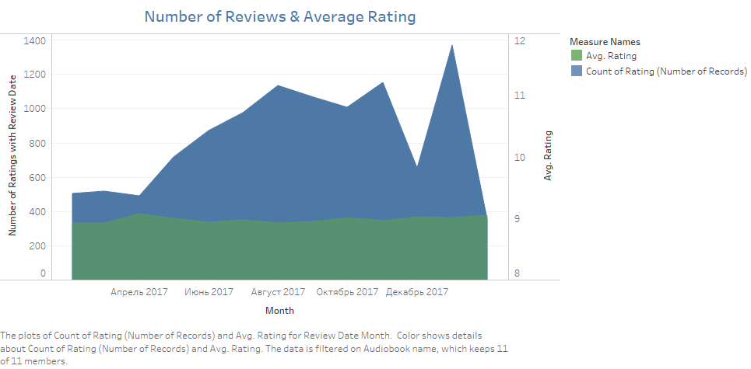

Slide 3
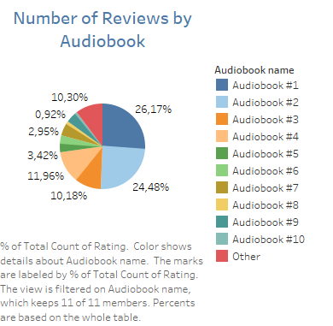

Slide 4
