Slide 1
PyMusiqMix
Constraint-based Playlist Generation by Applying Genetic Algorithm
SUBMITTED BY
PROJECT GUIDE
Mr.Febin P Jacob
NIMITHA LIZ SUNNY
RIYA MARY ROLY
TOM JOSEPH

Slide 2
INTRODUCTION

Slide 3
PROBLEM DEFINITION
With a huge amount of music collections, it might be difficult for users to find favorite music.
a variety of emerging music services is proposed
Presently there are no good playlist generation software.

Slide 4
SCOPE AND OBJECTIVE
By applying the genetic algorithm, playlists is generated which satisfy constraints entered by the user.
Playlist creation can be aided by personalized song recommendations, ratings and reviews.
Users having the same taste of music can share their playlists making the system more efficient.

Slide 5
LITERATURE SURVEY
Genetic algorithms are useful for problems in which you know the desired result and you know how to guess at the initial state, but don’t know how to get from the initial to final states.

Slide 6
ADVANTAGES OF GA
Deals with a large number of variables.
Simultaneously searches from a wide sampling of the cost surface.
Is well suited for parallel computers.
Provides a list of optimum variables, not just a single solution.

Slide 7
SOFTWARE AND HARDWARE REQUIREMENTS
HARDWARE REQUIREMENTS
RAM : 1 GB
Processor : Dual core Processor
Hard Disk : 80 GB
SOFTWARE REQUIREMENTS
Platform : Windows
IDE : Pycharm
Front end : PyQt
Back end : Python

Slide 8
SYSTEM ANALYSIS AND DESIGN
Existing system
Listener often gets frustrated when trying to select songs his favorite music from a large music collection.
recommendation and playlist generation .
maintaining those playlists is tedious.

Slide 9
REQUIREMENTS CONSIDERING THE PROJECT
System Requirements - Windows , Speakers , Python and mp3 songs.
Constraint module - handling the various constraints.
id3reader - reading metadata from the songs.
Phonon - playing songs.
PyQt - developing the Graphical User Interface(GUI).

Slide 10
Proposed System
Genetic algorithm is used to solve the playlist generation problem.
We use playlist generation with the help of constraints including parameter specific constraints and derived constraints.

Slide 11
MODULE DIVISION
Module 1- NIMITHA LIZ SUNNY
Gui - Layout Using PyQt
Module 2-TOM JOSEPH
Algorithm Combining With Gui
Module 3-RIYA MARY ROLY
Algorithm-design Of Functions And Data Structure
Notes:
In the 1970s, Holland first introduced genetic algorithmsto explain the adaptive processes of natural systems and to design an artificial system, which retains the robustness of natural systems
New offsprings are generated /evolved from the chromosomes using operators like selection, crossover and mutation

Slide 12
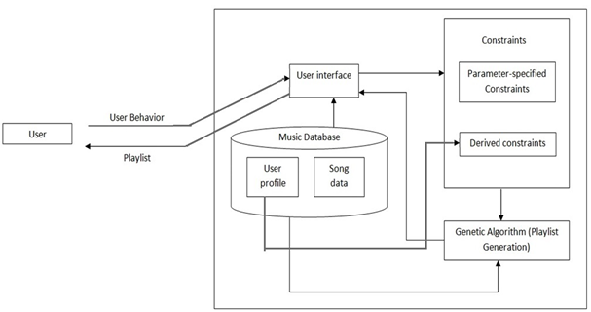
System Architecture

Slide 13
Derived Constraints: If naive users are not able to specify constraints , system will construct the corresponding constraints based on user.
Parameter-specified constraints: A scheme for experienced users to specify their constraints. In the system, Users express the parameter-specified constraints by filling the attributes.
Playlist generation: It is the core algorithm. The genetic representation of the solution domain along with the fitness function and stop criterion or the termination condition.

Slide 14
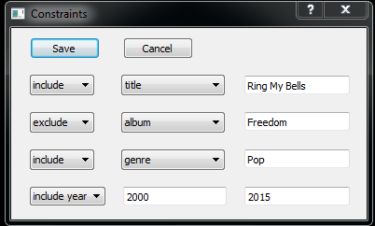
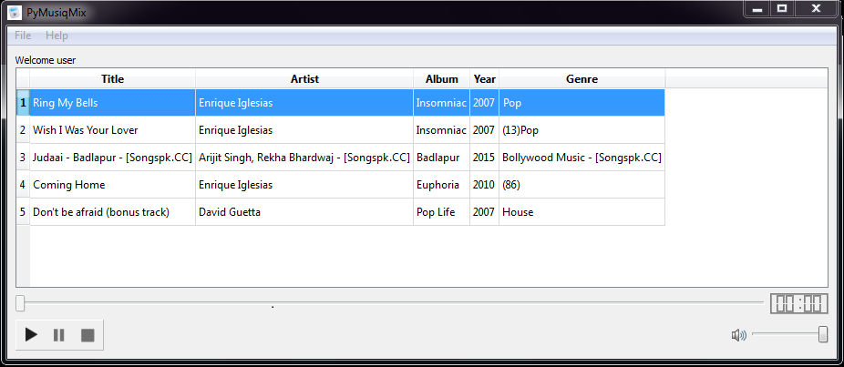

Slide 15
Nature to Computer Mapping
NATURE | COMPUTER
Population | Set of solutions
Individual | Solution to a problem
Fitness | Quality of a solution
Chromosome | Encoding for a solution
Gene | Part of the encoding solution
Reproduction | Crossover

Slide 16
Representation
In the system, each individual from the population is a candidate playlist, and the corresponding chromosome of the individual is a sequence of songIDs.
The representation of the individual is a playlist of length 5 and additional for calculating fitness value.
Chromosome is coded as integer string.
6 | 7 | 2 | 3 | 1 | 0

Slide 17
Songs
6 | 7 | 2 | 3 | 1
Rhythm of Love | Plain White T's | Rhythm of Love - Single | 2010 | Pop
Take It Off | Ke$ha | Animal | 2010 | Pop

Slide 18
ATTRIBUTE | DESCRIPTION | TYPE | EXAMPLE
Title | Album Title | text | Innocent
Artist | Name of performing artist | text | Jolin
Album | Album of the song | text | Speak Now
Year | Release year | numerical | 2007
Genre | Genre of the song | categorical | Popular

Slide 19
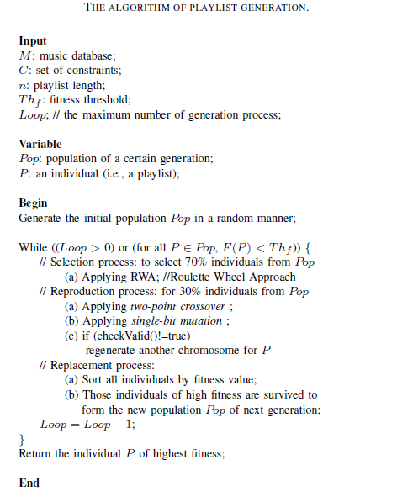
GENETIC ALGORITHM

Slide 20
Initialize population
6 | 7 | 2 | 3 | 1
6
7
2
3
1
0
6 | 7 | 2 | 3 | 1
6 | 7 | 2 | 3 | 1
6 | 7 | 2 | 3 | 1
9 | 3 | 1 | 5 | 4
Selection
9 | 3 | 1 | 5 | 4
Crossover
9 | 3 | 1 | 5 | 4
Mutation
9 | 3 | 1 | 5 | 4
1 | 5 | 2 | 3 | 8
1 | 5 | 2 | 3 | 8
1 | 5 | 2 | 3 | 8
1 | 5 | 7 | 3 | 8
2 | 3 | 4 | 9 | 2
6 | 7 | 2 | 5 | 4
6 | 7 | 2 | 5 | 4
4 | 7 | 8 | 3 | 1
9 | 3 | 1 | 3 | 1
9 | 3 | 1 | 3 | 1
while( fitness value != termination criteria)

Slide 21
Selection
The selection process is used to select the individuals from the population. The individuals are selected based on the fitness value for each playlist. Only 60 % i.e. 3 out of 5 is selected and the rest 2 are discarded.
Crossover
After the selection, the remained individuals of the population are applied for crossover and mutation. Single-point crossover, and two-point crossover are often to be used. The crossover methods are of two types:
Single-point crossover
Two-point crossover
Mutation
Mutation is to randomly select one gene (i.e., a substring) from a chromosome of individual, and then switch the bits of
the substring.

Slide 22
IMPLEMENTATION
The various modules was recognized allotted among the group members.
The genetic algorithm was broken down into module functions like selection , crossover , mutation and validation.
The coding for genetic algorithm was done
Genetic algorithm was tested.
The various needs for GUI was identified and user Interface was designed.
The coding for GUI application was done.
GUI was tested by given test cases.
The algorithm and GUI was integrated.
The system as a whole was tested and bugs was corrected.

Slide 23
TESTING STRATEGIES
Case no | Featured tested | Test procedure
1. | Main module | The user selects and runs the program
2. | Displaying options | Various options are enlisted.
3. | Login module | The user is allowed to login to the application by entering the username
4. | User module | The software is customized for a particular user.
5. | Add more Files | Different song files can be added by the user. These serve as seed songs
6. | Constraints | The user is able to select the required constraints and add constraints
7. | Generation of playlist | The playlist is generated according to the constraints entered.

Slide 24
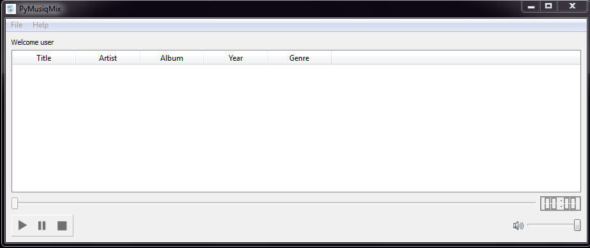
RESULTS

Slide 25
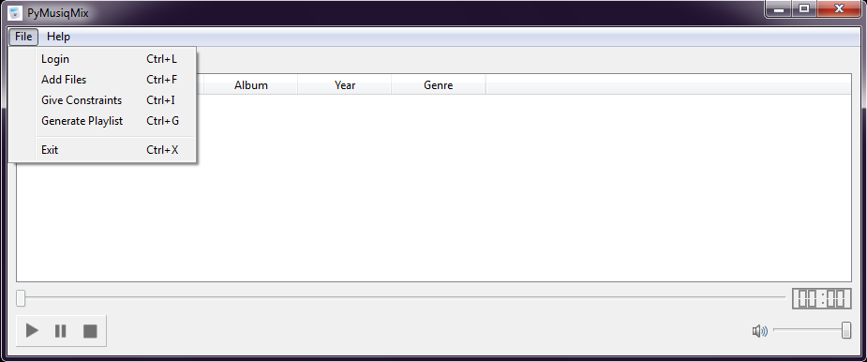

Slide 26
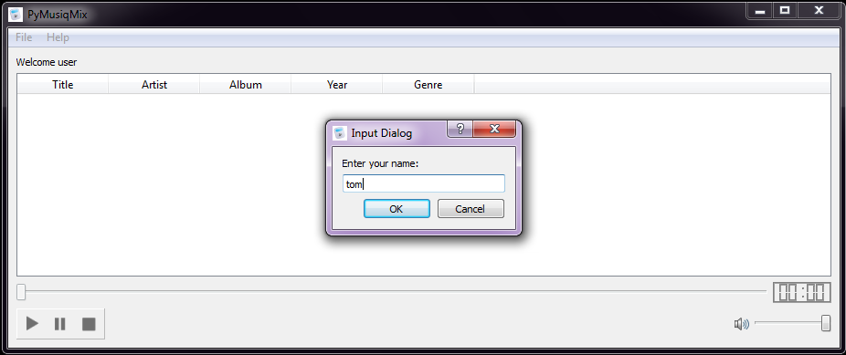

Slide 27
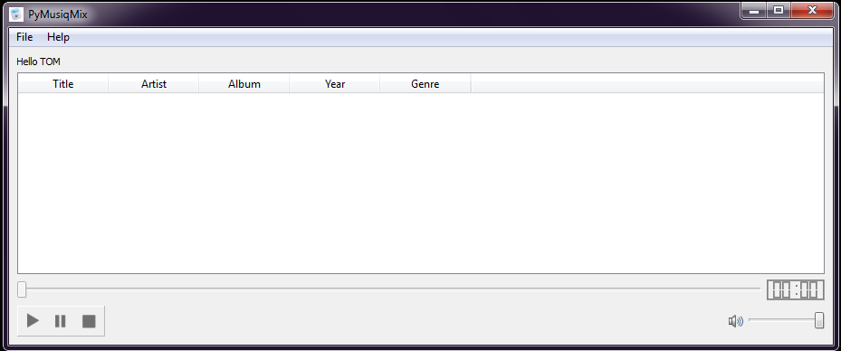

Slide 28
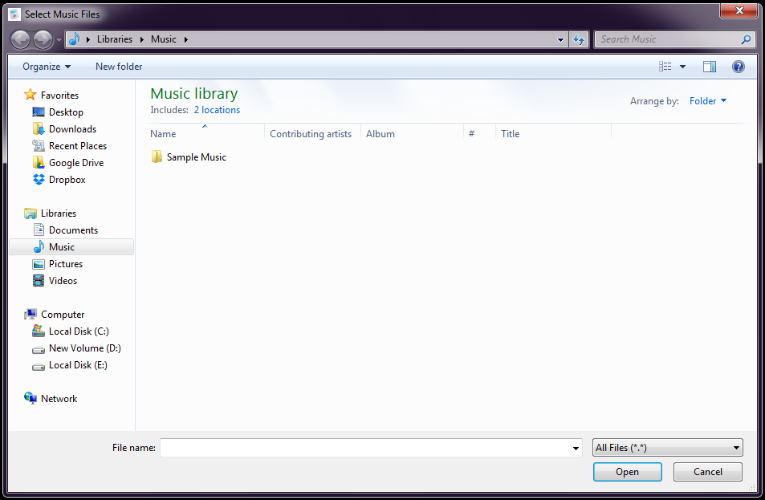

Slide 31
CONCLUSION
Given a set of constraints, we apply a genetic algorithm to generate a playlist which optimizes the number of matched constraints. We implemented our prototype, and performed experiments to show the feasibility and effectiveness of prototype. The prototype music player system was able to create a good playlist.

Slide 32
FUTURE ENHANCEMENT
We are planning to extend this application on all mobile phones. The mobile application developed will be user friendly so that large no of people can use . There are wide possibilities regarding the application of the project. Due to fact that the requirements are least for this system. We are planning to additional features like mood of user.

Slide 33
BIBLIOGRAPHY
Jia-Lien Hsu and Shuk-Chun Chung, “Consraint based Playlist generation by applying genetic algorithm”, IEEE 2011.
“Introduction to Genetic Algorithms”, Dr. Rajib Kumar Bhattacharjya, Department of Civil Engineering, IITG.
S. Pauws and B. Eggen, “Pats: Realization and user evaluation of an automatic playlist generation,” in Proceedings of the International Conference on Music Information Retrieval, 2002.

Slide 34
Any Queries ?
Q&A

Slide 35
THANK YOU!!

