Slide 1
Introduction Chapter 1
Uses of Computer Networks
Network Hardware
Network Software
Reference Models
Example Networks
Network Standardization
Metric Units

Slide 2
Question: What are the differences between various communication networks?
At first glance: Terminals in the network.
More technically: Services they provide.

Slide 3
What is a computer network?
Computer Network: a collection of autonomous computers interconnected by a single technology
autonomous: be able to compute independently
interconnected: be able to exchange information
Information today comes in different forms such as text, numbers, images, audio, and video.
Notes:
Contrast computer networks with distributed systems, in which a model on top of the network is used to present the independent computers to users as a single coherent system, e.g., the Web.

Slide 4
Uses of Computer Networks
Computer networks are collections of autonomous computers, e.g., the Internet
They have many uses:
Business Applications »
Home Applications »
Mobile Users »
These uses raise:
Social Issues »
This text covers networks for all of these uses

Slide 5
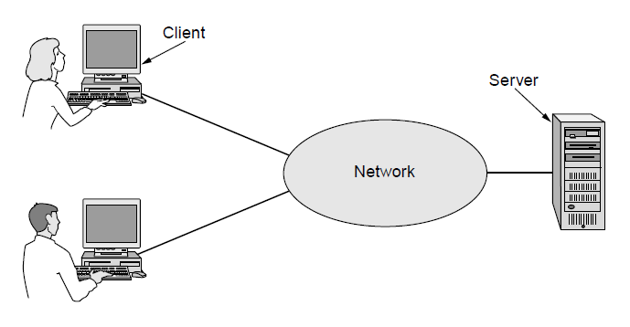
Business Applications
Companies use networks and computers for resource sharing with the client-server model:
Other popular uses are communication, e.g., email, VoIP, and e-commerce
request
response
Notes:
Resource sharing was initially about physical resources, such as printers, but is now often about access to information, such as a file server.
The Web is an example of client-server computing.

Slide 6
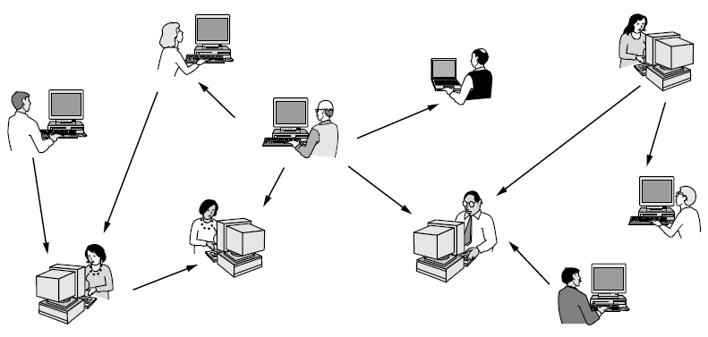
Home Applications
Homes contain many networked devices, e.g., computers, TVs, connected to the Internet by cable, DSL, wireless, etc.
Home users communicate, e.g., social networks, consume content, e.g., video, and transact, e.g., auctions
Some application use the peer-to-peer model in which there are no fixed clients and servers:
Notes:
P2P contrasts with client-server. Why is it under home applications? Because unlike cloud there is no need to have a business run dedicated infrastructure for the app to work.

Slide 7
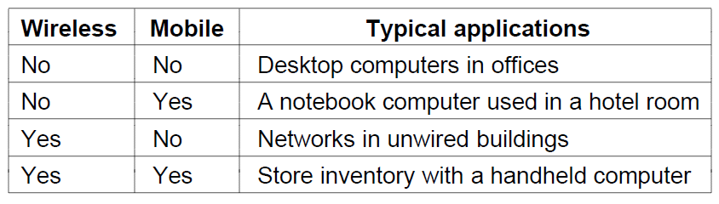
Mobile Users
Tablets, laptops, and smart phones are popular devices; WiFi hotspots and 3G cellular provide wireless connectivity.
Mobile users communicate, e.g., voice and texts, consume content, e.g., video and Web, and use sensors, e.g., GPS.
Wireless and mobile are related but different:
Notes:
Laptop sales outpaced desktop sales in 2010, and there are many more mobile phones (but not smart phones) than personal computers.

Slide 8
Social Issues
Network neutrality – no network restrictions
Content ownership, e.g., DMCA takedowns
Anonymity and censorship
Privacy, e.g., Web tracking and profiling
Theft, e.g., botnets and phishing
Notes:
In the US, DMCA (Digital Millennium Copyright Act) takedowns are automated notices sent by content owners to parties they believe are inappropriately putting copyrighted content online. They instruct the party to take down the content or face legal measures.

Slide 9
Network Hardware
Types of connection
Network Topologies
Types of network

Slide 10
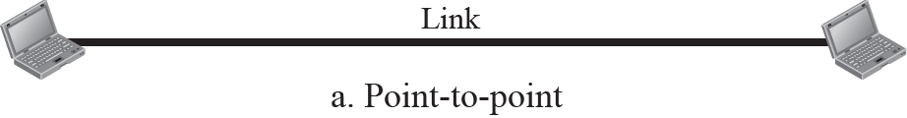
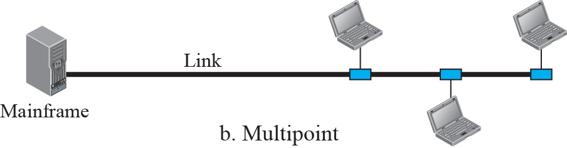
Types of connection

Slide 11
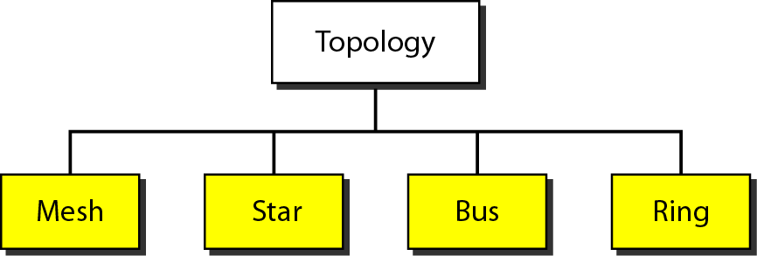
Network Topologies

Slide 12
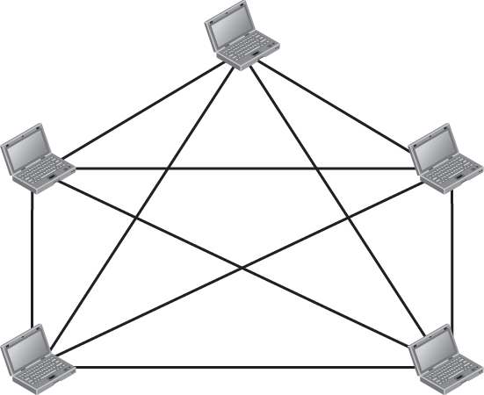


A fully-connected mesh topology

Slide 13
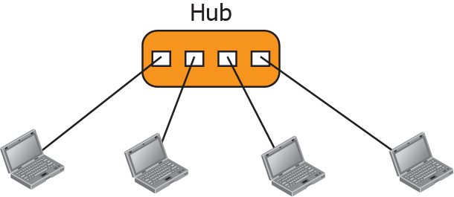
A star topology

Slide 14
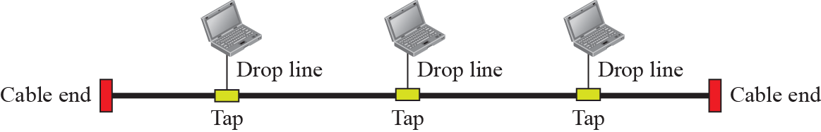
A bus topology

Slide 15
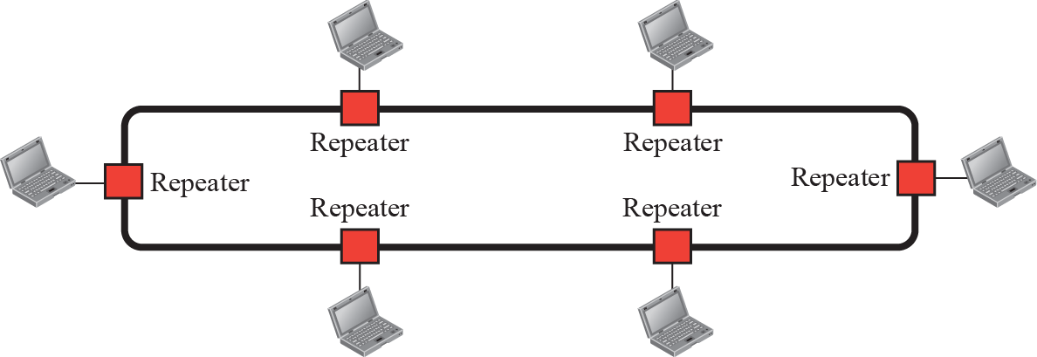
A ring topology

Slide 16
Types of Network – by transmission technology
Networks can be classified by their transmission technology:
Broadcast links
Point-to-point links：Unicasting

Slide 17
Types of Network – by scale
Networks can be classified by their scale:
Scale | Type
Vicinity | PAN (Personal Area Network) »
Building | LAN (Local Area Network) »
City | MAN (Metropolitan Area Network) »
Country | WAN (Wide Area Network) »
Planet | The Internet (network of all networks)
Notes:
An “internetwork” is any larger network made up of smaller component networks. The “Internet” (with a capital I) is the set of all connected networks.
关于计算机网络，没有一种被普遍接受的分类方法，但有两个因素是非常重要的：传输技术和距离尺度。
Broadcast links
Point-to-point links：Unicasting

Slide 18
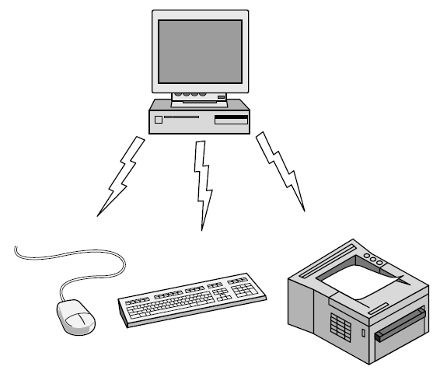
Personal Area Network
Connect devices over the range of a person
Example of a Bluetooth (wireless) PAN:

Slide 19
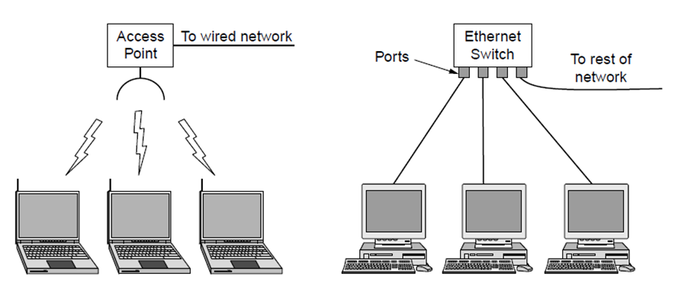
Local Area Networks
Connect devices in a home or office building
Called enterprise network in a company
Wireless LAN
with 802.11
Wired LAN with
switched Ethernet
Notes:
不同局域网有各自的特征：范围（决定了传输时间）、传输技术（决定传输速率）、拓扑结构（与媒体访问仲裁机制密切相关）。

Slide 20
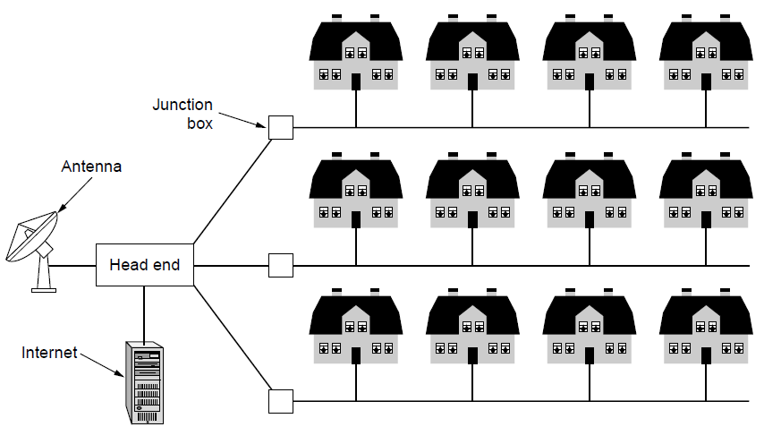
Metropolitan Area Networks
Connect devices over a metropolitan area
Example MAN based on cable TV:
Notes:
This is a common way in which home subscribers obtain access to the Internet in the US.

Slide 21
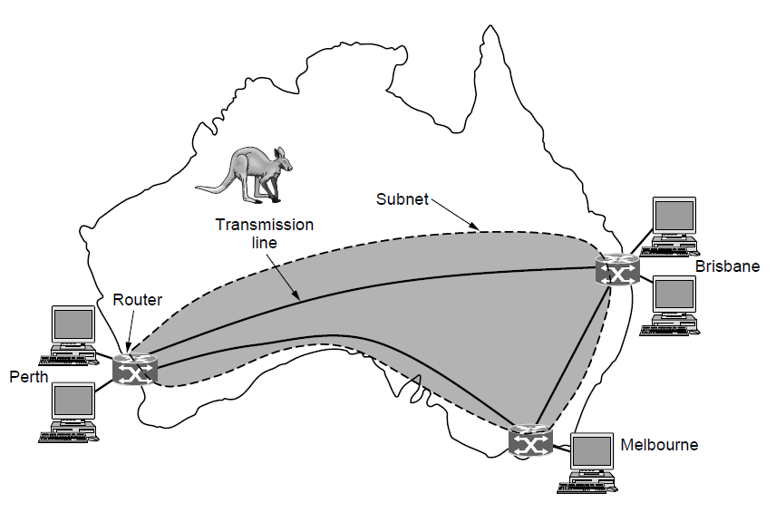
Wide Area Networks (1)
Connect devices over a country
Example WAN connecting three branch offices:
Notes:
The company probably leases the transmission lines (since most companies do not have their own lines).

Slide 22
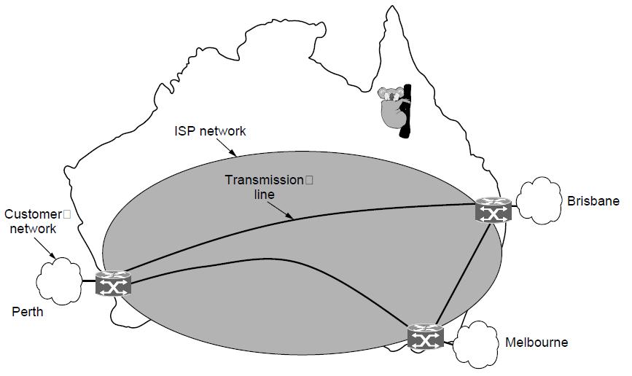
Wide Area Networks (2)
An ISP (Internet Service Provider) network is also a WAN.
Customers buy connectivity from the ISP to use it.
Notes:
Now the company/customer buys service from an ISP who uses its own lines to deliver packets.

Slide 23
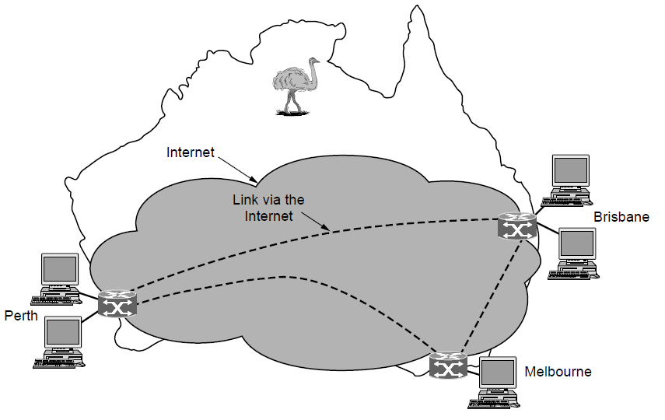
Wide Area Networks (3)
A VPN (Virtual Private Network) is a WAN built from virtual links that run on top of the Internet.
Notes:
Now the company/customer uses the Internet (might be multiple ISPs) for connectivity. The links are virtual in the sense that they refer to some path via the Internet rather than a particular transmission line.

Slide 24
Introduction Chapter 1
Uses of Computer Networks
Network Hardware
Network Software
Reference Models
Example Networks
Network Standardization
Metric Units

Slide 25
Network Software
Protocol layers »
Design issues for the layers »
Connection-oriented vs. connectionless service »
Service primitives »
Relationship of services to protocols »
Notes:
学习要点：
一组概念：对等体、协议、服务、接口、计算机网络体系结构、协议数据单元PDU、服务数据单元SDU
计算机网络协议分层的好处和缺点，通过协议分层实现数据封装及解封的过程
面向连接服务和面向无连接服务的特点及实现过程
面向连接与面向无连接VS.可靠与不可靠

Slide 26
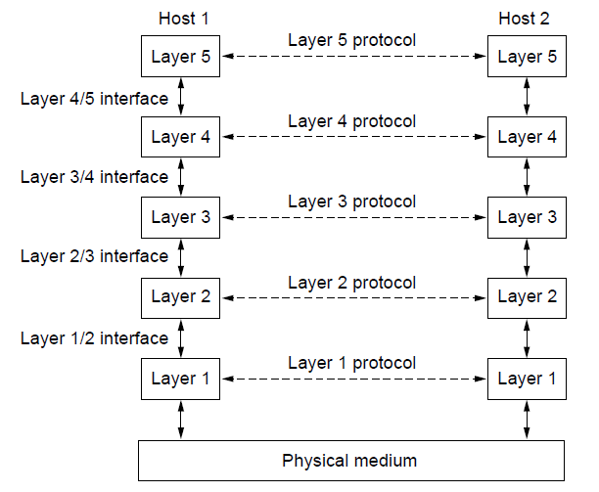
Protocol Layers (1)
Protocol layering is the main structuring method used to divide up network functionality.
Each protocol instance talks virtually to its peer
Each layer communicates only by using the one below
Lower layer services are accessed by an interface
At bottom, messages are carried by the medium
Notes:
服务：层间交换信息时必须遵守的规则。
接口：定义了下层向上层提供的原语操作和服务。
第N层协议：
不知道上、下层的内部结构
独立完成某种功能
为上层提供服务
使用下层提供的服务

Slide 27
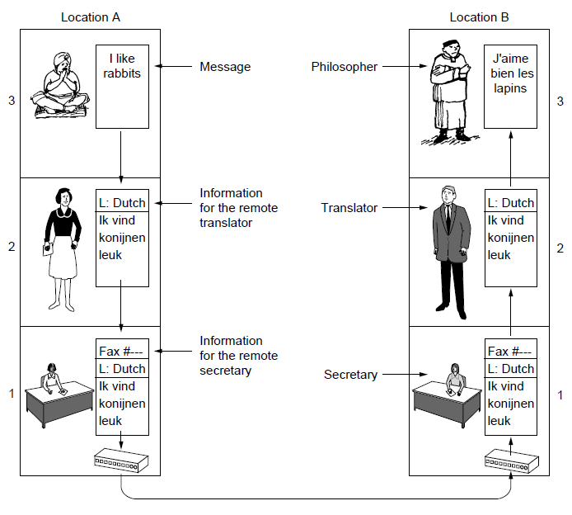
Protocol Layers (2)
Example: the philosopher-translator-secretary architecture
Each protocol at different layers serves a different purpose
The common Dutch
can be replaced with another language.
Email can be used
instead of fax.

Slide 28
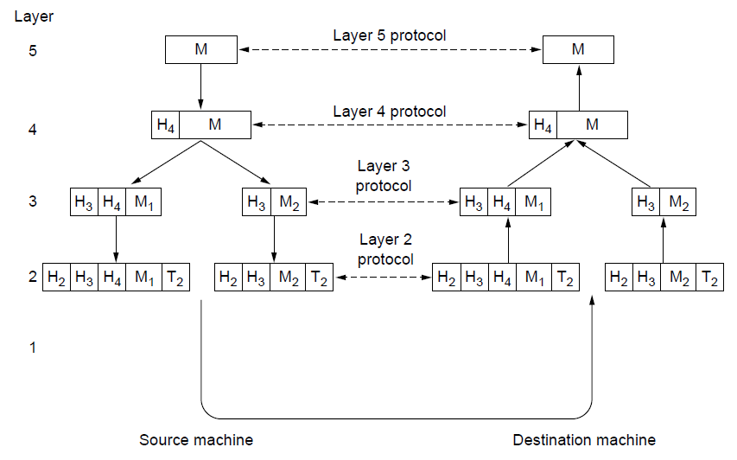
Protocol Layers (3)
Each lower layer adds its own header (with control inform-ation) to the message to transmit and removes it on receive
Layers may also split and join messages, etc.
水平通信/虚拟通信：对等实体进行的通信
垂直通信/实际通信：相邻层进行的通信
一个SDU可能要封装在多个PDU中传输
N层的PDU=N层PCI+N层SDU N层的SDU=(N+1)层的PDU
Notes:
服务访问点SAP（Service Access Point）
任何层间服务是在接口的SAP上进行的
每个SAP有唯一的识别地址
每个层间接口可以有多个SAP
接口数据单元IDU（Interface Data Unit）
IDU是通过SAP进行传送的层间信息单元
IDU由上层的服务数据单元SDU（Service Data Unit）和接口控制信息ICI（Interface Control Information）组成
协议数据单元PDU（Protocol Data Unit）
第N层实体通过网络传送给它的对等实体的信息单元
PDU由上层的服务数据单元SDU或其分段和协议控制信息PCI（Protocol Control Information）组成
服务数据单元SDU（Service Data Unit）
跨过网络传给对等实体并交给上层的信息

Slide 29
Design Issues for the Layers
Each layer solves a particular problem but must include mechanisms to address a set of recurring design issues
Issue | Example mechanisms at different layers
Reliability despite failures | Codes for error detection/correction (§3.2, 3.3) Routing around failures (§5.2)
Network growth and evolution | Addressing (§5.6) and naming (§7.1) Protocol layering (§1.3)
Allocation of resources like bandwidth | Multiple access (§4.2) Congestion control (§5.3, 6.3)
Security against various threats | Confidentiality of messages (§8.2, 8.6) Authentication of communicating parties (§8.7)
Notes:
The point is that there are some issues that are not wholly the responsibility of any one layer, and they crop up again and again in the text. For example, reliability is often considered a key function of the transport layer (i.e., making transport reliable) yet reliability mechanisms also appear in other layers (error codes in the link layer, routing around failures in the network layer, and replication at the application layer).

Slide 30
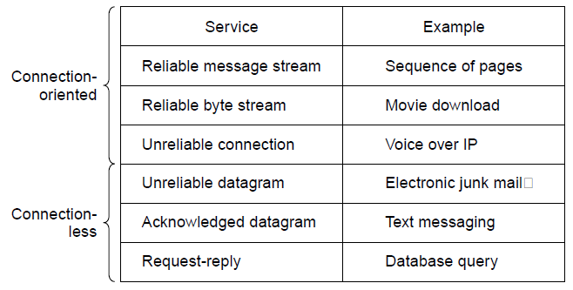
Connection-Oriented vs. Connectionless
Service provided by a layer may be kinds of either:
Connection-oriented, must be set up for ongoing use (and torn down after use), e.g., phone call
Connectionless, messages are handled separately, e.g., postal delivery
Negotiation
Quality of service
Notes:
TCP provides a reliable bytestream service at the Transport layer, IP provides unreliable datagram service at the Network layer.
More examples: RTP (used to carry VoIP data) provides unreliable connection service; 802.11 (WiFi) provides acknowledged datagram service; Ethernet provides unreliable datagram service.
面向连接的服务：建立连接（需要协商）、保持顺序。
无连接的服务（又称为数据报）：不建连，可能走不同的路径到达顺序可能不同。
可靠：有确认和丢失处理
不可靠：无确认，发送完就结束
消息流：有边界
字节流：无边界
Qos：时延、抖动、传输时间、丢包率……

Slide 31
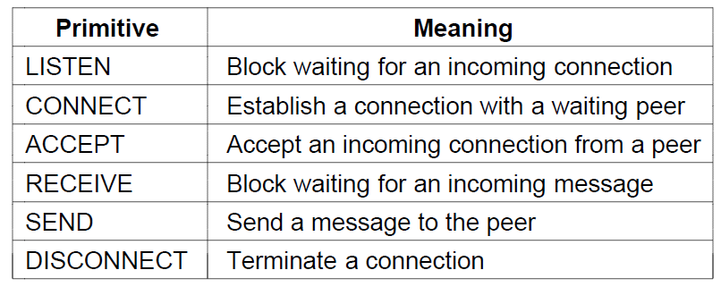
Service Primitives (1)
A service is provided to the layer above as primitives
Hypothetical example of service primitives that may provide a reliable byte stream (connection-oriented) service:

Slide 32
Service Primitives (2)
Hypothetical example of how these primitives may be used for a client-server interaction
Client
Server
LISTEN (0)
CONNECT (1)
Connect request
ACCEPT
(2)
Accept response
RECEIVE
SEND
Request for data
(3)
RECEIVE
SEND (4)
Reply
DISCONNECT (5)
Disconnect
DISCONNECT (6)
Disconnect
Notes:
The primitives are called at the client and server by the higher layer using the service. The layer implements the primitives by sending messages using the services of the lower layer; these messages are assumed to be reliable for simplicity and the lower layer service is not otherwise described.
This is similar to the way that simple Web browsers and Web servers work today.

Slide 33
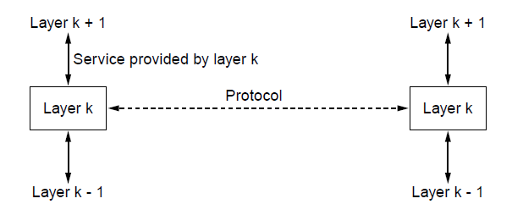
Relationship of Services to Protocols
Recap:
A layer provides a service to the one above [vertical]
A layer talks to its peer using a protocol [horizontal]
Notes:
A service defines what operations the layer is prepared to perform on behalf of its users, but it says nothing at all about how these operations are implemented.
A protocol, in contrast, is a set of rules governing the format and meaning of the frames, packets, or messages that are exchanged by the peer entities within a layer. Entities use protocols in order to implement their service definitions.
可以自由地改变协议，但不能改变服务，因为这些服务对于它们的用户是可见的，是提供给用户使用的。

Slide 34
Reference Models
Reference models describe the layers in a network architecture
OSI reference model »
TCP/IP reference model »
Model used for this text »
Critique of OSI and TCP/IP »

Slide 35
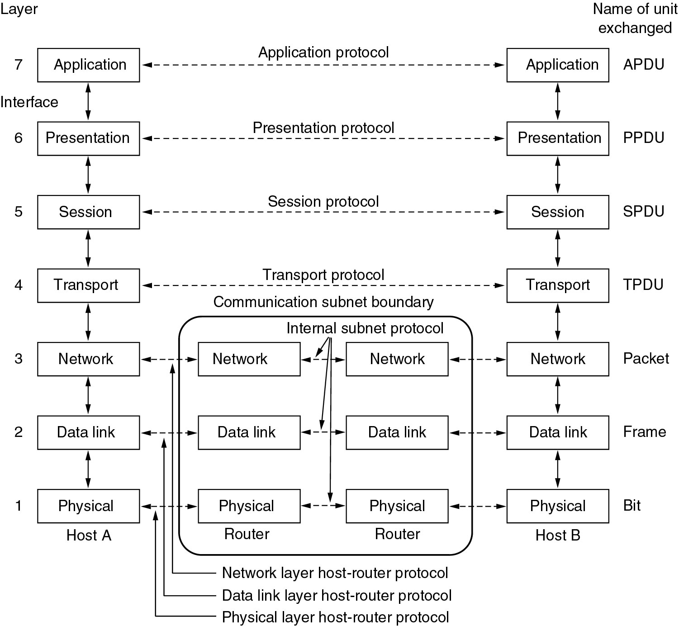
OSI Reference Model

Slide 36
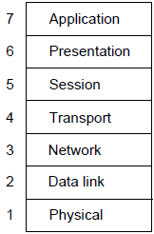
OSI Reference Model
A principled, international standard, seven layer model to connect different systems
– Provides functions needed by users
– Converts different representations
– Manages task dialogs
– Provides end-to-end delivery
– Sends packets over multiple links
– Sends frames of information
– Sends bits as signals

Slide 37
The Physical Layer
Transmitting raw bits over a communication channel.
The design issues have to do with making sure that when one side sends a 1 bit, it is received by the other side as a 1 bit, not as a 0 bit.
Represent a 1 or 0
Transmission simultaneous
Connection establishes and torn down
The network connector
Physical transmission medium

Slide 38
The Data Link Layer
The main task: a line that appears free of undetected transmission errors to the network layer.
The sender break up the input data into data frames, transmit the frames sequentially
If the service is reliable, the receiver confirms correct receipt of each frame by sending back an acknowledgement frame.
Flow control .
Broadcast networks: to control access to the shared channel.

Slide 39
The Network Layer
How packets are routed from source to destination.
Congestion control
Quality of service.
Heterogeneous networks interconnected.

Slide 40
The Transport Layer
Reliability
Ensures that packets arrive at their destination.
Reassembles out of order messages.
Hides network
Allows details of the network to be hidden from higher level layers.
Service Decisions
What type of service to provide; error-free point to point, datagram, etc.
Mapping
Determines which messages belong to which connections.
Flow control
keeps a fast transmitter from flooding a slow receiver
Efficiency

Slide 41
The Session Layer
On different machines to establish sessions
Various services
Dialog control (keeping track of whose turn it is to transmit)
Token management (preventing two parties from attempting the same critical operation at the same time)
Synchronization (check pointing long transmissions to allow them to continue from where they were after a crash).

Slide 42
The Presentation Layer
Concerned with the syntax and semantics of the information transmitted.
A standard encoding
Manages these abstract data structures
Allows higher-level data structures (e.g., banking records) to be defined and exchanged.

Slide 43
The Application Layer
A variety of protocols that are commonly needed by users.
WWW
File transfer
Electronic mail
Network news
Telnet

Slide 44
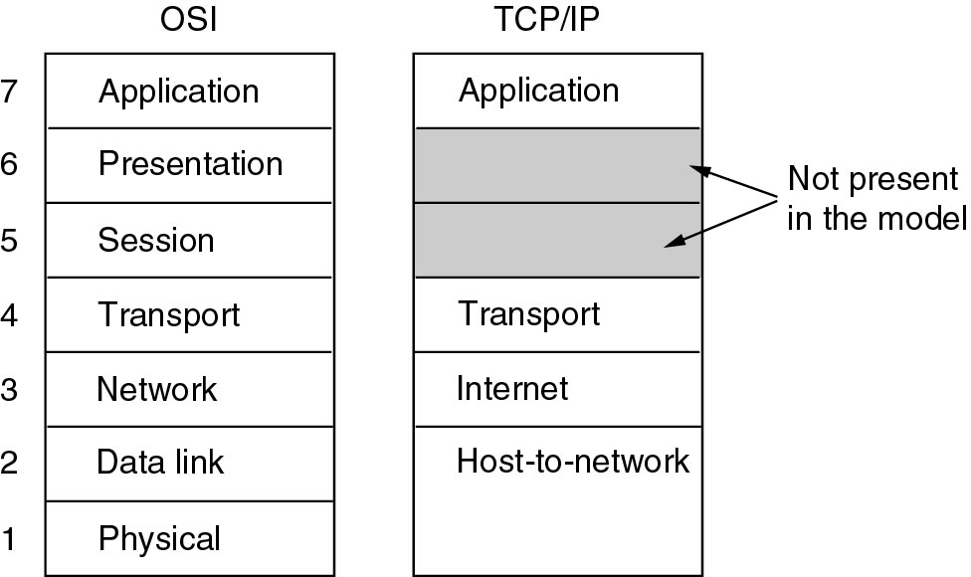
TCP/IP Reference Model

Slide 45
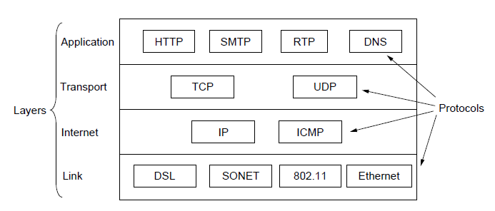
TCP/IP Reference Model
A four layer model derived from experimentation; omits some OSI layers and uses the IP as the network layer.
IP is the “narrow waist” of the Internet
Protocols are shown in their respective layers
Notes:
The comment about the narrow waist refers to the fact that the network layer of the Internet is IP (Internet Protocol) such that the network layer is called the “Internet” layer. The significance is that all Internet devices speak IP, which provides a point of interoperability that enables innovation both above (new applications and transports) and below (new link technologies).

Slide 46
The Internet Layer
To permit hosts to inject packets into any network and have them travel independently to the destination
Packets may arrive in a different order than they were sent.
Defined an official packet format and protocol called IP (Internet Protocol).
Packet routing
Avoiding congestion.
TCP/IP internet layer is similar in functionality to the OSI network layer.

Slide 47
The Transport Layer
To allow peer entities on the source and destination hosts to carry on a conversation
Two end-to-end transport protocols TCP and UDP
TCP (Transmission Control Protocol), is a reliable connection-oriented protocol
UDP (User Datagram Protocol), is an unreliable, connectionless protocol.

Slide 48
The Application Layer
Virtual terminal (TELNET), allows a user on one machine to log onto a distant machine and work there
File transfer (FTP), to move data efficiently from one machine to another
Electronic mail (SMTP)
Domain Name System (DNS) for mapping host names onto their network addresses
HTTP, the protocol for fetching pages on the World Wide Web

Slide 49
The Host-to-Network Layer
This protocol is not defined and varies from host to host and network to network.

Slide 50
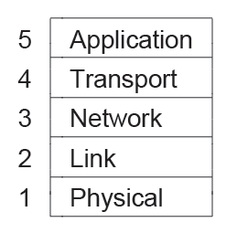
Model Used in this Book
It is based on the TCP/IP model but we call out the physical layer and look beyond Internet protocols.

Slide 51
Critique of OSI & TCP/IP
OSI:
Very influential model with clear concepts
Models, protocols and adoption all bogged down by politics and complexity
TCP/IP:
Very successful protocols that worked well and thrived
Weak model derived after the fact from protocols

Slide 52
Example Networks
The Internet »
3G mobile phone networks »
Wireless LANs »
RFID and sensor networks »

Slide 53
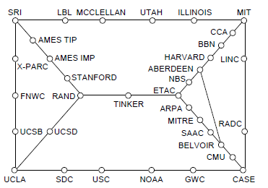
Internet (1)
Before the Internet was the ARPANET, a decentralized, packet-switched network based on Baran’s ideas.
Nodes are IMPs, or early routers, linked to hosts
56 kbps links
ARPANET topology in Sept 1972.
Notes:
Decentralized or fully distributed is a contrast to the hierarchical telephone network that came beforehand. Unlike the telephone network, blowing up a single important node will not break the network or large portions of it.

Slide 54
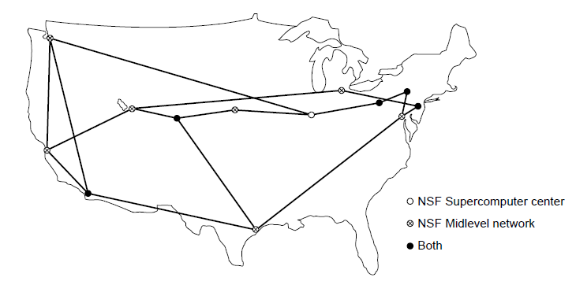
Internet (2)
The early Internet used NSFNET (1985-1995) as its backbone; universities connected to get on the Internet
T1 links (1.5 Mbps)
NSFNET topology in 1988
Notes:
NSFNET was an academic research network growing out of CSNET that was created so that universities without DoD contracts could participate. It was initially connected to the ARPANET by gateways, and later took over the central role as the “backbone of the Internet”, i.e., the network through which packets passed on their way between parties connected to different parts of the Internet.

Slide 55
Internet (3)
The modern Internet is more complex:
ISP networks serve as the Internet backbone
ISPs connect or peer to exchange traffic at IXPs
Within each network routers switch packets
Between networks, traffic exchange is set by business agreements
Customers connect at the edge by many means
Cable, DSL, Fiber-to-the-Home, 3G/4G wireless, dialup
Data centers concentrate many servers (“the cloud”)
Most traffic is content from data centers (esp. video)
The architecture continues to evolve
Notes:
ISP = Internet Service Provicer, IXP = Internet eXchange Point

Slide 56
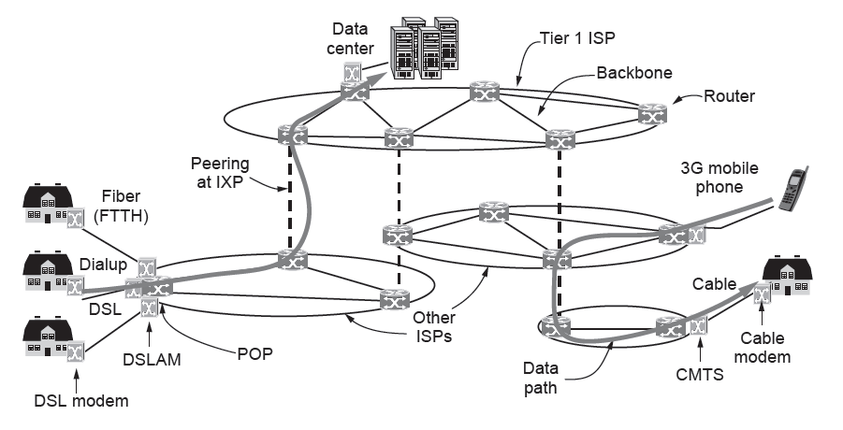
Internet (4)
Architecture of the Internet

Slide 57
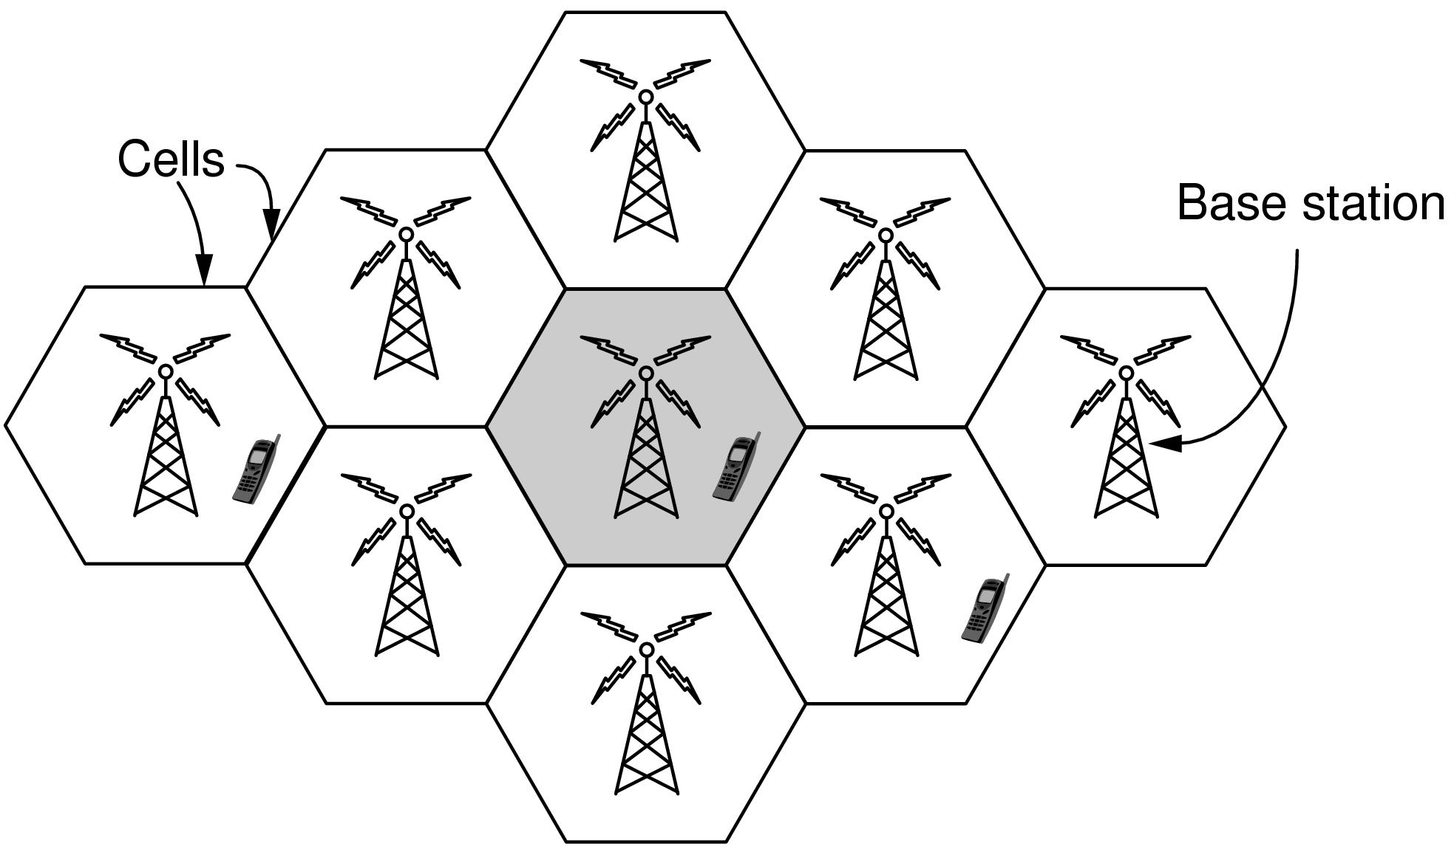
3G Mobile Phone Networks (1)
3G network is based on spatial cells; each cell provides wireless service to mobiles within it via a base station

Slide 58
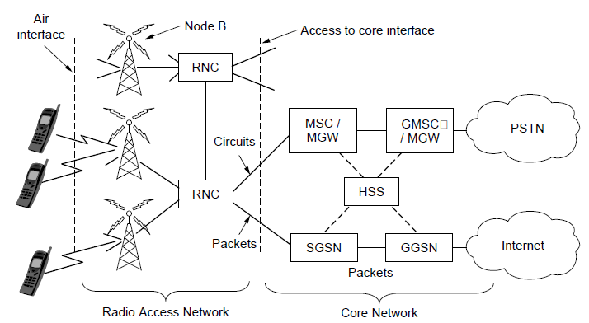
3G Mobile Phone Networks (2)
Base stations connect to the core network to find other mobiles and send data to the phone network and Internet

Slide 59
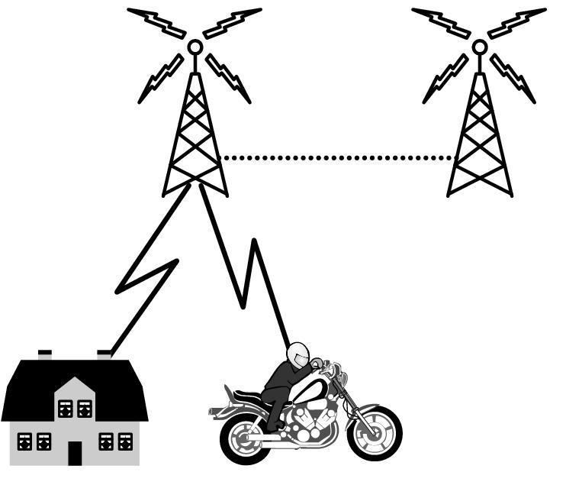
3G Mobile Phone Networks (3)
As mobiles move, base stations hand them off from one cell to the next, and the network tracks their location
Handover

Slide 60
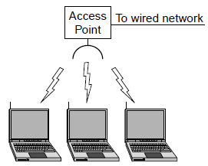
Wireless LANs (1)
In 802.11, clients communicate via an AP (Access Point) that is wired to the rest of the network.

Slide 61
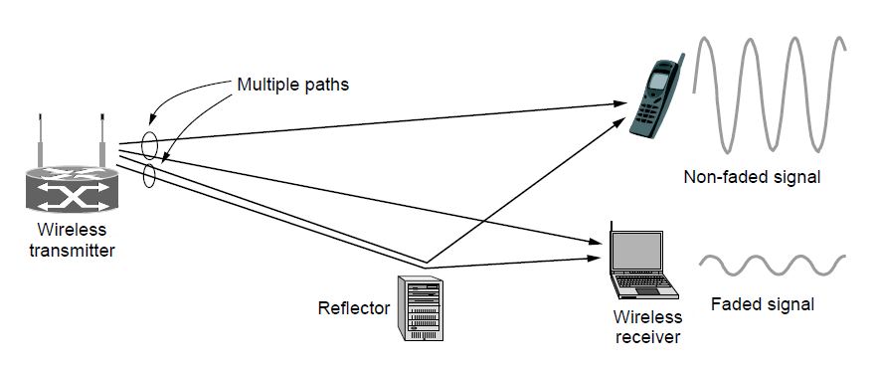
Wireless LANs (2)
Signals in the 2.4GHz ISM band vary in strength due to many effects, such as multipath fading due to reflections
requires complex transmission schemes, e.g., OFDM

Slide 62
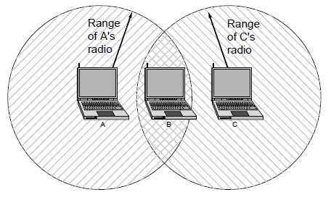
Wireless LANs (3)
Radio broadcasts interfere with each other, and radio ranges may incompletely overlap
CSMA (Carrier Sense Multiple Access) designs are used
Notes:
Both broadcast and different ranges are complications that do not exist for point-to-point wired links.

Slide 63
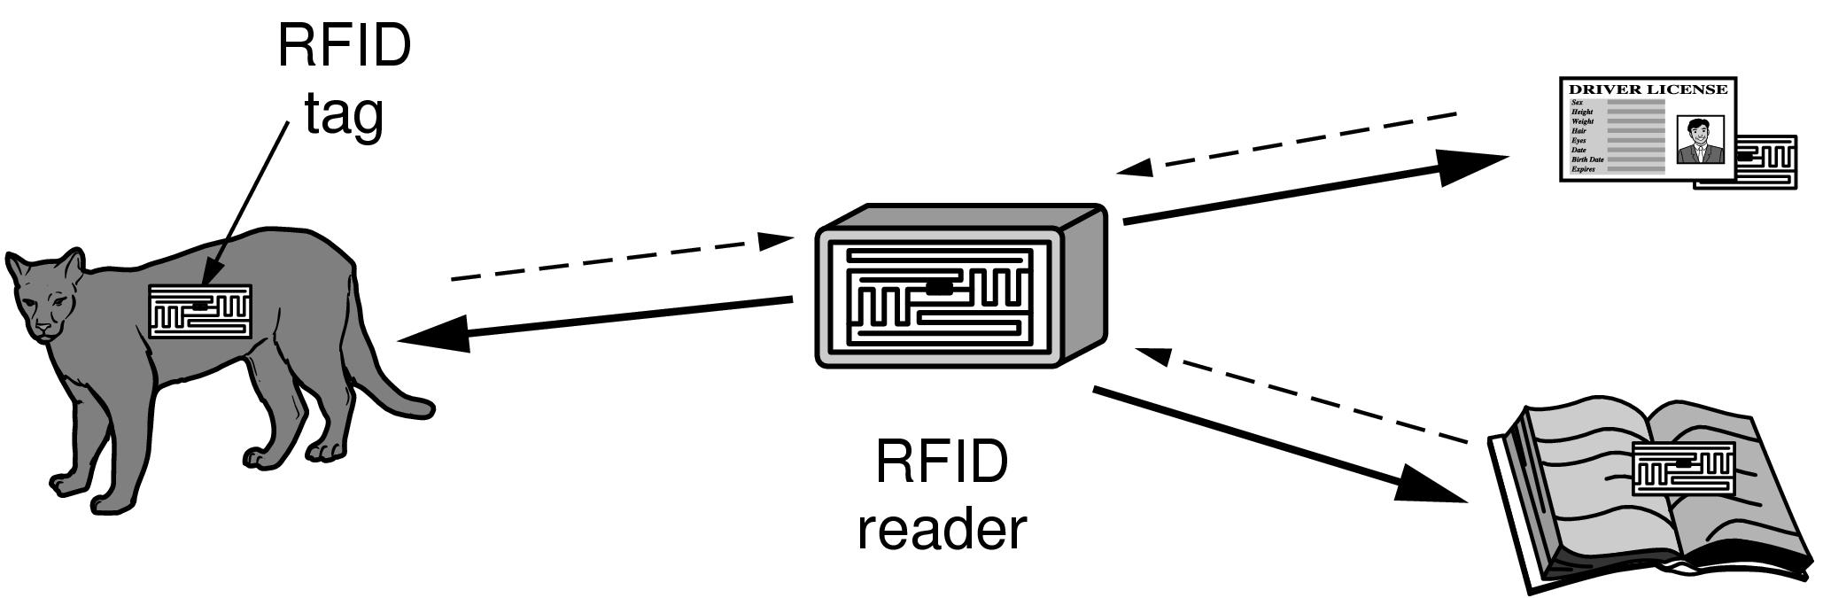
RFID and Sensor Networks (1)
Passive UHF RFID networks everyday objects:
Tags (stickers with not even a battery) are placed on objects
Readers send signals that the tags reflect to communicate

Slide 64
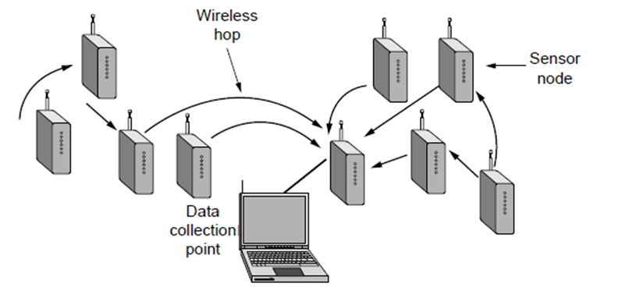
RFID and Sensor Networks (2)
Sensor networks spread small devices over an area:
Devices send sensed data to collector via wireless hops

Slide 65
Network Standardization
Standards define what is needed for interoperability
Some of the many standards bodies:
Body | Area | Examples
ITU | Telecommunications | G.992, ADSL H.264, MPEG4
IEEE | Communications | 802.3, Ethernet 802.11, WiFi
IETF | Internet | RFC 2616, HTTP/1.1 RFC 1034/1035, DNS
W3C | Web | HTML5 standard CSS standard

Slide 66
Metric Units
The main prefixes we use:
Use powers of 10 for rates, powers of 2 for storage
E.g., 1 Mbps = 1,000,000 bps, 1 KB = 1024 bytes
“B” is for bytes, “b” is for bits
Prefix | Exp. | prefix | exp.
K(ilo) | 10³ | m(illi) | 10⁻³
M(ega) | 10⁶ | μ(micro) | 10⁻⁶
G(iga) | 10⁹ | n(ano) | 10⁻⁹
Notes:
You’ll also see kbps and KB. The lowercase k in kbps is for historical reasons.

Slide 67
End
Chapter 1

