Slide 1
Application Layer
Chapter 7
  DNS – Domain Name System
  Electronic Mail
  The Web
  Streaming Audio and Video
  Content Delivery
CN5E by Tanenbaum & Wetherall, © Pearson Education-Prentice Hall and D. Wetherall, 2011

Slide 2
The Application Layer
Uses transport services to build distributed applications
Application
Transport
Network
Link
Physical
CN5E by Tanenbaum & Wetherall, © Pearson Education-Prentice Hall and D. Wetherall, 2011

Slide 3
DNS – Domain Name System
The DNS resolves high-level human readable names for computers to low-level IP addresses
  DNS name space »
  Domain Resource records »
  Name servers »
CN5E by Tanenbaum & Wetherall, © Pearson Education-Prentice Hall and D. Wetherall, 2011

Slide 4
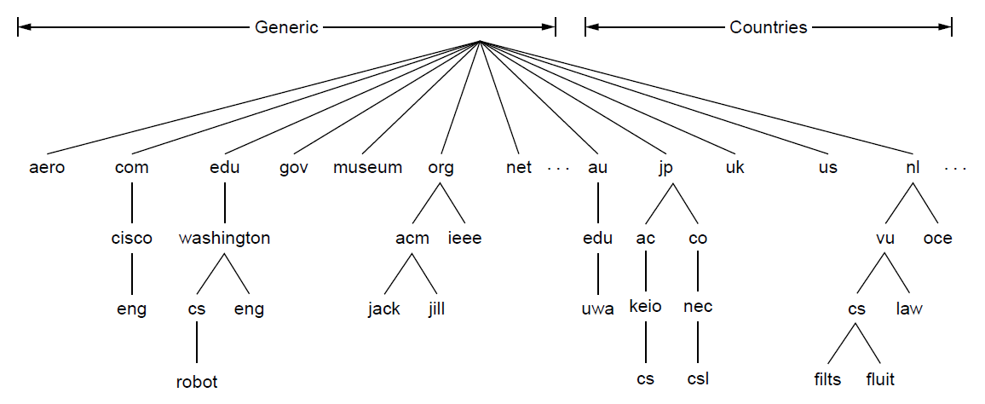
The DNS Name Space (1)
DNS namespace is hierarchical from the root down
  Different parts delegated to different organizations
The computer robot.cs.washington.edu
CN5E by Tanenbaum & Wetherall, © Pearson Education-Prentice Hall and D. Wetherall, 2011

Slide 5
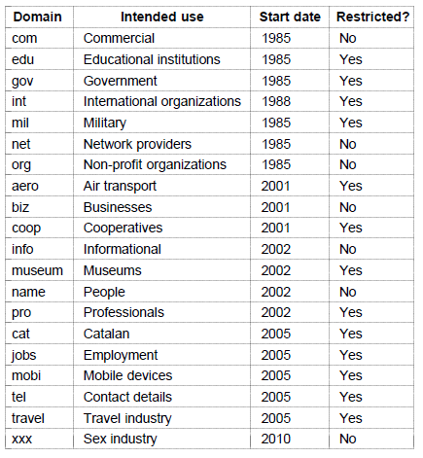
The DNS Name Space (2)
Generic top-level domains are controlled by ICANN who appoints registrars to run them
This one was controversial
CN5E by Tanenbaum & Wetherall, © Pearson Education-Prentice Hall and D. Wetherall, 2011

Slide 6
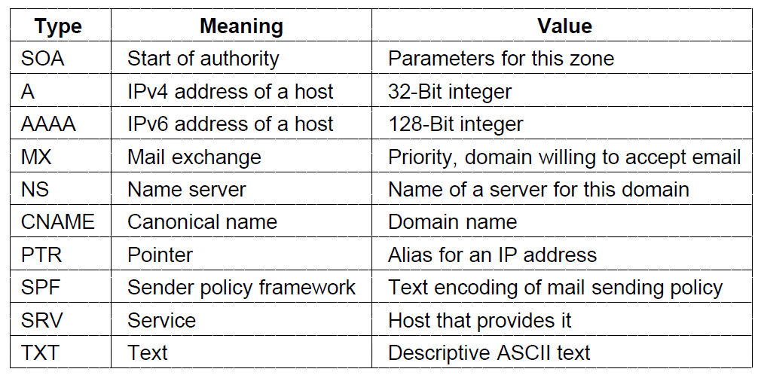
Domain Resource Records (1)
The key resource records in the namespace are IP addresses (A/AAAA) and name servers (NS), but there are others too (e.g., MX)
CN5E by Tanenbaum & Wetherall, © Pearson Education-Prentice Hall and D. Wetherall, 2011

Slide 7
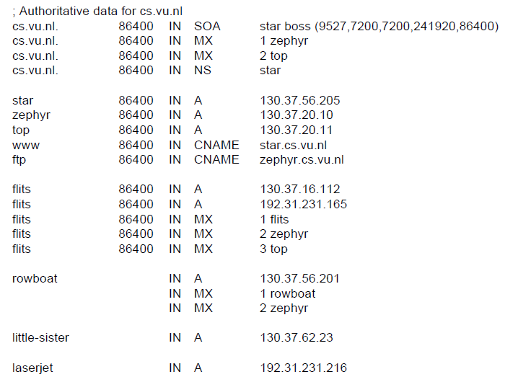
Domain Resource Records (2)
Name server
IP addresses of computers
Mail gateways
A portion of a possible DNS database for cs.vu.nl.
CN5E by Tanenbaum & Wetherall, © Pearson Education-Prentice Hall and D. Wetherall, 2011

Slide 8
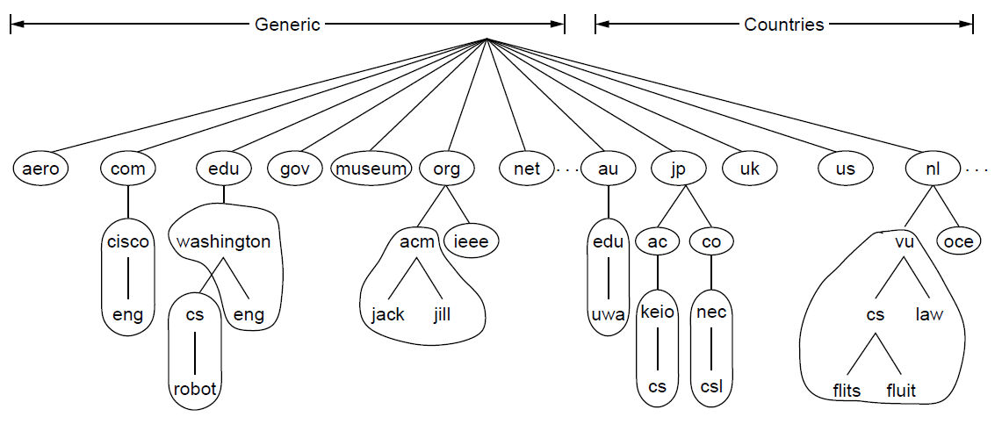
Name Servers (1)
Name servers contain data for portions of the name space called zones (circled).
One zone
CN5E by Tanenbaum & Wetherall, © Pearson Education-Prentice Hall and D. Wetherall, 2011

Slide 9
Name Servers (2)
Finding the IP address for a given hostname is called resolution and is done with the DNS protocol.
Resolution:
  Computer requests local name server to resolve
  Local name server asks the root name server
  Root returns the name server for a lower zone
  Continue down zones until name server can answer
DNS protocol:
  Runs on UDP port 53, retransmits lost messages
  Caches name server answers for better performance
CN5E by Tanenbaum & Wetherall, © Pearson Education-Prentice Hall and D. Wetherall, 2011

Slide 10

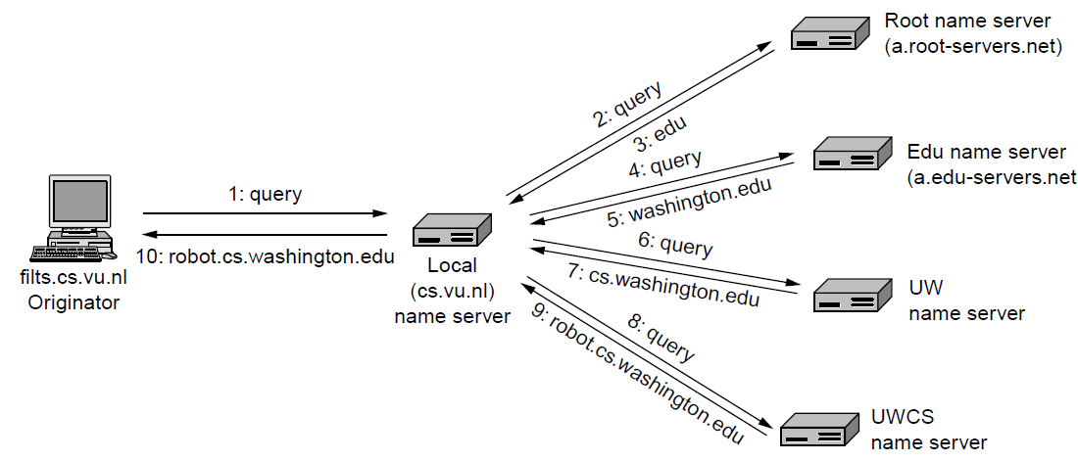
Name Servers (3)
Example of a computer looking up the IP for a name
CN5E by Tanenbaum & Wetherall, © Pearson Education-Prentice Hall and D. Wetherall, 2011

Slide 11
Electronic Mail
  Architecture and services »
  The user agent »
  Message formats »
  Message transfer »
  Final delivery »
CN5E by Tanenbaum & Wetherall, © Pearson Education-Prentice Hall and D. Wetherall, 2011

Slide 12
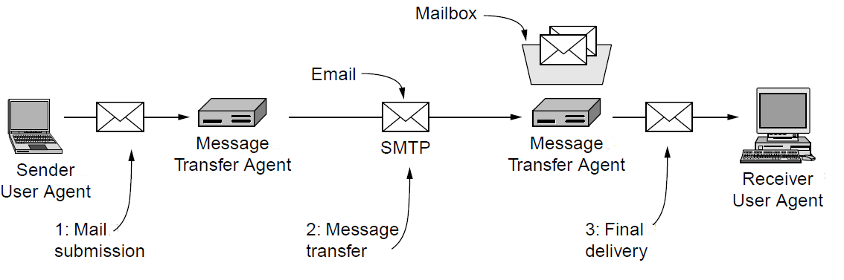
Architecture and Services (1)
The key components and steps (numbered) to send email
Architecture of the email system
CN5E by Tanenbaum & Wetherall, © Pearson Education-Prentice Hall and D. Wetherall, 2011

Slide 13
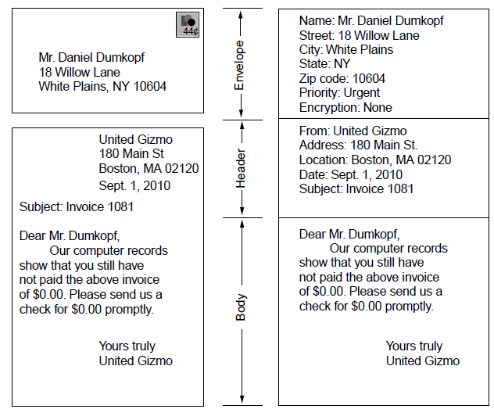
Architecture and Services (2)
Envelope
Message (= header and body)
Paper mail
Electronic mail
CN5E by Tanenbaum & Wetherall, © Pearson Education-Prentice Hall and D. Wetherall, 2011

Slide 14
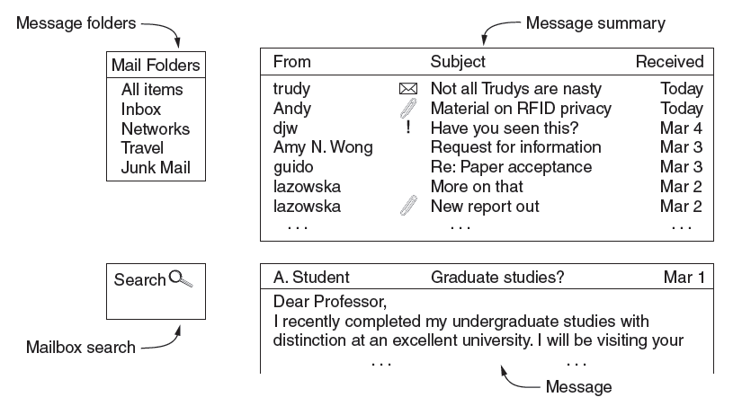
The User Agent
What users see – interface elements of a typical user agent
CN5E by Tanenbaum & Wetherall, © Pearson Education-Prentice Hall and D. Wetherall, 2011

Slide 15
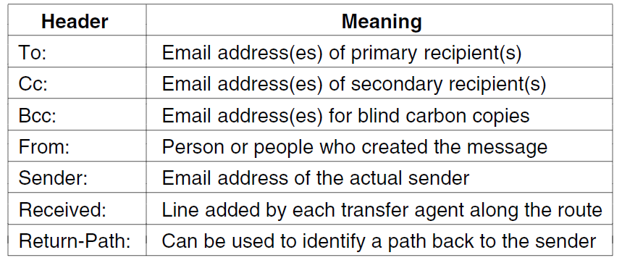
Message Formats (1)
Header fields related to message transport; headers are readable ASCII text
CN5E by Tanenbaum & Wetherall, © Pearson Education-Prentice Hall and D. Wetherall, 2011

Slide 16
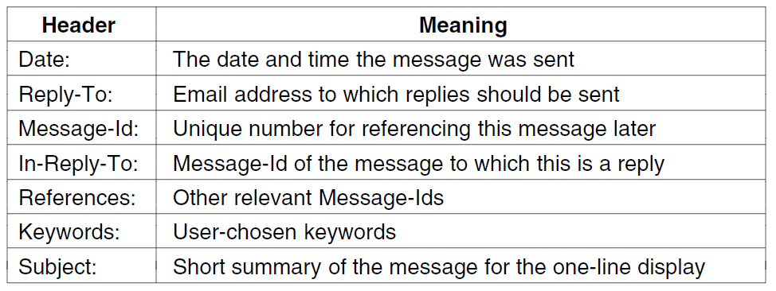
Message Formats (2)
Other header fields useful for user agents
CN5E by Tanenbaum & Wetherall, © Pearson Education-Prentice Hall and D. Wetherall, 2011

Slide 17
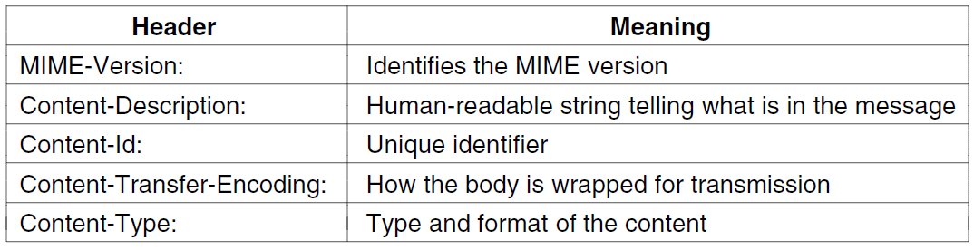
Message Formats (3)
MIME header fields used to describe what content is in the body of the message
CN5E by Tanenbaum & Wetherall, © Pearson Education-Prentice Hall and D. Wetherall, 2011

Slide 18
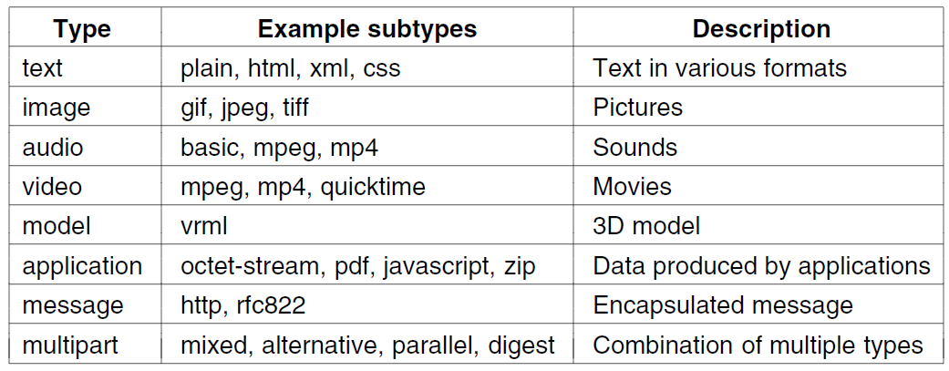
Message Formats (4)
Common MIME content types and subtypes
CN5E by Tanenbaum & Wetherall, © Pearson Education-Prentice Hall and D. Wetherall, 2011

Slide 19
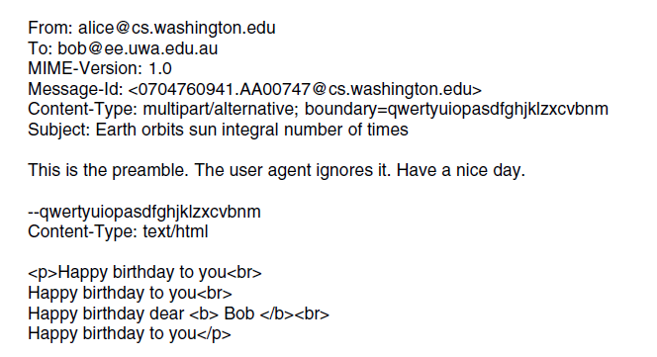
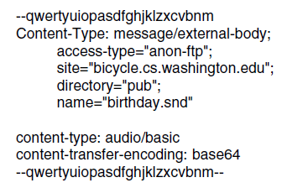
Message Formats (5)
Putting it all together: a multipart message containing HTML and audio alternatives.
One part (HTML)
Another
(audio)
CN5E by Tanenbaum & Wetherall, © Pearson Education-Prentice Hall and D. Wetherall, 2011

Slide 20
Message Transfer (1)
Messages are transferred with SMTP (Simple Mail Transfer Protocol)
  Readable text commands
  Submission from user agent to MTA on port 587
  One MTA to the next MTA on port 25
  Other protocols for final delivery (IMAP, POP3)
CN5E by Tanenbaum & Wetherall, © Pearson Education-Prentice Hall and D. Wetherall, 2011

Slide 21
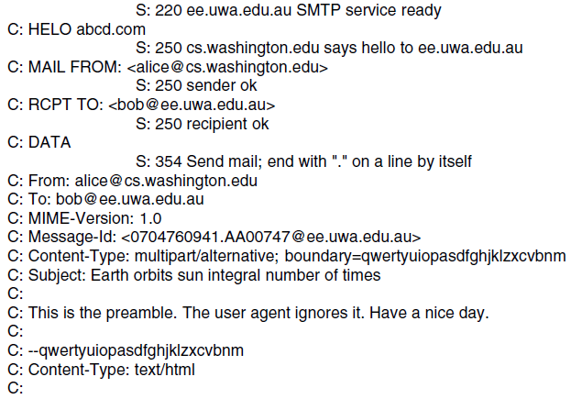
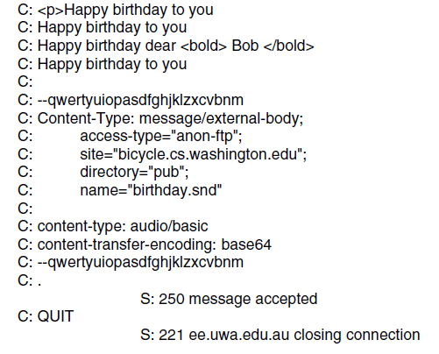
Message Transfer (2)
Sending a message:
From Alice to Bob
SMTP commands are marked [pink]
. . . (rest of message) . . .
CN5E by Tanenbaum & Wetherall, © Pearson Education-Prentice Hall and D. Wetherall, 2011

Slide 22
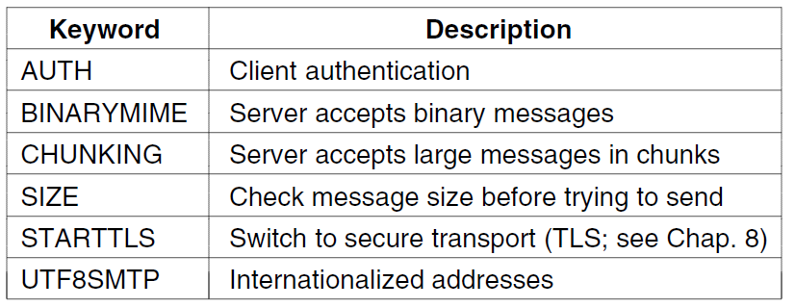
Message Transfer (3)
Common SMTP extensions (not in simple example)
CN5E by Tanenbaum & Wetherall, © Pearson Education-Prentice Hall and D. Wetherall, 2011

Slide 23
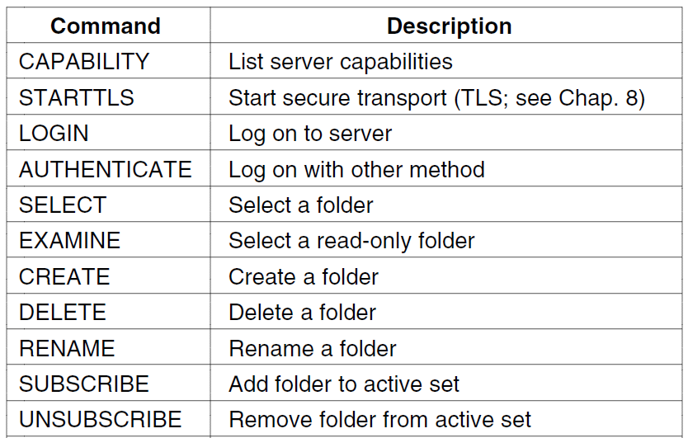
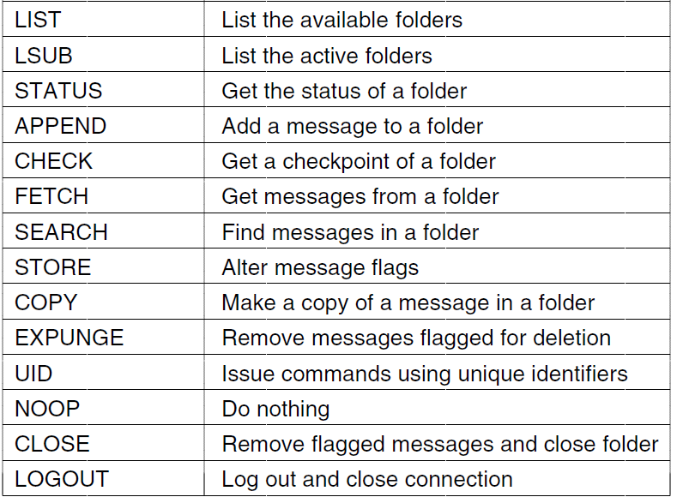
Final Delivery (1)
User agent uses protocol like IMAP for final delivery
  Has commands to manipulate folders / messages [right]
Alternatively, a Web interface (with proprietary protocol) might be used
CN5E by Tanenbaum & Wetherall, © Pearson Education-Prentice Hall and D. Wetherall, 2011

Slide 24
The World Wide Web
  Architectural overview »
  Static Web pages »
  Dynamic pages and Web applications »
  HTTP – HyperText Transfer Protocol »
  The mobile Web »
  Web search »
CN5E by Tanenbaum & Wetherall, © Pearson Education-Prentice Hall and D. Wetherall, 2011

Slide 25
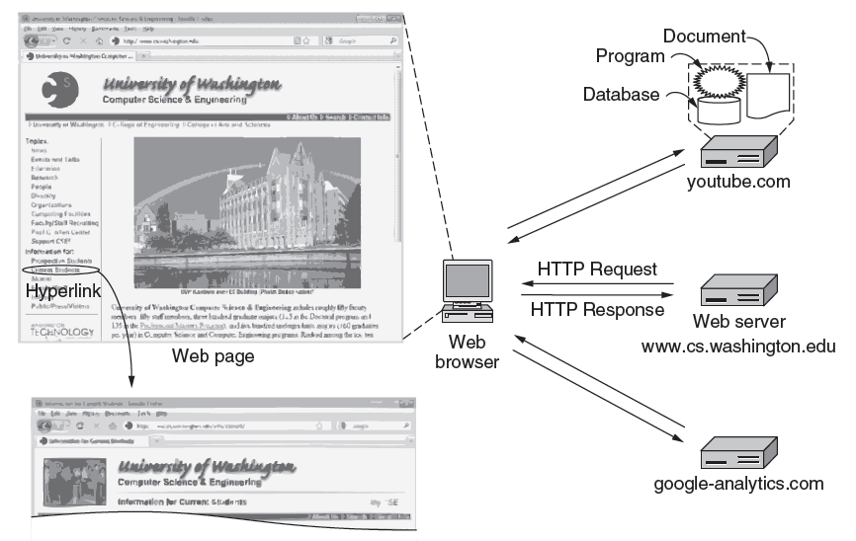
Architectural Overview (1)
HTTP transfers pages from servers to browsers
CN5E by Tanenbaum & Wetherall, © Pearson Education-Prentice Hall and D. Wetherall, 2011

Slide 26
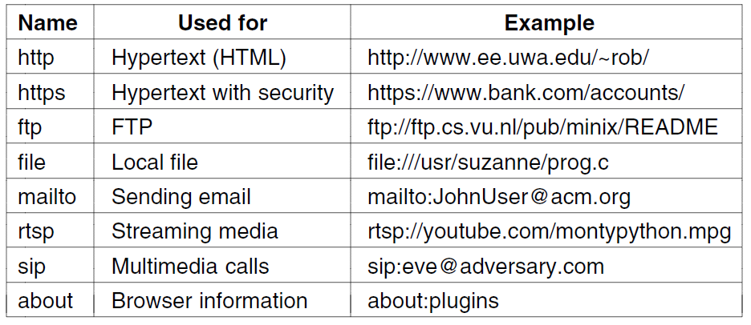
Architectural Overview (2)
Pages are named with URLs (Uniform Resource Locators)
  Example: http://www.phdcomics.com/comics.php
Protocol
Server
Page on server
Our
focus
Common URL protocols
CN5E by Tanenbaum & Wetherall, © Pearson Education-Prentice Hall and D. Wetherall, 2011

Slide 27
Architectural Overview (3)
  Steps a client (browser) takes to follow a hyperlink:
    Determine the protocol (HTTP)
    Ask DNS for the IP address of server
    Make a TCP connection to server
    Send request for the page; server sends it back
    Fetch other URLs as needed to display the page
    Close idle TCP connections
Steps a server takes to serve pages:
    Accept a TCP connection from client
    Get page request and map it to a resource (e.g., file name)
    Get the resource (e.g., file from disk)
    Send contents of the resource to the client.
    Release idle TCP connections
CN5E by Tanenbaum & Wetherall, © Pearson Education-Prentice Hall and D. Wetherall, 2011

Slide 28
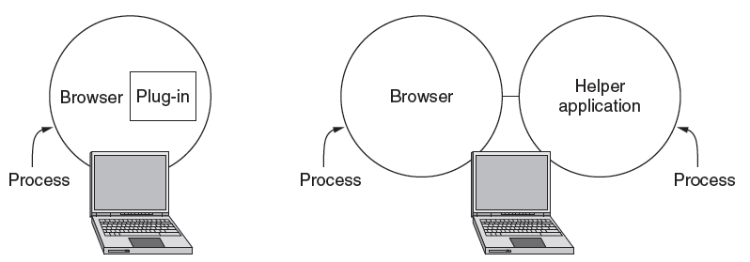
Architectural Overview (4)
Content type is identified by MIME types
  Browser takes the appropriate action to display
  Plug-ins / helper apps extend browser for new types
CN5E by Tanenbaum & Wetherall, © Pearson Education-Prentice Hall and D. Wetherall, 2011

Slide 29
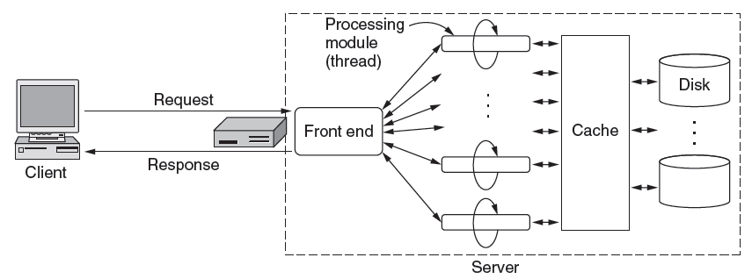
Architectural Overview (5)
To scale performance, Web servers can use:
  Caching, multiple threads, and a front end
CN5E by Tanenbaum & Wetherall, © Pearson Education-Prentice Hall and D. Wetherall, 2011

Slide 30
Architectural Overview (6)
Server steps, revisited:
  Resolve name of Web page requested
  Perform access control on the Web page
  Check the cache
  Fetch requested page from disk or run program
  Determine the rest of the response
  Return the response to the client
  Make an entry in the server log
CN5E by Tanenbaum & Wetherall, © Pearson Education-Prentice Hall and D. Wetherall, 2011

Slide 31
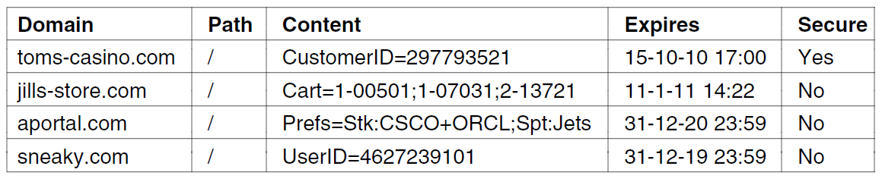
Architectural Overview (7)
Cookies support stateful client/server interactions
  Server sends cookies (state) with page response
  Client stores cookies across page fetches
  Client sends cookies back to server with requests
Examples of cookies
CN5E by Tanenbaum & Wetherall, © Pearson Education-Prentice Hall and D. Wetherall, 2011

Slide 32
Static Web Pages (1)
Static Web pages are simply files
  Have the same contents for each viewing
Can be visually rich and interactive nonetheless:
  HTML that mixes text and images
  Forms that gather user input
  Style sheets that tailor presentation
  Vector graphics, videos, and more (over) . . .
CN5E by Tanenbaum & Wetherall, © Pearson Education-Prentice Hall and D. Wetherall, 2011

Slide 33
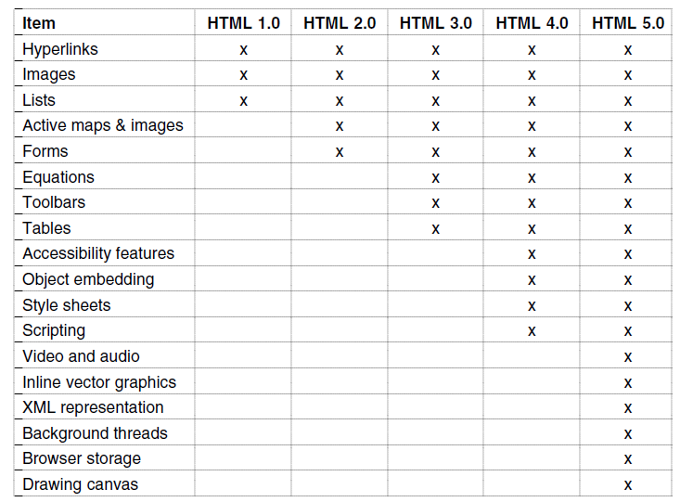
Static Web Pages (2)
Progression of features through HTML 5.0
CN5E by Tanenbaum & Wetherall, © Pearson Education-Prentice Hall and D. Wetherall, 2011

Slide 34
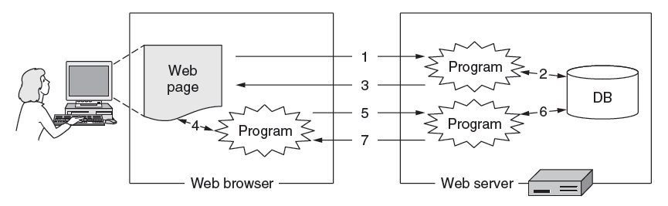
Dynamic Pages & Web Applications (1)
Dynamic pages are generated by programs running at the server (with a database) and the client
  E.g., PHP at server, JavaScript at client
  Pages vary each time like using an application
CN5E by Tanenbaum & Wetherall, © Pearson Education-Prentice Hall and D. Wetherall, 2011

Slide 35
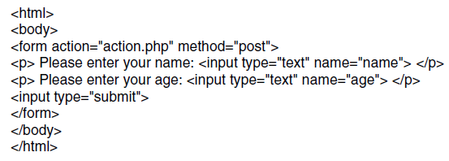
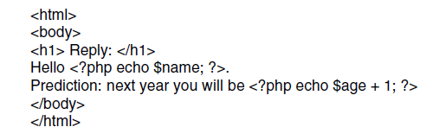
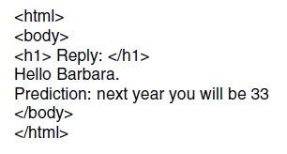
Dynamic Pages & Web Applications (2)
Web page that gets form input and calls a server program
PHP calls
PHP server program that creates a custom Web page
Resulting Web page (for inputs “Barbara” and “32”)
CN5E by Tanenbaum & Wetherall, © Pearson Education-Prentice Hall and D. Wetherall, 2011

Slide 36
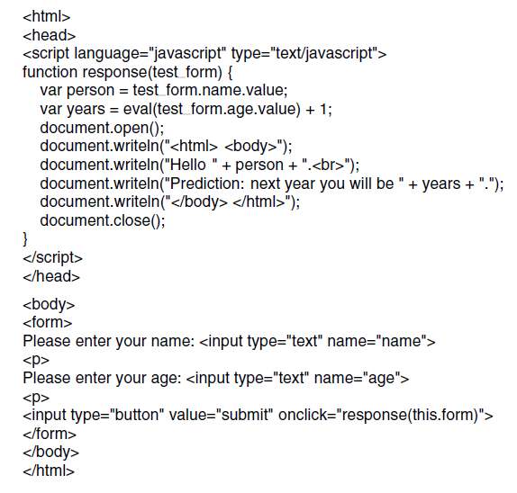
Dynamic Pages & Web Applications (3)
JavaScript program produces result page in the browser
First page with form, gets input and calls program above
CN5E by Tanenbaum & Wetherall, © Pearson Education-Prentice Hall and D. Wetherall, 2011

Slide 37
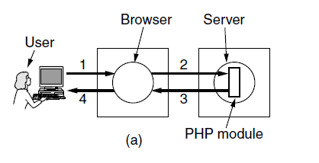
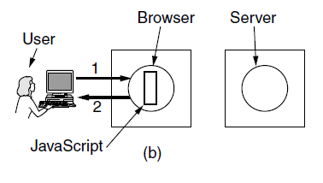
Dynamic Pages & Web Applications (4)
The difference between server and client programs
Server-side scripting with PHP
Client-side scripting with JavaScript
CN5E by Tanenbaum & Wetherall, © Pearson Education-Prentice Hall and D. Wetherall, 2011

Slide 38
Dynamic Pages & Web Applications (5)
  Web applications use a set of technologies that work together, e.g. AJAX:
  HTML: present information as pages.
  DOM: change parts of pages while they are viewed.
  XML: let programs exchange data with the server.
  Asynchronous way to send and retrieve XML data.
  JavaScript as a language to bind all this together.
CN5E by Tanenbaum & Wetherall, © Pearson Education-Prentice Hall and D. Wetherall, 2011

Slide 39
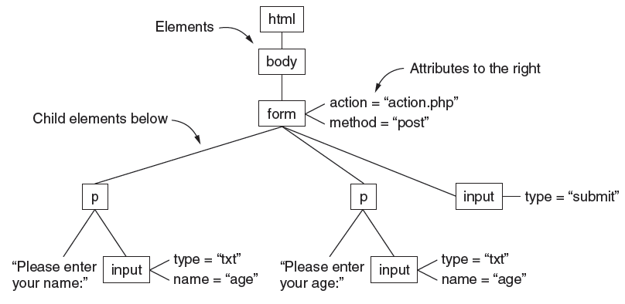
Dynamic Pages & Web Applications (6)
The DOM (Document Object Model) tree represents Web pages as a structure that programs can alter
CN5E by Tanenbaum & Wetherall, © Pearson Education-Prentice Hall and D. Wetherall, 2011

Slide 40
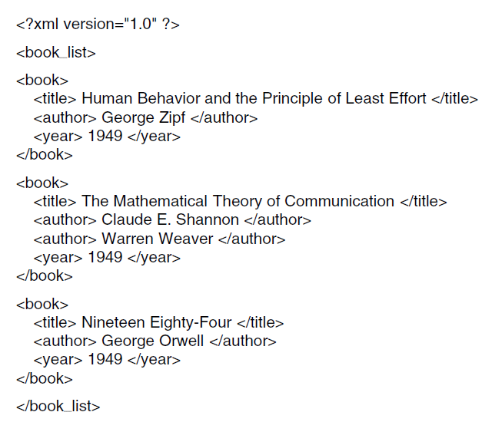
Dynamic Pages & Web Applications (7)
XML captures document structure, not presentation like HTML. Ex:
CN5E by Tanenbaum & Wetherall, © Pearson Education-Prentice Hall and D. Wetherall, 2011

Slide 41
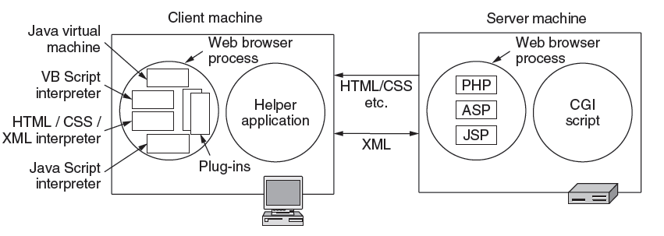
Dynamic Pages & Web Applications (8)
Web applications use a set of technologies, revisited:
CN5E by Tanenbaum & Wetherall, © Pearson Education-Prentice Hall and D. Wetherall, 2011

Slide 42
HTTP (1)
HTTP (HyperText Transfer Protocol) is a request-response protocol that runs on top of TCP
  Fetches pages from server to client
  Server usually runs on port 80
  Headers are given in readable ASCII
  Content is described with MIME types
  Protocol has support for pipelining requests
  Protocol has support for caching
CN5E by Tanenbaum & Wetherall, © Pearson Education-Prentice Hall and D. Wetherall, 2011

Slide 43
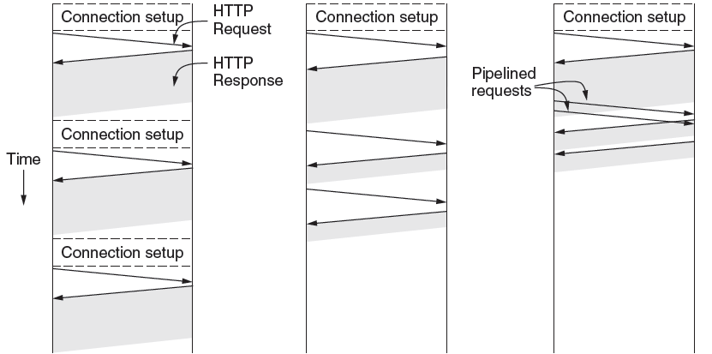
HTTP (2)
HTTP uses persistent connections to improve performance
One connection for each request
Sequential requests on one connection
Pipelined requests on one connection
CN5E by Tanenbaum & Wetherall, © Pearson Education-Prentice Hall and D. Wetherall, 2011

Slide 44
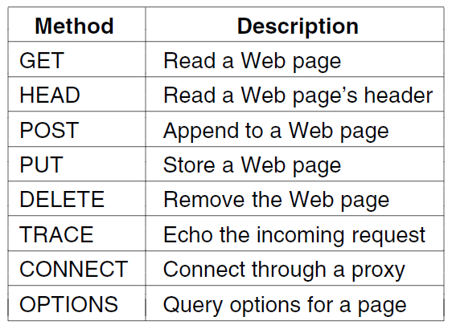
HTTP (3)
HTTP has several request methods.
Fetch a page
Used to send input data to a server program
CN5E by Tanenbaum & Wetherall, © Pearson Education-Prentice Hall and D. Wetherall, 2011

Slide 45
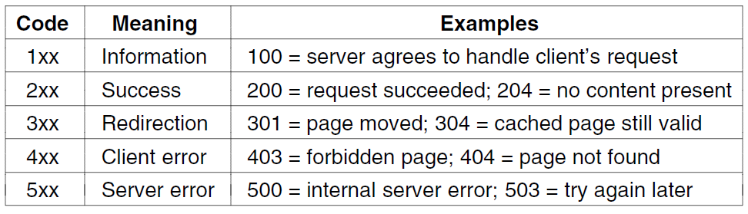
HTTP (4)
Response codes tell the client how the request fared:
CN5E by Tanenbaum & Wetherall, © Pearson Education-Prentice Hall and D. Wetherall, 2011

Slide 46
HTTP (5)
Many headers carry key information:
Function | Example Headers
Browser capabilities (client → server) | User-Agent, Accept, Accept-Charset, Accept-Encoding, Accept-Language
Caching related (mixed directions) | If-Modified-Since, If-None-Match, Date, Last-Modified, Expires, Cache-Control, ETag
Browser context (client → server) | Cookie, Referer, Authorization, Host
Content delivery (server → client) | Content-Encoding, Content-Length, Content-Type, Content-Language, Content-Range, Set-Cookie
CN5E by Tanenbaum & Wetherall, © Pearson Education-Prentice Hall and D. Wetherall, 2011

Slide 47
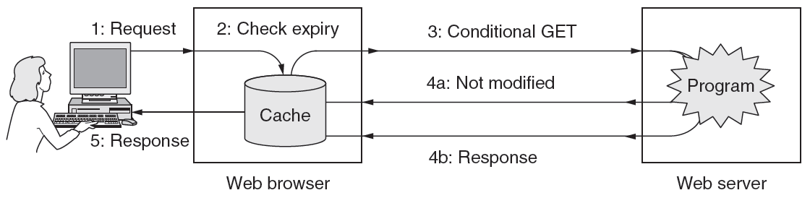
HTTP (6)
HTTP caching checks to see if the browser has a known fresh copy, and if not if the server has updated the page
  Uses a collection of headers for the checks
  Can include further levels of caching (e.g., proxy)
CN5E by Tanenbaum & Wetherall, © Pearson Education-Prentice Hall and D. Wetherall, 2011

Slide 48
The Mobile Web
Mobiles (phones, tablets) are challenging as clients:
    Relatively small screens
    Limited input capabilities, lengthy input.
    Network bandwidth is limited
    Connectivity may be intermittent.
    Computing power is limited
Strategies to handle them:
  Content: servers provide mobile-friendly versions; transcoding can also be used
  Protocols: no real need for specialized protocols; HTTP with header compression sufficient
CN5E by Tanenbaum & Wetherall, © Pearson Education-Prentice Hall and D. Wetherall, 2011

Slide 49
Web Search
Search has proved hugely popular, in tandem with advertising that has proved hugely profitable
  A simple interface for users to navigate the Web
Search engine requires:
  Content from all sites, accessed by crawling. Follow links to new pages, but beware programs.
  Indexing, which benefits from known and discovered structure (such as XML) to increase relevance
CN5E by Tanenbaum & Wetherall, © Pearson Education-Prentice Hall and D. Wetherall, 2011

Slide 50
Streaming Audio and Video
Audio and video have become key types of traffic, e.g., voice over IP, and video streaming.
  Digital audio »
  Digital video »
  Streaming stored media »
  Streaming live media »
  Real-time conferencing »
CN5E by Tanenbaum & Wetherall, © Pearson Education-Prentice Hall and D. Wetherall, 2011

Slide 51
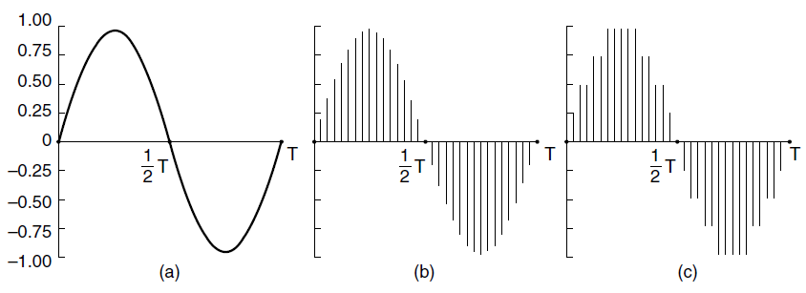
Digital Audio (1)
ADC (Analog-to-Digital Converter) produces digital audio from a microphone
  Telephone: 8000 8-bit samples/second (64 Kbps); computer audio is usually better quality (e.g., 16 bit)
ADC
Continuous audio
(sine wave)
Digital audio
(sampled, 4-bit quantized)
CN5E by Tanenbaum & Wetherall, © Pearson Education-Prentice Hall and D. Wetherall, 2011

Slide 52
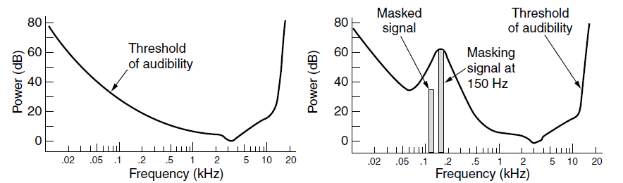
Digital Audio (2)
Digital audio is typically compressed before it is sent
  Lossy encoders (like AAC) exploit human perception
  Large compression ratios (can be >10X)
Sensitivity of the ear varies with frequency
A loud tone can mask nearby tones
CN5E by Tanenbaum & Wetherall, © Pearson Education-Prentice Hall and D. Wetherall, 2011

Slide 53
Digital Video (1)
Video is digitized as pixels (sampled, quantized)
  TV quality: 640x480 pixels, 24-bit color, 30 times/sec
Video is sent compressed due to its large bandwidth
  Lossy compression exploits human perception
    E.g., JPEG for still images, MPEG, H.264 for video
  Large compression ratios (often 50X for video)
  Video is normally > 1 Mbps, versus >10 kbps for speech and >100 kbps for music
CN5E by Tanenbaum & Wetherall, © Pearson Education-Prentice Hall and D. Wetherall, 2011

Slide 54
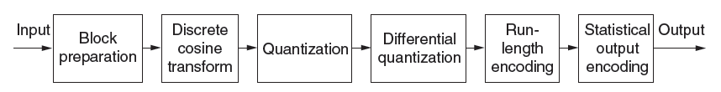
Digital Video (2)
JPEG lossy compression sequence for one image:
Step 1
Step 2
Step 3
Step 5
CN5E by Tanenbaum & Wetherall, © Pearson Education-Prentice Hall and D. Wetherall, 2011

Slide 55
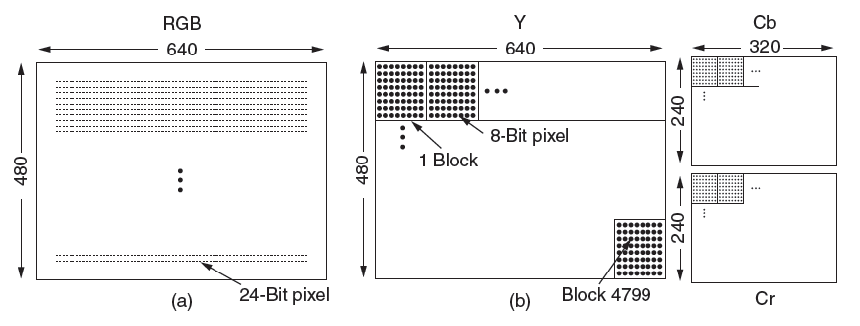
Digital Video (3)
Step 1: Pixels are mapped to luminance/chrominance (YCbCr) color space and chrominance is sub-sampled
  The eye is less sensitive to chrominance
Input 24-bit RGB pixels
8-bit luminance pixels
8-bit chrominances for every 4 pixels
CN5E by Tanenbaum & Wetherall, © Pearson Education-Prentice Hall and D. Wetherall, 2011

Slide 56
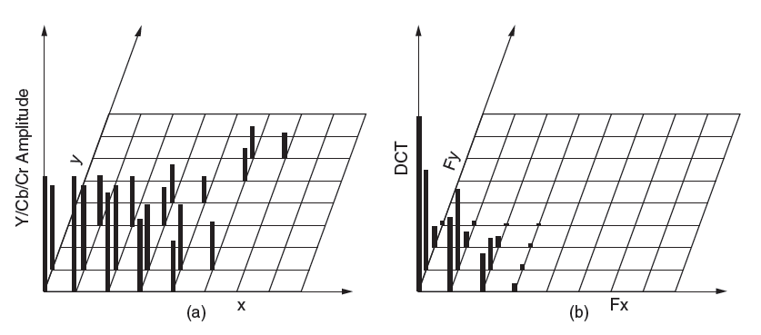
Digital Video (4)
Step 2: Each component block is transformed to spatial frequencies with DCT (Discrete Cosine Transformation)
  Captures the key image features
One component block
Transformed block
CN5E by Tanenbaum & Wetherall, © Pearson Education-Prentice Hall and D. Wetherall, 2011

Slide 57
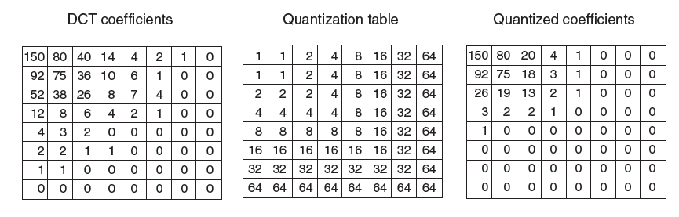
Digital Video (5)
Step 3: DCT coefficients are quantized by dividing by thresholds; reduces bits in higher spatial frequencies
  Top left element is differenced over blocks (Step 4)
Input
/
Thresholds
=
Output
CN5E by Tanenbaum & Wetherall, © Pearson Education-Prentice Hall and D. Wetherall, 2011

Slide 58
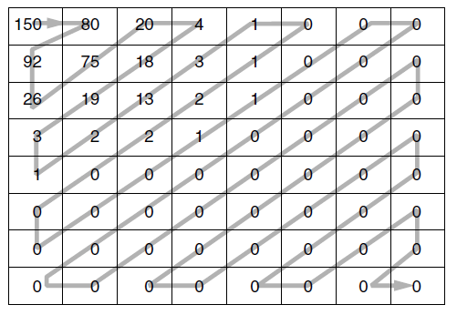
Digital Video (6)
Step 5: The block is run-length encoded in a zig-zag order. Then it is Huffman coded before sending (Step 6)
Order in which the block coefficients are sent
CN5E by Tanenbaum & Wetherall, © Pearson Education-Prentice Hall and D. Wetherall, 2011

Slide 59
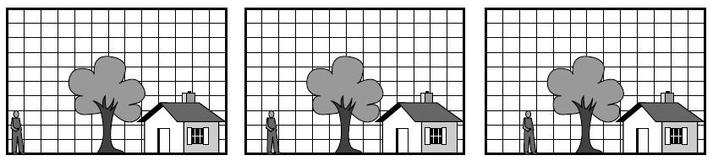
Digital Video (7)
MPEG compresses over a sequence of frames, further using motion tracking to remove temporal redundancy
    I (Intra-coded) frames are self-contained
    P (Predictive) frames use block motion predictions
    B (Bidirectional) frames may base prediction on future frame
Three consecutive frames with stationary and moving components
CN5E by Tanenbaum & Wetherall, © Pearson Education-Prentice Hall and D. Wetherall, 2011

Slide 60
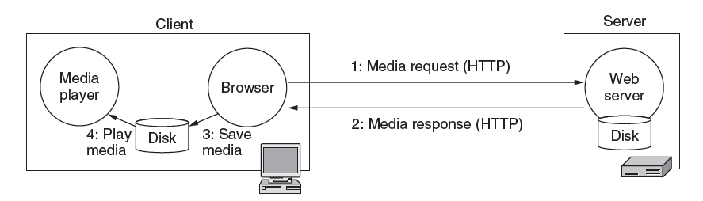
Streaming Stored Media (1)
A simple method to stream stored media, e.g., for video on demand, is to fetch the video as a file download
  But has large startup delay, except for short files
CN5E by Tanenbaum & Wetherall, © Pearson Education-Prentice Hall and D. Wetherall, 2011

Slide 61
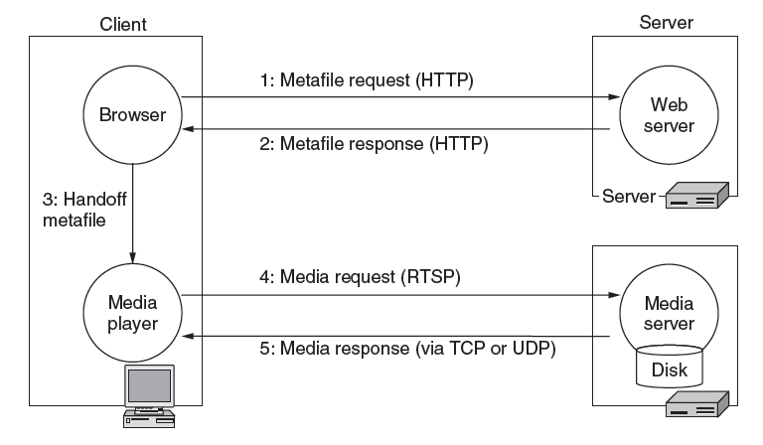
Streaming Stored Media (2)
Effective streaming starts the playout during transport
  With RTSP (Real-Time Streaming Protocol)
CN5E by Tanenbaum & Wetherall, © Pearson Education-Prentice Hall and D. Wetherall, 2011

Slide 62
Streaming Stored Media (3)
Key problem: how to handle transmission errors
Strategy | Advantage | Disadvantage
Use reliable transport (TCP) | Repairs all errors | Increases jitter significantly
Add FEC (e.g., parity) | Repairs most errors | Increases overhead, decoding complexity and jitter
Interleave media | Masks most errors | Slightly increases decoding complexity and jitter
CN5E by Tanenbaum & Wetherall, © Pearson Education-Prentice Hall and D. Wetherall, 2011

Slide 63

Streaming Stored Media (4)
Parity packet can repair one lost packet in a group of N
  Decoding is delayed for N packets
CN5E by Tanenbaum & Wetherall, © Pearson Education-Prentice Hall and D. Wetherall, 2011

Slide 64

Streaming Stored Media (5)
Interleaving spreads nearby media samples over different transmissions to reduce the impact of loss
Packet stream
Media samples
Loss reduces temporal resolution; doesn’t leave a gap
CN5E by Tanenbaum & Wetherall, © Pearson Education-Prentice Hall and D. Wetherall, 2011

Slide 65

Streaming Stored Media (6)
Key problem: media may not arrive in time for playout due to variable bandwidth and loss/retransmissions
  Client buffers media to absorb jitter; we still need to pick an achievable media rate
Safety margin, to avoid a stall
Can pause server (or go ahead and save to disk)
CN5E by Tanenbaum & Wetherall, © Pearson Education-Prentice Hall and D. Wetherall, 2011

Slide 66

Streaming Stored Media (7)
RTSP commands
  Sent from player to server to adjust streaming
CN5E by Tanenbaum & Wetherall, © Pearson Education-Prentice Hall and D. Wetherall, 2011

Slide 67
Streaming Live Media (1)
Streaming live media is similar to the stored case plus:
  Can’t stream faster than “live rate” to get ahead
    Usually need larger buffer to absorb jitter
  Often have many users viewing at the same time
    UDP with multicast greatly improves efficiency. It is rarely available, so many TCP connections are used.
    For very many users, content distribution is used [later]
CN5E by Tanenbaum & Wetherall, © Pearson Education-Prentice Hall and D. Wetherall, 2011
Notes:
An example of streaming live media is watching the French Open tennis tournament.
IP multicast is usually not available across the Internet. It is most likely to be available in a single providers network, such as a closed IPTV cable network.

Slide 68

Streaming Live Media (2)
With multicast streaming media, parity is effective
  Clients can each lose a different packet and recover
CN5E by Tanenbaum & Wetherall, © Pearson Education-Prentice Hall and D. Wetherall, 2011

Slide 69

Streaming Live Media (2)
Production side of a student radio station.
As before
CN5E by Tanenbaum & Wetherall, © Pearson Education-Prentice Hall and D. Wetherall, 2011

Slide 70
Real-Time Conferencing (1)
Real-time conferencing has two or more connected live media streams, e.g., voice over IP, Skype video call
Key issue over live streaming is low (interactive) latency
  Want to reduce delay to near propagation
  Benefits from network support, e.g., QoS
  Or, benefits from ample bandwidth (no congestion)
CN5E by Tanenbaum & Wetherall, © Pearson Education-Prentice Hall and D. Wetherall, 2011

Slide 71

Real-Time Conferencing (2)
H.323 architecture for Internet telephony supports calls between Internet computers and PSTN phones.
VoIP
call
Internet/PSTN
Internet
Gatekeeper controls calls for LAN hosts
CN5E by Tanenbaum & Wetherall, © Pearson Education-Prentice Hall and D. Wetherall, 2011

Slide 72

Real-Time Conferencing (3)
H.323 protocol stack:
  Call is digital audio/video over RTP/UDP/IP
  Call setup is handled by other protocols (Q.931 etc.)
CN5E by Tanenbaum & Wetherall, © Pearson Education-Prentice Hall and D. Wetherall, 2011

Slide 73

Real-Time Conferencing (4)
Logical channels that make up an H.323 call
CN5E by Tanenbaum & Wetherall, © Pearson Education-Prentice Hall and D. Wetherall, 2011

Slide 74

Real-Time Conferencing (5)
SIP (Session Initiation Protocol) is an alternative to H.323 to set up real-time calls
  Simple, text-based protocol with URLs for addresses
  Data is carried with RTP / RTCP as before
CN5E by Tanenbaum & Wetherall, © Pearson Education-Prentice Hall and D. Wetherall, 2011

Slide 75

Real-Time Conferencing (6)
Setting up a call with the SIP three-way handshake
  Proxy server lets a remote callee be connected
  Call data flows directly between caller/callee
CN5E by Tanenbaum & Wetherall, © Pearson Education-Prentice Hall and D. Wetherall, 2011

Slide 76

Real-Time Conferencing (7)
Comparison of H.323 and SIP.
CN5E by Tanenbaum & Wetherall, © Pearson Education-Prentice Hall and D. Wetherall, 2011

Slide 77
Content Delivery
Delivery of content, especially Web and video, to users is a major component of Internet traffic
  Content and Internet traffic »
  Server farms and Web proxies »
  Content delivery networks »
  Peer-to-peer networks »
CN5E by Tanenbaum & Wetherall, © Pearson Education-Prentice Hall and D. Wetherall, 2011

Slide 78

Content and Internet Traffic
Internet traffic:
  Shifts seismically (email→FTP→Web→P2P→video)
  Has many small/unpopular and few large/popular flows – mice and elephants
Zipf popularity distribution, 1/k
Shows up as a line on log-log plot
CN5E by Tanenbaum & Wetherall, © Pearson Education-Prentice Hall and D. Wetherall, 2011

Slide 79

Server Farms and Web Proxies (1)
Server farms enable large-scale Web servers:
  Front-end load-balances requests over servers
  Servers access the same backend database
CN5E by Tanenbaum & Wetherall, © Pearson Education-Prentice Hall and D. Wetherall, 2011

Slide 80

Server Farms and Web Proxies (2)
Proxy caches help organizations to scale the Web
  Caches server content over clients for performance
  Also implements organization policies (e.g., access)
CN5E by Tanenbaum & Wetherall, © Pearson Education-Prentice Hall and D. Wetherall, 2011

Slide 81

CDNs – Content Delivery Networks (1)
CDNs scale Web servers by having clients get content from a nearby CDN node (cache)
CN5E by Tanenbaum & Wetherall, © Pearson Education-Prentice Hall and D. Wetherall, 2011

Slide 82

Content Delivery Networks (2)
Directing clients to nearby CDN nodes with DNS:
  Client query returns local CDN node as response
  Local CDN node caches content for nearby clients and reduces load on the origin server
CN5E by Tanenbaum & Wetherall, © Pearson Education-Prentice Hall and D. Wetherall, 2011

Slide 83

Content Delivery Networks (3)
Origin server rewrites pages to serve content via CDN
Traditional Web page on server
Page that distributes content via CDN
CN5E by Tanenbaum & Wetherall, © Pearson Education-Prentice Hall and D. Wetherall, 2011

Slide 84
Peer-to-Peer Networks (1)
P2P (Peer-to-Peer) is an alternative CDN architecture with no dedicated infrastructure (i.e., servers)
  Clients serve content to each other as peers
Challenges when servers are removed:
  How do peers find each other?
  How do peers support rapid content downloads?
  How do peers encourage each other to upload?
CN5E by Tanenbaum & Wetherall, © Pearson Education-Prentice Hall and D. Wetherall, 2011

Slide 85

Peer-to-Peer Networks (2)
BitTorrent lets peers download torrents
    Peers find each other via Tracker in torrent file
    Peers swap chunks (parts of content) with partners, preferring those who send most quickly [2]
    Many peers speed download; preference helps uploads [3]
CN5E by Tanenbaum & Wetherall, © Pearson Education-Prentice Hall and D. Wetherall, 2011

Slide 86
Peer-to-Peer Networks (3)
Distributed Hash Tables (DHTs) are a fully distributed index that scales to very many clients/entries
  Need to follow O(log N) path for N entries
  Can use as Tracker to find peers with no servers [1]
  Look up torrent (identifier) in DHT to find IP of peers
  Kademlia is used in BitTorrent
CN5E by Tanenbaum & Wetherall, © Pearson Education-Prentice Hall and D. Wetherall, 2011

Slide 87

Peer-to-Peer Networks (3)
A Chord ring of 32 identifiers. Finger tables [at right, and as arcs] are used to navigate the ring.
  Example: path to look up 16 from 1 is 1 → 12 → 15
Identifier values are stored at predecessor
CN5E by Tanenbaum & Wetherall, © Pearson Education-Prentice Hall and D. Wetherall, 2011

Slide 88
End
Chapter 7
CN5E by Tanenbaum & Wetherall, © Pearson Education-Prentice Hall and D. Wetherall, 2011

