Slide 1
Homework-Ch1

Slide 2
1-1. Five routers are to be connected in a point-to-point subnet . Between each pair of routers, the designers may put a high-speed line, a medium-speed line, a low-speed line, or no line. If it takes 100 ms of computer time to generate and inspect each topology, how long will it take to inspect all of them?
Call the routers A, B, C, D, and E. There are ten potential lines: AB, AC, AD, AE, BC, BD, BE, CD, CE, and DE. Each of these has four possibilities (three speeds or no line), so the total number of topologies is 4¹⁰ = 1, 048, 576. At 100 ms each, it takes 104,857.6 sec, or slightly more than 29 hours to inspect them all.

Slide 3
1-2. What are two reasons for using layered protocols? What is one possible disadvantage of using layered protocols?
Among other reasons for using layered protocols, using them leads to breaking up the design problem into smaller, more manageable pieces, and layering means that protocols can be changed without affecting higher or lower ones.
One possible disadvantage is the performance of a layered system is likely to be worse than the performance of a monolithic system, although it is extremely difficult to implement and manage a monolithic system.
Advantages
Modularity
Abstraction
Reuse
Disadvantages
Information hiding
Inefficient implementations

Slide 4
1-3. What is the principal difference between connectionless communication and connection-oriented communication? Give one example of a protocol that uses
(i) connectionless communication
(ii) connection-oriented communication
Three phases VS. sending data directly
The order of the data is not guaranteed or not.
Connection-oriented communication has three phases. In the establishment phase a request is made to set up a connection. Only after this phase has been successfully completed can the data transfer phase be started and data transported. Then comes the release phase. In most cases the order is preserved so that the bits arrive in the order they were sent.
Connectionless communication does not have these phases. It just sends the data. The order of the data is not guaranteed.

Slide 5
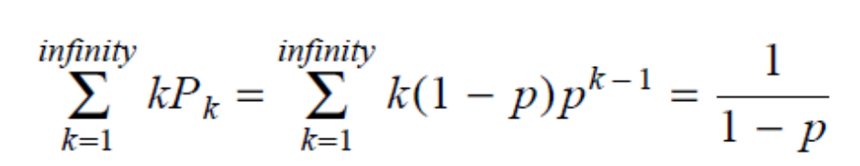
1-4. In some networks, the data link layer handles transmission errors by requesting that damaged frames be retransmitted. If the probability of a frame's being damaged is p, what is the mean number of transmissions required to send a frame? Assume that acknowledgements are never lost.
The probability, P_{k}, of a frame requiring exactly k transmissions is the probability of the first k - 1 attempts failing, p^{k - 1}, times the probability of the k-th transmission succeeding, (1 - p).
The mean number of transmission is then just
Or, more directly, if the probability of a message getting through is 1 - p then the expected number of transmissions per successful message is 1 / ( 1 - p ).

Slide 6
1-5. A system has an n-layer protocol hierarchy. Applications generate messages of length M bytes. At each of the layers, an h-byte header is added. What fraction of the network bandwidth is filled with headers?
With n layers and h bytes added per layer, the total number of header bytes per message is hn, so the space wasted on headers is hn.
The total message size is M + nh, so the fraction of bandwidth wasted on headers is hn/(M + hn).
This estimate does not take into account fragmentation (one higher layer message is sent as multiple lower layer messages) or aggregation (multiple higher layer messages are carried as one lower layer message) that may be present. If fragmentation is used, it will raise the overhead. If aggregation is used, it will lower the overhead.

Slide 7
1-6. What is the main difference between TCP and UDP?
TCP is connection oriented, whereas UDP is a connectionless service.
Alternatively, TCP provides a reliable service, whereas UDP provides an unreliable service.

Slide 8
1-7. When a file is transferred between two computers, two acknowledgement strategies are possible. In the first one, the file is chopped up into packets, which are individually acknowledged by the receiver, but the file transfer as a whole is not acknowledged. In the second one, the packets are not acknowledged individually, but the entire file is acknowledged when it arrives. Discuss these two approaches.
If the network tends to lose packets, it is better to acknowledge each one separately, so the lost packets can be retransmitted.
On the other hand, if the network is highly reliable, sending one acknowledgement at the end of the entire transfer saves bandwidth in the normal case (but requires the entire file to be retransmitted if even a single packet is lost).

Slide 9
1-8. An image is 1024 X 768 pixels with 3 bytes/pixel. Assume the image is uncompressed. How long does it take to transmit it over a 56-kbps modem channel?
Over a 1-Mbps cable modem?
Over a 10-Mbps Ethernet?
Over 100-Mbps Ethernet?
Over gigabit Ethernet?
The image is 1024 X 768 X 3 bytes or 2359296 bytes. This is 18874368 bits.
At 56,000 bits/sec, it takes about 337.042sec.
At 1,000,000 bits/sec, it takes 18.874 sec.
At 10,000,000 bits/sec, it takes 1.887 sec.
At 100,000,000 bits/sec, it takes about 0.189 sec.
At 1,000,000,000 bits/sec it takes about 19 msec.

Slide 10
1-9. Suppose the algorithms used to implement the operations at layer k is changed. How does this impact operations at layers k − 1 and k + 1?
This has no impact on the operations at layers k-1 or k+1.

Slide 11
1-10. Suppose there is a change in the service (set of operations) provided by layer k. How does this impact services at layers k-1 and k+1?
There is no impact at layer k-1, but operations in k+1 have to be reimplemented.

Slide 12
End

