Slide 1
Homework-Ch3

Slide 2
3-1. The following data fragment occurs in the middle of a data stream for which the byte stuffing algorithm described in the text is used: A B ESC C ESC FLAG FLAG D. What is the output after stuffing?
After stuffing, we get A B ESC ESC C ESC ESC ESC FLAG ESC FLAG D.

Slide 3
3-2. Can you think of any circumstances under which an open-loop protocol (e.g., a Hamming code) might be preferable to the feedback-type protocols discussed throughout this chapter?
If the propagation delay is very long, as in the case of a space probe on or near Mars or Venus, forward error correction is indicated.
It is also appropriate in a military situation in which the receiver does not want to disclose its location by transmitting.
If the error rate is low enough that an error-correcting code is good enough, it may also be simpler.
Finally, real-time systems cannot tolerate waiting for retransmissions.

Slide 4
3-3. An 8-bit byte with binary value 10101111 is to be encoded using an even-parity Hamming code. What is the binary value after encoding?
编号从左至右递增：
The encoded value is 101001001111.
编号从右向左递增：
The encoded value is 101001110101

Slide 5
3-4. What is the remainder obtained by dividing x⁷ + x⁵ +1by the generator polynomial x³+1?
The remainder is x² + x + 1.

Slide 6
3-5. Suppose that a message 1001 1100 1010 0011 is transmitted using Internet Checksum (4-bit word). What is the value of the checksum?
To obtain the checksum, we need to calculate the ones complement of the ones complement sum of the words. The ones complement sum is same as sum modulo 2⁴ and adding any overflow of high order bits back into low-order bits:
0011 + 1010 = 1101
1101 + 1100 = 1001 + 1 = 1010
1010 + 1001 = 0011 + 1 = 0100.
So, the Internet checksum is the ones complement of 0100, or 1011.

Slide 7
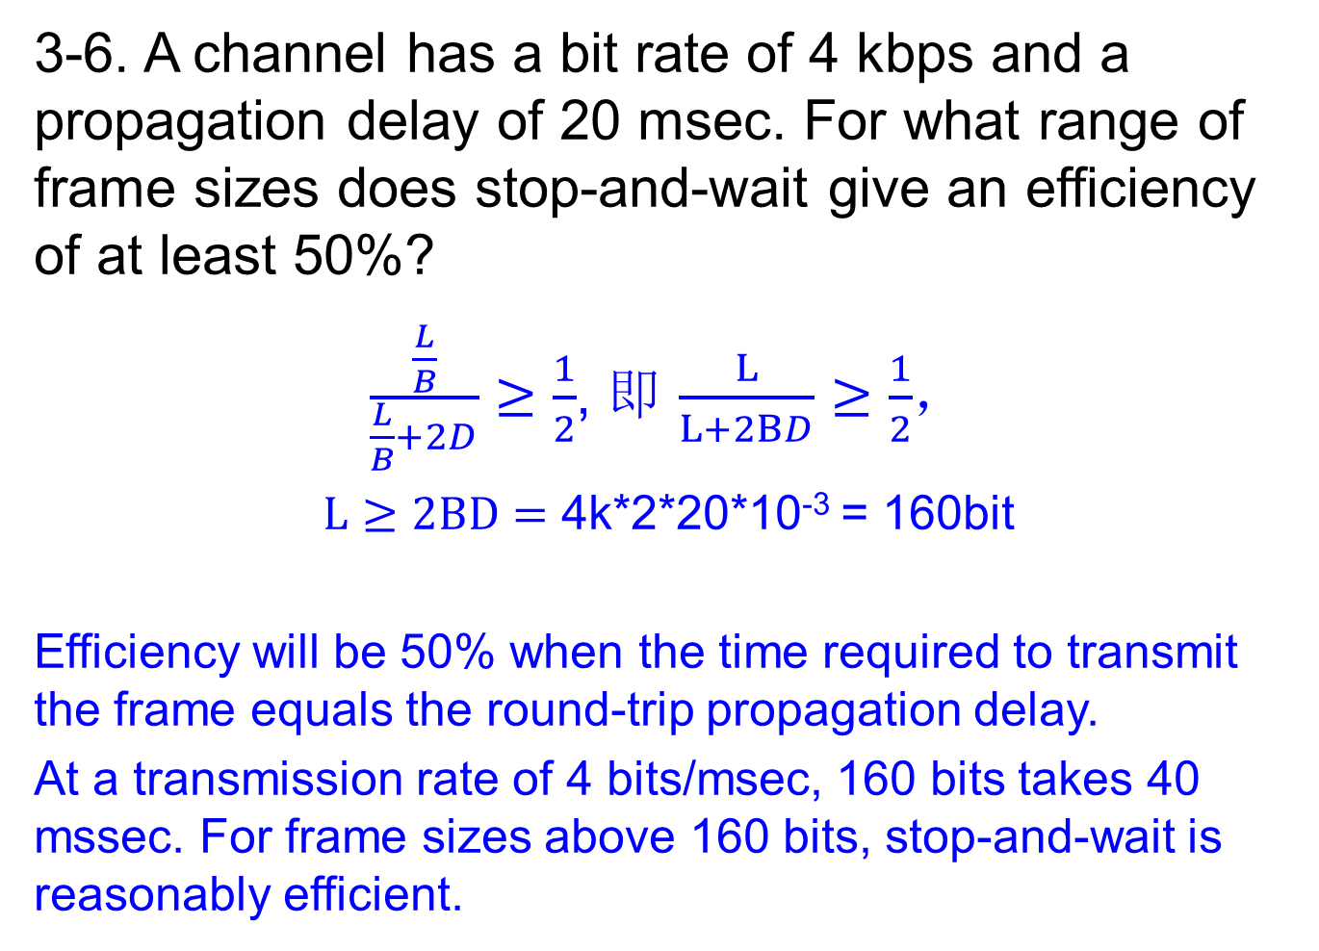
3-6. A channel has a bit rate of 4 kbps and a propagation delay of 20 msec. For what range of frame sizes does stop-and-wait give an efficiency of at least 50%?
$\frac{\frac{L}{B}}{\frac{L}{B}+2D}≥\frac{1}{2}$, 即 $\frac{L}{L+2BD}≥\frac{1}{2}$，
$L≥2BD=$ 4k*2*20*10⁻³ = 160bit
Efficiency will be 50% when the time required to transmit the frame equals the round-trip propagation delay.
At a transmission rate of 4 bits/msec, 160 bits takes 40 mssec. For frame sizes above 160 bits, stop-and-wait is reasonably efficient.

Slide 8
3-7. A 3000-km-long T1 trunk is used to transmit 64-byte frames using protocol 5. If the propagation speed is 6 μsec/km, how many bits should the sequence numbers be?
To operate efficiently, the sequence space (actually, the sender’s window size) must be large enough to allow the transmitter to keep transmitting until the first acknowledgement has been received.
The propagation time is 18 ms.
At T1 speed, which is 1.536 Mbps (excluding the 1 header bit), a 64-byte frame takes 0.300 msec.
Therefore, the first frame fully arrives 18.3 msec after its transmission was started.
The acknowledgement takes another 18 msec to get back, plus a small (negligible) time for the acknowledgement to arrive fully.
In all, this time is 36.3 msec, so the transmitter needs to have enough window space to keep going for 36.3 msec.
A frame takes 0.3 ms, so it takes 121 frames to fill the pipe.
Seven-bit sequence numbers are needed.

Slide 9
3-8. In protocol 6, when a data frame arrives, a check is made to see if the sequence number differs from the one expected and no nak is true. If both conditions hold, a NAK is sent. Otherwise, the auxiliary timer is started. Suppose that the else clause were omitted. Would this change affect the protocol’s correctness?
Yes. It might lead to deadlock.
Suppose that a batch of frames arrived correctly and was accepted. The receiver would advance its window.
Now suppose that all the acknowledgements were lost. The sender would eventually time out and send the first frame again. The receiver would then send a NAK.
If this packet were lost, from that point on, the sender would keep timing out and sending a frame that had already been accepted, but the receiver would just ignore it.
Setting the auxiliary timer results in a correct acknowledgement being sent back eventually instead, which resynchronizes.

Slide 10
3-9. Suppose that the three-statement while loop near the end of protocol 6 was removed from the code. Would this affect the correctness of the protocol or just the performance? Explain your answer.
It would lead to deadlock because this is the only place that incoming acknowledgements are processed. Without this code, the sender would keep timing out and never make any progress.

Slide 11
3-10. Frames of 1000 bits are sent over a 1-Mbps channel using a geostationary satellite whose propagation time from the earth is 270 msec. Acknowledgements are always piggybacked onto data frames. The headers are very short. Three-bit sequence numbers are used. What is the maximum achievable channel utilization for
(a) Stop-and-wait?
(b) Protocol 5?
(c) Protocol 6?
Let t = 0 denote the start of transmission.
At t = 1 msec, the first frame has been fully transmitted.
At t = 271 msec, the first frame has fully arrived.
At t = 272 msec, the frame acknowledging the first one has been fully sent.
At t = 542 msec, the acknowledgement-bearing frame has fully arrived.
Thus, the cycle is 542 msec. A total of k frames are sent in 542 msec, for an efficiency of k/542. Hence, for
(a) k = 1, efficiency = 1/542 = 0.18%.
(b) k = 7, efficiency = 7/542 = 1.29%.
(c) k = 4, efficiency = 4/542 = 0.74%.

Slide 12
Exercise: The distance from earth to a distant planet is approximately 9 × 10¹⁰ m. What is the channel utilization if a stop-and-wait protocol is used for frame transmission on a 64 Mbps point-to-point link? Assume that the frame size is 32 KB and the speed of light is 3 × 10⁸ m/s.
Link utilization = (1/(1 + 2BD))
BD = bandwidth-delay product / frame size
delay = (9 × 10¹⁰ ) / ( 3 × 10⁸ ) = 300 sec
bandwidth-delay product = 64 × 300 = 19. 2 Gbit
BD = 19200000 / 256 = 75000 frames.
So, link utilization is 6. 67 × 10⁻⁴%

Slide 13
End

