Slide 1
Homework-Ch5

Slide 2
5-1. Give three examples of protocol parameters that might be negotiated when a connection is set up.
The negotiation could set the windowsize, maximum packet size, data rate, and timer values.

Slide 3
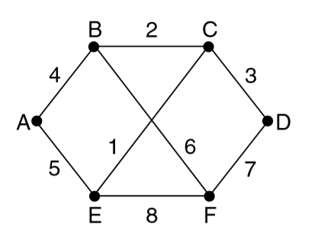
5-2. Consider the network of Fig. 5-12(a). Distance vector routing is used, and the following vectors have just come in to router C:
from B: (5, 0, 8, 12, 6, 2);
from D: (16, 12, 6, 0, 9, 10);
and from E: (7, 6, 3, 9, 0, 4).
The cost of the links from C to B, D, and E, are 6, 3, and 5, respectively.
What is C’s new routing table? Give both the outgoing line to use and the cost.
Going via B gives(11, 6, 14, 18, 12, 8).
Going via D gives(19, 15, 9, 3, 12, 13).
Going via E gives(12, 11, 8, 14, 5, 9).
Taking the minimum for each destination except C gives(11, 6, 0, 3, 5, 8). The outgoing lines are (B, B,– , D, E, B).

Slide 4
5-3. If costs are recorded as 8-bit numbers in a 50-router network, and distance vectors are exchanged twice a second, how much bandwidth per (full-duplex) line is chewed up by the distributed routing algorithm? Assume that each router has three lines to other routers.
The routing table is 400 bits. Twice a second this table is written onto each line, so 800 bps are needed on each line in each direction.

Slide 5
5-4. Suppose that host A is connected to a router R 1, R 1 is connected to another router, R 2, and R 2 is connected to host B. Suppose that a TCP message that contains 900 bytes of data and 20 bytes of TCP header is passed to the IP code at host A for delivery to B.
Show the Total length, Identification, DF, MF, and Fragment offset fields of the IP header in each packet transmitted over the three links.
Assume that link A-R1 can support a maximum frame size of 1024 bytes including a 14-byte frame header, link R1-R2 can support a maximum frame size of 512 bytes, including an 8-byte frame header, and link R2-B can support a maximum frame size of 512 bytes including a 12-byte frame header.

Slide 6
A----R1----R2----B
IP Packet(20B+920B)
A----R1: 940<1010, no fragmentation
R1----R2: 940 > 504, 504-20(IP Header) = 484/8=60..4
IP Packet 1
IP Packet 2
R2----B: 500 = 500, no fragmentation
IP Packet 1
IP Packet 2
IP Header (20 B) | TCP Header (20 B) | Data (900 B)
Frame Header (14 B) | IP Header (20 B) | TCP Header (20 B) | Data (900 B)
Frame Header (8 B) | IP Header (20 B) | TCP Header (20 B) | Data (460 B)
Frame Header (8 B) | IP Header (20 B) | Data (440 B)
Frame Header (12 B) | IP Header (20 B) | TCP Header (20 B) | Data (460 B)
Frame Header (12 B) | IP Header (20 B) | Data (440 B)
Notes:
We have an IP payload of 920 bytes to send.
Assume a 20 byte IPv4 header.
The ﬁrst link can carry IP packets up to 1010 bytes, so there will be no fragmentation.
The second link can carry IP packets up to 504 bytes, so there will be fragmentation. There may be up to 484 bytes of data, but fragments must carry a multiple of 8 bytes of data (except the last fragment). So the ﬁrst fragment will carry 480 bytes of data, and the second fragment will carry 440 bytes.
The third link can carry IP packets up to 500 bytes, so both fragments will ﬁt and no other fragmentation will occur.

Slide 7
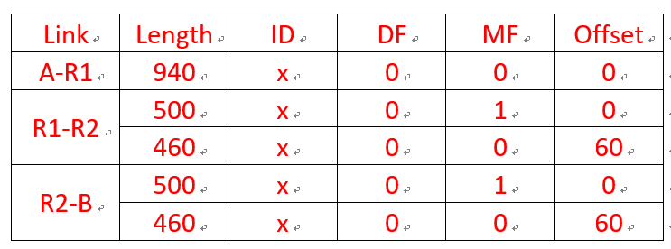

Slide 8
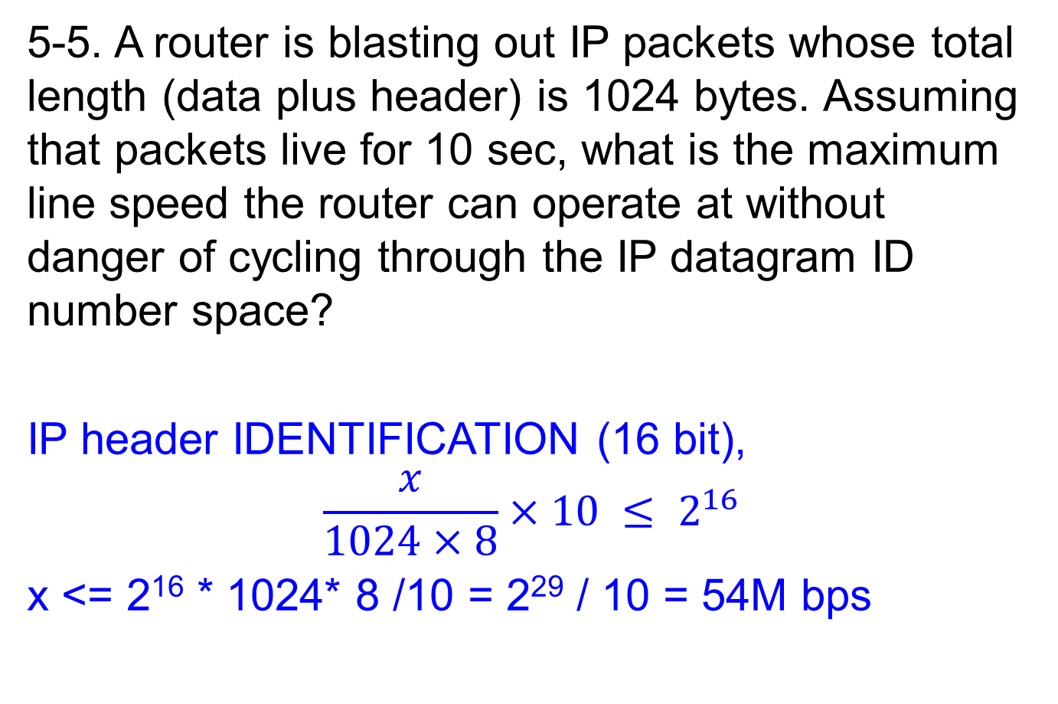
5-5. A router is blasting out IP packets whose total length (data plus header) is 1024 bytes. Assuming that packets live for 10 sec, what is the maximum line speed the router can operate at without danger of cycling through the IP datagram ID number space?
IP header IDENTIFICATION (16 bit),
$$\frac{x}{1024×8}×10 ≤ 2^{16}$$
x <= 2¹⁶ * 1024* 8 /10 = 2²⁹ / 10 = 54M bps
Notes:
If the bit rate of the line is b, the number of packets/sec that the router can emit is b/8192, so the number of seconds it takes to emit a packet is 8192/b. To put out 65,536 packets takes 2²⁹/b sec. Equating this to the maximum packet lifetime, we get 2²⁹/b = 10. Then, b is about 54 Mbps.

Slide 9
5-6. An IP datagram using the Strict source routing option has to be fragmented. Do you think the option is copied into each fragment, or is it sufficient to just put it in the first fragment? Explain your answer.
The info is needed to route every fragment, so it must appear in all of them.

Slide 10
5-7. Suppose that instead of using 16 bits for the network part of a class B address originally, 20 bits had been used. How many class B networks would there have been?
With a 2-bit preﬁx, there would have been 18 bits left over for the network. Consequently, the number of networks would have been 218 or 262,144. However, all 0s and all 1s are special, so only 262,142 are available.
10 | Network (18bit) | Host(12bit)

Slide 11
5-8. A large number of consecutive IP addresses are available starting at 198.16.0.0. Suppose that four organizations, A, B, C, and D, request 4000, 2000, 4000, and 8000 addresses, respectively, and in that order. For each of these, give the first IP address assigned, the last IP address assigned, and the mask in the w.x.y.z/s notation.
To start with, all the requests are rounded up to a power of two. The starting address, ending address, and mask are as follows:
Org. | IP address assignment | w.x.y.z/s notation
A | 198.16.0.0 – 198.16.15.255 | 198.16.0.0/20
B | 198.16.16.0 – 198.16.23.255 | 198.16.16.0/21
C | 198.16.32.0 – 198.16.47.255 | 198.16.32.0/20
D | 198.16.64.0 – 198.16.95.255 | 198.16.64.0/19

Slide 12
5-9. A router has the following (CIDR) entries in its routing table:
For each of the following IP addresses, what does the router do if a packet with that address arrives? (a) 135.46.63.10 (b) 135.46.57.14 (c) 135.46.52.2 (d) 192.53.40.7 (e) 192.53.56.7

Slide 13
Address/mask | The 3rd Byte (in Binary) | Next hop
192.53.40.0/23 | 0010 1000 | Router 1
135.46.56.0/22 | 0011 1000 | Interface 0
135.46.60.0/22 | 0011 1100 | Interface 1
default |  | Router 2
No. | Destination IP Address | The 3rd Byte (in Binary) | Output
(a) | 135.46.63.10 | 0011 1111 | Interface 1
(b) | 135.46.57.14 | 0011 1001 | Interface 0
(c) | 135.46.52.2 | 0011 0100 | Router 2
(d) | 192.53.40.7 | 0010 1000 | Router 1
(e) | 192.53.56.7 | 0011 1000 | Router 2

Slide 14
End

