Slide 1
ECNU
Course Overview
Computer System
Instructors:
Liu Xianzhong
62235306
xzliu@sei.ecnu.edu.cn
Room 215 (east), Math Building

Slide 2
Overview
ECNU
Course theme
Five realities
How the course fits into the SE curriculum
Logistics

Slide 3
Course Theme:
Abstraction Is Good But Don’t Forget Reality
ECNU
Most SE courses emphasize abstraction
  Abstract data types
  Asymptotic analysis
These abstractions have limits
  Especially in the presence of bugs
  Need to understand details of underlying implementations
Useful outcomes
  Become more effective programmers
    Able to find and eliminate bugs efficiently
    Able to understand and tune for program performance
  Prepare for later “systems” classes in SE
    Compilers, Operating Systems, Networks, Computer Organization, Embedded Systems

Slide 4
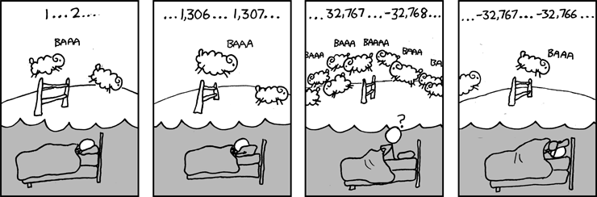
Great Reality #1:
Ints are not Integers, Floats are not Reals
ECNU
Example 1: Is x² ≥ 0?
  Float’s: Yes!
  Int’s:
    40000 * 40000 ➙ 1600000000
    50000 * 50000 ➙ ??
Example 2: Is (x + y) + z = x + (y + z)?
  Unsigned & Signed Int’s: Yes!
  Float’s: (浮点运算是不可结合的)
    (1e20 + -1e20) + 3.14 --> 3.14
    1e20 + (-1e20 + 3.14) --> ??

Slide 5
Code Security Example
ECNU
/* Illustration of code vulnerability similar to that found in FreeBSD's
* implementation of getpeername()*/
/* Declaration of library function memcpy */
void *memcpy(void *dest, void *src, size_t n);
/* Kernel memory region holding user-accessible data */
#define KSIZE 1024
char kbuf[KSIZE];
/* Copy at most maxlen bytes from kernel region to user buffer */
int copy_from_kernel(void *user_dest, int maxlen) {
/* Byte count len is minimum of buffer size and maxlen */
int len = KSIZE < maxlen ? KSIZE : maxlen;
memcpy(user_dest, kbuf, len);
return len;
}
Similar to code found in FreeBSD’s implementation of getpeername
There are legions of smart people trying to find vulnerabilities in programs

Slide 6
Typical Usage
ECNU
/* Kernel memory region holding user-accessible data */
#define KSIZE 1024
char kbuf[KSIZE];
/* Copy at most maxlen bytes from kernel region to user buffer */
int copy_from_kernel(void *user_dest, int maxlen) {
/* Byte count len is minimum of buffer size and maxlen */
int len = KSIZE < maxlen ? KSIZE : maxlen;
memcpy(user_dest, kbuf, len);
return len;
}
#define MSIZE 528
void getstuff() {
char mybuf[MSIZE];
copy_from_kernel(mybuf, MSIZE);
printf(“%s\n”, mybuf);
}

Slide 7
Malicious Usage
ECNU
/* Kernel memory region holding user-accessible data */
#define KSIZE 1024
char kbuf[KSIZE];
/* Copy at most maxlen bytes from kernel region to user buffer */
int copy_from_kernel(void *user_dest, int maxlen) {
/* Byte count len is minimum of buffer size and maxlen */
int len = KSIZE < maxlen ? KSIZE : maxlen;
memcpy(user_dest, kbuf, len);
return len;
}
#define MSIZE 528
void getstuff() {
char mybuf[MSIZE];
copy_from_kernel(mybuf, -MSIZE);
. . .
}

Slide 8
Computer Arithmetic
ECNU
Does not generate random values
  Arithmetic operations have important mathematical properties
Cannot assume all “usual” mathematical properties
  Due to finiteness of representations
  Integer operations satisfy “ring” properties
    Commutativity, associativity, distributivity
  Floating point operations satisfy “ordering” properties
    Monotonicity, values of signs
Observation
  Need to understand which abstractions apply in which contexts
  Important issues for compiler writers and serious application programmers

Slide 9
Great Reality #2:
You’ve Got to Know Assembly
ECNU
Chances are, you’ll never write programs in assembly
  Compilers are much better & more patient than you are
But: Understanding assembly is key to machine-level execution model
  Behavior of programs in presence of bugs
    High-level language models break down
  Tuning program performance
    Understand optimizations done / not done by the compiler
    Understanding sources of program inefficiency
  Implementing system software
    Compiler has machine code as target
    Operating systems must manage process state
  Creating / fighting malware
    x86 assembly is the language of choice!

Slide 10
Assembly Code Example
ECNU
Time Stamp Counter
  Special 64-bit register in Intel-compatible machines
  Incremented every clock cycle
  Read with rdtsc instruction
Application
  Measure time (in clock cycles) required by procedure
double t;
start_counter();
P();
t = get_counter();
printf("P required %f clock cycles\n", t);

Slide 11
Code to Read Counter
ECNU
Write small amount of assembly code using GCC’s asm facility
Inserts assembly code into machine code generated by compiler
static unsigned cyc_hi = 0;
static unsigned cyc_lo = 0;
/* Set *hi and *lo to the high and low order bits
of the cycle counter.
*/
void access_counter(unsigned *hi, unsigned *lo)
{
asm("rdtsc; movl %%edx,%0; movl %%eax,%1"
: "=r" (*hi), "=r" (*lo)
:
: "%edx", "%eax");
}
Notes:
GCC Extended assembly syntax
asm( assembler syntax
: output operands /*optional */
: input operands /* optional */
: list of clobbered registers /* optional */
);

Slide 12
Great Reality #3: Memory Matters
Random Access Memory Is an Unphysical Abstraction
ECNU
Memory is not unbounded
  It must be allocated and managed
  Many applications are memory dominated
Memory referencing bugs especially pernicious
  Effects are distant in both time and space
Memory performance is not uniform
  Cache and virtual memory effects can greatly affect program performance
  Adapting program to characteristics of memory system can lead to major speed improvements

Slide 13
Memory Referencing Bug Example
ECNU
double fun(int i)
{
volatile double d[1] = {3.14};
volatile long int a[2];
a[i] = 1073741824; /* Possibly out of bounds 1073741824=2³⁰ */
return d[0];
}
fun(0) ➙ 3.14
fun(1) ➙ 3.14
fun(2) ➙ 3.1399998664856
fun(3) ➙ 2.00000061035156
fun(4) ➙ 3.14, then segmentation fault
Result is architecture specific (Intel IA32)

Slide 14
Memory Referencing Bug Example
ECNU
double fun(int i)
{
volatile double d[1] = {3.14};
volatile long int a[2];
a[i] = 1073741824; /* Possibly out of bounds */
return d[0];
}
fun(0) ➙ 3.14
fun(1) ➙ 3.14
fun(2) ➙ 3.1399998664856
fun(3) ➙ 2.00000061035156
fun(4) ➙ 3.14, then segmentation fault
Explanation:
Saved State | 4
d7 ... d4 | 3
d3 ... d0 | 2
a[1] | 1
a[0] | 0
Location accessed by fun(i)

Slide 15
Memory Referencing Errors
ECNU
C and C++ do not provide any memory protection
  Out of bounds array references
  Invalid pointer values
  Abuses of malloc/free
Can lead to nasty bugs
  Whether or not bug has any effect depends on system and compiler
  Action at a distance
    Corrupted object logically unrelated to one being accessed
    Effect of bug may be first observed long after it is generated
How can I deal with this?
  Program in Java, Ruby or ML
  Understand what possible interactions may occur
  Use or develop tools to detect referencing errors (e.g. Valgrind)

Slide 16
Memory System Performance Example
ECNU
void copyij(int src[2048][2048],
int dst[2048][2048])
{
int i,j;
for (i = 0; i < 2048; i++)
for (j = 0; j < 2048; j++)
dst[i][j] = src[i][j];
}
void copyji(int src[2048][2048],
int dst[2048][2048])
{
int i,j;
for (j = 0; j < 2048; j++)
for (i = 0; i < 2048; i++)
dst[i][j] = src[i][j];
}
21 times slower
(Pentium 4)
Hierarchical memory organization
Performance depends on access patterns
  Including how step through multi-dimensional array

Slide 17
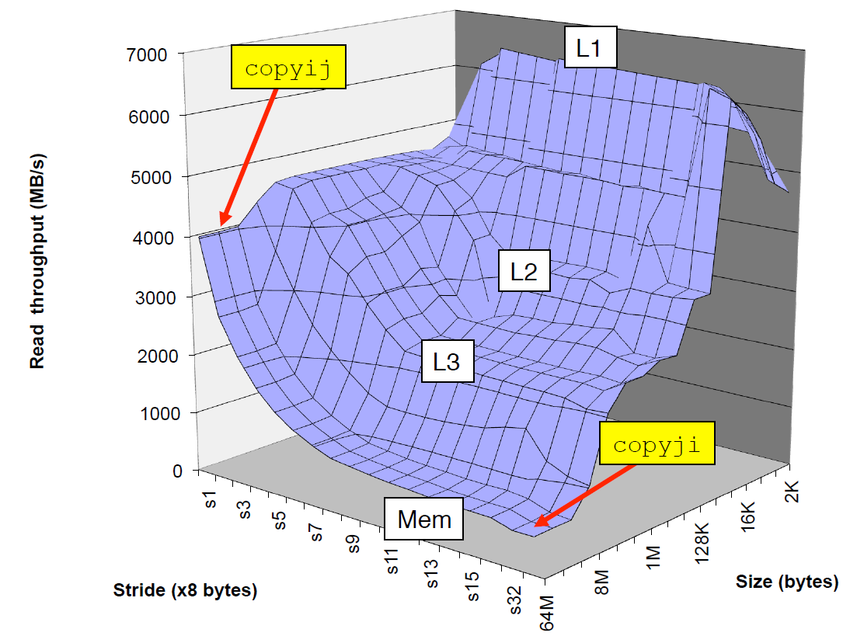
The Memory Mountain
ECNU
Intel Core i7
2.67 GHz
32 KB L1 d-cache
256 KB L2 cache
8 MB L3 cache

Slide 18
Great Reality #4: There’s more to performance than asymptotic complexity
ECNU
Constant factors matter too!
And even exact op count does not predict performance
  Easily see 10:1 performance range depending on how code written
  Must optimize at multiple levels: algorithm, data representations, procedures, and loops
Must understand system to optimize performance
  How programs compiled and executed
  How to measure program performance and identify bottlenecks
  How to improve performance without destroying code modularity and generality

Slide 19
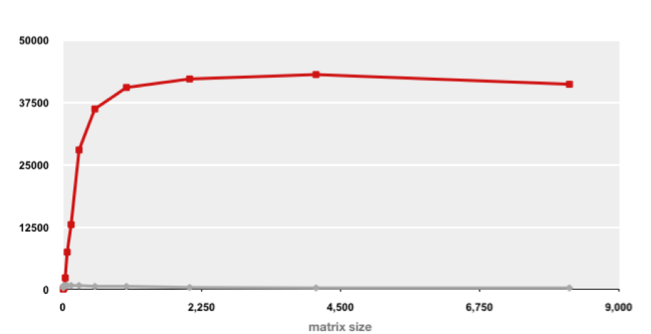
Example Matrix Multiplication
ECNU
Matrix-Matrix Multiplication (MMM) on 2 x Core 2 Duo 3 GHz (double precision)
Gflop/s
Best code (K. Goto)
160x
Triple loop
Standard desktop computer, vendor compiler, using optimization flags
Both implementations have exactly the same operations count (2n³)
What is going on?

Slide 20
Example Matrix Multiplication
ECNU
/* ijk */
for (i=0; i<n; i++) {
for (j=0; j<n; j++) {
sum = 0.0;
for (k=0; k<n; k++)
sum += a[i][k] * b[k][j];
c[i][j] = sum;
}
}
Inner loop:
(*,j)
(i,j)
(i,*)
A
B
C
Row-wise
Column-wise
Fixed
/* kij */
for (k=0; k<n; k++) {
for (i=0; i<n; i++) {
r = a[i][k];
for (j=0; j<n; j++)
c[i][j] += r * b[k][j];
}
}
Inner loop:
(i,k)
(k,*)
(i,*)
A
B
C
Best code (K. Goto)
Fixed
Row-wise
Row-wise

Slide 21
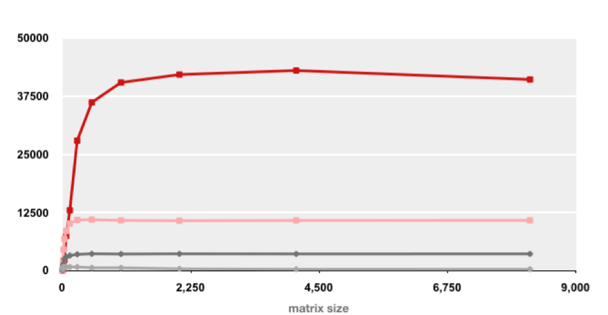
MMM Plot: Analysis
ECNU
Matrix-Matrix Multiplication (MMM) on 2 x Core 2 Duo 3 GHz
Gflop/s
Multiple threads: 4x
Vector instructions: 4x
Memory hierarchy and other optimizations: 20x
Reason for 20x: Blocking or tiling, loop unrolling, array scalarization, instruction scheduling, search to find best choice
Effect: fewer register spills, L1/L2 cache misses, and TLB misses

Slide 22
Great Reality #5:
Computers do more than execute programs
ECNU
They need to get data in and out
  I/O system critical to program reliability and performance
They communicate with each other over networks
  Many system-level issues arise in presence of network
    Concurrent operations by autonomous processes
    Coping with unreliable media
    Cross platform compatibility
    Complex performance issues

Slide 23
Role within SE Curriculum
ECNU
OS Practicum
Databases
Networks
Operating
Systems
Compilers
Digital
Computation
Organization
Embedded
Systems
Embedded
System Eng.
Data Reps.
Memory Model
Network
Protocols
Processes
Mem. Mgmt
Machine
Code
Arithmetic
Execution Model
Memory System
CS
Foundation of Computer Systems
Underlying principles for hardware,
software, and networking
C Programming

Slide 24
Course Perspective
ECNU
Most Systems Courses are Builder-Centric
  Computer Organization
    Design pipelined processor in Verilog
  Operating Systems
    Implement large portions of operating system
  Compilers
    Write compiler for simple language
  Networking
    Implement and simulate network protocols

Slide 25
Course Perspective (Cont.)
ECNU
Our Course is Programmer-Centric
  Purpose is to show how by knowing more about the underlying system, one can be more effective as a programmer
  Enable you to
    Write programs that are more reliable and efficient
    Incorporate features that require hooks into OS
      E.g., concurrency, signal handlers
  Not just a course for dedicated hackers
    We bring out the hidden hacker in everyone

Slide 26
Textbooks
ECNU
Randal E. Bryant and David R. O’Hallaron,
  “Computer Systems: A Programmer’s Perspective, Third Edition” , Prentice Hall, 2011(龚奕利 等译，深入理解计算机系统（第三版），机械工业出版社
Brian Kernighan and Dennis Ritchie,
  “The C Programming Language, Second Edition”, Prentice Hall （C语言程序设计（译文本），机械工业出版社，2004）
课件、资料下载
  http://pan.baidu.com/s/1pKxn9Sv

Slide 27
Course Components
ECNU
Lectures
  Higher level concepts
Recitations
  Applied concepts, important tools and skills for labs, clarification of lectures, exam coverage
Labs (6)
  The heart of the course
  1-2 weeks each
  Provide in-depth understanding of an aspect of systems
  Programming and measurement
  Work groups(You must work alone on all assignments)
  Labs: Email to the staff mailing list
  （ 孙菲菲： 841000934@qq.com 数学馆205（西））
Exams (1 + final)
  Test your understanding of concepts & mathematical principles

Slide 28
Cheating
ECNU
What is cheating?
  Sharing code: by copying, retyping, looking at, or supplying a file
  Coaching: helping your friend to write a lab, line by line
  Copying code from previous course or from elsewhere on WWW
What is NOT cheating?
  Explaining how to use systems or tools
  Helping others with high-level design issues
Penalty for cheating:
  Removal from course with failing grade
Detection of cheating:
  We do check

Slide 29
Other Rules of the Lecture Hall
ECNU
Laptops: permitted
Electronic communications: forbidden
  No email, instant messaging, cell phone calls, etc
Presence in lectures, recitations: voluntary, recommended

Slide 30
Programs and Data
ECNU
Topics
  Bits operations, arithmetic, assembly language programs
  Representation of C control and data structures
  Includes aspects of architecture and compilers
Assignments
  L1 (datalab): Manipulating bits
  L2 (bomblab): Defusing a binary bomb
  L3 (buflab): Hacking a buffer bomb

Slide 31
The Memory Hierarchy
ECNU
Topics
  Memory technology, memory hierarchy, caches, disks, locality
  Includes aspects of architecture and OS
Assignments
  L4 (cachelab): Building a cache simulator and optimizing for locality.
    Learn how to exploit locality in your programs.

Slide 32
Performance
ECNU
Topics
  Co-optimization (control and data), measuring time on a computer
  Includes aspects of architecture, compilers, and OS

Slide 33
Exceptional Control Flow
ECNU
Topics
  Hardware exceptions, processes, process control, Unix signals, nonlocal jumps
  Includes aspects of compilers, OS, and architecture
Assignments
  L5 (proclab): Writing puzzles using processes and signals.
    A first introduction to concurrency

Slide 34
Virtual Memory
ECNU
Topics
  Virtual memory, address translation, dynamic storage allocation
  Includes aspects of architecture and OS
Assignments
  L6 (malloclab): Writing your own malloc package
    Get a real feel for systems programming

Slide 35
Networking, and Concurrency*
ECNU
Topics
  High level and low-level I/O, network programming
  Internet services, Web servers
  concurrency, concurrent server design, threads
  I/O multiplexing with select
  Includes aspects of networking, OS, and architecture
Assignments
  L7 (proxylab): Writing your own Web proxy
    Learn network programming and more about concurrency and synchronization.

Slide 36
Lab Rationale
ECNU
Each lab has a well-defined goal such as solving a puzzle or winning a contest
Doing the lab should result in new skills and concepts
We try to use competition in a fun and healthy way

