Slide 1
Machine-Level Programming V:
Advanced Topics（3.9，3.10节）
Computer Systems
8th Lecture

Slide 2
Today
Memory Layout
Buffer Overflow
  Vulnerability
  Protection
Unions

Slide 3
x86-64 Linux Memory Layout
not drawn to scale
00007FFFFFFFFFFF
Stack
Stack
  Runtime stack (8MB limit)
  E. g., local variables
Heap
  Dynamically allocated as needed
  When call malloc(), calloc(), new()
Data
  Statically allocated data
  E.g., global vars, static vars, string constants
Text / Shared Libraries
  Executable machine instructions
  Read-only
8MB
Shared
Libraries
Heap
Data
Text
Hex Address
400000
000000

Slide 4
Memory Allocation Example
not drawn to scale
Stack
char big_array[1L<<24]; /* 16 MB */
char huge_array[1L<<31]; /* 2 GB */
int global = 0;
int useless() { return 0; }
int main ()
{
void *p1, *p2, *p3, *p4;
int local = 0;
p1 = malloc(1L << 28); /* 256 MB */
p2 = malloc(1L << 8); /* 256 B */
p3 = malloc(1L << 32); /* 4 GB */
p4 = malloc(1L << 8); /* 256 B */
/* Some print statements ... */
}
Shared
Libraries
Heap
Data
Text
Where does everything go?

Slide 5
x86-64 Example Addresses
not drawn to scale
00007F
Stack
address range ~2⁴⁷
Heap
local 0x00007ffe4d3be87c
p1 0x00007f7262a1e010
p3 0x00007f7162a1d010
p4 0x000000008359d120
p2 0x000000008359d010
big_array 0x0000000080601060
huge_array 0x0000000000601060
main() 0x000000000040060c
useless() 0x0000000000400590
Heap
Data
Text
000000

Slide 6
Today
Memory Layout
Buffer Overflow
  Vulnerability
  Protection
Unions

Slide 7
Recall: Memory Referencing Bug Example
typedef struct {
int a[2];
double d;
} struct_t;
double fun(int i) {
volatile struct_t s;
s.d = 3.14;
s.a[i] = 1073741824; /* Possibly out of bounds */
return s.d;
}
fun(0) ➙ 3.14
fun(1) ➙ 3.14
fun(2) ➙ 3.1399998664856
fun(3) ➙ 2.00000061035156
fun(4) ➙ 3.14
fun(6) ➙ Segmentation fault
  Result is system specific

Slide 8
Memory Referencing Bug Example
typedef struct {
int a[2];
double d;
} struct_t;
fun(0) ➙ 3.14
fun(1) ➙ 3.14
fun(2) ➙ 3.1399998664856
fun(3) ➙ 2.00000061035156
fun(4) ➙ 3.14
fun(6) ➙ Segmentation fault
Explanation:
Critical State | 6
? | 5
? | 4
d7 ... d4 | 3
d3 ... d0 | 2
a[1] | 1
a[0] | 0
Location accessed by fun(i)
struct_t

Slide 9
Such problems are a BIG deal
Generally called a “buffer overflow”
  when exceeding the memory size allocated for an array
Why a big deal?
  It’s the #1 technical cause of security vulnerabilities
    #1 overall cause is social engineering / user ignorance
Most common form
  Unchecked lengths on string inputs
  Particularly for bounded character arrays on the stack
    sometimes referred to as stack smashing

Slide 10
String Library Code
Implementation of Unix function gets()
  No way to specify limit on number of characters to read
Similar problems with other library functions
  strcpy, strcat: Copy strings of arbitrary length
  scanf, fscanf, sscanf, when given %s conversion specification
/* Get string from stdin */
char *gets(char *dest)
{
int c = getchar();
char *p = dest;
while (c != EOF && c != '\n') {
*p++ = c;
c = getchar();
}
*p = '\0';
return dest;
}

Slide 11
Vulnerable Buffer Code
/* Echo Line */
void echo()
{
char buf[4]; /* Way too small! */
gets(buf);
puts(buf);
}
btw, how big
is big enough?
void call_echo() {
echo();
}
unix>./bufdemo-nsp
Type a string:012345678901234567890123
012345678901234567890123
unix>./bufdemo-nsp
Type a string:0123456789012345678901234
Segmentation Fault

Slide 12
Buffer Overflow Disassembly
echo:
00000000004006cf <echo>:
4006cf: 48 83 ec 18 sub $0x18,%rsp
4006d3: 48 89 e7 mov %rsp,%rdi
4006d6: e8 a5 ff ff ff callq 400680 <gets>
4006db: 48 89 e7 mov %rsp,%rdi
4006de: e8 3d fe ff ff callq 400520 <puts@plt>
4006e3: 48 83 c4 18 add $0x18,%rsp
4006e7: c3 retq
call_echo:
4006e8: 48 83 ec 08 sub $0x8,%rsp
4006ec: b8 00 00 00 00 mov $0x0,%eax
4006f1: e8 d9 ff ff ff callq 4006cf <echo>
4006f6: 48 83 c4 08 add $0x8,%rsp
4006fa: c3 retq

Slide 13
Buffer Overflow Stack
Before call to gets
Stack Frame
for call_echo
/* Echo Line */
void echo()
{
char buf[4]; /* Way too small! */
gets(buf);
puts(buf);
}
Return Address
(8 bytes)
20 bytes unused
[3]
[2]
[1]
[0]
buf
%rsp
echo:
subq $24, %rsp
movq %rsp, %rdi
call gets
. . .

Slide 14
Buffer Overflow Stack Example
Before call to gets
void echo()
{
char buf[4];
gets(buf);
. . .
}
echo:
subq $24, %rsp
movq %rsp, %rdi
call gets
. . .
Stack Frame
for call_echo
00
00
00
00
Return Address
(8 bytes)
00
40
06
f6
20 bytes unused
call_echo:
. . .
4006f1: callq 4006cf <echo>
4006f6: add $0x8,%rsp
. . .
[3]
[2]
[1]
[0]
buf
%rsp

Slide 15
Buffer Overflow Stack Example #1
After call to gets
void echo()
{
char buf[4];
gets(buf);
. . .
}
echo:
subq $24, %rsp
movq %rsp, %rdi
call gets
. . .
Stack Frame
for call_echo
00
00
00
00
Return Address
(8 bytes)
00
40
06
f6
00
32
31
30
call_echo:
20 bytes unused
39
38
37
36
. . .
4006f1: callq 4006cf <echo>
4006f6: add $0x8,%rsp
. . .
35
34
33
32
31
30
39
38
37
36
35
34
33
32
31
30
buf
%rsp
unix>./bufdemo-nsp
Type a string:01234567890123456789012
01234567890123456789012
Overflowed buffer, but did not corrupt state

Slide 16
Buffer Overflow Stack Example #2
After call to gets
void echo()
{
char buf[4];
gets(buf);
. . .
}
echo:
subq $24, %rsp
movq %rsp, %rdi
call gets
. . .
Stack Frame
for call_echo
00
00
00
00
Return Address
(8 bytes)
00
40
00
34
33
32
31
30
call_echo:
20 bytes unused
39
38
37
36
. . .
4006f1: callq 4006cf <echo>
4006f6: add $0x8,%rsp
. . .
35
34
33
32
31
30
39
38
37
36
35
34
33
32
31
30
buf
%rsp
unix>./bufdemo-nsp
Type a string:0123456789012345678901234
Segmentation Fault
Overflowed buffer and corrupted return pointer

Slide 17
Buffer Overflow Stack Example #3
After call to gets
void echo()
{
char buf[4];
gets(buf);
. . .
}
echo:
subq $24, %rsp
movq %rsp, %rdi
call gets
. . .
Stack Frame
for call_echo
00
00
00
00
Return Address
(8 bytes)
00
40
06
00
33
32
31
30
call_echo:
20 bytes unused
39
38
37
36
. . .
4006f1: callq 4006cf <echo>
4006f6: add $0x8,%rsp
. . .
35
34
33
32
31
30
39
38
37
36
35
34
33
32
31
30
buf
%rsp
unix>./bufdemo-nsp
Type a string:012345678901234567890123
012345678901234567890123
Overflowed buffer, corrupted return pointer, but program seems to work!

Slide 18
Buffer Overflow Stack Example #3 Explained
After call to gets
Stack Frame
for call_echo
register_tm_clones:
. . .
400600: mov %rsp,%rbp
400603: mov %rax,%rdx
400606: shr $0x3f,%rdx
40060a: add %rdx,%rax
40060d: sar %rax
400610: jne 400614
400612: pop %rbp
400613: retq
00
00
00
00
Return Address
(8 bytes)
00
40
06
00
33
32
31
30
20 bytes unused
39
38
37
36
35
34
33
32
31
30
39
38
37
36
35
34
33
32
31
30
buf
%rsp
“Returns” to unrelated code
Lots of things happen, without modifying critical state
Eventually executes retq back to main

Slide 19
Code Injection Attacks
Stack after call to gets()
void P(){
Q();
...
}
P stack frame
return
address
A
B
pad
int Q() {
char buf[64];
gets(buf);
...
return ...;
}
data written
by gets()
exploit
code
Q stack frame
B
Input string contains byte representation of executable code
Overwrite return address A with address of buffer B
When Q executes ret, will jump to exploit code

Slide 20
Exploits Based on Buffer Overflows
Buffer overflow bugs can allow remote machines to execute arbitrary code on victim machines
Distressingly common in real progams
  Programmers keep making the same mistakes ☹
  Recent measures make these attacks much more difficult
Examples across the decades
  Original “Internet worm” (1988)
  “IM wars” (1999)
  Twilight hack on Wii (2000s)
  … and many, many more
You will learn some of the tricks in attacklab
  Hopefully to convince you to never leave such holes in your programs!!

Slide 21
Example: the original Internet worm (1988)
Exploited a few vulnerabilities to spread
  Early versions of the finger server (fingerd) used gets() to read the argument sent by the client:
    finger droh@cs.cmu.edu
  Worm attacked fingerd server by sending phony argument:
    finger “exploit-code padding new-return-address”
    exploit code: executed a root shell on the victim machine with a direct TCP connection to the attacker.
Once on a machine, scanned for other machines to attack
  invaded ~6000 computers in hours (10% of the Internet ☺ )
    see June 1989 article in Comm. of the ACM
  the young author of the worm was prosecuted…
  and CERT was formed… still homed at CMU

Slide 22
Example 2: IM War
July, 1999
  Microsoft launches MSN Messenger (instant messaging system).
  Messenger clients can access popular AOL Instant Messaging Service (AIM) servers
AIM
client
MSN
server
MSN
client
AIM
server
AIM
client

Slide 23
IM War (cont.)
August 1999
  Mysteriously, Messenger clients can no longer access AIM servers
  Microsoft and AOL begin the IM war:
    AOL changes server to disallow Messenger clients
    Microsoft makes changes to clients to defeat AOL changes
    At least 13 such skirmishes
  What was really happening?
    AOL had discovered a buffer overflow bug in their own AIM clients
    They exploited it to detect and block Microsoft: the exploit code returned a 4-byte signature (the bytes at some location in the AIM client) to server
    When Microsoft changed code to match signature, AOL changed signature location

Slide 24
Date: Wed, 11 Aug 1999 11:30:57 -0700 (PDT)
From: Phil Bucking <philbucking@yahoo.com>
Subject: AOL exploiting buffer overrun bug in their own software!
To: rms@pharlap.com
Mr. Smith,
I am writing you because I have discovered something that I think you
might find interesting because you are an Internet security expert with
experience in this area. I have also tried to contact AOL but received
no response.
I am a developer who has been working on a revolutionary new instant
messaging client that should be released later this year.
...
It appears that the AIM client has a buffer overrun bug. By itself
this might not be the end of the world, as MS surely has had its share.
But AOL is now *exploiting their own buffer overrun bug* to help in
its efforts to block MS Instant Messenger.
....
Since you have significant credibility with the press I hope that you
can use this information to help inform people that behind AOL's
friendly exterior they are nefariously compromising peoples' security.
Sincerely,
Phil Bucking
Founder, Bucking Consulting
philbucking@yahoo.com
It was later determined that this email originated from within Microsoft!

Slide 25
Aside: Worms and Viruses
Worm: A program that
  Can run by itself
  Can propagate a fully working version of itself to other computers
Virus: Code that
  Adds itself to other programs
  Does not run independently
Both are (usually) designed to spread among computers and to wreak havoc

Slide 26
OK, what to do about buffer overflow attacks
Avoid overflow vulnerabilities
Employ system-level protections
Have compiler use “stack canaries”
Lets talk about each…

Slide 27
1. Avoid Overflow Vulnerabilities in Code (!)
/* Echo Line */
void echo()
{
char buf[4]; /* Way too small! */
fgets(buf, 4, stdin);
puts(buf);
}
For example, use library routines that limit string lengths
  fgets instead of gets
  strncpy instead of strcpy
  Don’t use scanf with %s conversion specification
    Use fgets to read the string
    Or use %ns where n is a suitable integer

Slide 28
2. System-Level Protections can help
Randomized stack offsets
  At start of program, allocate random amount of space on stack
  Shifts stack addresses for entire program
  Makes it difficult for hacker to predict beginning of inserted code
  E.g.: 5 executions of memory allocation code
    Stack repositioned each time program executes
Stack base
Random
allocation
main
Application
Code
B?
pad
exploit
code
B?

Slide 29
2. System-Level Protections can help
Stack after call to gets()
Nonexecutable code segments
  In traditional x86, can mark region of memory as either “read-only” or “writeable”
    Can execute anything readable
  X86-64 added explicit “execute” permission
  Stack marked as non-executable
P stack frame
B
pad
data written
by gets()
exploit
code
Q stack frame
B
Any attempt to execute this code will fail

Slide 30
3. Stack Canaries can help
Idea
  Place special value (“canary”) on stack just beyond buffer
  Check for corruption before exiting function
GCC Implementation
  -fstack-protector
  Now the default (disabled earlier)
unix>./bufdemo-sp
Type a string:0123456
0123456
unix>./bufdemo-sp
Type a string:01234567
*** stack smashing detected ***

Slide 31
Protected Buffer Disassembly
echo:
40072f: sub $0x18,%rsp
400733: mov %fs:0x28,%rax
40073c: mov %rax,0x8(%rsp)
400741: xor %eax,%eax
400743: mov %rsp,%rdi
400746: callq 4006e0 <gets>
40074b: mov %rsp,%rdi
40074e: callq 400570 <puts@plt>
400753: mov 0x8(%rsp),%rax
400758: xor %fs:0x28,%rax
400761: je 400768 <echo+0x39>
400763: callq 400580 <__stack_chk_fail@plt>
400768: add $0x18,%rsp
40076c: retq

Slide 32
Setting Up Canary
Before call to gets
Stack Frame
for call_echo
/* Echo Line */
void echo()
{
char buf[4]; /* Way too small! */
gets(buf);
puts(buf);
}
Return Address
(8 bytes)
20 bytes unused
Canary
(8 bytes)
[3]
[2]
[1]
[0]
buf
%rsp
echo:
. . .
movq %fs:40, %rax # Get canary
movq %rax, 8(%rsp) # Place on stack
xorl %eax, %eax # Erase canary
. . .

Slide 33
Checking Canary
After call to gets
Before call to gets
/* Echo Line */
void echo()
{
char buf[4]; /* Way too small! */
gets(buf);
puts(buf);
}
Stack Frame
for call_echo
Stack Frame
for main
Return Address
(8 bytes)
Return Address
Saved %ebp
20 bytes unused
Saved %ebx
Canary
(8 bytes)
Canary
[3]
[2]
[1]
[0]
00
36
35
34
33
32
31
30
buf
%rsp
Input: 0123456
echo:
. . .
movq 8(%rsp), %rax # Retrieve from stack
xorq %fs:40, %rax # Compare to canary
je .L6 # If same, OK
call __stack_chk_fail # FAIL
.L6: . . .

Slide 34
Return-Oriented Programming Attacks
Challenge (for hackers)
  Stack randomization makes it hard to predict buffer location
  Marking stack nonexecutable makes it hard to insert binary code
Alternative Strategy
  Use existing code
    E.g., library code from stdlib
  String together fragments to achieve overall desired outcome
  Does not overcome stack canaries
Construct program from gadgets
  Sequence of instructions ending in ret
    Encoded by single byte 0xc3
  Code positions fixed from run to run
  Code is executable

Slide 35
Gadget Example #1
long ab_plus_c
(long a, long b, long c) {
return a*b + c;
}
00000000004004d0 <ab_plus_c>:
4004d0: 48 0f af fe imul %rsi,%rdi
4004d4: 48 8d 04 17 lea (%rdi,%rdx,1),%rax
4004d8: c3 retq
rax ← rdi + rdx
Gadget address = 0x4004d4
Use tail end of existing functions

Slide 36
Gadget Example #2
void setval(unsigned *p) {
*p = 3347663060u;
}
Encodes movq %rax, %rdi
<setval>:
4004d9: c7 07 d4 48 89 c7 movl $0xc78948d4,(%rdi)
4004df: c3 retq
rdi ← rax
Gadget address = 0x4004dc
Repurpose byte codes

Slide 37
ROP Execution
Stack
Gadget n code
c3
•
•
•
Gadget 2 code
c3
%rsp
Gadget 1 code
c3
Trigger with ret instruction
  Will start executing Gadget 1
Final ret in each gadget will start next one

Slide 38
Today
Memory Layout
Buffer Overflow
  Vulnerability
  Protection
Unions

Slide 39
Union Allocation
Allocate according to largest element
Can only use one field at a time
union U1 {
char c;
int i[2];
double v;
} *up;
 | c
 | i[0] |  |  |  | i[1]
 | v
up+0 |  |  | up+4 |  |  |  |  | up+8
struct S1 {
char c;
int i[2];
double v;
} *sp;
 | c | 3 bytes |  |  | i[0] |  |  |  | i[1] |  |  |  | 4 bytes |  |  | v
sp+0 |  |  |  | sp+4 |  |  |  | sp+8 |  |  |  |  |  |  | sp+16 |  |  |  |  |  | sp+24

Slide 40
Using Union to Access Bit Patterns
typedef union {
float f;
unsigned u;
} bit_float_t;
 | u
 | f
0 |  |  |  | 4
float bit2float(unsigned u) {
bit_float_t arg;
arg.u = u;
return arg.f;
}
unsigned float2bit(float f) {
bit_float_t arg;
arg.f = f;
return arg.u;
}
Same as (float) u ?
Same as (unsigned) f ?

Slide 41
Byte Ordering Revisited
Idea
  Short/long/quad words stored in memory as 2/4/8 consecutive bytes
  Which byte is most (least) significant?
  Can cause problems when exchanging binary data between machines
Big Endian
  Most significant byte has lowest address
  Sparc
Little Endian
  Least significant byte has lowest address
  Intel x86, ARM Android and IOS
Bi Endian
  Can be configured either way
  ARM

Slide 42
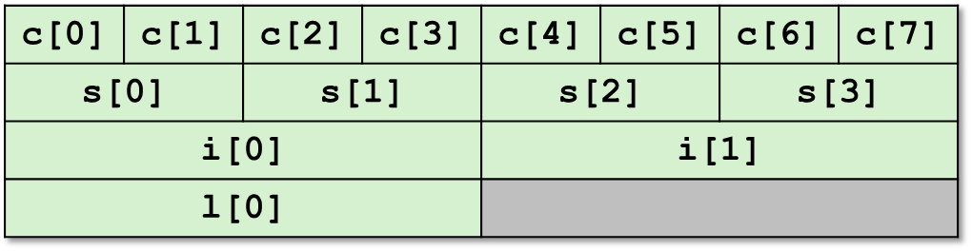
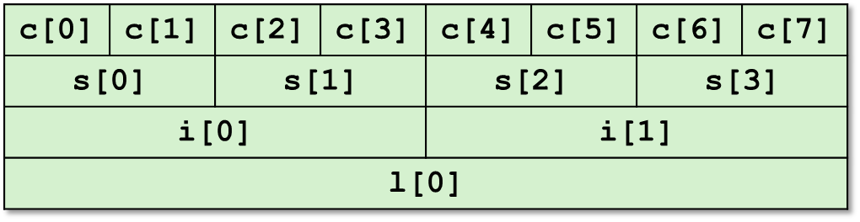
Byte Ordering Example
union {
unsigned char c[8];
unsigned short s[4];
unsigned int i[2];
unsigned long l[1];
} dw;
32-bit
64-bit

Slide 43
Byte Ordering Example (Cont).
int j;
for (j = 0; j < 8; j++)
dw.c[j] = 0xf0 + j;
printf("Characters 0-7 == [0x%x,0x%x,0x%x,0x%x,0x%x,0x%x,0x%x,0x%x]\n",
dw.c[0], dw.c[1], dw.c[2], dw.c[3],
dw.c[4], dw.c[5], dw.c[6], dw.c[7]);
printf("Shorts 0-3 == [0x%x,0x%x,0x%x,0x%x]\n",
dw.s[0], dw.s[1], dw.s[2], dw.s[3]);
printf("Ints 0-1 == [0x%x,0x%x]\n",
dw.i[0], dw.i[1]);
printf("Long 0 == [0x%lx]\n",
dw.l[0]);

Slide 44
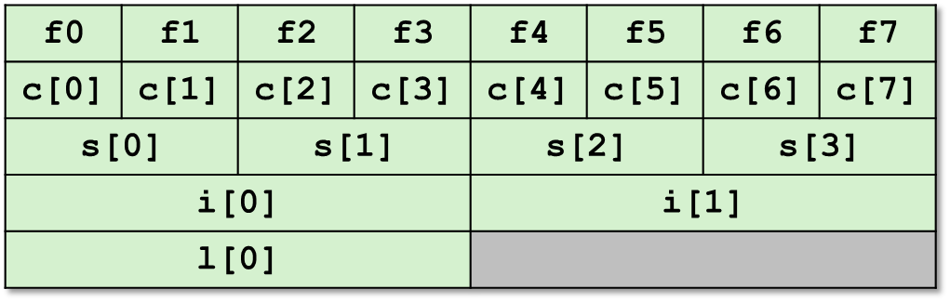
Byte Ordering on IA32
Little Endian
LSB
MSB
LSB
MSB
Print
Output:
Characters 0-7 == [0xf0,0xf1,0xf2,0xf3,0xf4,0xf5,0xf6,0xf7]
Shorts 0-3 == [0xf1f0,0xf3f2,0xf5f4,0xf7f6]
Ints 0-1 == [0xf3f2f1f0,0xf7f6f5f4]
Long 0 == [0xf3f2f1f0]

Slide 45
Byte Ordering on Sun
Big Endian
MSB
LSB
MSB
LSB
Print
Output on Sun:
Characters 0-7 == [0xf0,0xf1,0xf2,0xf3,0xf4,0xf5,0xf6,0xf7]
Shorts 0-3 == [0xf0f1,0xf2f3,0xf4f5,0xf6f7]
Ints 0-1 == [0xf0f1f2f3,0xf4f5f6f7]
Long 0 == [0xf0f1f2f3]

Slide 46
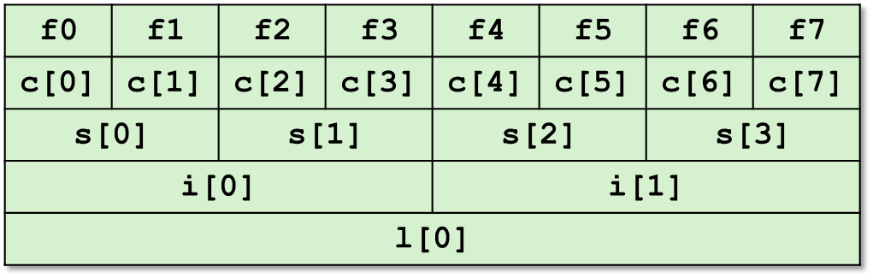
Byte Ordering on x86-64
Little Endian
LSB
MSB
Print
Output on x86-64:
Characters 0-7 == [0xf0,0xf1,0xf2,0xf3,0xf4,0xf5,0xf6,0xf7]
Shorts 0-3 == [0xf1f0,0xf3f2,0xf5f4,0xf7f6]
Ints 0-1 == [0xf3f2f1f0,0xf7f6f5f4]
Long 0 == [0xf7f6f5f4f3f2f1f0]

Slide 47
Summary of Compound Types in C
Arrays
  Contiguous allocation of memory
  Aligned to satisfy every element’s alignment requirement
  Pointer to first element
  No bounds checking
Structures
  Allocate bytes in order declared
  Pad in middle and at end to satisfy alignment
Unions
  Overlay declarations
  Way to circumvent type system

Slide 48
Homeworks
3.70
3.46（选做）

