Slide 1
Bits, Bytes, and Integers
Computer Systems
2nd Lecture

Slide 2
Today: Bits, Bytes, and Integers
Representing information as bits
Bit-level manipulations
Integers
  Representation: unsigned and signed
  Conversion, casting
  Expanding, truncating
  Addition, negation, multiplication, shifting
Summary

Slide 3
Binary Representations
0
1
0
3.3V
2.8V
0.5V
0.0V

Slide 4
Encoding Byte Values
Decimal
Hex
Binary
Byte = 8 bits
  Binary 000000002 to 111111112
  Decimal: 010 to 25510
  Hexadecimal 0016 to FF16
    Base 16 number representation
    Use characters ‘0’ to ‘9’ and ‘A’ to ‘F’
    Write FA1D37B16 in C as
      0xFA1D37B
      0xfa1d37b
0
0
0000
1
1
0001
2
2
0010
3
3
0011
4
4
0100
5
5
0101
6
6
0110
7
7
0111
8
8
1000
9
9
1001
A
10
1010
B
11
1011
C
12
1100
D
13
1101
E
14
1110
F
15
1111

Slide 5
Byte-Oriented Memory Organization
00•••0
FF•••F
• • •
Programs Refer to Virtual Addresses
  Conceptually very large array of bytes
  Actually implemented with hierarchy of different memory types
  System provides address space private to particular “process”
    Program being executed
    Program can clobber its own data, but not that of others
Compiler + Run-Time System Control Allocation
  Where different program objects should be stored
  All allocation within single virtual address space

Slide 6
Machine Words
Machine Has “Word Size”
  Nominal size of integer-valued data
    Including addresses
  Most current machines use 32 bits (4 bytes) words
    Limits addresses to 4GB
    Becoming too small for memory- intensive applications
  High-end systems use 64 bits (8 bytes) words
    Potential address space ≈ 1.8 X 10¹⁹ bytes
    x86-64 machines support 48-bit addresses: 256 Terabytes
  Machines support multiple data formats
    Fractions or multiples of word size
    Always integral number of bytes

Slide 7
Word-Oriented Memory Organization
32-bit
Words
64-bit
Words
Bytes
Addr.
Addresses Specify Byte Locations
  Address of first byte in word
  Addresses of successive words differ by 4 (32-bit) or 8 (64-bit)
0000
Addr
=
??
0001
0000
0002
Addr
=
??
0003
0000
0004
Addr
=
??
0005
0004
0006
0007
0008
Addr
=
??
0009
0008
0010
Addr
=
??
0011
0008
0012
Addr
=
??
0013
0012
0014
0015

Slide 8
Data Representations
C Data Type | Typical 32-bit | Intel IA32 | x86-64
char | 1 | 1 | 1
short | 2 | 2 | 2
int | 4 | 4 | 4
long | 4 | 4 | 8
long long | 8 | 8 | 8
float | 4 | 4 | 4
double | 8 | 8 | 8
long double | 8 | 10/12 | 10/16
pointer | 4 | 4 | 8

Slide 9
Byte Ordering
How should bytes within a multi-byte word be ordered in memory?
Conventions
  Big Endian: Sun, PPC Mac, Internet
    Least significant byte has highest address
  Little Endian: x86
    Least significant byte has lowest address

Slide 10
Byte Ordering Example
Big Endian
  Least significant byte has highest address
Little Endian
  Least significant byte has lowest address
Example
  Variable x has 4-byte representation 0x01234567
  Address given by &x is 0x100
Big Endian
0x100
0x101
0x102
0x103
01
23
45
67
01
23
45
67
Little Endian
0x100
0x101
0x102
0x103
67
45
23
01
67
45
23
01

Slide 11
Reading Byte-Reversed Listings
Disassembly
  Text representation of binary machine code
  Generated by program that reads the machine code
Example Fragment
Deciphering Numbers
  Value: 0x12ab
  Pad to 32 bits: 0x000012ab
  Split into bytes: 00 00 12 ab
  Reverse: ab 12 00 00
Address Instruction Code Assembly Rendition
8048365: 5b pop %ebx
8048366: 81 c3 ab 12 00 00 add $0x12ab,%ebx
804836c: 83 bb 28 00 00 00 00 cmpl $0x0,0x28(%ebx)

Slide 12
Examining Data Representations
Code to Print Byte Representation of Data
  Casting pointer to unsigned char * creates byte array
typedef unsigned char *pointer;
void show_bytes(pointer start, int len){
int i;
for (i = 0; i < len; i++)
printf(”%p\t0x%.2x\n",start+i, start[i]);
printf("\n");
}
Printf directives:
%p: Print pointer
%x: Print Hexadecimal

Slide 13
show_bytes Execution Example
int a = 15213;
printf("int a = 15213;\n");
show_bytes((pointer) &a, sizeof(int));
Result (Linux):
int a = 15213;
0x11ffffcb8 0x6d
0x11ffffcb9 0x3b
0x11ffffcba 0x00
0x11ffffcbb 0x00
15213₁₀=0x3b6d

Slide 14
Representing Integers
Decimal: 15213
Binary: 0011 1011 0110 1101
Hex: 3 B 6 D
int A = 15213;
long int C = 15213;
IA32, x86-64
Sun
IA32
x86-64
Sun
6D
00
3B
00
6D
6D
00
00
3B
3B
3B
00
00
6D
00
00
3B
00
00
6D
00
int B = -15213;
00
IA32, x86-64
Sun
00
00
93
FF
C4
FF
FF
C4
FF
93
Two’s complement representation
(Covered later)

Slide 15
Representing Pointers
int B = -15213;
int *P = &B;
Sun
IA32
x86-64
EF
FF
FB
2C
D4
F8
FF
BF
0C
89
EC
FF
FF
7F
00
00
Different compilers & machines assign different locations to objects

Slide 16
Representing Strings
char S[6] = "18243";
Strings in C
  Represented by array of characters
  Each character encoded in ASCII format
    Standard 7-bit encoding of character set
    Character “0” has code 0x30
      Digit i has code 0x30+i
  String should be null-terminated
    Final character = 0
Compatibility
  Byte ordering not an issue
Linux/Alpha
Sun
31
38
32
34
33
00
31
38
32
34
33
00

Slide 17
Today: Bits, Bytes, and Integers
Representing information as bits
Bit-level manipulations
Integers
  Representation: unsigned and signed
  Conversion, casting
  Expanding, truncating
  Addition, negation, multiplication, shifting
Summary

Slide 18
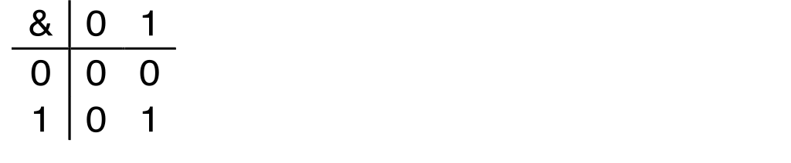
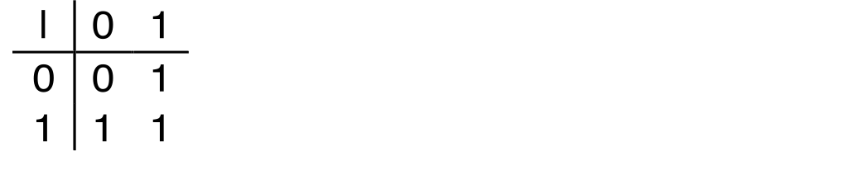
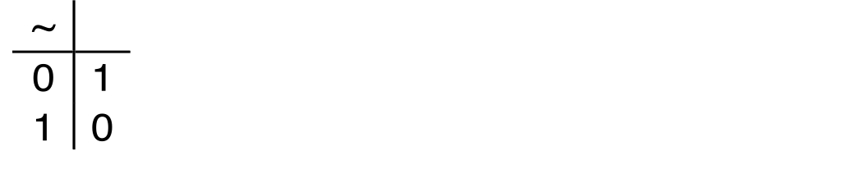
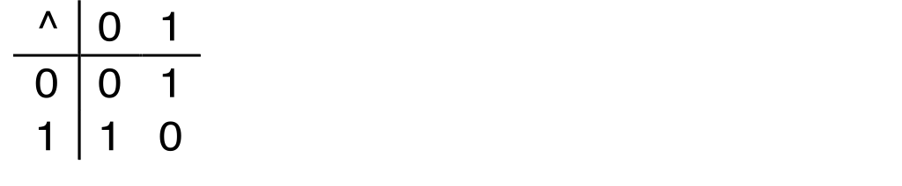
Boolean Algebra
Developed by George Boole in 19th Century
  Algebraic representation of logic
    Encode “True” as 1 and “False” as 0
And
A&B = 1 when both A=1 and B=1
Or
A|B = 1 when either A=1 or B=1
Not
~A = 1 when A=0
Exclusive-Or (Xor)
A^B = 1 when either A=1 or B=1, but not both

Slide 19
Application of Boolean Algebra
Applied to Digital Systems by Claude Shannon
  1937 MIT Master’s Thesis
  Reason about networks of relay switches
    Encode closed switch as 1, open switch as 0
A&~B
Connection when
A&~B | ~A&B
A
~B
~A
B
~A&B
= A^B

Slide 20
General Boolean Algebras
Operate on Bit Vectors
  Operations applied bitwise
All of the Properties of Boolean Algebra Apply
01101001
& 01010101
01000001
01101001
| 01010101
01111101
01101001
^ 01010101
00111100
~ 01010101
10101010
01000001
01111101
00111100
10101010

Slide 21
Representing & Manipulating Sets
Representation
  Width w bit vector represents subsets of {0, …, w–1}
  aj = 1 if j ∈ A
    集合A
    01010101 { 0, 2, 4, 6 }
    76543210
    集合B
    01101001 { 0, 3, 5, 6 }
    76543210
Operations
  & Intersection 01000001 { 0, 6 } A∩B
  | Union 01111101 { 0, 2, 3, 4, 5, 6 } AᴜB
  ^ Symmetric difference 00111100 { 2, 3, 4, 5 } （A-B）ᴜ（B-A）
  ~ Complement 10101010 { 1, 3, 5, 7 } ~A

Slide 22
Bit-Level Operations in C
Operations &, |, ~, ^ Available in C
  Apply to any “integral” data type
    long, int, short, char, unsigned
  View arguments as bit vectors
  Arguments applied bit-wise
Examples (Char data type)
  ~0x41 ➙ 0xBE
    ~010000012 ➙ 101111102
  ~0x00 ➙ 0xFF
    ~000000002 ➙ 111111112
  0x69 & 0x55 ➙ 0x41
    011010012 & 010101012 ➙ 010000012
  0x69 | 0x55 ➙ 0x7D
    011010012 | 010101012 ➙ 011111012

Slide 23
Contrast: Logic Operations in C
Contrast to Logical Operators
  &&, ||, !
    View 0 as “False”
    Anything nonzero as “True”
    Always return 0 or 1
    Early termination
Examples (char data type)
  !0x41 ➙ 0x00
  !0x00 ➙ 0x01
  !!0x41 ➙ 0x01
  0x69 && 0x55 ➙ 0x01
  0x69 || 0x55 ➙ 0x01
  p && *p++ (avoids null pointer access)

Slide 24
Shift Operations
Left Shift: x << y
  Shift bit-vector x left y positions
      Throw away extra bits on left
    Fill with 0’s on right
Right Shift: x >> y
  Shift bit-vector x right y positions
    Throw away extra bits on right
  Logical shift
    Fill with 0’s on left
  Arithmetic shift
    Replicate most significant bit on right
Undefined Behavior
  Shift amount < 0 or ≥ word size
Argument x
01100010
<< 3
00010000
00010000
00010000
Log. >> 2
00011000
00011000
00011000
Arith. >> 2
00011000
00011000
00011000
Argument x
10100010
<< 3
00010000
00010000
00010000
Log. >> 2
00101000
00101000
00101000
Arith. >> 2
11101000
11101000
11101000

Slide 25
Today: Bits, Bytes, and Integers
Representing information as bits
Bit-level manipulations
Integers
  Representation: unsigned and signed
  Conversion, casting
  Expanding, truncating
  Addition, negation, multiplication, shifting
Summary

Slide 26
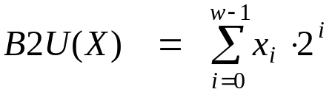
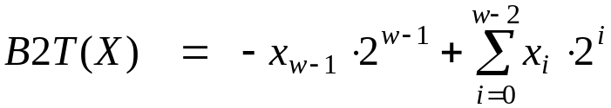
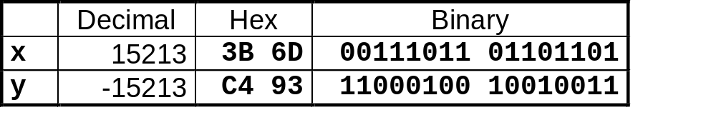
Encoding Integers
Unsigned
Two’s Complement
short int x = 15213;
short int y = -15213;
Sign
Bit
C short 2 bytes long
Sign Bit
  For 2’s complement, most significant bit indicates sign
    0 for nonnegative
    1 for negative

Slide 27
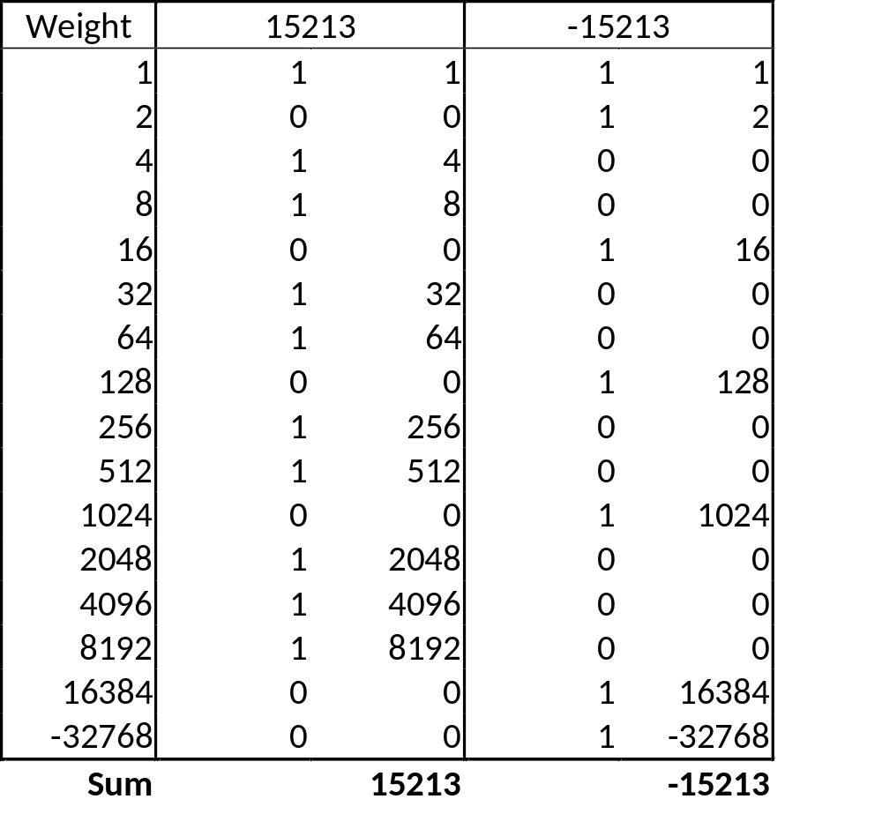
Encoding Example (Cont.)
x = 15213: 00111011 01101101
y = -15213: 11000100 10010011

Slide 28
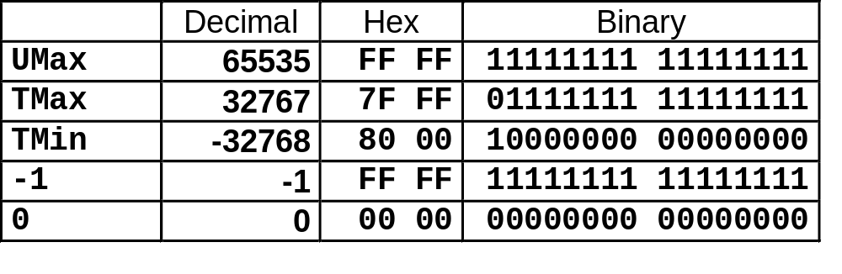
Numeric Ranges
Unsigned Values
  UMin = 0
    000…0
  UMax = 2^{w} – 1
    111…1
Two’s Complement Values
  TMin = –2^{w–1}
    100…0
  TMax = 2^{w–1} – 1
    011…1
Other Values
  -1
    111…1
Values for W = 16 bits

Slide 29
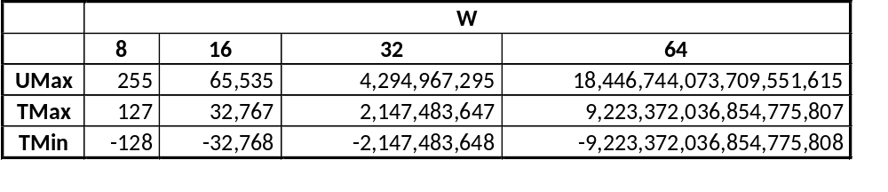
Values for Different Word Sizes
Observations
  |TMin | = TMax + 1
    Asymmetric range
  UMax = 2 * TMax + 1
C Programming
  #include <limits.h>
  Declares constants, e.g.,
    ULONG_MAX
    LONG_MAX
    LONG_MIN
  Values platform specific

Slide 30
Unsigned & Signed Numeric Values
Equivalence
  Same encodings for nonnegative values
Uniqueness
  Every bit pattern represents unique integer value
  Each representable integer has unique bit encoding
⇒ Can Invert Mappings
  U2B(x) = B2U⁻¹(x)
    Bit pattern for unsigned integer
  T2B(x) = B2T⁻¹(x)
    Bit pattern for two’s comp integer
X
B2U(X)
B2T(X)
0000
0
0
0001
1
1
0010
2
2
0011
3
3
0100
4
4
0101
5
5
0110
6
6
0111
7
7
1000
8
–8
1001
9
–7
1010
10
–6
1011
11
–5
1100
12
–4
1101
13
–3
1110
14
–2
1111
15
–1

Slide 31
Today: Bits, Bytes, and Integers
Representing information as bits
Bit-level manipulations
Integers
  Representation: unsigned and signed
  Conversion, casting
  Expanding, truncating
  Addition, negation, multiplication, shifting
Summary

Slide 32
Mapping Between Signed & Unsigned
Two’s Complement
Unsigned
T2U
x
T2B
B2U
ux
X
Maintain Same Bit Pattern
Unsigned
U2T
Two’s Complement
ux
U2B
B2T
x
X
Maintain Same Bit Pattern
Mappings between unsigned and two’s complement numbers:
keep bit representations and reinterpret

Slide 33
Mapping Signed ↔ Unsigned
Bits
0000
0001
0010
0011
0100
0101
0110
0111
1000
1001
1010
1011
1100
1101
1110
1111
Signed
0
1
2
3
4
5
6
7
-8
-7
-6
-5
-4
-3
-2
-1
Unsigned
0
1
2
3
4
5
6
7
8
9
10
11
12
13
14
15
T2U
U2T

Slide 34
Mapping Signed ↔ Unsigned
Bits
0000
0001
0010
0011
0100
0101
0110
0111
1000
1001
1010
1011
1100
1101
1110
1111
Signed
0
1
2
3
4
5
6
7
-8
-7
-6
-5
-4
-3
-2
-1
Unsigned
0
1
2
3
4
5
6
7
8
9
10
11
12
13
14
15
=
+/- 16

Slide 35


Relation between Signed & Unsigned
Two’s Complement
Unsigned
T2U
x
T2B
B2U
ux
X
Maintain Same Bit Pattern
w–1
0
ux
+
+
+
• • •
+
+
+
x
-
+
+
• • •
+
+
+
Large negative weight
becomes
Large positive weight

Slide 36
Conversion Visualized
2’s Comp. → Unsigned
  Ordering Inversion
  Negative → Big Positive
UMax
UMax – 1
TMax + 1
Unsigned
Range
TMax
TMax
2’s Complement Range
0
0
–1
–2
TMin

Slide 37
Signed vs. Unsigned in C
Constants
  By default are considered to be signed integers
  Unsigned if have “U” as suffix
    0U, 4294967259U
Casting
  Explicit casting between signed & unsigned same as U2T and T2U
    int tx, ty;
    unsigned ux, uy;
    tx = (int) ux;
    uy = (unsigned) ty;
  Implicit casting also occurs via assignments and procedure calls
    tx = ux;
    uy = ty;

Slide 38
Casting Surprises
Expression Evaluation
  If there is a mix of unsigned and signed in single expression,
  signed values implicitly cast to unsigned
  Including comparison operations <, >, ==, <=, >=
  Examples for W = 32: TMIN = -2,147,483,648 , TMAX = 2,147,483,647
Constant₁ Constant₂ Relation Evaluation
  0 0U
  -1 0
  -1 0U
  2147483647 -2147483647-1
  2147483647U -2147483647-1
  -1 -2
  (unsigned)-1 -2
  2147483647 2147483648U
  2147483647 (int) 2147483648U
  0 0U == unsigned
  -1 0 < signed
  -1 0U > unsigned
  2147483647 -2147483648 > signed
  2147483647U -2147483648 < unsigned
  -1 -2 > signed
  (unsigned) -1 -2 > unsigned
  2147483647 2147483648U < unsigned
  2147483647 (int) 2147483648U > signed

Slide 39
Code Security Example
/* Kernel memory region holding user-accessible data */
#define KSIZE 1024
char kbuf[KSIZE];
/* Copy at most maxlen bytes from kernel region to user buffer */
int copy_from_kernel(void *user_dest, int maxlen) {
/* Byte count len is minimum of buffer size and maxlen */
int len = KSIZE < maxlen ? KSIZE : maxlen;
memcpy(user_dest, kbuf, len);
return len;
}
Similar to code found in FreeBSD’s implementation of getpeername
There are legions of smart people trying to find vulnerabilities in programs

Slide 40
Typical Usage
/* Kernel memory region holding user-accessible data */
#define KSIZE 1024
char kbuf[KSIZE];
/* Copy at most maxlen bytes from kernel region to user buffer */
int copy_from_kernel(void *user_dest, int maxlen) {
/* Byte count len is minimum of buffer size and maxlen */
int len = KSIZE < maxlen ? KSIZE : maxlen;
memcpy(user_dest, kbuf, len);
return len;
}
#define MSIZE 528
void getstuff() {
char mybuf[MSIZE];
copy_from_kernel(mybuf, MSIZE);
printf(“%s\n”, mybuf);
}

Slide 41
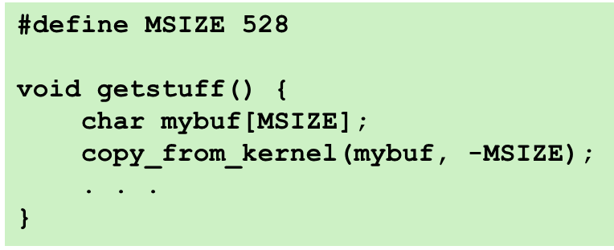
Malicious Usage
/* Declaration of library function memcpy */
void *memcpy(void *dest, void *src, size_t n);
/* Kernel memory region holding user-accessible data */
#define KSIZE 1024
char kbuf[KSIZE];
/* Copy at most maxlen bytes from kernel region to user buffer */
int copy_from_kernel(void *user_dest, int maxlen) {
/* Byte count len is minimum of buffer size and maxlen */
int len = KSIZE < maxlen ? KSIZE : maxlen;
memcpy(user_dest, kbuf, len);
return len;
}

Slide 42
Summary
Casting Signed ↔ Unsigned: Basic Rules
Bit pattern is maintained
But reinterpreted
Can have unexpected effects: adding or subtracting 2^{w}
Expression containing signed and unsigned int
  int is cast to unsigned!!

Slide 43
Today: Bits, Bytes, and Integers
Representing information as bits
Bit-level manipulations
Integers
  Representation: unsigned and signed
  Conversion, casting
  Expanding, truncating
  Addition, negation, multiplication, shifting
Summary

Slide 44
Sign Extension
Task:
  Given w-bit signed integer x
  Convert it to w+k-bit integer with same value
Rule:
  Make k copies of sign bit:
  X ′ = x_{w–1} ,…, x_{w–1} , x_{w–1} , x_{w–2} ,…, x₀
k copies of MSB
w
X
• • •
• • •
X ′
• • •
• • •
k
w

Slide 45
Sign Extension Example
short int x = 15213;
int ix = (int) x;
short int y = -15213;
int iy = (int) y;
Decimal
Hex
Binary
x
15213
3B 6D
00111011 01101101
ix
15213
00 00 3B 6D
00000000 00000000 00111011 01101101
y
-15213
C4 93
11000100 10010011
iy
-15213
FF FF C4 93
11111111 11111111 11000100 10010011
Converting from smaller to larger integer data type
C automatically performs sign extension

Slide 46
Summary:
Expanding, Truncating: Basic Rules
Expanding (e.g., short int to int)
  Unsigned: zeros added
  Signed: sign extension
  Both yield expected result
Truncating (e.g., unsigned int to unsigned short int)
  Unsigned/signed: bits are truncated
  Result reinterpreted
  Unsigned: mod operation
  Signed: similar to mod

Slide 47
Today: Bits, Bytes, and Integers
ECNU
Representing information as bits
Bit-level manipulations
Integers
  Representation: unsigned and signed
  Conversion, casting
  Expanding, truncating
  Addition, negation, multiplication, shifting
Summary

Slide 48
Negation: Complement & Increment
Claim: Following Holds for 2’s Complement
  ~x + 1 == -x
Complement
  Observation: ~x + x == 1111…111 == -1
Complete Proof?
x
1
0
0
1
1
1
0
1
+
~x
0
1
1
0
0
0
1
0
-1
1
1
1
1
1
1
1
1

Slide 49
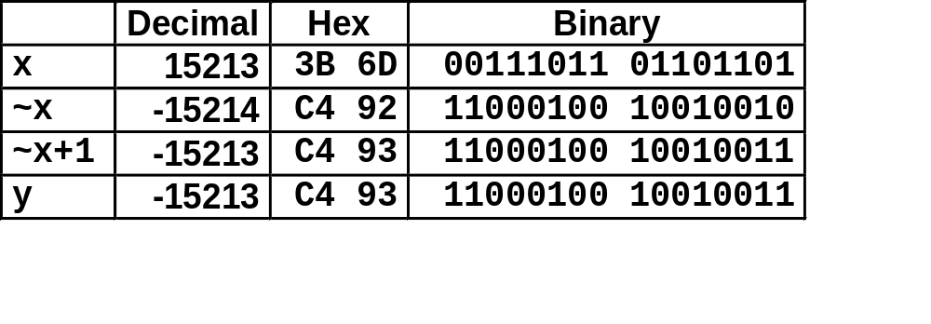
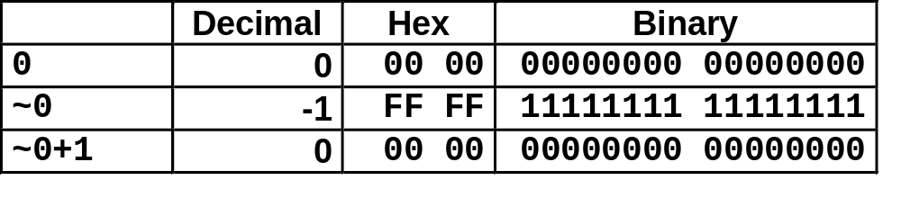
Complement & Increment Examples
x = 15213
x = 0

Slide 50

Unsigned Addition
u
Operands: w bits
• • •
+
v
• • •
True Sum: w+1 bits
u + v
• • •
Discard Carry: w bits
UAdd_{w}(u , v)
• • •
Standard Addition Function
  Ignores carry output
Implements Modular Arithmetic
  s = UAdd_{w}(u , v) = u + v mod 2^{w}

Slide 51
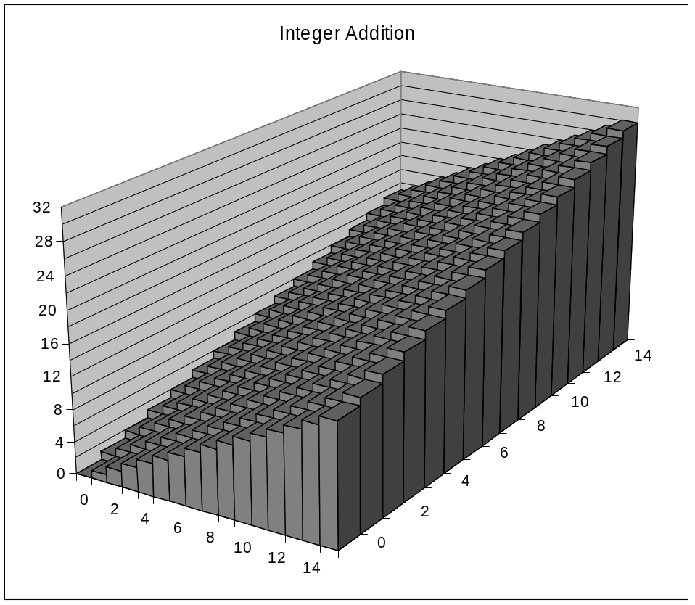
Visualizing (Mathematical) Integer Addition
Integer Addition
  4-bit integers u, v
  Compute true sum Add₄(u , v)
  Values increase linearly with u and v
  Forms planar surface
Add₄(u , v)
v
u

Slide 52
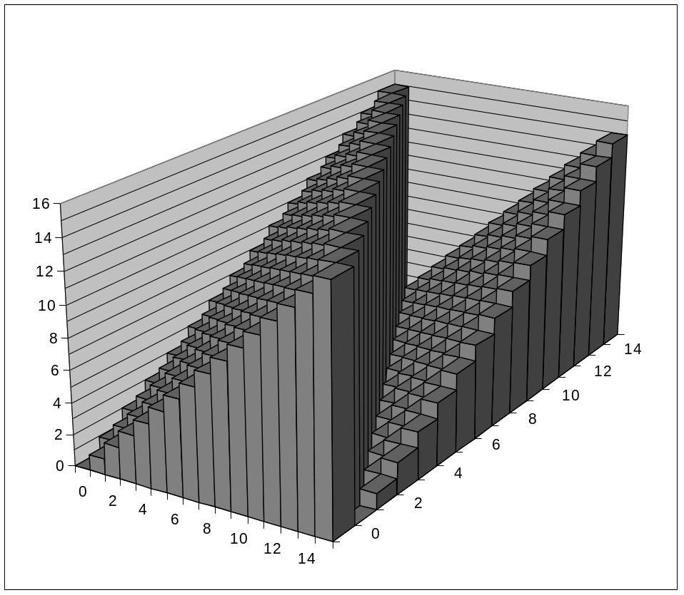
Visualizing Unsigned Addition
Wraps Around
  If true sum ≥ 2^{w}
  At most once
Overflow
UAdd₄(u , v)
True Sum
2^{w+1}
Overflow
2^{w}
v
0
Modular Sum
u

Slide 53
Mathematical Properties
Modular Addition Forms an Abelian Group（阿贝尔群）
  Closed under addition
    0 ≤ UAdd_{w}(u , v) ≤ 2^{w} –1
  Commutative
    UAdd_{w}(u , v) = UAdd_{w}(v , u)
  Associative
    UAdd_{w}(t, UAdd_{w}(u , v)) = UAdd_{w}(UAdd_{w}(t, u ), v)
  0 is additive identity
    UAdd_{w}(u , 0) = u
  Every element has additive inverse（加法逆元）
    Let UComp_{w} (u ) = 2^{w} – u u>0
    UComp_{w} (u ) = u u=0
    UAdd_{w}(u , UComp_{w} (u )) = 0

Slide 54
Two’s Complement Addition
Operands: w bits
u
• • •
+
v
• • •
True Sum: w+1 bits
u + v
• • •
Discard Carry: w bits
TAdd_{w}(u , v)
• • •
TAdd and UAdd have Identical Bit-Level Behavior
  Signed vs. unsigned addition in C:
  int s, t, u, v;
  s = (int) ((unsigned) u + (unsigned) v);
  t = u + v
  Will give s == t

Slide 55
TAdd Overflow
Functionality
  True sum requires w+1 bits
  Drop off MSB
  Treat remaining bits as 2’s comp. integer
True Sum
0 111…1
2^{w}–1
PosOver
TAdd Result
0 100…0
2^{w –1}
011…1
0 000…0
0
000…0
1 011…1
–2^{w –1}–1
100…0
1 000…0
–2^{w}
NegOver

Slide 56
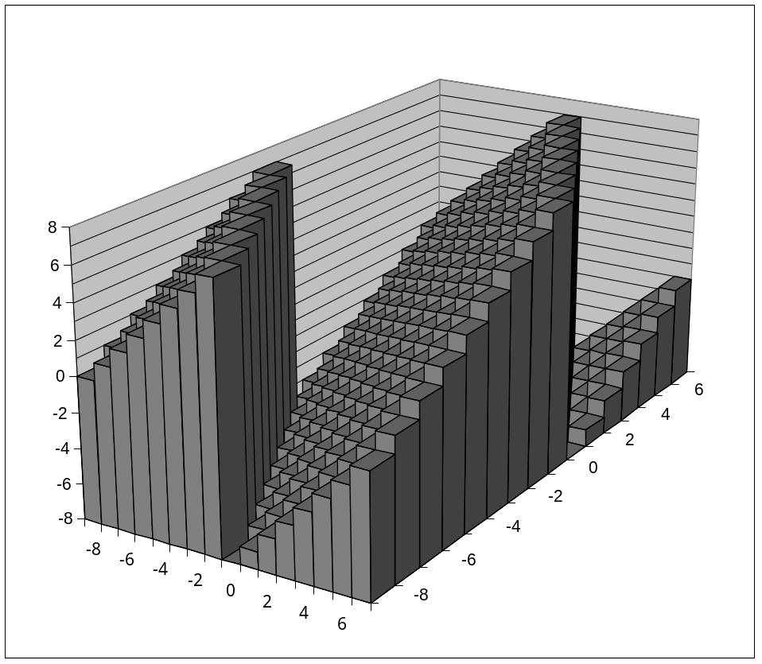
Visualizing 2’s Complement Addition
NegOver
Values
  4-bit two’s comp.
  Range from -8 to +7
Wraps Around
  If sum ≥ 2^{w–1}
    Becomes negative
    At most once
  If sum < –2^{w–1}
    Becomes positive
    At most once
TAdd₄(u , v)
v
u
PosOver

Slide 57

Characterizing TAdd
Positive Overflow
Functionality
  True sum requires w+1 bits
  Drop off MSB
  Treat remaining bits as 2’s comp. integer
TAdd(u , v)
> 0
v
< 0
< 0
> 0
u
Negative Overflow
2^{w}
(NegOver)
2^{w}
(PosOver)

Slide 58
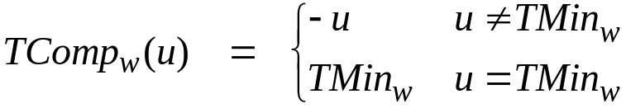
Mathematical Properties of TAdd
Isomorphic Group to unsigneds with UAdd
  TAdd_{w}(u , v) = U2T(UAdd_{w}(T2U(u ), T2U(v)))
    Since both have identical bit patterns
Two’s Complement Under TAdd Forms a Group
  Closed, Commutative, Associative, 0 is additive identity
  Every element has additive inverse

Slide 59
Multiplication
Computing Exact Product of w-bit numbers x, y
  Either signed or unsigned
Ranges
  Unsigned: 0 ≤ x * y ≤ (2^{w} – 1) ² = 2^{2w} – 2^{w+1} + 1
    Up to 2w bits
  Two’s complement min: x * y ≥ (–2^{w–1})*(2^{w–1}–1) = –2^{2w–2} + 2^{w–1}
    Up to 2w–1 bits
  Two’s complement max: x * y ≤ (–2^{w–1}) ² = 2^{2w–2}
    Up to 2w bits, but only for (TMin_{w})²
Maintaining Exact Results
  Would need to keep expanding word size with each product computed
  Done in software by “arbitrary precision” arithmetic packages

Slide 60
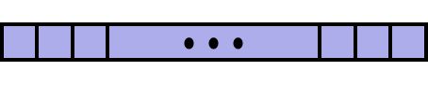
Unsigned Multiplication in C
u
• • •
Operands: w bits
*
v
• • •
True Product: 2*w bits
u · v
• • •
UMult_{w}(u , v)
Discard w bits: w bits
• • •
Standard Multiplication Function
  Ignores high order w bits
Implements Modular Arithmetic
  UMult_{w}(u , v) = u · v mod 2^{w}

Slide 61
Code Security Example #2
SUN XDR library
  Widely used library for transferring data between machines
void* copy_elements(void *ele_src[], int ele_cnt, size_t ele_size);
ele_src
malloc(ele_cnt * ele_size)

Slide 62
XDR Code
void* copy_elements(void *ele_src[], int ele_cnt, size_t ele_size) {
/*
* Allocate buffer for ele_cnt objects, each of ele_size bytes
* and copy from locations designated by ele_src
*/
void *result = malloc(ele_cnt * ele_size);
if (result == NULL)
/* malloc failed */
return NULL;
void *next = result;
int i;
for (i = 0; i < ele_cnt; i++) {
/* Copy object i to destination */
memcpy(next, ele_src[i], ele_size);
/* Move pointer to next memory region */
next += ele_size;
}
return result;
}

Slide 63
XDR Vulnerability
malloc(ele_cnt * ele_size)
What if:
  ele_cnt = 2²⁰ + 1
  ele_size = 4096 = 2¹²
  Allocation = ??
How can I make this function secure?(Practice Problem 2.37)

Slide 64
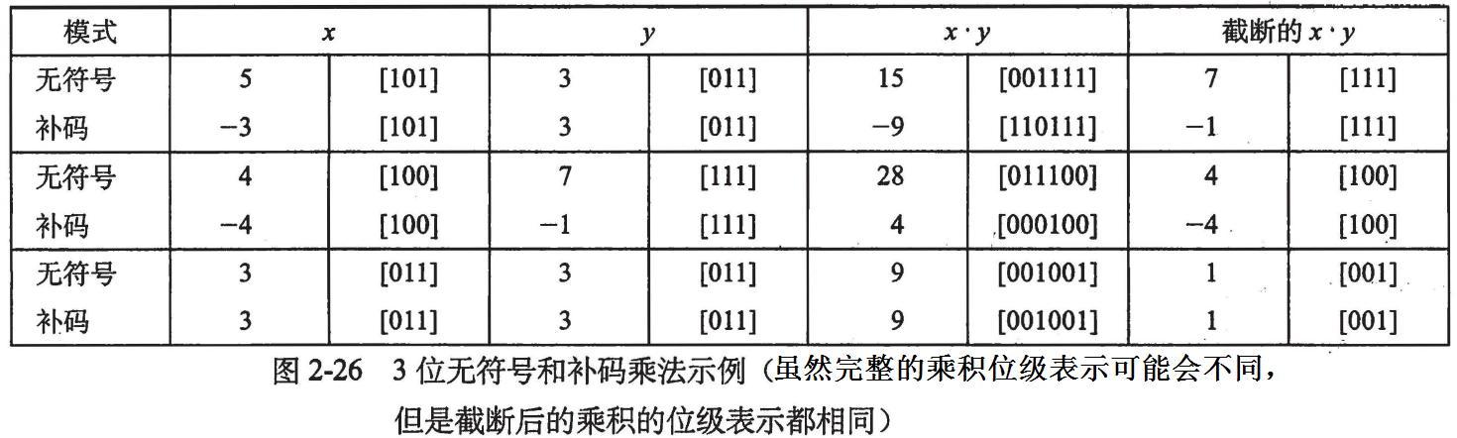
Signed Multiplication in C
u
• • •
Operands: w bits
*
v
• • •
True Product: 2*w bits
u · v
• • •
• • •
TMult_{w}(u , v)
Discard w bits: w bits
• • •
Standard Multiplication Function
  Ignores high order w bits
  Some of which are different for signed vs. unsigned multiplication
  Lower bits are the same

Slide 65
Power-of-2 Multiply with Shift
Operation
  u << k gives u * 2^{k}
  Both signed and unsigned
Examples
  u << 3 == u * 8
  u << 5 - u << 3 == u * 24
  Most machines shift and add faster than multiply
    Compiler generates this code automatically
k
u
• • •
Operands: w bits
*
2^{k}
0
•••
0
1
0
•••
0
0
True Product: w+k bits
u · 2^{k}
• • •
0
•••
0
0
Discard k bits: w bits
UMult_{w}(u , 2^{k})
•••
0
•••
0
0
TMult_{w}(u , 2^{k})

Slide 66
Compiled Multiplication Code
C Function
int mul12(int x)
{
return x*12;
}
Compiled Arithmetic Operations
Explanation
leal (%eax,%eax,2), %eax
sall $2, %eax
t <- x+x*2
return t << 2;
C compiler automatically generates shift/add code when multiplying by constant

Slide 67
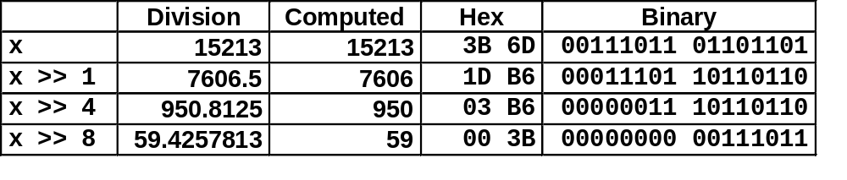
Unsigned Power-of-2 Divide with Shift
Quotient of Unsigned by Power of 2
  u >> k gives ⎣ u / 2^{k} ⎦
  Uses logical shift
k
u
•••
•••
Binary Point
Operands:
/
2^{k}
0
•••
0
1
0
•••
0
0
Division:
u / 2^{k}
0
.
0
•••
0
0
•••
•••
Result:
⎣ u / 2^{k} ⎦
0
0
•••
0
0
•••

Slide 68
Compiled Unsigned Division Code
C Function
unsigned udiv8(unsigned x)
{
return x/8;
}
Compiled Arithmetic Operations
Explanation
shrl $3, %eax
# Logical shift
return x >> 3;
Uses logical shift for unsigned
For Java Users
  Logical shift written as >>>

Slide 69
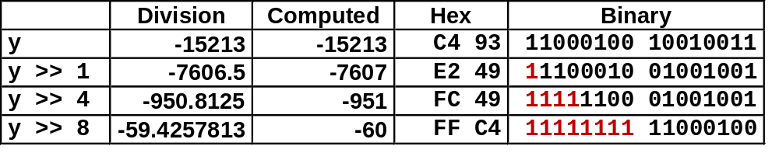
Signed Power-of-2 Divide with Shift
Quotient of Signed by Power of 2
  x >> k gives ⎣ x / 2^{k} ⎦
  Uses arithmetic shift
  Rounds wrong direction when u < 0
RoundDown：靠近零值向下舍入数字
k
x
•••
•••
Binary Point
Operands:
/
2^{k}
0
•••
0
1
0
•••
0
0
Division:
x / 2^{k}
0
•••
•••
.
•••
Result:
RoundDown(x / 2^{k})
0
•••
•••

Slide 70
Correct Power-of-2 Divide
Quotient of Negative Number by Power of 2
  Want ⎡ x / 2^{k} ⎤ (Round Toward 0)
  Compute as ⎣ (x+2^{k}-1)/ 2^{k} ⎦
    In C: (x + (1<<k)-1) >> k
    Biases dividend toward 0
Case 1: No rounding
k
Dividend:
u
1
•••
0
•••
0
0
+2^{k} –1
0
•••
0
0
1
•••
1
1
Binary Point
1
•••
1
•••
1
1
Divisor:
/
2^{k}
0
•••
0
1
0
•••
0
0
⎡ u / 2^{k} ⎤
0
.
1
•••
1
1
1
•••
1
•••
1
1
    Biasing has no effect

Slide 71
Correct Power-of-2 Divide (Cont.)
Case 2: Rounding
k
Dividend:
x
1
•••
•••
+2^{k} –1
0
•••
0
0
1
•••
1
1
1
•••
•••
Incremented by 1
Binary Point
Divisor:
/
2^{k}
0
•••
0
1
0
•••
0
0
⎡ x / 2^{k} ⎤
.
0
1
•••
1
1
1
•••
•••
Incremented by 1
    Biasing adds 1 to final result

Slide 72
Compiled Signed Division Code
C Function
int idiv8(int x)
{
return x/8;
}
Compiled Arithmetic Operations
Explanation
testl %eax, %eax
js L4
L3:
sarl $3, %eax
ret
L4:
addl $7, %eax
jmp L3
if x < 0
x += 7;
# Arithmetic shift
return x >> 3;
Uses arithmetic shift for int
For Java Users
  Arith. shift written as >>

Slide 73
Arithmetic: Basic Rules
Addition:
  Unsigned/signed: Normal addition followed by truncate,
  same operation on bit level
  Unsigned: addition mod 2^{w}
    Mathematical addition + possible subtraction of 2^{w}
  Signed: modified addition mod 2^{w} (result in proper range)
    Mathematical addition + possible addition or subtraction of 2^{w}
Multiplication:
  Unsigned/signed: Normal multiplication followed by truncate, same operation on bit level
  Unsigned: multiplication mod 2^{w}
  Signed: modified multiplication mod 2^{w} (result in proper range)

Slide 74
Arithmetic: Basic Rules
Unsigned ints, 2’s complement ints are isomorphic rings: isomorphism = casting
Left shift
  Unsigned/signed: multiplication by 2^{k}
  Always logical shift
Right shift
  Unsigned: logical shift, div (division + round to zero) by 2^{k}
  Signed: arithmetic shift
    Positive numbers: div (division + round to zero) by 2^{k}
    Negative numbers: div (division + round away from zero) by 2^{k}
    Use biasing to fix

Slide 75
Today: Integers
Representation: unsigned and signed
Conversion, casting
Expanding, truncating
Addition, negation, multiplication, shifting
Summary

Slide 76
Properties of Unsigned Arithmetic
Unsigned Multiplication with Addition Forms Commutative Ring
  Addition is commutative group
  Closed under multiplication
    0 ≤ UMult_{w}(u , v) ≤ 2^{w} –1
  Multiplication Commutative
    UMult_{w}(u , v) = UMult_{w}(v , u)
  Multiplication is Associative
    UMult_{w}(t, UMult_{w}(u , v)) = UMult_{w}(UMult_{w}(t, u ), v)
  1 is multiplicative identity
    UMult_{w}(u , 1) = u
  Multiplication distributes over addtion
    UMult_{w}(t, UAdd_{w}(u , v)) = UAdd_{w}(UMult_{w}(t, u ), UMult_{w}(t, v))

Slide 77
Properties of Two’s Comp. Arithmetic
Isomorphic Algebras
  Unsigned multiplication and addition
    Truncating to w bits
  Two’s complement multiplication and addition
    Truncating to w bits
Both Form Rings
  Isomorphic to ring of integers mod 2^{w}
Comparison to (Mathematical) Integer Arithmetic
  Both are rings
  Integers obey ordering properties, e.g.,
    u > 0 ⇒ u + v > v
    u > 0, v > 0 ⇒ u · v > 0
  These properties are not obeyed by two’s comp. arithmetic
    TMax + 1 == TMin
    15213 * 30426 == -10030 (16-bit words)

Slide 78
Why Should I Use Unsigned?
Don’t Use Just Because Number Nonnegative
  Easy to make mistakes
    unsigned i;
    for (i = cnt-2; i >= 0; i--)
    a[i] += a[i+1];
  Can be very subtle
    #define DELTA sizeof(int)
    int i;
    for (i = CNT; i-DELTA >= 0; i-= DELTA)
    . . .
Do Use When Performing Modular Arithmetic
  Multiprecision arithmetic
Do Use When Using Bits to Represent Sets
  Logical right shift, no sign extension

Slide 79
Homeworks
2.62, 2.67, 2.75, 2.82

