Slide 1
Machine-Level Programming V:
Advanced Topics
Computer Systems
8th Lecture

Slide 2
Today
Structures
  Alignment
Unions
Memory Layout
Buffer Overflow
  Vulnerability
  Protection

Slide 3
Structures & Alignment
Unaligned Data
Aligned Data
  Primitive data type requires K bytes
  Address must be multiple of K
struct S1 {
char c;
int i[2];
double v;
} *p;
c
i[0]
i[1]
v
p
p+1
p+5
p+9
p+17
c
3 bytes
i[0]
i[1]
4 bytes
v
p+0
p+4
p+8
p+16
p+24
Multiple of 4
Multiple of 8
Multiple of 8
Multiple of 8

Slide 4
Alignment Principles
Aligned Data
  Primitive data type requires K bytes
  Address must be multiple of K
  Required on some machines; advised on IA32
    treated differently by IA32 Linux, x86-64 Linux, and Windows!
Motivation for Aligning Data
  Memory accessed by (aligned) chunks of 4 or 8 bytes (system dependent)
    Inefficient to load or store datum that spans quad word boundaries
    Virtual memory very tricky when datum spans 2 pages
Compiler
  Inserts gaps in structure to ensure correct alignment of fields

Slide 5
Specific Cases of Alignment (IA32)
1 byte: char, …
  no restrictions on address
2 bytes: short, …
  lowest 1 bit of address must be 02
4 bytes: int, float, char *, …
  lowest 2 bits of address must be 002
8 bytes: double, …
  Windows (and most other OS’s & instruction sets):
    lowest 3 bits of address must be 0002
  Linux:
    lowest 2 bits of address must be 002
    i.e., treated the same as a 4-byte primitive data type
12 bytes: long double
  Windows, Linux:
    lowest 2 bits of address must be 002
    i.e., treated the same as a 4-byte primitive data type

Slide 6
Specific Cases of Alignment (x86-64)
1 byte: char, …
  no restrictions on address
2 bytes: short, …
  lowest 1 bit of address must be 02
4 bytes: int, float, …
  lowest 2 bits of address must be 002
8 bytes: double, char *, …
  Windows & Linux:
    lowest 3 bits of address must be 0002
16 bytes: long double
  Linux:
    lowest 3 bits of address must be 0002
    i.e., treated the same as a 8-byte primitive data type

Slide 7
Satisfying Alignment with Structures
Within structure:
  Must satisfy each element’s alignment requirement
Overall structure placement
  Each structure has alignment requirement K
    K = Largest alignment of any element
  Initial address & structure length must be multiples of K
Example (under Windows or x86-64):
  K = 8, due to double element
struct S1 {
char c;
int i[2];
double v;
} *p;
c
3 bytes
i[0]
i[1]
4 bytes
v
p+0
p+4
p+8
p+16
p+24
Multiple of 4
Multiple of 8
Multiple of 8
Multiple of 8

Slide 8
Different Alignment Conventions
struct S1 {
char c;
int i[2];
double v;
} *p;
x86-64 or IA32 Windows:
  K = 8, due to double element
IA32 Linux
  K = 4; double treated like a 4-byte data type
 | c | 3 bytes |  |  | i[0] |  |  |  | i[1] |  |  |  | 4 bytes |  |  |  | v
p+0 |  |  |  | p+4 |  |  |  | p+8 |  |  |  |  |  |  |  | p+16 |  |  |  |  |  |  |  | p+24
 | c | 3 bytes |  |  | i[0] |  |  |  | i[1] |  |  |  | v
p+0 |  |  |  | p+4 |  |  |  | p+8 |  |  |  | p+12 |  |  |  |  |  |  | p+20

Slide 9
Meeting Overall Alignment Requirement
For largest alignment requirement K
Overall structure must be multiple of K
struct S2 {
double v;
int i[2];
char c;
} *p;
 | v |  |  |  |  |  |  | i[0] |  |  |  | i[1] |  |  |  | c | 7 bytes
p+0 |  |  |  |  |  |  | p+8 |  |  |  |  |  |  |  | p+16 |  |  |  |  |  |  |  | p+24

Slide 10
Arrays of Structures
struct S2 {
double v;
int i[2];
char c;
} a[10];
Overall structure length multiple of K
Satisfy alignment requirement
for every element
 | a[0] |  |  |  |  | a[1] |  |  |  |  | a[2] |  |  |  |  | • • •
a+0 |  |  |  |  | a+24 |  |  |  |  | a+48 |  |  |  |  | a+72
 | v |  |  |  |  |  |  | i[0] |  |  |  | i[1] |  |  |  | c | 7 bytes
a+24 |  |  |  |  |  |  | a+32 |  |  |  |  |  |  |  | a+40 |  |  |  |  |  |  |  | a+48

Slide 11
Accessing Array Elements
struct S3 {
short i;
float v;
short j;
} a[10];
Compute array offset 12i
  sizeof(S3), including alignment spacers
Element j is at offset 8 within structure
Assembler gives offset a+8
  Resolved during linking
 | a[0] |  |  |  |  | • • • |  |  |  | a[i] |  |  |  | • • |  |  | •
a+0 |  |  |  |  | a+12 |  |  |  | a+12i
 |  |  |  |  |  | i |  | 2 bytes |  | v |  |  |  | j |  | 2 bytes
 |  |  |  |  | a+12i |  |  |  |  |  |  |  | a+12i+8
short get_j(int idx)
{
return a[idx].j;
}
# %eax = idx
leal (%eax,%eax,2),%eax # 3*idx
movswl a+8(,%eax,4),%eax

Slide 12
Saving Space
Put large data types first
Effect (K=4)
struct S4 {
char c;
int i;
char d;
} *p;
struct S5 {
int i;
char c;
char d;
} *p;
c
3 bytes
i
d
3 bytes
i
c
d
2 bytes

Slide 13
Today
Structures
  Alignment
Unions
Memory Layout
Buffer Overflow
  Vulnerability
  Protection

Slide 14
Union Allocation
Allocate according to largest element
Can only use one field at a time
union U1 {
char c;
int i[2];
double v;
} *up;
 | c
 | i[0] |  |  |  | i[1]
 | v
up+0 |  |  | up+4 |  |  |  |  | up+8
struct S1 {
char c;
int i[2];
double v;
} *sp;
 | c | 3 bytes |  |  | i[0] |  |  |  | i[1] |  |  |  | 4 bytes |  |  | v
sp+0 |  |  |  | sp+4 |  |  |  | sp+8 |  |  |  |  |  |  | sp+16 |  |  |  |  |  | sp+24

Slide 15
Using Union to Access Bit Patterns
typedef union {
float f;
unsigned u;
} bit_float_t;
 | u
 | f
0 |  |  |  | 4
float bit2float(unsigned u) {
bit_float_t arg;
arg.u = u;
return arg.f;
}
unsigned float2bit(float f) {
bit_float_t arg;
arg.f = f;
return arg.u;
}
Same as (float) u ?
Same as (unsigned) f ?

Slide 16
Byte Ordering Revisited
Idea
  Short/long/quad words stored in memory as 2/4/8 consecutive bytes
  Which is most (least) significant?
  Can cause problems when exchanging binary data between machines
Big Endian
  Most significant byte has lowest address
  Sparc
Little Endian
  Least significant byte has lowest address
  Intel x86

Slide 17
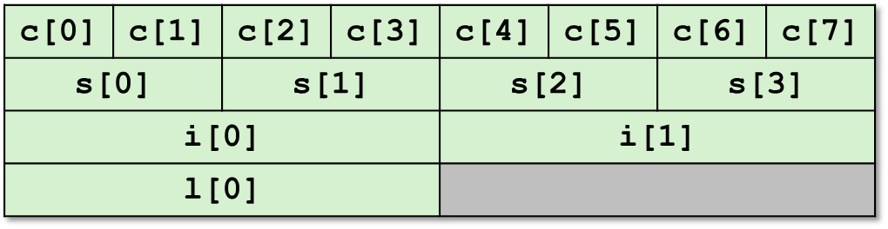
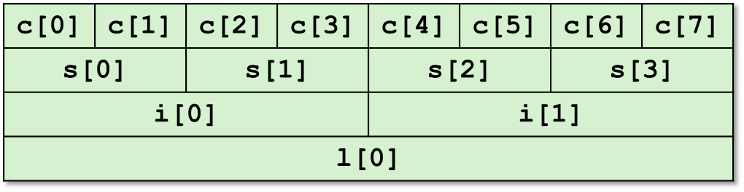
Byte Ordering Example
union {
unsigned char c[8];
unsigned short s[4];
unsigned int i[2];
unsigned long l[1];
} dw;
32-bit
64-bit

Slide 18
Byte Ordering Example (Cont).
int j;
for (j = 0; j < 8; j++)
dw.c[j] = 0xf0 + j;
printf("Characters 0-7 == [0x%x,0x%x,0x%x,0x%x,0x%x,0x%x,0x%x,0x%x]\n",
dw.c[0], dw.c[1], dw.c[2], dw.c[3],
dw.c[4], dw.c[5], dw.c[6], dw.c[7]);
printf("Shorts 0-3 == [0x%x,0x%x,0x%x,0x%x]\n",
dw.s[0], dw.s[1], dw.s[2], dw.s[3]);
printf("Ints 0-1 == [0x%x,0x%x]\n",
dw.i[0], dw.i[1]);
printf("Long 0 == [0x%lx]\n",
dw.l[0]);

Slide 19
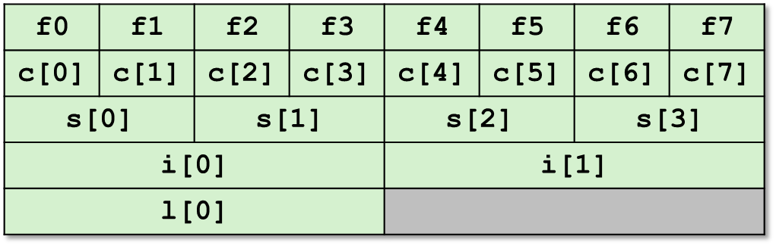
Byte Ordering on IA32
Little Endian
LSB
MSB
LSB
MSB
Print
Output:
Characters 0-7 == [0xf0,0xf1,0xf2,0xf3,0xf4,0xf5,0xf6,0xf7]
Shorts 0-3 == [0xf1f0,0xf3f2,0xf5f4,0xf7f6]
Ints 0-1 == [0xf3f2f1f0,0xf7f6f5f4]
Long 0 == [0xf3f2f1f0]

Slide 20
Byte Ordering on Sun
Big Endian
MSB
LSB
MSB
LSB
Print
Output on Sun:
Characters 0-7 == [0xf0,0xf1,0xf2,0xf3,0xf4,0xf5,0xf6,0xf7]
Shorts 0-3 == [0xf0f1,0xf2f3,0xf4f5,0xf6f7]
Ints 0-1 == [0xf0f1f2f3,0xf4f5f6f7]
Long 0 == [0xf0f1f2f3]

Slide 21
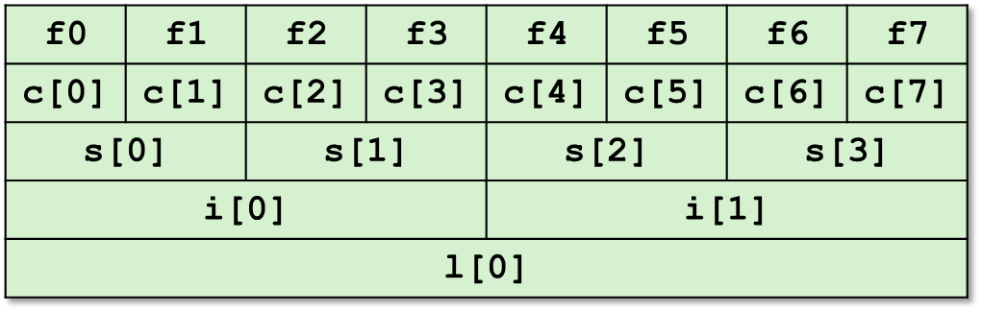
Byte Ordering on x86-64
Little Endian
LSB
MSB
Print
Output on x86-64:
Characters 0-7 == [0xf0,0xf1,0xf2,0xf3,0xf4,0xf5,0xf6,0xf7]
Shorts 0-3 == [0xf1f0,0xf3f2,0xf5f4,0xf7f6]
Ints 0-1 == [0xf3f2f1f0,0xf7f6f5f4]
Long 0 == [0xf7f6f5f4f3f2f1f0]

Slide 22
Summary
Arrays in C
  Contiguous allocation of memory
  Aligned to satisfy every element’s alignment requirement
  Pointer to first element
  No bounds checking
Structures
  Allocate bytes in order declared
  Pad in middle and at end to satisfy alignment
Unions
  Overlay declarations
  Way to circumvent type system

Slide 23
Today
Structures
  Alignment
Unions
Memory Layout
Buffer Overflow
  Vulnerability
  Protection

Slide 24
IA32 Linux Memory Layout
not drawn to scale
FF
Stack
Stack
  Runtime stack (8MB limit)
  E. g., local variables
Heap
  Dynamically allocated storage
  When call malloc(), calloc(), new()
Data
  Statically allocated data
  E.g., arrays & strings declared in code
Text
  Executable machine instructions
  Read-only
8MB
Heap
Data
Upper 2 hex digits
= 8 bits of address
Text
08
00

Slide 25
Memory Allocation Example
not drawn to scale
FF
Stack
char big_array[1<<24]; /* 16 MB */
char huge_array[1<<28]; /* 256 MB */
int beyond;
char *p1, *p2, *p3, *p4;
int useless() { return 0; }
int main()
{
p1 = malloc(1 <<28); /* 256 MB */
p2 = malloc(1 << 8); /* 256 B */
p3 = malloc(1 <<28); /* 256 MB */
p4 = malloc(1 << 8); /* 256 B */
/* Some print statements ... */
}
Heap
Data
Where does everything go?
Text
08
00

Slide 26
IA32 Example Addresses
not drawn to scale
FF
Stack
address range ~2³²
$esp 0xffffbcd0
p3 0x65586008
p1 0x55585008
p4 0x1904a110
p2 0x1904a008
&p2 0x18049760
&beyond 0x08049744
big_array 0x18049780
huge_array 0x08049760
main() 0x080483c6
useless() 0x08049744
final malloc() 0x006be166
80
Heap
Data
malloc() is dynamically linked
address determined at runtime
Text
08
00

Slide 27
x86-64 Example Addresses
not drawn to scale
00007F
Stack
address range ~2⁴⁷
$rsp 0x00007ffffff8d1f8
p3 0x00002aaabaadd010
p1 0x00002aaaaaadc010
p4 0x0000000011501120
p2 0x0000000011501010
&p2 0x0000000010500a60
&beyond 0x0000000000500a44
big_array 0x0000000010500a80
huge_array 0x0000000000500a50
main() 0x0000000000400510
useless() 0x0000000000400500
final malloc() 0x000000386ae6a170
000030
Heap
Data
malloc() is dynamically linked
address determined at runtime
Text
000000

Slide 28
Today
Structures
  Alignment
Unions
Memory Layout
Buffer Overflow
  Vulnerability
  Protection

Slide 29
Internet Worm and IM War
November, 1988
  Internet Worm attacks thousands of Internet hosts.
  How did it happen?

Slide 30
Internet Worm and IM War
November, 1988
  Internet Worm attacks thousands of Internet hosts.
  How did it happen?
July, 1999
  Microsoft launches MSN Messenger (instant messaging system).
  Messenger clients can access popular AOL Instant Messaging Service (AIM) servers
AIM
client
MSN
server
MSN
client
AIM
server
AIM
client

Slide 31
Internet Worm and IM War (cont.)
August 1999
  Mysteriously, Messenger clients can no longer access AIM servers.
  Microsoft and AOL begin the IM war:
    AOL changes server to disallow Messenger clients
    Microsoft makes changes to clients to defeat AOL changes.
    At least 13 such skirmishes.
  How did it happen?
The Internet Worm and AOL/Microsoft War were both based on stack buffer overflow exploits!
    many library functions do not check argument sizes.
    allows target buffers to overflow.

Slide 32
String Library Code
Implementation of Unix function gets()
  No way to specify limit on number of characters to read
Similar problems with other library functions
  strcpy, strcat: Copy strings of arbitrary length
  scanf, fscanf, sscanf, when given %s conversion specification
/* Get string from stdin */
char *gets(char *dest)
{
int c = getchar();
char *p = dest;
while (c != EOF && c != '\n') {
*p++ = c;
c = getchar();
}
*p = '\0';
return dest;
}

Slide 33
Vulnerable Buffer Code
/* Echo Line */
void echo()
{
char buf[4]; /* Way too small! */
gets(buf);
puts(buf);
}
void call_echo() {
echo();
}
unix>./bufdemo
Type a string:1234567
1234567
unix>./bufdemo
Type a string:12345678
Segmentation Fault
unix>./bufdemo
Type a string:123456789ABC
Segmentation Fault

Slide 34
Buffer Overflow Disassembly
echo:
80485c5: 55 push %ebp
80485c6: 89 e5 mov %esp,%ebp
80485c8: 53 push %ebx
80485c9: 83 ec 14 sub $0x14,%esp
80485cc: 8d 5d f8 lea 0xfffffff8(%ebp),%ebx
80485cf: 89 1c 24 mov %ebx,(%esp)
80485d2: e8 9e ff ff ff call 8048575 <gets>
80485d7: 89 1c 24 mov %ebx,(%esp)
80485da: e8 05 fe ff ff call 80483e4 <puts@plt>
80485df: 83 c4 14 add $0x14,%esp
80485e2: 5b pop %ebx
80485e3: 5d pop %ebp
80485e4: c3 ret
call_echo:
80485eb: e8 d5 ff ff ff call 80485c5 <echo>
80485f0: c9 leave
80485f1: c3 ret

Slide 35
Buffer Overflow Stack
Before call to gets
Stack Frame
for main
/* Echo Line */
void echo()
{
char buf[4]; /* Way too small! */
gets(buf);
puts(buf);
}
Return Address
Saved %ebp
%ebp
Stack Frame
for echo
Saved %ebx
[3]
[2]
[1]
[0]
buf
echo:
pushl %ebp # Save %ebp on stack
movl %esp, %ebp
pushl %ebx # Save %ebx
subl $20, %esp # Allocate stack space
leal -8(%ebp),%ebx # Compute buf as %ebp-8
movl %ebx, (%esp) # Push buf on stack
call gets # Call gets
. . .

Slide 36
Buffer Overflow Stack Example
unix> gdb bufdemo
(gdb) break echo
Breakpoint 1 at 0x80485c9
(gdb) run
Breakpoint 1, 0x80485c9 in echo ()
(gdb) print /x $ebp
$1 = 0xffffd678
(gdb) print /x *(unsigned *)$ebp
$2 = 0xffffd688
(gdb) print /x *((unsigned *)$ebp + 1)
$3 = 0x80485f0
Before call to gets
Before call to gets
Stack Frame
for main
Stack Frame
for main
0xffffd688
Return Address
08
04
85
f0
Saved %ebp
ff
ff
d6
88
0xffffd678
Stack Frame
for echo
Saved %ebx
Stack Frame
for echo
Saved %ebx
[3]
[2]
[1]
[0]
buf
xx
xx
xx
xx
buf
80485eb: e8 d5 ff ff ff call 80485c5 <echo>
80485f0: c9 leave

Slide 37
Buffer Overflow Example #1
Before call to gets
Input 1234567
Stack Frame
for main
0xffffd688
Stack Frame
for main
0xffffd688
08
04
85
f0
08
04
85
f0
ff
ff
d6
88
0xffffd678
ff
ff
d6
88
0xffffd678
Stack Frame
for echo
Saved %ebx
Stack Frame
for echo
00
37
36
35
xx
xx
xx
xx
buf
34
33
32
31
buf
Overflow buf, and corrupt %ebx,
but no problem

Slide 38
Buffer Overflow Example #2
Before call to gets
Input 12345678
Stack Frame
for main
0xffffd688
Stack Frame
for main
0xffffd688
08
04
85
f0
08
04
85
f0
ff
ff
d6
88
0xffffd678
ff
ff
d6
00
0xffffd678
Saved %ebx
Stack Frame
for echo
Stack Frame
for echo
38
37
36
35
xx
xx
xx
xx
buf
34
33
32
31
buf
Base pointer corrupted
. . .
80485eb: e8 d5 ff ff ff call 80485c5 <echo>
80485f0: c9 leave # Set %ebp to corrupted value
80485f1: c3 ret

Slide 39
Buffer Overflow Example #3
Before call to gets
Input 123456789ABC
Stack Frame
for main
0xffffd688
Stack Frame
for main
0xffffd688
08
04
85
f0
08
04
85
00
ff
ff
d6
88
0xffffd678
43
42
41
39
0xffffd678
Saved %ebx
Stack Frame
for echo
Stack Frame
for echo
38
37
36
35
xx
xx
xx
xx
buf
34
33
32
31
buf
Return address corrupted
80485eb: e8 d5 ff ff ff call 80485c5 <echo>
80485f0: c9 leave # Desired return point

Slide 40
Malicious Use of Buffer Overflow
Stack after call to gets()
void foo(){
bar();
...
}
foo stack frame
return
address
A
B
pad
int bar() {
char buf[64];
gets(buf);
...
return ...;
}
data written
by gets()
exploit
code
bar stack frame
B
Input string contains byte representation of executable code
Overwrite return address A with address of buffer B
When bar() executes ret, will jump to exploit code

Slide 41
Exploits Based on Buffer Overflows
Buffer overflow bugs allow remote machines to execute arbitrary code on victim machines
Internet worm
  Early versions of the finger server (fingerd) used gets() to read the argument sent by the client:
    finger droh@cs.cmu.edu
  Worm attacked fingerd server by sending phony argument:
    finger “exploit-code padding new-return-address”
    exploit code: executed a root shell on the victim machine with a direct TCP connection to the attacker.

Slide 42
Exploits Based on Buffer Overflows
Buffer overflow bugs allow remote machines to execute arbitrary code on victim machines
IM War
  AOL exploited existing buffer overflow bug in AIM clients
  exploit code: returned 4-byte signature (the bytes at some location in the AIM client) to server.
  When Microsoft changed code to match signature, AOL changed signature location.

Slide 43
Date: Wed, 11 Aug 1999 11:30:57 -0700 (PDT)
From: Phil Bucking <philbucking@yahoo.com>
Subject: AOL exploiting buffer overrun bug in their own software!
To: rms@pharlap.com
Mr. Smith,
I am writing you because I have discovered something that I think you
might find interesting because you are an Internet security expert with
experience in this area. I have also tried to contact AOL but received
no response.
I am a developer who has been working on a revolutionary new instant
messaging client that should be released later this year.
...
It appears that the AIM client has a buffer overrun bug. By itself
this might not be the end of the world, as MS surely has had its share.
But AOL is now *exploiting their own buffer overrun bug* to help in
its efforts to block MS Instant Messenger.
....
Since you have significant credibility with the press I hope that you
can use this information to help inform people that behind AOL's
friendly exterior they are nefariously compromising peoples' security.
Sincerely,
Phil Bucking
Founder, Bucking Consulting
philbucking@yahoo.com
It was later determined that this email originated from within Microsoft!

Slide 44

Code Red Exploit Code
Starts 100 threads running
Spread self
  Generate random IP addresses & send attack string
  Between 1st & 19th of month
Attack www.whitehouse.gov
  Send 98,304 packets; sleep for 4-1/2 hours; repeat
    Denial of service attack
  Between 21st & 27th of month
Deface server’s home page
  After waiting 2 hours

Slide 45
Avoiding Overflow Vulnerability
/* Echo Line */
void echo()
{
char buf[4]; /* Way too small! */
fgets(buf, 4, stdin);
puts(buf);
}
Use library routines that limit string lengths
  fgets instead of gets
  strncpy instead of strcpy
  Don’t use scanf with %s conversion specification
    Use fgets to read the string
    Or use %ns where n is a suitable integer

Slide 46
System-Level Protections
Randomized stack offsets
  At start of program, allocate random amount of space on stack
  Makes it difficult for hacker to predict beginning of inserted code
Nonexecutable code segments
  In traditional x86, can mark region of memory as either “read-only” or “writeable”
    Can execute anything readable
  X86-64 added explicit “execute” permission
unix> gdb bufdemo
(gdb) break echo
(gdb) run
(gdb) print /x $ebp
$1 = 0xffffc638
(gdb) run
(gdb) print /x $ebp
$2 = 0xffffbb08
(gdb) run
(gdb) print /x $ebp
$3 = 0xffffc6a8

Slide 47
Stack Canaries
Idea
  Place special value (“canary”) on stack just beyond buffer
  Check for corruption before exiting function
GCC Implementation
  -fstack-protector
  -fstack-protector-all
unix>./bufdemo-protected
Type a string:1234
1234
unix>./bufdemo-protected
Type a string:12345
*** stack smashing detected ***

Slide 48
Protected Buffer Disassembly
echo:
804864d: 55 push %ebp
804864e: 89 e5 mov %esp,%ebp
8048650: 53 push %ebx
8048651: 83 ec 14 sub $0x14,%esp
8048654: 65 a1 14 00 00 00 mov %gs:0x14,%eax
804865a: 89 45 f8 mov %eax,0xfffffff8(%ebp)
804865d: 31 c0 xor %eax,%eax
804865f: 8d 5d f4 lea 0xfffffff4(%ebp),%ebx
8048662: 89 1c 24 mov %ebx,(%esp)
8048665: e8 77 ff ff ff call 80485e1 <gets>
804866a: 89 1c 24 mov %ebx,(%esp)
804866d: e8 ca fd ff ff call 804843c <puts@plt>
8048672: 8b 45 f8 mov 0xfffffff8(%ebp),%eax
8048675: 65 33 05 14 00 00 00 xor %gs:0x14,%eax
804867c: 74 05 je 8048683 <echo+0x36>
804867e: e8 a9 fd ff ff call 804842c <FAIL>
8048683: 83 c4 14 add $0x14,%esp
8048686: 5b pop %ebx
8048687: 5d pop %ebp
8048688: c3 ret

Slide 49
Setting Up Canary
Before call to gets
/* Echo Line */
void echo()
{
char buf[4]; /* Way too small! */
gets(buf);
puts(buf);
}
Stack Frame
for main
Return Address
Saved %ebp
%ebp
Stack Frame
for echo
Saved %ebx
Canary
[3]
[2]
[1]
[0]
buf
echo:
. . .
movl %gs:20, %eax # Get canary
movl %eax, -8(%ebp) # Put on stack
xorl %eax, %eax # Erase canary
. . .

Slide 50
Checking Canary
Before call to gets
/* Echo Line */
void echo()
{
char buf[4]; /* Way too small! */
gets(buf);
puts(buf);
}
Stack Frame
for main
Return Address
Saved %ebp
%ebp
Stack Frame
for echo
Saved %ebx
Canary
[3]
[2]
[1]
[0]
buf
echo:
. . .
movl -8(%ebp), %eax # Retrieve from stack
xorl %gs:20, %eax # Compare with Canary
je .L24 # Same: skip ahead
call __stack_chk_fail # ERROR
.L24:
. . .

Slide 51
Canary Example
Before call to gets
Input 1234
Stack Frame
for main
Stack Frame
for main
Return Address
Return Address
Saved %ebp
%ebp
Saved %ebp
%ebp
Stack Frame
for echo
Stack Frame
for echo
Saved %ebx
Saved %ebx
03
e3
7d
00
03
e3
7d
00
[3]
[2]
[1]
[0]
buf
34
33
32
31
buf
(gdb) break echo
(gdb) run
(gdb) stepi 3
(gdb) print /x *((unsigned *) $ebp - 2)
$1 = 0x3e37d00
Benign corruption!
(allows programmers to make silent off-by-one errors)

Slide 52
Worms and Viruses
Worm: A program that
  Can run by itself
  Can propagate a fully working version of itself to other computers
Virus: Code that
  Add itself to other programs
  Cannot run independently
Both are (usually) designed to spread among computers and to wreak havoc

Slide 53
Today
Structures
  Alignment
Unions
Memory Layout
Buffer Overflow
  Vulnerability
  Protection

Slide 54
Homeworks
3.67,3.69,3.70
3.43（选做）

