Slide 1
Introduction to Computer Systems

Slide 2
Outline
Teaching staffs
Textbook and Grading
Motivation
Suggested reading
  Preface 7~9 (10~20 optional)

Slide 3
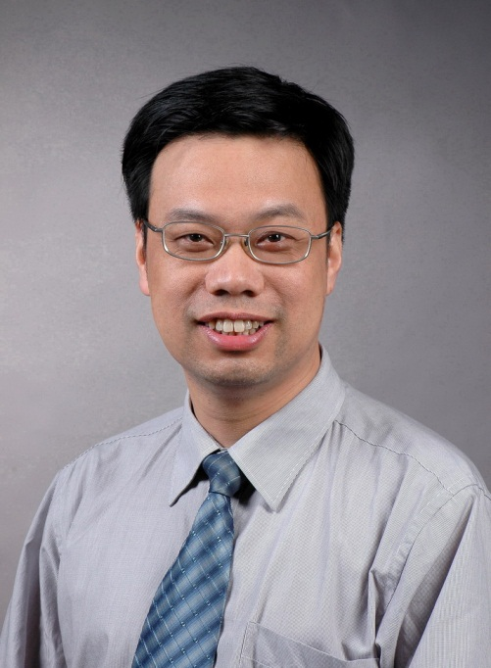

Instructor
臧斌宇
Email: byzang@sjtu.edu.cn
Office phone: 13917124245
Office hour: 20:00~21:00 Wednesday or make an appointment
Room: 1312 software Bld.
陈榕
Email: rongchen@sjtu.edu.cn
Office phone: 13616861826

Slide 4
Teaching Assistants
王夏阳、姚友阳、沈思杰、董致远
  软件楼3-408
周三
  上机：18:00～20:30 软件楼机房
    第1周（9.14）第2周（9.21）第5周或第六周
  习题：18:00～19:30
  期中考试
  上机考试

Slide 5
Text Books & Web Site
Randy Bryant and David O’Hallaron,
  Computer Systems: A Programmer’s Perspective
  2nd Edition
  Prentice Hall, 2011.
Brian Kernighan and Dennis Ritchie,
  The C Programming Language, Second Edition
  Prentice Hall, 1988
http://ipads.se.sjtu.edu.cn/courses/ics/

Slide 6
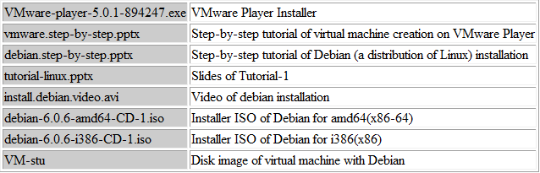
Prepare for Tutorial-1 (Wed.)
Downloading from FTP (Temporal)
  Address: ftp://202.120.40.60:21
    Username: temp Password: tempaaa
See related slides in schedule page
  http://ipads.se.sjtu.edu.cn/courses/ics/schedule.shtml

Slide 7
Grading
Exams(70%)
  Mid term (35%)
  Final (35%)
  All exams are open books/open notes.
Labs (25%)
  Lab 1 (%2)
  Lab 4, 5, 6 (9%, 3% each)
  lab 2&3 (offline and online 14%, 7% each)
Home work(5%)

Slide 8
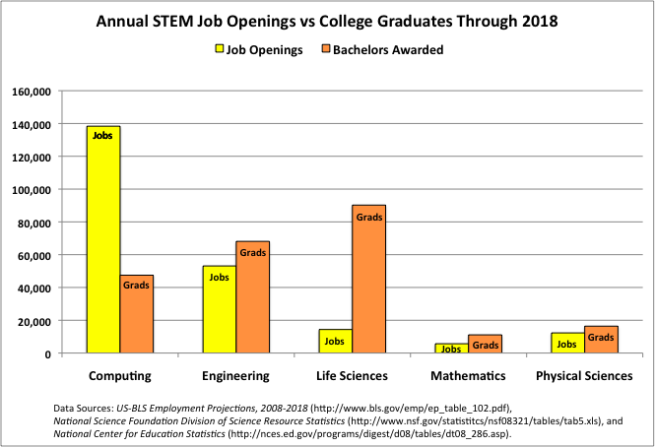
Understanding Supply Versus Demand

Slide 9
Increasing the Footprint of CS
Data mining
Databases
Hardware
Robotics
Machine Learning
Distributed Systems
Systems
Natural Language
Networking
AI
Security
Comp. Bio.
HCI
Theory
Comp. Economics
Graphics
Geometric Comp.
Algorithms

Slide 10
Footprint of CS Students Saw Previously
Data mining
Databases
Hardware
Robotics
Machine Learning
Distributed Systems
Systems
Natural Language
Networking
AI
Security
Comp. Bio.
HCI
Theory
Comp. Economics
Graphics
Geometric Comp.
Algorithms

Slide 11
Tracks Allow More Depth...
Data mining
Databases
Hardware
Robotics
Machine Learning
Distributed Systems
Systems
Natural Language
Networking
AI
Security
Comp. Bio.
HCI
Theory
Comp. Economics
Graphics
Geometric Comp.
Algorithms
Total amount of material covered must remain the same

Slide 12
...in a More Diverse Set of Areas
Data mining
Databases
Hardware
Robotics
Machine Learning
Distributed Systems
Systems
Natural Language
Networking
AI
Security
Comp. Bio.
HCI
Theory
Comp. Economics
Graphics
Geometric Comp.
Algorithms

Slide 13
Total Potential Footprint is Larger
Data mining
Databases
Hardware
Robotics
Machine Learning
Distributed Systems
Systems
Natural Language
Networking
AI
Security
Comp. Bio.
HCI
Theory
Comp. Economics
Graphics
Geometric Comp.
Algorithms
Core material everyone sees is streamlined to accommodate

Slide 14
“Big Tent” Computer Science
Statistics
Electrical
Engineering
Data mining
Databases
Hardware
Robotics
Linguistics
Machine Learning
Distributed Systems
Systems
Natural Language
Networking
AI
Design
Biology
Security
Comp. Bio.
HCI
Theory
Comp. Economics
Psychology
Graphics
Geometric Comp.
Economics
Algorithms
Art

Slide 15
Revised Curricular Structure: Core
Programming Core: 2 Courses
Proramming and Data Structures
Algorithms
Software engineering Core: 2 Courses
Introduction to software engineering
Software testing
Systems Core: 3 Courses
ICS(1) &(2)
Computer Systems Engineering
Developing Core: 2 Courses
Database
Web application

Slide 16







System Track Courses
Operating Systems
Architecture
Compilers
Digital Components
Distributed Systems
Computer Systems Engineering
Introduction to Computer Systems

Slide 17
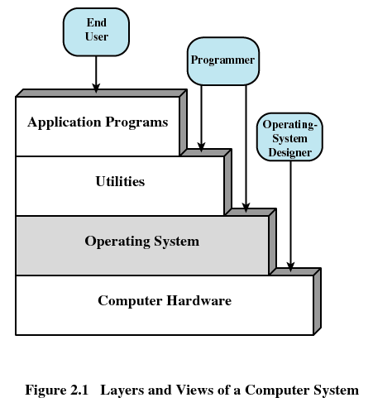
Layers of Computer Systems

Slide 18
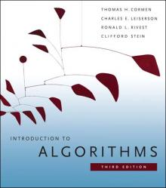
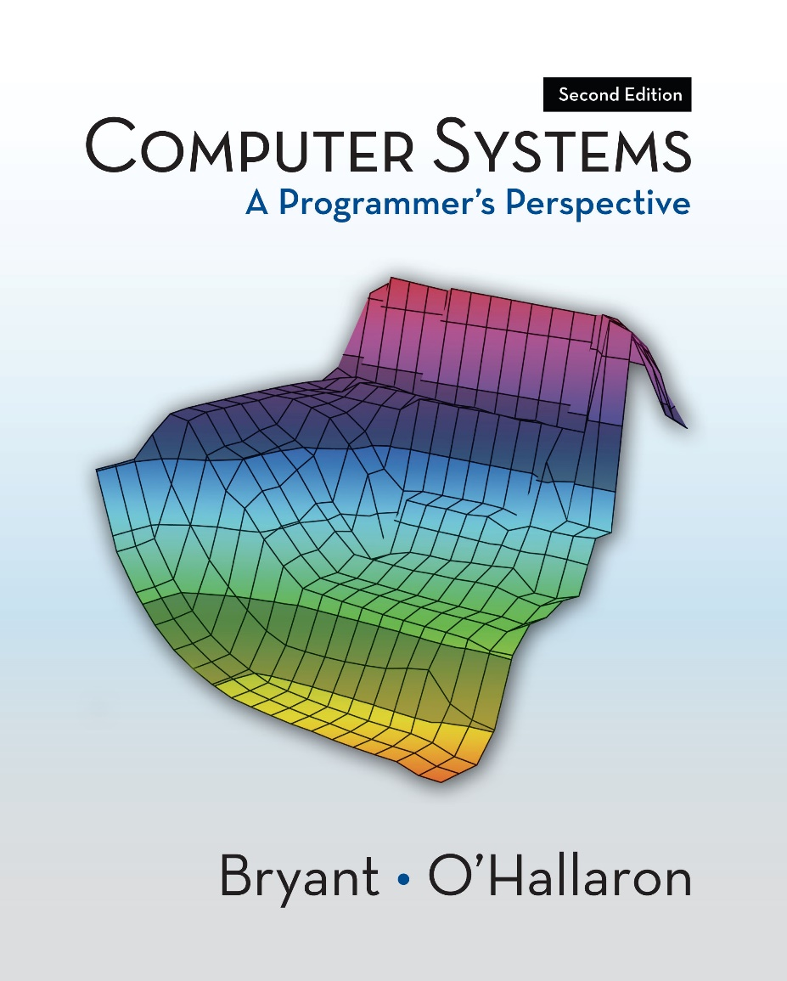
Bibles for Job Interview

Slide 19
Where are We?
Programming Lies at the Heart of Most Modern Systems
  Computer systems
  Embedded devices: cell phones, automobile controls, …
  Electronics: DSPs, programmable controllers
Programmers Have to Understand Their Machines and Their Limitations
  Correctness: computer arithmetic, storage allocation
  Efficiency: memory & CPU performance

Slide 20
Where are We?
From abstractions to details (realities)
From application level to system level
From C++ to C

Slide 21
Features of This Course
Enduring Concepts
From programmer’s perspective
Actively study
Becoming the rare “power programmer”

Slide 22
Enduring concepts
Computer systems consist hardware and systems software that work together to run programs
Specific implementations of systems change over time
But the underlying concepts do not
All computer systems have similar hardware and software components that perform similar functions

Slide 23
From Programmer’s Perspective
Rather than system designer’s perspective
  Few students would have the opportunity to build a computer system
  It’s wasteful to teach every computer scientist how to design a microprocessor
  Knowledge of how to build does not transfer to knowledge of how to use

Slide 24
From Programmer’s Perspective
It covers a topic only if it affected
  correctness, performance or utility of user-level C programs
Take a broader and more realistic view of the system
  What the computer hardware is
  How modern computer works

Slide 25
Actively Study
New concepts are followed by practical problems
Homework problems and labs are also real
Learning by doing
  Working concrete problems
  Writing and running programs on real systems
Practical, concrete, hands-on and exciting

Slide 26
Becoming the Rare “Power Programmer”
Enlightened by an understanding of
  the underlying computer system
  and its impact on your application programs
You know
  How things work and
  How to fix them when they break

Slide 27
Drawbacks of This Book
This book is written by famous professors
The materials in this book are very good
However, the book is not well organized for Chinese students
  Some parts are too tedious
  Some important ideas are not emphasized
It should be better for you to follow my directions to read the book

Slide 28
Good luck!

Slide 29
Overview of Computer Systems

Slide 30
Outline
Layers of computer systems
Suggested reading
  Preface 7-8, 1.2, 1.4.1, 1.7(before 1.7.1), 1.7.3, 1.8, 1.9.1 (the first paragraph), 4 asides in chapter 1

Slide 31
Layers of Computer Systems

Slide 32
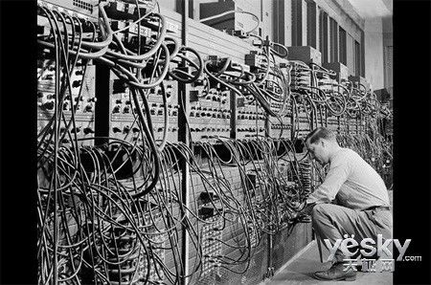
The first general purpose computer
ENIAC
  Electronic Numerical Integrator And Computer
  Delivered by UPenn. on Feb. 14, 1946
  John Mauchly、John Eckert
ABC
  Atanasoff–Berry Computer
  1941

Slide 33
Computer Hardware - Von Neumann Architecture
Instructions / Program
Main
Memory
Arithmetic
Unit
Control
Unit
PC
AC
IR
SR
Addresses
Input/Output
Unit
E.g. Storage
ENIAC
en:First Draft of a Report on the EDVAC

Slide 34
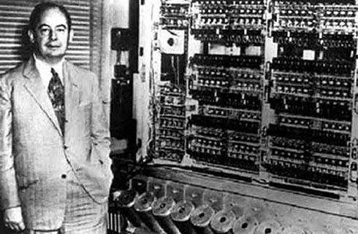
EDVAC(1944.8,1945.6,1949.8,1951-1961)

Slide 35
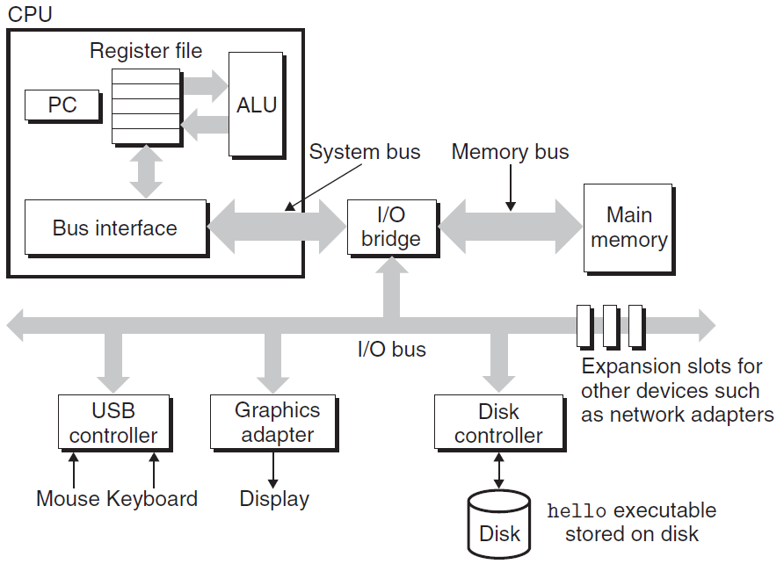
IA-32

Slide 36
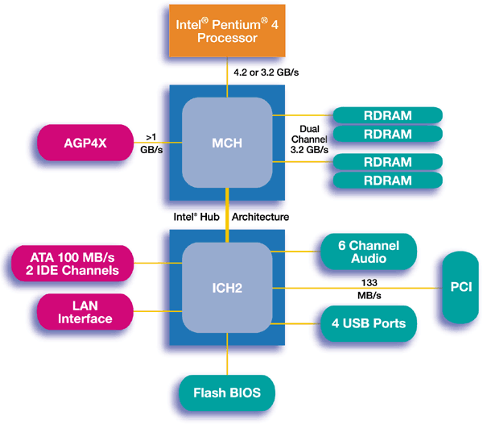
IA-32

Slide 37
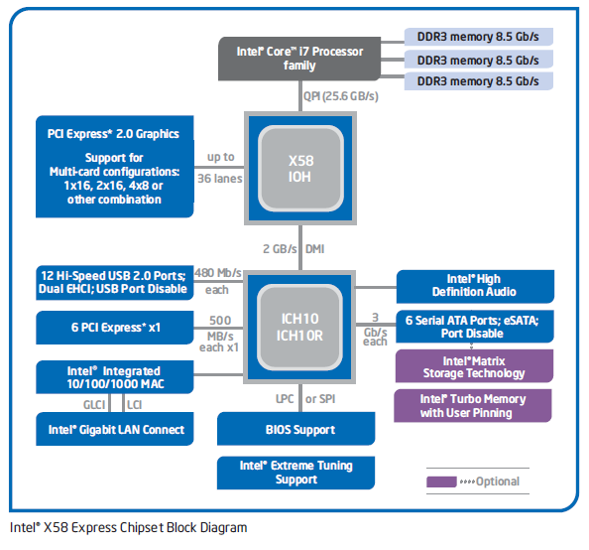
IA-32

Slide 38
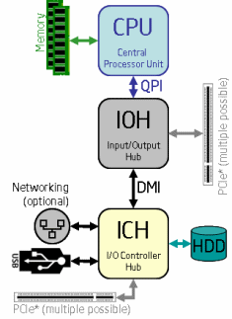
IA-32

Slide 39
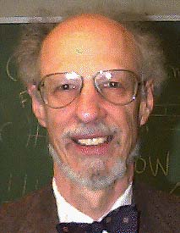
Operating Systems
1960’s
  IBM OS/360, Honeywell Multics,
Fernado Jose Corbató
  IEEE Computer Pioneer Award, 1982
  ACM Turing Award, 1990

Slide 40

Operating Systems
Unix
  Bell Lab, DEC PDP-7, 1969
  Ken Thompson, Dennis Ritchie, Doug Mcllroy, Joe Ossana
  1970 Brian Kernighan dubbed the system “Unix”
  Rewritten in C in 1973, announced in 1974
  BSD (UC, Berkeley), System V(Bell lab)
  Solaris (Sun Microsystem)
Posix standard
Ken Thompson, Dennis Ritchie
  ACM Turing Award, 1983

Slide 41
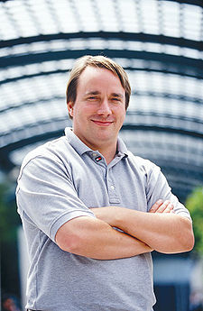

Linux
1991, Linus Torvalds
Unix-like operating systems
386(486)AT, bash(1.08), gcc(1.40)
Posix complaint version of Unix operating system
Available on a wide array of computers
  From handheld devices to mainframe computers
  wristwatch

Slide 42











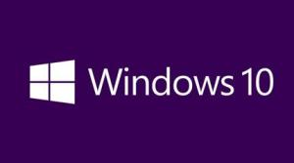
We have seen a bunch of Operating Systems

Slide 43












We have seen a bunch of Operating Systems

Slide 44
Utilities
Programming language
  ANSI C
Compiler
  GNU-gcc
Tools
  GNU tool chain
Notes:
W 87

Slide 45
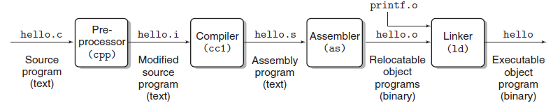
Compilation
Notes:
W 87

Slide 46
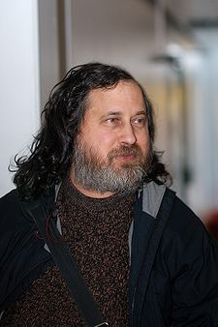

GNU
Free software
Richard Stallman, 1984
A complete Unix-like system with source code
An environment
  All major components of a Unix operating system
  Except for kernel
Notes:
W 87

Slide 47
The C Programming Language
C was developed
  in 1969 to 1973
  by Dennis Ritchie of Bell Laboratories.
The American National Standards Institute (ANSI)
  ratified the ANSI C standard in 1989.
The standard defines
  the C language
  and a set of library functions known as the C standard library.
Notes:
W 87

Slide 48
The C Programming Language
Kernighan and Ritchie describe ANSI C in their classic book
  which is known affectionately as “K&R” .
In Ritchie’s words, C is
  quirky,
  flawed,
  and an enormous success.
Why the success?
Notes:
W 87

Slide 49
The C Programming Language
C was closely tied with the Unix operating system
  C was developed from the beginning as the system programming language for Unix.
  Most of the Unix kernel, and all of its supporting tools and libraries, were written in C.
Notes:
W 87

Slide 50
The C Programming Language
C was closely tied with the Unix operating system
  As Unix became popular in universities in the late 1970s and early 1980s, many people were exposed to C and found that they liked it.
  Since Unix was written almost entirely in C, it could be easily ported to new machines, which created an even wider audience for both C and Unix.
Notes:
W 87

Slide 51
The C Programming Language
C is a small, simple language.
  The design was controlled by a single person, rather than a committee, and the result was a clean, consistent design with little baggage.
  The K&R book describes the complete language and standard library, with numerous examples and exercises, in only 261 pages.
  The simplicity of C made it relatively easy to learn and to port to different computers.
Notes:
W 87

Slide 52
The C Programming Language
C was designed for a practical purpose.
  C was designed to implement the Unix operating system.
  Later, other people found that they could write the programs they wanted, without the language getting in the way.
Notes:
W 87

Slide 53
The C Programming Language
C is the language of choice for system-level programming
There is a huge installed base of application-level programs as well.
Notes:
W 87

Slide 54
The C Programming Language
However, it is not perfect for all programmers and all situations
  C pointers are a common source of confusion and programming errors
  C also lacks explicit support for useful abstractions such as classes and objects
  Newer languages such as C++ and Java address these issues for application-level programs
Notes:
W 87

Slide 55
Standardization of C
The original Bell Labs version of C
  the 1st edition of the book K&R
The ANSI C standard in 1989
  The American National Standards Institute
  Modify the way functions are declared
  the 2nd edition of the book K&R
  ISO C90 (The International Standards Organization)

Slide 56
Standardization of C
ISO C99
  Introduced some new data types
  Provided support for text strings requiring characters not found in the English language
Gcc supporting
  Unix> gcc -std=c99 prog.c
  -ansi and -std=c89 have the same effect

Slide 57
Standardization of C
C version gcc | command line option
GNU 89 | none, -std=gnu89
ANSI, ISO C90 | -ansi, -std=c89
ISO C99 | -std=c99
GNU 99 | -std=gnu99
ACM:
  Association of Computing Machinery
IEEE:
  Institute of Electrical and Electronics Engineers

Slide 58
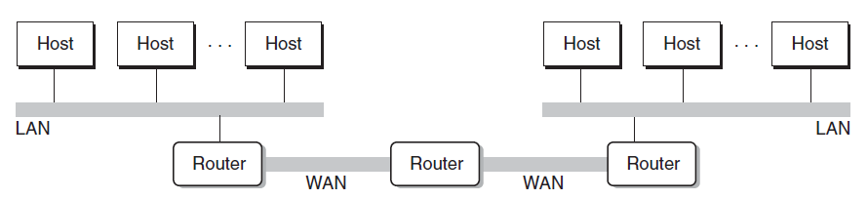
Networking
Computers are connected by networks
Notes:
W 87

Slide 59


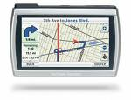
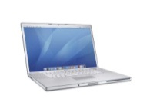
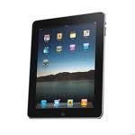
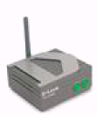

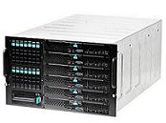

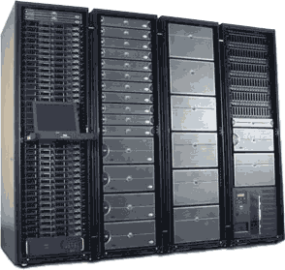
Cloud
Computer Systems support the cloud computing
Wireless
Ethernet
Notes:
W 87

Slide 60
Platforms
Hardware platform
  Intel IA-32/x86-64
Operating system
  Linux
Programming language
  ANSI C
Utility
  GNU
Networking
  TCP/IP, Sockets
Notes:
W 87

Slide 61
Important Themes
Concurrency an Parallelism
  Concurrency: multiple, simultaneous activities
  Parallelism: the use of concurrency to make a system run faster
abstraction
Notes:
W 87

Slide 62
