Slide 1
Manipulating Information（cont）

Slide 2
Logical Operations in C
Logical Operators
  &&, ||, !
    View 0 as “False”
    Anything nonzero as “True”
    Always return 0 or 1
    Early termination (short cut)

Slide 3
Logical Operations in C
Examples (char data type)
  !0x41 --> 0x00
  !0x00 --> 0x01
  !!0x41 --> 0x01
  0x69 && 0x55 --> 0x01
  0x69 || 0x55 --> 0x01

Slide 4
Short Cut in Logical Operations
a && 5/a
  If a is zero, the evaluation of 5/a is stopped
  avoid division by zero
Using only bit-level and logical operations
  Implement x == y
  it returns 1 when x and y are equal, and 0 otherwise

Slide 5
Shift Operations in C
Left Shift: x << y
  Shift bit-vector x left y positions
    Throw away extra bits on left
    Fill with 0’s on right
Argument x
01100010
<< 3
00010000
Argument x
10100010
<< 3
00010000

Slide 6
Shift Operations in C
Right Shift: x >> y
  Shift bit-vector x right y positions
    Throw away extra bits on right
  Logical shift
    Fill with 0’s on left
  Arithmetic shift
    Replicate most significant bit on right
    Useful with two’s complement integer representation (especially for the negative number )
Argument x
01100010
Log. >> 2
00011000
Arith. >> 2
00011000
Argument x
10100010
Log. >> 2
00101000
Arith. >> 2
11101000

Slide 7
Shift Operations in C
What happens ?
  int lval = 0xFEDCBA98 << 32;
  int aval = 0xFEDCBA98 >> 36;
  unsigned uval = 0xFEDCBA98u >> 40;
It may be
  lval 0xFEDCBA98 (0)
  aval 0xFFEDCBA9 (4)
  uval 0x00FEDCBA (8)
Be careful about
  1<<2 + 3<<4 means 1<<(2 + 3)<<4

Slide 8
bitCount
Returns number of 1's a in word
Examples: bitCount(5) = 2, bitCount(7) = 3
Legal ops: ! ~ & ^ | + << >>
Max ops: 40

Slide 9
Sum 8 groups of 4 bits each
int bitCount(int x) {
int m1 = 0x11 | (0x11 << 8);
int mask = m1 | (m1 << 16);
int s = x & mask;
s += x>>1 & mask;
s += x>>2 & mask;
s += x>>3 & mask;

Slide 10
Combine the sums
/* Now combine high and low order sums */
s = s + (s >> 16);
/* Low order 16 bits now consists of 4 sums.
Split into two groups and sum */
mask = 0xF | (0xF << 8);
s = (s & mask) + ((s >> 4) & mask);
return (s + (s>>8)) & 0x3F;
}

Slide 11
Information Storage

Slide 12
Outline
Virtual Memory
Pointers and word size
Suggested reading
  The first paragraph of 2.1
  2.1.2, 2.1.3, 2.1.4, 2.1.5, 2.1.6

Slide 13
Computer Hardware - Von Neumann Architecture
Instructions / Program
Main
Memory
Arithmetic
Unit
Control
Unit
PC
AC
IR
SR
Addresses
Input/Output
Unit
E.g. Storage

Slide 14
Storage
The system component that remembers data values for use in computation
A wide-ranging technology
  RAM chip
  Flash memory
  Magnetic disk
  CD
Abstract model
  READ and WRITE operations

Slide 15
READ/WRITE operations
Tow important concepts
  Name and value
WRITE(name, value) value ← READ(name)
WRITE operation specifies
  a value to be remembered
  a name by which one can recall that value in the future
READ operation specifies
  the name of some previous remembered value
  the memory device returns that value

Slide 16
Memory
Bytes
Addr.
One kind of storage device
  Value has only fixed size (usually byte)
  Name belongs to a set consisting of consecutive integers started from 0
    The integer number is called address
    The set is called address space
0000
0001
0002
0003
0004
0005
0006
0007
0008
0009
0010
0011
0012
0013
0014

Slide 17
Word Size
Indicating the normal size of
  pointer data
A virtual address is encoded by
  such a word
The maximum size of the virtual address space
  the most important system parameter determined by the word size

Slide 18
Word Size
For machine with n-bit word size
  Virtual address can range from 0 to 2^{n}-1
Most current machines are 64 bits (8 bytes)
  Potentially address ≈ 1.8 X 10¹⁹ bytes
Most current machines also support 32 bits (4 bytes)
  Limits addresses to 4GB
  Becoming too small for memory-intensive applications
Unfortunately
  it also used to indicate the normal size of integer

Slide 19
Data Size
Machines support multiple data formats
  Always integral number of bytes
Sizes of C Objects (in Bytes)
  C Data Type 32-bit 64-bit
    char 1 1
    short 2 2
    int 4 4
    long int 4 8
    long long int 8 8
    char * 4 8
    float 4 4
    double 8 8

Slide 20
intN_t and uintN_t
Another class of integer types
  specifying N-bit signed and unsigned integers
  Introduced by the ISO C99 standard
  In the file stdint.h.
Typical values
  int8_t, int16_t, int32_t, int64_t
  unit8_t, uint16_t, uint32_t, uint64_t
  N are implementation dependent

Slide 21
Data Size Related Bugs
Difficulty to make programs portable across different machines and compilers
  The program is sensitive to the exact sizes of the different data types
  The C standard sets lower bounds on the numeric ranges of the different data types
  but there are no upper bounds

Slide 22
Data Size Related Bugs
32-bit machines have been the standard from 1990s to 2010s
Many programs have been written
  assuming the allocations listed as “32-bit” in the table
With the increasing of 64-bit machines
  many hidden word size dependencies show up as
    bugs in migrating these programs to new machines

Slide 23
Example
At the time 32-bit dominated, many programmers assumed that
  a program object declared as type int can be used to store a pointer
This works fine for most 32-bit machines
But leads to problems on an 64-bit machine

Slide 24
Virtual Memory
The memory introduced in previous slides
  is only an conceptual object and
  does not exist actually
It provides the program with what appears to be a monolithic byte array
It is a conceptual image presented to the machine-level program

Slide 25
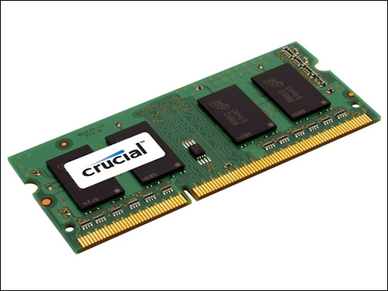
Virtual Memory
The actual implementation uses a combination of
  Hardware
  Software
Hardware
  random-access memory (RAM) (physical)
  disk storage (physical)
  special hardware (performing the abstraction )
Software
  and operating system software (abstraction)

Slide 26
Way to the Abstraction
Taking something physical and abstract it logical
Virtual memory
WRITE
(vadd value)
Operating
System
Special
hardware
RAM
Chips
Disk
storage
WRITE
(padd value)
READ(vadd)
READ(padd)
Abstraction
layer
Physical
layer

Slide 27
Subdivide Virtual Memory into More Manageable Units
One task of
  a compiler and
  the run-time system
To store the different program objects
  Program data
  Instructions
  Control information

Slide 28
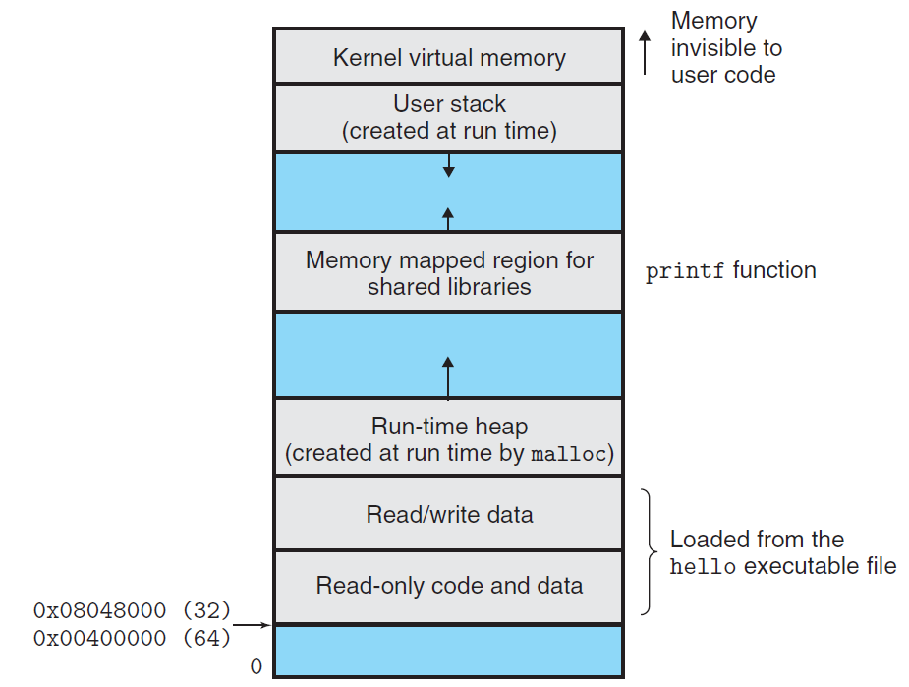

Slide 29
Byte Ordering
How should a large object be stored in memory?
For program objects that span multiple bytes
  What will be the address of the object?
  How will we order the bytes in memory?
A multi-byte object is stored as
  a contiguous sequence of bytes
  with the address of the object given by the smallest address of the bytes used

Slide 30
Byte Ordering
Little Endian
  Least significant byte has lowest address
  Intel
Big Endian
  Least significant byte has highest address
  Sun, IBM
Bi-Endian
  Machines can be configured to operate as either little- or big-endian
  Many recent microprocessors

Slide 31
Big Endian (0x1234567)
0x100
0x101
0x102
0x103
01
23
45
67

Slide 32
Little Endian (0x1234567)
0x100
0x101
0x102
0x103
67
45
23
01

Slide 33
How to Access an Object
The actual machine-level program generated by C compiler
  simply treats each program object as a block of bytes
The value of a pointer in C
  is the virtual address of the first byte of the above block of storage

Slide 34
How to Access an Object
The C compiler
  Associates type information with each pointer
  Generates different machine-level code to access the pointed value
    stored at the location designated by the pointer depending on the type of that value
The actual machine-level program generated by C compiler
  has no information about data types

Slide 35
Code to Print Byte Representation
typedef unsigned char *byte_pointer;
void show_bytes(byte_pointer start, int len)
{
int i;
for (i = 0; i < len; i++)
printf("0x%p\t0x%.2x\n",
start+i, start[i]);
printf("\n");
}

Slide 36
Code to Print Byte Representation
void show_int(int x) {
show_bytes((byte_pointer) &x, sizeof(int));
}
void show_float(float x) {
show_bytes((byte_pointer) &x, sizeof(float));
}
void show_pointer(void *x) {
show_bytes((byte_pointer) &x, sizeof(void *));
}

Slide 37
Features in C
typedef
  Giving a name of type
  Syntax is exactly like that of declaring a variable
printf
  Format string: %d, %c, %x, %f, %p
sizeof
  sizeof(T) returns the number of bytes required to store an object of type T
  One step toward writing code that is portable across different machine types

Slide 38
Features in C
Pointers and arrays
  start is declared as a pointer
  It is referenced as an array start[i]
Pointer creation and dereferencing
  Address of operator &
  &x
Type casting
  (byte_pointer) &x

Slide 39
Code to Print Byte Representation
void test_show_bytes(int val) {
int ival = val;
float fval = (float) ival;
int *pval = &ival;
show_int(ival);
show_float(fval);
show_pointer(pval);
}

Slide 40
Example
Linux 32: Intel IA32 processor running Linux
Windows: Intel IA32 processor running Windows
Sun: Sun Microsystems SPARC processor running Solaris
Linux 64: Intel x86-64 processor running Linux
With argument 12345 which is 0x3039

Slide 41
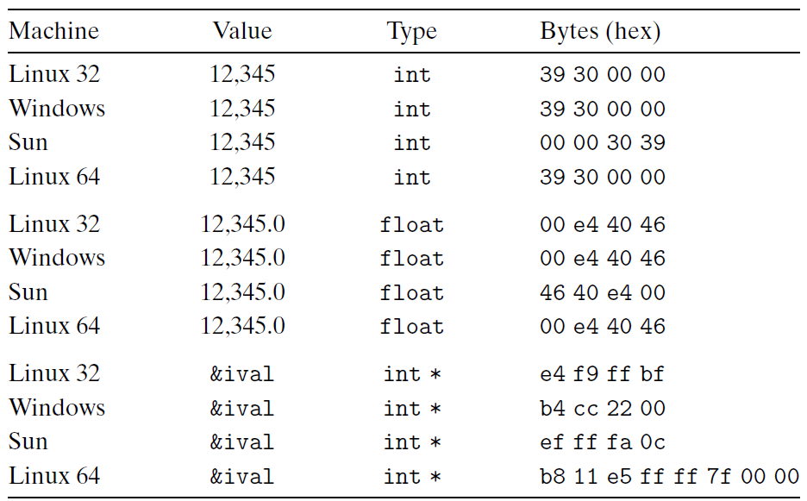
Example
Linux 32: Intel IA32 processor running Linux
Windows: Intel IA32 processor running Windows
Sun: Sun Microsystems SPARC processor running Solaris
Linux 64: Intel x86-64 processor running Linux

Slide 42
Representing Codes
int sum(int x, int y) {
return x + y;
}
Linux 32: 55 89 e5 8b 45 0c 03 45 08 c9 c3
Windows: 55 89 e5 8b 45 0c 03 45 08 5d c3
Sun: 81 c3 e0 08 90 02 00 09
Linux 64: 55 48 89 e5 89 7d fc 89 75 f8 03 45 fc c9 c3

Slide 43
Byte Ordering Becomes Visible
Circumvent the normal type system
  Casting
  Reference an object according to a different data type from which it was created
  Strongly discouraged for most application programming
  Quite useful and even necessary for system-level programming
Disassembler
  80483bd: 01 05 64 94 04 08->add %eax, 0x8049464
Communicate between different machines

Slide 44
Representing Strings
Strings in C
  Represented by array of characters
  Each character encoded in ASCII format
  String should be null-terminated Final character = 0
  \a \b \f \n \r \t \v
  \\ \? \’ \” \000 \xhh
char S[6] = "12345";
Linux S
Sun S
31
31
32
32
33
33
34
34
35
35
00
00

Slide 45
Representing Strings
Compatibility
  Byte ordering not an issue
    Data are single byte quantities
  Text files generally platform independent
    Except for different conventions of line termination character!
char S[6] = "12345";
Linux S
Sun S
31
31
32
32
33
33
34
34
35
35
00
00

Slide 46
Representing Strings
  /* strlen: return length of string s */
  int strlen(char *s)
  {
  char *p = s ;
  while (*p != ‘\0’)
  p++ ;
  return p-s ;
  }
  <string.h>

Slide 47
Representing Strings
  /* trim: remove trailing blanks, tabs, newlines */
  int trim(char s[])
  {
  int n;
  for (n = strlen(s)-1; n >= 0; n--)
  if ( s[n] != ‘ ‘ && s[n] != ‘\t’ && s[n] != ‘\n’)
  break;
  s[n+1] = ‘\0’;
  return n
  }

Slide 48
Address issues
IBM S/360: 24-bit address
PDP-11: 16-bit address
Intel 8086: 16-bit address
X86 (80386): 32-bit address
X86 32/64: 32/64-bit address

Slide 49
64-bit data models
Processors
4-bit | 8-bit | 12-bit | 16-bit | 18-bit | 24-bit | 31-bit | 32-bit | 36-bit | 48-bit | 64-bit | 128-bit
Applications
 |  |  | 16-bit |  |  |  | 32-bit |  |  | 64-bit
Data Sizes
nibble octet byte word dword qword

Slide 50
64-bit data models
Data model | short | int | long | long long | pointers | Sample operating systems
LLP64 | 16 | 32 | 32 | 64 | 64 | Microsoft Win64 (X64/IA64)
LP64 | 16 | 32 | 64 | 64 | 64 | Most Unix and Unix-like systems (Solaris, Linux, etc.)
ILP64 | 16 | 64 | 64 | 64 | 64 | HAL(Fujitsu subsidiary)
SILP64 | 64 | 64 | 64 | 64 | 64 | ?

