Slide 1
Representing Information (2)

Slide 2
Outline
Encodings
  Unsigned and two’s complement
Suggested reading
  Chap 2.2

Slide 3
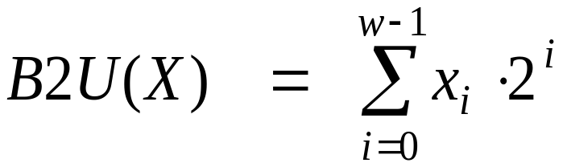
Unsigned Representation
Binary (physical)
  Bit vector [x_{w-1},x_{w-2},x_{w-3},…x₀]
Binary to Unsigned (logical)

Slide 4
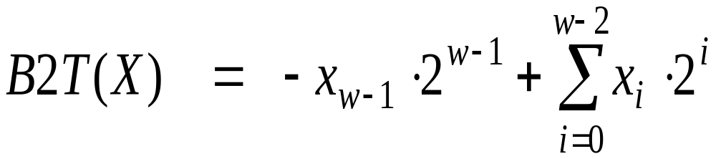
Two’s Complement
Binary (physical)
  Bit vector [x_{w-1},x_{w-2},x_{w-3},…x₀]
Binary to Signed (logical)
2’s complement
Sign
Bit

Slide 5
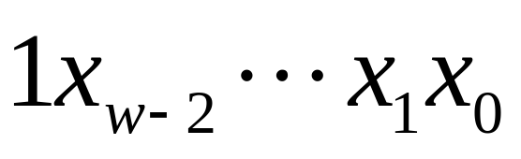
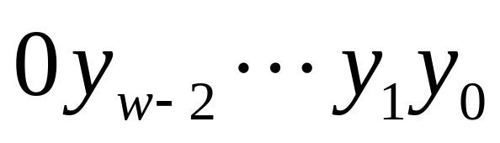
From Two’s Complement to Binary
If nonnegative
  Nothing changes
If negative, its binary representation is
Its value is x
  Assume its absolute value is y = -x
  The binary representation of y is

Slide 6
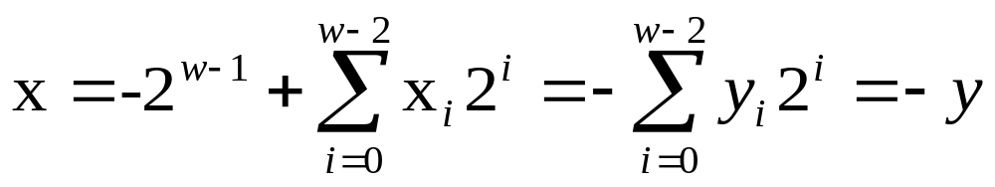
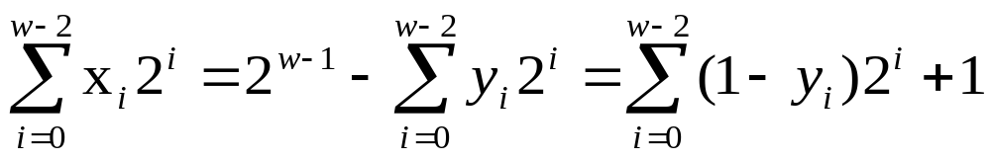
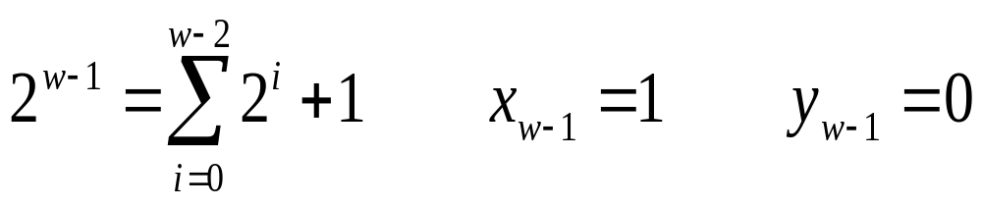
From Two’s Complement to Binary

Slide 7
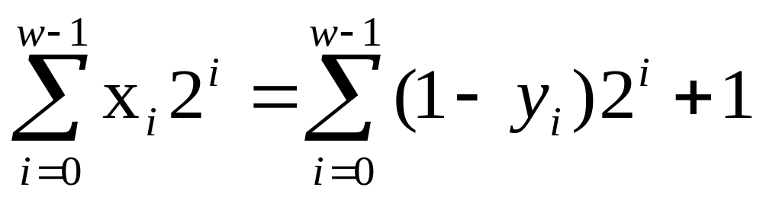
Two’s Complement
What does it mean?
  Computing the negation of x into binary with w-bits
  Complementing the result
  Adding 1

Slide 8
From a Number to Two’s Complement
-5
  5
  0101 (binary for 5)
  1010 (after complement)
  1011 (add 1)

Slide 9
Two’s Complement Encoding Examples
Binary/Hexadecimal Representation for -12345
Binary: 0011 0000 0011 1001 (12345)
Hex: 3 0 3 9
Binary: 1100 1111 1100 0110 (after complement)
Hex: C F C 6
Binary: 1100 1111 1100 0111 (add 1)
Hex: C F C 7

Slide 10
Numeric Range
Unsigned Values
  Umin=0
  Umax=2^{w}-1
Two’s Complement Values
  Tmin = -2^{w-1}
  Tmax = 2^{w-1}-1

Slide 11
Numeric Range
Relationship
  |TMin| = TMax + 1
  Umax = 2*TMax + 1
  -1 has the same bit representation as Umax,
    a string of all 1s
  Numeric value 0 is represented as
    a string of all 0s in both representations

Slide 12
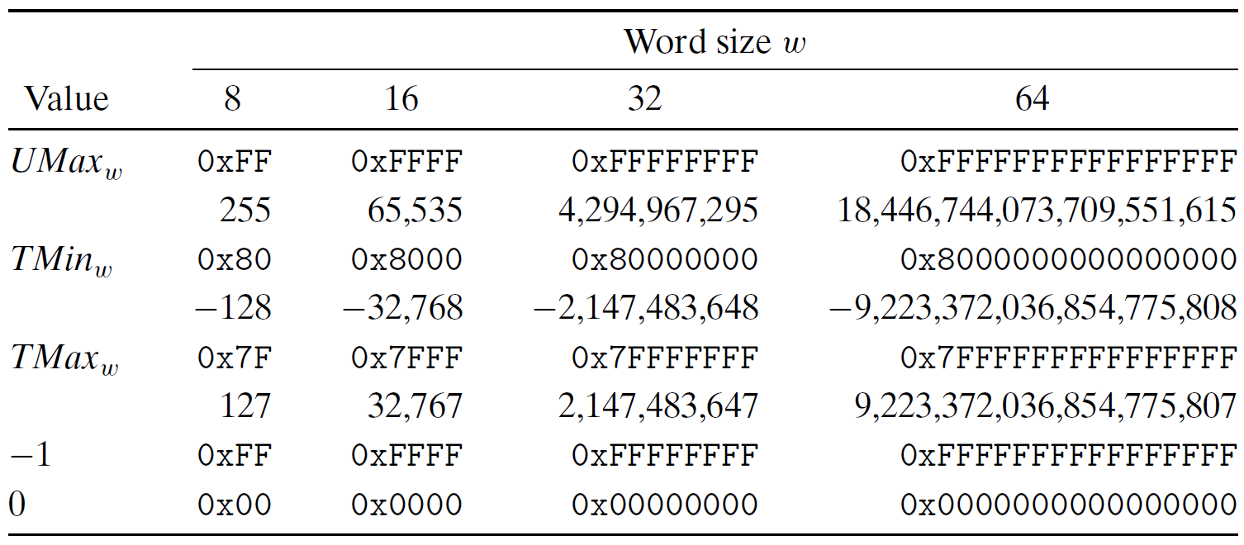
Interesting Numbers

Slide 13
Alternative representations of signed numbers
Ones’ Complement:
  The most significant bit has weight 2^{w-1}-1
Sign-Magnitude
  The most significant bit is a sign bit
    that determines whether the remaining bits should be given negative or positive weight

Slide 14
X
B2U(X)
B2T(X)
0000
0
0
0001
1
1
0010
2
2
0011
3
3
0100
4
4
0101
5
5
0110
6
6
0111
7
7
1000
8
–8
1001
9
–7
1010
10
–6
1011
11
–5
1100
12
–4
1101
13
–3
1110
14
–2
1111
15
–1

Slide 15
Mappings between logical and physical
Uniqueness
  Every bit pattern represents unique integer value
  Each representable integer has unique bit encoding

Slide 16
Mappings between logical and physical
Invert Mappings (from logical to physical)
  U2B(x) = B2U⁻¹(x)
    Bit pattern for unsigned integer
  T2B(x) = B2T⁻¹(x)
    Bit pattern for two’s comp integer

Slide 17
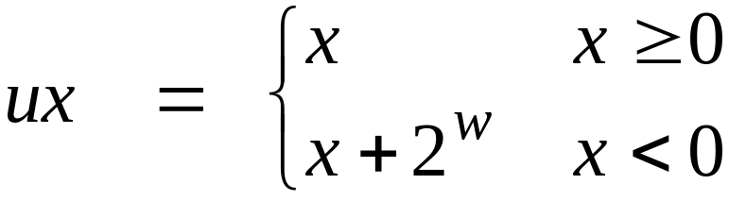
Relation Between 2’s Comp. & Unsigned
Two’s Complement
T2U
Unsigned
x
T2B
B2U
ux
X
Maintain Same Bit Pattern
w–1
0
ux
+
+
+
• • •
+
+
+
-
x
-
+
+
• • •
+
+
+
+2^{w–1} – –2^{w–1} = 2*2^{w–1} = 2^{w}

Slide 18
Conversion between two Representations
UMax
UMax – 1
TMax + 1
Unsigned
Range
TMax
TMax
2’s Comp.
Range
0
0
–1
–2
TMin

Slide 19
Casting among Integral Data Type

Slide 20
Outline
Conversions
  Signed vs. unsigned
  Long vs. short
Suggested reading
  Chap 2.2

Slide 21
Integral data type in C
Signed type (for integer numbers)
  char, short [int], int, long [int]
Unsigned type (for nonnegative numbers)
  unsigned char, unsigned short [int], unsigned [int], unsigned long [int]
Java has no unsigned data type
  Using byte to replace the char

Slide 22
Integral Data Types
C supports a variety of integral data types
  Represent a finite range of integers
C declaration | guaranteed |  | Typical 32-bit
 | minimum | maximum | minimum | maximum
char unsigned char | -127 0 | 127 255 | -128 0 | 127 255
short [int] unsigned short | -32,767 0 | 32,767 65,535 | -32,768 0 | 32,767 65,535
int unsigned [int] | -32,767 0 | 32,767 65,535 | -2,147,483,648 0 | 2,147,483,647 4,294,967,295
long [int] unsigned long | -2,147,483,647 0 | 2,147,483,647 0 | -2,147,483,648 0 | 2,147,483,647 4,294,967,295

Slide 23
Casting among Signed and Unsigned in C
C Allows a variable of one type to be interpreted as other data type
  Type conversion (implicitly)
  Type casting (explicitly)

Slide 24
Signed vs. Unsigned in C
Casting
  Explicit casting between signed & unsigned
  same as U2T and T2U
    int tx, ty;
    unsigned ux, uy;
    tx = (int) ux;
    uy = (unsigned) ty;

Slide 25
Signed vs. Unsigned in C
Conversion
  Implicit casting also occurs via assignments and procedure calls
    int tx, ty;
    unsigned ux, uy;
    tx = ux;
    uy = ty;

Slide 26
Casting from Signed to Unsigned
short int x = 12345;
unsigned short int ux = (unsigned short) x;
short int y = -12345;
unsigned short int uy = (unsigned short) y;
Resulting Value
  No change in bit representation
  Nonnegative values unchanged
    ux = 12345
  Negative values change into (large) positive values
    uy = 53191

Slide 27
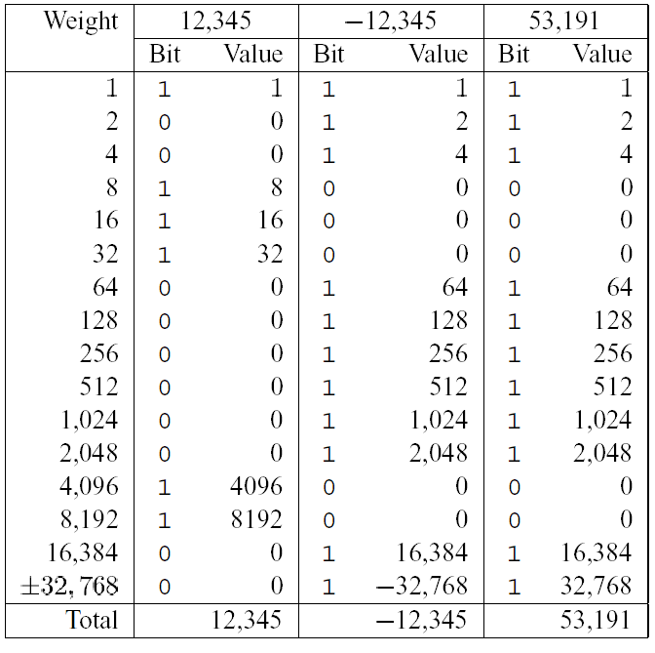
back

Slide 28
Unsigned Constants in C
By default
  constants are considered to be signed integers
Unsigned if have “U” as suffix
  0U, 4294967259U

Slide 29
Casting Convention
Expression Evaluation
  If mix unsigned and signed in single expression
    signed values implicitly cast to unsigned
  Including comparison operations <, >, ==, <=, >=
  Examples for W = 32

Slide 30
Casting Convention
Constant1 Constant2 Relation Evaluation
  0 0U == unsigned
  -1 0 < signed
  -1 0U > unsigned
  2147483647 -2147483648 > signed
  2147483647U -2147483648 < unsigned
  -1 -2 > signed
  (unsigned)-1 -2 > unsigned

Slide 31
From short to long
short int x = 12345;
int ix = (int) x;
short int y = -12345;
int iy = (int) y;
We need to expand the data size
Casting among unsigned types is normal
Casing among signed types is trick

Slide 32
Expanding the Bit Representation
Zero extension
  Add leading 0s to the representation
Sign extension
  [x_{w-1},x_{w-2},x_{w-3},…x₀]
w
X
• • •
X
-
• • •
• • •
X ′
X ′
• • •
• • •
-
+
• • •
w+1

Slide 33
From short to long
short int sx = 12345; ：0x0309
int x = (int) sx; : 0x00000309
short int sy =-12345;: 0xcfc7
int y = (int) sy; : 0xffffcfc7
usinged ux = sx; : 0xffffcfc7

Slide 34
From short to long
int fun1(unsigned word) {
return (int) ((word << 24) >> 24);
}
int fun2(unsigned word) {
return ((int) word << 24) >> 24;
}
w fun1(w) fun2(w)
0x00000076
0x87654321
0x000000C9
0xEDCBA987
Describe in words the useful computation each of these functions performs.
00000076 00000076
00000021 00000021
000000C9 FFFFFFC9
00000087 FFFFFF87

Slide 35
From long to short
int x = 53191;
short int sx = x;
int y = -12345;
Short int sy = y;
We need to truncate the data size
Casing from long to short is trick

Slide 36
Truncating Numbers
 | Decimal | Hex | Binary
x | 53191 | 00 00 CF C7 | 00000000 00000000 11001111 11000111
sx | -12345 | CF C7 | 11001111 11000111
y | -12345 | FF FF CF C7 | 11111111 11111111 11001111 11000111
sy | -12345 | CF C7 | 11001111 11000111
X ′
• • •
• • •
X
• • •

Slide 37
Truncating Numbers
Unsigned Truncating
Signed Truncating

Slide 38
Advice on Signed vs. Unsigned
Non-intuitive Features
float sum_elements ( float a[], unsigned length )
{
int i ;
for ( i = 0; i <= length – 1; i++)
result += a[i] ;
}

Slide 39
Advice on Signed vs. Unsigned
/* Prototype for library function strlen */
size_t strlen(const char *s); /*size_t is usigned */
/* Determine whether string s is longer than string t */
/* WARNING: This function is buggy */
int strlonger(char *s, char *t) {
return strlen(s) - strlen(t) > 0;
}

Slide 40
Advice on Signed vs. Unsigned
1 /*
2 * Illustration of code vulnerability similar to that found in
3 * FreeBSD’s implementation of getpeername()
4 */
5
6 /* Declaration of library function memcpy */
7 void *memcpy(void *dest, void *src, size_t n);
8

Slide 41
Advice on Signed vs. Unsigned
9 /* Kernel memory region holding user-accessible data */
10 #define KSIZE 1024
11 char kbuf[KSIZE];
12
13 /* Copy at most maxlen bytes from kernel region to user buffer */
14 int copy_from_kernel(void *user_dest, int maxlen) {
15 /* Byte count len is minimum of buffer size and maxlen */
16 int len = KSIZE < maxlen ? KSIZE : maxlen;
17 memcpy(user_dest, kbuf, len);
18 return len;
19 }

Slide 42
Advice on Signed vs. Unsigned
Collections of bits
  Bit vectors
  Masks
Addresses
Multiprecision Arithmetic
  Numbers are represented by arrays of words

