Slide 1
Arithmetic Operations

Slide 2
Outline
Arithmetic Operations
  Unsigned addition, multiplication
  Signed addition, negation, multiplication
  Using Shift to perform power-of-2 multiply
Suggested reading
  Chap 2.3

Slide 3
Unsigned Addition
u
• • •
Operands: w bits
+
v
• • •
True Sum: w+1 bits
u + v
• • •
Discard Carry: w bits
UAdd_{w}(u , v)
• • •

Slide 4

Unsigned Addition
Standard Addition Function
  Ignores carry output
Implements Modular Arithmetic
  s = UAddw(u , v) = (u + v) mod 2^{w}

Slide 5
Unsigned Addition
Practice Problem 2.27
Write a function with the following prototype:
/* Determine whether arguments can be added without overflow */
int uadd_ok(unsigned x, unsigned y);
This function should return 1 if arguments x and y can be added without causing overflow
  Overflow iff (X+Y) < X

Slide 6
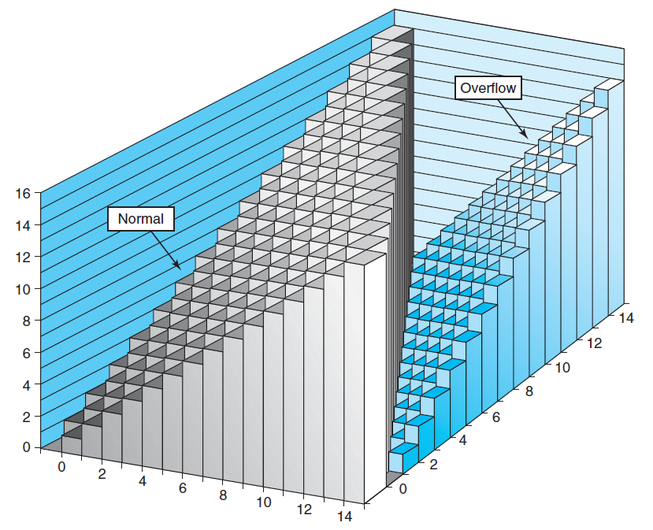
Unsigned Addition

Slide 7
Unsigned Addition Forms an Abelian Group
Closed under addition
  0 ≤ UAdd_{w}(u , v) ≤ 2^{w} –1
Associative
  UAdd_{w} (t, UAdd_{w} (u,v)) = UAdd_{w} (UAdd_{w} (t, u ), v)
0 is additive identity
  UAdd_{w} (u , 0) = u

Slide 8
Unsigned Addition Forms an Abelian Group
Every element has additive inverse
  Let UComp_{w} (u ) = 2^{w} – u
  UAddw(u , UComp_{w} (u )) = 0
Commutative
  UAdd_{w}(u , v) = UAdd_{w}(v , u)

Slide 9
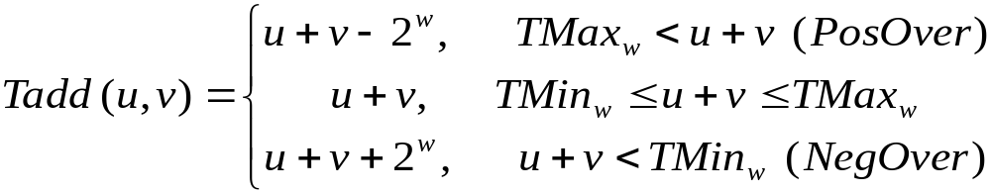
Signed Addition
Functionality
  True sum requires w+1 bits
  Drop off MSB
  Treat remaining bits as 2’s comp. integer

Slide 10
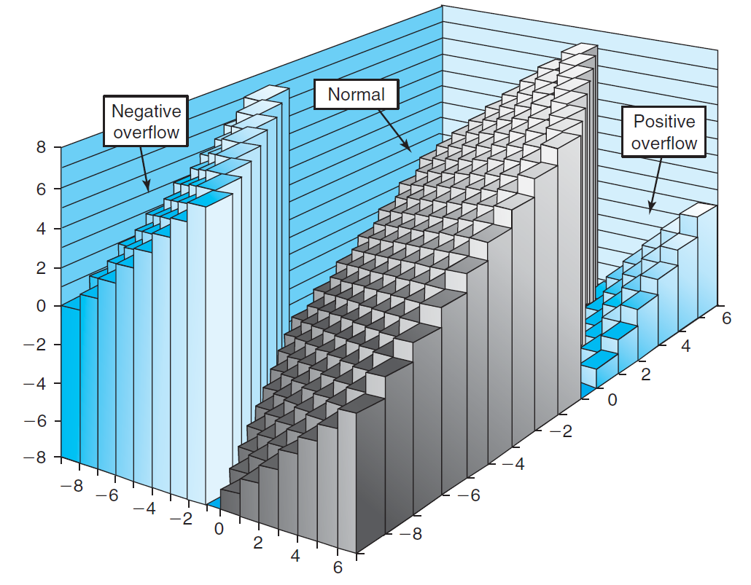
Signed Addition

Slide 11
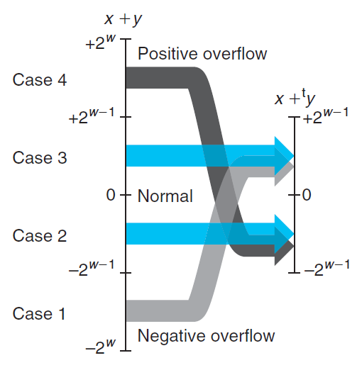
Signed Addition

Slide 12
Detecting Tadd Overflow
Task
  Given s = TAdd_{w}(u , v)
  Determine if s = Add_{w}(u , v)
Claim
  Overflow iff either:
    u, v < 0, s ≥ 0 (NegOver)
    u, v ≥ 0, s < 0 (PosOver)
  ovf = (u<0 == v<0) && (u<0 != s<0);

Slide 13
Detecting Tadd Overflow
int tadd_ok_bugy(int x, int y)
{
int sum = x + y ;
return (sum-x == y) && (sum-y == x)
}
int tsub_ok(int x, int y)
{
return tadd_ok(x, -y) ;
}

Slide 14
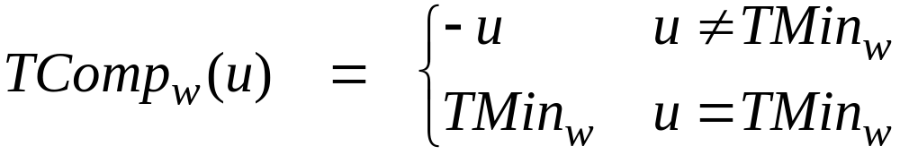
Mathematical Properties of TAdd
Two’s Complement Under TAdd Forms a Group
  Closed, Commutative, Associative, 0 is additive identity
  Every element has additive inverse
    Let
    TAdd_{w}(u , TComp_{w} (u )) = 0

Slide 15
Mathematical Properties of TAdd
Isomorphic Algebra to UAdd
  TAdd_{w} (u , v) = U2T (UAdd_{w}(T2U(u ), T2U(v)))
    Since both have identical bit patterns
  T2U(TAdd_{w} (u , v)) = UAdd_{w}(T2U(u ), T2U(v))

Slide 16
Negating with Complement & Increment
x
1
0
0
1
1
1
0
1
In C
  ~x + 1 == -x
Complement
  Observation: ~x + x == 1111…111 == -1
Increment
  ~x + x + (-x + 1) == -1 + (-x + 1)
  ~x + 1 == -x
+
~x
0
1
1
0
0
0
1
0
-1
1
1
1
1
1
1
1
1

Slide 17
Multiplication
Computing Exact Product of w-bit numbers x, y
  Either signed or unsigned
Ranges
  Unsigned: 0 ≤ x * y ≤ (2^{w} – 1) ² = 2^{2w} – 2^{w+1} + 1
    Up to 2w bits
  Two’s complement min: x *y ≥–2^{w–1}*(2^{w–1}–1) = –2^{2w–2} + 2^{w–1}
    Up to 2w–1 bits
  Two’s complement max: x * y ≤ (–2^{w–1}) ² = 2^{2w–2}
    Up to 2w bits, but only for TMinw²

Slide 18







Multiplication
Unsigned
Signed
Given two bit vectors and
is identical to
in binary

Slide 19
Multiplication
Maintaining Exact Results
  Would need to keep expanding word size with each product computed
  Done in software by “arbitrary precision” arithmetic packages

Slide 20
Power-of-2 Multiply with Shift
k
u
• • •
Operands: w bits
*
2^{k}
0
•••
0
1
0
•••
0
0
True Product: w+k bits
u · 2^{k}
• • •
0
•••
0
0
Discard k bits: w bits
UMult_{w}(u , 2^{k})
•••
0
•••
0
0
TMult_{w}(u , 2^{k})

Slide 21
Power-of-2 Multiply with Shift
Operation
  u << k gives u * 2^{k}
  Both signed and unsigned
Examples
  u << 3 == u * 8
  u << 5 - u << 3 == u * 24
  Most machines shift and add much faster than multiply
    Compiler will generate this code automatically

Slide 22
Security Vulnerability in the XDR Library
1 /*
2 * Illustration of code vulnerability similar to that found in
3 * Sun’s XDR library.
4 */

Slide 23
Security Vulnerability in the XDR Library
5 void* copy_elements(void *ele_src[], int ele_cnt, size_t ele_size) {
6 /*
7 * Allocate buffer for ele_cnt objects, each of ele_size bytes
8 * and copy from locations designated by ele_src
9 */
10 void *result = malloc(ele_cnt * ele_size);
11 if (result == NULL)
12 /* malloc failed */
13 return NULL;

Slide 24
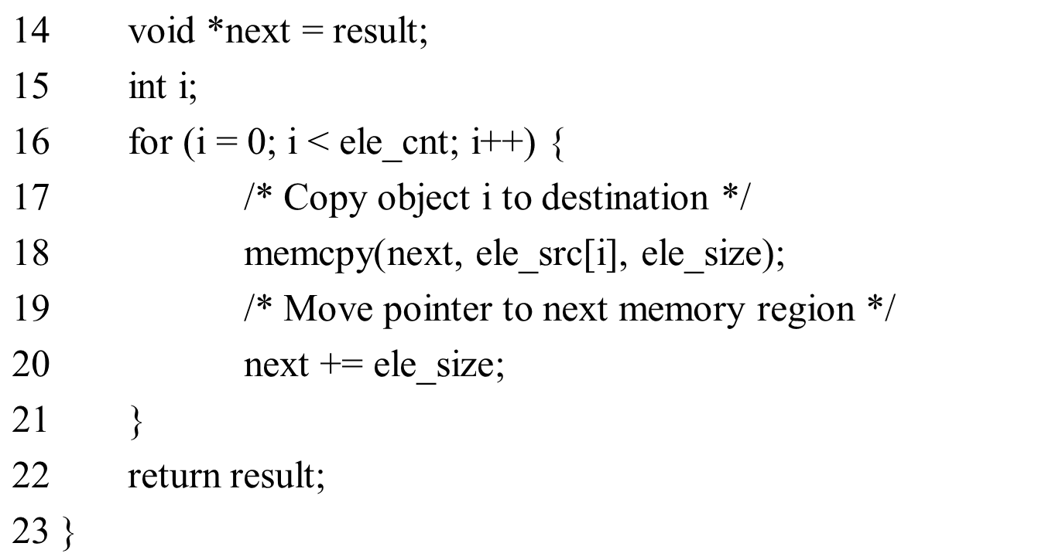
Security Vulnerability in the XDR Library

Slide 25
Machine-Level Representation of Programs I

Slide 26
Outline
Memory and Registers
Suggested reading
  Chap 3.1, 3.2, 3.3

Slide 27
A Historical Perspective – X86
Long evolutionary development
  Started from rather primitive 16-bit processors
  Added more features
    Take the advantage of the technology improvements
    Satisfy the demands for higher performance and for supporting more advanced operating systems
  Laden with features providing backward compatibility that are obsolete

Slide 28
X86 family
8086(1978, 29K)
  The heart of the IBM PC & DOS (8088)
  16-bit, 1M bytes addressable, 640K for users
  x87 for floating pointing
80286(1982, 134K)
  More (now obsolete) addressing modes
  Basis of the IBM PC-AT & Windows
i386(1985, 275K)
  32 bits architecture, flat addressing model
  Support a Unix operating system

Slide 29
X86 family
I486(1989, 1.9M)
  Integrated the floating-point unit onto the processor chip
Pentium(1993, 3.1M)
  Improved performance, added minor extensions
PentiumPro(1995, 5.5M)
  P6 microarchitecture
  Conditional mov
Pentium II(1997, 7M)
  Continuation of the P6

Slide 30
X86 family
Pentium III(1999, 8.2M)
  New class of instructions for manipulating vectors of floating-point numbers(SSE, Stream SIMD Extension)
  Later to 24M due to the incorporation of the level-2 cache
Pentium 4(2001, 42M)
  Netburst microarchitecture with high clock rate but high power consumption
  SSE2 instructions, new data types (eg. Double precision)

Slide 31
X86 family
Pentium 4E: (2004, 125Mtransistors).
  Added hyperthreading
    run two programs simultaneously on a single processor
  EM64T, 64-bit extension to IA32
    First developed by Advanced Micro Devices (AMD)
    x86-64
Core 2: (2006, 291Mtransistors)
  back to a microarchitecture similar to P6
  multi-core (multiple processors a single chip)
  Did not support hyperthreading

Slide 32
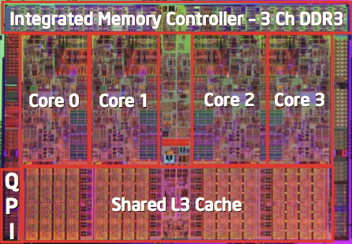
X86 family
Core i7: (2008, 781 M transistors).
  Incorporated both hyperthreading and multi-core
  the initial version supporting two executing programs on each core
Core i7: (2012, 2.27B transistors,
Sandy Bridge-EP)
  8 cores on each chip
  2.7G (3.3G)
Core i7: (2015, 5.5B transistors, Haswell-EP)
  18-core Xeon

Slide 33
X86 family
Advanced Micro Devices (AMD)
  At beginning,
    lagged just behind Intel in technology,
    produced less expensive and lower performance processors
In 1999
  First broke the 1-gigahertz clock-speed barrier
In 2002
  Introduced x86-64
  The widely adopted 64-bit extension to IA32

Slide 34
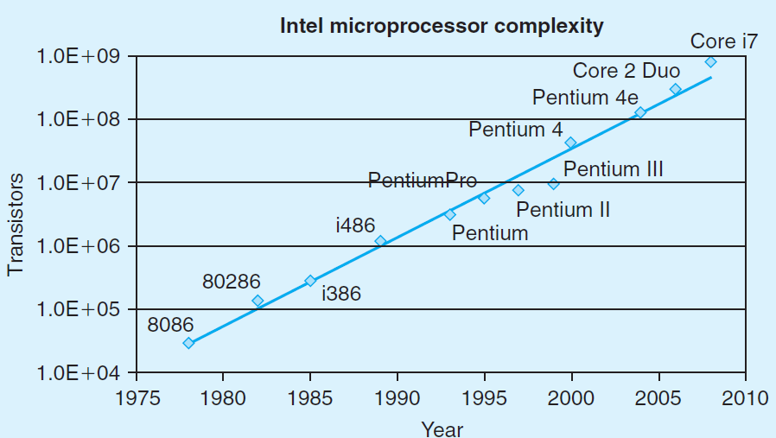
Moor’s Law

Slide 35
Our Coverage
IA32
  The traditional x86
  shark> gcc –m32 hello.c
x86-64
  The emerging standard
  shark> gcc hello.c
  shark> gcc –m64 hello.c

Slide 36
Characteristics of the high level programming languages
Abstraction
  Productive
  reliable
Type checking
As efficient as hand written code
Can be compiled and executed on a number of different machines

Slide 37
Characteristics of the assembly programming languages
Managing memory
Low level instructions to carry out the computation
Highly machine specific

Slide 38
Why should we understand the assembly code
Understand the optimization capabilities of the compiler
Analyze the underlying inefficiencies in the code
Sometimes the run-time behavior of a program is needed

Slide 39
From writing assembly code to understand assembly code
Different set of skills
  Transformations
  Relation between source code and assembly code
Reverse engineering
  Trying to understand the process by which a system was created
    By studying the system and
    By working backward

Slide 40
Understanding how compilation systems works
Optimizing Program Performance
Understanding link-time error
Avoid Security hole
  Buffer Overflow

Slide 41
C constructs
Variable
  Different data types can be declared
Operation
  Assignment, Arithmetic expression evaluation
control
  Loops
  Procedure calls and returns

Slide 42
Code Examples
//C code int accum = 0; int sum(int x, int y) { int t = x+y; accum += t; return t; }

Slide 43
Code Examples
instruction
//C code int accum = 0; int sum(int x, int y) { int t = x+y; accum += t; return t; } | _sum: pushl %ebp movl %esp,%ebp movl 12(%ebp),%eax addl 8(%ebp),%eax addl %eax, accum movl %ebp,%esp popl %ebp ret
Obtain with command gcc –O2 -S code.c Assembly file code.s
addl 8(%ebp),%eax

Slide 44
From C Codes to Assembly codes
Instruction
  Performs a very elementary operation only
Add two signed integers
  C code:
    int t = x+y;
  Assembly code:
    addl 8(%ebp),%eax
    Add 2 4-byte integers
    Similar to expression x +=y

Slide 45
Operands
In high level languages
  Either constants
  Or variable
Example
  A = A + 4
variable
constant

Slide 46
Assembly Code
Operands:
  x: Register %eax
  y: Memory M[%ebp+8]
  4: Immediate $4

Slide 47
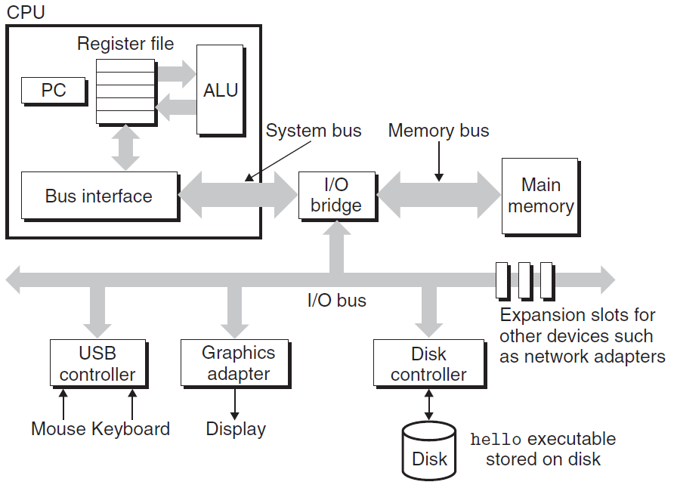
IA-32
Register
Memory
  The fastest storage units in computer systems, 32-bit long
Disk

Slide 48
READ/WRITE operations
Two important concepts
  Name and value
WRITE(name, value) value ← READ(name)
WRITE operation specifies
  a value to be remembered
  a name by which one can recall that value in the future
READ operation specifies
  the name of some previous remembered value
  the memory device returns that value

Slide 49
Registers vs. Virtual Memory
How to name registers
  Using specific names,
  For example, in IA-32
    %eax, %ecx, %edx, %ebx, %esi, %edi, %esp, %ebp
How to name virtual memory
  Using address as we have studied
What’s the difference
  Accessing values in Registers is fast
  Number of the registers is small
  Most modern instructions can access registers only

Slide 50
Where are the variables? — registers & Memory
0xffffffff
0xfffffffe
0x2
0x1
0x0
… … …
%eax
%edx
contents
addresses
%ecx
%ebx
%esi
%edi
%esp
%ebp

Slide 51
Operands
Counterparts in assembly languages
  Immediate ( constant )
  Register ( variable )
  Memory ( variable )
Example
  movl 8(%ebp), %eax
  addl $4, %eax
memory
register
immediate

Slide 52
Express Operands in Assembly (Addressing Mode)
Immediate
  represents a constant
  The format is $imm ($4, $0xffffffff)
Registers
  Register mode E_{a}
    %eax
    The value stored in the register %eax
      Noted as R[E_{a}] (R[%eax])

Slide 53
Virtual spaces
A linear array of bytes
  each with its own unique address (array index) starting at zero
0xffffffff
0xfffffffe
0x2
0x1
0x0
… … … …
contents
addresses

Slide 54
Memory References
The name of the array is annotated as M
If addr is a memory address
M[addr] is the content of the memory starting at addr
addr is used as an array index
How many bytes are there in M[addr]?
  It depends on the context

Slide 55
Indexed Addressing Mode
An expression for
  a memory address (or an array index)
Most general form
  Imm(E_{b}, E_{i}, s)
  Constant “displacement” Imm: 1, 2 or 4 bytes
  Base register E_{b}: Any of 8 integer registers
  Index register E_{i} : Any, except for %esp
  S: Scale: 1, 2, 4, or 8

Slide 56
Memory Addressing Mode
The address represented by the above form
  imm + R[E_{b}] + R[E_{i}] * s
It gives the value
  M[imm + R[E_{b}] + R[E_{i}] * s]

Slide 57
Addressing Mode
Type | Form | Operand value | Name
Immediate | $Imm | Imm | Immediate
Register | E_{a} | R[E_{a}] | Register
Indexed | Imm | M[Imm] | Absolute
Indexed | (E_{a}) | M[R[E_{a}]] | Indirect
Indexed | Imm(E_{b}) | M[Imm+ R[E_{b}]] | Base+displacement
Indexed | (E_{b}, E_{i}) | M[R[E_{b}]+ R[E_{i}]*s] | Indexed
Indexed | Imm(E_{b}, E_{i}) | M[Imm+ R[E_{b}]+ R[E_{i}]] | Scaled indexed
Indexed | (, E_{i}, s) | M[R[E_{i}]*s] | Scaled indexed
Indexed | (E_{b}, E_{i}, s) | M[R[E_{b}]+ R[E_{i}]*s] | Scaled indexed
Indexed | Imm(E_{b}, E_{i}, s) | M[Imm+ R[E_{b}]+ R[E_{i}]*s] | Scaled indexed

Slide 58
Address | Value
0x100 | 0xFF
0x104 | 0xAB
0x108 | 0x13
0x10C | 0x11
Register | Value
%eax | 0x100
%ecx | 0x1
%edx | 0x3
Operand
Value
%eax
0x100
(%eax)
0xFF
$0x108
0x108
0x108
0x13
260(%ecx,%edx)
(0x108)0x13
(%eax,%edx,4)
(0x10C)0x11

