Slide 1
Introduction
Notes:
介绍

Slide 2

Lesson Objectives
After completing this lesson, you should be able to do the following:
Define the goals of the course
List the features of Oracle Database 12c
Discuss the theoretical and physical aspects of a relational database
Describe Oracle server’s implementation of relational database management system (RDBMS) and object relational database management system (ORDBMS)
Identify the development environments that can be used for this course
Describe the database and schema used in this course
Notes:
In this lesson, you gain an understanding of RDBMS. You are also introduced to Oracle SQL Developer and SQL*Plus as development environments used for executing SQL statements, and for formatting and reporting purposes.
完成本课后，您应该能够执行以下操作：
确定课程的目标
列出Oracle数据库12c的功能
讨论关系数据库的理论和物理方面
描述Oracle服务器关系数据库管理系统（RDBMS）和对象关系数据库管理系统（ORDBMS）的实现
确定可用于本课程的开发环境
描述本课程中使用的数据库和模式
在本课中，您将了解RDBMS。 您还将介绍Oracle SQL Developer和SQL * Plus作为用于执行SQL语句以及格式和报告目的的开发环境。

Slide 3

Lesson Agenda
Course objectives, roadmap, and appendixes used in the course
Overview of Oracle Database 12c and related products
Overview of relational database management concepts and terminologies
Human Resource (HR) Schema and the tables used in the course
Introduction to SQL and its development environments
Oracle Database 12c SQL Documentation and Additional Resources
Notes:
课程目标，路线图和附录
Oracle数据库12c及相关产品概述
关系数据库管理概念和术语概述
人力资源（HR）模式和课程中使用的表格
SQL简介及其开发环境
Oracle数据库12c SQL文档和其他资源

Slide 4
Course Objectives
After completing this course, you should be able to:
Identify the major components of Oracle Database
Retrieve row and column data from tables with the SELECT statement
Create reports of sorted and restricted data
Employ SQL functions to generate and retrieve customized data
Run complex queries to retrieve data from multiple tables
Run data manipulation language (DML) statements to update data in Oracle Database
Run data definition language (DDL) statements to create and manage schema objects
Notes:
This course offers you an introduction to the Oracle Database technology. Completing this course will equip you with essential SQL skills. Some of the tasks you can do with these skills include querying single and multiple tables, inserting data in tables, creating tables, and querying metadata.
完成本课程后，您应该能够：
识别Oracle数据库的主要组件
使用SELECT语句从表中检索行和列数据
创建排序和受限数据的报告
使用SQL函数生成和检索自定义数据
运行复杂查询以从多个表中检索数据
运行数据操作语言（DML）语句来更新Oracle数据库中的数据
运行数据定义语言（DDL）语句来创建和管理模式对象
本课程为您介绍Oracle数据库技术。 完成本课程将为您提供必要的SQL技能。 您可以使用这些技能执行的一些任务包括查询单个表和多个表，在表中插入数据，创建表和查询元数据。

Slide 5
Course Roadmap
Lesson 1: Introduction
Lesson 2: Retrieving Data using SQL SELECT
Unit 1: Retrieving, Restricting, and Sorting Data
Lesson 3: Restricting and Sorting Data
Unit 2: Joins, Subqueries, and Set Operators
Lesson 4: Using Single-Row Functions to Customize Output
Lesson 5: Using Conversion Functions and Conditional Expressions
Unit 3: DML and DDL
Notes:
In Unit 1, you will learn how to query data from tables, how to query selected records from tables, and also how to sort the data retrieved from the tables.

Slide 6
Course Roadmap
Lesson 1: Introduction
Lesson 6: Reporting Aggregated Data Using Group Functions
Unit 1: Retrieving, Restricting, and Sorting Data
Lesson 7: Displaying Data from Multiple Tables Using Joins
Unit 2: Joins, Subqueries, and Set Operators
Lesson 8: Using Subqueries to Solve Queries
Unit 3: DML and DDL
Lesson 9: Using Set Operators
Notes:
In Unit 2, you will learn about SQL statements to query and display data from multiple tables using Joins. You will also learn to use subqueries when the condition is unknown, use group functions to aggregate data, and use set operators.

Slide 7
Course Roadmap
Lesson 1: Introduction
Unit 1: Retrieving, Restricting, and Sorting Data
Unit 2: Joins, Subqueries, and Set Operators
Lesson 10: Managing Tables Using DML Statements
Lesson 11: Introduction to Data Definition Language
Unit 3: DML and DDL
Notes:
In Unit 3, you will learn how to create and manage database objects using DDL statements. You will also learn how to manage data in the tables using DML statements.

Slide 8

Appendixes and Practices Used in the Course
Appendix A: Table Descriptions
Appendix B: Using SQL Developer
Appendix C: Using SQL*Plus
Appendix D: Commonly Used SQL Commands
Activity Guide
Practices and Solutions
Additional Practices and Solutions

Slide 9
Lesson Agenda
Course objectives, roadmap, and appendixes used in the course
Overview of Oracle Database 12c and related products
Overview of relational database management concepts and terminologies
Human Resource (HR) Schema and the tables used in the course
Introduction to SQL and its development environments
Oracle Database 12c SQL Documentation and Additional Resources
Notes:
Oracle数据库12c及相关产品概述

Slide 10







Oracle Database 12c: Focus Areas
Information
Management
Application
Development
Oracle Cloud
Infrastructure
Grids
Notes:
By using Oracle Database 12c, you can utilize the following features across focus areas:
With the Infrastructure Grid technology of Oracle, you can pool low-cost servers and storage to form systems that deliver the highest quality of service in terms of manageability, high availability, and performance. Oracle Database 12c also helps you to consolidate and extend the benefits of grid computing and manage changes in a controlled and cost-effective manner.
Oracle Database 12c enables Information Management by providing capabilities in content management, information integration, and information lifecycle management areas. You can manage content of advanced data types such as Extensible Markup Language (XML), text, spatial, multimedia, medical imaging, and semantic technologies using the features provided by Oracle.
With Oracle Database 12c, you can manage all the major Application Development environments such as PL/SQL, Java/JDBC, .NET, Windows, PHP, SQL Developer, and Application Express.
You can now plug into Oracle Cloud with Oracle Database 12c. This will help you to standardize, consolidate, and automate database services on the cloud.
通过使用Oracle数据库12c，您可以跨焦点区域使用以下功能：
通过Oracle的基础架构网格技术，您可以将低成本的服务器和存储集中在一起，形成在可管理性，高可用性和性能方面提供最高质量服务的系统。 Oracle数据库12c还可帮助您整合和扩展网格计算的优势，并以受控和具有成本效益的方式管理变更。
Oracle数据库12c通过提供内容管理，信息集成和信息生命周期管理领域的功能来实现信息管理。您可以使用Oracle提供的功能来管理高级数据类型的内容，如可扩展标记语言（XML），文本，空间，多媒体，医学成像和语义技术。
使用Oracle Database 12c，您可以管理所有主要的应用程序开发环境，如PL / SQL，Java / JDBC，.NET，Windows，PHP，SQL Developer和Application Express。
您现在可以使用Oracle Database 12c插入Oracle Cloud。这将有助于您在云上对数据库服务进行标准化，整合和自动化。

Slide 11






Oracle Database 12c
High Availability
Manageability
Performance
Information
Integration
Security
Notes:
Imagine you have an organization that needs to support multiple terabytes of information for users who demand fast and secure access to business applications round the clock. The database systems must be reliable and must be able to recover quickly in the event of any kind of failure. Oracle Database 12c is designed to help organizations manage infrastructure grids easily and deliver high-quality service:
Manageability: By using some of the change assurance, management automation, and fault diagnostics features, the database administrators (DBAs) can increase their productivity, reduce costs, minimize errors, and maximize quality of service. Some of the useful features that promote better management are the Database Replay facility, the SQL Performance Analyzer, the Automatic SQL Tuning facility, and Real-Time Database Operations Monitoring.
Enterprise Manager Database Express 12c is a web-based tool for managing Oracle databases. It greatly simplifies database performance diagnostics by consolidating the relevant database performance screens into a view called Database Performance Hub. DBAs get a single, consolidated view of the current real-time and historical view of the database performance across multiple dimensions such as database load, monitored SQL and PL/SQL, and Active Session History (ASH) on a single page for the selected time period.
想象一下，您有一个组织需要为需要快速安全地访问业务应用程序的用户提供多TB信息。数据库系统必须可靠，并且在发生任何故障时必须能够快速恢复。 Oracle数据库12c旨在帮助组织轻松管理基础架构网格并提供高质量的服务：
可管理性：通过使用某些变更保证，管理自动化和故障诊断功能，数据库管理员（DBA）可以提高其生产力，降低成本，最大限度地减少错误并最大限度地提高服务质量。促进更好管理的一些有用的功能是数据库重放工具，SQL性能分析器，自动SQL调优工具和实时数据库操作监控。
企业管理器数据库快速12c是一种用于管理Oracle数据库的基于Web的工具。通过将相关数据库性能屏幕合并到称为数据库性能中心的视图中，可大大简化数据库性能诊断。 DBA可以在单个页面上为所选时间获得数据库性能的多个维度的当前实时和历史视图，例如数据库加载，受监视的SQL和PL / SQL以及活动会话历史记录（ASH）期。

Slide 12
Notes:
High availability: By using the high availability features, you can reduce the risk of down time and data loss. These features improve online operations and enable faster database upgrades.
Performance: By using capabilities such as SecureFiles, Result Caches, and so on, you can greatly improve the performance of your database. Oracle Database 12c enables organizations to manage large, scalable, transactional, and data warehousing systems that deliver fast data access using low-cost modular storage.
Security: Oracle Database 12c helps in protecting your information with unique secure configurations, data encryption and masking, and sophisticated auditing capabilities.
Information integration: You can utilize Oracle Database 12c features to integrate data throughout the enterprise in a better way. You can also manage the changing data in your database by using Oracle Database 12c’s advanced information lifecycle management capabilities.
高可用性：通过使用高可用性功能，可以降低停机时间和数据丢失的风险。 这些功能可改进在线操作，并可实现更快的数据库升级
性能：通过使用诸如SecureFiles，结果缓存等功能，可以大大提高数据库的性能。 Oracle数据库12c使组织能够管理大型，可扩展的，事务性的和数据仓库系统，可以使用低成本的模块化存储提供快速的数据访问。
安全性：Oracle Database 12c通过独特的安全配置，数据加密和掩蔽以及复杂的审核功能，有助于保护您的信息。
信息集成：您可以利用Oracle Database 12c功能，以更好的方式整合整个企业的数据。 您还可以使用Oracle Database 12c的高级信息生命周期管理功能来管理数据库中不断变化的数据。

Slide 13
Lesson Agenda
Course objectives, agenda, and appendixes used in the course
Overview of Oracle Database 12c and related products
Overview of relational database management concepts and terminologies
Human Resource (HR) Schema and the tables used in this course
Introduction to SQL and its development environments
Oracle Database 12c SQL Documentation and Additional Resources
Notes:
关系数据库管理概念和术语概述

Slide 14


Relational and Object Relational Database Management Systems
Relational model and object relational model
User-defined data types and objects
Fully compatible with relational database
Supports multimedia and large objects
High-quality database server features
Notes:
Consider a situation where you put all your stationery in a single drawer without organizing. When you want a pencil immediately, you tend to search the entire drawer, which consumes a lot of time. This can be compared to the normal file storage in your system. But if the amount of information is huge, this system becomes inefficient.
Now imagine that you organize your stationery such that all the pencils/pens go into the first drawer, notepads in the second, gluesticks in third, and so on. Now when you want to fetch a pencil immediately, you will know where to find it efficiently. This can be compared to the relational model of storage.
Oracle Database is a Relational Database Management System (RDBMS). An RDBMS that implements object-oriented features such as user-defined types, inheritance, and polymorphism is called an object relational database management system (ORDBMS). Oracle Database has extended the relational model to an object relational model, making it possible to store complex business models in a relational database.
Some of the advantages are:
Improved performance and functionality
Better sharing of runtime data structures
Larger buffer caches
Deferrable constraints
考虑一下您将所有文具放在一个抽屉里而不组织的情况。当你想要一支铅笔时，你会倾向于搜索整个抽屉，消耗大量的时间。这可以与系统中的正常文件存储进行比较。但如果信息量很大，这个系统就会变得无效。
现在想象，你组织你的文具，所有的铅笔/笔进入第一个抽屉，第二个的记事本，第三个的胶纸，等等。现在，当你想要立即拿起一支铅笔时，你会知道在哪里找到它。这可以与存储的关系模型进行比较。
Oracle数据库是一个关系数据库管理系统（RDBMS）。实现面向对象功能（如用户定义的类型，继承和多态）的RDBMS称为对象关系数据库管理系统（ORDBMS）。 Oracle数据库将关系模型扩展到对象关系模型，使得可以在关系数据库中存储复杂的业务模型。
一些优点是：
改进的性能和功能
更好地共享运行时数据结构
较大的缓冲区缓存
可延迟约束

Slide 15
Notes:
Features such as parallel execution of insert, update, and delete operations; partitioning; and parallel-aware query optimization provide benefits to data warehouse applications.
The Oracle model supports client/server and web-based applications that are distributed and multi-tiered.
For more information about the relational and object relational model, refer to Oracle Database Concepts for 12c Database.
诸如并行执行插入，更新和删除操作等功能;分区; 并行感知查询优化为数据仓库应用程序提供了好处。
Oracle模型支持分布式和多层次的客户端/服务器和基于Web的应用程序。
有关关系和对象关系模型的更多信息，请参阅12c数据库的Oracle数据库概念。

Slide 16
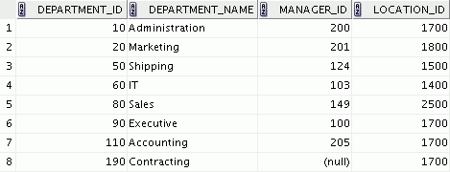
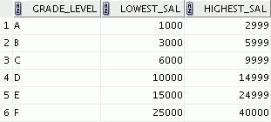




Data Storage on Different Media
Electronic spreadsheet
Filing cabinet
Database
Notes:
Every organization has some information needs. A library keeps a list of members, books, due dates, and fines. A company needs to save information about its employees, departments, and salaries. These pieces of information are called data.
Organizations can store data in various media and in different formats, such as a hard copy document in a filing cabinet, or data stored in electronic spreadsheets, or in databases.
A database is an organized collection of information.
To manage databases, you need a database management system (DBMS). A DBMS is a program that stores, retrieves, and modifies data in databases on request. There are four main types of databases: hierarchical, network, relational, and (most recently) object relational.
每个组织都有一些信息需求。 图书馆保存了会员，书籍，到期日期和罚款清单。 公司需要保存有关员工，部门和工资的信息。 这些信息被称为数据。
组织可以以各种媒体和不同格式存储数据，例如文件柜中的硬拷贝文档，或存储在电子电子表格中或数据库中的数据。
数据库是一个有组织的信息收集。
要管理数据库，您需要一个数据库管理系统（DBMS）。 DBMS是根据请求存储，检索和修改数据库中的数据的程序。 数据库有四种主要类型：分层，网络，关系和（最近）对象关系。

Slide 17

Relational Database Concept
Dr. E. F. Codd proposed the relational model for database systems in 1970.
It is the basis for RDBMS.
The relational model consists of the following:
Collection of objects or relations
Set of operators to act on the relations
Data integrity for accuracy and consistency
Notes:
The principles of the relational model were first outlined by Dr. E. F. Codd in a June 1970 paper titled A Relational Model of Data for Large Shared Data Banks. In this paper, Dr. Codd proposed the relational model for database systems.
The common models used at that time were hierarchical and network, or even simple flat-file data structures. Relational database management systems (RDBMS) soon became very popular, especially for their ease of use and flexibility in structure. In addition, a number of innovative vendors, such as Oracle, supplemented the RDBMS with a suite of powerful application development and user-interface products, thereby providing a total solution.
Components of the Relational Model
Collections of objects or relations that store the data
A set of operators that can act on the relations to produce other relations
Data integrity for accuracy and consistency
关系模型的原则首先由E. F. Codd博士在1970年6月的一篇题为“大型共享数据库数据关系模型”的文件中概述。 在本文中，Codd博士提出了数据库系统的关系模型。
当时使用的常用模型是分层和网络，甚至简单的平面文件数据结构。 关系数据库管理系统（RDBMS）很快就变得非常受欢迎，特别是对于其易用性和结构灵活性。 此外，一些创新的供应商（如Oracle）通过一系列强大的应用程序开发和用户界面产品来补充RDBMS，从而提供了一个完整的解决方案。
关系模型的组成部分
存储数据的对象或关系的集合
一套可以对关系发挥作用的经营者，产生其他关系
数据完整性的准确性和一致性

Slide 18



Definition of a Relational Database
A relational database is a collection of relations or two-dimensional tables controlled by the Oracle server.
Oracle server
Table name: EMPLOYEES
Table name: DEPARTMENTS
…
…
Notes:
Every organization has information that it must store and manage to meet its requirements.
For example, you might want to store information about all the employees in your company. In a relational database, you create several tables to store different pieces of information about your employees, such as an employee table, a department table, and a salary table.
A relational database uses relations or two-dimensional tables to store information.
But before storing any information in the database, you need to first design a model of how and what data will be stored in the tables. In the following slide, you will learn about different data models that help in visualizing the architecture.
每个组织都有信息，它必须存储和管理以满足其要求。
例如，您可能想要存储有关您公司中所有员工的信息。 在关系数据库中，您创建多个表以存储有关员工的不同信息，例如员工表，部门表和薪水表。
关系数据库使用关系或二维表来存储信息。
但在将任何信息存储在数据库中之前，您需要首先设计一个如何以及将哪些数据存储在表中的模型。 在下面的幻灯片中，您将了解有助于可视化体系结构的不同数据模型。

Slide 19







Data Models
Model of system in client’s mind
Entity model of client’s model
Oracle
server
Table model of entity model
Tables on disk
Notes:
Models are the cornerstone of design. Engineers build a model of a car to work out any details before putting it into production. In the same manner, system designers develop models to explore ideas and improve the understanding of database design.
Purpose of Models
Models help you to communicate the concepts that are in people’s minds. They can be used to do the following:
Communicate
Categorize
Describe
Specify
Investigate
Evolve
Analyze
Imitate
The objective is to produce a model that fits a multitude of these uses, can be understood by an end user, and contains sufficient detail for a developer to build a database system. An Entity-Relationship model is one such data model.
模型是设计的基石。 工程师在投入生产之前，建立一个汽车模型来制定出任何细节。 以同样的方式，系统设计师开发模型来探索想法并提高对数据库设计的理解。
模型的目的
模型可帮助您沟通人心中的概念。 它们可用于执行以下操作：
通信
分类
描述
指定
调查
发展
分析
模拟
目标是产生一个适合大量这些用途的模型，可以由最终用户理解，并且包含足够的细节来开发人员构建数据库系统。 实体关系模型是一个这样的数据模型。

Slide 20
Entity Relationship Model
Create an entity relationship diagram from business specifications or narratives:
Scenario:
“. . . Assign one or more employees to a department. . .”
“. . . Some departments do not yet have assigned employees. . .”
EMPLOYEE
#* number
* name
o job title
DEPARTMENT
#* number
* name
o location
assigned to
composed of
Notes:
Entity relationship model is widely used because in an effective system, data is divided into discrete categories or entities.
An entity relationship (ER) model is an illustration of the various entities in a business and the relationships among them. You can derive an ER model from business specifications or narratives and build it during the analysis phase of the system development life cycle. ER models separate the information required by a business from the activities performed within the business. Although businesses can change their activities, the type of information tends to remain constant. Therefore, the data structures also tend to be constant.
Benefits of ER Modeling
You can:
Document information for the organization in a clear, precise format
Provide a clear picture of the scope of the information requirement
Provide an easily understood pictorial map for database design
Offer an effective framework for integrating multiple applications
实体关系模型被广泛使用，因为在有效的系统中，数据被分为离散类别或实体。
实体关系（ER）模型是企业中各种实体及其关系的说明。 您可以从业务规范或叙述导出ER模型，并在系统开发生命周期的分析阶段进行构建。 ER模型将业务所需的信息与业务中执行的活动分开。 虽然企业可以改变活动，但信息类型往往保持不变。 因此，数据结构也趋向于恒定。
ER建模的好处
您可以：
以清晰，精确的格式为组织提供文件信息
提供信息要求范围的清晰图片
提供一个易于理解的数据库设计图示
为整合多个应用程序提供有效的框架

Slide 21
Notes:
Key Components
Entity: An aspect of significance about which information must be known. For example, departments, employees, and orders are entities.
Attribute: Something that describes or qualifies an entity. For example, in the employee entity, the attributes would be the employee number, name, job title, hire date, department number, and so on. Each of the attributes is either required or optional. This state is called optionality.
Relationship: A named association between entities showing optionality and degree. For example, an employee assigned to a department is a relationship between the employee and department entities.
关键组件
实体：必须了解哪些信息的重要性。 例如，部门，员工和订单是实体。
属性：描述或限定实体的东西。 例如，在员工实体中，属性将是雇员编号，姓名，职称，雇用日期，部门号等。 每个属性都是必需的或可选的。 这种状态称为可选性。
关系：显示可选性和程度的实体之间的命名关联。 例如，分配给部门的员工是员工和部门实体之间的关系。

Slide 22
Entity Relationship Modeling Conventions
Entity
Attribute
Singular, unique name
Uppercase
Soft box
Synonym in parentheses
Singular name
Lowercase
Mandatory marked with ‘*’
Optional marked with ‘o’
EMPLOYEE
#* number
* name
o job title
DEPARTMENT
#* number
* name
o location
assigned to
composed of
Unique Identifier (UID)
Primary marked with “#”
Secondary marked with “(#)”
Notes:
Entities
To represent an entity in a model, use the following conventions:
Singular, unique entity name
Entity name in uppercase
Soft box
Optional synonym names in uppercase within parentheses: ( )
Attributes
To represent an attribute in a model, use the following conventions:
Singular name in lowercase
Asterisk (*) tag for mandatory attributes (that is, values that must be known)
Letter “o” tag for optional attributes (that is, values that may be known)
实体
要在模型中表示实体，请使用以下约定：
独特的实体名称
实体名称大写
软盒
括号内的大写可选同义词名称：（）
属性
要在模型中表示属性，请使用以下约定：
单数名字小写
用于强制属性的星号（*）标签（即必须知道的值）
字母“o”标签用于可选属性（即可能已知的值）

Slide 23
Notes:
Relationships
Each direction of the relationship contains:
A label: For example, taught by or assigned to
An optionality: Either must be or maybe
A degree: Either one and only one or one or more
关系
关系的每个方向都包含：
一个标签：例如，教导或分配给
一个可选性：一定是或者也许
等级：只有一个或一个或多个
Note: The term cardinality is a synonym for the term degree.
Each source entity {may be | must be} in relation {one and only one | one or more} with the destination entity.
Note: The convention is to read clockwise.
Unique Identifiers
A unique identifier (UID) is any combination of attributes or relationships, or both, that serves to distinguish occurrences of an entity. Each entity occurrence must be uniquely identifiable.
Tag each attribute that is part of the UID with a hash sign “#”.
Tag secondary UIDs with a hash sign in parentheses (#).
For example, employee ID is an unique identifier in EMPLOYEE entity since no two employees can have the same employee ID.

Slide 24
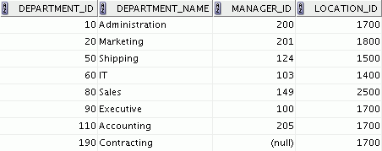
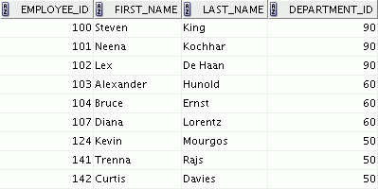
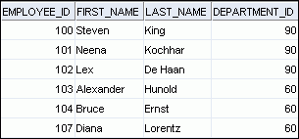
Relating Multiple Tables
Each row of data in a table can be uniquely identified by a primary key.
You can logically relate data from multiple tables using foreign keys.
Table name: DEPARTMENTS
Table name: EMPLOYEES
…
Primary key
Primary key
Foreign key
Notes:
Each table contains data that describes exactly one entity. For example, the EMPLOYEES table contains information about employees. Categories of data are listed across the top of each table, and individual records are listed below. Each table can have one primary key, which in effect names the row and ensures no duplicate rows exist.
Because data about different entities is stored in different tables, you may need to combine two or more tables to answer a particular question. For example, you may want to know the location of the department where an employee works.
In this scenario, you need information from the EMPLOYEES table (which contains data about employees) and the DEPARTMENTS table (which contains information about departments). With an RDBMS, you can relate the data in one table to the data in another table by using foreign keys. A foreign key is a column (or a set of columns) that refers to a primary key in the same table or another table.
You can use the ability to relate data in one table to the data in another table to organize information in separate, manageable units. Employee data can be kept logically distinct from the department data by storing them in separate tables.
每个表都包含一个实体描述的数据。例如，EMPLOYEES表包含有关员工的信息。数据类别列在每个表的顶部，单个记录列在下面。每个表可以有一个主键，这实际上命名该行，并确保不存在重复的行。
由于有关不同实体的数据存储在不同的表中，您可能需要组合两个或多个表以回答特定问题。例如，您可能想知道员工工作部门的位置。
在这种情况下，您需要EMPLOYEES表（其中包含有关员工的数据）和DEPARTMENTS表（其中包含有关部门的信息）的信息。使用RDBMS，您可以通过使用外键将一个表中的数据与另一个表中的数据相关联。外键是引用同一个表或另一个表中的主键的列（或一组列）。
您可以使用将表中的数据与另一个表中的数据相关联的功能来以单独的，可管理的单位组织信息。通过将员工数据存储在单独的表中，员工数据可以在逻辑上与部门数据保持不同。

Slide 25
Notes:
Guidelines for Primary Keys and Foreign Keys
You cannot use duplicate values in a primary key.
Primary keys generally cannot be changed.
Foreign keys are based on data values and are purely logical (not physical) pointers.
A foreign key value must match an existing primary key value or unique key value; otherwise, it must be null.
A foreign key must reference either a primary key or a unique key column.
主键和外键指南
您不能在主键中使用重复值。
主键通常不能更改。
外键基于数据值，纯粹是逻辑（非物理）指针。
外键值必须与现有主键值或唯一键值匹配; 否则，它必须为null。
外键必须引用主键或唯一键列。

Slide 26
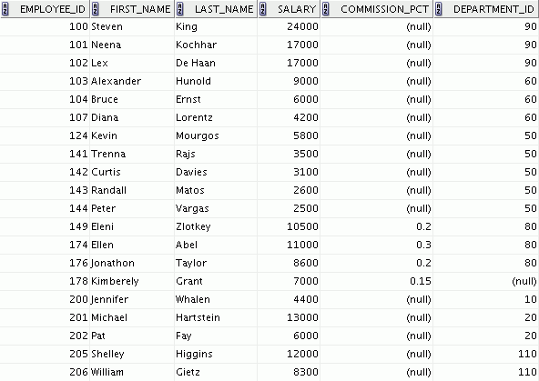
Relational Database Terminology
3
2
4
5
6
1
Notes:
A relational database can contain one or many tables. A table is the basic storage structure of an RDBMS. A table holds all the data necessary about something in the real world, such as employees, invoices, or customers.
The slide shows the contents of the EMPLOYEES table or relation. The numbers indicate the following:
1. A single row (or tuple) representing all the data required for a particular employee. Each row in a table should be identified by a primary key, which permits no duplicate rows. The order of rows is insignificant; specify the row order when the data is retrieved.
2. A column or attribute containing the employee number. The employee number identifies a unique employee in the EMPLOYEES table. In this example, the employee number column is designated as the primary key. A primary key must contain a value and the value must be unique.
A column that is not a key value. A column represents one kind of data in a table; in this example, the data is the salaries of all the employees. Column order is insignificant when storing data; specify the column order when the data is retrieved.
关系数据库可以包含一个或多个表。表是RDBMS的基本存储结构。表格包含了现实世界中有关某些事物的所有数据，如员工，发票或客户。
幻灯片显示EMPLOYEES表或关系的内容。数字表示如下：
1.表示特定员工所需的所有数据的单行（或元组）。表中的每一行都应该由一个主键标识，这样不允许重复的行。行的顺序是微不足道的;在检索数据时指定行顺序。
2.包含员工编号的列或属性。员工编号标识EMPLOYEES表中的唯一员工。在此示例中，将员工号码列指定为主键。主键必须包含一个值，该值必须是唯一的。
3.不是键值的列。列表示表中的一种数据;在这个例子中，数据是所有员工的工资。存储数据时，列顺序不重要;在检索数据时指定列顺序。

Slide 27
Notes:
4. A column containing the department number, which is also a foreign key. A foreign key is a column that defines how tables relate to each other. A foreign key refers to a primary key or a unique key in the same table or in another table. In the example, DEPARTMENT_ID uniquely identifies a department in the DEPARTMENTS table.
5. A field can be found at the intersection of a row and a column. There can be only one value in it.
A field may have no value in it. This is called a null value. In the EMPLOYEES table, only those employees who have the role of sales representative have a value in the COMMISSION_PCT (commission) field.
4.包含部门号码的列，也是外键。 外键是定义表如何相互关联的列。 外键指的是同一表或另一个表中的主键或唯一键。 在示例中，DEPARTMENT_ID唯一标识DEPARTMENTS表中的一个部门。
5.可以在行和列的交叉点找到一个字段。 它只能有一个值。
一个字段可能没有价值。 这被称为空值。 在EMPLOYEES表中，只有具有销售代表角色的员工在COMMISSION_PCT（佣金）字段中有一个值。

Slide 28
Lesson Agenda
Course objectives, agenda, and appendixes used in the course
Overview of Oracle Database 12c and related products
Overview of relational database management concepts and terminologies
Human Resource (HR) Schema and the tables used in this course
Introduction to SQL and its development environments
Oracle Database 12c SQL Documentation and Additional Resources
Notes:
人力资源（HR）模式和本课程中使用的表格

Slide 29








Human Resources (HR) application
HR Application
Basic Search:
Advanced Search:
First Name
Emp. ID
Last Name
Department
GO
Notes:
The slide shows an example of a sample HR application, which is generally used by the HR department in the organization. The HR application consists of details of all the employees in the organization whose information is stored in various tables such as EMPLOYEES, DEPARTMENTS, JOBS, LOCATIONS, etc. The HR managers use this application to search for an employee’s details, to update employee records such as when an employee gets promoted, to add new employee records such as when an employee joins the organization, or delete employee records of employees who have quit. In addition to these, the HR managers can use this application to generate a variety of reports, such as the number of employees who have quit and the number of new hires, average salaries in each department, list of employees who received a bonus this year, etc.
In this course, we will discuss various scenarios based on the sample HR application. You will also see different examples in the lessons based on the HR schema.
该幻灯片显示了人力资源部门在组织中通常使用的示例人力资源应用程序的示例。人力资源应用程序包括组织中所有员工的详细信息，其信息存储在各种表格中，如员工，部门，职位，地点等。人力资源经理使用此应用程序搜索员工的详细信息，更新员工记录当员工晋升时，添加新的员工记录，例如员工何时加入组织，或删除退出员工的员工记录。除此之外，人力资源经理可以使用此应用程序生成各种报告，例如退出的员工人数和新员工人数，每个部门的平均工资，今年收到奖金的员工名单等等
在本课程中，我们将讨论基于样本人力资源应用程序的各种场景。您还将在基于人力资源模式的课程中看到不同的示例。

Slide 30







Tables Used in This Course
DEPARTMENTS
department_id
department_name
manager_id
location_id
LOCATIONS
location_id
street_address
postal_code
city
state_province
country_id
JOB_HISTORY employee_id
start_date
end_date
job_id
department_id
EMPLOYEES
employee_id
first_name
last_name
email
phone_number
hire_date
job_id
salary
commission_pct
manager_id
department_id
COUNTRIES
country_id
country_name
region_id
JOBS job_id
job_title
min_salary
max_salary
REGIONS
region_id
region_name
JOB_GRADES
grade_level
lowest_sal
highest_sal
Notes:
This course uses data from the following tables:
Table Descriptions
The EMPLOYEES table contains information about all the employees, such as their first and last names, job IDs, salaries, hire dates, department IDs, and manager IDs. This table is a child of the DEPARTMENTS table.
The DEPARTMENTS table contains information such as the department ID, department name, manager ID, and location ID. This table is the primary key table to the EMPLOYEES table.
The LOCATIONS table contains department location information. It contains location ID, street address, city, state province, postal code, and country ID information. It is the primary key table to the DEPARTMENTS table and is a child of the COUNTRIES table.
The COUNTRIES table contains the country names, country IDs, and region IDs. It is a child of the REGIONS table. This table is the primary key table to the LOCATIONS table.
The REGIONS table contains region IDs and region names of the various countries. It is a primary key table to the COUNTRIES table.
本课程使用下列表格中的数据：
表说明
EMPLOYEES表包含有关所有员工的信息，例如姓名，职位ID，工资，雇用日期，部门ID和经理ID。该表是DEPARTMENTS表的子项。
DEPARTMENTS表包含部门ID，部门名称，管理员ID和位置ID等信息。该表是EMPLOYEES表的主键表。
LOCATIONS表包含部门位置信息。它包含位置ID，街道地址，城市，省份，邮政编码和国家ID信息。它是DEPARTMENTS表的主键表，是COUNTRIES表的子代。
COUNTRIES表包含国家名称，国家/地区ID和区域ID。它是REGIONS表的一个孩子。该表是LOCATIONS表的主键表。
REGIONS表包含各国的区域ID和区域名称。它是COUNTRIES表的主键表。

Slide 31
Notes:
The JOB_GRADES table identifies a salary range per job grade. The salary ranges do not overlap.
The JOB_HISTORY table stores job history of the employees.
The JOBS table contains job titles and salary ranges.
JOB_GRADES表识别每个工作职等的工资范围。 工资范围不重叠。
JOB_HISTORY表存储员工的工作历史。
JOBS表包含职称和工资范围。

Slide 32
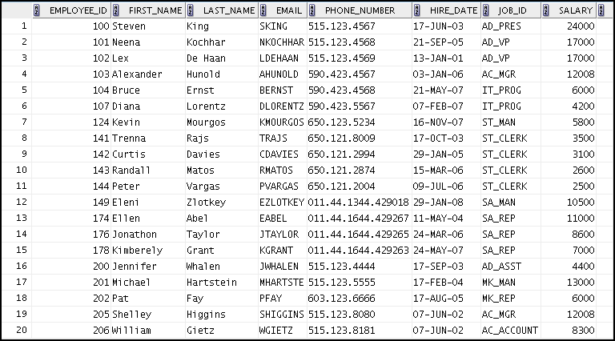
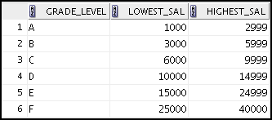
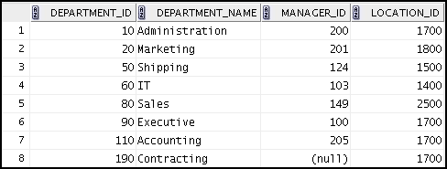
Tables Used in the Course
EMPLOYEES
JOB_GRADES
DEPARTMENTS
Notes:
The following main tables are used in this course:
EMPLOYEES table: Gives details of all the employees
DEPARTMENTS table: Gives details of all the departments
JOB_GRADES table: Gives details of salaries for various grades
Apart from these tables, you will also use the other tables listed in the previous slide such as the LOCATIONS and the JOB_HISTORY table.
Note: The structure and data for all the tables are provided in Appendix A.
本课程使用以下主要表格：
EMPLOYEES表：提供所有员工的详细信息
DEPARTMENTS表：提供所有部门的详细信息
JOB_GRADES表：提供不同等级的工资细节
除了这些表格，您还将使用上一张幻灯片中列出的其他表格，如LOCATIONS和JOB_HISTORY表。
注：所有表格的结构和数据见附录A.

Slide 33
Lesson Agenda
Course objectives, agenda, and appendixes used in the course
Overview of Oracle Database 12c and related products
Overview of relational database management concepts and terminologies
Human Resource (HR) Schema and the tables used in this course
Introduction to SQL and its development environments
Oracle Database 12c SQL Documentation and Additional Resources
Notes:
SQL简介及其开发环境

Slide 34

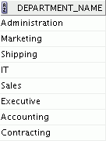
Using SQL to Query Your Database
Structured query language (SQL) is:
The ANSI standard language for operating relational databases
Efficient, easy to learn and use
Functionally complete (With SQL, you can define, retrieve, and manipulate data in tables.)
SELECT department_name
FROM departments;
Oracle Server
Notes:
In a relational database, you do not specify the access route to the tables, and you do not need to know how the data is arranged physically.
To access the database, you execute a structured query language (SQL) statement, which is the American National Standards Institute (ANSI) standard language for operating relational databases. SQL is also compliant to ISO Standard (SQL 1999).
SQL is a set of statements with which all programs and users access data in an Oracle database. Application programs and Oracle tools often allow users access to the database without using SQL directly, but these applications, in turn, must use SQL when executing the user’s request. Oracle Application Express is one such example.
SQL provides statements for a variety of tasks, including:
Querying data
Inserting, updating, and deleting rows in a table
Creating, replacing, altering, and dropping objects
Controlling access to the database and its objects
Guaranteeing database consistency and integrity
SQL unifies all of the preceding tasks in one consistent language and enables you to work with data at a logical level.
在关系数据库中，您不指定访问表的访问路径，您不需要知道数据的物理位置。
要访问数据库，您执行结构化查询语言（SQL）语句，这是用于操作关系数据库的美国国家标准协会（ANSI）标准语言。 SQL也符合ISO标准（SQL 1999）。
SQL是一组语句，所有程序和用户都可以通过该语句访问Oracle数据库中的数据。应用程序和Oracle工具通常允许用户直接访问数据库，而不直接使用SQL，但这些应用程序在执行用户请求时必须使用SQL。 Oracle Application Express就是这样一个例子。
SQL为各种任务提供语句，包括：
查询数据
插入，更新和删除表中的行
创建，替换，更改和删除对象
控制对数据库及其对象的访问
保证数据库的一致性和完整性
SQL将所有前述任务统一为一致的语言，并使您能够在逻辑级别处理数据。

Slide 35



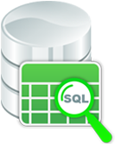
How SQL Works
SQL is standalone and powerful.
SQL processes groups of data.
SQL lets you work with data at a logical level.
Notes:
Using SQL benefits all types of users, including application programmers, database administrators, managers, and end users. The purpose of SQL is to provide an interface to a relational database such as Oracle Database. All SQL statements are instructions to the database. Some of the features of SQL are:
It processes sets of data as groups rather than as individual units.
It provides automatic navigation to the data.
It uses statements that are complex and powerful individually, and are therefore standalone.
SQL lets you work with data at the logical level. For example, to retrieve a set of rows from a table, you define a condition used to filter the rows. All rows satisfying the condition are retrieved in a single step and can be passed as a unit to the user, to another SQL statement, or to an application. You need not deal with the rows one by one, nor do you have to worry about how they are physically stored or retrieved.
使用SQL可以使所有类型的用户受益，包括应用程序员，数据库管理员，管理员和最终用户。 SQL的目的是为关系数据库（如Oracle数据库）提供一个接口。 所有SQL语句都是指向数据库的指令。 SQL的一些功能是：
它将数据集合作为组而不是单个单元进行处理。
它提供对数据的自动导航。
它使用单独复杂和强大的语句，因此是独立的。
SQL允许您在逻辑级别处理数据。 例如，要从表中检索一组行，您可以定义用于过滤行的条件。 满足条件的所有行都是在单个步骤中检索的，可以作为单位传递给用户，另一个SQL语句或应用程序。 您不必一一处理这些行，也不必担心物理存储或检索的方式。

Slide 36
SQL Statements Used in the Course
Data manipulation language (DML)
SELECT
INSERT
UPDATE
DELETE
MERGE
Data definition language (DDL)
CREATE
ALTER
DROP
RENAME
TRUNCATE
COMMENT
Data control language (DCL)
GRANT
REVOKE
Transaction control
COMMIT
ROLLBACK
SAVEPOINT
Notes:
SQL statements are used to access the database and maintain the data.
SQL statements supported by Oracle comply with industry standards. Oracle Corporation ensures future compliance with evolving standards by actively involving key personnel in SQL standards committees. The industry-accepted committees are ANSI and International Standards Organization (ISO). Both ANSI and ISO have accepted SQL as the standard language for relational databases.
SQL语句用于访问数据库并维护数据。
Oracle支持的SQL语句符合行业标准。 Oracle公司通过积极参与SQL标准委员会的关键人员，确保未来遵循不断发展的标准。 业界认可的委员会是ANSI和国际标准组织（ISO）。 ANSI和ISO均接受SQL作为关系数据库的标准语言。

Slide 37
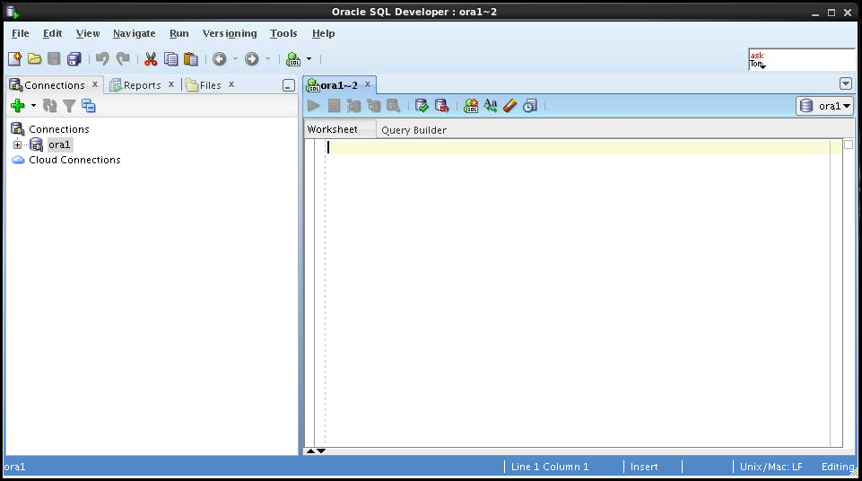
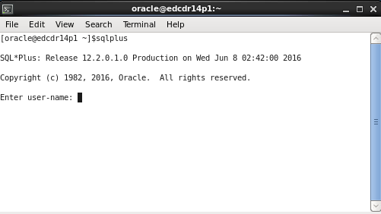
Development Environments for SQL
There are two development environments for this course:
The primary tool is Oracle SQL Developer.
The SQL*Plus command-line interface can also be used.
SQL Developer
SQL*Plus
Notes:
There are various development environments for writing SQL statements. Oracle SQL Developer and Oracle SQL*Plus are the commonly used tools.
Oracle SQL Developer
Oracle SQL Developer is a graphical interface for developing SQL. It provides features to view the database components and update values without writing any SQL query. In this course, Oracle SQL Developer is used to create and execute example SQL statements. You will use Oracle SQL Developer to perform the hands-on exercises.
Oracle SQL*Plus
If you like working with a command-line interface, you can use Oracle SQL*Plus, which is a command-line based environment. It can also be used to run all SQL commands covered in this course.
Note
See Appendix B for information about using Oracle SQL Developer, including simple instructions on the installation process.
See Appendix C for information about using Oracle SQL*Plus.
编写SQL语句有各种开发环境。 Oracle SQL Developer和Oracle SQL * Plus是常用的工具。
Oracle SQL Developer
Oracle SQL Developer是开发SQL的图形界面。 它提供查看数据库组件和更新值而不编写任何SQL查询的功能。 在本课程中，Oracle SQL Developer用于创建和执行示例SQL语句。 您将使用Oracle SQL Developer执行实践练习。
Oracle SQL * Plus
如果您喜欢使用命令行界面，可以使用Oracle SQL * Plus，这是基于命令行的环境。 它也可以用于运行本课程涵盖的所有SQL命令。
注意
有关使用Oracle SQL Developer的信息，请参阅附录B，其中包括有关安装过程的简单说明。
有关使用Oracle SQL * Plus的信息，请参阅附录C.

Slide 38
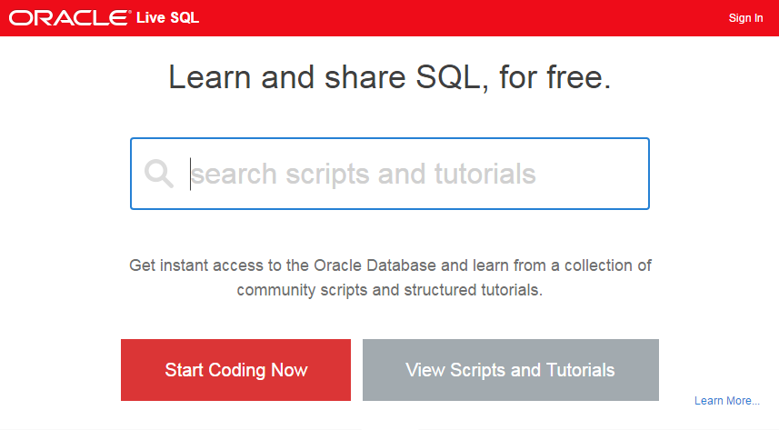

Introduction to Oracle Live SQL
Easy way to learn, access, test, and share SQL and PL/SQL scripts on Oracle Database
Sign up and use it free of cost.
Notes:
Oracle Live SQL is another environment where you can write and execute SQL statements.
You can now learn SQL without the need to install a database or download any tool. Oracle Live SQL exists to provide the Oracle database community with an easy online way to test and share SQL and PL/SQL application development concepts.
Let us look at some of the features of Oracle Live SQL:
Provides browser-based SQL worksheet access to an Oracle database schema
Has the ability to save and share SQL scripts
Provides a schema browser to view and extend database objects
Provides access to interactive educational tutorials
Provides customized data access examples for PL/SQL, Java, PHP, C
You can continue to learn SQL by using Live SQL yourself. All you need is your Oracle Technology Network (OTN) credentials and an interest in learning SQL.
Note: Oracle Live SQL cannot be used to execute the lab exercises without the initial schema setup.
Oracle Live SQL是另一个可以编写和执行SQL语句的环境。
您现在可以学习SQL，而无需安装数据库或下载任何工具。 存在Oracle Live SQL，为Oracle数据库社区提供了一种简单的在线方式来测试和共享SQL和PL / SQL应用程序开发概念。
我们来看看Oracle Live SQL的一些功能：
提供基于浏览器的SQL工作表访问Oracle数据库模式
有能力保存和共享SQL脚本
提供一个模式浏览器来查看和扩展数据库对象
提供访问互动教育教程
为PL / SQL，Java，PHP，C提供定制的数据访问示例
您可以继续使用Live SQL学习SQL。 所有您需要的是您的Oracle技术网络（OTN）凭据和对学习SQL的兴趣。
注意：在没有初始架构设置的情况下，Oracle Live SQL不能用于执行实验练习。

Slide 39
Lesson Agenda
Course objectives, agenda, and appendixes used in the course
Overview of Oracle Database 12c and related products
Overview of relational database management concepts and terminologies
Human Resource (HR) Schema and the tables used in this course
Introduction to SQL and its development environments
Oracle Database 12c SQL Documentation and Additional Resources
Notes:
Oracle数据库12c SQL文档和其他资源

Slide 40

Oracle Database Documentation
Oracle Database New Features Guide
Oracle Database Reference
Oracle Database SQL Language Reference
Oracle Database Concepts
Oracle Database SQL Developer User’s Guide
Notes:
Navigate to https://docs.oracle.com/en/database/database.html to access the Oracle Database 12c documentation library.

Slide 41

Additional Resources
For additional information about Oracle Database 12c, refer to the following:
Oracle Database 12c: New Features eStudies
Oracle Learning Library:
http://www.oracle.com/goto/oll
Oracle Cloud:
cloud.oracle.com
The online SQL Developer Home Page, which is available at:
http://www.oracle.com/technology/products/database/sql_developer/index.html
The SQL Developer tutorial, which is available online at:
http://download.oracle.com/oll/tutorials/SQLDeveloper/index.htm

Slide 42

Summary
In this lesson, you should have learned about:
The goals of the course
Features of Oracle Database 12c
The theoretical and physical aspects of a relational database
Oracle server’s implementation of RDBMS and ORDBMS
The development environments that can be used for this course
The database and schema used in this course
Notes:
Relational database management systems are composed of objects or relations. They are managed by operations and governed by data integrity constraints.
Oracle Corporation produces products and services to meet your RDBMS needs. The main products are the following:
Oracle Database, which you use to store and manage information by using SQL
Oracle Fusion Middleware, which you use to develop, deploy, and manage modular business services that can be integrated and reused
Oracle Enterprise Manager Grid Control, which you use to manage and automate administrative tasks across sets of systems in a grid environment
SQL
The Oracle server supports ANSI-standard SQL and contains extensions. SQL is the language that is used to communicate with the server to access, manipulate, and control data.
关系数据库管理系统由对象或关系组成。 它们由操作管理，并受数据完整性限制的约束。
Oracle Corporation生产产品和服务，以满足您的RDBMS需求。 主要产品有：
Oracle数据库，用于通过使用SQL来存储和管理信息
Oracle融合中间件，用于开发，部署和管理可集成和重用的模块化业务服务
Oracle企业管理器网格控制，用于在网格环境中跨系统集合管理和自动化管理任务
SQL
Oracle服务器支持ANSI标准SQL并包含扩展。 SQL是用于与服务器通信以访问，操纵和控制数据的语言。

Slide 43

Practice 1: Overview
This practice covers the following topics:
Starting Oracle SQL Developer
Creating a new database connection
Browsing the HR tables
Notes:
In this practice, you perform the following:
Start Oracle SQL Developer and create a new connection to the ora1 account.
Use Oracle SQL Developer to examine data objects in the ora1 account. The ora1 account contains the HR schema tables.
Note the following location for the lab files:
/home/oracle/labs/sql1/labs
If you are asked to save any lab files, save them in this location.
In any practice, there may be exercises that are prefaced with the phrases “If you have time” or “If you want an extra challenge.” Work on these exercises only if you have completed all other exercises within the allocated time and would like a further challenge to your skills.
Perform the practices slowly and precisely. You can experiment with saving and running command files. If you have any questions at any time, ask your instructor.
Note: All written practices use Oracle SQL Developer as the development environment. Although it is recommended that you use Oracle SQL Developer, you can also use SQL*Plus that is available in this course.
在这种做法中，您执行以下操作：
启动Oracle SQL Developer并创建与ora1帐户的新连接。
使用Oracle SQL Developer来检查ora1帐户中的数据对象。 ora1帐户包含HR模式表。
请注意实验室文件的以下位置：
/家庭/ ORACLE /实验室/ SQL1 /实验室
如果要求您保存任何实验室文件，请将其保存在此位置。
在任何实践中，可能会出现以“如果你有时间”或“如果你想要额外的挑战”这个词的前面的练习。只有在已分配的时间内完成了所有其他练习，并且想要进一步挑战你的技能。
慢慢准确地执行实践。您可以尝试保存并运行命令文件。如果您随时有任何疑问，请咨询您的教练。
注意：所有书面实践都使用Oracle SQL Developer作为开发环境。虽然建议您使用Oracle SQL Developer，但您也可以使用本课程中提供的SQL * Plus。

