Slide 1
Oracle Database Management Tools

Slide 2
Objectives
After completing this lesson, you should be able to:
  Use SQL*Plus to access the Oracle database
  Use Oracle Enterprise Manager Database Express to perform administrative tasks
  Use Oracle Enterprise Manager Cloud Control to manage the database instance
Notes:
Oracle Database 12c: Administration Workshop 3 - <number>
完成本课后，您应该能够：
使用SQL * Plus访问Oracle数据库
使用Oracle Enterprise Manager数据库执行管理任务
使用Oracle Enterprise Manager Cloud Control来管理数据库实例

Slide 3
Oracle Database Management Tools: Introduction
  SQL*Plus provides an interface to your database so that you can:
    Perform database management operations
    Execute SQL commands to query, insert, update, and delete data in your database
  SQL Developer
    Is a graphical user interface for accessing your instance of Oracle Database
    Supports development in both SQL and PL/SQL
    Is available in the default installation of Oracle Database
  Oracle Enterprise Manager Database Express
  Oracle Enterprise Manager Cloud Control
Notes:
Oracle Database 12c: Administration Workshop 3 - <number>
SQL*Plus is a command-line program that you use to submit SQL and PL/SQL statements to an Oracle database. You can submit statements interactively or as SQL*Plus scripts. SQL*Plus is installed with the database and is located in your $ORACLE_HOME/bin directory.
You can start SQL*Plus from the command line, or from the Start menu on a Windows client.
SQL Developer is a graphical user interface for accessing your instance of Oracle Database. SQL Developer supports development in both the SQL and PL/SQL languages. It is available in the default installation of Oracle Database.
With SQL Developer, you can browse database objects, run SQL statements and SQL scripts, and edit and debug PL/SQL statements. You can also run any number of provided reports, as well as create and save your own.
SQL * Plus是用于向Oracle数据库提交SQL和PL / SQL语句的命令行程序。 您可以交互地或以SQL * Plus脚本提交语句。 SQL * Plus与数据库一起安装，位于$ ORACLE_HOME / bin目录中。
您可以从命令行或Windows客户端上的“开始”菜单启动SQL * Plus。
SQL Developer是用于访问Oracle数据库实例的图形用户界面。 SQL Developer支持SQL和PL / SQL语言的开发。 它在Oracle数据库的默认安装中可用。
使用SQL Developer，您可以浏览数据库对象，运行SQL语句和SQL脚本，以及编辑和调试PL / SQL语句。 您还可以运行任何数量的提供的报告，以及创建和保存您自己的报告。

Slide 4
Using SQL*Plus
SQL*Plus is:
  A command-line tool
  Used interactively or in batch mode
$ sqlplus hr
SQL*Plus: Release 12.1.0.2.0 Production on Mon Oct 6 13:28:12 2014
Copyright (c) 1982, 2014, Oracle. All rights reserved.
Enter password:
Last Successful login time: Mon Oct 06 2014 13:24:35 +00:00
Connected to:
Oracle Database 12c Enterprise Edition Release 12.1.0.2.0 - 64bit Production
With the Partitioning, OLAP, Advanced Analytics and Real Application Testing options
SQL> SELECT last_name FROM employees;
LAST_NAME
-------------------------
Abel
Ande
…
Notes:
Oracle Database 12c: Administration Workshop 3 - <number>
You can use the SQL*Plus command-line interface to execute SQL*Plus, SQL, and PL/SQL commands to:
Enter, edit, run, store, retrieve, and save SQL commands and PL/SQL blocks
Format, calculate, store, and print query results
List column definitions for any table
Send messages to and accept responses from an end user
Perform database administration
To start SQL*Plus:
1. Open a terminal window.
2. At the command-line prompt, enter the SQL*Plus command in the following form:
$ sqlplus <userid>/<pwd> or /nolog
3. If you use the NOLOG option, you must enter CONNECT followed by the username you want to connect as.
SQL> connect <username>
When prompted, enter the user’s password. SQL*Plus starts and connects to the default database.
您可以使用SQL * Plus命令行界面执行SQL * Plus，SQL和PL / SQL命令：
输入，编辑，运行，存储，检索和保存SQL命令和PL / SQL块
格式化，计算，存储和打印查询结果
列出任何表的列定义
向最终用户发送消息并接受来自最终用户的响应
执行数据库管理

Slide 5
Calling SQL*Plus from a Shell Script
$ ./batch_sqlplus.sh
SQL*Plus: Release 12.1.0.1.0 Production on Thu Nov 15 09:10:48 2012
Copyright (c) 1982, 2012, Oracle. All rights reserved.
Last Successful login time: Wed Nov 14 2012 12:10:11 +00:00
Connected to:
Oracle Database 12c Enterprise Edition Release 12.1.0.1.0 - 64bit Production
With the Partitioning, OLAP, Advanced Analytics, Real Application Testing and Unified Auditing options
SQL>
COUNT(*)
----------
107
SQL>
107 rows updated.
SQL>
Commit complete.
SQL> Disconnected from Oracle Database 12c Enterprise Edition Release 12.1.0.1.0 - 64bit Production
With the Partitioning, OLAP, Advanced Analytics, Real Application Testing
and Unified Auditing options
$
Output
# Name of this file: batch_sqlplus.sh
# Count employees and give raise.
sqlplus hr/hr <<EOF
select count(*) from employees;
update employees set salary = salary*1.10;
commit;
quit
EOF
Notes:
Oracle Database 12c: Administration Workshop 3 - <number>
You can call SQL*Plus from a shell script or BAT file by invoking sqlplus and using the operating system scripting syntax for passing parameters.
In this example, the SELECT, UPATE, and COMMIT statements are executed before SQL*Plus returns control to the operating system.
您可以通过调用sqlplus并使用操作系统脚本语法传递参数，从shell脚本或BAT文件调用SQL * Plus。
在此示例中，SQL * Plus将控制权返回到操作系统之前执行SELECT，UPATE和COMMIT语句。

Slide 6
Calling a SQL Script from SQL*Plus
script.sql
select * from departments where location_id = 1400;
quit
Output
$ sqlplus hr/hr @script.sql
SQL*Plus: Release 12.1.0.1.0 Production on Thu Nov 15 09:32:36 2012
Copyright (c) 1982, 2012, Oracle. All rights reserved.
Last Successful login time: Thu Nov 15 2012 09:30:49 +00:00
Connected to:
Oracle Database 12c Enterprise Edition Release 12.1.0.1.0 - 64bit Production
With the Partitioning, OLAP, Advanced Analytics, Real Application Testing
and Unified Auditing options
DEPARTMENT_ID DEPARTMENT_NAME MANAGER_ID LOCATION_ID
------------- ------------------------------ ---------- -----------
60 IT 103 1400
Disconnected from Oracle Database 12c Enterprise Edition Release 12.1.0.1.0 - 64bit Production
With the Partitioning, OLAP, Advanced Analytics, Real Application Testing
and Unified Auditing options
Notes:
Oracle Database 12c: Administration Workshop 3 - <number>
You can call an existing SQL script file from within SQL*Plus. This can be done at the command line when first invoking SQL*Plus, as shown in the slide. It can also be done from inside a SQL*Plus session simply by using the “@” operator. For example, this example shows executing the script from within an already established SQL*Plus session:
SQL> @script.sql
Note: The default file extension for script files is .sql. When a script is saved from SQL*Plus by using the SAVE command, this extension is automatically supplied. Scripts with this extension can be executed without supplying the extension at execution time, as in the following example:
SQL> @script
您可以从SQL * Plus中调用现有的SQL脚本文件。 首先调用SQL * Plus时，可以在命令行中完成，如幻灯片所示。 也可以通过使用“@”运算符从SQL * Plus会话中完成。 例如，此示例显示从已建立的SQL * Plus会话中执行脚本：
SQL> @ script.sql
注意：脚本文件的默认文件扩展名为.sql。 当使用SAVE命令从SQL * Plus保存脚本时，会自动提供此扩展名。 具有此扩展名的脚本可以执行，而不在执行时提供扩展名，如以下示例所示：
SQL> @script

Slide 7
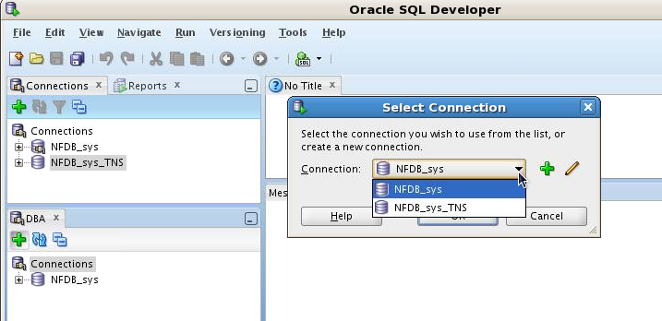
Oracle SQL Developer: Connections
Perform DBA operations in the DBA navigator by using DBA connections:
Notes:
Oracle SQL Developer is a tool that allows stand-alone graphical browsing and development of database schema objects, as well as execution of database administrative tasks.
SQL Developer enables users with database administrator privileges to view and edit certain information relevant to DBAs and perform DBA operations. To perform DBA operations, use the DBA navigator, which is similar to the Connections navigator in that it has nodes for all defined database connections. If the DBA navigator is not visible, select View, then DBA. You should add only connections for which the associated database user has DBA privileges, or at least privileges for the desired DBA navigator operations on the specified database.
Oracle SQL Developer是允许独立图形浏览和开发数据库模式对象以及执行数据库管理任务的工具。 ？SQL Developer允许具有数据库管理员权限的用户查看和编辑与DBA相关的某些信息并执行DBA操作。 要执行DBA操作，请使用DBA导航器，其类似于Connections导航器，因为它具有用于所有定义的数据库连接的节点。 如果DBA导航器不可见，请选择“查看”，然后选择“DBA”。 您应该仅添加关联数据库用户具有DBA权限的连接，或至少为指定数据库上所需的DBA导航器操作的权限。
Oracle Database 12c: Administration Workshop 3 - <number>

Slide 8
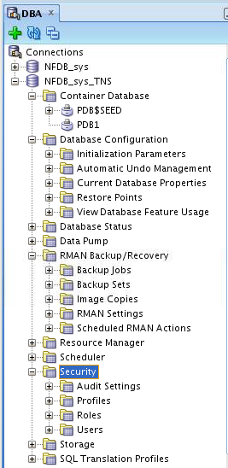
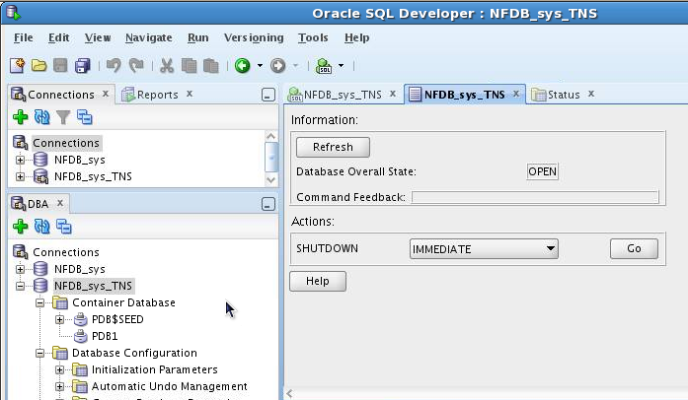
Oracle SQL Developer: DBA Actions
Using DBA features through DBA navigator
Performing DBA actions
Notes:
The DBA operations that can be performed are the following:
Database startup/shutdown
Database configuration: Initialization Parameters, Automatic Undo Management, Current Database Properties, Restore Points, View Database Feature Usage
Database status view
Data Pump export and import jobs
RMAN backup/recovery actions
Resource Manager configuration
Scheduler setting
Security configuration like audit settings, profiles, roles, and users
Storage configuration for archive logs, control files, data files, redo log groups, tablespaces, and temporary tablespace groups
可执行的DBA操作如下：
数据库启动/关机
数据库配置：初始化参数，自动撤销管理，当前数据库属性，恢复点，查看数据库功能使用情况
数据库状态视图
数据泵导出和导入作业
RMAN备份/恢复操作
资源管理器配置
计划程序设置
安全配置，如审核设置，配置文件，角色和用户
归档日志，控制文件，数据文件，重做日志组，表空间和临时表空间组的存储配置
Oracle Database 12c: Administration Workshop 3 - <number>

Slide 9


Oracle Enterprise Manager
Database Express Architecture
Listener
Console
Oracle Database Instance
Dispatcher
Shared
Server
Get Report
Common
Reporting
Framework
Request
Oracle Web Server
EM Express Servlet
Authentication
Session Management
Compression
Caching
File
Manager
Get shell files
Notes:
Oracle Enterprise Manager Database Express is a lightweight administration tool. It provides an out-of-box browser-based management solution for a single Oracle database (or database cluster), including performance monitoring, configuration management, administration, diagnostics and tuning.
Oracle Enterprise Manager Database Express uses a web-based console, communicating with the built-in web server available in XML DB.
As requests from the console are processed, the Enterprise Manager Database Express servlet handles the requests, including authentication, session management, compression, and caching. The servlet passes requests for reports to the Common Reporting Framework and actions requiring shell files to the File Manager.
Enterprise Manager Database Express is available only when the database is open. This means that Enterprise Manager Database Express cannot be used to start up the database. Other operations that require that the database change state, such as enable or disable ARCHIVELOG mode, are also not available in Enterprise Manager Database Express.
Oracle Enterprise Manager Database Express是一种轻量级的管理工具。它为单个Oracle数据库（或数据库集群）提供了基于浏览器的开箱管理解决方案，包括性能监控，配置管理，管理，诊断和调优。
Oracle Enterprise Manager Database Express使用基于Web的控制台，与XML DB中可用的内置Web服务器进行通信。
在处理来自控制台的请求时，Enterprise Manager Database Express servlet处理请求，包括身份验证，会话管理，压缩和缓存。 servlet将报告请求传递到公共报告框架，并将需要shell文件的操作传递给文件管理器。
Enterprise Manager Database Express仅在数据库打开时可用。这意味着Enterprise Manager Database Express不能用于启动数据库。要求数据库更改状态的其他操作（如启用或禁用ARCHIVELOG模式）在Enterprise Manager Database Express中也不可用。
Oracle Database 12c: Administration Workshop 3 - <number>

Slide 10
Configuring Enterprise Manager
Database Express
  Configure an HTTP listener port for each database instance.
    Verify DISPATCHERS parameter.
    Use DBMS_XDB.setHTTPPort procedure.
    Launch Enterprise Manager Database Express:
  Use a different port for each instance.
  Browser requires Flash plug-in.
    dispatchers=(PROTOCOL=TCP)(SERVICE=sampleXDB)
    exec DBMS_XDB.setHTTPPort(5500)
    http://hostname:5500/em
Notes:
Oracle Enterprise Manager Database Express is configurable with a single click in Database Configuration Assistant (DBCA).
Enterprise Manager Database Express requires that the XMLDB components are installed. All Oracle version 12.1.0 databases have XMLDB installed.
To activate Enterprise Manager Database Express in a database, verify that the DISPATCHERS initialization parameter has at least one dispatcher configured for the XMLDB service with the TCP protocol.
Use the SETHTTPPORT procedure in the DBMS_XDB package to configure a port on the server. Connect to the Enterprise Manager Database Express console with the URL shown in the slide. Substitute the host name of the server and the port number you set by using the SETHTTPPORT procedure.
If you have multiple database instances to monitor on the same machine, set a different port for each. To find the port used for each database instance, execute the following statement:
SQL> SELECT dbms_xdb.gethttpport FROM DUAL;
Enterprise Manager Database Express uses Shockwave Flash (SWF) files, so the web browser must have the Flash plug-in installed.
Oracle Enterprise Manager Database Express可以通过数据库配置助手（DBCA）中的单击进行配置。
Enterprise Manager Database Express要求安装XMLDB组件。 所有Oracle版本12.1.0数据库都安装了XMLDB。
要在数据库中激活Enterprise Manager Database Express，请验证DISPATCHERS初始化参数是否为使用TCP协议的XMLDB服务配置了至少一个调度程序。
在DBMS_XDB包中使用SETHTTPPORT过程来配置服务器端口。 使用幻灯片中显示的URL连接到Enterprise Manager Database Express控制台。 用SETHTTPPORT过程代替服务器的主机名和您设置的端口号。
如果您有多个数据库实例要在同一台计算机上进行监视，请为每个实例设置不同的端口。 要查找每个数据库实例使用的端口，请执行以下语句：
Oracle Database 12c: Administration Workshop 3 - <number>

Slide 11
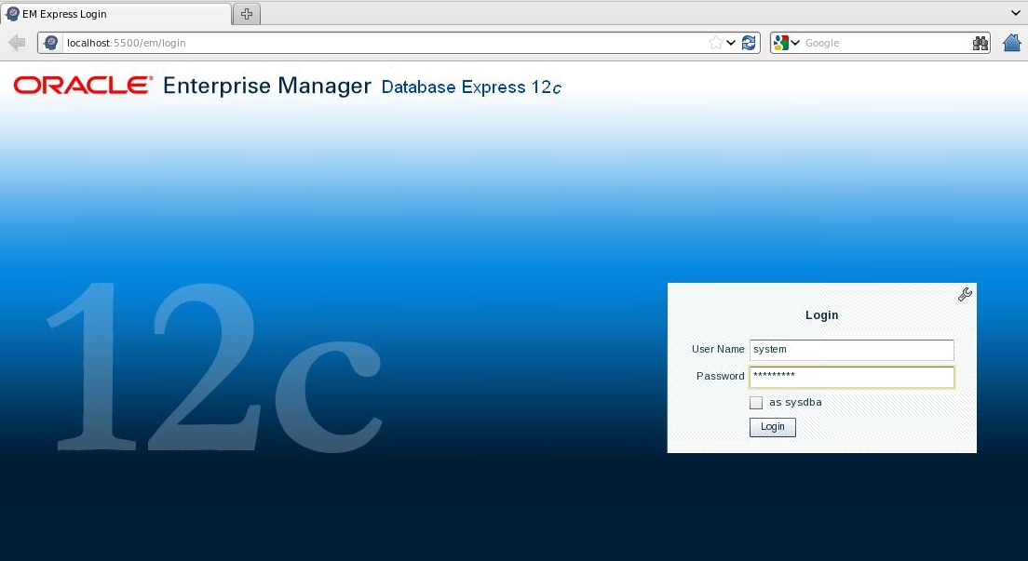
Logging In to Oracle Enterprise Manager Database Express
Notes:
Oracle Database 12c: Administration Workshop 3 - <number>
Launch Enterprise Manager Database Express by using the configured HTTP port. Log in as the database user appropriate to the tasks you want to accomplish.
使用配置的HTTP端口启动Enterprise Manager Database Express。 以适合您要完成的任务的数据库用户身份登录。

Slide 12
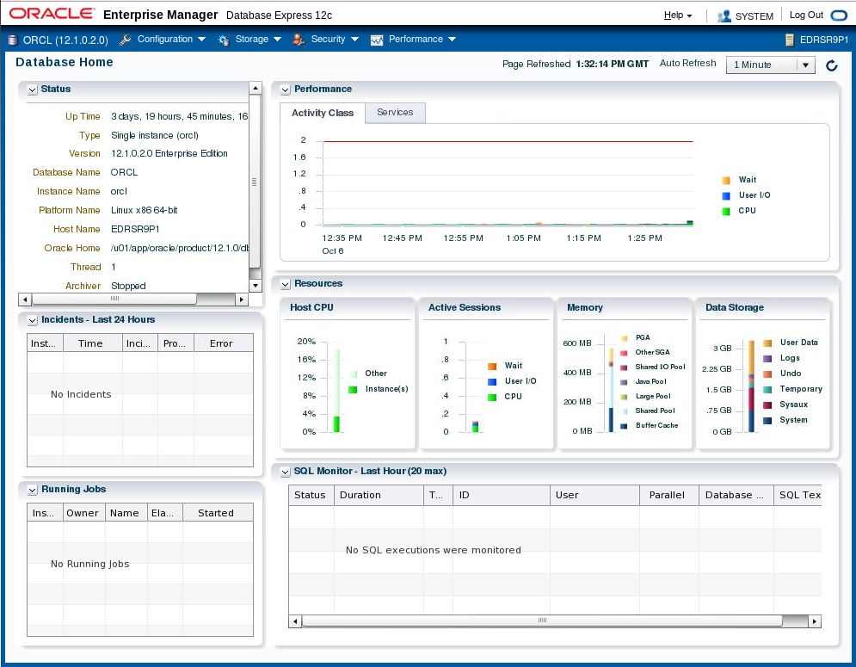
Using the Database Home Page
Notes:
The Enterprise Manager Database Express Home page presents an overall view of the database instance status and activity.
Enterprise Manager Database Express主页提供了数据库实例状态和活动的总体视图。
Oracle Database 12c: Administration Workshop 3 - <number>

Slide 13

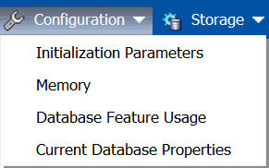
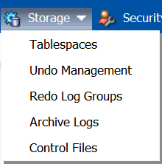
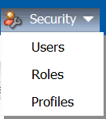
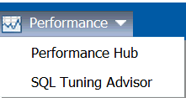
Using Enterprise Manager
Database Express Menus
Notes:
The menu layout for Enterprise Manager Database Express is shown in the slide. There are four main menu items: Configuration, Storage, Security, and Performance. The menu selections for each of the main items are shown.
The Configuration menu includes: Initialization Parameters, Memory, Database Feature Usage, and Current Database Properties. The Storage menu includes Tablespaces, Undo Management, Redo Log Groups, Archive Logs, and Control Files. The Security menu includes: Users, Roles, and Profiles. The Performance menu includes: Performance Hub and SQL Tuning Advisor.
In each of the menu areas, the menu selection directs you to a page that allows you to manage a particular area. For example, the Configuration => Initialization Parameters selection will display a page that allows you to search, view, and modify current and server parameter file (SPFILE) initialization parameters. In many of the pages, when you select an action, a pop-up dialog box enables you to specify parameters. A SQL command is then created to perform the action. You may view the SQL command before you submit it, or you can copy and paste the SQL command.
Enterprise Manager Database Express的菜单布局显示在幻灯片中。有四个主要菜单项：配置，存储，安全和性能。显示每个主要项目的菜单选择。
配置菜单包括：初始化参数，内存，数据库功能使用和当前数据库属性。存储菜单包括表空间，撤消管理，重做日志组，归档日志和控制文件。安全菜单包括：用户，角色和配置文件。性能菜单包括：性能中心和SQL调优顾问。
在每个菜单区域中，菜单选项会将您引导到允许您管理特定区域的页面。例如，Configuration => Initialization Parameters选项将显示一个页面，允许您搜索，查看和修改当前和服务器参数文件（SPFILE）初始化参数。在许多页面中，当您选择操作时，弹出对话框可以指定参数。然后创建一个SQL命令来执行该操作。您可以在提交SQL命令之前查看SQL命令，也可以复制和粘贴SQL命令。
Oracle Database 12c: Administration Workshop 3 - <number>

Slide 14













Oracle Enterprise Manager
Cloud Control Components
Oracle Management Agent
Target-specific plug-in
Managed Hosts
Oracle Management Service
Cloud Control Console
Oracle Management Repository
Notes:
Oracle Enterprise Manager Cloud Control is composed of four main components as illustrated in the slide:
Oracle Management Repository (OMR)
Oracle Management Service (OMS)
Oracle Management Agent (OMA or agent) with target-specific plug-ins
Cloud Control Console
The Oracle Management Agent runs on hosts, gathering metric data about those host environments as well as using plug-ins to monitor availability, configuration, and performance and to manage targets running on the host. The agents communicate with the Oracle Management Service to upload metric data collected by them and their plug-ins. In turn, the OMS stores the data it collects in the Oracle Management Repository where it can be accessed by the OMS for automated and manual reporting and monitoring. The OMS also communicates with the agents to orchestrate the management of their monitored targets. As well as coordinating the agents, the OMS runs the Cloud Control Console web pages that are used by administrators and users to report on, monitor, and manage the computing environment that is visible to Cloud Control via the agents and their plug-ins.
Oracle企业管理器云控制由幻灯片中所示的四个主要组件组成：
Oracle管理存储库（OMR）
Oracle管理服务（OMS）
具有目标特定插件的Oracle管理代理（OMA或代理）
云控制台
Oracle管理代理在主机上运行，​​收集关于这些主机环境的度量数据以及使用插件来监视可用性，配置和性能以及管理在主机上运行的目标。代理与Oracle管理服务部门进行通信，以上传由他们及其插件收集的度量标准数据。反过来，OMS将其收集的数据存储在Oracle管理库中，OMS可以访问它们进行自动和手动报告和监视。 OMS还与代理人进行沟通，协调其监控目标的管理。除了协调代理之外，OMS运行云控制控制台网页，由管理员和用户使用它们来报告，监视和管理云控制通过代理及其插件可见的计算环境。
Oracle Database 12c: Administration Workshop 3 - <number>

Slide 15


Controlling the Enterprise Manager
Cloud Control Framework
WebLogic
EM
Repository
OMS
Agents
Component Control Utilities
Repository | OMS | Agent
SQL*Plus or Server Control | Enterprise Manager Control | Enterprise Manager Control
Listener Control
Notes:
Each component of the Enterprise Manager Cloud Control framework has its own utility or utilities that can be used to monitor, start, and stop the component. In many cases, these utilities also provide some capability to configure the component beyond the simple start-and-stop functionality.
RAC databases require the use of Server Control commands; for single instances, there is a choice between SQL*Plus and Server Control. Server Control can be used when Oracle Restart is installed and the database is registered with the OLR.
To start and stop the listener, use either the Server Control utility or the lsnrctl command.
Examples:
srvctl stop database -d orcl -o immediate
srvctl start database -d orcl -o open
企业管理器云控制框架的每个组件都有自己的实用程序或实用程序，可用于监视，启动和停止组件。 在许多情况下，这些实用程序还提供了一些配置组件超越简单启动和停止功能的功能。
RAC数据库需要使用Server Control命令; 对于单个实例，可以选择SQL * Plus和Server Control。 可以在安装Oracle Restart并将数据库注册到OLR时使用服务器控件。
要启动和停止侦听器，请使用服务器控制实用程序或lsnrctl命令。
Oracle Database 12c: Administration Workshop 3 - <number>

Slide 16


Starting the Enterprise Manager
Cloud Control Framework
To start the Cloud Control framework, perform the following steps:
  Start the repository database listener.
  Start the repository database instance.
  Start OMS.
  Start the agent on the OMS/repository server.
  Start the agents on the managed servers.
WebLogic
EM
OMS
OHS
Repository
Agents
Notes:
Oracle Database 12c: Administration Workshop 3 - <number>
To start the whole Enterprise Manager Cloud Control framework, follow the steps below:
1. Start the repository listener:
$ORACLE_HOME/bin/lsnrctl start
2. Start the repository database instance:
$ORACLE_HOME/bin/sqlplus / as sysdba
SQL> startup
Start OMS (including OHS and WebLogic Managed Server):
$OMS_HOME/bin/emctl start oms
4. Start the agent (on OMS/repository host):
$AGENT_HOME/bin/emctl start agent
5. Start the agent on the managed servers:
$AGENT_HOME/bin/emctl start agent
Note: Use the SRVCTL command if you have a RAC instance for the repository or the repository is controlled by Oracle Restart.

Slide 17

Stopping the Enterprise Manager
Cloud Control Framework
To stop the Enterprise Manager Cloud Control framework, perform the following steps:
  Stop the agents on managed servers.
  Stop the agent on the OMS/repository server.
  Stop OMS.
  Stop the repository database instance.
WebLogic
EM
Agents
OHS
OMS
Repository
Notes:
Oracle Database 12c: Administration Workshop 3 - <number>
To stop the whole Enterprise Manager Cloud Control framework, perform the following steps:
1. Stop the agent on the managed servers:
$AGENT_HOME/bin/emctl stop agent
2. Stop the agent (on OMS/repository host):
$AGENT_HOME/bin/emctl stop agent
3. Stop OMS (including OHS and WebLogic Managed Server):
$OMS_HOME/bin/emctl stop oms
4. Stop the repository database instance:
$ORACLE_HOME/bin/sqlplus / as sysdba
SQL> shutdown immediate
Note: Use the SRVCTL command if you have a RAC instance for the repository.

Slide 18
Types of Enterprise Manager
Cloud Control Targets
Enterprise Manager Cloud Control can monitor, administer, maintain, and manage many different types of targets including:
  Oracle databases
  Oracle Database Listener
  Oracle Fusion Middleware products
  Oracle Application Server
  Oracle WebLogic Server
  Oracle applications, including E-Business Suite, SOA, Siebel, and PeopleSoft
  Exadata and Exalogic
  Cloud Control Components: OMR and OMS
  Third-party products
Notes:
Targets are the entities that Enterprise Manager Cloud Control manages. To do so, it uses target-type-specific plug-ins and host-specific agents.
Enterprise Manager Cloud Control can monitor, administer, maintain, and manage different types of targets as listed in the slide. As your environment changes, you can add and remove targets from Enterprise Manager Cloud Control as needed. The commonly used Oracle targets (including Enterprise Manager Cloud Control components, such as the OMR and OMS) are predefined as part of the base Enterprise Manager Cloud Control product, but Enterprise Manager Cloud Control has an open API that enables you to create custom targets.
目标是企业管理器云控制管理的实体。 为此，它使用特定于特定于目标的插件和特定于主机的代理。
企业管理器云控制可以监控，管理，维护和管理幻灯片中列出的不同类型的目标。 随着环境的变化，您可以根据需要从企业管理器云控制中添加和删除目标。 常用的Oracle目标（包括企业管理器云控制组件（如OMR和OMS））作为基础企业管理器云控制产品的一部分进行预定义，但企业管理器云控制具有一个开放式API，可让您创建自定义目标
Oracle Database 12c: Administration Workshop 3 - <number>

Slide 19
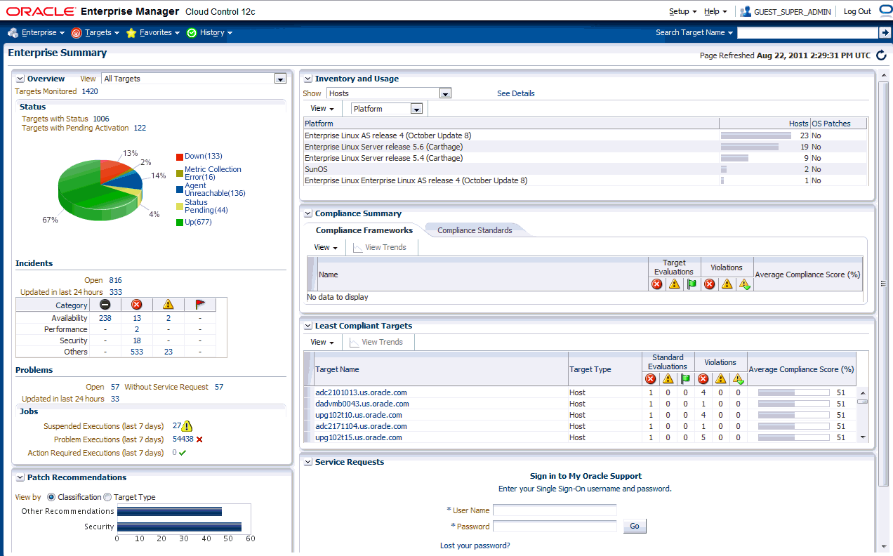
Enterprise Manager Cloud Control
Notes:
The screenshot in the slide is of the Enterprise Summary page of Oracle Enterprise Manager Cloud Control. The user interface (UI) functionality includes:
Information displayed in graphs and tables
Summary information with drilldown capability to relevant details
User-selected home page from a predefined set or based on any page in the console
Menu-driven navigation
Global target search
History and favorites
Customizable target home pages (per-user basis)
幻灯片中的屏幕截图是Oracle Enterprise Manager Cloud Control的“企业摘要”页面。 用户界面（UI）功能包括：
信息显示在图表中
摘要信息，具有向下钻取能力的相关细节
用户选择的主页从预定义集或基于控制台中的任何页面
菜单导航
全球目标搜索
历史和收藏
可定制的目标主页（基于用户）
Oracle Database 12c: Administration Workshop 3 - <number>

Slide 20
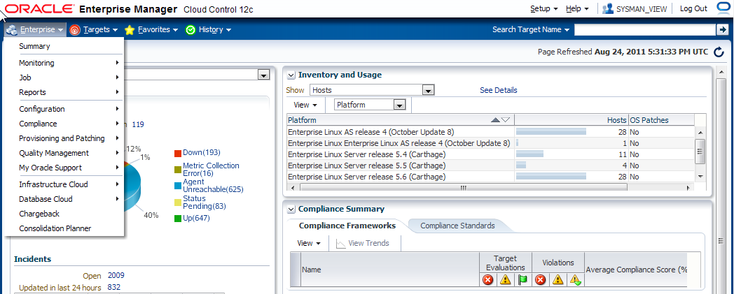
Using Enterprise Manager Cloud Control
  Predefined home page based on roles
  Setting any page as home page
  Menu-based navigation
  Making any page “favorite” for quick access
Notes:
Use drop-down menus to navigate from one place to another in the product.
Choose your own home page: When you first log in to Enterprise Manager, you are provided with a selection of pre-defined home pages based on roles. If you are managing databases, you can choose the database home page.
If those are not suitable, you can select any page to be your home page instead.
Mark any page as a “favorite” for quick access. For example, if there are certain targets that you manage quite often, you can mark the page you manage them from as a favorite in much the same way you mark a favorite in a browser. However, because the favorites you mark in Enterprise Manager are stored in the repository, you can move from client machine to client machine and your favorites are still available to you.
使用下拉菜单在产品中从一个地方导航到另一个地方。
选择您自己的主页：首次登录到企业管理器时，将根据角色为您提供一些预定义的主页。 如果您正在管理数据库，您可以选择数据库主页。如果不合适，可以选择任何页面作为您的主页。
将任何页面标记为“收藏夹”，以便快速访问。 例如，如果您经常管理某些目标，则可以将您将其管理的页面标记为收藏夹，方式与在浏览器中标记收藏夹的方式相同。 但是，由于您在企业管理器中标记的收藏夹存储在存储库中，您可以从客户端计算机移动到客户端计算机，并且您的收藏夹仍然可用。
Oracle Database 12c: Administration Workshop 3 - <number>

Slide 21
Quiz
Enterprise Manager Database Express can be used to manage many databases concurrently.
  True
  False
Notes:
Oracle Database 12c: Administration Workshop 3 - <number>
Answer: b

Slide 22
Summary
In this lesson, you should have learned how to:
  Use SQL*Plus to access the Oracle database
  Use Oracle Enterprise Manager Database Express to perform administrative tasks
  Use Oracle Enterprise Manager Cloud Control to manage the database instance
Notes:
Oracle Database 12c: Administration Workshop 3 - <number>

Slide 23
Practice: Overview
This practice covers the following topics:
  Connecting to the database by using SQL*Plus
  Navigating in Enterprise Manager Database Express
  Navigating in Enterprise Manager Cloud Control
Notes:
Oracle Database 12c: Administration Workshop 3 - <number>

