Slide 1
Performing Database Backups

Slide 2
Objectives
After completing this lesson, you should be able to:
  Create consistent database backups
  Back up your database without shutting it down
  Create incremental backups
  Automate database backups
  Manage backups
Notes:
Oracle Database 12c: Administration Workshop 14 - <number>
完成本课后，您应该能够：
创建一致的数据库备份
备份您的数据库而不关闭它
创建增量备份
自动化数据库备份
管理备份

Slide 3



Backup Solutions: Overview
Data files
User-managed OS backup
Fast recovery area or other disk areas
Image copies
Backup pieces
Archive log files
RMAN
Backup to disk
Backup data
Backup to SBT channel
Backup with third-party media manager
RMAN
Control
file
Target database
Media Management
(Example: Oracle Secure Backup)
Oracle
Secure
Backup
Backup to Tape
Non database files
Notes:
Recovery Manager (RMAN) is the recommended method of backing up your Oracle database. You can use it to back up to disk or to a system backup to tape (SBT) channel. Oracle recommends that disk backups be stored in the fast recovery area (FRA).
Oracle Secure Backup complements existing functionality by adding backup to tape and backup of file system data. It interacts transparently with RMAN. Third-party media managers can also be used to back up to tape.
User-managed backups are non-RMAN backups, for example, using an OS utility. They are often based on scripts that a DBA must write. This option is being phased out because it is more labor intensive.
恢复管理器（RMAN）是备份Oracle数据库的推荐方法。 您可以使用它来备份到磁盘或系统备份到磁带（SBT）通道。 Oracle建议将磁盘备份存储在快速恢复区（FRA）中。
Oracle Secure Backup通过将备份添加到磁带和备份文件系统数据来补充现有功能。 它与RMAN透明地交互。 第三方媒体管理员也可以用来备份到磁带。
用户管理的备份是非RMAN备份，例如使用OS实用程序。 它们通常基于DBA必须写的脚本。 这个选择正在逐步淘汰，因为它更加劳动密集。
Oracle Database 12c: Administration Workshop 14 - <number>

Slide 4

Oracle Secure Backup
  Oracle Secure Backup and RMAN provide an
  end-to-end backup solution for Oracle environments:
    Centralized tape backup management for file system data and the Oracle database
    Most well-integrated media management layer for RMAN backups
    Backup of any data anywhere on the network
  A single technical support resource for the entire backup solution expedites problem resolution.
  This ensures reliable data protection at lower cost and complexity.
Notes:
Oracle Database 12c: Administration Workshop 14 - <number>
Oracle Secure Backup和RMAN为Oracle环境提供了端到端的备份解决方案：
文件系统数据和Oracle数据库的集中磁带备份管理
用于RMAN备份的最佳集成媒体管理层
在网络上的任何地方备份任何数据
整个备份解决方案的单一技术支持资源可以快速解决问题。
这样可以以更低的成本和复杂性确保可靠的数据保护
Oracle’s current backup and recovery product for the database is Recovery Manager. Oracle Secure Backup complements existing functionality in the following ways:
Complete backup solution: Oracle Secure Backup provides data protection for the database and nondatabase data to protect the entire Oracle environment.
Media management: Oracle Secure Backup provides the media management layer for RMAN database backups to tape. Before Oracle Secure Backup, customers had to purchase expensive third-party media management products offering integration with RMAN tape backups.
Backup anywhere on the network: Oracle Secure Backup backs up data from multiple network-attached computer systems to tertiary storage resources on the network. Oracle Secure Backup supports diverse configurations of servers, clients, Network Attached Storage (NAS) servers, and tertiary storage devices and protects network storage environments.
The combination of RMAN and Oracle Secure Backup provides an end-to-end backup solution that is entirely within the Oracle product stack. This solution makes better customer support possible because Oracle Corporation is responsible for the entire backup solution.
Oracle目前的数据库备份和恢复产品是Recovery Manager。 Oracle Secure Backup通过以下方式补充现有功能：
完整的备份解决方案：Oracle Secure Backup为数据库和非数据库数据提供数据保护，以保护整个Oracle环境。
媒体管理：Oracle Secure Backup提供RMAN数据库备份到磁带的媒体管理层。在Oracle Secure Backup之前，客户不得不购买昂贵的第三方媒体管理产品，提供与RMAN磁带备份的集成。
在网络上的任何地方备份：Oracle Secure Backup将数据从多个网络连接的计算机系统备份到网络上的三级存储资源。 Oracle Secure Backup支持服务器，客户端，网络连接存储（NAS）服务器和三级存储设备的多种配置，并保护网络存储环境。
RMAN和Oracle Secure Backup的组合提供了完全在Oracle产品堆栈内的端到端备份解决方案。该解决方案可以提供更好的客户支持，因为Oracle Corporation负责整个备份解决方案。

Slide 5
User-Managed Backup
A user-managed scenario:
  Is a manual process of tracking backup needs and status
  Typically uses your own written scripts
  Requires that database files be put in the correct mode for backup
  Relies on operating system commands to make backups of files
Notes:
Oracle Database 12c: Administration Workshop 14 - <number>
用户管理的场景：
是手动跟踪备份需求和状态的过程
通常使用您自己的书写脚本
需要将数据库文件置于正确的备份模式
依赖操作系统命令来备份文件
A user-managed backup can be performed interactively. However, most often it entails the writing of scripts to perform the backup. There are several scenarios that can be run, and scripts must be written to handle them.
Some of the actions that scripts must take:
Querying V$DATAFILE to determine the data files that need to be backed up and their current state
Querying V$LOGFILE to identify the online redo log files
Querying V$CONTROLFILE to identify the control file to back up
Placing each tablespace in online backup mode
Querying V$BACKUP to see what data files are part of a tablespace that has been placed in online backup mode
Issuing operating system copy commands to copy the data files to the backup location
Bringing each tablespace out of online backup mode
用户管理的备份可以交互式执行。 然而，通常它需要编写脚本来执行备份。 有几种方案可以运行，脚本必须被写入来处理它们。
脚本必须采取的一些操作：
查询V $ DATAFILE以确定需要备份的数据文件及其当前状态
查询V $ LOGFILE以确定联机重做日志文件
查询V $ CONTROLFILE以识别要备份的控制文件
将每个表空间置于联机备份模式
查询V $ BACKUP以查看哪些数据文件是已处于联机备份模式的表空间的一部分
发出操作系统复制命令将数据文件复制到备份位置
将每个表空间带出联机备份模式

Slide 6

Understanding Backup Terminology
  Backup strategy may include:
    Entire database (whole)
    Portion of the database (partial)
  Backup type may indicate inclusion of:
    All data blocks within your chosen files (full)
    Only information that has changed since a previous backup (incremental)
      Cumulative (changes since last level 0)
      Differential (changes since last incremental)
  Backup mode may be:
    Offline (consistent, cold)
    Online (inconsistent, hot)
Database
Control files
Online redo log files
Data files
Notes:
Oracle Database 12c: Administration Workshop 14 - <number>
备份策略可能包括：
整个数据库（整体）
部分数据库（部分）
备份类型可能表示包含：
所选文件中的所有数据块（全部）
只有自上一次备份以来发生变化的信息（增量）
累积（自上次0以来发生变化）
差分（自上次增量以来发生变化）
备份模式可能是：
离线（一致，冷）
在线（不一致，热）
Whole database backup: Includes all data files and at least one control file (Remember that all control files in a database are identical.)
Partial database backup: May include zero or more tablespaces and zero or more data files; may or may not include a control file
Full backup: Makes a copy of each data block that contains data and that is within the files being backed up
Incremental backup: Makes a copy of all data blocks that have changed since a previous backup. Oracle Database supports two levels of incremental backup (0 and 1). A level 1 incremental backup can be one of two types: cumulative or differential. A cumulative backup backs up all changes since the last level 0 backup. A differential backup backs up all changes since the last incremental backup (which could be either a level 0 or level 1 backup). Change Tracking with RMAN supports incremental backups.
Offline backups (also known as “cold” or consistent backup): Are taken while the database is not open. They are consistent because, at the time of the backup, the system change number (SCN) in data file headers matches the SCN in the control files.
Online backups (also known as “hot” or inconsistent backup): Are taken while the database is open. They are inconsistent because, with the database open, there is no guarantee that the data files are synchronized with the control files.
整个数据库备份：包括所有数据文件和至少一个控制文件（请记住，数据库中的所有控制文件都是相同的。）
部分数据库备份：可能包含零个或多个表空间和零个或多个数据文件;可能包含也可能不包含控制文件
完全备份： 创建包含数据的每个数据块的副本，并且正在备份的文件中
增量备份： 创建自上次备份以来已更改的所有数据块的副本。 Oracle数据库支持两级增量备份（0和1）。级别1增量备份可以是两种类型之一：累积或差异。累积备份备份自上一级0备份以来的所有更改。差异备份备份自上次增量备份以来的所有更改（可能是0或1级备份）。使用RMAN更改跟踪支持增量备份。
脱机备份（也称为“冷”或一致备份）： 数据库未打开时采取。它们是一致的，因为在备份时，数据文件头中的系统更改号（SCN）与控制文件中的SCN匹配。
在线备份（也称为“热”或不一致的备份）：数据库打开时被采取。它们不一致，因为数据库打开时，不能保证数据文件与控制文件同步。

Slide 7
Understanding Types of Backups
Backups may be stored as:
  Image copies
  Backup sets
Data file #1
Data file #1 | Data file #2
Data file #3 | Data file #4
Data file #5 | Data file #6
Data file #2
Data file #3
Backup set
(Binary, compressed files in Oracle proprietary format)
Data file #4
Data file #5
Data file #6
Image copies
(Duplicate data and log files in OS format)
Notes:
Oracle Database 12c: Administration Workshop 14 - <number>
Image copies: Are duplicates of data or archived log files (similar to simply copying the files by using operating system commands)
Backup sets: Are collections of one or more binary files that contain one or more data files, control files, server parameter files, or archived log files. With backup sets, empty data blocks are not stored, thereby causing backup sets to use less space on the disk or tape. Backup sets can be compressed to further reduce the space requirements of the backup.
Image copies must be backed up to the disk. Backup sets can be sent to the disk or directly to the tape.
The advantage of creating a backup as an image copy is improved granularity of the restore operation. With an image copy, only the file or files need to be retrieved from your backup location. With backup sets, the entire backup set must be retrieved from your backup location before you extract the file or files that are needed.
The advantage of creating backups as backup sets is better space usage. In most databases, 20% or more of the data blocks are empty blocks. Image copies back up every data block, even if the data block is empty. Backup sets significantly reduce the space required by the backup. In most systems, the advantages of backup sets outweigh the advantages of image copies.
图像副本：是数据或归档日志文件的重复（类似于使用操作系统命令简单地复制文件）
备份集：是包含一个或多个数据文件，控制文件，服务器参数文件或归档日志文件的一个或多个二进制文件的集合。使用备份集时，不会存储空数据块，从而使备份集在磁盘或磁带上占用较少的空间。备份集可以被压缩，以进一步减少备份的空间要求。
映像副本必须备份到磁盘。备份集可以发送到磁盘或直接发送到磁带。
创建备份作为映像副本的优点是恢复操作的细粒度。使用图像副本，只需要从备份位置检索文件或文件。使用备份集，必须从备份位置检索整个备份集，然后才能解压缩需要的文件。
创建备份作为备份集的优点是更好的空间使用。在大多数数据库中，20％或更多的数据块是空块。图像复制备份每个数据块，即使数据块为空。备份集显着减少了备份所需的空间。在大多数系统中，备份集的优点胜过图像副本的优势。

Slide 8
RMAN Backup Types
  A full backup contains all used data file blocks.
  A level 0 incremental backup is equivalent to a full backup that has been marked as level 0.
  A cumulative level 1
  incremental backup contains
  only blocks modified since the
  last level 0 incremental
  backup.
  A differential level 1
  incremental backup contains
  only blocks modified since the
  last incremental backup.
Full, or “level 0
incremental backup”
Cumulative
incremental backup
Differential
incremental backup
Notes:
完整备份包含所有使用的数据文件块。
级别0增量备份等同于已标记为级别0的完整备份。
累积级1 增量备份包含 自从最后一级0增量备份以来修改的块？
差异级别1增量备份包含 自最后一次增量备份以来修改的块。
Full Backups
A full backup is different from a whole database backup. A full data file backup is a backup that includes every used data block in the file. RMAN copies all blocks into the backup set or image copy, skipping only those data file blocks that are not part of an existing segment. For a full image copy, the entire file contents are reproduced exactly. A full backup cannot be part of an incremental backup strategy; it cannot be the parent for a subsequent incremental backup.
Incremental Backups
An incremental backup is either a level 0 backup, which includes every block in the data files except blocks that have never been used, or a level 1 backup, which includes only those blocks that have been changed since a previous backup was taken. A level 0 incremental backup is physically identical to a full backup. The only difference is that the level 0 backup (as well as an image copy) can be used as the base for a level 1 backup, but a full backup can never be used as the base for a level 1 backup.
Incremental backups are specified using the INCREMENTAL keyword of the BACKUP command. You specify INCREMENTAL LEVEL [0 | 1].
完全备份
完整备份与整个数据库备份不同。完整的数据文件备份是包含文件中每个使用的数据块的备份。 RMAN将所有块复制到备份集或映像副本中，仅跳过不属于现有段的那些数据文件块。对于完整的图像副本，整个文件内容都将被精确转载。完全备份不能是增量备份策略的一部分;它不能作为后续增量备份的父级。
增量备份
增量备份是0级备份，其中包括数据文件中的每个块，除了未使用的块之外的数据文件或第1级备份，其中仅包含自上次备份以来已更改的块。 0级增量备份在物理上与完整备份完全相同。唯一的区别是，0级备份（以及映像副本）可以用作1级备份的基础，但完全备份永远不能用作1级备份的基础。
使用BACKUP命令的INCREMENTAL关键字指定增量备份。你指定INCREMENTAL LEVEL [0 | 1]。
Oracle Database 12c: Administration Workshop 14 - <number>

Slide 9
Notes:
RMAN can create multilevel incremental backups as follows:
Differential: Is the default type of incremental backup that backs up all blocks changed after the most recent incremental backup at either level 1 or level 0
Cumulative: Backs up all blocks changed after the most recent backup at level 0
Examples
To perform an incremental backup at level 0, use the following command:
RMAN> BACKUP INCREMENTAL LEVEL 0 DATABASE;
To perform a differential incremental backup, use the following command:
RMAN> BACKUP INCREMENTAL LEVEL 1 DATABASE;
To perform a cumulative incremental backup, use the following command:
RMAN> BACKUP INCREMENTAL LEVEL 1 CUMULATIVE DATABASE;
RMAN makes full backups by default if neither FULL nor INCREMENTAL is specified. Unused block compression causes never-written blocks to be skipped when backing up data files to backup sets, even for full backups.
A full backup has no effect on subsequent incremental backups, and is not considered part of any incremental backup strategy, although a full image copy backup can be incrementally updated by applying incremental backups with the RECOVER command.
Note: It is possible to perform any type of backup (full or incremental) of a database that is in NOARCHIVELOG mode—if, of course, the database is not open. Note also that recovery is limited to the time of the last backup. The database can be recovered to the last committed transaction only when the database is in ARCHIVELOG mode.
默认情况下，如果未指定FULL或INCREMENTAL，RMAN将进行完全备份。 将数据文件备份到备份集时，即使是完全备份，未使用的块压缩也会导致未写入的块被跳过。
完整备份对后续增量备份无影响，并且不被视为任何增量备份策略的一部分，尽管可以通过使用RECOVER命令应用增量备份来逐步更新完整镜像副本备份。
注意：可以执行NOARCHIVELOG模式的数据库的任何类型的备份（完全或增量） - 如果当然数据库未打开。 还要注意，恢复仅限于上次备份的时间。 只有当数据库处于ARCHIVELOG模式时，数据库才能恢复到最后提交的事务。
Oracle Database 12c: Administration Workshop 14 - <number>

Slide 10
Using Recovery Manager (RMAN)
  Provides a powerful control and scripting language
  Includes a published API that enables interface with most popular backup software
  Backs up data, control, archived redo log, and server parameter files
  Backs up files to disk or tape
  Is integrated with Enterprise Manager Cloud Control
Notes:
Oracle Database 12c: Administration Workshop 14 - <number>
提供强大的控制和脚本语言
包括一个已发布的API，可以与最流行的备份软件进行接口
备份数据，控制，归档重做日志和服务器参数文件
将文件备份到磁盘或磁带
与企业管理器云控制集成
RMAN is the component of the Oracle Database server that is used to perform backup and recovery operations. It can be used to make consistent and inconsistent backups, perform incremental and full backups, and back up either the whole database or a portion of it.
RMAN uses its own powerful job control and scripting language, as well as a published API that interfaces RMAN with many popular backup software solutions.
RMAN can store backups on the disk for quick recovery or place them on the tape for long-term storage. For RMAN to store backups on the tape, you must either use Oracle Secure Backup or configure an interface to the tape device known as a media management library (MML).
Enterprise Manager Cloud Control provides a graphical interface to the most commonly used RMAN functionality. Advanced backup and recovery operations are accessible through RMAN’s command-line client. For more information about advanced RMAN capabilities, see the course titled Oracle Database 12c: Backup and Recovery Workshop or consult the Oracle Backup and Recovery User’s Guide.
RMAN是用于执行备份和恢复操作的Oracle数据库服务器的组件。它可用于进行一致和不一致的备份，执行增量备份和完整备份，并备份整个数据库或其一部分。
RMAN使用自己强大的作业控制和脚本语言，以及已发布的API，可将RMAN与许多流行的备份软件解决方案相连接。
RMAN可以将备份存储在磁盘上以进行快速恢复，或将其放在磁带上进行长期存储。要使RMAN将备份存储在磁带上，必须使用Oracle Secure Backup或配置与称为介质管理库（MML）的磁带设备的接口。
企业管理器云控制提供了最常用的RMAN功能的图形界面。高级备份和恢复操作可通过RMAN的命令行客户机访问。有关高级RMAN功能的更多信息，请参阅题为Oracle Database 12c：备份和恢复Workshop的课程，或参阅“Oracle备份和恢复用户指南”。

Slide 11
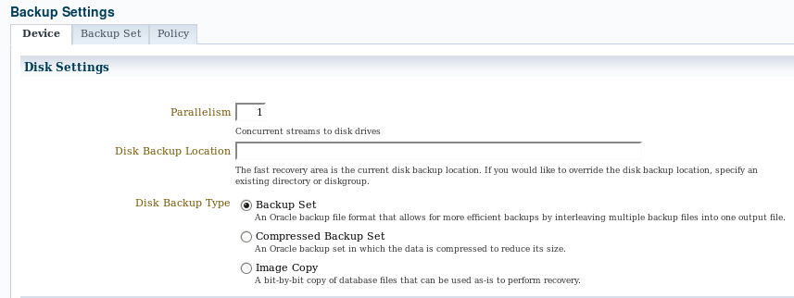
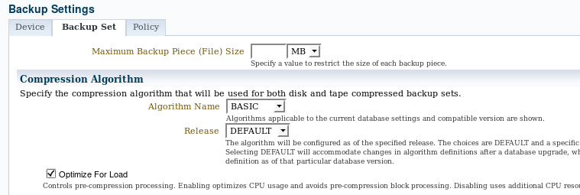
Configuring Backup Settings
Notes:
Oracle Database 12c: Administration Workshop 14 - <number>
By using RMAN commands or the Enterprise Manager Cloud Control interface, you can manage the persistent backup settings that are used for creating backups. In Enterprise Manager Cloud Control, select Availability > Backup & Recovery > Backup Settings. There are separate settings for disk and tape. Tape settings depend on the media management library capabilities. Disk settings include:
Parallelism: How many separate streams of backup information do you want to create? The best setting for parallelism depends on your hardware. As hardware resources increase, the appropriate degree of parallelism also increases. Generally, you want to set your parallelism to the number of disks that your disk backup location is striped over. For tape backup, you want to set your parallelism to the same number of tape drives that you have.
Disk backup location: Where should backups be stored? The default is the fast recovery area. If you change this, click Test Disk Backup to verify that RMAN can write to the new location.
Disk backup type: Select Backup Set, Compressed Backup Set, or Image Copy.
Click the Backup Set tab to set the maximum file size of backup pieces, specify the compression algorithm to be used for compressed backup sets, and specify redundancy for tape backups. Host credentials are required to save changes to the backup settings.
通过使用RMAN命令或企业管理器云控制界面，您可以管理用于创建备份的持久备份设置。在企业管理器云控制中，选择可用性>备份和恢复>备份设置。磁盘和磁带有单独的设置。磁带设置取决于媒体管理库功能。磁盘设置包括：
并行性：您要创建多少个独立的备份信息流？并行性的最佳设置取决于您的硬件。随着硬件资源的增加，适当的并行度也增加。通常，您要将并行性设置为磁盘备份位置的条带数。对于磁带备份，您需要将并行度设置为相同数量的磁带机。
磁盘备份位置：备份应在哪里存储？默认值是快速恢复区域。如果更改此选项，请单击测试磁盘备份以验证RMAN是否可写入新位置。
磁盘备份类型：选择备份集，压缩备份集或映像副本。
单击“备份集”选项卡设置备份片段的最大文件大小，指定要用于压缩备份集的压缩算法，并指定磁带备份的冗余。需要主机凭据来保存对备份设置的更改。

Slide 12
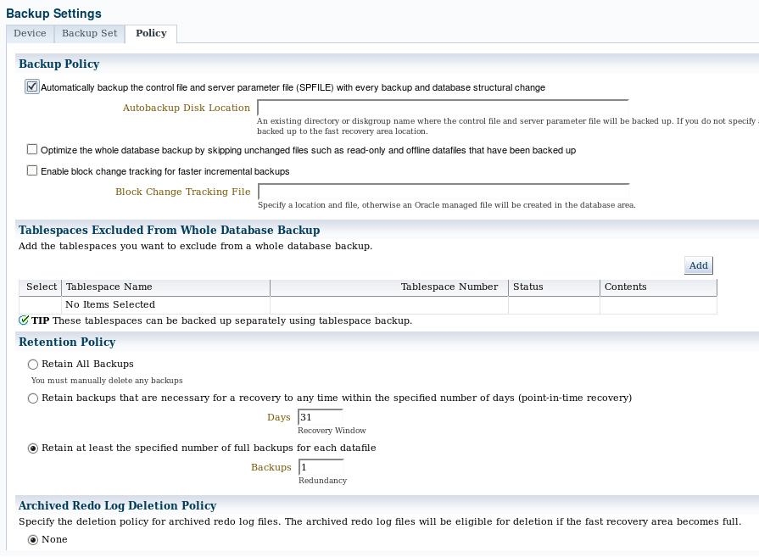

Configuring Backup Settings
Best practice
Backup
pieces
Change
tracking
file
Recovery area
Data files
Notes:
Oracle Database 12c: Administration Workshop 14 - <number>
Click the Policy tab to:
Automatically back up the control file and server parameter file (SPFILE) with each backup. You can also specify a location for these backups if you do not want them to go to the fast recovery area.
Optimize backups by not backing up files that exactly match a file that is already part of the retained backups. This setting enables you to skip read-only and offline data files.
Enable block change tracking and specify a location for the tracking file. If you intend to create incremental backups, this setting can decrease the time required to choose which blocks to include in the incremental backup.
Exclude tablespaces from a whole database backup. Some administrators choose not to back up tablespaces containing data or objects that can be easily re-created (such as indexes or data that is batch-loaded frequently).
Specify a retention policy: How long should RMAN keep your backups? If you are using the fast recovery area to store backups, RMAN automatically deletes old backups to make room for new ones (if the retention policy allows it). By default, only the last backup is retained. The retention policy can be specified as a number of backups or a number of days.
单击“策略”选项卡：
自动备份每个备份的控制文件和服务器参数文件（SPFILE）。如果不想让它们进入快速恢复区域，也可以为这些备份指定位置。
通过不备份与已保留备份的一部分文件完全匹配的文件来优化备份。此设置使您能够跳过只读和脱机数据文件。
启用块更改跟踪并指定跟踪文件的位置。如果要创建增量备份，则此设置可以减少选择要在增量备份中包含哪些块所需的时间。
从整个数据库备份中排除表空间。某些管理员选择不备份包含可以轻松重新创建的数据或对象的表空间（例如经常批量加载的索引或数据）。
指定保留策略：RMAN保留备份需要多长时间？如果您正在使用快速恢复区来存储备份，RMAN会自动删除旧的备份，为新的备份腾出空间（如果保留策略允许）。默认情况下，只保留最后一个备份。保留策略可以指定为多个备份或多天。

Slide 13
Oracle-Suggested Backup
  Provides an out-of-the-box backup strategy based on the backup destination
  Sets up a recovery window for backup management
  Schedules recurring and immediate backups:
    Full backup
    + daily incremental
    = new “full” backup
    + daily archived logs for recovery
Notes:
Enterprise Manager Cloud Control makes it easy for you to set up an Oracle-suggested backup strategy that protects your data and provides efficient recoverability to any point in the preceding 24 hours, and possibly as far back as 48 hours, depending on when the last backup was created. The Oracle-suggested strategy uses the incremental backup and incrementally updated backup features, providing faster recoverability than is possible when applying database changes from the archived redo log files.
Because these backups on disk are retained, you can always perform a full database recovery or a point-in-time recovery to any time within the past 24 hours, at the minimum. The recovery time could reach back as far as 48 hours. This is because just before a backup is taken on a given day, the backup from the beginning of day n–1 still exists.
企业管理器云控制使您可以轻松设置Oracle建议的备份策略，保护您的数据，并提供高效的可恢复性，可以在前24小时内的任何时间点，最长可能长达48小时，具体取决于上次备份的时间 被创建 Oracle建议的策略使用增量备份和增量更新的备份功能，与从存档的重做日志文件应用数据库更改时相比，可以提供更快的可恢复性。
因为磁盘上的这些备份保留，所以您可以始终至少在过去24小时内随时执行完整的数据库恢复或时间点恢复。 恢复时间可以达到48小时。 这是因为在某一天进行备份之前，从n-1天开始的备份仍然存在。
Oracle Database 12c: Administration Workshop 14 - <number>

Slide 14
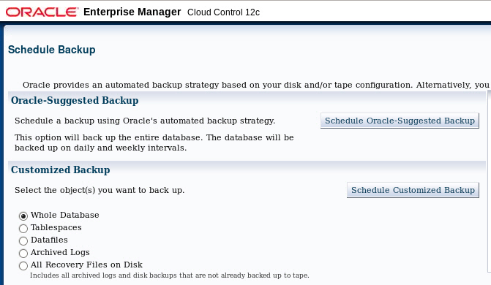
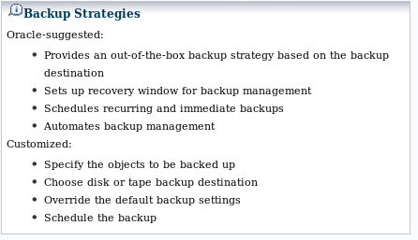
Selecting a Backup Strategy
Notes:
Oracle Database 12c: Administration Workshop 14 - <number>
To establish an Oracle-suggested strategy, navigate to the database home page > Availability > Backup & Recovery > Schedule Backup. The Backup Strategies section enables you to select from the Oracle-suggested backup and Customized backup strategies. The Oracle-suggested strategy takes a full database copy as the first backup. Because it is a whole database backup, you might want to consider taking this at the period of least activity. After that, an incremental backup to disk is taken every day. Optionally, a weekly tape backup can be made, which backs up all recovery-related files.
By clicking Schedule Customized Backup, you gain access to a wider range of configuration options. Select the objects that you want to back up—the whole database (the default) or individual tablespaces, data files, archived logs, or any Oracle backups currently residing on the disk (to move them to the tape).
Both strategies enable you to set up encrypted backups.
要建立Oracle建议的策略，请转到数据库主页>可用性>备份和恢复>计划备份。 “备份策略”部分允许您从Oracle建议的备份和自定义备份策略中进行选择。 Oracle建议的策略将完整的数据库副本作为第一个备份。 因为它是一个完整的数据库备份，您可能需要考虑在最少的活动期间采取这一点。 之后，每天都会对磁盘进行增量备份。 可以选择每周磁带备份，备份所有与恢复相关的文件。
通过单击计划定制备份，您可以访问更广泛的配置选项。 选择要备份的对象 - 整个数据库（默认）或单个表空间，数据文件，归档日志或当前驻留在磁盘上的任何Oracle备份（将其移动到磁带）。
这两种策略使您能够设置加密备份。

Slide 15
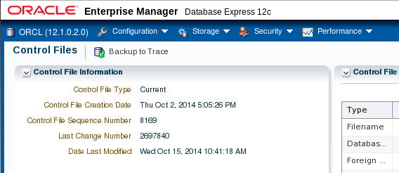
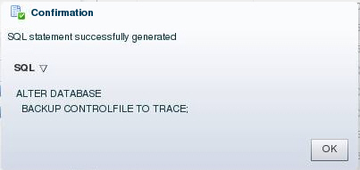
Backing Up the Control File to a Trace File
  Control files can be backed up to a trace file, generating a SQL command to re-create the control file.
  Control file trace backups may be used to recover from loss of all control files.
Notes:
Oracle Database 12c: Administration Workshop 14 - <number>
In Enterprise Manager Database Express, select Storage > Control Files to manage your database’s control files. Control files have an additional backup option; they may be backed up to a trace file. A control file trace backup contains the SQL statement that is required to re-create the control files in the event that all control files are lost.
Although it is very unlikely that a properly configured database (with multiple copies of the control file placed on separate disks and separate controllers) would lose all control files at the same time, it is possible. Therefore, you should back up the control file to a trace file after each change to the physical structure of the database (adding tablespaces or data files, or adding additional redo log groups).
Trace copies of the control file can be created by using Enterprise Manager Database Express, Enterprise Manager Cloud Control, or by using the following SQL command:
ALTER DATABASE BACKUP CONTROLFILE TO TRACE
The trace backup is created in the location specified by the DIAGNOSTIC_DEST initialization parameter. For example, in this course, the trace file for the orcl database is found in the /u01/app/oracle/diag/rdbms/orcl/orcl/trace directory and will have a file name such as orcl_ora_924.trc.
在Enterprise Manager Database Express中，选择“存储”>“控制文件”来管理数据库的控制文件。控制文件有一个额外的备份选项;它们可能被备份到跟踪文件。控制文件跟踪备份包含在所有控制文件丢失的情况下重新创建控制文件所需的SQL语句。
虽然正确配置的数据库（将控制文件的多个副本放在单独的磁盘和单独的控制器上）不太可能会同时丢失所有控制文件，但这是可能的。因此，每次更改数据库的物理结构后，应将控制文件备份到跟踪文件（添加表空间或数据文件或添加其他重做日志组）。
可以使用Enterprise Manager Database Express，Enterprise Manager Cloud Control或使用以下SQL命令创建控制文件的跟踪副本：
ALTER DATABASE BACKUP CONTROLFILE TO TRACE
跟踪备份是由DIAGNOSTIC_DEST初始化参数指定的位置创建的。例如，在本课程中，orcl数据库的跟踪文件位于/ u01 / app / oracle / diag / rdbms / orcl / orcl / trace目录中，并具有文件名，如orcl_ora_924.trc。

Slide 16
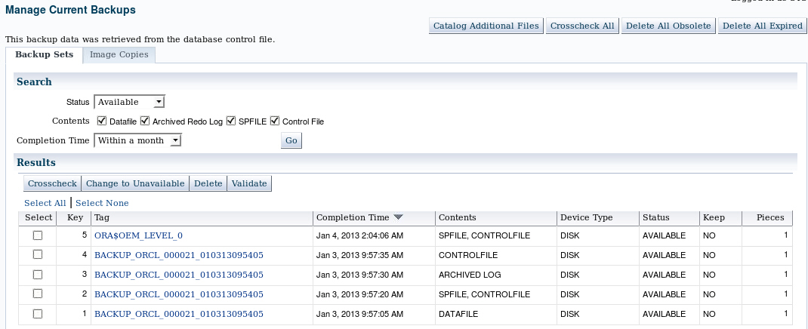
Managing Backups
Notes:
Oracle Database 12c: Administration Workshop 14 - <number>
In Enterprise Manager Cloud Control, select Availability > Backup & Recovery > Manage Current Backups to manage your existing backups. On this page, you can see when a backup was completed, where it was created (disk or tape), and whether it is still available.
At the top of the Manage Current Backups page, four buttons enable you to work with existing backups:
Catalog Additional Files: Although RMAN (working through Enterprise Manager) is the recommended way to create backups, you might have image copies or backup sets that were created by some other means or in some other environment with the result that RMAN is not aware of them. This task identifies those files and adds them to the catalog.
Crosscheck All: RMAN can automatically delete obsolete backups, but you can also delete them by using operating system commands. If you delete a backup without using RMAN, the catalog does not know whether the backup is missing until you perform a cross-check between the catalog and what is really there.
Delete All Obsolete: This deletes backups older than the retention policy.
Delete All Expired: This deletes the catalog listing for any backups that are not found when the cross-check is performed as described previously.
在企业管理器云控制中，选择可用性>备份和恢复>管理当前备份以管理现有备份。在此页面上，您可以看到备份完成，创建的位置（磁盘或磁带）以及它是否仍然可用。
在“管理当前备份”页面的顶部，使用四个按钮可以使用现有备份：
目录附加文件：虽然RMAN（通过企业管理器工作）是推荐的创建备份方式，但可能具有通过某种其他方式或某些其他环境创建的映像副本或备份集，结果是RMAN不知道它们。此任务标识这些文件并将其添加到目录中。
全面检查：RMAN可以自动删除过时的备份，但也可以使用操作系统命令删除它们。如果在不使用RMAN的情况下删除备份，则在执行目录与真正存在的目录之间的交叉检查时，目录不知道备份是否丢失。
删除全部废弃：这将删除早于保留策略的备份。
删除全部已过期：如前所述，执行交叉检查时，将删除未找到的任何备份的目录列表。

Slide 17



Using RMAN Commands to Create Backups
1
$ rman target /
RMAN> CONFIGURE …
RMAN> BACKUP DATABASE PLUS ARCHIVELOG;
2
3
Control
file
Control files
Archived redo
log file
SPFILE
Data files
Notes:
Oracle Database 12c: Administration Workshop 14 - <number>
1. In a terminal session, start RMAN and connect to the target database.
2. Execute configuration commands:
CONFIGURE DEFAULT DEVICE TYPE TO disk;
CONFIGURE DEVICE TYPE DISK BACKUP TYPE TO COPY;
CONFIGURE CONTROLFILE AUTOBACKUP ON;
3. A whole database backup is a copy of all data files and the control file. You can optionally include the server parameter file (SPFILE) and archived redo log files. Using RMAN to make an image copy of all the database files simply requires mounting or opening the database, starting RMAN, and entering the BACKUP command shown in the slide.
Optionally, you can supply the DELETE INPUT option when backing up archive log files.
That causes RMAN to remove the archive log files after backing them up. This is useful especially if you are not using a fast recovery area, which would perform space management for you, deleting files when space pressure grows. In that case, the command in the slide would look like the following:
RMAN> BACKUP DATABASE PLUS ARCHIVELOG DELETE INPUT;
You can also create a backup (either a backup set or image copies) of previous image copies of all data files and control files in the database by using the following command:
RMAN> BACKUP COPY OF DATABASE;
1.在终端会话中，启动RMAN并连接到目标数据库。
2.执行配置命令：
配置默认设备类型到磁盘;
配置设备类型盘备份类型复制;
配置控制自动启动;
3.整个数据库备份是所有数据文件和控制文件的副本。您可以选择包括服务器参数文件（SPFILE）和归档重做日志文件。使用RMAN创建所有数据库文件的映像副本只需要安装或打开数据库，启动RMAN，并输入幻灯片中显示的BACKUP命令。
或者，备份存档日志文件时可以提供DELETE INPUT选项。 ？这会导致RMAN在备份之后删除归档日志文件。这是非常有用的，特别是如果您不使用快速恢复区域，这将为您执行空间管理，在空间压力增长时删除文件。在这种情况下，幻灯片中的命令将如下所示：
RMAN> BACKUP DATABASE PLUS ARCHIVELOG DELETE INPUT;
您还可以使用以下命令创建数据库中所有数据文件和控制文件的先前映像副本的备份（备份集或映像副本）：

Slide 18
Quiz
Using the change-tracking feature, an image copy backup performed by RMAN can skip blocks that have not changed since the last backup.
  True
  False
Notes:
Oracle Database 12c: Administration Workshop 14 - <number>
Answer: b

Slide 19
Summary
In this lesson, you should have learned how to:
  Create consistent database backups
  Back up your database without shutting it down
  Create incremental backups
  Automate database backups
  Manage backups and view backup reports
Notes:
Oracle Database 12c: Administration Workshop 14 - <number>
在本课中，您应该学会了如何：
创建一致的数据库备份
备份您的数据库而不关闭它
创建增量备份
自动化数据库备份
管理备份和查看备份报告

Slide 20
Practice: Overview
This practice covers the following topics:
  Backing up your database while the database is open for user activity
  Scheduling automatic nightly incremental backups for your database
Notes:
Oracle Database 12c: Administration Workshop 14 - <number>
此练习涵盖以下主题：
数据库在用户活动打开时备份数据库
为您的数据库安排自动的夜间增量备份

