Slide 1
Database Maintenance

Slide 2
Objectives
After completing this lesson, you should be able to:
  Manage the Automatic Workload Repository (AWR)
  Use the Automatic Database Diagnostic Monitor (ADDM)
  Describe and use the advisory framework
  Set alert thresholds
  Use server-generated alerts
  Use automated tasks
Notes:
Oracle Database 12c: Administration Workshop 17 - <number>
完成本课后，您应该能够：
管理自动工作量存储库（AWR）
使用自动数据库诊断监视器（ADDM）
描述和使用咨询框架
设置警报阈值
使用服务器生成的警报
使用自动化任务

Slide 3
Database Maintenance
Automatic
Automated
tasks
Proactive
Reactive
Advisory
framework
Server alerts
Critical errors
Automatic
Workload Repository
Automatic
Diagnostic Repository
Efficient
Data warehouse
of the database
Automatic collection
of important statistics
Direct memory
access
Notes:
Oracle Database 12c: Administration Workshop 17 - <number>
Proactive database maintenance is made easy by the sophisticated infrastructure of the Oracle database, including the following main elements:
The Automatic Workload Repository (AWR) is a built-in repository in each Oracle database.
At regular intervals, the Oracle database server makes a snapshot of all its vital statistics and workload information and stores this data in the AWR. The captured data can be analyzed by you, by the database server itself, or by both.
Using automated tasks, the database server performs routine maintenance operations, such as regular backups, refreshing optimizer statistics, and database health checks.
Reactive database maintenance includes critical errors and conditions discovered by database health checkers:
For problems that cannot be resolved automatically and require administrators to be notified (such as running out of space), the Oracle database server provides server-generated alerts. The Oracle database server, by default, monitors itself and sends out alerts to notify you of problems. The alerts notify you and often also provide recommendations on how to resolve the reported problem.
Recommendations are generated from several advisors, each of which is responsible for a subsystem. For example, there are memory, segment, and SQL advisors.
Oracle数据库的复杂基础架构使主动数据库维护变得容易，包括以下主要元素：
自动工作负载存储库（AWR）是每个Oracle数据库中的内置存储库。 定期，Oracle数据库服务器会对其所有重要统计信息和工作负载信息进行快照，并将此数据存储在AWR中。捕获的数据可以由您，数据库服务器本身或两者分析。
使用自动化任务，数据库服务器执行例行维护操作，例如常规备份，刷新优化程序统计信息和数据库运行状况检查。
反应性数据库维护包括数据库运行状况检查器发现的关键错误和条件：
对于无法自动解决并要求管理员进行通知（例如空间不足）的问题，Oracle数据库服务器提供服务器生成的警报。默认情况下，Oracle数据库服务器监视自身并发出警报以通知您问题。警报通知您，并经常提供如何解决报告问题的建议。
建议由几位顾问生成，每个顾问负责一个子系统。例如，有内存，段和SQL顾问。

Slide 4
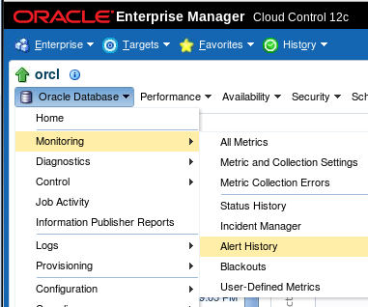
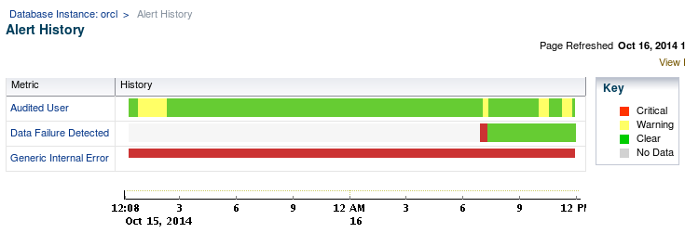
Viewing the Alert History
Notes:
Oracle Database 12c: Administration Workshop 17 - <number>
The Alert History page displays a chart that shows the alert history of the current database in segments of time that you designate. An alert indicates a potential problem: either a warning or critical threshold for a monitored metric, or an indication that a target is no longer available. Click the metric name listed on the Alert History page to get detailed statistics, graphs, and actual time stamps for each alert.
“警报历史”页面显示一个图表，显示您指定的时间段中当前数据库的警报历史记录。 警报表示潜在的问题：监视的度量标准的警告或临界阈值，或目标不再可用的指示。 单击“警报历史”页面上列出的指标名称，以获取每个警报的详细统计信息，图表和实际时间戳。

Slide 5

Terminology
  Statistics: Data collections providing database and object detail
    Optimizer statistics: Used by query optimizer
    Database statistics: Used for performance
  Metric: Rate of change in a cumulative statistic
  Threshold: A boundary value against which metric values are compared
  Automatic Workload Repository (AWR): Infrastructure for data gathering, analysis, and solutions recommendations
  AWR Baseline: A set of AWR snapshots for performance comparison
Notes:
Oracle Database 12c: Administration Workshop 17 - <number>
Statistics are collections of data that provide more details about the database and the objects in it. Optimizer statistics are used by the query optimizer to choose the best execution plan for each SQL statement. Database statistics provide information for performance monitoring.
The Automatic Workload Repository (AWR) provides services to internal Oracle server components to collect, process, maintain, and use performance statistics for problem detection and self-tuning purposes. Active Session History (ASH) is the history of recent session activity stored in the AWR.
AWR snapshots include database statistics and metrics, application statistics (transaction volumes, response time), operating system statistics, and other measures. An AWR baseline is a set of AWR snapshots collected over a period of time. The baseline is used for performance comparison, either current performance versus the baseline or one baseline compared to another.
The System Moving Window baseline is collected by default. The System Moving Window baseline is a changing set of snapshots that include the last eight days of snapshots by default. This baseline becomes valid after sufficient data has been collected and the statistics calculation occurs. The statistics calculation is scheduled for every Saturday at midnight by default.
统计数据是提供有关数据库及其中的对象的更多详细信息的数据集合。优化器统计信息由查询优化器用于为每个SQL语句选择最佳执行计划。数据库统计提供了性能监控的信息。
自动工作负载存储库（AWR）为内部Oracle服务器组件提供服务，以收集，处理，维护和使用性能统计信息，以进行问题检测和自整定。活动会话历史（ASH）是存储在AWR中的最近会话活动的历史。
AWR快照包括数据库统计和指标，应用程序统计信息（事务卷，响应时间），操作系统统计信息和其他措施。 AWR基线是在一段时间内收集的一组AWR快照。基线用于性能比较，无论是当前绩效与基线相比，还是与另一基准相比较。
默认情况下收集系统移动窗口基线。系统移动窗口基线是一组更改的快照，包括默认最近8天的快照。该基线在收集足够的数据并进行统计计算之后生效。默认情况下，每个星期六计划统计计算。

Slide 6

Automatic Workload Repository (AWR): Overview
  Built-in repository of performance information
  Snapshots of database metrics taken every 60 minutes and retained for eight days
  Foundation for all self-management functions
In-memory
statistics
60 minutes
MMON
Snapshots
SGA
AWR
Notes:
Oracle Database 12c: Administration Workshop 17 - <number>
The AWR is the infrastructure that provides services to Oracle Database components to collect, maintain, and use statistics for problem detection and self-tuning purposes. You can view it as a data warehouse for database statistics, metrics, and so on.
Every 60 minutes (by default), the database automatically captures statistical information from the SGA and stores it in the AWR in the form of snapshots. These snapshots are stored on disk by a background process called Manageability Monitor (MMON). By default, snapshots are retained for eight days. You can modify both the snapshot interval and the retention intervals.
The AWR contains hundreds of tables, all belonging to the SYS schema and stored in the SYSAUX tablespace. Oracle recommends that the repository be accessed only through Enterprise Manager or the DBMS_WORKLOAD_REPOSITORY package to work with the AWR. Direct data manipulation language (DML) commands against the repository tables are not supported.
AWR是为Oracle数据库组件提供服务以收集，维护和使用统计信息进行问题检测和自整定的基础架构。 您可以将其视为数据库统计信息，指标等的数据仓库。
每60分钟（默认情况下），数据库会自动从SGA捕获统计信息，并以快照的形式将其存储在AWR中。 这些快照由称为可管理性监视器（MMON）的后台进程存储在磁盘上。 默认情况下，快照保留八天。 您可以修改快照间隔和保留间隔。
AWR包含数百个表，全部属于SYS模式并存储在SYSAUX表空间中。 Oracle建议仅通过企业管理器或DBMS_WORKLOAD_REPOSITORY包来访问存储库，以使用AWR。 不支持针对存储库表的直接数据操作语言（DML）命令。

Slide 7
AWR Infrastructure
External clients
EM
SQL*Plus
…
SGA
Efficient
in-memory
statistics
collection
V$
DBA_*
AWR
snapshots
MMON
ADDM
Self-tuning
component
…
Self-tuning
component
Internal clients
Notes:
Oracle Database 12c: Administration Workshop 17 - <number>
The AWR infrastructure has two major parts:
An in-memory statistics collection facility that is used by Oracle Database components to collect statistics. These statistics are stored in memory for performance reasons. Statistics stored in memory are accessible through dynamic performance (V$) views.
The AWR snapshots that represent the persistent portion of the facility. AWR snapshots are accessible through data dictionary views and Enterprise Manager.
Statistics are stored in persistent storage for several reasons:
The statistics need to survive instance crashes.
Some analyses need historical data for baseline comparisons.
A memory overflow can occur. When old statistics are replaced by new ones because of memory shortage, the replaced data can be stored for later use.
The memory version of the statistics is transferred to disk on a regular basis by the MMON background process. With the AWR, the Oracle database server provides a way to capture historical statistics data automatically without DBA intervention.
AWR基础设施有两个主要部分：
由Oracle数据库组件用于收集统计信息的内存中统计信息收集工具。出于性能原因，这些统计信息存储在内存中。存储在内存中的统计信息可通过动态性能（V $）视图访问。
表示设施持续部分的AWR快照。通过数据字典视图和企业管理器访问AWR快照。
统计信息存储在持久存储器中有几个原因：
统计数据需要在实例崩溃之后生存。
一些分析需要历史数据进行基线比较。
可能会发生内存溢出。由于内存不足，旧的统计信息被替换为新的统计信息时，可以存储替换的数据以备以后使用。
统计信息的内存版本由MMON后台进程定期传输到磁盘。使用AWR，Oracle数据库服务器提供了一种在没有DBA干预的情况下自动捕获历史统计数据的方法。

Slide 8



Automatic Workload Repository
MMON
ADDM finds
top problems.
SYSAUX
SGA
6:00 AM
Snapshot 1
In-memory
statistics
7:00 AM
Snapshot 2
8:00 AM
Snapshot 3
9:00 AM
Snapshot 4
Notes:
The Automatic Workload Repository (AWR) is a collection of persistent system performance statistics owned by SYS. The AWR resides in the SYSAUX tablespace.
A snapshot is a set of performance statistics captured at a certain time and stored in the AWR. Each snapshot is identified by a snapshot sequence number (SNAP_ID) that is unique in the AWR. By default, snapshots are generated every 60 minutes. You can adjust this frequency by changing the snapshot INTERVAL parameter. Because the database advisors rely on these snapshots, be aware that adjustment of the interval setting can affect diagnostic precision. For example, if the INTERVAL is set to four hours, you may miss transient events that would be noticeable in 60-minute intervals.
You can use the DBMS_WORKLOAD_REPOSITORY.MODIFY_SNAPSHOT_SETTINGS stored procedure or Enterprise Manager to change the settings that control snapshot collection.
You can take manual snapshots by using Enterprise Manager or the DBMS_WORKLOAD_REPOSITORY.CREATE_SNAPSHOT stored procedure. Taking manual snapshots is supported in conjunction with the automatic snapshots that the system generates. Manual snapshots are expected to be used when you want to capture the system behavior at two specific points in time that do not coincide with the automatic schedule.
自动工作负载存储库（AWR）是由SYS拥有的持久系统性能统计信息的集合。 AWR驻留在SYSAUX表空间中。
快照是在特定时间捕获并存储在AWR中的一组性能统计信息。每个快照由AWR中唯一的快照序列号（SNAP_ID）标识。默认情况下，快照每60分钟生成一次。您可以通过更改快照INTERVAL参数来调整此频率。由于数据库顾问依赖这些快照，请注意，间隔设置的调整可能会影响诊断精度。例如，如果INTERVAL设置为四小时，您可能会错过以60分钟间隔显着的瞬态事件。
您可以使用DBMS_WORKLOAD_REPOSITORY.MODIFY_SNAPSHOT_SETTINGS存储过程或企业管理器来更改控制快照集合的设置。
您可以使用企业管理器或DBMS_WORKLOAD_REPOSITORY.CREATE_SNAPSHOT存储过程来手动拍摄快照。与手动快照一起支持系统生成的自动快照。当您希望在两个特定的时间点捕获与自动计划不一致的时间点时，手动快照将被使用。
Oracle Database 12c: Administration Workshop 17 - <number>

Slide 9
Notes:
Statspack is a bundled utility that provides a subset of the collection and reporting capability of the AWR. However, there is no supported path to migrate Statspack data into the workload repository. Also, the workload repository is not compatible with the Statspack schema. Statspack is not accessible through Enterprise Manager; it requires setup, and does not have automatic retention settings, or automatic purge. The Statspack utility does provide scripts for setup, automatic snapshot collection, and reporting. Statspack snapshots can be marked for retention, as part of a Statspack baseline, or purged with provided scripts.
Statspack is documented in the $ORACLE_HOME/rdbms/admin/spdoc.txt file.
Statspack是一个捆绑的实用程序，它提供AWR的收集和报告功能的一个子集。 但是，没有支持的路径将Statspack数据迁移到工作负载存储库。 此外，工作负载存储库与Statspack模式不兼容。 Statspack不能通过企业管理器访问; 它需要安装，并且没有自动保留设置或自动清除。 Statspack实用程序提供设置脚本，自动快照收集和报告。 Statspack快照可以标记为保留，作为Statspack基准的一部分，或者使用提供的脚本进行清除。
Statspack已记录在$ ORACLE_HOME / rdbms / admin / spdoc.txt文件中。
Oracle Database 12c: Administration Workshop 17 - <number>

Slide 10

AWR Baselines
Relevant period
in the past
DBMS_WORKLOAD_REPOSITORY.CREATE_BASELINE ( -
start_snap_id IN NUMBER,
end_snap_id IN NUMBER,
baseline_name IN VARCHAR2);
Notes:
Oracle Database 12c: Administration Workshop 17 - <number>
An AWR baseline is a set of AWR snapshots. This is usually a set of snapshot data for an important period that you tag and retain in the AWR. A baseline is defined on a pair of snapshots; the snapshots are identified by their snapshot sequence numbers (SNAP_IDs) or a start and end time. Each snapshot set has starting and ending snapshots and includes all the snapshots in between. Snapshot sets are used to retain snapshot data. Therefore, by default, snapshots belonging to snapshot sets are retained until the snapshot sets are dropped. You can specify an expiration value to indicate the number of days that the snapshot will be retained.
A baseline is identified by a user-supplied name. Execute the CREATE_BASELINE procedure to create a baseline from a set of snapshots, and specify a name and a pair of snapshot identifiers. A baseline identifier that is unique for the life of a database is assigned to the newly created baseline. Usually, you set up baselines from representative periods in the past, to be used for comparisons with current system behavior. You can also set up threshold-based alerts by using baselines from Enterprise Manager. You can set the expiration time (in number of days) with the expiration parameter of this procedure. The default is NULL, meaning “never expire.”
You can get the SNAP_IDs directly from DBA_HIST_SNAPSHOT, or from Enterprise Manager.
Note: For more information about the DBMS_WORKLOAD_REPOSITORY package, see the Oracle Database PL/SQL Packages and Types Reference guide.
AWR基线是一组AWR快照。这通常是您在AWR中标记和保留的重要时段的一组快照数据。在一对快照上定义基线;快照由其快照序列号（SNAP_ID）或开始和结束时间标识。每个快照集具有开始和结束快照，并包括其间的所有快照。快照集用于保留快照数据。因此，默认情况下，将保留属于快照集的快照，直到快照集被删除。您可以指定到期值，以指示快照将被保留的天数。
基准由用户提供的名称标识。执行CREATE_BASELINE过程从一组快照创建基准，并指定名称和一对快照标识符。在数据库的生命周期中唯一的基准标识符被分配给新创建的基准。通常，您从过去的代表性时期设置基线，用于与当前系统行为进行比较。您还可以使用企业管理器中的基准设置基于阈值的警报。您可以使用此过程的到期参数设置到期时间（天数）。默认值为NULL，表示“永不过期”。
您可以直接从DBA_HIST_SNAPSHOT或企业管理器获取SNAP_ID。
注意：有关DBMS_WORKLOAD_REPOSITORY软件包的更多信息，请参阅“Oracle数据库PL / SQL软件包和类型参考指南”。

Slide 11
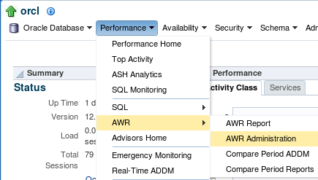
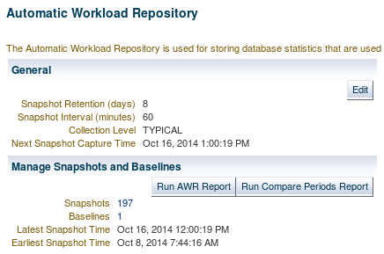
Accessing the AWR Page
Notes:
Oracle Database 12c: Administration Workshop 17 - <number>
In Enterprise Manager Cloud Control, navigate to the Automatic Workload Repository page by expanding the Performance menu, selecting AWR, and then selecting AWR Administration.
On the Automatic Workload Repository page, click Edit to change the settings.
On the Automatic Workload Repository page, you can:
Edit the workload repository settings
Look at detailed information about created snapshots and manually create new ones
Create AWR baselines
Generate an AWR report
在企业管理器云控制中，通过展开性能菜单，选择AWR，然后选择AWR管理，导航到自动工作负载存储库页面。
在“自动工作负载资源库”页面上，单击“编辑”更改设置。
在“自动工作负载存储库”页面上，您可以：
编辑工作负载库设置
查看有关创建的快照的详细信息，并手动创建新的快照
创建AWR基准
生成AWR报告

Slide 12
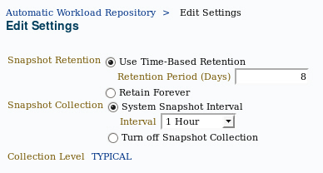
Managing the AWR
  Retention period
    Default: Eight days
    Consider storage needs
  Collection interval
    Default: 60 minutes
    Consider storage needs
    and performance impact
  Collection level
    Basic (disables most ADDM functionality)
    Typical (recommended)
    All (adds additional SQL tuning information to snapshots)
Notes:
Oracle Database 12c: Administration Workshop 17 - <number>
AWR settings include retention period, collection interval, and collection level. Remember that decreasing any of these settings affects the functionality of components that depend on the AWR, including the advisors.
Increasing the settings can provide improved advisor recommendations—but at the cost of the space that is required to store the snapshots and the performance expended in collecting the snapshot information.
Consider setting collection level to ALL when tuning a new application. The ALL setting collects SQL execution plans and timing statistics that enhance the recommendations of the SQL advisors. When tuning is complete, this setting should be returned to the TYPICAL setting.
AWR设置包括保留期限，收集间隔和收集级别。 请记住，减少这些设置会影响依赖于AWR的组件的功能，包括顾问。
增加设置可以提供改进的顾问建议，但是以收集快照所需的空间为代价，以及收集快照信息所花费的性能。
在调整新应用程序时，请考虑将集合级别设置为ALL。 ALL设置收集SQL执行计划和计时统计信息，以增强SQL顾问的建议。 调整完成后，此设置应返回到TYPICAL设置。

Slide 13


Statistic Levels
STATISTICS_LEVEL
BASIC
TYPICAL
ALL
Self-tuning
capabilities disabled
Recommended
default value
Additional statistics
for manual
SQL diagnostics
Notes:
Oracle Database 12c: Administration Workshop 17 - <number>
The STATISTICS_LEVEL initialization parameter controls the capture of a variety of statistics and various advisors, including the automatic maintenance tasks. The automatic maintenance tasks include gathering optimizer statistics. The STATISTICS_LEVEL parameter can be set to the following levels:
BASIC: The computation of AWR statistics and metrics is turned off. The automatic optimizer statistics task is disabled, as are all advisors and server-generated alerts.
TYPICAL: Major statistics that are required for database self-management are collected. They represent what is typically needed to monitor Oracle database behavior. This includes automatic gathering of statistics to reduce the likelihood of poorly performing SQL statements due to stale or invalid statistics.
ALL: All possible statistics are captured. This level of capture adds timed OS statistics and plan execution statistics. These statistics are not needed in most cases and should not be enabled for best performance; they are sometimes needed for specific diagnostics tests.
Oracle recommends that the default value of TYPICAL be set for the STATISTICS_LEVEL initialization parameter. Setting the value to BASIC disables the automatic gathering of optimizer statistics.
STATISTICS_LEVEL初始化参数控制捕获各种统计信息和各种顾问，包括自动维护任务。自动维护任务包括收集优化器统计信息。 STATISTICS_LEVEL参数可以设置为以下级别：
BASIC：关闭AWR统计和度量的计算。自动优化器统计信息任务被禁用，所有的顾问和服务器生成的警报也被禁用。
典型：收集数据库自我管理所需的主要统计数据。它们代表监视Oracle数据库行为通常需要的内容。这包括自动收集统计信息，以减少由于陈旧或无效的统计信息导致SQL语句执行不佳的可能性。
ALL：捕获所有可能的统计信息。这种捕获级别可增加定时操作系统统计信息和计划执行统计信息这些统计数据在大多数情况下不是必需的，不应该被启用以获得最佳性能;它们有时需要进行特定的诊断测试。
Oracle建议为STATISTICS_LEVEL初始化参数设置默认值TYPICAL。将值设置为BASIC会禁用优化器统计信息的自动收集。

Slide 14
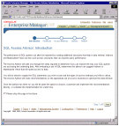


Automatic Database
Diagnostic Monitor (ADDM)
  Runs after each AWR snapshot
  Monitors the instance; detects bottlenecks
  Stores results in the AWR
Snapshots
EM
ADDM
ADDM results
AWR
Notes:
Oracle Database 12c: Administration Workshop 17 - <number>
Unlike the other advisors, the ADDM runs automatically after each AWR snapshot. Each time a snapshot is taken, the ADDM performs an analysis of the period corresponding to the last two snapshots. The ADDM proactively monitors the instance and detects most bottlenecks before they become a significant problem.
In many cases, the ADDM recommends solutions for detected problems and even quantifies the benefits for the recommendations.
Some common problems that are detected by the ADDM:
CPU bottlenecks
Poor Oracle Net connection management
Lock contention
Input/output (I/O) capacity
Undersizing of database instance memory structures
High-load SQL statements
High PL/SQL and Java time
High checkpoint load and cause (for example, small log files)
The results of each ADDM analysis are stored in the AWR and are also accessible through Enterprise Manager.
与其他顾问不同，ADDM在每个AWR快照后自动运行。 每次拍摄快照时，ADDM会对与最后两个快照相对应的周期进行分析。 ADDM主动监视实例，并在其成为重大问题之前检测出大多数瓶颈。
在许多情况下，ADDM建议为检测到的问题提供解决方案，甚至量化建议的好处。
ADDM检测到的一些常见问题：
CPU瓶颈
糟糕的Oracle Net连接管理
锁定争用
输入/输出（I / O）容量
数据库实例内存结构不足
高负载SQL语句
高PL / SQL和Java时间
高检查点加载和原因（例如，小日志文件）
每个ADDM分析的结果存储在AWR中，也可以通过企业管理器访问。

Slide 15
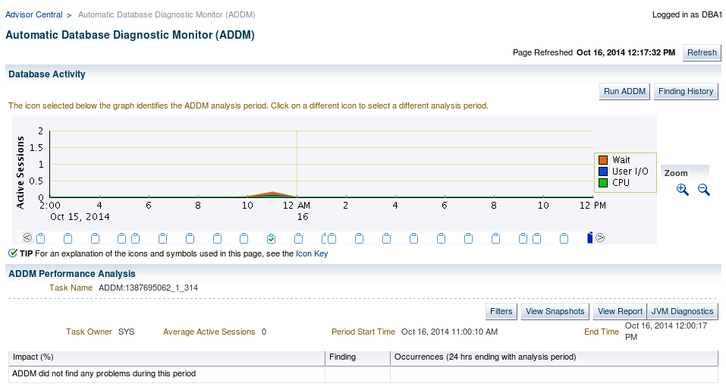
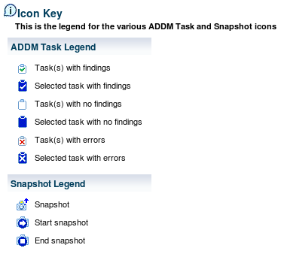
ADDM Findings in
Enterprise Manager Cloud Control
Notes:
Oracle Database 12c: Administration Workshop 17 - <number>
You can use Enterprise Manager Cloud Control to view ADDM findings. Select Advisors Home in the Performance menu. Select an ADDM autorun on the Advisors Central page.
On the Automatic Database Diagnostic Monitor (ADDM) page, you see detailed findings for the latest ADDM run. Database Time represents the sum of the non-idle time spent by sessions in the database for the analysis period. A specific impact percentage is given for each finding. The impact represents the time consumed by the corresponding issue compared with the database time for the analysis period.
Click the View Report button to get details about the performance analysis in the form of a text report.
您可以使用企业管理器云控制来查看ADDM发现。 在“性能”菜单中选择“顾问主页”。 在“顾问中心”页面上选择ADDM自动运行。
在自动数据库诊断监视器（ADDM）页面上，您将看到最新ADDM运行的详细发现。 数据库时间表示分析期间数据库中会话所花费的非空闲时间的总和。 每个发现给出了具体的影响百分比。 影响代表相应问题与分析期间的数据库时间相比所消耗的时间。
单击查看报告按钮以文本报告的形式获取有关性能分析的详细信息。

Slide 16
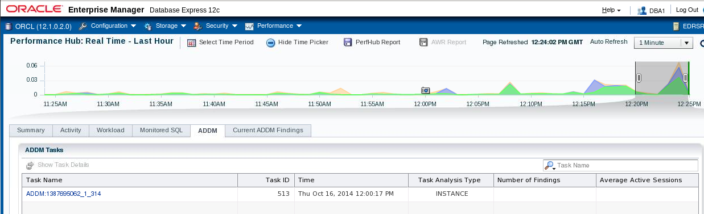
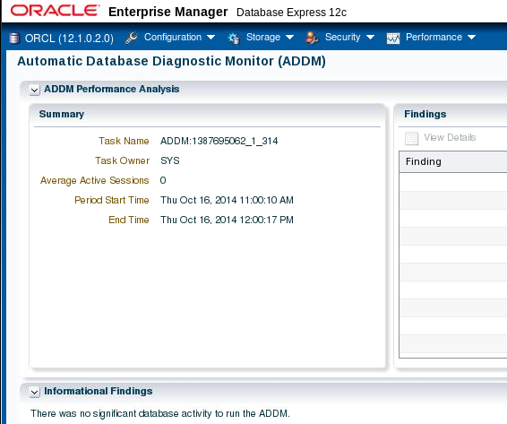
ADDM Findings in
Enterprise Manager Database Express
Notes:
Oracle Database 12c: Administration Workshop 17 - <number>
You can also use Enterprise Manager Database Express to view ADDM information. Select Performance Hub from the Performance menu. Click the ADDM tab. Select a task to view detailed information.
您还可以使用Enterprise Manager Database Express查看ADDM信息。 从性能菜单中选择性能集线器。 单击ADDM选项卡。 选择任务以查看详细信息。

Slide 17
Advisory Framework
ADDM
SQL Tuning Advisor
Buffer Cache
Advisor
PGA
Advisor
SQL Access Advisor
Shared Pool
Advisor
Memory Advisor
Java Pool
Advisor
SGA
Advisor
Streams Pool
Advisor
Segment Advisor
Space
Undo Advisor
Backup
MTTR Advisor
Notes:
Oracle Database 12c: Administration Workshop 17 - <number>
Advisors provide you with useful feedback about resource utilization and performance for their respective server components. For example, the Memory Advisor provides a recommended value for the MEMORY_TARGET initialization parameter, which controls the total amount of memory used by the Oracle database instance.
By building on the data captured in the AWR, the ADDM enables the Oracle Database server to diagnose its own performance and determine how identified problems can be resolved. ADDM runs automatically after each AWR statistics capture. It can potentially call other advisors.
Here are the major benefits that are provided by the advisor infrastructure:
All advisors use a uniform interface.
All advisors have a common data source and results storage by using the workload repository.
Not all advisors are shown in the slide (for example, the Data Recovery Advisor and the SQL Repair Advisor are not listed).
Automatic Database Diagnostic Monitor (ADDM)
The ADDM is a server-based expert that reviews database performance every 60 minutes. Its goal is to detect possible system bottlenecks early and recommend fixes before system performance degrades noticeably.
顾问为您提供有关其各自服务器组件的资源利用率和性能的有用反馈。例如，Memory Advisor为MEMORY_TARGET初始化参数提供了一个推荐值，该参数控制了Oracle数据库实例使用的总内存量。
通过基于AWR中捕获的数据，ADDM使Oracle数据库服务器能够诊断自身的性能，并确定已识别的问题如何解决。每次AWR统计捕获后，ADDM都会自动运行。它可以潜在地呼叫其他顾问。
以下是顾问基础设施提供的主要好处：
所有顾问使用统一的界面。
所有顾问通过使用工作负载存储库具有通用数据源和结果存储。
并不是所有的顾问都在幻灯片中显示（例如，Data Recovery Advisor和SQL Repair Advisor没有列出）。
自动数据库诊断监视器（ADDM）
ADDM是一个基于服务器的专家，每60分钟检查一次数据库性能。其目标是尽早检测可能的系统瓶颈，并在系统性能明显下降之前推荐修复。

Slide 18
Notes:
Oracle Database 12c: Administration Workshop 17 - <number>
Memory Advisors
The Memory Advisor is actually a collection of several advisory functions that help determine the best settings for the total memory used by the database instance. The System Global Area (SGA) has a set of advisors for the shared pool, database buffer cache, Java pool, and streams pool. The Java pool and streams pool advisors are not exposed on the Enterprise Manager Memory Advisor page. There is an advisor for the Program Global Area (PGA). In addition to the advisory functions, this advisor provides a central point of control for the large pool and the Java pool.
Mean-Time-To-Recover (MTTR) Advisor
Using the MTTR Advisor, you set the length of time required for the database to recover after an instance crash.
Segment Advisor
This advisor looks for tables and indexes that consume more space than they require. The advisor checks for inefficient space consumption at the tablespace or schema level and produces scripts to reduce space consumption where possible.
SQL Access Advisor
This advisor analyzes all SQL statements that are issued in a given period and suggests the creation of additional indexes or materialized views that will improve performance.
SQL Tuning Advisor
This advisor analyzes an individual SQL statement and makes recommendations for improving its performance. Recommendations may include actions, such as rewriting the statement, changing the instance configuration, or adding indexes.
Undo Management Advisor
With the Undo Management Advisor, you can determine the undo tablespace size that is required to support a given retention period. Undo management and the use of the advisor is covered in the lesson titled “Managing Undo Data.”
Data Recovery Advisor
This advisor automatically diagnoses persistent data failures, presents repair options to the user, and executes repairs at the user’s request. The purpose of the Data Recovery Advisor is to reduce the mean time to recover (MTTR) and provide a centralized tool for automated data repair.
SQL Repair Advisor
You run the SQL Repair Advisor after a SQL statement fails with a critical error that generates a problem in the Automatic Diagnostic Repository. The advisor analyzes the statement and, in many cases, recommends a patch to repair the statement. If you implement the recommendation, the applied SQL patch circumvents the failure by causing the query optimizer to choose an alternative execution plan for future executions. This is done without changing the SQL statement itself.
记忆顾问
Memory Advisor实际上是几个咨询功能的集合，有助于确定数据库实例使用的总内存的最佳设置。系统全局区域（SGA）具有一组共享池，数据库缓冲区缓存，Java池和流池的顾问。 Java池和流池顾问不会在Enterprise Manager Memory Advisor页面上公开。计划全球领域（PGA）的顾问。除了咨询功能之外，该顾问还提供了大型池和Java池的中心控制点。
平均收费时间（MTTR）顾问
使用MTTR Advisor，您可以设置实例崩溃后数据库恢复所需的时间长度。
分部顾问
该顾问寻找占用更多空间的表和索引。顾问检查表空间或模式级别的低效空间消耗，并生成脚本以尽可能减少空间消耗。
SQL Access顾问
该顾问程序分析在给定时间段内发布的所有SQL语句，并建议创建额外的索引或物化视图，以提高性能。
SQL调优顾问
该顾问分析单个SQL语句，并提出改进其性能的建议。建议可能包括操作，如重写语句，更改实例配置或添加索引。
撤销管理顾问
使用撤消管理顾问，您可以确定支持给定保留期限所需的撤消表空间大小。题为“管理撤消数据”的课程涵盖撤销管理和顾问的使用。
数据恢复顾问
该顾问会自动诊断持续的数据故障，向用户显示修复选项，并根据用户的要求执行修复。数据恢复顾问的目的是减少平均恢复时间（MTTR），并为自动数据修复提供集中的工具。
SQL修复顾问
在SQL语句失败后运行SQL Repair Advisor，并出现自动诊断存储库中产生问题的严重错误。顾问分析该语句，并且在许多情况下，建议修补该语句。如果实施该建议，则应用的SQL补丁会通过使查询优化器为未来的执行选择替代执行计划来规避失败。这是在不改变SQL语句本身的情况下完成的。

Slide 19
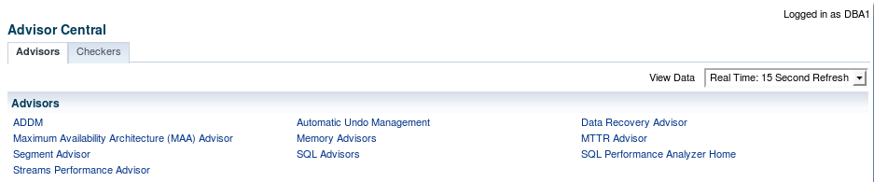
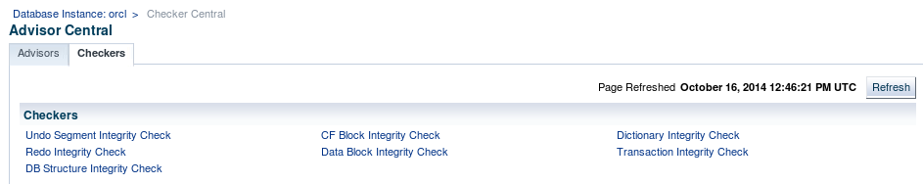
Viewing the Advisor Central Page in
Enterprise Manager Cloud Control
Notes:
Oracle Database 12c: Administration Workshop 17 - <number>
The Advisor Central page is the main page of all advisors. You can reach this page by selecting Advisors Home in the Performance menu. It is also possible to have access to advisors in certain contexts.
On the Advisors tab of the Advisor Central page, you can see all the advisor tasks that are registered in the workload repository. You can also filter this list by advisor type and for predefined time periods.
The Checkers tab of the Advisor Central page enables you to schedule various database integrity checkers. You can see all the checker runs by name, type, or time period.
Some advisors are described in greater detail in the lessons titled “Managing Undo Data,” “Managing Performance,” “Managing Performance: SQL Tuning,” and “Backup and Recovery Concepts.”
Note: Use the Change Default Parameters page to change the default expiration (in days) for all future tasks. You can also use this page to change the parameters of some important advisors.
顾问中心页面是所有顾问的主页。 您可以通过在“性能”菜单中选择“Advisors Home”来访问此页面。 在某些情况下也可以访问顾问。
在“顾问中心”页面的“顾问”选项卡上，可以看到在工作负载存储库中注册的所有顾问任务。 您还可以按照顾问类型和预定义的时间段过滤此列表。
Advisor Central页面的Checkers选项卡使您可以安排各种数据库完整性检查程序。 您可以按名称，类型或时间段查看所有检查程序。
有些顾问在题为“管理撤消数据”，“管理性能”，“管理性能：SQL调优”和“备份和恢复概念”的课程中有更详细的描述。
注意：使用“更改默认参数”页更改以后所有任务的默认过期日期（以天为单位）。 您还可以使用此页面更改一些重要顾问的参数。

Slide 20
Using Packages to Invoke the Advisors
Package Name | Advisor Name
DBMS_ADDM | Automatic Database Diagnostic Monitor (DBMS_ADDM)
DBMS_ADVISOR | SQL Access Advisor and Segment Advisor
DBMS_COMPRESSION | Compression Advisor
DBMS_SQLDIAG | SQL Repair Advisor
DBMS_SQLPA | SQL Performance Analyzer
DBMS_SQLTUNE | SQL Tuning Advisor
Notes:
Oracle Database 12c: Administration Workshop 17 - <number>
The DBMS_ADVISOR package contains all constants and procedure declarations for all advisor modules. However, some of the advisors have their own separate packages. Oracle recommends that you use the advisor-specific package rather than DBMS_ADVISOR for the following advisors:
Automatic Database Diagnostic Monitor (DBMS_ADDM)
SQL Performance Analyzer (DBMS_SQLPA)
SQL Repair Advisor (DBMS_SQLDIAG)
SQL Tuning Advisor (DBMS_SQLTUNE)
Compression Advisor (DBMS_COMPRESSION.GET_COMPRESSION_RATIO)
You can use DBMS_ADVISOR and the other advisor packages to execute tasks from the command line.
To execute advisor procedures, you must be granted the ADVISOR privilege. The ADVISOR privilege permits full access to the advisor procedures and views.
Note: For more information about all the procedures found in the advisor packages, refer to the Oracle Database PL/SQL Packages and Types Reference.
DBMS_ADVISOR包包含所有顾问模块的所有常量和过程声明。 但是，有些顾问有自己独立的包。 Oracle建议您对以下顾问使用特定于Advisor的程序包而不是DBMS_ADVISOR：
自动数据库诊断监视器（DBMS_ADDM）
SQL性能分析器（DBMS_SQLPA）
SQL修复顾问（DBMS_SQLDIAG）
SQL调优顾问（DBMS_SQLTUNE）
压缩顾问（DBMS_COMPRESSION.GET_COMPRESSION_RATIO）
您可以使用DBMS_ADVISOR和其他顾问程序包从命令行执行任务。
要执行顾问程序，您必须获得ADVISOR权限。 ADVISOR权限允许完全访问顾问程序和视图。
注意：有关顾问程序包中的所有过程的更多信息，请参阅“Oracle数据库PL / SQL包和类型参考”。

Slide 21

Automated Maintenance Tasks
Autotask maintenance process:
  Maintenance Window opens.
  Autotask background process schedules jobs.
  Scheduler initiates jobs.
  Resource Manager limits impact of Autotask jobs.
Default Autotask maintenance jobs:
  Gathering optimizer statistics
  Automatic Segment Advisor
  Automatic SQL Advisor
Notes:
Oracle Database 12c: Administration Workshop 17 - <number>
By analyzing the information stored in the AWR, the database server can identify the need to perform routine maintenance tasks, such as optimizer statistics refresh. The automated maintenance tasks infrastructure enables the Oracle Database server to automatically perform such operations. It uses the Scheduler to run such tasks in predefined maintenance windows.
By default, the weekday maintenance windows start at 10:00 PM and last four hours. On Saturday and Sunday, the maintenance window starts at 6:00 AM and lasts for 20 hours. All attributes of the maintenance windows are customizable, including the start and end times, frequency, days of the week, and so on. In addition, the impact of automated maintenance tasks on normal database operations can be limited by associating a Database Resource Manager resource plan to the maintenance window.
Examples of maintenance:
Optimizer statistics are automatically refreshed by using the automatic maintenance task infrastructure.
The Automatic Segment Advisor has default jobs, which run in the maintenance window.
When creating a database with the DBCA, you can initiate regular database backups.
通过分析存储在AWR中的信息，数据库服务器可以识别执行例行维护任务的需要，例如优化器统计刷新。自动化维护任务基础架构使Oracle数据库服务器能够自动执行此类操作。它使用计划程序在预定义的维护窗口中运行这些任务。
默认情况下，工作日维护窗口从上午10点和最后4小时开始。在星期六和星期天，维修窗口从上午6:00开始，持续20小时。维护窗口的所有属性都是可自定义的，包括开始和结束时间，频率，星期几等。此外，通过将数据库资源管理器资源计划与维护窗口相关联，可以限制自动维护任务对正常数据库操作的影响。
维护示例：
使用自动维护任务基础设施自动刷新优化程序统计信息。
自动段顾问具有默认作业，它在维护窗口中运行。
使用DBCA创建数据库时，可以启动常规数据库备份。

Slide 22
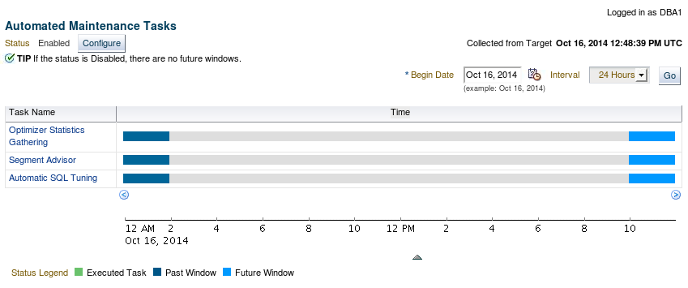
Automated Maintenance Tasks
Notes:
Oracle Database 12c: Administration Workshop 17 - <number>
To access the Automated Maintenance Task page, expand the Administration menu and select Automated Maintenance Tasks in the Oracle Scheduler submenu. On this page, you can view the automated maintenance task schedule and recent history. From here, you can drill down to details on some tasks. Click Configure to go to the Automated Maintenance Tasks Configuration page. A task executes in a window. The graph shows the last window in which a task was executed and the next window in which the task is scheduled to be executed.
Note: The default windows for tasks are shown in the example. When the maintenance window closes, the Scheduler terminates the optimizer statistics–gathering job by default. The remaining objects are then processed in the next maintenance window.
要访问“自动维护任务”页面，请展开“管理”菜单，然后在“Oracle调度程序”子菜单中选择“自动维护任务”。 在此页面上，您可以查看自动维护任务计划和最近的历史记录。 从这里，您可以深入了解一些任务的详细信息。 单击配置以转到自动维护任务配置页面。 任务在窗口中执行。 该图显示了执行任务的最后一个窗口以及其中要执行任务的下一个窗口。
注意：示例中显示了任务的默认窗口。 维护窗口关闭时，默认情况下，计划程序将终止优化程序统计信息收集作业。 然后在下一个维护窗口中处理剩余的对象。

Slide 23
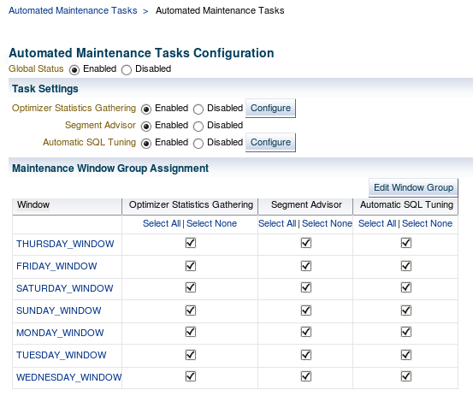
Automated Maintenance Tasks Configuration
Notes:
Oracle Database 12c: Administration Workshop 17 - <number>
On the Automated Maintenance Tasks Configuration page, you can enable and disable automatic maintenance tasks—all at once, by individual tasks, or by particular windows. You can also configure the settings that are used for optimizer statistics gathering and the job control parameters for the automatic SQL Tuning Advisor.
Select the window name to view or edit the window schedule.
Click Edit Window Group to add and remove windows in the window group.
在“自动维护任务配置”页面上，您可以通过单独的任务或特定的窗口启用和禁用自动维护任务。 您还可以配置用于优化程序统计信息收集的设置和自动SQL Tuning Advisor的作业控制参数。
选择窗口名称以查看或编辑窗口计划。
单击编辑窗口组以添加和删除窗口组中的窗口。

Slide 24




Server-Generated Alerts
Enterprise Manager
Server
alerts
queue.
Oracle
instance
Metric exceeds
threshold.
AWR
Notes:
Oracle Database 12c: Administration Workshop 17 - <number>
Alerts are notifications of when a database is in an undesirable state and needs your attention. By default, the Oracle Database server provides alerts via Enterprise Manager. Optionally, Enterprise Manager can be configured to send an email message to the administrator about problem conditions as well as display alert information on the console.
You can also set thresholds on many of the pertinent metrics for your system. Oracle Database proactively notifies you if the database deviates sufficiently from normal readings to reach those thresholds. An early notification of potential problems enables you to respond quickly and, in many cases, resolve issues before users even notice them.
Approximately, 60 metrics are monitored by default, among which are:
Broken Job Count
Database Time Spent Waiting (%)
Dump Area Used (%)
SQL Response Time (%) compared to baseline
Tablespace Used (%)
Generic Incident
A few additional key metrics can provide early problem notification:
Average File Read Time (centiseconds)
Response Time (per transaction)
Wait Time (%)
警报是数据库处于不良状态并需要您注意的通知。默认情况下，Oracle数据库服务器通过企业管理器提供警报。 （可选）企业管理器可以配置为向管理员发送有关问题状况的电子邮件消息以及在控制台上显示警报信息。
您还可以为系统的许多相关指标设置阈值。 Oracle数据库主动通知您数据库是否与正常读数足够的偏差达到这些阈值。早日通知潜在的问题使您能够快速响应，并且在许多情况下，在用户甚至注意到这些问题之前可以解决问题。
大约默认情况下监视60个指标，其中包括：
破碎的工作计数
数据库时间等待（％）
使用转储区（％）
SQL响应时间（％）与基线相比
使用的表空间（％）
一般事件
一些附加的关键指标可以提供早期的问题通知：
平均文件读取时间（厘秒）
响应时间（每次交易）
等待时间 （％）

Slide 25
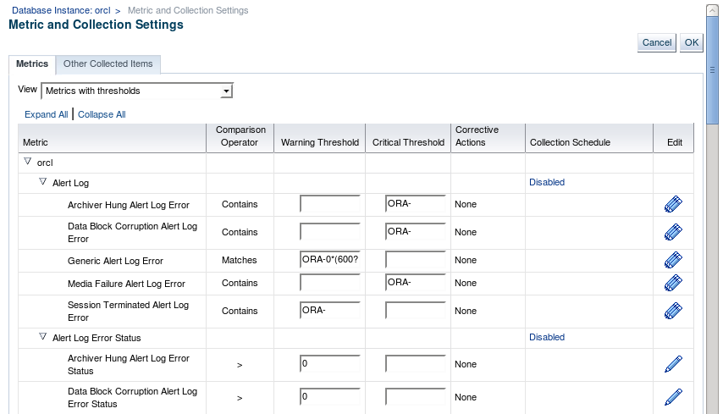
Setting Metrics Thresholds
Notes:
Oracle Database 12c: Administration Workshop 17 - <number>
To access the Metric and Collection Settings page, expand the Oracle Database menu and select Metric and Collection Settings from the Monitoring submenu.
Enter your desired warning and critical threshold values for the metric. The appropriate alerts appear when the database reaches your specified values.
The thresholds that are already set appear in the “Metrics with thresholds” list. By default, approximately 60 metrics have preset thresholds; you may change these as needed. The “All metrics” list shows the metrics that do not have thresholds set.
Click the Edit icon to access a page where you can specify additional corrective actions for either warning or critical thresholds.
Click a Collection Schedule link to change the scheduled collection interval. Be aware that each schedule affects a group of metrics.
要访问“度量和集合设置”页面，请展开“Oracle数据库”菜单，然后从“监视”子菜单中选择“度量标准和集合设置”。
为指标输入所需的警告和临界阈值。 当数据库达到您指定的值时，出现适当的警报。
已设置的阈值显示在“带阈值的度量标准”列表中。 默认情况下，约60个指标具有预设阈值; 您可以根据需要更改这些。 “所有度量”列表显示没有设置阈值的指标。
单击编辑图标访问一个页面，您可以在其中为警告或临界阈值指定其他纠正措施。
单击收集计划链接以更改计划收集间隔。 请注意，每个日程表都会影响一组指标。

Slide 26

Reacting to Alerts
  If necessary, you should gather more input (for example, by running ADDM or another advisor).
  Investigate critical errors.
  Take corrective measures.
  Acknowledge alerts that are not automatically cleared.
Notes:
Oracle Database 12c: Administration Workshop 17 - <number>
When you receive an alert, follow the recommendations that it provides. Or you can consider running the ADDM (or another advisor as appropriate) to obtain more detailed diagnostics of system or object behavior.
Alerts and incidents are generated for critical errors. Critical errors usually generate incidents that are collected into problems. You use the Support Workbench to investigate and possibly report the problem to Oracle Support.
Most alerts (such as “Out of Space”) are cleared automatically when the cause of the problem disappears. However, other alerts (such as Generic Alert Log Error) are sent to you for notification and must be acknowledged by you. After taking the necessary corrective measures, you acknowledge an alert by clearing or purging it. Clearing an alert sends the alert to the Alert History, which is accessible from the Monitoring submenu. Purging an alert removes it from the Alert History.
收到警报后，请遵循其提供的建议。 或者您可以考虑运行ADDM（或适当的其他顾问）来获取更详细的系统或对象行为诊断。
警报和事件是为严重错误而生成的。 严重错误通常会导致收集到问题中的事件。 您可以使用支持工作台调查并可能将问题报告给Oracle支持。
当问题的原因消失时，大多数警报（例如“空间不足”）将被自动清除。 但是，其他警报（例如通用警报日志错误）将发送给您进行通知，并且必须由您确认。 在采取必要的纠正措施后，您通过清除或清除来确认警报。 清除警报将警报发送到警报历史记录，可从“监视”子菜单访问该记录。 清除警报将从警报历史记录中删除。

Slide 27
Alert Types and Clearing Alerts
Metric based
Threshold
(stateful)
alerts
97% Critical
Cleared
85% Warning
Cleared
MMON
DBA_OUTSTANDING_ALERTS
DBA_ALERT_HISTORY
Resumable
Session
Suspended
Recovery Area
Low On
Free Space
Snapshot
Too Old
Nonthreshold (stateless)
alerts
Alert
Event based
Notes:
Oracle Database 12c: Administration Workshop 17 - <number>
There are two kinds of server-generated alerts: threshold and nonthreshold.
Most server-generated alerts are configured by setting a warning and critical threshold values on database metrics. You can define thresholds for more than 120 metrics, including the following:
Physical Reads Per Sec
User Commits Per Sec
SQL Service Response Time
Except for the Tablespace Space Usage metric, which is database related, the other metrics are instance related. Threshold alerts are also referred to as stateful alerts, which are automatically cleared when an alert condition clears. Stateful alerts appear in DBA_OUTSTANDING_ALERTS and, when cleared, go to DBA_ALERT_HISTORY.
Other server-generated alerts correspond to specific database events, such as ORA-* errors, “Snapshot too old” errors, Recovery Area Low On Free Space, and Resumable Session Suspended. These are non-threshold-based alerts, also referred to as stateless alerts. Stateless alerts go directly to the history table.
有两种服务器生成的警报：阈值和非阈值。
大多数服务器生成的警报通过在数据库指标上设置警告和关键阈值进行配置。 您可以为超过120个指标定义阈值，包括以下内容：
每秒物理读数
用户提交每秒
SQL服务响应时间
除了与数据库相关的“表空间空间使用度量”，其他指标与实例相关。 阈值警报也称为状态警报，当警报条件清除时，警报将自动清除。 状态警报会显示在DBA_OUTSTANDING_ALERTS中，并且清除后，请转到DBA_ALERT_HISTORY。
其他服务器生成的警报对应于特定的数据库事件，例如ORA- *错误，“快照太旧”错误，恢复区域低可用空间和可恢复会话已暂停。 这些是基于非阈值的警报，也称为无状态警报。 无状态警报直接进入历史表。

Slide 28
Quiz
Stateless alerts, such as SNAPSHOT TOO OLD can be found in the dictionary view DBA_OUTSTANDING_ALERTS.
  True
  False
Notes:
Oracle Database 12c: Administration Workshop 17 - <number>
Answer: b

Slide 29
Summary
In this lesson, you should have learned how to:
  Manage the Automatic Workload Repository (AWR)
  Use the Automatic Database Diagnostic Monitor (ADDM)
  Describe and use the advisory framework
  Set alert thresholds
  Use server-generated alerts
  Use automated tasks
Notes:
Oracle Database 12c: Administration Workshop 17 - <number>
在本课中，您应该学会了如何：
管理自动工作量存储库（AWR）
使用自动数据库诊断监视器（ADDM）
描述和使用咨询框架
设置警报阈值
使用服务器生成的警报
使用自动化任务

Slide 30
Practice: Overview
This practice covers proactively managing your database with ADDM, including:
  Setting up an issue for analysis
  Reviewing your database performance
  Implementing a solution
Notes:
Oracle Database 12c: Administration Workshop 17 - <number>
This practice covers proactively managing your database with ADDM, including:
Setting up an issue for analysis
Reviewing your database performance
Implementing a solution

