Slide 1
Backup and Recovery: Configuration

Slide 2
Objectives
After completing this lesson, you should be able to:
  Configure the fast recovery area
  Multiplex the control file
  Multiplex redo log files
  Configure ARCHIVELOG mode
Notes:
Oracle Database 12c: Administration Workshop 13 - <number>
完成本课后，您应该能够：
配置快速恢复区域
复制控制文件
多重重做日志文件
配置ARCHIVELOG模式

Slide 3
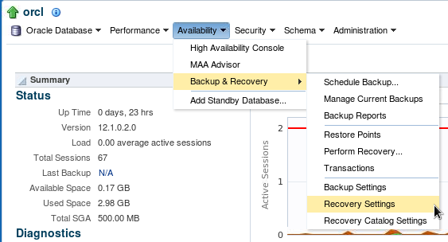
Configuring for Recoverability
Configure your database for maximum recoverability by:
  Scheduling regular backups
  Multiplexing control files
  Multiplexing redo log groups
  Retaining archived copies of redo logs
Notes:
Oracle Database 12c: Administration Workshop 13 - <number>
To provide the best protection for your data, you must:
Schedule regular backups: Most media failures require that you restore the lost or damaged file from backup.
Multiplex control files: All control files associated with a database are identical. Recovering from the loss of a single control file is not difficult; recovering from the loss of all control files is much more challenging. Guard against losing all control files by having at least two copies.
Multiplex redo log groups: To recover from instance or media failure, redo log information is used to roll data files forward to the last committed transaction. If your redo log groups rely on a single redo log file, the loss of that file means that data is likely to be lost. Ensure that there are at least two copies of each redo log group; if possible, each copy should be under different disk controllers.
Retain archived copies of redo logs: If a file is lost and restored from backup, the instance must apply redo information to bring that file up to the latest SCN contained in the control file. With the default setting, the database can overwrite redo information after it has been written to the data files. Your database can be configured to retain redo information in archived copies of the redo logs. This is known as placing the database in ARCHIVELOG mode.
You can perform configuration tasks in Enterprise Manager Cloud Control or by using the SQL command line.
为了对您的数据提供最佳保护，您必须：
安排常规备份：大多数介质故障都要求从备份还原丢失或损坏的文件。
多路复制控制文件：与数据库关联的所有控制文件是相同的。从单个控制文件的丢失中恢复并不困难;从所有控制文件的丢失中恢复更具挑战性。至少拥有两份副本，防止丢失所有控制文件。
多路复用重做日志组：要从实例或介质故障中恢复，重做日志信息用于将数据文件转发到最后提交的事务。如果您的重做日志组依赖于单个重做日志文件，则该文件的丢失意味着数据可能会丢失。确保每个重做日志组至少有两个副本;如果可能，每个副本应该在不同的磁盘控制器下。
保留重做日志的存档副本：如果文件丢失并从备份还原，则实例必须应用重做信息才能将该文件保存到控制文件中包含的最新SCN。使用默认设置，数据库在写入数据文件后可以覆盖重做信息。您的数据库可以配置为在重做日志的归档副本中保留重做信息。这被称为将数据库置于ARCHIVELOG模式。
您可以在Enterprise Manager Cloud Control中执行配置任务，也可以使用SQL命令行执行配置任务。

Slide 4
Configuring the Fast Recovery Area
  Fast recovery area:
    Strongly recommended for simplified backup storage management
    Storage space (separate from working database files)
    Location specified by the DB_RECOVERY_FILE_DEST parameter
    Size specified by the DB_RECOVERY_FILE_DEST_SIZE parameter
    Large enough for backups, archived logs, flashback logs, multiplexed control files, and multiplexed redo logs
    Automatically managed according to your retention policy
  Configuration of the fast recovery area includes specifying the location, size, and retention policy.
Notes:
Oracle Database 12c: Administration Workshop 13 - <number>
The fast recovery area is space that is set aside on disk to contain archived logs, backups, flashback logs, multiplexed control files, and multiplexed redo logs. A fast recovery area simplifies backup storage management and is strongly recommended. You should place the fast recovery area on storage space that is separate from the location of your database data files and primary online log files and control file.
The amount of disk space to allocate for the fast recovery area depends on the size and activity levels of your database. As a general rule, the larger the fast recovery area, the more useful it is. Ideally, the fast recovery area should be large enough for copies of your data and control files and for flashback, online redo, and archived logs needed to recover the database with the backups kept based on the retention policy. (In short, the fast recovery area should be at least twice the size of the database so that it can hold one backup and several archived logs.)
Space management in the fast recovery area is governed by a backup retention policy. A retention policy determines when files are obsolete, which means that they are no longer needed to meet your data recovery objectives. The Oracle Database server automatically manages this storage by deleting files that are no longer needed.
快速恢复区域是在磁盘上放置的空间，用于包含归档日志，备份，闪回日志，复用控制文件和多路复用重做日志。快速恢复区域简化了备份存储管理，强烈建议。您应该将快速恢复区域放在与数据库数据文件和主要在线日志文件和控制文件位置分开的存储空间上。
要为快速恢复区域分配的磁盘空间量取决于数据库的大小和活动级别。作为一般规则，快速恢复区域越大越有用。理想情况下，快速恢复区域应足够大，可以复制您的数据和控制文件，以及恢复数据库所需的闪回，联机重做和归档日志，并根据保留策略保留备份。 （简而言之，快速恢复区域应至少是数据库大小的两倍，以便它可以容纳一个备份和多个归档日志。）
快速恢复区域中的空间管理由备份保留策略控制。保留策略确定文件何时过时，这意味着不再需要它们来满足数据恢复目标。 Oracle数据库服务器通过删除不再需要的文件来自动管理此存储。

Slide 5
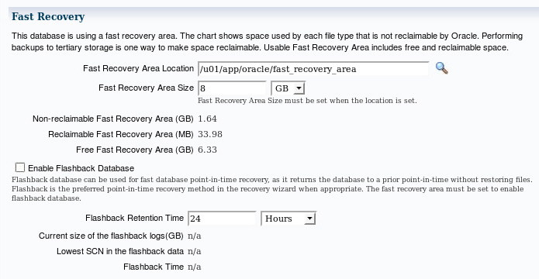
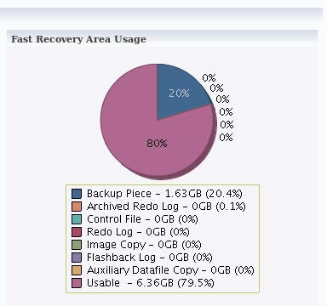
Monitoring the Fast Recovery Area
Notes:
Oracle Database 12c: Administration Workshop 13 - <number>
If you have configured your archived logs to be written to this location, it is important to monitor this space to ensure that it does not reach its capacity. If the instance is unable to create an archived log because of lack of space, it pauses until the administrator corrects the situation.
In Enterprise Manager Cloud Control, select Availability > Backup & Recovery > Recovery Settings. On this page, you can:
Verify how much of the fast recovery area has been consumed
Specify the location of the fast recovery area
Specify the size of the fast recovery area
Configure Flashback Database
Specify the retention time
The retention time determines when files are obsolete (that is, when they are no longer needed to meet your data recovery objectives). The Oracle Database server automatically manages this storage, deleting files that are no longer needed. You can back up the recovery area so that Oracle Recovery Manager (RMAN) can fail over to other archived redo log destinations if the archived redo log in the fast recovery area is inaccessible or corrupted.
Periodically copying backups to tape frees space in the fast recovery area for other files, but retrieving files from tape causes longer database restoration and recovery times.
如果已将归档日志配置为写入此位置，则监视此空间以确保其不能达到其重要性。如果实例由于缺少空间而无法创建归档日志，则会暂停直到管理员更正此情况。
在企业管理器云控制中，选择可用性>备份和恢复>恢复设置。在此页面上，您可以：
验证已经消耗了多少快速恢复区域
指定快速恢复区域的位置
指定快速恢复区域的大小
配置闪回数据库
指定保留时间
保留时间决定文件何时过时（即不再需要它们来满足数据恢复目标）。 Oracle数据库服务器自动管理此存储，删除不再需要的文件。您可以备份恢复区域，以便如果快速恢复区域中归档的重做日志不可访问或损坏，Oracle Recovery Manager（RMAN）可以故障切换到其他已归档的重做日志目标。
将备份定期复制到磁带可以在快速恢复区域中释放其他文件的空间，但从磁带检索文件会导致更长的数据库恢复和恢复时间。

Slide 6
Multiplexing Control Files
To protect against database failure, your database should have multiple copies of the control file.
 | ASM Storage | File System Storage
Best Practice | One copy on each disk group (such as +DATA and +FRA) | At least two copies, each on separate disk (at least one on separate disk controller)
Steps to create additional control files | No additional control file copies required | 1. Alter the SPFILE with the ALTER SYSTEM SET control_files command. 2. Shut down the database. 3. Copy control file to a new location. 4. Open the database and verify the addition of the new control file.
Notes:
Oracle Database 12c: Administration Workshop 13 - <number>
A control file is a small binary file that describes the structure of the database. It must be available for writing by the Oracle server whenever the database is mounted or opened. Without this file, the database cannot be mounted, and recovery or re-creation of the control file is required. Your database should have a minimum of two control files on different storage devices to minimize the impact of a loss of one control file.
The loss of a single control file causes the instance to fail because all control files must be available at all times. However, recovery can be a simple matter of copying one of the other control files. The loss of all control files is slightly more difficult to recover from but is not usually catastrophic.
控制文件是描述数据库结构的小型二进制文件。 每当安装或打开数据库时，它都必须可以由Oracle服务器进行写入。 如果没有此文件，则无法装载数据库，并且需要恢复或重新创建控制文件。 您的数据库在不同的存储设备上应至少有两个控制文件，以最大限度地减少丢失一个控制文件的影响。
单个控制文件的丢失会导致实例失败，因为所有控制文件必须始终可用。 然而，恢复可能是复制其他控制文件之一的简单问题。 所有控制文件的丢失稍微难以恢复，但通常不是灾难性的。

Slide 7
Notes:
Oracle Database 12c: Administration Workshop 13 - <number>
Adding a Control File
If you are using ASM as your storage technique, then as long as you have two control files, one in each disk group (such as +DATA and +FRA), then you should not require further multiplexing. In a database using Oracle Managed Files (OMF)—such as a database using ASM storage—all additional control files must be created as part of a recovery process using RMAN (or through Enterprise Manager).
添加控制文件
如果您使用ASM作为存储技术，那么只要有两个控制文件，每个磁盘组中就有一个（如+ DATA和+ FRA），则不需要进一步的复用。 在使用Oracle管理文件（OMF）的数据库（如使用ASM存储的数据库）中，必须使用RMAN（或通过企业管理器）将所有其他控制文件创建为恢复过程的一部分。
In a database using regular file system storage, adding a control file is a manual operation:
1. Alter the SPFILE with the following command specifying the appropriate location of your files:
ALTER SYSTEM SET control_files =
'/u01/app/oracle/oradata/orcl/control01.ctl' ,
'/u02/app/oracle/oradata/orcl/control02.ctl' ,
'/u03/app/oracle/oradata/orcl/control03.ctl' SCOPE=SPFILE;
2. Shut down the database instance.
3. Use an operating system command to copy an existing control file to the location you select for your new file.
4. Open the database.
Note: More information about using RMAN is provided in the Oracle Database 12c: Backup and Recovery Workshop and in product documentation.

Slide 8
Redo Log Files
Multiplex redo log groups to protect against media failure and loss of data. This increases database I/O. It is suggested that redo log groups have:
  At least two members (files) per group
  Each member:
    On a separate disk or
    controller if using
    file system storage
    In a separate disk group
    (such as +DATA and +FRA)
    if using ASM
+DATA
Member a
Member a
Member a
+FRA
Member b
Member b
Member b
Group 1
Group 2
Group 3
Note: Multiplexing redo logs may impact overall database performance.
Notes:
Oracle Database 12c: Administration Workshop 13 - <number>
多重重做日志组，以防止媒体故障和数据丢失。 这增加了数据库I / O。 建议重做日志组具有：
每组至少有两个成员（文件）
每位成员：
在单独的磁盘或 控制器上使用 文件系统存储
在单独的磁盘组 （如+ DATA和+ FRA） 如果使用ASM
Redo log groups are made up of one or more redo log files. Each log file in a group is a duplicate of the others. Oracle Corporation recommends that redo log groups have at least two files per group. If using file system storage, then each member should be distributed on separate disks or controllers so that no single equipment failure impacts an entire log group. If you are using ASM storage, then each member should be in a separate disk group, such as +DATA and +FRA.
The loss of an entire current log group is one of the most serious media failures because it can result in loss of data. The loss of a single member of a multiple-member log group is trivial and does not affect database operation (other than causing an alert to be published in the alert log). Recovery from the loss of an entire log group requires advanced recovery techniques and is discussed in the course titled Oracle Database 12c: Backup and Recovery Workshop.
Remember that multiplexing redo logs may heavily influence database performance because a commit cannot complete until the transaction information has been written to the logs. You must place your redo log files on your fastest disks served by your fastest controllers. If possible, do not place any other database files on the same disks as your redo log files (unless you are using ASM). Because only one group is written to at a given time, there is no performance impact in having members from several groups on the same disk.
重做日志组由一个或多个重做日志文件组成。组中的每个日志文件与其他日志文件重复。 Oracle Corporation建议重做日志组每个组至少有两个文件。如果使用文件系统存储，则每个成员应分布在单独的磁盘或控制器上，以免单个设备故障影响整个日志组。如果您使用ASM存储，则每个成员应该在一个单独的磁盘组中，例如+ DATA和+ FRA。
整个当前日志组的丢失是最严重的媒体故障之一，因为它可能导致数据丢失。多成员日志组的单个成员的丢失是微不足道的，并不会影响数据库操作（除了在警报日志中发布警报之外）。从整个日志组丢失恢复需要高级恢复技术，并在题为Oracle Database 12c：备份和恢复工作坊的课程中进行讨论。
请记住，复用重做日志可能会严重影响数据库性能，因为在事务信息已写入日志之前，提交无法完成。您必须将重做日志文件放在您最快的控制器提供的最快的磁盘上。如果可能，请勿将任何其他数据库文件放在与重做日志文件相同的磁盘上（除非使用ASM）。因为在给定时间只写入一个组，所以对同一磁盘上的几个组中的成员不会产生任何性能影响。

Slide 9
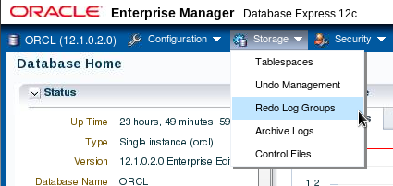
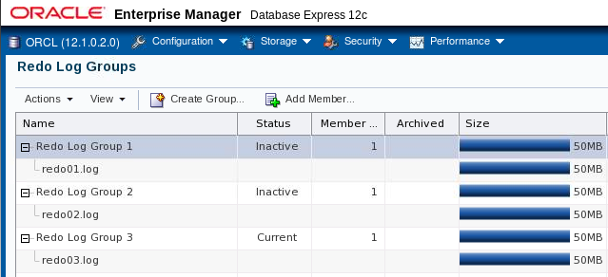
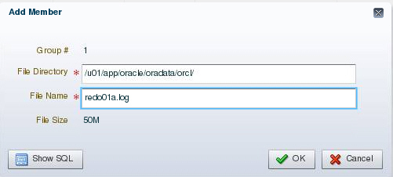
Multiplexing the Redo Log
Notes:
Oracle Database 12c: Administration Workshop 13 - <number>
You can multiplex your redo log by adding a member to an existing log group. To add a member to a redo log group (with open database and no impact on user performance), perform the following steps in Enterprise Manager Database Express:
您可以通过向现有日志组添加成员来复用重做日志。 要将成员添加到重做日志组（使用开放数据库并且不影响用户性能），请在Enterprise Manager Database Express中执行以下步骤：
1. Select Storage > Redo Log Groups.
2. Select a group and click Add Member.
3. The Add Member page appears.
4. For File System storage, enter the file name and the file directory. Click OK.
Repeat these steps for every existing group that you want to multiplex. An example showing the SQL syntax of adding a redo log member to redo log group 1 (using ASM) is shown here:
SQL> ALTER DATABASE ADD LOGFILE MEMBER '+DATA' TO GROUP 1;
When you add the redo log member to a group, the member’s status is marked as INVALID (as can be seen in the V$LOGFILE view). This is the expected state because the new member of the group has not yet been written to. When a log switch occurs and the group containing the new member becomes CURRENT, the member’s status changes to null.
当您将重做日志成员添加到组时，会员的状态被标记为INVALID（可以在V $ LOGFILE视图中看到）。 这是预期的状态，因为该组的新成员尚未写入。 当发生日志切换并且包含新成员的组成为CURRENT时，成员的状态更改为null。

Slide 10

Creating Archived Redo Log Files
To preserve redo information, create archived copies of redo log files by performing the following steps:
  Specify archived redo log file-naming convention.
  Specify one or more archived redo log file locations.
  Place the database in ARCHIVELOG mode.
Archiver
(ARCn)
Online redo
log files
Archived
redo log files
Notes:
The Oracle Database server treats the online redo log groups as a circular buffer in which to store transaction information, filling one group and then moving on to the next. After all groups have been written to, the Oracle Database server begins overwriting information in the first log group.
To configure your database for maximum recoverability, you must instruct the Oracle Database server to make a copy of the online redo log group before allowing it to be overwritten. These copies are known as archived redo log files.
To facilitate the creation of archived redo log files:
1. Specify a naming convention for your archived redo log files.
2. Specify a destination or destinations for storing your archived redo log files.
3. Place the database in ARCHIVELOG mode.
Note: Steps 1 and 2 are not necessary if you are using a fast recovery area.
The destination should exist before placing the database in ARCHIVELOG mode. When a directory is specified as a destination, there should be a slash at the end of the directory name.
Oracle数据库服务器将在线重做日志组视为循环缓冲区，用于存储事务信息，填充一个组，然后转移到下一个。所有组写入后，Oracle数据库服务器将开始覆盖第一个日志组中的信息。
要配置数据库以获得最大的可恢复性，必须指示Oracle数据库服务器在重写日志组之前创建一个副本，然后才能覆盖它。这些副本称为归档重做日志文件。
为了方便创建存档的重做日志文件：
1.为归档的重做日志文件指定一个命名约定。
2.指定用于存储归档重做日志文件的目的地。
3.将数据库置于ARCHIVELOG模式。
注意：如果使用快速恢复区域，则不需要步骤1和2。
在将数据库置于ARCHIVELOG模式之前，目的地应该存在。当目录被指定为目的地时，目录名称末尾应该有斜杠。
Oracle Database 12c: Administration Workshop 13 - <number>

Slide 11

Archiver (ARCn) Process
Archiver (ARCn):
  Is an optional background process
  Automatically archives online redo log files when the database is in ARCHIVELOG mode
  Preserves a record of all changes made to the database
SGA
Redo log buffer
LGWR
Log Writer
Copies of Redo log
files
Redo log
files
ARCn
Archiver process
Notes:
Oracle Database 12c: Administration Workshop 13 - <number>
ARCn is an optional background process. However, it is crucial to the recovery of a database after the loss of a disk. When an online redo log group gets filled, the Oracle Database server begins writing to the next online redo log group. The process of switching from one online redo log group to another is called a log switch. The ARCn process initiates archiving of the filled log group at every log switch. It automatically archives the online redo log group before the log group can be reused so that all the changes made to the database are preserved. This enables recovery of the database to the point of failure even if a disk drive is damaged.
One of the important decisions that a DBA must make is whether to configure the database to operate in ARCHIVELOG mode or in NOARCHIVELOG mode.
In NOARCHIVELOG mode, the online redo log files are overwritten each time a log switch occurs.
In ARCHIVELOG mode, inactive groups of filled online redo log files must be archived before they can be used again.
Note
ARCHIVELOG mode is essential for most backup strategies.
If the archived redo log file destination fills up or cannot be written to, the database will eventually come to a halt. Remove archived redo log files from the archived redo log file destination and the database will resume operations.
ARCn是一个可选的后台进程。但是，丢失磁盘后恢复数据库至关重要。当联机重做日志组被填满时，Oracle数据库服务器开始写入下一个联机重做日志组。从一个在线重做日志组切换到另一个在线重做日志组的过程称为日志切换。 ARCn进程在每个日志切换时启动对已填充日志组的归档。它会自动归档在线重做日志组，然后可以重新使用日志组，以便保留对数据库所做的所有更改。即使磁盘驱动器已损坏，也可以将数据库恢复到故障点。
DBA必须做出的重要决定之一是是否将数据库配置为以ARCHIVELOG模式或NOARCHIVELOG模式运行。
在NOARCHIVELOG模式下，每次发生日志切换时，将重写联机重做日志文件。
在ARCHIVELOG模式下，必须归档非活动组的在线重做日志文件，然后才能再次使用。
注意
ARCHIVELOG模式对于大多数备份策略至关重要。
如果存档的重做日志文件目标填满或不能写入，数据库将最终停止。从存档的重做日志文件目标中删除归档重做日志文件，数据库将恢复操作。

Slide 12
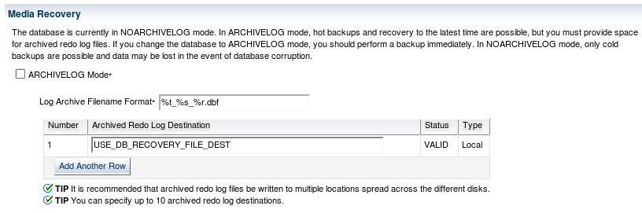
Archived Redo Log Files:
Naming and Destinations
Specify naming and archive destination information on the Recovery Settings page. If you are using file system storage, it is recommended that you add multiple locations across different disks.
Notes:
Oracle Database 12c: Administration Workshop 13 - <number>
To configure archived redo log file names and destinations by using Enterprise Manager Cloud Control, select Availability > Backup & Recovery > Recovery Settings.
Each archived redo log file must have a unique name to avoid overwriting older log files. Specify the naming format as shown in the slide. To help create unique file names, Oracle Database allows several wildcard characters in the name format:
%s: Includes the log sequence number as part of the file name
%t: Includes the thread number as part of the file name
%r: Includes the resetlogs ID to ensure that the archive log file name remains unique (even after certain advanced recovery techniques that reset log sequence numbers)
%d: Includes the database ID as part of the file name
The format should include %s, %t, and %r as best practice (%d can also be included if multiple databases share the same archive log destination).
By default, if the fast recovery area is enabled, USE_DB_RECOVERY_FILE_DEST is specified as an archived redo log file destination. Archived redo log files can be written to as many as 10 different destinations. Destinations may be local (a directory) or remote (an Oracle Net alias for a standby database).
要使用Enterprise Manager Cloud Control配置归档重做日志文件名和目标，请选择“可用性”>“备份和恢复”>“恢复设置”。
每个存档的重做日志文件必须具有唯一的名称，以避免覆盖较旧的日志文件。指定幻灯片中显示的命名格式。为了帮助创建唯一的文件名，Oracle数据库允许使用以下名称格式的几个通配符：
％s：将日志序列号作为文件名的一部分
％t：将线程号作为文件名的一部分
％r：包括重置日志ID，以确保归档日志文件名称保持唯一（即使在某些高级恢复技术重置日志序列号后）
％d：将数据库ID作为文件名的一部分
格式应包括％s，％t和％r作为最佳做法（如果多个数据库共享相同的归档日志目标，也可以包括％d）。
默认情况下，如果启用快速恢复区域，则将USE_DB_RECOVERY_FILE_DEST指定为归档重做日志文件目标。存档的重做日志文件可以写入多达10个不同的目的地。目的地可以是本地（目录）或远程（备用数据库的Oracle Net别名）。

Slide 13
Notes:
Click Add Another Row to add further destinations. To change recovery settings, you must be connected as SYSDBA, SYSOPER, or SYSBACKUP.
Note: If you do not want archives sent to this location, delete USE_DB_RECOVERY_FILE_DEST.
单击添加另一行以添加更多目的地。 要更改恢复设置，必须以SYSDBA，SYSOPER或SYSBACKUP连接。
注意：如果不要将归档发送到此位置，请删除USE_DB_RECOVERY_FILE_DEST。
Oracle Database 12c: Administration Workshop 13 - <number>

Slide 14
Configuring ARCHIVELOG Mode
To place the database in ARCHIVELOG mode, perform the following steps:
  Using Enterprise Manager Cloud Control:
    On the Recovery Settings page, select “ARCHIVELOG Mode” and click Apply. The database can be set to ARCHIVELOG mode only from the MOUNT state.
    Restart the database instance by clicking “Yes” when prompted.
  Using SQL commands:
    Mount the database.
    Issue the ALTER DATABASE ARCHIVELOG command.
    Open the database.
Notes:
Placing the database in ARCHIVELOG mode prevents redo logs from being overwritten until they have been archived.
In Enterprise Manager Cloud Control, select Availability > Backup & Recovery > Recovery Settings. Select “ARCHIVELOG Mode” and click Apply. The database instance must be restarted after making this change.
将数据库置于ARCHIVELOG模式可防止重做日志被覆盖，直到它们被归档为止。
在企业管理器云控制中，选择可用性>备份和恢复>恢复设置。 选择“ARCHIVELOG模式”，然后单击应用。 进行此更改后，必须重新启动数据库实例。
To issue the SQL command to put the database in ARCHIVELOG mode, the database must be in MOUNT mode. If the database is currently open, you must shut it down cleanly (not abort), and then mount it as shown in the following example:
shutdown immediate
startup mount
alter database archivelog;
alter database open;
With the database in NOARCHIVELOG mode (the default), recovery is possible only until the time of the last backup. All transactions made after that backup are lost.
In ARCHIVELOG mode, recovery is possible until the time of the last commit. Most production databases are operated in ARCHIVELOG mode.
Note: Back up your database after switching to ARCHIVELOG mode because your database is recoverable only from the first backup taken in that mode.
将数据库设置为NOARCHIVELOG模式（默认值），只有在上次备份时才可以进行恢复。 在备份后进行的所有事务都将丢失。
在ARCHIVELOG模式下，恢复可以直到最后一次提交。 大多数生产数据库以ARCHIVELOG模式运行。
注意：在切换到ARCHIVELOG模式后备份数据库，因为您的数据库只能从该模式下的第一个备份恢复。
Oracle Database 12c: Administration Workshop 13 - <number>

Slide 15
Quiz
Which parameters configure the fast recovery area?
  FLASH_RECOVERY_AREA_SIZE
  DB_RECOVERY_FILE_DEST
  FLASH_RECOVERY_AREA_LOC
  DB_RECOVERY_FILE_DEST_SIZE
Notes:
Oracle Database 12c: Administration Workshop 13 - <number>
Answer: b, d

Slide 16
Summary
In this lesson, you should have learned how to:
  Configure the fast recovery area
  Multiplex the control file
  Multiplex redo log files
  Configure ARCHIVELOG mode
Notes:
Oracle Database 12c: Administration Workshop 13 - <number>
在本课中，您应该学会了如何：
配置快速恢复区域
复制控制文件
多重重做日志文件
配置ARCHIVELOG模式

Slide 17
Practice: Overview
This practice covers the following topics:
  Verifying control files
  Configuring a default fast recovery area
  Multiplexing redo log groups
  Placing your database in ARCHIVELOG mode
  Ensuring that redundant archive logs are created
Notes:
Oracle Database 12c: Administration Workshop 13 - <number>
此练习涵盖以下主题：
验证控制文件
配置默认的快速恢复区域
复用重做日志组
将数据库放入ARCHIVELOG模式
确保创建冗余归档日志

