Slide 1
Administering User Security

Slide 2
Objectives
After completing this lesson, you should be able to:
  Create and manage database user accounts:
    Authenticate users
    Assign default storage areas (tablespaces)
  Grant and revoke privileges
  Create and manage roles
  Create and manage profiles:
    Implement standard password security features
    Control resource usage by users
Notes:
Oracle Database 12c: Administration Workshop 6 - <number>
The following terms relate to administering database users and assist you in understanding the objectives:
A database user account is a way to organize the ownership of and access to database objects.
A password is an authentication by the Oracle database.
A privilege is a right to execute a particular type of SQL statement or to access another user’s object.
A role is a named group of related privileges that are granted to users or to other roles.
Profiles impose a named set of resource limits on database usage and instance resources, and manage account status and password management rules.
A quota is a space allowance in a given tablespace. This is one of the ways by which you can control resource usage by users.
以下术语涉及管理数据库用户并协助您了解目标：
数据库用户帐户是组织对数据库对象的所有权和访问权限的一种方式。
密码是Oracle数据库的认证
权限是执行特定类型的SQL语句或访问另一个用户的对象的权利。
角色是授予用户或其他角色的一组相关权限
配置文件对数据库使用情况和实例资源规定了一组命名资源限制，并管理帐户状态和密码管理规则。
配额是给定表空间中的空间容限。 这是用户可以控制资源使用的方法之一。

Slide 3

Database User Accounts
Each database user account has:
  A unique username
  An authentication method
  A default tablespace
  A temporary tablespace
  A user profile
  An initial consumer group
  An account status
A schema:
  Is a collection of database objects that are owned by a database user
  Has the same name as the user account
Notes:
Oracle Database 12c: Administration Workshop 6 - <number>
To access the database, a user must specify a valid database user account and successfully authenticate as required by that user account. Each database user has a unique database account.
Oracle recommends this to avoid potential security holes and provide meaningful data for certain audit activities. However, users may sometimes share a common database account. In these rare cases, the operating system and applications must provide adequate security for the database. Each user account has:
Unique username: Usernames cannot exceed 30 bytes, cannot contain special characters, and must start with a letter.
Authentication method: The most common authentication method is a password. Oracle Database supports password, global, and external authentication methods (such as biometric, certificate, and token authentication).
Default tablespace: This is a place where a user creates objects if the user does not specify some other tablespace. Note that having a default tablespace does not imply that the user has the privilege of creating objects in that tablespace, nor does the user have a quota of space in that tablespace in which to create objects. Both of these are granted separately.
要访问数据库，用户必须指定有效的数据库用户帐户，并根据该用户帐户的要求成功进行身份验证。每个数据库用户都有唯一的数据库帐户。
Oracle建议您避免潜在的安全漏洞，并为某些审核活动提供有意义的数据。但是，用户有时可能会共享一个公共数据库帐户。在这些罕见的情况下，操作系统和应用程序必须为数据库提供足够的安全性。每个用户帐户都有：
唯一用户名：用户名不能超过30个字节，不能包含特殊字符，必须以字母开头。
认证方式：最常见的认证方式是密码。 Oracle数据库支持密码，全局和外部身份验证方法（如生物特征，证书和令牌认证）。
默认表空间：如果用户没有指定其他表空间，则这是用户创建对象的位置。请注意，具有默认表空间并不意味着用户具有在该表空间中创建对象的权限，也不会在用于创建对象的表空间中具有空间配额。这两个都是单独授予的。

Slide 4
Notes:
Oracle Database 12c: Administration Workshop 6 - <number>
Temporary tablespace: This is a place where temporary objects, such as sorts and temporary tables, are created on behalf of the user by the instance. No quota is applied to temporary tablespaces.
User profile: This is a set of resource and password restrictions assigned to the user.
Initial consumer group: This is used by the Resource Manager.
Account status: Users can access only “open” accounts. The account status may be “locked” and/or “expired.”
Schemas: A schema is a collection of database objects that are owned by a database user. Schema objects are the logical structures that directly refer to the database’s data. Schema objects include such structures as tables, views, sequences, stored procedures, synonyms, indexes, clusters, and database links. In general, schema objects include everything that your application creates in the database.
Note: A database user is not necessarily a person. It is a common practice to create a user that owns the database objects of a particular application, such as HR. The database user can be a device, an application, or just a way to group database objects for security purposes. The personal identifying information of a person is not needed for a database user.
临时表空间：这是由实例代表用户创建临时对象（如排序和临时表）的位置。没有配额应用于临时表空间。
用户配置文件：这是分配给用户的一组资源和密码限制。
初始消费者组：资源管理器使用此组。
帐户状态：用户只能访问“打开”帐户。帐户状态可能被“锁定”和/或“过期”。
模式：模式是数据库用户拥有的数据库对象的集合。模式对象是直接引用数据库数据的逻辑结构。模式对象包括诸如表，视图，序列，存储过程，同义词，索引，集群和数据库链接等结构。通常，模式对象包括应用程序在数据库中创建的所有内容。
注意：数据库用户不一定是个人。创建拥有特定应用程序（如HR）的数据库对象的用户是一种常见做法。为了安全起见，数据库用户可以是设备，应用程序，或只是为了分组数据库对象。数据库用户不需要个人的个人识别信息。

Slide 5
Predefined Administrative Accounts
  SYS:
    Owns the data dictionary and the Automatic Workload Repository (AWR)
    Used for startup and shutdown of the database instance
  SYSTEM: Owns additional administrative tables and views
  SYSBACKUP: Facilitates Oracle Recovery Manager (RMAN) backup and recovery operations
  SYSDG: Facilitates Oracle Data Guard operations
  SYSKM: Facilitates Transparent Data Encryption wallet operations
Notes:
Oracle Database 12c: Administration Workshop 6 - <number>
The SYS and SYSTEM accounts have the database administrator (DBA) role granted to them by default. In addition, the SYS account has all privileges with ADMIN OPTION and owns the data dictionary. To connect to the SYS account, you must use the AS SYSDBA clause for a database instance and AS SYSASM for an Automatic Storage Management (ASM) instance. Any user that is granted the SYSDBA privilege can connect to the SYS account by using the AS SYSDBA clause. Only “privileged” users who are granted the SYSDBA, SYSOPER, or SYSASM privileges are allowed to start up and shut down instances. The SYSTEM account does not have the SYSDBA privilege. SYSTEM is also granted the AQ_ADMINISTRATOR_ROLE and MGMT_USER roles. The SYS and SYSTEM accounts are required accounts in the database. They cannot be dropped.
Best practice: Applying the principle of least privilege, these accounts are not used for routine operations. Users who need DBA privileges have separate accounts with the required privileges granted to them.
The SYSBACKUP, SYSDG, and SYSKM users are created to facilitate separation of duties for database administrators. Each of these provides a designated use for an administrative privilege by the same name. You should create a user and grant the appropriate administrative privilege to that user.
Privileges are discussed in detail later in the lesson.
默认情况下，SYS和SYSTEM帐户具有授予它们的数据库管理员（DBA）角色。此外，SYS帐户具有ADMIN OPTION的所有权限，并拥有数据字典。要连接到SYS帐户，必须对数据库实例使用AS SYSDBA子句，并为自动存储管理（ASM）实例使用AS SYSASM。授予SYSDBA权限的任何用户都可以使用AS SYSDBA子句连接到SYS帐户。授予SYSDBA，SYSOPER或SYSASM权限的“特权”用户只能启动和关闭实例。 SYSTEM帐户没有SYSDBA权限。 SYSTEM也被授予AQ_ADMINISTRATOR_ROLE和MGMT_USER角色。 SYS和SYSTEM帐户是数据库中必需的帐户。他们不能掉下来
最佳实践：应用最小权限的原则，这些帐户不用于日常操作。需要DBA权限的用户具有分配给他们所需权限的独立帐户。
创建SYSBACKUP，SYSDG和SYSKM用户以便于分离数据库管理员的职责。它们中的每一个都提供相同名称的管理权限的指定用途。您应该创建一个用户，并为该用户授予相应的管理权限。
特权在课程的后面详细讨论。

Slide 6
Administrative Privileges
Privilege | Description
SYSDBA | Standard database operations, such as starting and shutting down the database instance, creating the server parameter file (SPFILE), and changing the ARCHIVELOG mode Allows the grantee to view user data
SYSOPER | Standard database operations, such as starting and shutting down the database instance, creating the server parameter file (SPFILE), and changing the ARCHIVELOG mode
SYSBACKUP | Oracle Recovery Manager (RMAN) backup and recovery operations by using RMAN or SQL*Plus
SYSDG | Data Guard operations by using the Data Guard Broker or the DGMGRL command-line interface
SYSKM | Manage Transparent Data Encryption wallet operations
Notes:
Oracle Database 12c: Administration Workshop 6 - <number>
Oracle Database includes five administrative privileges that are provided to facilitate separation of duty. The SYSDBA and SYSOPER administrative privileges are used to perform a variety of standard database operations including starting up the database instance and shutting it down. Refer to the Oracle Database Administrator’s Guide for a complete list of authorized operations for the SYSDBA and SYSOPER privileges.
SYSBACKUP, SYSDG, and SYSKM are new to Oracle Database 12c and are tailored for the specific administrative tasks of backup and recovery, Oracle Data Guard, and Transparent Data Encryption key management. In previous releases, the SYSDBA privilege was required for these tasks. These privileges enable you to connect to the database even if the database is not open. Refer to the Oracle Database Security Guide for a list of supported operations for the SYSBACKUP, SYSDG, and SYSKM privileges.
Oracle数据库包括提供的五个管理权限，以便于分离职责。 SYSDBA和SYSOPER管理权限用于执行各种标准数据库操作，包括启动数据库实例并将其关闭。 有关SYSDBA和SYSOPER权限的授权操作的完整列表，请参阅“Oracle数据库管理员指南”。
SYSBACKUP，SYSDG和SYSKM是Oracle数据库12c的新功能，针对备份和恢复，Oracle Data Guard和透明数据加密密钥管理的特定管理任务量身定制。 在以前的版本中，这些任务需要SYSDBA权限。 这些权限使您能够连接到数据库，即使数据库未打开。 有关SYSBACKUP，SYSDG和SYSKM权限的受支持操作的列表，请参阅“Oracle数据库安全性指南”。

Slide 7




Protecting Privileged Accounts
Privileged accounts can be protected by:
  Using a password file with case-sensitive passwords
  Enabling strong authentication for administrator roles
SYSDBA
Notes:
Oracle Database 12c: Administration Workshop 6 - <number>
Users with SYSDBA or SYSOPER privileges must always be authenticated. When connecting locally, the user is authenticated by the local OS by being a member of a privileged OS group. If connecting remotely, a password file is used to authenticate privileged users. If the password file is configured, it will be checked first. In Oracle Database, these passwords are case-sensitive. Oracle Database provides other methods that make remote administrator authentication more secure and centralize the administration of these privileged users.
When a database is created using the Database Configuration Assistant, the password file is case-sensitive. If you upgrade from earlier database versions, be sure to make the password file case-sensitive for remote connections:
orapwd file=orapworcl entries=5 ignorecase=N
If your concern is that the password file might be vulnerable or that the maintenance of many password files is a burden, strong authentication can be implemented. The Advanced Security option is required if you want to use strong authentication methods. For more information about strong authentication, see the Oracle Database Advanced Security Administrator’s Guide.
必须始终对具有SYSDBA或SYSOPER权限的用户进行身份验证。当本地连接时，用户将通过作为特权OS组的成员由本地OS进行身份验证。如果远程连接，则使用密码文件来验证特权用户。如果配置了密码文件，将首先进行检查。在Oracle数据库中，这些密码区分大小写。 Oracle数据库提供了使远程管理员身份验证更安全并集中管理这些特权用户的其他方法。
使用数据库配置助手创建数据库时，密码文件区分大小写。如果从早期的数据库版本升级，请确保为远程连接使密码文件区分大小写：
orapwd file = orapworcl entries = 5 ignorecase = N
如果您担心密码文件可能易受攻击，或者维护许多密码文件是一种负担，则可以实施强大的身份验证。如果要使用强身份验证方法，则需要“高级安全性”选项。有关强身份验证的详细信息，请参阅“Oracle数据库高级安全管理员指南”。

Slide 8

Authenticating Users
  Password: User definition includes a password that must be supplied when the user attempts to log in to the database
  External: Authentication by a method outside the database (operating system, Kerberos, or Radius)
  Global: Users are identified by using an LDAP-based directory service
Notes:
Oracle Database 12c: Administration Workshop 6 - <number>
Authentication means verifying the identity of someone or something (a user, device, or other entity) that wants to use data, resources, or applications. Validating that identity establishes a trust relationship for further interactions. Authentication also enables accountability by making it possible to link access and actions to specific identities. After authentication, authorization processes can allow or limit the levels of access and action that are permitted to that entity.
When you create a user, you must decide on the authentication technique to use, which can be modified later.
Password: This is also referred to as authentication by the Oracle Database server. Create each user with an associated password that must be supplied when the user attempts to establish a connection. When setting up a password, you can expire the password immediately, which forces the user to change the password after first logging in. If you decide on expiring user passwords, make sure that users have the ability to change the password. Some applications do not have this functionality. All passwords created in Oracle Database are case-sensitive by default. These passwords may also contain multibyte characters and are limited to 30 bytes.
Passwords are always automatically and transparently encrypted by using the Advanced Encryption Standard (AES) algorithm during network (client/server and server/server) connections before sending them across the network.
身份验证意味着验证某人或某些东西（用户，设备或其他实体）的身份，这些身份是希望使用数据，资源或应用程序的。验证身份为进一步的交互建立信任关系。身份验证还可以通过使访问和操作与特定身份链接成为可能。验证之后，授权过程可以允许或限制允许该实体访问和操作的级别。
创建用户时，必须决定要使用的身份验证技术，稍后可以修改。
密码：这也被称为Oracle数据库服务器的身份验证。使用用户尝试建立连接时必须提供的关联密码创建每个用户。设置密码时，可以立即过期密码，强制用户首次登录后更改密码。如果您决定过期用户密码，请确保用户可以更改密码。某些应用程序没有此功能。默认情况下，在Oracle数据库中创建的所有密码区分大小写。这些密码也可能包含多字节字符，限制为30个字节。
在网络（客户端/服务器和服务器/服务器）连接之前，通过使用高级加密标准（AES）算法在通过网络发送密码之前，密码始终会自动和透明地加密。

Slide 9
Notes:
Oracle Database 12c: Administration Workshop 6 - <number>
External: This is authentication by a method outside the database (operating system, Kerberos, or Radius). The Advanced Security Option is required for Kerberos or Radius. Users can connect to the Oracle database without specifying a username or password. The Advanced Security Option (which is a strong authentication) allows users to be identified by using biometrics, x509 certificates, and token devices. With external authentication, your database relies on the underlying operating system, network authentication service, or external authentication service to restrict access to database accounts. A database password is not used for this type of login. If your operating system or network service permits, you can have it authenticate users. If you use operating system authentication, set the OS_AUTHENT_PREFIX initialization parameter and use this prefix in Oracle usernames. The OS_AUTHENT_PREFIX parameter defines a prefix that the Oracle database adds to the beginning of each user’s operating system account name. The default value of this parameter is OPS$ for backward compatibility with the previous versions of the Oracle software. The Oracle database compares the prefixed username with the Oracle usernames in the database when a user attempts to connect. For example, suppose that OS_AUTHENT_PREFIX is set as follows:
OS_AUTHENT_PREFIX=OPS$
If a user with an operating system account named tsmith needs to connect to an Oracle database and be authenticated by the operating system, the Oracle database checks whether there is a corresponding database user OPS$tsmith and, if so, allows the user to connect. All references to a user who is authenticated by the operating system must include the prefix, as seen in OPS$tsmith.
Note: The text of the OS_AUTHENT_PREFIX initialization parameter is case-sensitive on some operating systems. See the Oracle documentation that is specific to your operating system for more information about this initialization parameter.
Global: With the Oracle Advanced Security option, global authentication enables users to be identified by using an LDAP-based directory service.
For more information about advanced authentication methods, see the Oracle Database Security course.
外部：这是通过数据库（操作系统，Kerberos或Radius）之外的方法的身份验证。 Kerberos或Radius需要高级安全选项。用户可以连接到Oracle数据库，而无需指定用户名或密码。高级安全选项（强身份验证）允许用户使用生物识别，x509证书和令牌设备进行识别。使用外部身份验证，您的数据库依赖于底层操作系统，网络身份验证服务或外部身份验证服务来限制对数据库帐户的访问。数据库密码不用于此类型的登录。如果您的操作系统或网络服务允许，您可以对用户进行身份验证。如果使用操作系统身份验证，请设置OS_AUTHENT_PREFIX初始化参数，并在Oracle用户名中使用此前缀。 OS_AUTHENT_PREFIX参数定义了Oracle数据库添加到每个用户操作系统帐户名称开头的前缀。此参数的默认值为OPS $，用于与以前版本的Oracle软件向后兼容。当用户尝试连接时，Oracle数据库会将前缀用户名与数据库中的Oracle用户名进行比较。例如，假设OS_AUTHENT_PREFIX设置如下：OS_AUTHENT_PREFIX=OPS$
如果具有名为tsmith的操作系统帐户的用户需要连接到Oracle数据库并由操作系统进行身份验证，则Oracle数据库将检查是否存在相应的数据库用户OPS $ tsmith，如果是，则允许用户连接。 对操作系统进行身份验证的用户的所有引用必须包含前缀，如OPS $ tsmith所示。
注意：OS_AUTHENT_PREFIX初始化参数的文本在某些操作系统上区分大小写。 有关此初始化参数的更多信息，请参阅操作系统特有的Oracle文档。
全局：使用Oracle高级安全性选项，全局身份验证可以通过使用基于LDAP的目录服务来标识用户。
有关高级身份验证方法的更多信息，请参阅Oracle数据库安全性课程。

Slide 10
Administrator Authentication
Operating system security:
  DBAs must have the OS privileges to create and delete files.
  Typical database users should not have the OS privileges to create or delete database files.
Administrator security:
  For SYSDBA and SYSOPER connections:
    DBA user by name is audited for password file and strong authentication methods.
    OS account name is audited for OS authentication.
    OS authentication takes precedence over password file authentication for privileged users.
    Password file uses case-sensitive passwords.
Notes:
Oracle Database 12c: Administration Workshop 6 - <number>
Operating system security: In UNIX and Linux, DBAs by default belong to the oinstall OS group, which has the required privileges to create and delete database files.
Administrator security: Connections for the privileged users SYSDBA, SYSOPER, and SYSASM are authorized only after verification with the password file or with the OS privileges and permissions. If OS authentication is used, the database does not use the supplied username and password. OS authentication is used if there is no password file, if the supplied username or password is not in that file, or if no username and password are supplied. The password file in Oracle Database 12c uses case-sensitive passwords by default.
However, if authentication succeeds by means of the password file, the connection is logged with the username. If authentication succeeds by means of the operating system, it is a CONNECT / connection that does not record the specific user.
Note: If you are a member of the OSDBA or OSOPER group for the operating system and you connect as SYSDBA or SYSOPER, you will be connected with the associated administrative privileges regardless of the username and password that you specify.
In Oracle Database 12c, a privileged user may use strong authentication methods: Kerberos, SSL, or directory authentication if the Advanced Security Option is licensed.
操作系统安全性：在UNIX和Linux中，默认情况下，DBA属于oinstall操作系统组，它具有创建和删除数据库文件所需的权限。
管理员安全性：特权用户的连接SYSDBA，SYSOPER和SYSASM仅在使用密码文件验证或具有操作系统权限和权限后才能进行授权。如果使用OS验证，则数据库不使用提供的用户名和密码。如果没有密码文件，如果提供的用户名或密码不在该文件中，或没有提供用户名和密码，则使用操作系统身份验证。默认情况下，Oracle Database 12c中的密码文件使用区分大小写的密码。
但是，如果身份验证通过密码文件成功，则用用户名记录连接。如果认证通过操作系统成功，则它是不记录特定用户的CONNECT /连接。
注意：如果您是操作系统的OSDBA或OSOPER组的成员，并以SYSDBA或SYSOPER身份连接，则无论您指定的用户名和密码如何，都将连接相关的管理权限。
在Oracle数据库12c中，如果高级安全选项获得许可，特权用户可能会使用强身份验证方法：Kerberos，SSL或目录身份验证。

Slide 11
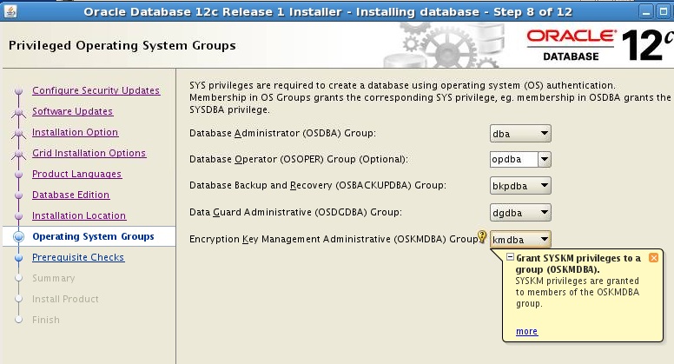
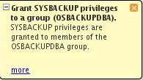
OS Authentication and OS Groups
1
2
  #define SS_DBA_GRP "dba"
  #define SS_OPER_GRP "opdba"
  #define SS_ASM_GRP ""
  #define SS_BKP_GRP "bkpdba"
  #define SS_DGD_GRP "dgdba"
  #define SS_KMT_GRP "kmdba"
3
$ORACLE_HOME/rdbms/lib/
config.[cs]
  $ mv config.o config.o.orig
  $ make -f ins_rdbms.mk ioracle
Notes:
Oracle Database 12c: Administration Workshop 6 - <number>
In OS authentication, the groups are created and assigned specific names as part of the database installation process, provided that OS UNIX or WINDOWS groups are created and accounts are assigned to the appropriate operating-system-defined groups.
Membership in a UNIX or WINDOWS group affects your connection to the database as follows:
If you are a member of the OSBACKUP group, and you specify AS SYSBACKUP when you connect to the database, you connect to the database with the SYSBACKUP administrative privilege under the SYSBACKUP user.
If you are a member of the OSDG group, and you specify AS SYSDG when you connect to the database, you connect to the database with the SYSDG administrative privilege under the SYSDG user.
If you are a member of the OSKM group, and you specify AS SYSKM when you connect to the database, you connect to the database with the SYSKM administrative privilege under the SYSKM user.
在OS身份验证中，创建组并将其指定为数据库安装过程的一部分，前提是创建了OS UNIX或WINDOWS组，并将帐户分配给相应的操作系统定义的组。
UNIX或WINDOWS组中的成员身份会影响到与数据库的连接，如下所示：
如果您是OSBACKUP组的成员，并且在连接到数据库时指定AS SYSBACKUP，则使用SYSBACKUP用户下的SYSBACKUP管理权限连接到数据库。
如果您是OSDG组的成员，并且在连接到数据库时指定AS SYSDG，则使用SYSDG用户下的SYSDG管理权限连接到数据库。
如果您是OSKM组的成员，并且在连接到数据库时指定AS SYSKM，则使用SYSKM用户下的SYSKM管理权限连接到数据库。

Slide 12
Notes:
If they are not members of these OS groups, users will not be able to connect as administrative users with the OS authentication. That is, “CONNECT / AS SYSDBA” will fail. However, the users can still connect using other authentication mechanisms (for example, network, password, or directory-based authentication). To change the OS group names (as shown in step 1 and 2 in the slide), ensure that you are using the groups defined in the $ORACLE_HOME/rdbms/lib/config.[cs] file. Next, shut down all databases, and then relink the Oracle executable as shown in step 3 in the slide.
Windows User Groups
The Windows user groups are ORA_%HOMENAME%_SYSBACKUP, ORA_%HOMENAME%_SYSDG, and ORA_%HOMENAME%_SYSKM. These user groups cannot be changed.
如果他们不是这些操作系统组的成员，用户将无法通过操作系统身份验证作为管理用户进行连接。 也就是说，“CONNECT / AS SYSDBA”将失败。 但是，用户仍然可以使用其他身份验证机制进行连接（例如，网络，密码或基于目录的身份验证）。 要更改OS组名称（如幻灯片中的步骤1和2所示），请确保使用$ ORACLE_HOME / rdbms / lib / config。[cs]文件中定义的组。 接下来，关闭所有数据库，然后重新链接Oracle可执行文件，如幻灯片中的步骤3所示。
Oracle Database 12c: Administration Workshop 6 - <number>

Slide 13
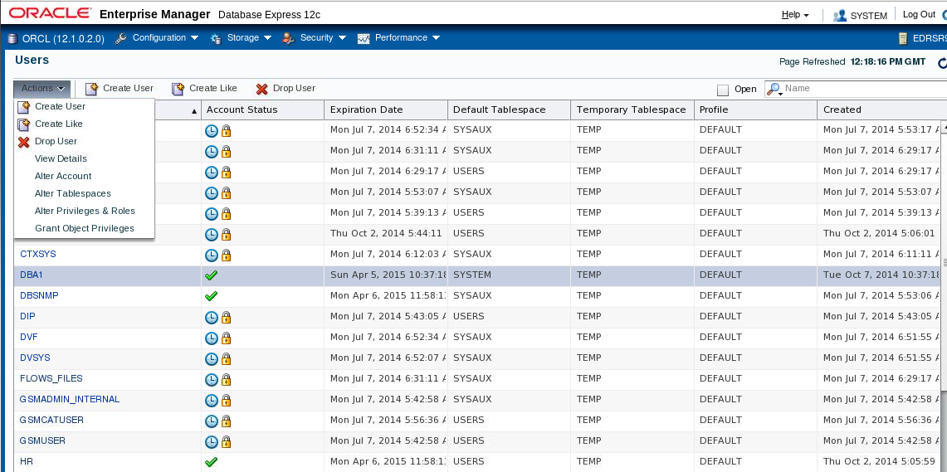
Managing Users
Notes:
Oracle Database 12c: Administration Workshop 6 - <number>
On the Users page of Enterprise Manager Database Express, you manage the database users who are allowed to access the current database. You use this page to create, delete, and modify the settings of a user.
To access the Users page, expand the Security menu and select Users.
在Enterprise Manager Database Express的“用户”页面上，您可以管理被允许访问当前数据库的数据库用户。 您可以使用此页面创建，删除和修改用户的设置。
要访问“用户”页面，请展开“安全”菜单并选择“用户”。

Slide 14
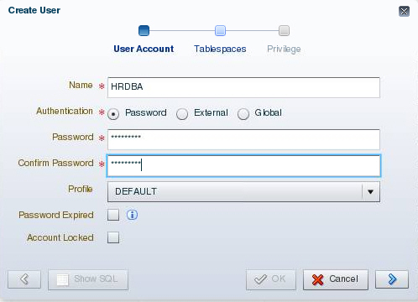
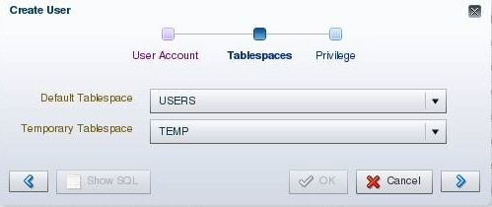
Creating a User
Notes:
Oracle Database 12c: Administration Workshop 6 - <number>
To create a database user by using Enterprise Manager Database Express, select Create User on the Users page.
Provide the required information. Mandatory items (such as Name) are marked with an asterisk (*). The name specified must follow the same rules as those used for creating database objects. The pages that follow in this lesson give you more information about authentication. Profiles are covered later in this lesson.
Assign a default tablespace and a temporary tablespace to each user. If users do not specify a tablespace when creating an object, the object will be created in the default tablespace assigned to the object owner. This enables you to control where their objects are created. If you do not choose a default tablespace, the system-defined default permanent tablespace is used. The case is similar for the temporary tablespace: if you do not specify a tablespace, the system-defined temporary tablespace is used.
要使用Enterprise Manager Database Express创建数据库用户，请在“用户”页面上选择“创建用户”。
提供所需的信息。 强制项目（如名称）标有星号（*）。 指定的名称必须遵循与创建数据库对象所用的规则相同的规则。 本课程中的页面将为您提供有关身份验证的更多信息。 配置文件将在本课中稍后介绍。
为每个用户分配默认表空间和临时表空间。 如果用户在创建对象时未指定表空间，则将在分配给对象所有者的默认表空间中创建该对象。 这使您可以控制其对象的创建位置。 如果不选择默认表空间，则使用系统定义的默认永久表空间。 临时表空间的情况类似：如果不指定表空间，则使用系统定义的临时表空间。

Slide 15
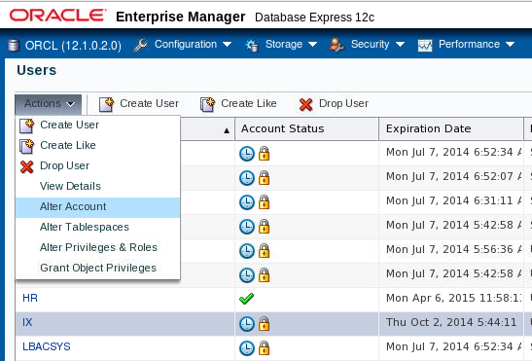
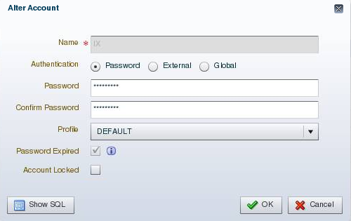
Unlocking a User Account and Resetting the Password
Select “Alter Account.”
Enter a new password and confirm.
Password is expired and account is locked.
Deselect “Account Locked.”
Notes:
Oracle Database 12c: Administration Workshop 6 - <number>
During installation and database creation, you can unlock and reset many of the Oracle-supplied database user accounts. If you did not choose to unlock the user accounts at that time, you can unlock the user by selecting the user on the Users page, selecting Alter User from the Actions list, and deselecting Account Locked. If the password is expired, enter a new password in the Password and Confirm Password fields.
在安装和数据库创建过程中，您可以解锁和重置许多Oracle提供的数据库用户帐户。 如果您当时没有选择解锁用户帐户，则可以通过在“用户”页面上选择用户，从“操作”列表中选择“更改用户”，然后取消选择“已锁定帐户”来解锁用户。 如果密码过期，请在密码和确认密码字段中输入新密码。

Slide 16
Privileges
There are two types of user privileges:
  System: Enables users to perform particular actions in the database
  Object: Enables users to access and manipulate a specific object
HR_DBA
Object privilege:
Update employees
System privilege:
Create session
Notes:
Oracle Database 12c: Administration Workshop 6 - <number>
A privilege is a right to execute a particular type of SQL statement or to access another user’s object.
Privileges are divided into two categories:
System privileges: Each system privilege allows a user to perform a particular database operation or class of database operations. For example, the privilege to create tablespaces is a system privilege. System privileges can be granted by the administrator or by someone who has been given explicit permission to administer the privilege. There are more than 170 distinct system privileges. Many system privileges contain the ANY clause.
Object privileges: Object privileges allow a user to perform a particular action on a specific object, such as a table, view, sequence, procedure, function, or package. Without specific permission, users can access only their own objects. Object privileges can be granted by the owner of an object, by the administrator, or by someone who has been explicitly given permission to grant privileges on the object.
权限是执行特定类型的SQL语句或访问另一个用户的对象的权利。
权限分为两类：
系统权限：每个系统特权允许用户执行特定的数据库操作或数据库操作类。 例如，创建表空间的权限是系统特权。 系统权限可以由管理员或被授予显式权限的人授予管理权限。 有超过170个不同的系统特权。 许多系统权限包含ANY子句。
对象权限：对象权限允许用户对特定对象（如表，视图，序列，过程，函数或包）执行特定操作。 没有特定权限，用户只能访问自己的对象。 对象权限可以由对象的所有者，管理员或已被明确授予权限的人授予给对象的权限。

Slide 17
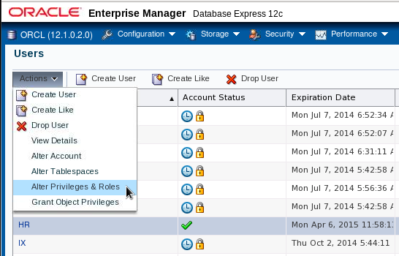
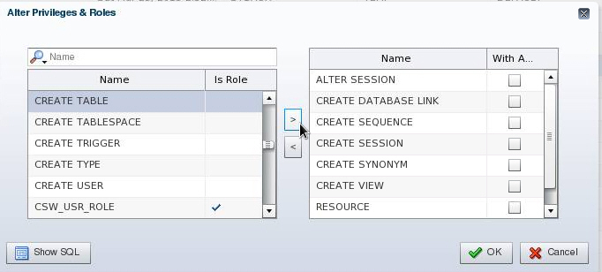
System Privileges
Notes:
Oracle Database 12c: Administration Workshop 6 - <number>
You can administer system privileges when you create a user or at a later time.
To grant or revoke system privileges, select the user, and then select “Alter Privileges & Roles” on the Users page. Select the appropriate privileges from the list of privileges and move them by clicking the appropriate arrow.
Granting a privilege with the ANY clause means that the privilege crosses schema lines. For example, if you have the CREATE TABLE privilege, you can create a table—but only in your own schema. The SELECT ANY TABLE privilege allows you to select from tables owned by other users. The SYS user and users with the DBA role are granted all of the ANY privileges; they can therefore do anything to any data object. The scope of the ANY system privileges can be controlled by using the Oracle Database Vault Option.
Select the With Admin check box to enable the user to administer the privilege and grant the system privilege to other users.
The SQL syntax for granting system privileges is:
GRANT <system_privilege> TO <grantee clause> [WITH ADMIN OPTION]
Carefully consider security requirements before granting system permissions. Some system privileges are usually granted only to administrators:
RESTRICTED SESSION: This privilege allows you to log in even if the database has been opened in restricted mode.
您可以在创建用户时或以后管理系统权限。
要授予或撤销系统权限，请选择该用户，然后在“用户”页面上选择“更改权限和角色”。从权限列表中选择适当的权限，并通过单击适当的箭头移动它们。
使用ANY子句授予权限意味着权限跨越模式行。例如，如果您具有CREATE TABLE权限，则可以创建一个表，但只能在您自己的模式中。 SELECT ANY TABLE权限允许您从其他用户拥有的表中进行选择。具有DBA角色的SYS用户和用户将被授予所有任何权限;他们可以对任何数据对象做任何事情。可以使用Oracle Database Vault选项来控制任何系统权限的范围。
选中With Admin复选框，以使用户能够管理该权限，并向其他用户授予系统权限。
授予系统权限的SQL语法是：
GRANT <system_privilege> TO <grantee clause> [WITH ADMIN OPTION]
在授予系统权限之前，请认真考虑安全性要求。某些系统权限通常仅授予管理员权限：
限制会话：即使数据库已在受限模式下打开，此权限也允许您登录。

Slide 18
Notes:
Oracle Database 12c: Administration Workshop 6 - <number>
SYSDBA and SYSOPER: These privileges allow you to shut down, start up, and perform recovery and other administrative tasks in the database. SYSOPER allows a user to perform basic operational tasks, but without the ability to look at user data. It includes the following system privileges:
STARTUP and SHUTDOWN
CREATE SPFILE
ALTER DATABASE OPEN/MOUNT/BACKUP
ALTER DATABASE ARCHIVELOG
ALTER DATABASE RECOVER (Complete recovery only. Any form of incomplete recovery, such as UNTIL TIME|CHANGE|CANCEL|CONTROLFILE, requires connecting as SYSDBA.)
RESTRICTED SESSION
The SYSDBA system privilege additionally authorizes incomplete recovery and the deletion of a database. Effectively, the SYSDBA system privilege allows a user to connect as the SYS user.
SYSASM: This privilege allows you to start up, shut down, and administer an ASM instance.
DROP ANY object: The DROP ANY privilege allows you to delete objects that other schema users own.
CREATE, MANAGE, DROP, and ALTER TABLESPACE: These privileges allow for tablespace administration, including creating, dropping, and changing tablespace attributes.
CREATE LIBRARY: The Oracle database allows developers to create and call external code (for example, a C library) from PL/SQL. The library must be named by a LIBRARY object in the database. The CREATE LIBRARY privilege allows a user to create an arbitrary code library that is executable from PL/SQL.
CREATE ANY DIRECTORY: As a security measure, the operating system directory where the code resides must be linked to a virtual Oracle directory object. With the CREATE ANY DIRECTORY privilege, you can potentially call insecure code objects.
The CREATE ANY DIRECTORY privilege allows a user to create a directory object (with read and write access) to any directory that the Oracle software owner can access. This means that the user can access external procedures in those directories. The user can attempt to directly read and write any database file, such as data files, redo log, and audit logs. Ensure that your organization has a security strategy that prevents misuse of powerful privileges such as this one.
GRANT ANY OBJECT PRIVILEGE: This privilege allows you to grant object permissions on objects that you do not own.
ALTER DATABASE and ALTER SYSTEM: These very powerful privileges allow you to modify the database and the Oracle instance (for example, renaming a data file or flushing the buffer cache).
SYSDBA和SYSOPER：这些权限允许您关闭，启动并执行数据库中的恢复和其他管理任务。 SYSOPER允许用户执行基本的操作任务，但无法查看用户数据。它包括以下系统特权：
STARTUP和SHUTDOWN
创建SPFILE
ALTER DATABASE OPEN / MOUNT / BACKUP
ALTER DATABASE ARCHIVELOG
ALTER DATABASE RECOVER（仅完全恢复）任何形式的不完全恢复，如UNTIL TIME | CHANGE | CANCEL | CONTROLFILE，需要连接为SYSDBA。）
限制性会议
SYSDBA系统特权还授权不完全恢复和删除数据库。实际上，SYSDBA系统特权允许用户作为SYS用户进行连接。
SYSASM：此权限允许您启动，关闭和管理ASM实例。
DROP ANY对象：DROP ANY权限允许您删除其他模式用户拥有的对象。
CREATE，MANAGE，DROP和ALTER TABLESPACE：这些权限允许表空间管理，包括创建，删除和更改表空间属性。
CREATE LIBRARY：Oracle数据库允许开发人员从PL / SQL创建和调用外部代码（例如，C库）。库必须由数据库中的LIBRARY对象命名。 CREATE LIBRARY权限允许用户创建一个可从PL / SQL执行的任意代码库。
创建任何目录：作为安全措施，代码所在的操作系统目录必须链接到虚拟Oracle目录对象。使用CREATE ANY DIRECTORY权限，您可以调用不安全的代码对象。CREATE ANY DIRECTORY权限允许用户创建目录对象（具有读取和写入权限）到Oracle软件所有者可以访问的任何目录。这意味着用户可以访问这些目录中的外部过程。用户可以尝试直接读取和写入任何数据库文件，如数据文件，重做日志和审核日志。确保您的组织有一个安全策略，防止滥用强大的权限，如这一个。
授予任何对象专有权：此特权允许您为不拥有的对象授予对象权限。
ALTER DATABASE和ALTER SYSTEM：这些非常强大的权限允许您修改数据库和Oracle实例（例如，重命名数据文件或刷新缓冲区缓存）。

Slide 19

Revoking System Privileges with ADMIN OPTION
DBA
Joe
Emily
User
GRANT
Privilege
Object
DBA
Joe
Emily
REVOKE
REVOKE CREATE TABLE FROM joe;
Notes:
Oracle Database 12c: Administration Workshop 6 - <number>
System privileges that have been granted directly with a GRANT command can be revoked by using the REVOKE SQL statement. Users with ADMIN OPTION for a system privilege can revoke the privilege from any other database user. The revoker does not have to be the same user who originally granted the privilege.
There are no cascading effects when a system privilege is revoked, regardless of whether it is given the ADMIN OPTION.
The SQL syntax for revoking system privileges is:
通过使用REVOKE SQL语句可以撤销直接授予GRANT命令的系统权限。 具有系统权限的ADMIN OPTION用户可以从任何其他数据库用户撤销该权限。 撤销者不一定是原来授予权限的用户。
当系统特权被撤销时，无论是否给予ADMIN选项，都没有级联效应。
撤销系统权限的SQL语法是：
REVOKE <system_privilege> FROM <grantee clause>
The slide illustrates the following situation.
Scenario
1. The DBA grants the CREATE TABLE system privilege to Joe with ADMIN OPTION.
2. Joe creates a table.
3. Joe grants the CREATE TABLE system privilege to Emily.
4. Emily creates a table.
5. The DBA revokes the CREATE TABLE system privilege from Joe.
Result
Joe’s table still exists, but Joe cannot create new tables. Emily’s table still exists, and she still has the CREATE TABLE system privilege.
脚本
DBA使用ADMIN OPTION向Joe授予CREATE TABLE系统权限。
乔创建一张表。
Joe向Emily授予CREATE TABLE系统权限。
艾米莉创造了一张表。
DBA从Joe中撤销CREATE TABLE系统特权。
结果
乔的表仍然存在，但是Joe不能创建新的表。 Emily的表仍然存在，她仍然具有CREATE TABLE系统特权。

Slide 20
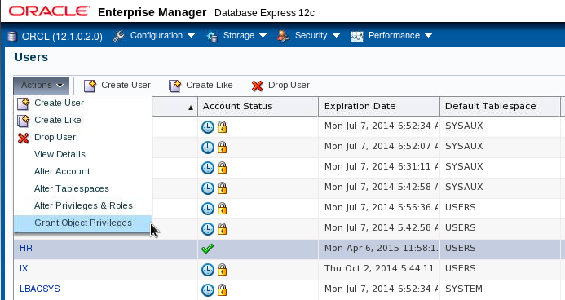
Granting Object Privileges
Notes:
Oracle Database 12c: Administration Workshop 6 - <number>
To grant object privileges, select the user on the Users page. Select “Grant Object Privileges” in the Actions menu.

Slide 21
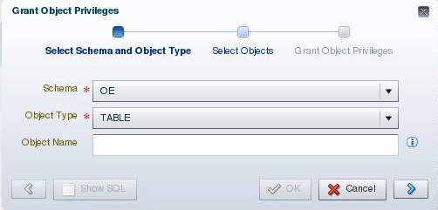
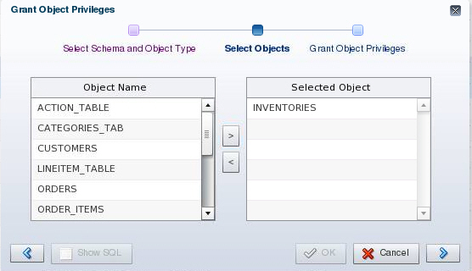
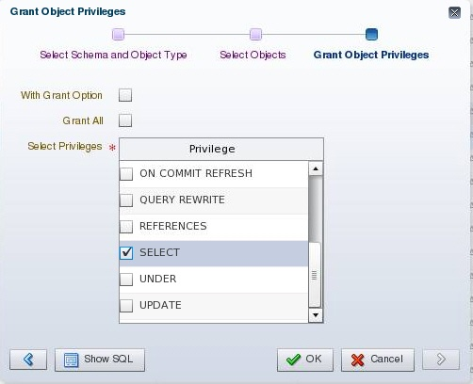
Object Privileges
Notes:
Oracle Database 12c: Administration Workshop 6 - <number>
Perform the following steps to grant object privileges by using Enterprise Manager Database Express:
1. Specify the schema name for the object and select the type of object on which you want to grant privileges. Click the arrow to proceed.
2. Select the objects from the Object Name list and move them to the Selected Object list. When you have selected all objects, click the arrow to move to the next page.
3. Then select the appropriate privileges from the Privileges list. Select the “With Grant Option” check box if this user is allowed to grant other users the same access.
The SQL syntax for granting object privileges is:
GRANT <object_privilege> ON <object> TO <grantee clause>
[WITH GRANT OPTION]
执行以下步骤以使用Enterprise Manager Database Express授予对象权限：
1.指定对象的模式名称，并选择要在其上授予权限的对象类型。 单击箭头继续。
2.从对象名称列表中选择对象并将其移动到“选定对象”列表。 选择所有对象后，单击箭头移至下一页。
3.然后从“权限”列表中选择适当的权限。 如果允许该用户授予其他用户相同的访问权限，请选中“使用授权选项”复选框。
授予对象权限的SQL语法是：

Slide 22
Revoking Object Privileges with GRANT OPTION
Bob
Joe
Emily
GRANT
REVOKE
Bob
Joe
Emily
Notes:
Oracle Database 12c: Administration Workshop 6 - <number>
Cascading effects can be observed when revoking a system privilege that is related to a data manipulation language (DML) operation. For example, if the SELECT ANY TABLE privilege is granted to a user, and if that user has created procedures that use the table, all procedures that are contained in the user’s schema must be recompiled before they can be used again.
Revoking object privileges also cascades when given with GRANT OPTION. As a user, you can revoke only those privileges that you have granted. For example, Bob cannot revoke the object privilege that Joe granted to Emily. Only the grantee or a user with the privilege called GRANT ANY OBJECT PRIVILEGE can revoke object privileges.
Scenario
1. Joe is granted the SELECT object privilege on EMPLOYEES with GRANT OPTION.
2. Joe grants the SELECT privilege on EMPLOYEES to Emily.
The SELECT privilege is revoked from Joe. This revoke is cascaded to Emily as well.
撤销与数据操作语言（DML）操作相关的系统特权时，可以观察到级联效应。 例如，如果SELECT ANY TABLE权限被授予用户，并且该用户创建了使用该表的过程，则必须重新编译用户模式中包含的所有过程，然后才能再次使用。
当GRANT OPTION给定时，撤销对象权限也会级联。 作为用户，您只能撤销您授予的那些权限。 例如，Bob不能撤销Joe授予Emily的对象权限。 只有受让人或具有GRANT ANY OBJECT PRIVILEGE权限的用户才能撤销对象权限。
脚本
Joe被授予具有GRANT OPTION的EMPLOYEES的SELECT对象特权。
Joe将EMPLOYEES的SELECT权限授予Emily。
3.从Joe撤销SELECT权限。 这个撤销也是级联到艾米莉。

Slide 23

Using Roles to Manage Privileges
  Roles:
    Used to group together privileges and roles
    Facilitate granting of multiple privileges or roles to users
  Benefits of roles:
    Easier privilege management
    Dynamic privilege management
    Selective availability of privileges
Notes:
Oracle Database 12c: Administration Workshop 6 - <number>
A role is a named group of related privileges that are granted to users or to other roles.
You can use roles to administer database privileges. You can add privileges to a role and grant the role to a user. The user can then enable the role and exercise the privileges granted by the role. A role contains all privileges that are granted to that role and all privileges of other roles that are granted to it.
Roles provide the following benefits with respect to managing privileges:
Easier privilege management: Use roles to simplify privilege management. Rather than granting the same set of privileges to several users, you can grant the privileges to a role and then grant that role to each user.
Dynamic privilege management: If the privileges associated with a role are modified, all users who are granted the role acquire the modified privileges automatically and immediately.
Selective availability of privileges: Roles can be enabled and disabled to turn privileges on and off temporarily. This allows the privileges of the user to be controlled in a given situation.
角色是授予用户或其他角色的一组相关权限。
您可以使用角色来管理数据库权限。您可以向角色添加权限，并将角色授予用户。然后，用户可以启用角色并行使角色授予的权限。角色包含授予该角色的所有权限以及授予该角色的其他角色的所有权限。
角色在管理权限方面提供以下好处：
更轻松的权限管理：使用角色来简化权限管理。您可以向角色授予权限，而不是向多个用户授予相同的权限集，然后将该角色授予每个用户。
动态权限管理：如果修改与角色关联的权限，则授予该角色的所有用户将自动立即获取已修改的权限。
特权的选择性可用性：可以启用和禁用角色临时打开和关闭特权。这允许在给定情况下控制用户的特权。

Slide 24

Assigning Privileges to Roles and
Assigning Roles to Users
Users
Jenny
David
Rachel
Roles
HR_MGR
HR_CLERK
Delete
employees.
Create
Job.
Update
employees.
Privileges
Insert
employees.
Select
employees.
Notes:
Oracle Database 12c: Administration Workshop 6 - <number>
In most systems, it is time-consuming and error-prone to grant necessary privileges to each user individually. Oracle software provides for easy and controlled privilege management through roles. Roles are named groups of related privileges that are granted to users or to other roles. Roles are designed to ease the administration of privileges in the database and, therefore, improve security.
Role characteristics
Privileges are granted to and revoked from roles as though the role were a user.
Roles are granted to and revoked from users or other roles as though they were system privileges.
A role can consist of both system and object privileges.
A role can be enabled or disabled for each user who is granted the role.
A role can require a password to be enabled.
Roles are not owned by anyone, and they are not in any schema.
In the slide example, the SELECT and UPDATE privileges on the employees table and the CREATE JOB system privilege are granted to the HR_CLERK role. DELETE and INSERT privileges on the employees table and the HR_CLERK role are granted to the HR_MGR role.
The manager is granted the HR_MGR role and can now select, delete, insert, and update the employees table.
在大多数系统中，分别为每个用户授予必要的权限是耗时且容易出错的。 Oracle软件通过角色提供易于管理的权限管理。角色被命名为授予用户或其他角色的相关权限组。角色旨在简化数据库中权限的管理，从而提高安全性。
角色特征
权限被授予和从角色撤销，就像角色是用户一样。
角色被授予和撤销用户或其他角色，就像他们是系统权限一样。
角色可以由系统和对象特权组成。
可以为授予角色的每个用户启用或禁用角色。
角色可能需要启用密码。
角色不是任何人拥有的，而不是任何模式。
在幻灯片示例中，将对employee表和CREATE JOB系统特权的SELECT和UPDATE权限授予HR_CLERK角色。对employee表和HR_CLERK角色的DELETE和INSERT权限被授予HR_MGR角色。经理被授予HR_MGR角色，现在可以选择，删除，插入和更新employees表。

Slide 25
Predefined Roles
Role | Privileges Included
CONNECT | CREATE SESSION
DBA | Most system privileges; several other roles. Do not grant to non-administrators.
RESOURCE | CREATE CLUSTER, CREATE INDEXTYPE, CREATE OPERATOR, CREATE PROCEDURE, CREATE SEQUENCE, CREATE TABLE, CREATE TRIGGER, CREATE TYPE
SCHEDULER_ ADMIN | CREATE ANY JOB, CREATE EXTERNAL JOB, CREATE JOB, EXECUTE ANY CLASS, EXECUTE ANY PROGRAM, MANAGE SCHEDULER
SELECT_CATALOG_ROLE | SELECT privileges on data dictionary objects
Notes:
Oracle Database 12c: Administration Workshop 6 - <number>
There are several roles that are defined automatically for Oracle databases when you run database creation scripts. CONNECT is granted automatically to any user that is created with Enterprise Manager.
The SELECT ANY DICTIONARY system privilege does not permit access to sensitive data dictionary tables, which are owned by the SYS schema.
Refer to the Oracle Database Security Guide for a complete list of predefined roles.
Other roles that authorize you to administer special functions are created when that functionality is installed. For example, XDBADMIN contains the privileges required to administer the Extensible Markup Language (XML) database if that feature is installed. AQ_ADMINISTRATOR_ROLE provides privileges to administer advanced queuing. HS_ADMIN_ROLE includes the privileges needed to administer heterogeneous services.
You must not alter the privileges granted to these functional roles without the assistance of Oracle Support because you may inadvertently disable the needed functionality.
运行数据库创建脚本时，有几个角色自动为Oracle数据库定义。 CONNECT被自动授予使用Enterprise Manager创建的任何用户。
SELECT ANY DICTIONARY系统特权不允许访问由SYS模式拥有的敏感数据字典表。
有关预定义角色的完整列表，请参阅“Oracle数据库安全性指南”。
授权您管理特殊功能的其他角色将在安装该功能时创建。例如，如果安装了该功能，XDBADMIN包含管理可扩展标记语言（XML）数据库所需的权限。 AQ_ADMINISTRATOR_ROLE提供管理高级队列的权限。 HS_ADMIN_ROLE包括管理异构服务所需的权限。
您不能在没有Oracle支持的帮助下更改授予这些功能角色的权限，因为您可能会无意中禁用所需的功能。

Slide 26
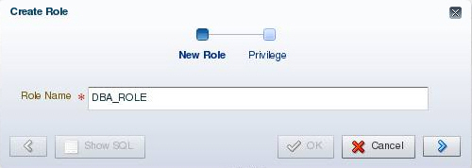
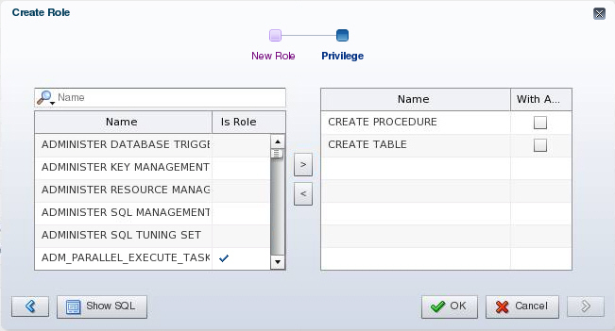
Creating a Role
Notes:
Oracle Database 12c: Administration Workshop 6 - <number>
To create a role by using Enterprise Manager Database Express, perform the following steps:
1. Navigate to the Roles page and click Create Role.
2. Enter a name for the role.
3. Optionally add the system privileges and other roles as required. The role can be edited at a later time to modify these settings if necessary. You can also add object privileges to a role after it is created.
Click OK to create the role.
要使用Enterprise Manager Database Express创建角色，请执行以下步骤：
1.导航到“角色”页面，然后单击“创建角色”。
2.输入角色的名称。
3.可以根据需要添加系统权限和其他角色。 如果需要，可以稍后修改角色来修改这些设置。 在角色创建后，您还可以添加对象权限。
4.单击“确定”创建角色。

Slide 27
Secure Roles
  Roles can be nondefault and enabled when required.
  Roles can be protected through authentication.
  Roles can also be secured programmatically.
SET ROLE vacationdba;
CREATE ROLE secure_application_role
IDENTIFIED USING <security_procedure_name>;
Notes:
Oracle Database 12c: Administration Workshop 6 - <number>
Roles are usually enabled by default, which means that if a role is granted to a user, then that user can exercise the privileges given to the role. Default roles are assigned to the user at connect time.
It is possible to:
Make a role nondefault. The user must now explicitly enable the role before the role’s privileges can be exercised.
Have a role require additional authentication by using the IDENTIFIED clause to indicate that a user must be authorized by a specified method before the role is enabled with the SET ROLE statement. The default authentication for a role is None.
Create secure application roles that can be enabled only by executing a PL/SQL procedure successfully. The PL/SQL procedure can check things such as the user’s network address, the program that the user is running, the time of day, and other elements needed to properly secure a group of permissions.
Administer roles easily using the Oracle Database Vault option. Secure application roles are simplified, and traditional roles can be further restricted.
Note: Role authentication can be defined by using Enterprise Manager Cloud Control, but not in Enterprise Manager Database Express.
角色通常默认启用，这意味着如果角色被授予用户，那么该用户可以行使角色授予的权限。默认角色在连接时分配给用户。
可能做到：
做出非默认的角色用户现在必须在角色的权限执行之前明确地启用该角色。
通过使用IDENTIFIED子句来指示用户必须在使用SET ROLE语句启用角色之前由指定的方法授权才能使用角色。角色的默认身份验证为“无”。
创建只能通过成功执行PL / SQL过程才能启用的安全应用程序角色。 PL / SQL过程可以检查用户的网络地址，用户正在运行的程序，一天中的时间以及正确保护一组权限所需的其他元素。
使用Oracle Database Vault选项轻松管理角色。安全的应用角色被简化，传统角色可以进一步限制。
注意：可以使用企业管理器云控件定义角色身份验证，但不能在企业管理器数据库快速中定义。

Slide 28
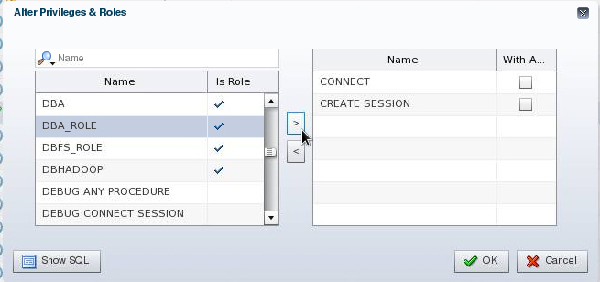
Assigning Roles to Users
Notes:
Oracle Database 12c: Administration Workshop 6 - <number>
By default, Enterprise Manager Database Express automatically grants the CONNECT role to new users. This allows users to connect to the database and create database objects in their own schemas.
To assign a role to a user by using Enterprise Manager Database Express, perform the following steps:
1. Navigate to the Users page.
2. Select the user and select “Alter Privileges & Roles” in the Actions menu.
3. Select the desired role in the list on the left and move it by using the right arrow.
When you have assigned all appropriate roles, click OK.
默认情况下，Enterprise Manager Database Express会自动向新用户授予CONNECT角色。 这允许用户连接到数据库并在自己的模式中创建数据库对象。
要使用Enterprise Manager Database Express为用户分配角色，请执行以下步骤：
1.导航到“用户”页面。
2.选择用户并在“操作”菜单中选择“更改权限和角色”。
3.在左侧的列表中选择所需的角色，并使用向右箭头移动它。
4.分配所有相应的角色后，单击“确定”。

Slide 29




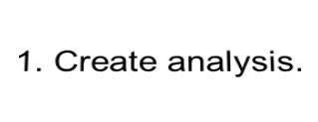
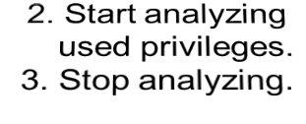
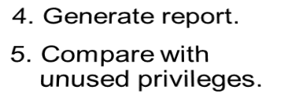
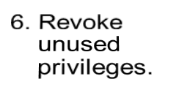






Privilege Analysis
  Analyze used privileges to revoke unnecessary privileges.
  Use DBMS_PRIVILEGE_CAPTURE package.
INSERT on HR.EMP
DELETE on HR.DEPT
EXECUTE on SALES.PROC1
UNLIMITED TABLESPACE
SELECT ANY TABLE
EXECUTE ANY PROCEDURE
APPS
PUBLIC
role
SELECT ANY TABLE
Sales
module
Used privileges
Unused privileges
Notes:
Oracle Database 12c: Administration Workshop 6 - <number>
A major concern in many databases is that existing database and application users have excessive privileges. Excessive privileges violate the principle of least privilege. To achieve the least privilege principle, unused privileges need to be identified.
Oracle Database 12c provides a package named DBMS_PRIVILEGE_CAPTURE to analyze used privileges.
You can use a privilege analysis policy to identify object and system privileges used to run an application module or to execute certain SQL statements or privileges used by defined roles. You can generate reports of used and unused privileges during the analysis period. The report helps the security officer revoke unnecessary privileges by comparing the used and unused granted privilege lists.
许多数据库的一个主要问题是现有的数据库和应用程序用户具有过多的权限。 特权过多违反了最低特权原则。 为了达到最低权限原则，需要识别未使用的权限。
Oracle数据库12c提供了一个名为DBMS_PRIVILEGE_CAPTURE的软件包来分析使用的权限。
您可以使用特权分析策略来标识用于运行应用程序模块的对象和系统特权，或者执行定义的角色使用的某些SQL语句或特权。 您可以在分析期间生成已使用和未使用权限的报告。 该报告帮助安全官员通过比较使用的和未使用的授权特权列表来撤销不必要的权限。

Slide 30

Privilege Analysis Flow
Requires
CAPTURE_ADMIN
role
1
Define types of analysis.
Define conditions of analysis.
Database
Role
Context
Role and Context
No condition: all privileges
Roles: MGR_SALES, PUBLIC
Condition:
  Users = HR, SCOTT, OE
  Modules = sales
  DBMS_PRIVILEGE_CAPTURE.CREATE_CAPTURE
Start / stop analyzing used privileges.
2
  DBMS_PRIVILEGE_CAPTURE.ENABLE_CAPTURE
  DBMS_PRIVILEGE_CAPTURE.DISABLE_CAPTURE
3
Report used privileges.
  DBMS_PRIVILEGE_CAPTURE.GENERATE_RESULT
DBA_USED_PUBPRIVS
DBA_USED_OBJPRIVS
DBA_USED_SYSPRIVS
DBA_USED_PRIVS
DBA_USED_OBJPRIVS_PATH
DBA_USED_SYSPRIVS_PATH
DBA_UNUSED_OBJPRIVS
DBA_UNUSED_SYSPRIVS
DBA_UNUSED_PRIVS
DBA_UNUSED_OBJPRIVS_PATH
DBA_UNUSED_SYSPRIVS_PATH
Notes:
Oracle Database 12c: Administration Workshop 6 - <number>
When creating an analysis, you first define the targeted objects to be analyzed in used privileges. You do that by setting the type of analysis:
Database analysis: If no condition is given, it analyzes the used privileges (except privileges used by administrative users) within the whole database.
Role analysis: If roles are defined, it analyzes the privileges exercised through any given role. For example, if you create a privilege analysis policy to analyze on PUBLIC, the privileges that are directly and indirectly granted to PUBLIC are analyzed when they are used.
Context-specific analysis: If the contexts are defined, it analyzes the privileges that are used through a given application module or specified contexts.
Different conditions can be combined with “AND” and/or “OR” Boolean operators.
Because the created policy is not enabled by default, your next step is to enable the policy to start analyzing used privileges. After a certain time, you stop analyzing.
Your third step is to generate a report. Reporting includes two types of results:
Used privileges visible in DBA_USED_xxx and DBA_USED_xxx_PATH views
Unused privileges visible in DBA_UNUSED_xxx and DBA_UNUSED_xxx_PATH views
创建分析时，首先要定义要使用的特权进行分析的目标对象。您可以通过设置分析类型来进行此操作：
数据库分析：如果没有给出条件，它将分析整个数据库中使用的特权（管理用户使用的权限除外）。
角色分析：如果角色被定义，它分析通过任何给定角色行使的特权。例如，如果您创建了要在PUBLIC上进行分析的权限分析策略，则在使用PUBLIC时直接和间接授予PUBLIC的特权将被分析。
上下文特定分析：如果上下文被定义，它将分析通过给定应用程序模块或指定上下文使用的权限。
不同的条件可以与“AND”和/或“OR”布尔运算符相结合。
由于默认情况下未启用创建的策略，因此下一步是启用策略来开始分析已使用的权限。一段时间后，你停止分析。
你的第三步是生成报告。报告包括两种类型的结果：
已使用的权限在DBA_USED_xxx和DBA_USED_xxx_PATH视图中可见
未使用的权限在DBA_UNUSED_xxx和DBA_UNUSED_xxx_PATH视图中可见

Slide 31
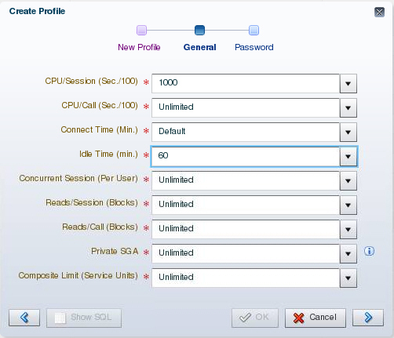
Profiles and Users
Users are assigned only one profile at a time.
Profiles:
  Control resource consumption
  Manage account status and password expiration
Note: RESOURCE_LIMIT must be set to TRUE before profiles can impose resource limitations.
Notes:
Oracle Database 12c: Administration Workshop 6 - <number>
Profiles impose a named set of resource limits on database usage and instance resources. Profiles also manage the account status and place limitations on users’ passwords (length, expiration time, and so on). Every user is assigned a profile and may belong to only one profile at any given time. If users have already logged in when you change their profile, the change does not take effect until their next login.
The DEFAULT profile serves as the basis for all other profiles. As illustrated in the slide, limitations for a profile can be implicitly specified (as in CPU/Session), can be unlimited (as in CPU/Call), or can reference whatever setting is in the DEFAULT profile (as in Connect Time).
Profiles cannot impose resource limitations on users unless the RESOURCE_LIMIT initialization parameter is set to TRUE. With RESOURCE_LIMIT at its default value of FALSE, profile resource limitations are ignored. Profile password settings are always enforced.
Profiles enable an administrator to control the following system resources:
CPU: CPU resources may be limited on a per-session or per-call basis. A CPU/Session limitation of 1,000 means that if any individual session that uses this profile consumes more than 10 seconds of CPU time (CPU time limitations are in hundredths of a second), that session receives an error and is logged off:
ORA-02392: exceeded session limit on CPU usage, you are being logged off
配置文件对数据库使用和实例资源设置了一组命名的资源限制。配置文件还管理帐户状态，并对用户密码（长度，到期时间等）设置限制。每个用户都被分配一个配置文件，并且在任何给定的时间只能属于一个配置文件。如果用户在更改配置文件时已经登录，则更改在下次登录之前才会生效。
DEFAULT配置文件作为所有其他配置文件的基础。如幻灯片所示，可以隐式指定配置文件的限制（如在CPU /会话中），可以是无限制的（如在CPU /呼叫中），或者可以引用DEFAULT配置文件中的任何设置（如“连接时间”）。
配置文件不能对用户施加资源限制，除非RESOURCE_LIMIT初始化参数设置为TRUE。 RESOURCE_LIMIT的默认值为FALSE，概要资源限制将被忽略。配置文件密码设置始终被强制执行。
配置文件使管理员能够控制以下系统资源：
CPU：每个会话或每个通话的CPU资源可能会受到限制。 CPU /会话限制为1,000表示如果使用此配置文件的任何单个会话消耗超过10秒的CPU时间（CPU时间限制为百分之一秒），该会话将收到错误并注销：

Slide 32
Notes:
Oracle Database 12c: Administration Workshop 6 - <number>
A per-call limitation does the same thing, but instead of limiting the user’s overall session, it prevents any single command from consuming too much CPU. If CPU/Call is limited and the user exceeds the limitation, the command aborts. The user receives an error message such as the following:
ORA-02393: exceeded call limit on CPU usage
Network/Memory: Each database session consumes system memory resources and (if the session is from a user who is not local to the server) network resources. You can specify the following:
Connect Time: Indicates for how many minutes a user can be connected before being automatically logged off
Idle Time: Indicates for how many minutes a user’s session can remain idle before being automatically logged off. Idle time is calculated for the server process only. It does not take into account application activity. The IDLE_TIME limit is not affected by long-running queries and other operations.
Concurrent Sessions: Indicates how many concurrent sessions can be created by using a database user account
Private SGA: Limits the amount of space consumed in the System Global Area (SGA) for sorting, merging bitmaps, and so on. This restriction takes effect only if the session uses a shared server. (Shared servers are covered in the lesson titled “Configuring the Oracle Network Environment.”)
Disk I/O: This limits the amount of data a user can read at the per-session level or per-call level. Reads/Session and Reads/Call place a limitation on the total number of reads from both memory and the disk. This can be done to ensure that no I/O-intensive statements overuse memory and disks.
Profiles also allow a composite limit. Composite limits are based on a weighted combination of CPU/Session, Reads/Session, Connect Time, and Private SGA. Composite limits are discussed in more detail in the Oracle Database Security Guide.
To create a profile by using Enterprise Manager Database Express:
1. Select Profiles in the Security menu.
2. Select Create Profile.
3. Enter the profile name and then click the arrow to continue.
4. On the General page, enter the values for the resources you want to define. Click the arrow to continue.
5. On the Password page, enter the appropriate values.
6. Click OK to create the profile.
Note: Resource Manager is an alternative to many of the profile settings. For more details about Resource Manager, see the Oracle Database Administrator’s Guide.
每个呼叫的限制做同样的事情，但不是限制用户的整体会话，它可以防止任何单个命令消耗太多的CPU。如果CPU /呼叫受限并且用户超出限制，则该命令中止。用户收到以下错误消息：
ORA-02393：超过CPU使用率的呼叫限制
网络/内存：每个数据库会话都消耗系统内存资源，（如果会话来自服务器本地的用户）网络资源。您可以指定以下内容：
连接时间：表示用户在自动注销之前可以连接多少分钟
空闲时间：表示在自动注销之前用户会话可以保持空闲的时间。空闲时间仅针对服务器进程计算。它不考虑应用程序活动。 IDLE_TIME限制不受长时间运行的查询和其他操作的影响。
并发会话：指示通过使用数据库用户帐户可以创建多少并发会话
私有SGA：限制系统全局区域（SGA）中消耗的空间量进行排序，合并位图等。此限制仅在会话使用共享服务器时生效。 （共享服务器在题为“配置Oracle网络环境”的课程中有介绍。）
磁盘I / O：这限制了用户在每个会话级别或每个呼叫级别读取的数据量。读取/会话和读取/调用对从内存和磁盘读取的总数进行限制。这样做可以确保没有I / O密集型语句过度使用内存和磁盘。
配置文件还允许复合限制。组合限制基于CPU /会话，读取/会话，连接时间和私有SGA的加权组合。 “Oracle数据库安全指南”中更详细地讨论了复合限制。
使用Enterprise Manager Database Express创建配置文件：
1.在安全菜单中选择配置文件。
2.选择创建配置文件。
3.输入配置文件名称，然后单击箭头继续。
4.在“常规”页面上，输入要定义的资源的值。单击箭头继续。
5.在密码页面上，输入适当的值。
6.单击“确定”创建配置文件。
注意：资源管理器是许多配置文件设置的替代方法。有关资源管理器的更多详细信息，请参阅“Oracle数据库管理员指南”。

Slide 33




Implementing Password Security Features
Password complexity verification
Password history
User
Setting up profiles
Password aging
and expiration
Account locking
Note: Do not use profiles that cause the SYS, SYSMAN, and DBSNMP passwords to expire and the accounts to be locked.
Notes:
Oracle Database 12c: Administration Workshop 6 - <number>
Oracle password management is implemented with user profiles. Profiles can provide many standard security features.
Account locking: Enables automatic locking of accounts for a set duration when users fail to log in to the system in the specified number of attempts
FAILED_LOGIN_ATTEMPTS: Specifies the number of failed login attempts before the lockout of the account
PASSWORD_LOCK_TIME: Specifies the number of days for which the account is locked after the specified number of failed login attempts
Password aging and expiration: Enables user passwords to have a lifetime, after which the passwords expire and must be changed
PASSWORD_LIFE_TIME: Determines the lifetime of the password in days, after which the password expires
PASSWORD_GRACE_TIME: Specifies a grace period in days for changing the password after the first successful login after the password has expired
Note: Expiring passwords and locking the SYS, SYSMAN, and DBSNMP accounts prevent Enterprise Manager from functioning properly. The applications must catch the “password expired” warning message and handle the password change; otherwise, the grace period expires and the user is locked out without knowing the reason.
用户配置文件实现了Oracle密码管理。配置文件可以提供许多标准的安全功能。
帐户锁定：当用户在指定次数的尝试中无法登录系统时，启用帐户自动锁定设定的持续时间
FAILED_LOGIN_ATTEMPTS：指定在帐户锁定之前失败的登录尝试次数
PASSWORD_LOCK_TIME：指定在指定的失败登录尝试次数后，帐户被锁定的天数
密码老化和到期：使用户密码具有生命周期，此后密码过期，必须更改
PASSWORD_LIFE_TIME：确定密码的生存期，以密码过期为止
PASSWORD_GRACE_TIME：指定在密码过期后第一次成功登录后更改密码的天数宽限期
注意：过期密码并锁定SYS，SYSMAN和DBSNMP帐户可防止企业管理器正常运行。应用程序必须捕获“密码过期”警告消息并处理密码更改;否则，宽限期到期，用户在不知道原因的情况下被锁定。

Slide 34
Notes:
Oracle Database 12c: Administration Workshop 6 - <number>
Password history: Checks the new password to ensure that the password is not reused for a specified amount of time or a specified number of password changes. These checks can be implemented by using one of the following:
PASSWORD_REUSE_TIME: Specifies that a user cannot reuse a password for a given number of days
PASSWORD_REUSE_MAX: Specifies the number of password changes that are required before the current password can be reused
Recall that the values of the profile parameters are either set or inherited from the DEFAULT profile.
If both password history parameters have a value of UNLIMITED, Oracle Database ignores both. The user can reuse any password at any time, which is not a good security practice.
If both parameters are set, password reuse is allowed—but only after meeting both conditions. The user must have changed the password the specified number of times, and the specified number of days must have passed since the old password was last used.
For example, the profile of user ALFRED has PASSWORD_REUSE_MAX set to 10 and PASSWORD_REUSE_TIME set to 30. User ALFRED cannot reuse a password until he has reset the password 10 times and until 30 days have passed since the password was last used.
If one parameter is set to a number and the other parameter is specified as UNLIMITED, then the user can never reuse a password.
Password complexity verification: Makes a complexity check on the password to verify that it meets certain rules. The check must ensure that the password is complex enough to provide protection against intruders who may try to break into the system by guessing the password.
The PASSWORD_VERIFY_FUNCTION parameter names a PL/SQL function that performs a password complexity check before a password is assigned. Password verification functions must be owned by the SYS user and must return a Boolean value (TRUE or FALSE). A model password verification function is provided in the utlpwdmg.sql script found in the following directories:
UNIX and Linux platforms: $ORACLE_HOME/rdbms/admin
Windows platforms: %ORACLE_HOME%\rdbms\admin
密码历史记录：检查新密码，以确保密码在指定的时间内不被重复使用或者指定的密码更改次数。这些检查可以通过使用以下之一来实现：
PASSWORD_REUSE_TIME：指定用户无法在给定天数内重复使用密码
PASSWORD_REUSE_MAX：指定在重新使用当前密码之前需要的密码更改次数
回想一下，配置文件参数的值是从DEFAULT配置文件设置或继承的。
如果两个密码历史记录参数的值都是UNLIMITED，则Oracle数据库将忽略这两者。用户可以随时重用任何密码，这不是一个很好的安全措施。
如果设置了两个参数，则允许密码重用，但只有在满足这两个条件之后。用户必须将密码更改为指定的次数，并且自上次使用旧密码以来必须已经过去的指定天数。
例如，用户ALFRED的配置文件的PASSWORD_REUSE_MAX设置为10，PASSWORD_REUSE_TIME设置为30.用户ALFRED无法重新使用密码，直到密码重置为止，密码最后一次使用10次，直到30天为止。
如果一个参数设置为一个数字，另一个参数指定为UNLIMITED，则用户永远不能重复使用密码。
密码复杂度验证：对密码进行复杂检查，以验证其是否符合某些规则。检查必须确保密码足够复杂，以防止可能通过猜测密码来尝试入侵系统的入侵者。
PASSWORD_VERIFY_FUNCTION参数指定在分配密码之前执行密码复杂度检查的PL / SQL函数。密码验证功能必须由SYS用户拥有，并且必须返回一个布尔值（TRUE或FALSE）。在以下目录中的utlpwdmg.sql脚本中提供了模型密码验证功能：

Slide 35
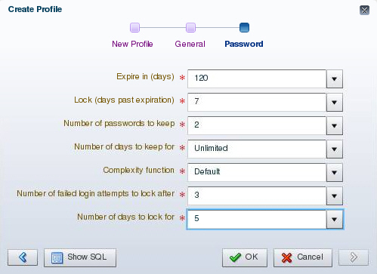
Creating a Password Profile
Notes:
Oracle Database 12c: Administration Workshop 6 - <number>
You can choose common values for each of the settings from a list of values (click the flashlight icon to browse), or you can enter a custom value.
All time periods are expressed in days but can also be expressed as fractions. There are 1,440 minutes in a day; 5/1,440 is therefore five minutes.
Enterprise Manager can also be used to edit existing password profiles.
If the utlpwdmg.sql script has been executed, the VERIFY_FUNCTION_11G, ORA12C_VERIFY_FUNCTION, and ORA12C_STRONG_VERIFY_FUNCTION functions are available. Additional information about these functions is provided later in the lesson. If you have created your own complexity function, the name of that function may be entered. The function name does not appear in the Select list. If the function produces runtime errors, the user is unable to change the password.
Dropping a Password Profile
In Enterprise Manager, you cannot drop a profile that is used by users. However, if you drop a profile with the CASCADE option (for example, in SQL*Plus), all users who have that profile are automatically assigned the DEFAULT profile.
您可以从值列表中选择每个设置的常用值（单击要浏览的手电筒图标），也可以输入自定义值。
所有时间段以天表示，但也可以表示为分数。一天有1440分钟; 5 / 1,440因此是五分钟。
企业管理器也可用于编辑现有密码配置文件。
如果utlpwdmg.sql脚本已经执行，则VERIFY_FUNCTION_11G，ORA12C_VERIFY_FUNCTION和ORA12C_STRONG_VERIFY_FUNCTION功能可用。有关这些功能的其他信息将在本课中稍后提供。如果您创建了自己的复杂度函数，则可以输入该函数的名称。功能名称不会出现在选择列表中。如果该功能产生运行时错误，则用户无法更改密码。
删除密码配置文件
在企业管理器中，您不能删除用户使用的配置文件。但是，如果使用CASCADE选项删除配置文件（例如，在SQL * Plus中），则具有该配置文件的所有用户都将自动分配DEFAULT配置文件。

Slide 36

Supplied Password Verification Functions
  The following functions are created by the $ORACLE_HOME/rdbms/admin/utlpwdmg.sql script:
    VERIFY_FUNCTION_11G
    ORA12C_VERIFY_FUNCTION
    ORA12C_STRONG_VERIFY_FUNCTION
  The functions require the following of passwords:
    Have a minimum number of characters
    Not be the username, username with a number, or username reversed
    Not be the database name or the database name with a number
    Have at least one alphabetic and one numeric character
    Differ from the previous password by at least three letters
Notes:
Oracle Database 12c: Administration Workshop 6 - <number>
You can create the following password verification functions by executing the utlpwdmg.sql script:
ORA12C_VERIFY_FUNCTION: This function makes the minimum complexity checks such as checking for a minimum password length and that the password is not the same as the username.
ORA12C_STRONG_VERIFY_FUNCTION: This function provides a stronger password complexity function that takes into consideration recommendations from the US Department of Defense Database Security Technical Implementation Guide.
VERIFY_FUNCTION_11G: This function makes minimum complexity checks such as checking for a minimum password length and that the password is not the same as the username. This function was provided with Oracle Database 11g.
Note: The functions must be owned by the SYS user. Password complexity checking is not enforced for the SYS user.
Refer to the Oracle Database Security Guide for a detailed description of each of the functions.
您可以通过执行utlpwdmg.sql脚本来创建以下密码验证功能：
ORA12C_VERIFY_FUNCTION：此函数进行最小复杂度检查，例如检查最小密码长度，并且密码与用户名不同。
ORA12C_STRONG_VERIFY_FUNCTION：该功能提供了更强大的密码复杂性功能，该功能考虑了美国国防部数据库安全技术实施指南的建议。
VERIFY_FUNCTION_11G：此功能进行最小复杂度检查，例如检查最小密码长度，密码与用户名不同。 此功能与Oracle数据库11g一起提供。
注意：这些功能必须由SYS用户拥有。 对SYS用户不执行密码复杂度检查。
有关每个功能的详细说明，请参阅“Oracle数据库安全性指南”。
-------------------------------
提供的密码验证功能
这些功能需要以下密码：
具有最少的字符数
不是用户名，带号码的用户名或用户名反转
不是数据库名称或具有数字的数据库名称
至少有一个字母和一个数字字符
与以前的密码不同，至少有三个字母

Slide 37
Modifications to the Default Profile
The utlpwdmg.sql script also modifies the DEFAULT profile as follows:
    ALTER PROFILE DEFAULT LIMIT
    PASSWORD_LIFE_TIME 180
    PASSWORD_GRACE_TIME 7
    PASSWORD_REUSE_TIME UNLIMITED
    PASSWORD_REUSE_MAX UNLIMITED
    FAILED_LOGIN_ATTEMPTS 10
    PASSWORD_LOCK_TIME 1
    PASSWORD_VERIFY_FUNCTION ora12c_verify_function;
Notes:
Oracle Database 12c: Administration Workshop 6 - <number>
In addition to creating the functions as shown on the previous page, the utlpwdmg script also changes the DEFAULT profile with the following ALTER PROFILE command:
ALTER PROFILE default LIMIT
PASSWORD_LIFE_TIME 180
PASSWORD_GRACE_TIME 7
PASSWORD_REUSE_TIME UNLIMITED
PASSWORD_REUSE_MAX UNLIMITED
FAILED_LOGIN_ATTEMPTS 10
PASSWORD_LOCK_TIME 1
PASSWORD_VERIFY_FUNCTION ora12c_verify_function;
Remember that when users are created, they are assigned the DEFAULT profile unless another profile is specified.
除了创建上一页所示的功能之外，utlpwdmg脚本还会使用以下ALTER PROFILE更改DEFAULT配置文件
请记住，创建用户时，将分配DEFAULT配置文件，除非指定了另一个配置文件。

Slide 38
Assigning Quotas to Users
  Users who do not have the UNLIMITED TABLESPACE system privilege must be given a quota before they can create objects in a tablespace.
  Quotas can be:
    A specific value in megabytes or kilobytes
    Unlimited
Notes:
Oracle Database 12c: Administration Workshop 6 - <number>
A quota is a space allowance in a given tablespace. By default, a user has no quota on any of the tablespaces. You have three options for providing a quota for a user on a tablespace.
Unlimited: Allows the user to use as much space as is available in the tablespace
Value: Number of kilobytes or megabytes that the user can use. This does not guarantee that the space is set aside for the user. This value can be larger or smaller than the current space that is available in the tablespace.
UNLIMITED TABLESPACE system privilege: Overrides all individual tablespace quotas and gives the user unlimited quota on all tablespaces, including SYSTEM and SYSAUX. This privilege must be granted with caution.
You must not provide a quota to users on the SYSTEM or SYSAUX tablespaces. Typically, only the SYS and SYSTEM users are able to create objects in the SYSTEM or SYSAUX tablespaces.
You do not need a quota on an assigned temporary tablespace or any undo tablespaces. You do not need to have a quota to insert, update, and delete data in an Oracle database. The only users that need quota are the accounts that own the database objects. It is typical when installing application code that the installer creates database accounts to own the objects. Only these accounts need quotas. Other database users can be granted permission to use these objects without a quota.
配额是给定表空间中的空间容限。默认情况下，用户在任何表空间上都没有配额。您有三个选项可用于在表空间上为用户提供配额。
无限制：允许用户使用与表空间相同的空间
值：用户可以使用的千字节或兆字节数。这并不能保证为用户留出空间。该值可以大于或小于表空间中可用的当前空间。
UNLIMITED TABLESPACE系统特权：覆盖所有单独的表空间配额，并为所有表空间（包括SYSTEM和SYSAUX）提供无限制的配额。必须谨慎地授予此权限。
您不能在SYSTEM或SYSAUX表空间上为用户提供配额。通常，只有SYS和SYSTEM用户能够在SYSTEM或SYSAUX表空间中创建对象。
您不需要在分配的临时表空间或任何undo表空间上配额。您不需要在Oracle数据库中插入，更新和删除数据的配额。需要配额的唯一用户是拥有数据库对象的帐户。安装应用程序代码时，典型的是安装程序创建数据库帐户以拥有对象。只有这些帐户需要配额。其他数据库用户可以被授予使用这些对象而没有配额。

Slide 39
Notes:
Oracle Database 12c: Administration Workshop 6 - <number>
The Oracle server checks the quota when a user creates or extends a segment.
For activities that are assigned to a user schema, only those activities that use space in a tablespace count against the quota. Activities that do not use space in the assigned tablespace do not affect the quota (such as creating views or using temporary tablespaces).
The quota is replenished when objects owned by the user are dropped with the PURGE clause or when the objects owned by the user in the recycle bin are purged.
当用户创建或扩展段时，Oracle服务器会检查配额。
对于分配给用户模式的活动，只有在表空间中使用空格的活动才会计入配额。 在分配的表空间中不使用空格的活动不会影响配额（例如创建视图或使用临时表空间）。
当用户拥有的对象用PURGE子句或用户在回收站中拥有的对象被清除时，配额将被补充。

Slide 40
Applying the Principle of Least Privilege
  Protect the data dictionary:
  Revoke unnecessary privileges from PUBLIC.
  Use access control lists (ACL) to control network access.
  Restrict the directories accessible by users.
  Limit users with administrative privileges.
  Restrict remote database authentication:
O7_DICTIONARY_ACCESSIBILITY=FALSE
REMOTE_OS_AUTHENT=FALSE
Notes:
Oracle Database 12c: Administration Workshop 6 - <number>
The principle of least privilege means that a user must be given only those privileges that are required to efficiently complete a task. This reduces the chances of users modifying or viewing data (either accidentally or maliciously) that they do not have the privilege to modify or view.
Protect the data dictionary: The O7_DICTIONARY_ACCESSIBILITY parameter is set by default to FALSE. You must not allow this to be changed without a very good reason because it prevents users with the ANY TABLE system privileges from accessing the data dictionary base tables. It also ensures that the SYS user can log in only as SYSDBA.
Revoke unnecessary privileges from PUBLIC: Several packages are extremely useful to applications that need them, but require proper configuration to be used securely. PUBLIC is granted execute privilege on the following packages: UTL_SMTP, UTL_TCP, UTL_HTTP, and UTL_FILE.
Control network access: In Oracle Database, network access is controlled by an access control list (ACL) that may be configured to allow certain users access to specific network services. Network access is denied by default. An ACL must be created to allow network access. File access through UTL_FILE is controlled at two levels:
最小权限的原则意味着必须只给予用户有效完成任务所需的那些权限。这减少了用户修改或查看他们没有权限修改或查看的数据（意外或恶意）的机会。
保护数据字典：O7_DICTIONARY_ACCESSIBILITY参数默认设置为FALSE。您不能因为无法很好的理由而更改此权限，因为它会阻止具​​有ANY TABLE系统权限的用户访问数据字典基表。它还可以确保SYS用户只能以SYSDBA方式登录。
从PUBLIC撤消不必要的权限：几个包对于需要它们的应用程序非常有用，但需要正确配置才能安全使用。 PUBLIC被授予以下软件包的执行权限：UTL_SMTP，UTL_TCP，UTL_HTTP和UTL_FILE。
控制网络访问：在Oracle数据库中，网络访问由访问控制列表（ACL）控制，访问控制列表（ACL）可能被配置为允许某些用户访问特定的网络服务。默认情况下，网络访问被拒绝。必须创建ACL以允许网络访问。通过UTL_FILE的文件访问控制在两个层面

Slide 41
Notes:
Oracle Database 12c: Administration Workshop 6 - <number>
At the OS level with permissions on files and directories
In the database by DIRECTORY objects that allow access to specific file system directories. The DIRECTORY object may be granted to a user for read or for read and write. Execute privileges on other PL/SQL packages should be carefully controlled.
The more powerful packages that may potentially be misused include:
UTL_SMTP: Permits arbitrary email messages to be sent by using the database as a Simple Mail Transfer Protocol (SMTP) mail server. Use the ACL to control which machines may be accessed by which users.
UTL_TCP: Permits outgoing network connections to be established by the database server to any receiving or waiting network service. Thus, arbitrary data can be sent between the database server and any waiting network service. Use the ACL to control access.
UTL_HTTP: Allows the database server to request and retrieve data via HTTP. Granting this package to a user may permit data to be sent via HTML forms to a malicious website. Limit access by using the ACL.
UTL_FILE: If configured improperly, allows text-level access to any file on the host operating system. When properly configured, this package limits user access to specific directory locations.
Restrict access to OS directories: The DIRECTORY object inside the database enables DBAs to map directories to OS paths and to grant privileges on those directories to individual users.
Limit users with administrative privileges: Do not provide database users more privileges than necessary. Non-administrators must not be granted the DBA role. To implement least privilege, restrict the following types of privileges:
Grants of system and object privileges
SYS-privileged connections to the database, such as SYSDBA and SYSOPER
Other DBA-type privileges, such as DROP ANY TABLE
Restrict remote database authentication: The REMOTE_OS_AUTHENT parameter is set to FALSE by default. It must not be changed unless all clients can be trusted to authenticate users appropriately.
In the remote authentication process:
The database user is authenticated externally
The remote system authenticates the user
The user logs in to the database without further authentication
Note: Always test your applications thoroughly if you have revoked privileges.
在具有对文件和目录的权限的OS级别
在数据库中由DIRECTORY对象允许访问特定的文件系统目录。 DIRECTORY对象可能被授予用户读取或读取和写入。对其他PL / SQL包的执行权限应仔细控制。
可能被滥用的功能更强大的软件包包括：
UTL_SMTP：允许使用数据库作为简单邮件传输协议（SMTP）邮件服务器发送任意电子邮件。使用ACL来控制哪些用户可以访问哪些机器。
UTL_TCP：允许数据库服务器将任何接收或等待的网络服务建立传出的网络连接。因此，可以在数据库服务器和任何等待的网络服务之间发送任意数据。使用ACL控制访问。
UTL_HTTP：允许数据库服务器通过HTTP请求和检索数据。向用户授予此包可能允许通过HTML表单将数据发送到恶意网站。通过使用ACL限制访问。
UTL_FILE：如果配置不正确，允许文本级别访问主机操作系统上的任何文件。正确配置后，此软件包可限制用户访问特定的目录位置。
限制对操作系统目录的访问：数据库中的DIRECTORY对象使数据库管理员能够将目录映射到操作系统路径，并将这些目录的权限授予单个用户。
限制具有管理权限的用户：不要为数据库用户提供比必要更多的权限。非管理员不得被授予DBA角色。要实现最低权限，请限制以下类型的权限：
授予系统和对象权限
SYS数据库的SYS特权连接，如SYSDBA和SYSOPER
其他DBA类型的权限，如DROP ANY TABLE
限制远程数据库认证：默认情况下，REMOTE_OS_AUTHENT参数设置为FALSE。除非所有客户端都可以信任，才能正确验证用户，否则不能更改。
在远程认证过程中：
数据库用户在外部进行身份验证
远程系统认证用户
用户登录到数据库，无需进一步验证
注意：如果您撤销了特权，请务必彻底测试应用程序。

Slide 42
Quiz
All passwords created in Oracle Database are not case-sensitive by default.
  True
  False
Notes:
Oracle Database 12c: Administration Workshop 6 - <number>
Answer: b
默认情况下，在Oracle数据库中创建的所有密码不区分大小写。

Slide 43
Quiz
A database role:
  Can be enabled or disabled
  Can consist of system and object privileges
  Is owned by its creator
  Cannot be protected by a password
Notes:
Oracle Database 12c: Administration Workshop 6 - <number>
Answer: a, b

Slide 44
Quiz
With RESOURCE_LIMIT set at its default value of FALSE, profile password limitations are ignored.
  True
  False
Notes:
Oracle Database 12c: Administration Workshop 6 - <number>
Answer: b

Slide 45
Quiz
Applying the principle of least privilege is not enough to harden the Oracle database.
  True
  False
Notes:
Oracle Database 12c: Administration Workshop 6 - <number>
Answer: a

Slide 46
Summary
In this lesson, you should have learned how to:
  Create and manage database user accounts:
    Authenticate users
    Assign default storage areas (tablespaces)
  Grant and revoke privileges
  Create and manage roles
  Create and manage profiles:
    Implement standard password security features
    Control resource usage by users
Notes:
Oracle Database 12c: Administration Workshop 6 - <number>
在本课中，您应该学会了如何：
创建和管理数据库用户帐户：
认证用户
分配默认存储区域（表空间）
授予和撤销权限
创建和管理角色
创建和管理配置文件：
实施标准密码安全功能
控制用户的资源使用情况

Slide 47
Practice: Overview
This practice covers the following topics:
  Creating a profile to limit resource consumption
  Creating two roles:
    HRCLERK
    HRMANAGER
  Creating four new users:
    One manager and two clerks
    One schema user for the next practice session
Notes:
Oracle Database 12c: Administration Workshop 6 - <number>
此练习涵盖以下主题：
创建配置文件以限制资源消耗
创建两个角色：
HRCLERK
人力资源经理
创建四个新用户：
一位经理和两位文员
下一个练习会话的一个模式用户

