Slide 1
Managing Database Storage Structures

Slide 2
Objectives
After completing this lesson, you should be able to:
  Describe the storage of table row data in blocks
  Create and manage tablespaces
  Obtain tablespace information
Notes:
Oracle Database 12c: Administration Workshop 7 - <number>
完成本课后，您应该能够：
以块为单位描述表行数据的存储
创建和管理表空间
获取表空间信息

Slide 3
How Table Data Is Stored
Columns
Blocks
Table A
Table B
Rows
Segment
Segment
Table
Tablespace
Row piece
Extent
Notes:
Oracle Database 12c: Administration Workshop 7 - <number>
When a table is created, a segment is created to hold its data. A tablespace contains a collection of segments.
Logically, a table contains rows of column values. A row is ultimately stored in a database block in the form of a row piece. It is called a row piece because, under some circumstances, the entire row may not be stored in one place. This happens when an inserted row is too large to fit into a single block (chained row) or when an update causes an existing row to outgrow the available free space of the current block (migrated row). Row pieces are also used when a table has more than 255 columns. In this case the pieces may be in the same block (intra-block chaining) or across multiple blocks.
创建表时，创建一个段以保存其数据。 表空间包含段的集合。
逻辑上，一个表包含列值行。 行最终以行的形式存储在数据库块中。 它被称为行片，因为在某些情况下，整行可能不会存储在一个地方。 当插入的行太大而不能嵌入单个块（链接行）或更新导致现有行超出当前块（已迁移行）的可用空闲空间时，会发生这种情况。 当表格有255列以上时，也会使用行。 在这种情况下，片段可以在相同的块（块内链接）中或跨多个块。

Slide 4
Database Block: Contents
Block header
Growth
Free space
Row data
Notes:
Oracle Database 12c: Administration Workshop 7 - <number>
Block header: The block header contains the segment type (such as table or index), data block address, table directory, row directory, and transaction slots of approximately 23 bytes each, which are used when modifications are made to rows in the block. The block header grows downward from the top.
Row data: This is the actual data for the rows in the block. Row data space grows upward from the bottom.
Free space: Free space is in the middle of the block, enabling the header and the row data space to grow when necessary. Row data takes up free space as new rows are inserted or as columns of existing rows are updated with larger values.
Examples of events that cause header growth:
Row directories that need more row entries
More transaction slots required than initially configured
Initially, the free space in a block is contiguous. However, deletions and updates may fragment the free space in the block. The free space in the block is coalesced by the Oracle server when necessary.
块头：块头包含每块约23个字节的段类型（如表或索引），数据块地址，表目录，行目录和事务插槽，这些块在对块中的行进行修改时使用。 块头从顶部向下生长。
行数据：这是块中行的实际数据。 行数据空间从底部向上增长。
可用空间：可用空间位于块的中间，使得标题和行数据空间在必要时增长。 行数据占用可用空间，因为插入了新行，或者以更大的值更新现有行的列。导致头部增长的事件的示例：
需要更多行条目的行目录
需要比初始配置更多的事务槽
最初，块中的可用空间是连续的。 但是，删除和更新可能会破坏块中的可用空间。 必要时，Oracle服务器会将块中的可用空间合并。

Slide 5
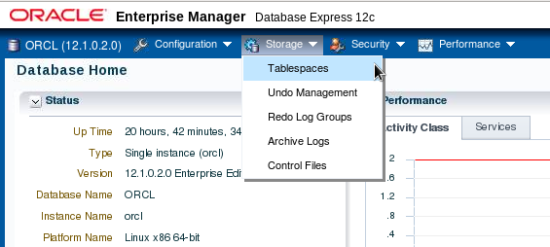
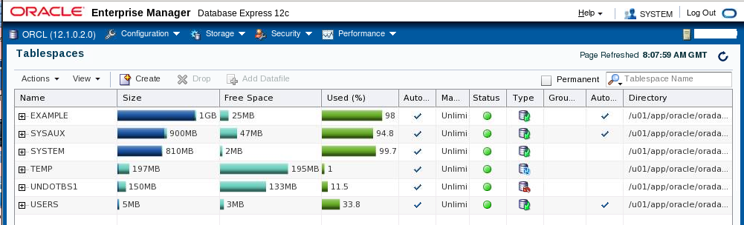
Exploring the Storage Structure
Notes:
Oracle Database 12c: Administration Workshop 7 - <number>
You can easily view the storage structures of your database through Enterprise Manager Database Express. Detailed information about each structure can be obtained by selecting the structure in the Storage menu.
您可以通过Enterprise Manager Database Express轻松查看数据库的存储结构。 可以通过选择存储菜单中的结构来获得有关每个结构的详细信息。

Slide 6
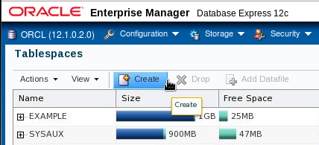
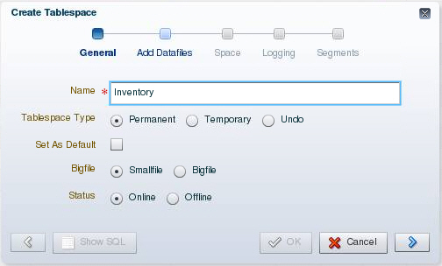
Creating a New Tablespace
Notes:
Oracle Database 12c: Administration Workshop 7 - <number>
1. Expand the Storage menu, and then select Tablespaces.
2. Click Create.
3. Enter a name for the tablespace.
4. In the Tablespace Type field, select Permanent.
Permanent tablespaces store permanent database objects that are created by the system or users.
5. In the Bigfile field, select Smallfile. Bigfile tablespaces are used with extremely large databases, in which ASM or other logical volume managers support the striping or redundant array of independent disks (RAID) and dynamically extensible logical volumes.
6. In the Status field, select Online.
Online means that users can read and write to the tablespace after it is created. This is the default.
Click the blue arrow to add data files to the tablespace.
1.展开“存储”菜单，然后选择“表空间”。
2.单击创建。
3.输入表空间的名称。
4.在“表空间类型”字段中，选择“永久”。 永久表空间存储由系统或用户创建的永久数据库对象。
5.在Bigfile字段中，选择Smallfile。 Bigfile表空间与非常大的数据库一起使用，其中ASM或其他逻辑卷管理器支持独立磁盘（RAID）和动态可扩展逻辑卷的条带化或冗余阵列。
6.在状态字段中，选择联机。 ？在线意味着用户可以在创建表空间后对其进行读写。 这是默认值。
7.单击蓝色箭头将数据文件添加到表空间。

Slide 7
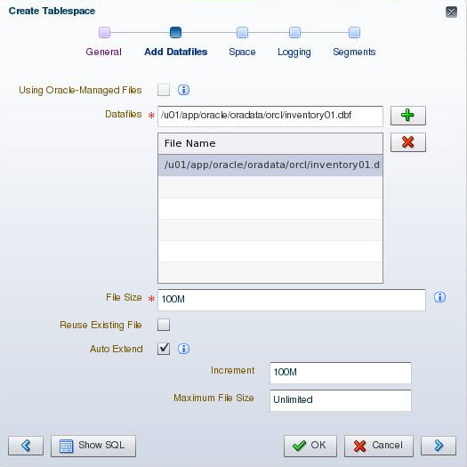
Creating a New Tablespace
Notes:
Oracle Database 12c: Administration Workshop 7 - <number>
A tablespace must have at least one file.
8. On the Add Datafiles page, enter a file directory and file name for the data file.
9. Enter the desired file size.
10. Select “Auto Extend” to automatically extend the data file when it is full and specify an increment amount in the Increment field. This causes the data file to extend automatically each time it runs out of space. It is limited, of course, by the physical media on which it resides. Leave Maximum File Size as Unlimited or enter a maximum size.
11. Click the blue arrow to continue.
表空间必须至少有一个文件。
8.在“添加数据文件”页面上，输入数据文件的文件目录和文件名。
9.输入所需的文件大小。
10.选择“自动扩展”，在数据文件已满时自动扩展数据文件，并在“增量”字段中指定增量。 这将导致数据文件在空间不足时自动扩展。 当然，它是有限的，它所在的物理媒体。 将最大文件大小保留为无限制或输入最大大小。
11.点击蓝色箭头继续。

Slide 8
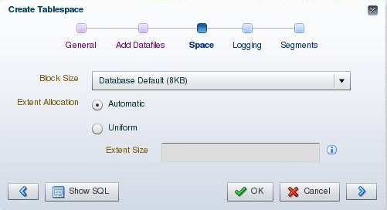
Creating a New Tablespace
Notes:
Oracle Database 12c: Administration Workshop 7 - <number>
Block Size: This field shows the block size that is used for the tablespace being created.
Extent Allocation: The extents can be allocated in one of these two ways:
Automatic: Also called autoallocate, it specifies that the sizes of the extents in the tablespace are system managed. You cannot specify Automatic for a temporary tablespace.
Uniform: It specifies that the tablespace is managed with uniform extents of a size that you specify. The default size is 1 MB. All extents of temporary tablespaces are uniform. You cannot specify Uniform for an undo tablespace.
块大小：此字段显示用于正在创建的表空间的块大小。
范围分配：可以通过以下两种方式之一分配扩展区：
自动：也称为autoallocate，它指定表空间中的扩展区的大小是系统管理的。 您不能为临时表空间指定自动。
统一：它指定表空间以您指定的大小的均匀范围进行管理。 默认大小为1 MB。 所有临时表空间均匀。 您不能为undo表空间指定Uniform。

Slide 9
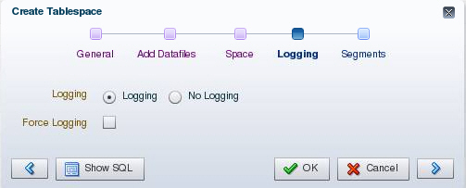
Creating a New Tablespace
Notes:
Oracle Database 12c: Administration Workshop 7 - <number>
Logging: The LOGGING clause sets the default logging value for any segment created in the tablespace. Changes made to objects in the tablespace are written to the redo log. If logging is not enabled, any direct loads using SQL*Loader and direct load INSERT operations are not written to the redo log, and the objects are thus unrecoverable in the event of data loss. When an object is created without logging enabled, you must back up those objects if you want them to be recoverable. Choosing not to enable logging can have a significant impact on the ability to recover objects in the future. Use with caution. For more details about the logging clause, see the Oracle Database SQL Reference.
Note: If FORCE LOGGING mode is in effect for the database, it takes precedence over the tablespace logging setting. The database can be put into FORCE LOGGING mode at the time of database creation or after database creation using the ALTER DATABASE FORCE LOGGING command.
日志记录：LOGGING子句为表空间中创建的任何段设置默认日志记录值。 对表空间中的对象所做的更改将写入重做日志。 如果未启用日志记录，则使用SQL * Loader和直接加载INSERT操作的任何直接加载都不会写入重做日志，因此在发生数据丢失的情况下，对象无法恢复。 当创建对象而不启用日志记录时，如果希望它们可恢复，则必须备份这些对象。 选择不启用日志记录可能会对将来恢复对象的能力产生重大影响。 谨慎使用。 有关logging子句的更多详细信息，请参见“Oracle数据库SQL参考”。
注意：如果FORCE LOGGING模式对数据库有效，则它优先于表空间日志记录设置。 数据库可以在数据库创建时或使用ALTER DATABASE FORCE LOGGING命令创建数据库后进入强制登录模式。

Slide 10
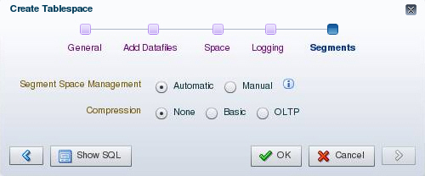
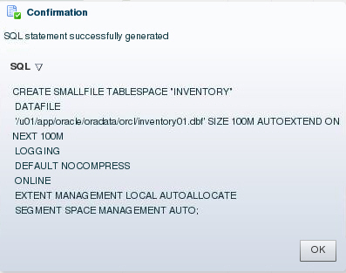
Creating a New Tablespace
Notes:
Oracle Database 12c: Administration Workshop 7 - <number>
Segment Space Management: Segment space management can be specified as:
Automatic: The Oracle Database server uses bitmaps to manage the free space in segments. The bitmap describes the status of each data block in a segment with respect to the amount of space in the block that is available for inserting rows. As more or less space becomes available in a data block, the new state is reflected in the bitmap. With bitmaps, the Oracle database manages free space more automatically. As a result, this form of space management is called Automatic Segment Space Management (ASSM).
Manual: This specifies that you want to use free lists for managing free space in segments. Free lists are lists of data blocks that have space available for inserting rows. This form of managing space in segments is called manual segment space management because of the need to specify and tune the PCTUSED, FREELISTS, and FREELIST GROUPS storage parameters for schema objects created in the tablespace. This is supported for backward compatibility; it is recommended that you use ASSM.
段空间管理：段空间管理可以指定为：
自动：Oracle数据库服务器使用位图来管理段中的可用空间。位图描述段中每个数据块相对于可用于插入行的块中的空间量的状态。随着数据块中可用的空间越来越多，新状态将反映在位图中。利用位图，Oracle数据库可以更自动地管理可用空间。因此，这种形式的空间管理称为自动段空间管理（ASSM）。
手动：这指定您要使用空闲列表来管理段中的可用空间。免费列表是具有可用于插入行的空间的数据块列表。由于需要指定和调整在表空间中创建的模式对象的PCTUSED，FREELISTS和FREELIST GROUPS存储参数，因此这种分段管理空间的形式称为手动分段空间管理。支持向后兼容;建议您使用ASSM。

Slide 11
Notes:
Oracle Database 12c: Administration Workshop 7 - <number>
Compression Options: Data segment compression is disabled by default. Enabling data segment compression can save disk space usage, reduce memory use in the buffer cache, and speed up query execution during reads. There is, however, a cost in CPU overhead for data loading and DML. It is especially useful in online analytical processing (OLAP) systems, where there are lengthy read-only operations, but can also be used in online transaction processing (OLTP) systems.
For more details about when to use the compression clause, see the Oracle Database Administrator’s Guide.
压缩选项：默认情况下禁用数据段压缩。 启用数据段压缩可以节省磁盘空间使用量，减少缓冲区缓存中的内存使用，并加快读取期间的查询执行速度。 然而，数据加载和DML的CPU开销有一个成本。 它在在线分析处理（OLAP）系统中特别有用，其中存在冗长的只读操作，但也可用于在线事务处理（OLTP）系统。
有关何时使用compression子句的更多详细信息，请参阅“Oracle数据库管理员指南”。

Slide 12
Tablespaces Created by Default: Overview
  EXAMPLE (optional)
  SYSAUX
  SYSTEM
  TEMP
  UNDOTBS1
  USERS
Notes:
Oracle Database 12c: Administration Workshop 7 - <number>
The following tablespaces are created by default when you create an Oracle database:
SYSAUX: This is an auxiliary tablespace to the SYSTEM tablespace. Some components and products that used the SYSTEM tablespace or their own tablespaces in earlier releases of Oracle Database now use the SYSAUX tablespace.
SYSTEM: The SYSTEM tablespace is used by the Oracle server to manage the database. It contains the data dictionary and tables that contain administrative information about the database. These are all contained in the SYS schema and can be accessed only by the SYS user or other administrative users with the required privilege.
TEMP: Your temporary tablespace is used when you execute a SQL statement that requires the creation of temporary segments (such as a large sort or the creation of an index). Just as each user is assigned a default tablespace for storing created data objects, each user is assigned a temporary tablespace. The best practice is to define a default temporary tablespace for the database, which is assigned to all newly created users unless otherwise specified. In the preconfigured database, the TEMP tablespace is specified as the default temporary tablespace. This means that if no temporary tablespace is specified when the user account is created, Oracle Database assigns this tablespace to the user.
创建Oracle数据库时，默认创建以下表空间：
SYSAUX：这是SYSTEM表空间的辅助表空间。在Oracle数据库的早期版本中使用SYSTEM表空间或其自己的表空间的某些组件和产品现在使用SYSAUX表空间。
SYSTEM：Oracle服务器使用SYSTEM表空间来管理数据库。它包含数据字典和表，其中包含有关数据库的管理信息。这些都包含在SYS模式中，只能由SYS用户或具有所需权限的其他管理用户访问。
TEMP：当您执行需要创建临时段（如大型或创建索引）的SQL语句时，将使用临时表空间。正如为每个用户分配了用于存储创建的数据对象的默认表空间，每个用户都被分配一个临时表空间。最佳做法是定义数据库的默认临时表空间，除非另有说明，否则它将分配给所有新创建的用户。在预配置的数据库中，TEMP表空间被指定为默认的临时表空间。这意味着如果在创建用户帐户时未指定临时表空间，则Oracle数据库会将该表空间分配给用户。

Slide 13
Notes:
Oracle Database 12c: Administration Workshop 7 - <number>
UNDOTBS1: This is the undo tablespace used by the database server to store undo information. If a database uses Automatic Undo Management, then it can only use a single undo tablespace at any given time. This tablespace is created at database creation time.
USERS: This tablespace is used to store user objects and data. If no default tablespace is specified when a user is created, then the USERS tablespace is the default tablespace for all objects created by that user. For the SYS and SYSTEM users, the default permanent tablespace is SYSTEM.
The EXAMPLE tablespace contains the sample schemas that can be installed when you create the database. The sample schemas provide a common platform for examples. Oracle documentation and courseware contain examples based on the sample schemas.
Note: To simplify administration, it is common to have a tablespace for indexes alone.
UNDOTBS1：这是数据库服务器用于存储撤消信息的undo表空间。 如果数据库使用自动撤消管理，则在任何给定时间只能使用单个撤消表空间。 此表空间是在数据库创建时创建的。
USERS：此表空间用于存储用户对象和数据。 如果在创建用户时未指定默认表空间，则USERS表空间是该用户创建的所有对象的默认表空间。 对于SYS和SYSTEM用户，默认的永久表空间是SYSTEM。
EXAMPLE表空间包含创建数据库时可以安装的示例模式。 示例模式为示例提供了一个通用平台。 Oracle文档和课件包含基于示例模式的示例。
注意：为了简化管理，通常只有索引的表空间。

Slide 14
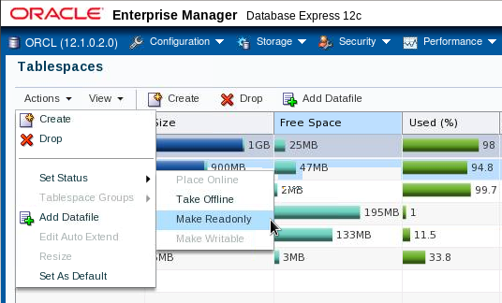
Altering a Tablespace
Notes:
Oracle Database 12c: Administration Workshop 7 - <number>
After you create a tablespace, you can alter it in several ways as the needs of your system change.
Changing the status: A tablespace can be in one of three different statuses or states. Any of the following three states may not be available because their availability depends on the type of tablespace.
Read Write: The tablespace is online and can be read from and written to.
Read Only: Specify read-only to place the tablespace in transition read-only mode. In this state, existing transactions can be completed (committed or rolled back), but no further data manipulation language (DML) operations are allowed on the objects in the tablespace. The tablespace is online while in the read-only state. You cannot make the SYSTEM or SYSAUX tablespaces read-only.
Note: The undo and temporary tablespaces cannot be made read-only.
Offline: You can take an online tablespace offline so that this portion of the database is temporarily unavailable for general use. The rest of the database is open and available for users to access data. When you take it offline, you can use the following options:
Normal: A tablespace can be taken offline normally if no error conditions exist for any of the data files of the tablespace. Oracle Database ensures that all data is written to disk by taking a checkpoint for all data files of the tablespace as it takes them offline.
创建表空间后，可以通过多种方式更改表空间，因为系统需要更改。
更改状态：表空间可以是三种不同的状态或状态之一。以下三个状态中的任何一个可能不可用，因为它们的可用性取决于表空间的类型。
读写：表空间在线，可以读写。
只读：指定只读，将表空间置于转换只读模式。在这种状态下，可以完成（提交或回滚）现有的事务，但在表空间中的对象上不允许进一步执行数据操作语言（DML）操作。处于只读状态时，表空间处于联机状态。您不能只读SYSTEM或SYSAUX表空间。注意：撤销和临时表空间不能是只读的。
脱机：您可以使联机表空间脱机，以使数据库的这一部分暂时不可用于一般用途。数据库的其余部分是开放的，可供用户访问数据。当您脱机时，您可以使用以下选项：
正常：如果表空间的任何数据文件没有错误条件，表空间可以正常脱机。 Oracle数据库可确保将所有数据写入磁盘，方法是将表空间的所有数据文件的检查点置于离线状态。

Slide 15
Notes:
Oracle Database 12c: Administration Workshop 7 - <number>
Temporary: A tablespace can be taken offline temporarily even if there are error conditions for one or more files of the tablespace. Oracle Database takes the data files (which are not already offline) offline, performing checkpointing on them as it does so. If no files are offline, but you use the Temporary clause, media recovery is not required to bring the tablespace back online. However, if one or more files of the tablespace are offline because of write errors, and you take the tablespace offline temporarily, the tablespace requires recovery before you can bring it back online.
Immediate: A tablespace can be taken offline immediately without Oracle Database taking a checkpoint on any of the data files. When you specify Immediate, media recovery for the tablespace is required before the tablespace can be brought online. You cannot take a tablespace offline immediately if the database is running in NOARCHIVELOG mode.
Note: System tablespaces may not be taken offline.
临时：即使表空间的一个或多个文件存在错误条件，表空间也可以临时脱机。 Oracle数据库将离线的数据文件（它们尚未脱机）执行，因此执行检查点。 如果没有文件脱机，但是您使用Temporary子句，则不需要介质恢复使表空间重新联机。 但是，如果表空间的一个或多个文件因为写入错误而脱机，并且临时使表空间脱机，则表空间需要恢复才能使其重新联机。
立即：如果Oracle数据库在任何数据文件上都有检查点，则表空间可以立即脱机。 当您指定立即时，表空间的介质恢复是必需的，才能使表空间联机。 如果数据库以NOARCHIVELOG模式运行，则不能立即将表空间离线。
注意：系统表空间可能不会脱机。

Slide 16
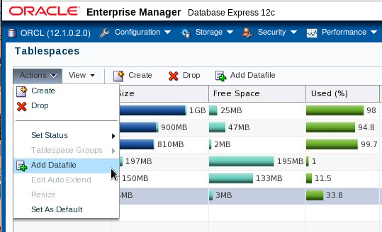
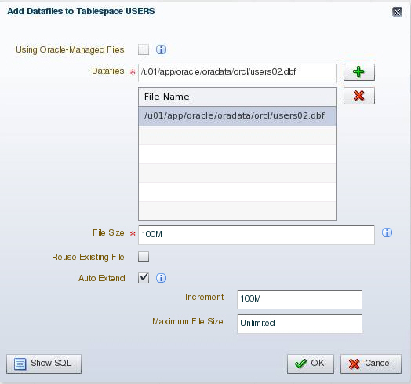
Adding a Data File to a Tablespace
Notes:
Oracle Database 12c: Administration Workshop 7 - <number>
Changing the size: You can add space to an existing tablespace by either adding data files to the tablespace or changing the size of an existing data file. To add a new data file to the tablespace, click Add. Then enter the information about the data file on the Add Datafile page.
Note: You cannot add additional data files to bigfile tablespaces.
间添加空间。 要将新数据文件添加到表空间，请单击添加。 然后在“添加数据文件”页面上输入有关数据文件的信息。
注意：您不能向bigfile表空间添加其他数据文件。

Slide 17
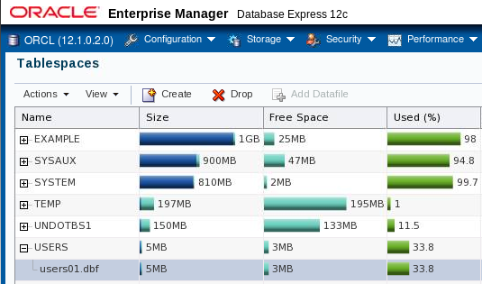
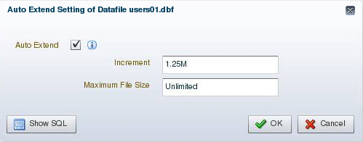
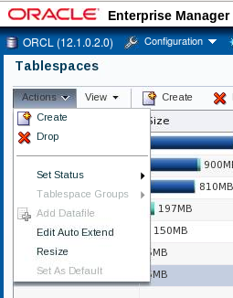
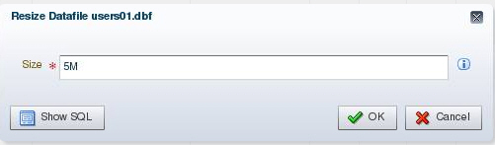
Making Changes to a Data File
Notes:
Oracle Database 12c: Administration Workshop 7 - <number>
You can change the settings of a data file by expanding the tablespace on the Tablespaces page, selecting the data file, and selecting the appropriate task in the Actions menu.
To take a data file offline, select “Take Offline” from the “Set Status” menu.
To change the size of an existing data file:
1. Expand the tablespace on the Tablespaces page and select the data file.
2. Select Resize in the Actions menu.
3. Then, on the Edit Datafile page, you can change the size of the data file. You can make the tablespace either larger or smaller. However, you cannot make a data file smaller than the used space in the file; if you try to do so, you get the following error:
ORA-03297: file contains used data beyond requested RESIZE value
您可以通过在“表空间”页面上展开表空间，选择数据文件以及在“操作”菜单中选择相应的任务来更改数据文件的设置。
要使数据文件脱机，请从“设置状态”菜单中选择“脱机”。
要更改现有数据文件的大小：
1.展开“表空间”页面上的表空间，然后选择数据文件。
2.在“操作”菜单中选择“调整大小”。
3.然后，在“编辑数据文件”页面上，可以更改数据文件的大小。 您可以使表空间更大或更小。 但是，您不能使数据文件小于文件中使用的空间; 如果您尝试这样做，您会收到以下错误：
ORA-03297：文件包含超出请求的RESIZE值的使用数据

Slide 18
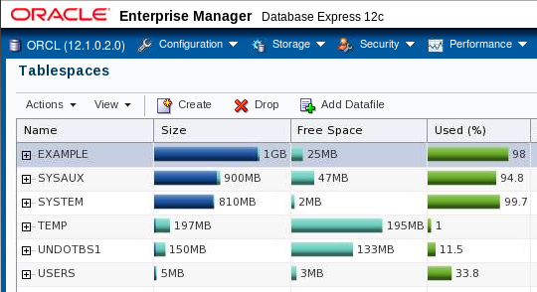
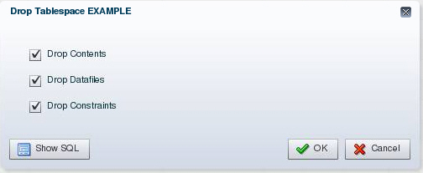
Dropping Tablespaces
Notes:
Oracle Database 12c: Administration Workshop 7 - <number>
You can drop a tablespace and its contents (the segments contained in the tablespace) from the database if the tablespace and its contents are no longer required. You must have the DROP TABLESPACE system privilege to drop a tablespace.
When you drop a tablespace, the file pointers in the control file of the associated database are removed. If you are using Oracle Managed Files (OMF), the underlying operating system files are also removed. Otherwise, without OMF, you can optionally direct the Oracle server to delete the operating system files (data files) that constitute the dropped tablespace. If you do not direct the Oracle server to delete the data files at the same time that it deletes the tablespace, you must later use the appropriate commands of your operating system if you want them to be deleted.
You cannot drop a tablespace that contains active segments. For example, if a table in the tablespace is currently being used, or if the tablespace contains undo data that is needed to roll back uncommitted transactions, you cannot drop the tablespace. It is best to take the tablespace offline before dropping it.
如果表空间及其内容不再需要，您可以从数据库中删除表空间及其内容（表空间中包含的段）。您必须具有DROP TABLESPACE系统权限才能删除表空间。
删除表空间时，相关数据库的控制文件中的文件指针将被删除。如果使用Oracle Managed Files（OMF），底层操作系统文件也会被删除。否则，没有OMF，您可以选择指示Oracle服务器删除构成删除的表空间的操作系统文件（数据文件）。如果您不指示Oracle服务器在删除表空间的同时删除数据文件，则必须稍后使用操作系统的相应命令，如果希望将其删除。
您不能删除包含活动段的表空间。例如，如果当前正在使用表空间中的表，或者如果表空间包含回滚未提交的事务所需的撤消数据，则不能删除表空间。最好在删除表空间之前将其放在离线状态。

Slide 19
Viewing Tablespace Information
SQL> SELECT tablespace_name, status, contents, logging,
2 extent_management, allocation_type,
3 segment_space_management
4 FROM dba_tablespaces;
TABLESPACE_NAME STATUS CONTENTS LOGGING EXTENT_MAN ALLOCATIO SEGMEN
--------------- ------- --------- -------- ---------- --------- -----
SYSTEM ONLINE PERMANENT LOGGING LOCAL SYSTEM MANUAL
SYSAUX ONLINE PERMANENT LOGGING LOCAL SYSTEM AUTO
UNDOTBS1 ONLINE UNDO LOGGING LOCAL SYSTEM MANUAL
TEMP ONLINE TEMPORARY NOLOGGING LOCAL UNIFORM MANUAL
USERS ONLINE PERMANENT LOGGING LOCAL SYSTEM AUTO
EXAMPLE ONLINE PERMANENT NOLOGGING LOCAL SYSTEM AUTO
SQL> SELECT file_name, file_id, tablespace_name
2 FROM dba_data_files;
FILE_NAME FILE_ID TABLESPACE_NAME
------------------------------------------ ---------- ----------------
/u01/app/oracle/oradata/orcl/system01.dbf 1 SYSTEM
/u01/app/oracle/oradata/orcl/sysaux01.dbf 3 SYSAUX
/u01/app/oracle/oradata/orcl/users01.dbf 6 USERS
/u01/app/oracle/oradata/orcl/example01.dbf 2 EXAMPLE
/u01/app/oracle/oradata/orcl/undotbs01.dbf 4 UNDOTBS1
Notes:
Oracle Database 12c: Administration Workshop 7 - <number>
Tablespace and data file information can also be obtained by querying the following:
Tablespace information:
DBA_TABLESPACES
V$TABLESPACE
Data file information:
DBA_DATA_FILES
V$DATAFILE
Temp file information:
DBA_TEMP_FILES
V$TEMPFILE

Slide 20
Oracle Managed Files (OMF)
Specify file operations in terms of database objects rather than file names.
Parameter | Description
DB_CREATE_FILE_DEST | Defines the location of the default file system directory for data files and temporary files
DB_CREATE_ONLINE_LOG_DEST_n | Defines the location for redo log files and control file creation
DB_RECOVERY_FILE_DEST | Gives the default location for the fast recovery area
Example:
SQL> ALTER SYSTEM
2 SET DB_CREATE_FILE_DEST='/u01/app/oracle/oradata';
SQL> CREATE TABLESPACE tbs_1;
Notes:
Oracle Database 12c: Administration Workshop 7 - <number>
Oracle Managed Files eliminate the need for you to directly manage the operating system files in an Oracle database. You specify operations in terms of database objects rather than file names. The database internally uses standard file system interfaces to create and delete files as needed for the following database structures:
Tablespaces
Redo log files
Control files
Archived logs
Block change tracking files
Flashback logs
RMAN backups
A database can have a mixture of Oracle-managed and Oracle-unmanaged files. The file system directory specified by either of these parameters must already exist; the database does not create it. The directory must also have permissions for the database to create the files in it.
The example shows that after DB_CREATE_FILE_DEST is set, the DATAFILE clause can be omitted from a CREATE TABLESPACE statement. The data file is created in the location specified by DB_CREATE_FILE_DEST. When you create a tablespace as shown, default values are assigned to all parameters.
Oracle Managed Files不需要您直接管理Oracle数据库中的操作系统文件。 您可以使用数据库对象而不是文件名指定操作。 数据库内部使用标准文件系统接口根据需要为以下数据库结构创建和删除文件：
数据库可以混合使用Oracle管理和Oracle非管理文件。 由这些参数指定的文件系统目录必须已经存在; 数据库不会创建它。 该目录还必须具有数据库创建其中的文件的权限。
该示例显示，在设置DB_CREATE_FILE_DEST之后，可以从CREATE TABLESPACE语句中省略DATAFILE子句。 数据文件在DB_CREATE_FILE_DEST指定的位置创建。 当您创建一个表空间，如图所示，默认值分配给所有参数。

Slide 21
Notes:
Oracle Database 12c: Administration Workshop 7 - <number>
Oracle-managed files have a specific naming format. For example, on Linux- and UNIX-based systems the following format is used:
<destination_prefix>/o1_mf_%t_%u_.dbf
Do not rename an Oracle-managed file. The database identifies an Oracle-managed file based on its name. If you rename the file, the database is no longer able to recognize it as an Oracle-managed file and will not manage the file accordingly.
The following example sets the default location for data file creations to /u01/oradata and then creates a tablespace tbs_1 with a data file in that location.
SQL> ALTER SYSTEM SET DB_CREATE_FILE_DEST = '/u01/oradata';
SQL> CREATE TABLESPACE tbs_1;
By default, Oracle-managed data files, including those for the SYSTEM and SYSAUX tablespaces, are 100 MB and auto-extensible.
Note: By default, ASM uses OMF files, but if you specify an alias name for an ASM data file at tablespace creation time or when adding an ASM data file to an existing tablespace, then that file will not be OMF.
Oracle管理的文件具有特定的命名格式。 例如，在基于Linux和UNIX的系统上，使用以下格式：
<destination_prefix>/o1_mf_%t_%u_.dbf
不要重命名Oracle管理的文件。 数据库根据其名称识别Oracle管理的文件。 如果重命名文件，数据库将无法将其识别为Oracle管理的文件，因此不会相应地管理该文件。以下示例将数据文件创建的默认位置设置为/ u01 / oradata，然后创建一个 表空间tbs_1与该位置的数据文件。
SQL> ALTER SYSTEM SET DB_CREATE_FILE_DEST ='/ u01 / oradata';
SQL> CREATE TABLESPACE tbs_1;
默认情况下，Oracle管理的数据文件（包括SYSTEM和SYSAUX表空间的数据文件）为100 MB，可自动扩展。
注意：默认情况下，ASM使用OMF文件，但是如果在表空间创建时指定ASM数据文件的别名，或者将ASM数据文件添加到现有表空间中，则该文件不会是OMF。

Slide 22
Quiz
A database can have a mixture of Oracle-managed and unmanaged files.
  True
  False
Notes:
Oracle Database 12c: Administration Workshop 7 - <number>
Answer: a

Slide 23

Enlarging the Database
You can enlarge the database in the following ways:
  Create a new tablespace.
  Add a data file to an existing smallfile tablespace.
  Increase the size of a data file.
  Provide for the dynamic growth of a data file.
Database
SYSTEM
tablespace
INVENTORY
tablespace
Notes:
Oracle Database 12c: Administration Workshop 7 - <number>
These activities can be performed with Enterprise Manager or with SQL statements. The size of the database can be described as the sum of all of its tablespaces.
您可以通过以下方式放大数据库：
创建一个新的表空间。
将数据文件添加到现有的小型文件表空间。
增加数据文件的大小。
提供数据文件的动态增长

Slide 24


Moving or Renaming an Online Data File
1
File System Storage
2
ASM Storage
MOVE
ONLINE
Tablespace HR: 3 data files
Tablespace HR: Diskgroup A
1
ASM Storage
2
File System Storage
MOVE
ONLINE
Tablespace APP: Diskgroup B
Tablespace APP: 3 data files
Notes:
Oracle Database 12c: Administration Workshop 7 - <number>
You can rename or move an online data file from one kind of storage system to another while the database is opened and accessing the file.
Queries and DML and DDL operations can be performed while the data file is being moved, including the following:
SELECT statements against tables and partitions
Creation of tables and indexes
Rebuilding of indexes
Note: If objects are compressed while the data file is moved, the compression remains the same.
当打开数据库并访问该文件时，可以将在线数据文件从一种存储系统重命名或移动到另一种。
可以在数据文件移动时执行查询和DML和DDL操作，其中包括：
针对表和分区的SELECT语句
创建表和索引
重建索引
注意：如果在数据文件移动时对象被压缩，则压缩保持不变。

Slide 25
Moving or Renaming an Online Data File
  Relocating an online data file:
  Copying a data file from a file system to ASM:
  Renaming an online data file:
  ALTER DATABASE MOVE DATAFILE '/disk1/myexample01.dbf'
  TO '/disk2/myexample01.dbf';
  ALTER DATABASE MOVE DATAFILE '/disk1/myexample01.dbf'
  TO '+DiskGroup2' KEEP;
  ALTER DATABASE MOVE DATAFILE '/disk1/myexample1.dbf'
  TO '/disk1/myexample01.dbf';
Notes:
You do not have to shut down the database or take the data file offline while you move a data file to another location, disk, or storage system.
The TO clause can be omitted only when an Oracle-managed file is used. In this case, the DB_CREATE_FILE_DEST parameter should be set to indicate the new location.
If the REUSE option is specified, the existing file is overwritten.
If the KEEP clause is specified, the old file will be kept after the move operation. The KEEP clause is not allowed if the source file is an Oracle-managed file.
Use the V$SESSION_LONGOPS view to display ongoing online move operations. Each ongoing operation has one row. The state transition of a successful online move operation is usually NORMAL to COPYING to SUCCESS and finally to NORMAL.
在将数据文件移动到另一个位置，磁盘或存储系统时，不必关闭数据库或使数据文件脱机。
只有当使用Oracle管理的文件时，TO子句才能被省略。 在这种情况下，应该将DB_CREATE_FILE_DEST参数设置为指示新的位置。
如果指定了REUSE选项，现有文件将被覆盖。
如果指定了KEEP子句，则在移动操作后将保留旧文件。 如果源文件是Oracle管理的文件，则不允许使用KEEP子句。
使用V $ SESSION_LONGOPS视图显示正在进行的在线移动操作。 每个正在进行的操作都有一行。 成功的在线移动操作的状态转换通常是复制到成功的NORMAL，最后到正常。
Oracle Database 12c: Administration Workshop 7 - <number>

Slide 26
Summary
In this lesson, you should have learned how to:
  Describe the storage of table row data in blocks
  Create and manage tablespaces
  Obtain tablespace information
Notes:
Oracle Database 12c: Administration Workshop 7 - <number>

Slide 27
Practice: Overview
This practice covers the following topics:
  Creating tablespaces
  Gathering information about tablespaces
Notes:
Oracle Database 12c: Administration Workshop 7 - <number>

