Slide 1
Managing Undo Data

Slide 2
Objectives
After completing this lesson, you should be able to:
  Explain DML and undo data generation
  Monitor and administer undo data
  Describe the difference between undo data and redo data
  Configure undo retention
  Guarantee undo retention
  Enable temporary undo
  Use the Undo Advisor
Notes:
Oracle Database 12c: Administration Workshop 9 - <number>
完成本课后，您应该能够：
解释DML和撤消数据生成
监控并管理撤消数据
描述撤消数据和重做数据之间的区别
配置撤消保留
保证撤消保留
启用临时撤消
使用撤消顾问

Slide 3




Undo Data: Overview
Undo data is:
  A record of the action of a transaction
  Captured for every transaction that changes data
  Retained at least until the transaction is ended
  Used to support:
    Rollback operations
    Read-consistent queries
    Oracle Flashback Query, Oracle Flashback
    Transaction, and Oracle Flashback Table
    Recovery from failed transactions
User
Notes:
Oracle Database 12c: Administration Workshop 9 - <number>
撤消数据是：
交易记录
被捕获用于更改数据的每个事务
至少保留至交易结束为止
用于支持：
回滚操作
一致的查询
Oracle Flashback Query，Oracle Flashback？Transaction和Oracle Flashback Table
从故障交易中恢复
The Oracle Database server saves the old value (undo data) when a process changes data in a database. It stores the data as it exists before modifications. Capturing undo data enables you to roll back your uncommitted data. Undo supports read-consistent and flashback queries. Undo can also be used to “rewind” (flash back) transactions and tables.
Read-consistent queries provide results that are consistent with the data as of the time a query started. For a read-consistent query to succeed, the original information must still exist as undo information. If the original data is no longer available, you receive a “Snapshot too old” error (ORA-01555). As long as the undo information is retained, the Oracle Database server can reconstruct data to satisfy read-consistent queries.
Flashback queries purposely ask for a version of the data as it existed at some time in the past. As long as undo information for that past time still exists, flashback queries can complete successfully. Oracle Flashback Transaction uses undo to create compensating transactions, to back out a transaction and its dependent transactions. With Oracle Flashback Table, you can recover a table to a specific point in time.
Undo data is also used to recover from failed transactions. A failed transaction occurs when a user session ends abnormally (possibly because of network errors or a failure on the client computer) before the user decides to commit or roll back the transaction. Failed transactions may also occur when the instance crashes or you issue the SHUTDOWN ABORT command.
Oracle数据库服务器在流程更改数据库中的数据时保存旧值（撤消数据）。它在修改之前存储数据。捕获撤消数据使您能够回滚未提交的数据。撤消支持读取一致和闪回查询。撤消也可以用来“倒带”（闪回）交易和表。
读取一致性查询提供与查询开始时的数据一致的结果。为了使一致性查询成功，原始信息仍然作为撤销信息存在。如果原始数据不再可用，您将收到“快照太旧”错误（ORA-01555）。只要保留撤消信息，Oracle数据库服务器就可以重建数据以满足一致性查询。
闪回查询有意要求在过去某个时间存在的数据版本。只要该过去时间的撤消信息仍然存在，闪回查询可以成功完成。 Oracle Flashback Transaction使用undo创建补偿事务，以备份事务及其依赖事务。使用Oracle闪回表，您可以将表恢复到特定的时间点。
撤销数据也用于从失败的事务中恢复。当用户决定提交或回滚事务之前，用户会话异常结束（可能是由于网络错误或客户端计算机上的故障）而发生故障事务。当实例崩溃或发出SHUTDOWN ABORT命令时，也可能会发生失败的事务。

Slide 4
Notes:
Oracle Database 12c: Administration Workshop 9 - <number>
In case of a failed transaction, the safest behavior is chosen, and the Oracle Database server reverses all changes made by a user, thereby restoring the original data.
Undo information is retained for all transactions, at least until the transaction is ended by one of the following:
User undoes a transaction (transaction rolls back).
User ends a transaction (transaction commits).
User executes a DDL statement, such as a CREATE, DROP, RENAME, or ALTER statement. If the current transaction contains any DML statements, the database server first commits the transaction and then executes and commits the DDL as a new transaction.
User session terminates abnormally (transaction rolls back).
User session terminates normally with an exit (transaction commits).
The amount of undo data that is retained and the time for which it is retained depend on the amount of database activity and the database configuration.
Note: Oracle Flashback Transaction leverages the online redo logs to mine the appropriate undo SQL for execution. It only uses undo as an artificial time boundary, to determine a redo mining start time for the target transaction, if a transaction start time is not supplied in the flashback transaction invocation.
在事件失败的情况下，选择最安全的行为，并且Oracle数据库服务器反转用户所做的所有更改，从而恢复原始数据。
至少在交易结束之前，所有交易都将保留撤消信息：
用户撤销事务（事务回滚）。
用户结束事务（事务提交）。
用户执行DDL语句，如CREATE，DROP，RENAME或ALTER语句。如果当前事务包含任何DML语句，则数据库服务器首先提交事务，然后执行并将DDL作为新事务提交。
用户会话异常终止（事务回滚）。
用户会话正常使用退出（事务提交）终止。
保留的撤消数据量以及保留的时间取决于数据库活动和数据库配置的数量。
注意：Oracle Flashback Transaction利用联机重做日志挖掘相应的撤销SQL执行。如果在闪回事务调用中没有提供事务开始时间，则它仅使用撤消作为人工时间边界来确定目标事务的重做挖掘开始时间。

Slide 5


Transactions and Undo Data
Undo segment
Data in
Undo “old” data
in undo tablespace
buffer cache
Redo log
buffer
New change details
in redo log files
UPDATE
DML operations
Redo log
files
  Each transaction is assigned to only one undo segment.
  An undo segment can service more than one transaction at a time.
Notes:
Oracle Database 12c: Administration Workshop 9 - <number>
When a transaction starts, it is assigned to an undo segment. Throughout the life of the transaction, when data is changed, the original (before the change) values are copied into the undo segment. You can see which transactions are assigned to which undo segments by checking the V$TRANSACTION dynamic performance view.
Undo segments are specialized segments that are automatically created by the database server as needed to support transactions. Like all segments, undo segments are made up of extents, which, in turn, consist of data blocks. Undo segments automatically grow and shrink as needed, acting as a circular storage buffer for their assigned transactions.
Transactions fill extents in their undo segments until a transaction is completed or all space is consumed. If an extent fills up and more space is needed, the transaction acquires that space from the next extent in the segment. After all extents have been consumed, the transaction either wraps around back into the first extent or requests a new extent to be allocated to the undo segment.
Note: Parallel DML and DDL operations can actually cause a transaction to use more than one undo segment. To learn more about parallel DML execution, see the Oracle Database Administrator’s Guide.
事务开始时，它被分配到一个撤销段。在整个交易期间，当数据更改时，原始（更改前）值被复制到撤消段。您可以通过检查V $ TRANSACTION动态性能视图来查看哪些事务分配给哪些撤销段。
撤消细分是根据需要自动创建数据库服务器来支持交易的特殊细分。像所有段一样，撤销段由扩展区组成，而区段又由数据块组成。撤销段会根据需要自动增长和缩小，充当其分配的事务的循环存储缓冲区。
事务在其撤销段中填充扩展区，直到事务完成或所有空间被消耗。如果一个盘区填满并需要更多的空间，那么该交易将从该段的下一个盘区获取该空间。在所有范围已经被消耗之后，事务将返回到第一个扩展区域，或者要求将一个新的区段分配给undo段。
注意：并行DML和DDL操作实际上可能导致事务使用多个撤销段。要了解有关并行DML执行的更多信息，请参阅“Oracle数据库管理员指南”。

Slide 6
Storing Undo Information
  Undo information is stored in undo segments, which are stored in an undo tablespace.
  Undo tablespaces:
    Are used only for undo segments
    Have special recovery considerations
    May be associated with only a single instance
    Require that only one of them be the current writable undo tablespace for a given instance at any given time
Notes:
Oracle Database 12c: Administration Workshop 9 - <number>
撤消信息存储在存储在撤销表空间中的undo段中。
撤销表空间：
仅用于撤消段
有特殊的恢复考虑
可能只与一个实例相关联
要求在任何给定时间，只有其中一个是给定实例的当前可写入的undo表空间
Undo segments can exist only in a specialized form of tablespace called an undo tablespace. (You cannot create other segment types, such as tables, in the undo tablespace.)
The Database Configuration Assistant (DBCA) automatically creates a smallfile undo tablespace. You can also create a bigfile undo tablespace. However, in a high-volume online transaction processing (OLTP) environment with many short concurrent transactions, contention could occur on the file header. An undo tablespace, stored in multiple data files, can resolve this potential issue.
Although a database may have many undo tablespaces, only one of them at a time can be designated as the current undo tablespace for any instance in the database.
Undo segments are automatically created and always owned by SYS. Because the undo segments act as a circular buffer, each segment has a minimum of two extents. The default maximum number of extents depends on the database block size but is very high (32,765 for an 8 KB block size).
Undo tablespaces are permanent, locally managed tablespaces with automatic extent allocation. They are automatically managed by the database.
Because undo data is required to recover from failed transactions (such as those that may occur when an instance crashes), undo tablespaces can be recovered only while the instance is in the MOUNT state.
撤销段只能以称为undo表空间的特殊形式的表空间存在。 （您不能在undo表空间中创建其他段类型，例如表）。
数据库配置助手（DBCA）自动创建一个小文件undo tablespace。您还可以创建一个bigfile undo tablespace。然而，在具有许多短并发事务的大容量在线事务处理（OLTP）环境中，文件头上可能会发生争用。存储在多个数据文件中的撤销表空间可以解决此潜在问题。
虽然数据库可能有许多撤销表空间，但一次只能将其中一个表指定为数据库中任何实例的当前undo表空间。
自动创建撤消段，并始终由SYS拥有。因为撤销段作为循环缓冲区，每个段最少有两个扩展区。默认的最大扩展数量取决于数据库块大小，但是非常高（对于8 KB块大小，为32,765）。
撤销表空间是具有自动扩展分配的永久性，本地管理的表空间。它们由数据库自动管理。
因为撤销数据需要从失败的事务中恢复（例如在实例崩溃时可能发生的事务），所以在实例处于MOUNT状态时，只能恢复撤销表空间。

Slide 7
Comparing Undo Data and Redo Data
 | Undo | Redo
Record of | How to undo a change | How to reproduce a change
Used for | Rollback, read consistency, flashback | Rolling forward database changes
Stored in | Undo segments | Redo log files
Undo segment
Redo log
files
Notes:
Oracle Database 12c: Administration Workshop 9 - <number>
Undo data and redo data seem similar at first, but they serve different purposes. Undo data is needed if there is the need to undo a change, and this occurs for read consistency and rollback. Redo data is needed if there is the need to perform the changes again, in cases where they are lost for some reason. Undo block changes are also written to the redo log.
The process of committing entails a verification that the changes in the transaction have been written to the redo log file, which is persistent storage on the disk, as opposed to memory. In addition, the redo log file is typically multiplexed. As a result, there are multiple copies of the redo data on the disk. Although the changes may not yet have been written to the data files where the table’s blocks are actually stored, writing to the persistent redo log is enough to guarantee consistency of the database.
Suppose that a power outage occurs just before committed changes have been reflected in the data files. This situation does not cause a problem because the transaction has been committed. When the system starts up again, it is able to roll forward any redo records that are not yet reflected in data files at the time of the outage.
首先取消数据和重做数据似乎相似，但它们的用途不同。如果需要撤消更改，则需要撤消数据，这会在读取一致性和回滚时发生。如果需要再次执行更改，则在需要重做数据的情况下，由于某些原因丢失数据。撤消块更改也将写入重做日志。
提交过程需要验证交易中的更改是否已写入重做日志文件，该日志文件是磁盘上的持久存储，而不是内存。此外，重做日志文件通常被复用。因此，磁盘上有重复数据的多个副本。虽然更改可能尚未写入表的块实际存储的数据文件，但写持久重做日志足以保证数据库的一致性。
假设在数据文件中反映出承诺更改之前发生停电。这种情况不会因为交易被提交而导致问题。当系统再次启动时，可以在中断时将任何尚未反映在数据文件中的重做记录滚动。

Slide 8
Managing Undo
Automatic undo management:
  Fully automated management of undo data and space in a dedicated undo tablespace
  For all sessions
  Self-tuning in AUTOEXTEND tablespaces to satisfy long-running queries
  Self-tuning in fixed-size tablespaces for best retention
DBA tasks in support of Flashback operations:
  Configuring undo retention
  Changing undo tablespace to a fixed size
  Avoiding space and “snapshot too old” errors
Notes:
Oracle Database 12c: Administration Workshop 9 - <number>
自动撤销管理：
在专用的撤销表空间中完全自动管理撤消数据和空间
对于所有会话
自动调整AUTOEXTEND表空间以满足长时间运行的查询
在固定大小的表空间中进行自整定，以保持最佳状态
支持闪回操作的DBA任务：
配置撤消保留
将undo表空间更改为固定大小
避免空间和“快照太旧”错误
The Oracle Database server provides automatic undo management, which is a fully automated mechanism for managing undo information and space in a dedicated undo tablespace for all sessions. The system automatically tunes itself to provide the best possible retention of undo information. More precisely, the undo retention period for auto-extending tablespaces is tuned to be slightly longer than the longest-running active query. For fixed-size undo tablespaces, the database dynamically tunes for best possible retention.
Although by default the Oracle Database server manages undo data and space automatically, you may need to perform some tasks if your database is using Flashback operations. The administration of undo should prevent space errors, the use of too much space, and “Snapshot too old” errors.
Oracle数据库服务器提供自动撤销管理，这是一种完全自动化的机制，用于在所有会话的专用undo表空间中管理撤消信息和空间。 系统自动调整自身，以提供最佳的撤销信息保留。 更确切地说，自动扩展表空间的撤销保留期被调整为比最长运行的活动查询稍长。 对于固定大小的撤销表空间，数据库将动态调整最佳可能的保留。
尽管默认情况下，Oracle数据库服务器会自动管理撤消数据和空间，但如果数据库使用闪回操作，则可能需要执行某些任务。 撤销的管理应该防止空间错误，使用太多的空间和“快照太旧”错误。

Slide 9

Configuring Undo Retention
  UNDO_RETENTION specifies (in seconds) how long already committed undo information is to be retained.
  Set this parameter when:
    The undo tablespace has the AUTOEXTEND option enabled
    You want to set undo retention for LOBs
    You want to guarantee retention
DBA
Notes:
Oracle Database 12c: Administration Workshop 9 - <number>
UNDO_RETENTION指定（以秒为单位）已经提交的撤销信息要保留多久。
设置此参数：
undo表空间启用了AUTOEXTEND选项
您要为LOB设置撤消保留
你想保证保留
The UNDO_RETENTION initialization parameter specifies (in seconds) the low threshold value of undo retention. Set the minimum undo retention period for the auto-extending undo tablespace to be as long as the longest expected Flashback operation. For auto-extending undo tablespaces, the system retains undo for at least the time specified in this parameter, and automatically tunes the undo retention period to meet the undo requirements of the queries. But this autotuned retention period may be insufficient for your Flashback operations.
For fixed-size undo tablespaces, the system automatically tunes for the best possible undo retention period on the basis of undo tablespace size and usage history; it ignores UNDO_RETENTION unless retention guarantee is enabled. So for automatic undo management, the UNDO_RETENTION setting is used for the three cases listed in the slide.
In cases other than these three, this parameter is ignored.
UNDO_RETENTION初始化参数指定撤消保留的低阈值（以秒为单位）。 将自动扩展的undo表空间的最小撤销保留期限设置为与预期的最长Flashback操作一样长。 对于自动扩展的undo表空间，系统至少在此参数指定的时间内保留undo，并自动调整undo保留周期以满足查询的undo需求。 但是，这种自动调整的保留期可能不足以进行闪回操作。
对于固定大小的撤销表空间，系统将根据撤销表空间大小和使用历史自动调整最佳撤销保留期限; 除非启用保留保证，否则忽略UNDO_RETENTION。 因此，对于自动撤消管理，UNDO_RETENTION设置用于幻灯片中列出的三种情况。 ？在这三个以外的情况下，该参数被忽略。

Slide 10
Categories of Undo
Category | Description
Active: Uncommitted undo information | Supports an active transaction and is never overwritten
Unexpired: Committed undo information | Required to meet the undo retention interval
Expired: Expired undo information | Overwritten when space is required for an active transaction
Notes:
Oracle Database 12c: Administration Workshop 9 - <number>
Undo information is divided into three categories:
Uncommitted undo information (Active): Supports a currently running transaction, and is required if a user wants to roll back or if the transaction has failed. Uncommitted undo information is never overwritten.
Committed undo information (Unexpired): Is no longer needed to support a running transaction but is still needed to meet the undo retention interval. It is also known as “unexpired” undo information. Committed undo information is retained when possible without causing an active transaction to fail because of lack of space.
Expired undo information (Expired): Is no longer needed to support a running transaction. Expired undo information is overwritten when space is required by an active transaction.
撤销信息分为三类：
未提交的撤销信息（活动）：支持当前运行的事务，如果用户想要回滚或者事务失败，则需要该事务。 未提交的撤消信息不会被覆盖。
提交的撤消信息（未过期）：不再需要支持正在运行的事务，但仍然需要满足撤销保留间隔。 它也被称为“未过期”撤消信息。 提交的撤消信息在可能的情况下保留不会导致活动事务由于缺少空间而失败。
已过期的撤消信息（已过期）：不再需要支持正在运行的事务。 当活动事务需要空间时，过期的撤消信息将被覆盖。

Slide 11


Guaranteeing Undo Retention
SQL> ALTER TABLESPACE undotbs1 RETENTION GUARANTEE;
Retention guarantee:
15 minutes
Undo data in undo tablespace
SELECT statements
running 15 minutes or less
are always satisfied.
A transaction will fail
if it generates more undo than there is space.
Note: This example is based on an UNDO_RETENTION setting of 900 seconds (15 minutes).
Notes:
Oracle Database 12c: Administration Workshop 9 - <number>
The default undo behavior is to overwrite the undo information of committed transactions that has not yet expired rather than to allow an active transaction to fail because of lack of undo space.
This behavior can be changed by guaranteeing retention. With guaranteed retention, undo retention settings are enforced even if they cause transactions to fail.
RETENTION GUARANTEE is a tablespace attribute rather than an initialization parameter. This attribute can be changed only with SQL command-line statements. The syntax to change an undo tablespace to guarantee retention is:
SQL> ALTER TABLESPACE undotbs1 RETENTION GUARANTEE;
To return a guaranteed undo tablespace to its normal setting, use the following command:
SQL> ALTER TABLESPACE undotbs1 RETENTION NOGUARANTEE;
The retention guarantee applies only to undo tablespaces. Attempts to set it on a non-undo tablespace result in the following error:
SQL> ALTER TABLESPACE example RETENTION GUARANTEE;
ERROR at line 1:
ORA-30044: 'Retention' can only specified for undo tablespace
默认的undo行为是覆盖尚未到期的提交事务的undo信息，而不是允许活动事务由于缺少undo空间而失败。
可以通过保留保留来更改此行为。 通过保证保留，撤销保留设置即使导致事务失败也会被强制执行。
RETENTION GUARANTEE是一个表空间属性而不是一个初始化参数。 只能使用SQL命令行语句更改此属性。

Slide 12
Changing an Undo Tablespace to a Fixed Size
  Rationale:
    Supporting Flashback operations
    Limiting tablespace growth
  Steps:
    Run regular workload.
    Self-tuning mechanism establishes minimum required size.
    (Optional) Use the Enterprise Manager Cloud Control Undo Advisor, which calculates required size for future growth.
    (Optional) Change undo tablespace to a fixed size.
Notes:
Oracle Database 12c: Administration Workshop 9 - <number>
理由：
支持闪回操作
限制表空间增长
设置：
运行常规工作量。
自整定机构建立最小要求的尺寸。
（可选）使用企业管理器云控制撤销顾问程序，用于计算未来增长所需的大小。
（可选）将表空间更改为固定大小。
You might have two reasons for changing the undo tablespace to a fixed size: to support Flashback operations (where you expect future use of the undo) or to prevent the tablespace from growing too large.
If you decide to change the undo tablespace to a fixed size, you must choose a large enough size to avoid the following two errors:
DML failures (because there is not enough space to create the undo for new transactions)
“Snapshot too old” errors (because there was insufficient undo data for read consistency)
Oracle recommends that you run a regular, full workload allowing the undo tablespace to grow to its minimum required size. The automatically gathered statistics include the duration of the longest-running query and the undo generation rate. Computing the minimum undo tablespace size based on these statistics is advisable for a system without Flashback operations, and for a system for which you do not expect longer-running queries in the future.
You can use the Enterprise Manager Cloud Control Undo Advisor to enter your desired duration for the undo period for longer-running queries and flashback.
将undo表空间更改为固定大小可能有两个原因：支持Flashback操作（希望将来可以使用undo）或防止表空间增长太大。
如果您决定将undo表空间更改为固定大小，则必须选择足够大的大小以避免以下两个错误：
DML失败（因为没有足够的空间为新事务创建撤消）
“快照太旧”错误（因为读取一致性的撤消数据不足）
Oracle建议您运行一个常规的完整工作负载，以使undo表空间增长到最小所需大小。自动收集的统计信息包括最长运行查询的持续时间和撤消生成率。对于没有Flashback操作的系统以及您以后不期望更长时间运行的查询的系统，建议基于这些统计信息计算最小的undo表空间大小。
您可以使用Enterprise Manager Cloud Control Undo Advisor为延长运行的查询和闪回而在撤消期间输入所需的持续时间。

Slide 13
Temporary Undo: Overview
Stored in
temporary
tablespace
Stored in
user
tablespace
If using
temporary undo
Temporary
Table
If not using
temporary undo
Persistent
Table
Temporary
Undo
Permanent
Undo
Redo
Stored in
temporary tablespace
Stored in
undo tablespace
Stored in
redo log files
Notes:
Temporary tables are widely used as scratch areas for staging intermediate results. This is because changing those tables is much faster than with non-temporary tables. The performance gain is mainly because no redo entries are directly generated for changes on temporary tables. However, the undo for operations on temporary tables (and indices) is still logged to the redo log.
Undo for temporary tables is useful for consistent reads and transaction rollbacks during the life of that temporary object. Beyond this scope the undo is superfluous. Hence it need not be persisted in the redo stream. For instance, transaction recovery just discards undo for temporary objects.
Starting with Oracle Database 12c it is possible for undo generated by temporary tables’ transactions to be stored in a separate undo stream directly in the temporary tablespace to avoid for that undo to be logged in the redo stream. This mode is called temporary undo.
Note: A temporary undo segment is session private. It stores undo for the changes to temporary tables (temporary objects in general) belonging to the corresponding session.
临时表被广泛用作分期中间结果的划痕区域。这是因为更改这些表比非临时表快得多。性能增益主要是因为不会对临时表的更改直接生成重做条目。但是，对于临时表（和索引）的操作的撤销仍会记录到重做日志中。
临时表的撤消对于在该临时对象的生命期间的一致的读取和事务回滚是有用的。除了这个范围之外，撤消是多余的。因此，它不需要在重做流中保留。例如，事务恢复只是放弃对临时对象的撤消。
从Oracle数据库12c开始，可以将临时表的事务生成的撤销直接存储在临时表空间中的单独的撤销流中，以避免将该撤销记录在重做流中。此模式称为临时撤消。
注意：临时undo段是会话私有的。它将更改存储在属于相应会话的临时表（一般临时对象）中。
Oracle Database 12c: Administration Workshop 9 - <number>

Slide 14
Temporary Undo: Benefits
  Temporary undo reduces the amount of undo stored in the undo tablespaces.
  Temporary undo reduces the size of the redo log.
  Temporary undo enables DML operations on temporary tables in a physical standby database with the Oracle Active Data Guard option.
Notes:
Enabling temporary undo provides the following benefits:
Temporary undo reduces the amount of undo stored in the undo tablespaces. Less undo in the undo tablespaces can result in more realistic undo retention period requirements for undo records.
Temporary undo reduces the size of the redo log. Performance is improved because less data is written to the redo log, and components that parse redo log records, such as LogMiner, perform better because there is less redo data to parse.
Temporary undo enables data manipulation language (DML) operations on temporary tables in a physical standby database with the Oracle Active Data Guard option. However, data definition language (DDL) operations that create temporary tables must be issued on the primary database.
启用临时撤消提供以下好处：
Temporary undo减少undo表空间中存储的undo数量。 在undo表空间中减少undo可以为撤消记录带来更实际的撤销保留期限。
Temporary undo减少重做日志的大小。 性能得到改善，因为较少的数据写入重做日志，解析重做日志记录的组件（如LogMiner）性能更好，因为重做数据不太可能被解析。
临时撤消使用Oracle Active Data Guard选项在物理备用数据库中的临时表上执行数据操作语言（DML）操作。 但是，必须在主数据库上发出创建临时表的数据定义语言（DDL）操作。
Oracle Database 12c: Administration Workshop 9 - <number>

Slide 15
Enabling Temporary Undo
  Enable temporary undo for a session:
  Enable temporary undo for the database instance:
  Temporary undo mode is selected when a session first uses a temporary object.
SQL> ALTER session SET temp_undo_enabled = true;
SQL> ALTER system SET temp_undo_enabled = true;
Notes:
You can enable temporary undo for a specific session or for the entire database. When you enable temporary undo for a session using an ALTER SESSION statement, the session creates temporary undo without affecting other sessions. When you enable temporary undo for the system using an ALTER SYSTEM statement, all existing sessions and new sessions create temporary undo.
When a session uses temporary objects for the first time, the current value of the TEMP_UNDO_ENABLED initialization parameter is set for the rest of the session. Therefore, if temporary undo is enabled for a session and the session uses temporary objects, then temporary undo cannot be disabled for the session. Similarly, if temporary undo is disabled for a session and the session uses temporary objects, then temporary undo cannot be enabled for the session.
The feature of temporary undo is available for databases with the COMPATIBLE initialization parameter set to at least 12.1.0.0.0.
Note: Temporary undo is enabled by default for a physical standby database with the Oracle Active Data Guard option. The TEMP_UNDO_ENABLED initialization parameter has no effect on a physical standby database with Active Data Guard option because of the default setting.
您可以为特定会话或整个数据库启用临时撤消。当使用ALTER SESSION语句为会话启用临时撤消时，会话将创建临时撤消而不影响其他会话。当使用ALTER SYSTEM语句为系统启用临时撤消时，所有现有会话和新会话都将创建临时撤消。
当会话第一次使用临时对象时，将为会话的其余部分设置TEMP_UNDO_ENABLED初始化参数的当前值。因此，如果对会话启用了临时撤消，并且会话使用临时对象，则无法为会话禁用临时撤消。类似地，如果对于会话禁用了临时撤销，并且会话使用临时对象，则无法为会话启用临时撤消。
临时撤销的功能适用于COMPATIBLE初始化参数设置为至少12.1.0.0.0的数据库。
注意：对于具有Oracle Active Data Guard选项的物理备用数据库，默认情况下启用临时撤消。由于默认设置，TEMP_UNDO_ENABLED初始化参数对具有Active Data Guard选项的物理备用数据库没有影响。
Oracle Database 12c: Administration Workshop 9 - <number>

Slide 16
Monitoring Temporary Undo
SELECT to_char(BEGIN_TIME,'dd/mm/yy hh24:mi:ss'),
TXNCOUNT,MAXCONCURRENCY,UNDOBLKCNT,USCOUNT,NOSPACEERRCNT
FROM V$TEMPUNDOSTAT;
TO_CHAR(BEGIN_TIM TXNCOUNT MAXCONCURRENCY UNDOBLKCNT USCOUNT NOSPACEERRCNT
----------------- -------- -------------- ---------- ------- -------------
…
19/08/12 22:19:44 0 0 0 0 0
19/08/12 22:09:44 0 0 0 0 0
…
19/08/12 13:09:44 0 0 0 0 0
19/08/12 12:59:44 3 1 24 1 0
576 rows selected.
SQL>
Notes:
V$TEMPUNDOSTAT shows various statistics related to the temporary undo log for this database instance. It displays a histogram of statistical data to show how the system is working. Each row in the view keeps statistics collected in the instance for a 10-minute interval. The rows are in descending order of the BEGIN_TIME column value. This view contains a total of 576 rows, spanning a 4-day cycle. This view is similar to the V$UNDOSTAT view.
The example shows you some of the important columns of the V$TEMPUNDOSTAT view:
BEGIN_TIME: Identifies the beginning of the time interval
TXNCOUNT: Total Number of transactions that have bound to temp undo segment within the corresponding time interval
MAXCONCURRENCY: Highest number of transactions executed concurrently, which modified temporary objects within the corresponding time interval
UNDOBLKCNT: Total number of temporary undo blocks consumed during the corresponding time interval
USCOUNT: Temp undo segments created during the corresponding time interval
NOSPACEERRCNT: Total number of times the error no space left for temporary undo was raised during the corresponding time interval
Note: For more information on V$TEMPUNDOSTAT, refer to the Oracle Database Reference Guide.
V $ TEMPUNDOSTAT显示与此数据库实例的临时撤销日志相关的各种统计信息。它显示统计数据的直方图，以显示系统的工作原理。视图中的每一行将统计信息收集在实例中10分钟的间隔。这些行按照BEGIN_TIME列值的降序排列。此视图包含总共576行，跨越4天周期。这个视图类似于V $ UNDOSTAT视图。
该示例显示了V $ TEMPUNDOSTAT视图的一些重要列：
BEGIN_TIME：标识时间间隔的开始
TXNCOUNT：Total在相应的时间间隔内绑定到temp undo段的事务数
MAXCONCURRENCY：同时执行的最大事务数，在相应的时间间隔内修改了临时对象
UNDOBLKCNT：在相应的时间间隔内消耗的临时undo块的总数
USCOUNT：Temp undo对应时间间隔内创建的段
NOSPACEERRCNT：在相应的时间间隔内提高了临时撤消空间剩余空间的总次数
注意：有关V $ TEMPUNDOSTAT的更多信息，请参阅“Oracle数据库参考指南”。
Oracle Database 12c: Administration Workshop 9 - <number>

Slide 17
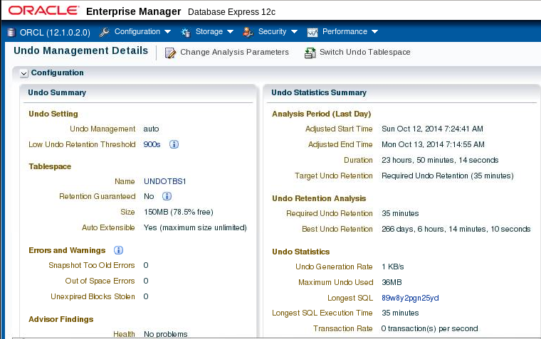
Viewing Undo Information
Notes:
Oracle Database 12c: Administration Workshop 9 - <number>
You can view undo information on the Undo Management Details page in Enterprise Manager Database Express.
您可以在“企业管理器数据库快速”中的撤消管理详细信息页面上查看撤消信息。

Slide 18
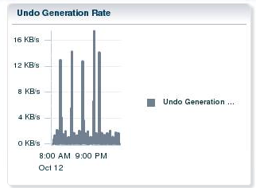
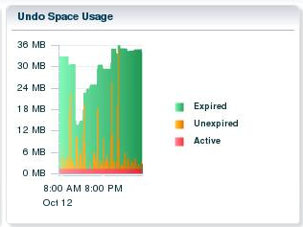
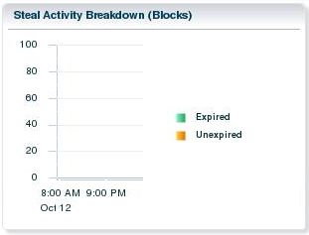
Viewing Undo Activity
Notes:
Oracle Database 12c: Administration Workshop 9 - <number>
At the bottom of the Undo Management Details page, you can view additional statistical information:
Undo Generation Rate: Displays the undo generation (in KB per second)
Undo Space Usage: Shows the use of space in the tablespace
Steal Activity Breakdown: Shows the number of attempts to steal expired undo blocks from other undo segments and attempts to obtain undo space by stealing unexpired extents from other transactions
在“撤消管理详细信息”页面的底部，您可以查看其他统计信息：
撤消生成率：显示撤消生成（以KB为单位）
撤消空间使用：显示表空间中的空间的使用
窃取活动细分：显示从其他撤销段窃取过期的撤消块的尝试次数，并尝试通过从其他事务中窃取未过期的扩展数据块来获取撤销空间

Slide 19
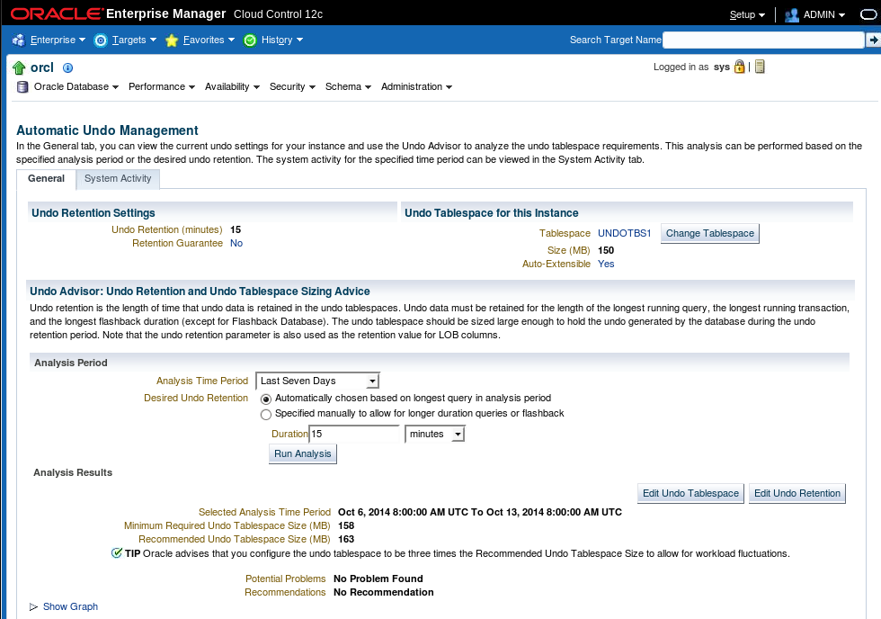
Using the Undo Advisor
Notes:
Oracle Database 12c: Administration Workshop 9 - <number>
You can access the Undo Advisor in Enterprise Manager Cloud Control by clicking Performance > Advisors Home > Automatic Undo Management after selecting the database.
The middle part of the General tab contains the Undo Advisor analysis. It provides an estimate of the undo tablespace size required to satisfy a given undo retention.
Click Show Graph to see a graphical representation of the required tablespace size. You can click a point on the graph to see the tablespace size required to support the selected period.
To change the undo tablespace to a fixed size, click Edit Undo Tablespace, and then click Edit in the Datafile section.
您可以在选择数据库后单击“性能”>“顾问主页”>“自动撤销管理”，访问企业管理器云控制中的撤消顾问。
“常规”选项卡的中间部分包含“撤消顾问”分析。 它提供了满足给定撤消保留所需的撤消表空间大小的估计。
单击“显示图”以查看所需表空间大小的图形表示。 您可以单击图形上的一个点，以查看支持所选时段所需的表空间大小。
要将undo表空间更改为固定大小，请单击“编辑撤销表空间”，然后单击“数据文件”部分中的“编辑”。

Slide 20
Quiz
All you need to do to guarantee that all queries under 15 minutes will find the undo data needed for read consistency, is set the UNDO_RETENTION parameter to 15 minutes.
  True
  False
Notes:
Oracle Database 12c: Administration Workshop 9 - <number>
Answer: b

Slide 21
Summary
In this lesson, you should have learned how to:
  Explain DML and undo data generation
  Monitor and administer undo data
  Describe the difference between undo data and redo data
  Configure undo retention
  Guarantee undo retention
  Enable temporary undo
  Use the Undo Advisor
Notes:
Oracle Database 12c: Administration Workshop 9 - <number>

Slide 22
Practice: Overview
This practice covers the following topics:
  Viewing system activity
  Calculating undo tablespace sizing to support a 48-hour retention interval
  Modifying an undo tablespace to support a 48-hour retention interval
Notes:
Oracle Database 12c: Administration Workshop 9 - <number>

