Slide 1
Displaying Data from Multiple Tables Using Joins

Slide 2
Course Roadmap
Lesson 1: Introduction
Lesson 6: Reporting Aggregated Data Using Group Functions
Unit 1: Retrieving, Restricting, and Sorting Data
Lesson 7: Displaying Data from Multiple Tables Using Joins
Unit 2: Joins, Subqueries, and Set Operators
Lesson 8: Using Subqueries to Solve Queries
You are here!
Unit 3: DML and DDL
Lesson 9: Using Set Operators
Notes:
In Unit 2, you will learn to use:
SQL statements to query and display data from multiple tables using Joins
Subqueries when the condition is unknown
Group functions to aggregate data
Set operators

Slide 3

Objectives
After completing this lesson, you should be able to do the following:
Write SELECT statements to access data from more than one table by using equijoins and nonequijoins
Join a table to itself by using a self-join
View data that generally does not meet a join condition by using OUTER joins
Generate a Cartesian product of all rows from two or more tables
Notes:
In this lesson, you learn how to obtain data from more than one table. A join is used to view information from multiple tables. Therefore, you can join tables together to view information from more than one table.
Note: For information about joins, refer to the “SQL Queries and Subqueries: Joins” section in Oracle Database SQL Language Reference for 12c database.
完成本课后，您应该能够执行以下操作：
编写SELECT语句以通过使用equijoins和nonequijoins从多个表访问数据
通过使用自连接来加入表
通过使用OUTER连接查看通常不符合连接条件的数据
从两个或多个表生成所有行的笛卡尔乘积

Slide 4

Lesson Agenda
Types of JOINS and their syntax
Natural join
Join with the USING clause
Join with the ON clause
Self-join
Nonequijoins
OUTER join:
LEFT OUTER JOIN
RIGHT OUTER JOIN
FULL OUTER JOIN
Cartesian product
Cross join

Slide 5



Why Join?
HR Application
Select the desired columns:
EMPLOYEE
>
>>
first_name employee_id
last_name job_id
…
I want the information of all employees and their jobs. But they are stored in different tables. How to I combine them into a single report?
JOBS
>
>>
min_salary job_id
max_salary job_title
…
GO
Combines columns from both the tables
HR Application
Emp_ID | Job_id | Job_title
206 | AC_ACCOUNTANT | Public Accountant
103 | AC_MGR | Accounting Manager
100 | AD_PRES | President
Jody
…
Notes:
Jody, an HR Manager located in Mexico, wants a report of all employees working in the organization, their respective job IDs, and job titles. You cannot get this report by querying a single table because the employee information is in one table and the job information in another table.
What is the solution for Jody’s query?
You will need to write a SQL statement to fetch the required information from two different tables. This SQL statement will fetch the employee IDs from the EMPLOYEE table and Job Title from the JOBS table by using JOB ID as the common column. The result of the SQL Query is a single report consisting of the following columns: Employee ID, Job ID, and Job title.
The following slides explain in detail about Joins and how to use them.
位于墨西哥的人力资源经理Jody想要在组织中工作的所有员工的报告，他们各自的工作ID和职位。 由于员工信息位于一个表中，而是另一个表中的作业信息，因此无法通过查询单个表来获取此报告。
Jody的查询是什么解决方案？
您将需要编写SQL语句以从两个不同的表中获取所需的信息。 此SQL语句将通过使用JOB ID作为公共列从JOBS表中的EMPLOYEE表和作业标题中获取员工ID。 SQL查询的结果是由以下列组成的单个报告：员工ID，作业ID和作业标题。
以下幻灯片详细介绍了连接及其使用方法。

Slide 6
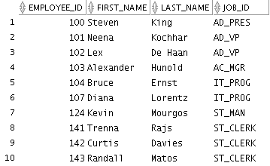
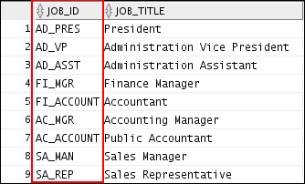
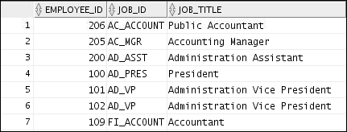
Obtaining Data from Multiple Tables
EMPLOYEES
JOBS
…
…
…
Notes:
Sometimes you need to use data from more than one table. In the example in the slide, the report displays data from two separate tables:
Employee IDs exist in the EMPLOYEES table.
Job IDs exist in both the EMPLOYEES and JOBS tables.
Job titles exist in the JOBS table.
To produce the report, you need to link the EMPLOYEES and JOBS tables, and access data from both of them.
有时您需要使用来自多个表的数据。 在幻灯片中的示例中，报告显示来自两个单独表格的数据：
雇员ID存在于雇员表中。
作业ID都存在于EMPLOYEES和JOBS表中。
职位名称存在于JOBS表中。
要生成报告，您需要链接EMPLOYEES和JOBS表，并访问其中的数据。

Slide 7



Types of Joins
Joins that are compliant with the SQL:1999 standard include the following:
Natural join with the NATURAL JOIN clause
Join with the USING clause
Join with the ON clause
OUTER joins:
LEFT OUTER JOIN
RIGHT OUTER JOIN
FULL OUTER JOIN
Cross joins
Notes:
A join is a query that combines rows from two or more tables or views. To join tables, you can use a join syntax that is compliant with the SQL:1999 standard.
Note: Before the Oracle9i release, the Oracle join syntax was different from the American National Standards Institute (ANSI) standards. The SQL:1999–compliant join syntax does not offer any performance benefits over the Oracle-proprietary join syntax that existed in the earlier releases.
The following slide discusses the SQL:1999 join syntax.
连接是一个组合来自两个或多个表或视图的行的查询。 要连接表，可以使用符合SQL：1999标准的连接语法。
注意：在Oracle9i发行之前，Oracle联接语法与美国国家标准协会（ANSI）标准不同。 与早期版本中存在的Oracle专有连接语法相比，SQL：1999兼容连接语法不具有任何性能优势。
以下幻灯片讨论SQL：1999连接语法。

Slide 8
Joining Tables Using SQL:1999 Syntax
Use a join to query data from more than one table:
SELECT table1.column, table2.column
FROM table1
[NATURAL JOIN table2] |
[JOIN table2 USING (column_name)] |
[JOIN table2 ON (table1.column_name = table2.column_name)]|
[LEFT|RIGHT|FULL OUTER JOIN table2
ON (table1.column_name = table2.column_name)]|
[CROSS JOIN table2];
Notes:
In the syntax:
table1.column denotes the table and the column from which data is retrieved
NATURAL JOIN joins two tables based on the same column name
JOIN table2 USING column_name performs an equijoin based on the column name
JOIN table2 ON table1.column_name = table2.column_name performs an equijoin based on the condition in the ON clause
LEFT/RIGHT/FULL OUTER is used to perform OUTER joins
CROSS JOIN returns a Cartesian product from the two tables
For more information, see the section titled “SELECT” in Oracle Database SQL Language Reference for 12c database.

Slide 9
Lesson Agenda
Types of JOINS and their syntax
Natural join
Join with the USING clause
Join with the ON clause
Self-join
Nonequijoins
OUTER join:
LEFT OUTER JOIN
RIGHT OUTER JOIN
FULL OUTER JOIN
Cartesian product
Cross join

Slide 10


Creating Natural Joins
The NATURAL JOIN clause is based on all the columns that have the same name in two tables.
It selects rows from the two tables that have equal values in all matched columns.
If the columns having the same names have different data types, an error is returned.
SELECT * FROM table1 NATURAL JOIN table2;
Notes:
You can join tables automatically based on the columns in the two tables that have matching data types and names. You do this by using the NATURAL JOIN clause.
Note: The join can happen on only those columns that have the same names and data types in both tables. If the columns have the same name but different data types, the NATURAL JOIN clause causes an error.

Slide 11
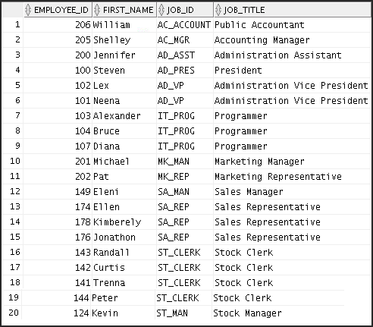
Retrieving Records with Natural Joins
SELECT employee_id, first_name, job_id, job_title
from employees NATURAL JOIN jobs;
Notes:
In the example in the slide, observe that the JOBS table is joined to the EMPLOYEES table by the JOB_ID column, which is the only column of the same name in both tables. If other common columns were present, the join would have used them all.
Natural Joins with a WHERE Clause
Additional restrictions on a natural join are implemented by using a WHERE clause. The following example limits the rows of output to those with a DEPARTMENT_ID equal to 20 or 50:
SELECT department_id, department_name,
location_id, city
FROM departments
NATURAL JOIN locations
WHERE department_id IN (20, 50);

Slide 12

Creating Joins with the USING Clause
When should you use the USING clause?
If several columns have the same names but the data types do not match, use the USING clause to specify the columns for the equijoin.
Use the USING clause to match only one column when more than one column matches.
Notes:
Natural joins use all columns with matching names and data types to join the tables. You can use the USING clause to specify only those columns that should be used for an equijoin.
An equijoin is a join containing an equality operator. A natural join is a type of equijoin.

Slide 13
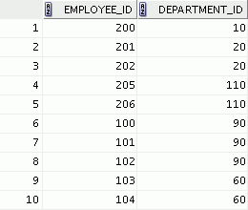
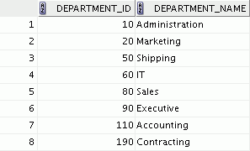
Joining Column Names
EMPLOYEES
DEPARTMENTS
…
Foreign key
Primary key
Notes:
To determine an employee’s department name, you compare the value in the DEPARTMENT_ID column in the EMPLOYEES table with the DEPARTMENT_ID values in the DEPARTMENTS table.
The relationship between the EMPLOYEES and DEPARTMENTS tables is an equijoin; that is, values in the DEPARTMENT_ID column in both the tables must be equal. Frequently, this type of join involves primary and foreign key complements.

Slide 14
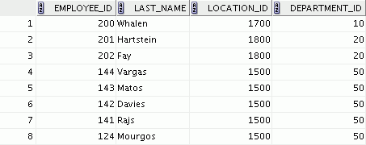

Retrieving Records with the USING Clause
SELECT employee_id, last_name,
location_id, department_id
FROM employees JOIN departments
USING (department_id) ;
…
Notes:
In the example in the slide, the DEPARTMENT_ID columns in the EMPLOYEES and DEPARTMENTS tables are joined and thus the LOCATION_ID of the department where an employee works is shown.
Note that the EMPLOYEE_ID and LAST_NAME columns belong to the EMPLOYEE table, whereas LOCATION_ID belongs to the DEPARTMENTS table and the DEPARTMENT_ID column belongs to both these tables.

Slide 15



Qualifying Ambiguous Column Names
Use table prefixes to:
Qualify column names that are in multiple tables
Increase the speed of parsing of a statement
Instead of full table name prefixes, use table aliases.
Table alias gives a table a shorter name:
Keeps SQL code smaller, uses less memory
Use column aliases to distinguish columns that have identical names, but reside in different tables.
Notes:
When joining two or more tables, you need to qualify the names of the columns with the table name to avoid ambiguity. Without table prefixes, the DEPARTMENT_ID column in the SELECT list could be from either the DEPARTMENTS table or the EMPLOYEES table. It is necessary to add the table prefix to execute your query. If there are no common column names between the two tables, there is no need to qualify the columns. Basically, using the table prefix increases the speed of parsing of the statement, because you tell the Oracle server exactly where to find the columns.
However, qualifying column names with table names can be time consuming, particularly if the table names are lengthy. Instead, you can use table aliases. Just as a column alias gives a column another name, a table alias gives a table another name. Table aliases help to keep SQL code smaller; therefore, use less memory.
The table name is specified in full, followed by a space, and then the table alias. For example, the EMPLOYEES table can be given an alias of e, and the DEPARTMENTS table an alias of d.
Guidelines
Table aliases can be up to 30 characters in length, but shorter aliases are better than longer ones.
If a table alias is used for a particular table name in the FROM clause, that table alias must be substituted for the table name throughout the SELECT statement.
Table aliases should be meaningful.
The table alias is valid for only the current SELECT statement.
加入两个或多个表时，您需要使用表名限定列的名称，以避免歧义。没有表前缀，SELECT列表中的DEPARTMENT_ID列可能来自DEPARTMENTS表或EMPLOYEES表。有必要添加表前缀来执行查询。如果两个表之间没有共同的列名称，则无需对列进行限定。基本上，使用表前缀可以增加解析语句的速度，因为您将Oracle服务器确切地指向哪里查找列。
但是，使用表名称限定列名称可能很耗时，特别是如果表名冗长。相反，您可以使用表别名。正如列别名给列另一个名称一样，表别名给一个表另一个名字。表别名有助于保持SQL代码更小;因此，使用较少的内存。
表名称已全部指定，后跟一个空格，然后是表的别名。例如，EMPLOYEES表可以给出别名e，DEPARTMENTS表的别名为d。
方针
表别名长度最多可达30个字符，但较短的别名优于较长的字符。
如果FROM子句中的特定表名使用了表别名，则该表别名必须在整个SELECT语句中替代表名。
表别名应该是有意义的。
表别名仅对当前的SELECT语句有效。

Slide 16

Using Table Aliases with the USING Clause
Do not qualify a column that is used in the NATURAL join or a join with a USING clause.
If the same column is used elsewhere in the SQL statement, do not alias it.
SELECT l.city, d.department_name
FROM locations l JOIN departments d
USING (location_id)
WHERE d.location_id = 1400;
Notes:
When joining with the USING clause, you cannot qualify a column that is used in the USING clause itself. Furthermore, if that column is used anywhere in the SQL statement, you cannot alias it. For example, in the query mentioned in the slide, you should not alias the location_id column in the WHERE clause because the column is used in the USING clause.
The columns that are referenced in the USING clause should not have a qualifier (table name or alias) anywhere in the SQL statement. For example, the following statement is valid:
当使用USING子句加入时，您不能限定USING子句本身使用的列。 此外，如果该列用于SQL语句中的任何位置，则不能将其替换为别名。 例如，在幻灯片中提到的查询中，您不应该将WHERE子句中的location_id列别名，因为在USING子句中使用该列。
USING子句中引用的列不应在SQL语句中的任何位置都具有限定符（表名或别名）。 例如，以下语句有效：
SELECT l.city, d.department_name
FROM locations l JOIN departments d USING (location_id)
WHERE location_id = 1400;
The columns that are common in both the tables, but not used in the USING clause, must be prefixed with a table alias; otherwise, you get the “column ambiguously defined” error.
In the following statement, manager_id is present in both the employees and departments table; if manager_id is not prefixed with a table alias, it gives a “column ambiguously defined” error.
The following statement is valid:
在两个表中通用但在USING子句中未使用的列必须以表别名为前缀; 否则，您会得到“列模糊定义”错误。
在以下语句中，manager_id存在于员工和部门表中; 如果manager_id没有以表别名为前缀，则会给出“列明确定义”错误。
以下声明有效：
SELECT first_name, d.department_name, d.manager_id
FROM employees e JOIN departments d USING (department_id)
WHERE department_id = 50;

Slide 17


Creating Joins with the ON Clause
The join condition for the natural join is basically an equijoin of all columns with the same name.
Use the ON clause to specify arbitrary conditions or specify the columns to join.
Use the ON clause to separate the join condition from other search conditions.
The ON clause makes code easy to understand.
Notes:
Use the ON clause to specify a join condition. With this, you can specify join conditions separate from any search or filter conditions in the WHERE clause.
自然连接的连接条件基本上是具有相同名称的所有列的等价物。
使用ON子句指定任意条件或指定要加入的列。
使用ON子句将连接条件与其他搜索条件分开。
ON子句使代码易于理解。

Slide 18
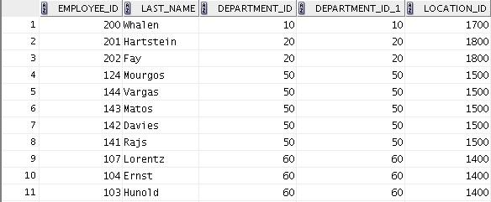
Retrieving Records with the ON Clause
SELECT e.employee_id, e.last_name, e.department_id,
d.department_id, d.location_id
FROM employees e JOIN departments d
ON (e.department_id = d.department_id);
…
Notes:
In this example, the DEPARTMENT_ID columns in the EMPLOYEES and DEPARTMENTS table are joined using the ON clause. Wherever a department ID in the EMPLOYEES table equals a department ID in the DEPARTMENTS table, the row is returned. The table alias is necessary to qualify the matching column_names.
You can also use the ON clause to join columns that have different names. The parentheses around the joined columns, as in the example in the slide, (e.department_id = d.department_id) is optional. So, even ON e.department_id = d.department_id will work.
Note: When you use the Execute Statement icon to run the query, SQL Developer suffixes a ‘_1’ to differentiate between the two department_ids.
在此示例中，EMPLOYEES和DEPARTMENTS表中的DEPARTMENT_ID列使用ON子句连接。 EMPLOYEES表中的部门ID等于DEPARTMENTS表中的部门ID，则返回该行。 表格别名是必需的，以符合匹配的column_names。
您也可以使用ON子句来连接具有不同名称的列。 连接列周围的括号，如幻灯片中的示例（e.department_id = d.department_id）是可选的。 所以，即使打开e.department_id = d.department_id也可以工作。
注意：使用Execute Statement图标运行查询时，SQL Developer会后缀“_1”以区分两个department_ids。

Slide 19
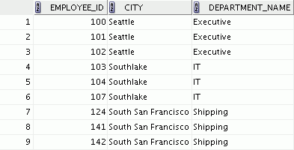

Creating Three-Way Joins
SELECT employee_id, city, department_name
FROM employees e
JOIN departments d
ON d.department_id = e.department_id
JOIN locations l
ON d.location_id = l.location_id;
…
Notes:
A three-way join is a join of three tables. Here, the first join to be performed is EMPLOYEES JOIN DEPARTMENTS. The first join condition can reference columns in EMPLOYEES and DEPARTMENTS but cannot reference columns in LOCATIONS. The second join condition can reference columns from all three tables.
Note: The code example in the slide can also be accomplished with the USING clause:
SELECT e.employee_id, l.city, d.department_name
FROM employees e
JOIN departments d
USING (department_id)
JOIN locations l
USING (location_id);
三方连接是三个表的连接。 在这里，第一次加入将是员工加盟部门。 第一个连接条件可以引用EMPLOYEES和DEPARTMENTS中的列，但不能引用LOCATIONS中的列。 第二个连接条件可以引用所有三个表的列。
注意：幻灯片中的代码示例也可以使用USING子句完成：

Slide 20
Applying Additional Conditions to a Join
Use the AND clause or the WHERE clause to apply additional conditions:
SELECT e.employee_id, e.last_name, e.department_id,
d.department_id, d.location_id
FROM employees e JOIN departments d
ON (e.department_id = d.department_id)
AND e.manager_id = 149 ;
OR
SELECT e.employee_id, e.last_name, e.department_id,
d.department_id, d.location_id
FROM employees e JOIN departments d
ON (e.department_id = d.department_id)
WHERE e.manager_id = 149 ;
Notes:
You can apply additional conditions to the join.
The example shown performs a join on the EMPLOYEES and DEPARTMENTS tables and, in addition, displays only employees who have a manager ID of 149. To add additional conditions to the ON clause, you can add AND clauses. Alternatively, you can use a WHERE clause to apply additional conditions.
Both the queries produce the same output.
您可以为连接应用其他条件。
显示的示例在EMPLOYEES和DEPARTMENTS表上执行连接，此外，仅显示管理员标识为149的员工。要向ON子句添加其他条件，可以添加AND子句。 或者，您可以使用WHERE子句来应用其他条件。
这两个查询产生相同的输出。

Slide 21
Lesson Agenda
Types of JOINS and their syntax
Natural join
Join with the USING clause
Join with the ON clause
Self-join
Nonequijoins
OUTER join:
LEFT OUTER JOIN
RIGHT OUTER JOIN
FULL OUTER JOIN
Cartesian product
Cross join

Slide 22
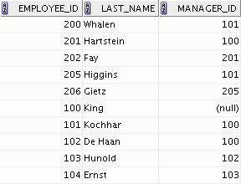
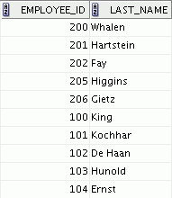
Joining a Table to Itself
EMPLOYEES (WORKER)
EMPLOYEES (MANAGER)
…
…
MANAGER_ID in the WORKER table is equal to EMPLOYEE_ID in the MANAGER table.
Notes:
Sometimes you need to join a table to itself. To find the name of each employee’s manager, you need to join the EMPLOYEES table to itself, or perform a self-join. For example, to find the name of Ernst’s manager, you need to:
Find Ernst in the EMPLOYEES table by looking at the LAST_NAME column
Find the manager number for Ernst by looking at the MANAGER_ID column. Ernst’s manager number is 103.
Find the name of the manager with EMPLOYEE_ID 103 by looking at the LAST_NAME column. Hunold’s employee number is 103, so Hunold is Ernst’s manager.
In this process, you look in the table twice. The first time you look in the table to find Ernst in the LAST_NAME column and the MANAGER_ID value of 103. The second time you look in the EMPLOYEE_ID column to find 103 and the LAST_NAME column to find Hunold.
有时候你需要加入一张桌子给自己。 要查找每个员工经理的名字，您需要将EMPLOYEES表加入自己，或执行自我加入。 例如，要找到Ernst经理的名字，您需要：
通过查看LAST_NAME列，在EMPLOYEES表中查找Ernst
通过查看MANAGER_ID列查找Ernst的经理号码。 安永的经理人数为103人。
查看LAST_NAME列，找出具有EMPLOYEE_ID 103的管理员名称。 Hunold的员工人数为103人，所以Hunold是Ernst的经理。
在这个过程中，你看两次表。 您第一次在表中查找“LAST_NAME”列中的Ernst，而MANAGER_ID值为103.第二次查看EMPLOYEE_ID列以查找103和“LAST_NAME”列以查找Hunold。

Slide 23
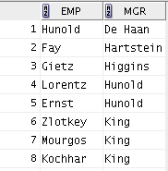
Self-Joins Using the ON Clause
SELECT worker.last_name emp, manager.last_name mgr
FROM employees worker JOIN employees manager
ON (worker.manager_id = manager.employee_id);
…
Notes:
The ON clause can also be used to join columns that have different names, within the same table or in a different table.
The example shown is a self-join of the EMPLOYEES table, based on the EMPLOYEE_ID and MANAGER_ID columns.
ON子句也可用于连接具有不同名称的列，在同一个表或不同的表中。
显示的示例是EMPLOYEES表的自连接，基于EMPLOYEE_ID和MANAGER_ID列。

Slide 24
Lesson Agenda
Types of JOINS and their syntax
Natural join
Join with the USING clause
Join with the ON clause
Self-join
Nonequijoins
OUTER join:
LEFT OUTER JOIN
RIGHT OUTER JOIN
FULL OUTER JOIN
Cartesian product
Cross join

Slide 25
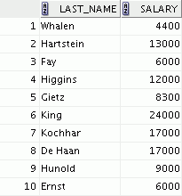
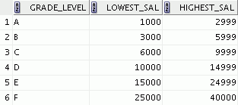

Nonequijoins
EMPLOYEES
JOB_GRADES
The JOB_GRADES table defines the LOWEST_SAL and HIGHEST_SAL range of values for each GRADE_LEVEL.
…
Therefore, the GRADE_LEVEL column can be used to assign grades to each employee based on his salary.
Notes:
A nonequijoin is a join condition containing something other than an equality operator.
The relationship between the EMPLOYEES table and the JOB_GRADES table is an example of a nonequijoin. The SALARY column in the EMPLOYEES table ranges between the values in the LOWEST_SAL and HIGHEST_SAL columns of the JOB_GRADES table. Therefore, each employee can be graded based on their salary. The relationship is obtained using an operator other than the equality (=) operator.
非奇偶校验是包含除等于运算符以外的其他条件的连接条件。
EMPLOYEES表和JOB_GRADES表之间的关系是一个非奇异的例子。 EMPLOYEES表中的SALARY列范围在JOB_GRADES表的LOWEST_SAL和HIGHEST_SAL列之间。 因此，每个员工都可以根据自己的薪水进行评分。 使用除等于（=）运算符之外的运算符获得关系。

Slide 26
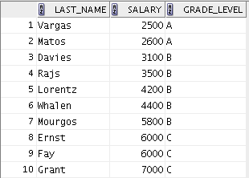
Retrieving Records with Nonequijoins
SELECT e.last_name, e.salary, j.grade_level
FROM employees e JOIN job_grades j
ON e.salary
BETWEEN j.lowest_sal AND j.highest_sal;
…
Notes:
The example in the slide creates a nonequijoin to evaluate an employee’s salary grade. The salary must be between any pair of the low and high salary ranges.
It is important to note that all employees appear exactly once when this query is executed. No employee is repeated in the list. There are two reasons for this:
None of the rows in the JOB_GRADES table contain grades that overlap. That is, the salary value for an employee can lie only between the low-salary and high-salary values of one of the rows in the salary grade table.
All of the employees’ salaries lie within the limits provided by the JOB_GRADES table. That is, no employee earns less than the lowest value contained in the LOWEST_SAL column or more than the highest value contained in the HIGHEST_SAL column.
Note: Other conditions (such as <= and >=) can be used, but BETWEEN is the simplest. Remember to specify the low value first and the high value last when using the BETWEEN condition. The Oracle server translates the BETWEEN condition to a pair of AND conditions. Therefore, using BETWEEN has no performance benefits, but should be used only for logical simplicity.
Table aliases have been specified in the example in the slide for performance reasons, not because of possible ambiguity.
幻灯片中的示例创建了一个评估员工薪水等级的无疑。工资必须在任何一对低薪和高薪之间。
重要的是要注意，执行此查询时，所有员工都会出现一次。名单中没有重复雇员。有两个原因：
JOB_GRADES表中的任何行都不包含重叠的等级。也就是说，员工的薪酬价值只能在薪资等级表的其中一行的低工资和高薪之间。
所有员工的工资都在JOB_GRADES表提供的限度之内。也就是说，没有员工的收入低于LOWEST_SAL列中包含的最低值或超过HIGHEST_SAL列中包含的最高值。
注意：可以使用其他条件（如<=和> =），但BETWEEN是最简单的。记住在使用BETWEEN条件时，首先指定最小值和最高值。 Oracle服务器将BETWEEN条件转换为一对AND条件。因此，使用BETWEEN没有性能优势，但应仅用于逻辑简单。
由于性能原因，表格别名已在幻灯片中的示例中指定，而不是因为可能的歧义。

Slide 27
Lesson Agenda
Types of JOINS and their syntax
Natural join
Join with the USING clause
Join with the ON clause
Self-join
Nonequijoins
OUTER join:
LEFT OUTER JOIN
RIGHT OUTER JOIN
FULL OUTER JOIN
Cartesian product
Cross join

Slide 28
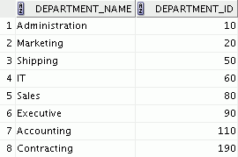
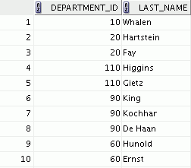

Returning Records with No Direct Match Using OUTER Joins
DEPARTMENTS
Equijoin with EMPLOYEES
There are no employees in department 190.
Employee “Grant” has not been assigned a department ID.
…
Therefore, the above two records do not appear in the equijoin result.
Notes:
If a row does not satisfy a join condition, the row does not appear in the query result.
In the example in the slide, a simple equijoin condition is used on the EMPLOYEES and DEPARTMENTS tables to return the result on the right. The result set does not contain the following:
Department ID 190, because there are no employees with that department ID recorded in the EMPLOYEES table
The employee with the last name of Grant, because this employee has not been assigned a department ID
To return the department record that does not have any employees, or employees that do not have an assigned department, you can use an OUTER join.
如果一行不满足连接条件，则该行不会显示在查询结果中。
在幻灯片中的示例中，EMPLOYEES和DEPARTMENTS表上使用一个简单的等价条件来返回右侧的结果。 结果集不包含以下内容：
部门ID 190，因为在雇员表中没有记录该部门ID的员工
该名雇员姓名为Grant，因为该员工未被分配部门ID
要返回没有任何员工的部门记录，或没有分配部门的员工，可以使用OUTER加入。

Slide 29


INNER Versus OUTER Joins
In SQL:1999, the join of two tables returning only matched rows is called an INNER join.
A join between two tables that returns the results of the INNER join as well as the unmatched rows from the left (or right) table is called a LEFT (or RIGHT) OUTER join.
A join between two tables that returns the results of an INNER join as well as the results of a left and right join is a FULL OUTER JOIN.
A
B
AB
(Matched & Unmatched rows)
Notes:
Joining tables with the NATURAL JOIN, USING, or ON clause results in an INNER join. Any unmatched rows are not displayed in the output. To return the unmatched rows, you can use an OUTER join. An OUTER join returns all rows that satisfy the join condition and also returns some or all of those rows from one table for which no rows from the other table satisfy the join condition.
There are three types of OUTER joins:
LEFT OUTER
RIGHT OUTER
FULL OUTER
使用NATURAL JOIN，USING或ON子句连接表会导致INNER加入。 输出中不显示任何不匹配的行。 要返回不匹配的行，可以使用OUTER连接。 OUTER连接返回满足连接条件的所有行，并从一个表中返回部分或全部这些行，而另一个表中的任何行都不满足连接条件。

Slide 30
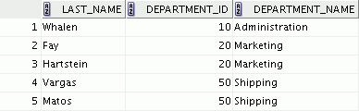
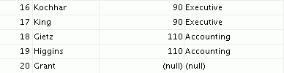
LEFT OUTER JOIN
SELECT e.last_name, e.department_id, d.department_name
FROM employees e LEFT OUTER JOIN departments d
ON (e.department_id = d.department_id) ;
…
Notes:
This query retrieves all the rows in the EMPLOYEES table, which is the left table, even if there is no match in the DEPARTMENTS table.
Basically, a LEFT OUTER JOIN will return all the rows that matches between the two tables on the given condition and also returns the unmatched rows of the left table, that is, the table mentioned first in the SQL statement.
此查询检索EMPLOYEES表中的所有行，即左表，即使DEPARTMENTS表中没有匹配。
基本上，LEFT OUTER JOIN将返回给定条件下两个表之间匹配的所有行，并返回左表的不匹配行，即SQL语句中首先提到的表。

Slide 31
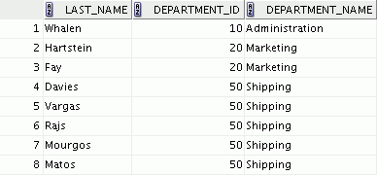

RIGHT OUTER JOIN
SELECT e.last_name, d.department_id, d.department_name
FROM employees e RIGHT OUTER JOIN departments d
ON (e.department_id = d.department_id) ;
…
Notes:
This query retrieves all the rows in the DEPARTMENTS table, which is the table at the right, even if there is no match in the EMPLOYEES table.
Basically, a RIGHT OUTER JOIN will return all the rows that matches between the two tables on the given condition and also returns the unmatched rows of the right table, that is, the table mentioned second in the SQL statement.
即使在EMPLOYEES表中没有匹配，此查询将检索DEPARTMENTS表中的所有行，即表右侧。
基本上，RIGHT OUTER JOIN将返回给定条件下两个表之间匹配的所有行，并返回正确表的不匹配行，即SQL语句中第二个表。

Slide 32
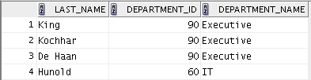
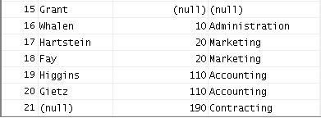
FULL OUTER JOIN
SELECT e.last_name, d.department_id, d.department_name
FROM employees e FULL OUTER JOIN departments d
ON (e.department_id = d.department_id) ;
…
Notes:
This query retrieves all rows in the EMPLOYEES table, even if there is no match in the DEPARTMENTS table. It also retrieves all rows in the DEPARTMENTS table, even if there is no match in the EMPLOYEES table.
Basically, a FULL OUTER JOIN will return all the rows that match between the two tables on the given condition and also returns the unmatched rows of both the tables.

Slide 33
Lesson Agenda
Types of JOINS and their syntax
Natural join
Join with the USING clause
Join with the ON clause
Self-join
Nonequijoins
OUTER join:
LEFT OUTER JOIN
RIGHT OUTER JOIN
FULL OUTER JOIN
Cartesian product
Cross join

Slide 34



Cartesian Products
A Cartesian product:
Is a join of every row of one table to every row of another table
Generates a large number of rows and the result is rarely useful
Notes:
A Cartesian product tends to generate a large number of rows and the result is rarely useful. You should, therefore, always include a valid join condition unless you have a specific need to combine all rows from all tables.
Cartesian products are useful for some tests when you need to generate a large number of rows to simulate a reasonable amount of data.

Slide 35
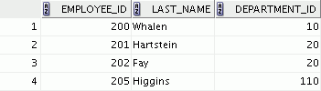
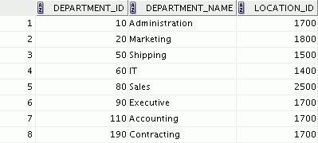




Generating a Cartesian Product
EMPLOYEES (20 rows)
DEPARTMENTS (8 rows)
…
Cartesian product: 20 x 8 = 160 rows
…
…
Notes:
A Cartesian product is generated if a join condition is omitted. The example in the slide displays the employee ID, department ID, and location ID from the EMPLOYEES and DEPARTMENTS tables. Because no join condition was specified, all rows (20 rows) from the EMPLOYEES table are joined with all rows (8 rows) in the DEPARTMENTS table, thereby generating 160 rows in the output.

Slide 36
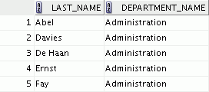

Creating Cross Joins
A CROSS JOIN is a JOIN operation that produces a Cartesian product of two tables.
To create a Cartesian product, specify CROSS JOIN in your SELECT statement.
SELECT last_name, department_name
FROM employees
CROSS JOIN departments ;
…
Notes:
The example in the slide produces a Cartesian product of EMPLOYEES and DEPARTMENTS tables.
It is a good practice to explicitly state CROSS JOIN in your SELECT statement when you intend to create a Cartesian product. Therefore, it is very clear that you intend for this to happen and it is not the result of missing joins.
CROSS JOIN是一个JOIN操作，可以生成两个表的笛卡尔乘积。
要创建笛卡儿乘积，请在SELECT语句中指定CROSS JOIN。

Slide 37

Quiz
If you join a table to itself, what kind of join are you using?
Nonequijoin
Left OUTER join
Right OUTER join
Full OUTER join
Self-join
Natural join
Cartesian products
Notes:
Answer: e

Slide 38

Summary
In this lesson, you should have learned how to :
Write SELECT statements to access data from more than one table using equijoins and nonequijoins
Join a table to itself by using a self-join
View data that generally does not meet a join condition by using OUTER joins
Generate a Cartesian product of all rows from two tables
Notes:
There are multiple ways to join tables.
Types of Joins
Equijoins
Nonequijoins
OUTER joins
Self-joins
Cross joins
Natural joins
Full (or two-sided) OUTER joins
Cartesian Products
A Cartesian product results in the display of all combinations of rows. This is done by either omitting the WHERE clause or specifying the CROSS JOIN clause.
Table Aliases
Table aliases speed up database access.
They can help to keep SQL code smaller by conserving memory.
They are sometimes mandatory to avoid column ambiguity.

Slide 39

Practice 7: Overview
This practice covers the following topics:
Joining tables using an equijoin
Performing outer and self-joins
Adding conditions
Notes:
This practice is intended to give you experience in extracting data from more than one table using the SQL:1999–compliant joins.

