Slide 1
Oracle Cloud Overview

Slide 2

Lesson Objectives
After completing this lesson, you should be able to do the following:
Describe the salient features of Oracle Cloud
Discuss the features of Oracle Database Exadata Express Cloud Service
Notes:
完成本课后，您应该能够执行以下操作：
描述Oracle Cloud的突出特点
讨论Oracle数据库Exadata Express云服务的功能

Slide 3

Lesson Agenda
Overview of Oracle Cloud
Working with Oracle Database Exadata Express Cloud Service

Slide 4

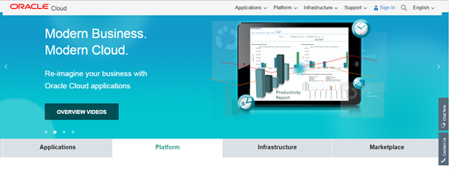
Introduction to Oracle Cloud
Any business can now use the enterprise cloud provided by Oracle.
You can access the Oracle Cloud from cloud.oracle.com.
Measured service
Rapid elasticity
Resource pooling
On-demand
self-service
Broad network
access
Notes:
The Oracle Cloud is an enterprise cloud for business. Oracle Cloud services are built on Oracle Exalogic Elastic Cloud and Oracle Exadata Database Machine, together offering a platform that delivers extreme performance and scalability.
The top two benefits of cloud computing are speed and cost.
As a result, the applications and databases deployed in the Oracle Cloud are portable and you can easily move them to or from a private cloud or on-premise environment.
You can request and get the cloud services provisioned through a self-service interface.
You can either use an integrated development and deployment platform to rapidly extend and create new services.
Using Oracle Cloud services, you can benefit from the following five essential characteristics:
On-demand self-service: You can provision, monitor, and manage cloud on your own.
Resource pooling: You can share resources and maintain a level of abstraction between consumers and services.
Rapid elasticity: You can quickly scale up or down as needed.
Measured service: You pay for what you use with either internal chargeback (private cloud) or external billing (public cloud).
Broad network access: You can access the cloud services through a browser on any networked device.
Oracle Cloud是企业云业务。 Oracle Cloud服务基于Oracle Exalogic弹性云和Oracle Exadata数据库云服务器，共同提供了提供极高性能和可伸缩性的平台。
云计算的最大好处是速度和成本。
因此，部署在Oracle Cloud中的应用程序和数据库是可移植的，您可以轻松将其移动到私有云或内部部署环境中。
您可以通过自助服务界面请求并获取云服务。
您可以使用集成的开发和部署平台来快速扩展和创建新的服务。
使用Oracle云服务，您可以从以下五个基本特征中受益：
按需自助服务：您可以自行提供，监控和管理云端。
资源池：您可以共享资源并维持消费者和服务之间的抽象层次。
弹性快：您可以根据需要快速放大或缩小。
测量服务：您可以使用内部退款（私有云）或外部计费（公共云）来支付所需费用。
广泛的网络访问：您可以通过任何联网设备上的浏览器访问云服务

Slide 5

Oracle Cloud Services
Oracle Cloud provides three types of services:
Software as a Service (SaaS)
Platform as a Service (PaaS)
Infrastructure as a Service (IaaS)
Notes:
SaaS generally refers to applications that are delivered to end users over the Internet. Oracle CRM On Demand is an example of a SaaS offering that provides both multitenant as well as single-tenant options, depending on the customer’s preferences.
PaaS generally refers to an application development and deployment platform that is delivered as a service to developers, enabling them to quickly build and deploy a SaaS application to end users. The platform typically includes databases, middleware, and development tools, all delivered as a service via the Internet.
IaaS refers to computing hardware (servers, storage, and network) delivered as a service. This service typically includes the associated software as well as operating systems, virtualization, clustering, and so on. Examples of IaaS in the public cloud include Amazon’s Elastic Compute Cloud (EC2) and Simple Storage Service (S3).
The Oracle Cloud Database is built as a PaaS model. It provides on-demand access to database services in a self-service, scalable, and metered manner. You can deploy a database within a virtual machine in an IaaS platform.
You can rapidly deploy Oracle Cloud Database on Oracle Exadata, which is a pre-integrated and optimized hardware platform that supports both online transaction processing (OLTP) and Data Warehouse workloads.
SaaS通常是指通过Internet传递给最终用户的应用程序。 Oracle CRM On Demand是SaaS产品的一个例子，可根据客户的偏好提供多租户和单租户选项。
PaaS通常指的是作为服务交付给开发人员的应用程序开发和部署平台，使他们可以快速构建和部署SaaS应用程序给最终用户。该平台通常包括数据库，中间件和开发工具，所有这些都通过互联网作为服务提供。
IaaS是指作为服务提供的计算硬件（服务器，存储和网络）。该服务通常包括相关联的软件以及操作系统，虚拟化，集群等。公共云中的IaaS示例包括亚马逊的弹性计算云（EC2）和简单存储服务（S3）。
Oracle云数据库构建为PaaS模型。它以自助服务，可扩展和计量的方式提供对数据库服务的按需访问。您可以在IaaS平台的虚拟机中部署数据库。
您可以在Oracle Exadata上快速部署Oracle云数据库，Oracle Exadata是一个预先集成和优化的硬件平台，可支持在线事务处理（OLTP）和数据仓库工作负载。

Slide 6






Cloud Deployment Models
Community cloud
Cloud Deployment Models
Public cloud
Private cloud
Hybrid cloud
Notes:
Private cloud: A single organization uses a private cloud, which it typically controls, manages, and hosts in private data centers. However, the organization can also outsource hosting and operation to a third-party service provider. Amazon’s Virtual Private Cloud is an example of a private cloud in an external provider setting.
Public cloud: Multiple organizations (tenants) use a private cloud on a shared basis. This private cloud is hosted and managed by a third-party service provider. For example: Amazon’s Elastic Compute Cloud (EC2), IBM’s Blue Cloud, Sun Cloud, and Google AppEngine
Community cloud: A group of related organizations, who want to make use of a common cloud computing environment, uses the community cloud. It is managed by the participating organizations or by a third-party managed service provider. It is hosted internally or externally. For example, a community might consist of the different branches of the military, all the universities in a given region, or all the suppliers to a large manufacturer.
Hybrid cloud: A single organization that wants to adopt both private and public clouds for a single application uses the hybrid cloud. A third model, the hybrid cloud, is maintained by both internal and external providers. For example, an organization might use a public cloud service, such as Amazon Simple Storage Service (Amazon S3), for archived data but continue to maintain in-house (private cloud) storage for operational customer data.
私有云：单个组织使用私有云，它通常在私人数据中心中进行控制，管理和托管。然而，组织也可以将主机和操作外包给第三方服务提供商。亚马逊的虚拟私有云是外部提供商设置中的私有云的一个例子。
公共云：多个组织（租户）在共享的基础上使用私有云。该私有云由第三方服务提供商托管和管理。例如：亚马逊的弹性计算云（EC2），IBM的蓝云，Sun Cloud和Google AppEngine
社区云：希望利用常见云计算环境的一组相关组织使用社区云。它由参与组织或第三方托管服务提供商管理。它内部或外部托管。例如，社区可能包括军队的不同部门，给定地区的所有大学，或大型制造商的所有供应商。
混合云：一个单一的组织，想要采用私有云和公共云单一应用程序使用混合云。第三种模式，即混合云，由内部和外部供应商维护。例如，组织可能会使用公共云服务（如Amazon Simple Storage Service（Amazon S3））存档数据，但是继续维护用于运营客户数据的内部（私有云）存储。

Slide 7
Lesson Agenda
Overview of Oracle Cloud
Working with Oracle Database Exadata Express Cloud Service
Notes:
In this topic, you gain an introduction to Oracle Exadata Express Cloud Service and its features. You will take a tour of its service console and also learn about the different database clients such as Oracle SQL Developer, SQL CL, SQL Workshop and SQL * Plus that can be used to connect to Oracle Exadata Express Cloud Service.
在本主题中，您将了解Oracle Exadata Express Cloud Service及其功能。 您将参观其服务控制台，并了解可用于连接Oracle Exadata Express Cloud Service的不同数据库客户端，例如Oracle SQL Developer，SQL CL，SQL Workshop和SQL * Plus。

Slide 8







Evolving from On-premises to Exadata Express
On-premises Database deployments
Cloud Database deployments
Notes:
Cloud deployments provide end users and enterprises with different capabilities to store and process data. They enable users to have high performance and huge computing resources at a lower price as compared to traditional on-premises deployments.
Exadata Express is a powerful database machine, extended as a cloud service. End users can use it for Oracle 12c database deployments. It delivers a complete database experience for developers and enterprises.
Exadata express being a cloud deployment provides high scalability, performance and availability to its users.
It is fully managed database, therefore you need not worry about patching, upgrading or other DBA tasks.
云部署为最终用户和企业提供了不同的功能来存储和处理数据。 与传统的内部部署相比，它们使用户能够以更低的价格获得高性能和巨大的计算资源。
Exadata Express是一个功能强大的数据库机器，作为云服务扩展。 最终用户可以将其用于Oracle 12c数据库部署。 它为开发人员和企业提供完整的数据库体验。
Exadata表示，云部署为其用户提供了高可扩展性，性能和可用性。
它是完全托管的数据库，因此您不必担心修补，升级或其他DBA任务。

Slide 9
What is in Exadata Express?
A fully managed database service
Provides powerful yet elastic database cloud service for developers
Provides on-demand access to a shared pool of database resources
Comes with built-in tools for rapid application development
APEX for web application development
Compatibility with clients such as SQL Developer, SQLcl
Notes:
Exadata Express is a fully managed database service where end users need not worry about upgrades to the database and other components of the service. All enhancements are automatically managed by the cloud service.
Being a cloud deployment, Exadata Express, allows end users to scale their data virtually to unlimited size.
Dynamic provisioning of resources allows users to access huge amount of compute and storage resources in no time.
For developers, it provides built-in application development tool – APEX. APEX(Application Express) is a rapid web application development tool for Oracle database. Developers with minimal development experience can develop and deploy professional applications through web browser using APEX.
Oracle makes a variety of database client drivers and tools available for use with Oracle Database Exadata Express Cloud Service. You can use Exadata Express with Oracle SQL Developer, an IDE used for SQL, PL/SQL development and Oracle SQLcl, an enhanced command line interface.
Exadata Express是一个完全托管的数据库服务，最终用户不必担心升级到数据库和服务的其他组件。所有增强功能都由云服务自动管理。
作为云端部署，Exadata Express允许最终用户将数据实际扩展到无限大小。
资源的动态配置允许用户随时访问大量的计算和存储资源。
对于开发人员，它提供了内置的应用程序开发工具 - APEX。 APEX（Application Express）是用于Oracle数据库的快速Web应用程序开发工具。具有最少开发经验的开发人员可以通过使用APEX的Web浏览器开发和部署专业应用程序。
Oracle使Oracle数据库Exadata Express Cloud Service可以使用各种数据库客户端驱动程序和工具。您可以使用Exadata Express与Oracle SQL Developer，用于SQL，PL / SQL开发的IDE和增强的命令行界面的Oracle SQLcl。

Slide 10
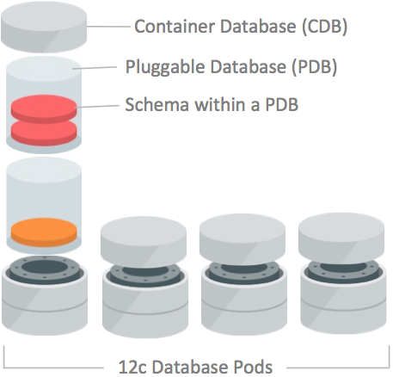
Exadata Express for Users
Oracle manages the service as multiple Container databases(CDBs), also known as database pods
Each CDB can accommodate upto 1000 Pluggable databases(PDBs).
Each user is provisioned with a PDB on subscribing to the service, where the user can create several schemas.
Notes:
Exadata Express is ideal for production applications that consist of small to medium sized data as well as developers, testers, evaluators and other users who are looking for a full Oracle Database experience at an affordable entry-level price. It is a fully managed database service, is organized into Container databases(CDBs). These container databases are also known as database pods.
Each container database in turn can contain several Pluggable databases(PDBs). When a user subscribes to the Exadata Service, a pluggable database is provisioned. Within the PDB, the user can create several schemas. However, PDB Services are constrained by CPU, storage and memory.
Exadata Express是适用于包含中小型数据的生产应用程序，以及开发人员，测试人员，评估人员和其他正在以可负担的入门级价格寻找完整的Oracle数据库体验的用户。 它是一个完全托管的数据库服务，被组织成容器数据库（CDB）。 这些容器数据库也称为数据库窗格。
每个容器数据库依次可以包含几个可插拔数据库（PDB）。 当用户订阅Exadata服务时，将配置可插拔数据库。 在PDB内，用户可以创建多个模式。 但是，PDB服务受到CPU，存储和内存的约束。
Oracle将服务管理为多个Container数据库（CDB），也称为数据库pod
每个CDB最多可容纳1000个可插拔数据库（PDB）。
每个用户在订阅服务时配置了PDB，用户可以在其中创建多个模式。

Slide 11
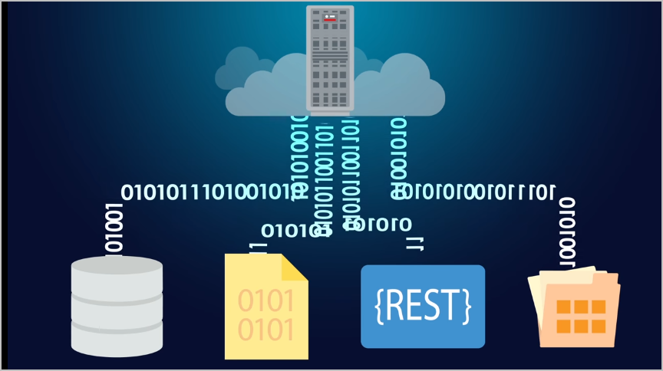
Exadata Express for Developers
Developers can connect with a wide range of data sources for their applications
JSON Document Storage
Document Style data access
Oracle Rest Data Services
Notes:
JSON Document Storage - Oracle Database in Exadata Express provides direct storage, access and management of JSON documents. See JSON Support in Oracle Database New Features Guide 12c Release 2 (12.2).
Document-Style Data Access - Oracle Database in Exadata Express gives you the ability to store and access data as schema-less documents and collections using the Simple Oracle Document Access (SODA) API. See Working with JSON and Other Data Using SODA in Using Oracle Database Exadata Express Cloud Service.
Oracle REST Data Services 3 - Exadata Express includes the newest Oracle REST Data Services (ORDS). With ORDS 3, it’s easy to develop modern RESTful interfaces for relational data and now JSON documents stored in Oracle Database.
JSON文档存储 - Exadata Express中的Oracle数据库提供对JSON文档的直接存储，访问和管理。 请参阅Oracle数据库中的JSON支持新功能指南12c第2版（12.2）。
文件式数据访问 - Exadata Express中的Oracle数据库使您能够使用简单的Oracle文档访问（SODA）API将数据存储和访问作为无模式的文档和集合。 请参阅使用SODA使用JSON和其他数据来使用Oracle数据库Exadata Express云服务。
Oracle REST数据服务3 - Exadata Express包括最新的Oracle REST数据服务（ORDS）。 使用ORDS 3，可轻松开发用于关系数据和现在存储在Oracle数据库中的JSON文档的现代RESTful接口。

Slide 12
Getting Started with Exadata Express
Purchase a subscription.
Activate and verify the service.
Verify activation.
Learn about users and roles.
Create accounts for your users and assign them appropriate privileges and roles.
Set the password for the database user authorized to perform administrative tasks for your service (PDB_ADMIN).
Note: You can refer to Using Oracle Database Exadata Express Cloud Service (https://docs.oracle.com/cloud/latest/exadataexpress-cloud/CSDBP/toc.htm) for details on the subscription process.
Notes:
The steps in the slide provide you a brief overview of how to get started with Exadata Express. In the following slides, you will learn in detail how to perform the aforementioned steps.
购买订阅
激活并验证服务。
验证激活。
了解用户和角色。
为您的用户创建帐户并分配适当的权限和角色。
设置被授权执行服务管理任务的数据库用户的密码（PDB_ADMIN）。
注意：有关订阅过程的详细信息，请参阅使用Oracle数据库Exadata Express Cloud Service（https://docs.oracle.com/cloud/latest/exadataexpress-cloud/CSDBP/toc.htm）。

Slide 13
Oracle Exadata Express Cloud Service
You can refer to Working with Oracle Database Exadata Express Cloud Service (http://oukc.oracle.com/public/redir.html?type=player&offid=1984115860) to gain an introduction to the service and its features.
Notes:
In this video, you gain an introduction to Oracle Exadata Express Cloud Service and its features. You will take a tour of its service console and also learn about the different database clients such as Oracle SQL Developer, SQL CL, SQL Workshop and SQL * Plus that can be used to connect to Oracle Exadata Express Cloud Service.
Note: This demonstration has audi
在本视频中，您将了解Oracle Exadata Express Cloud Service及其功能。 您将参观其服务控制台，并了解可用于连接Oracle Exadata Express Cloud Service的不同数据库客户端，例如Oracle SQL Developer，SQL CL，SQL Workshop和SQL * Plus。
注意：此演示具有音频，不能在OU Classroom内播放。 但是，参与者可以在开放互联网上访问此链接并方便查看。o, which cannot be played inside OU Classroom. However participants can access this link on open internet and review at their convenience.

Slide 14
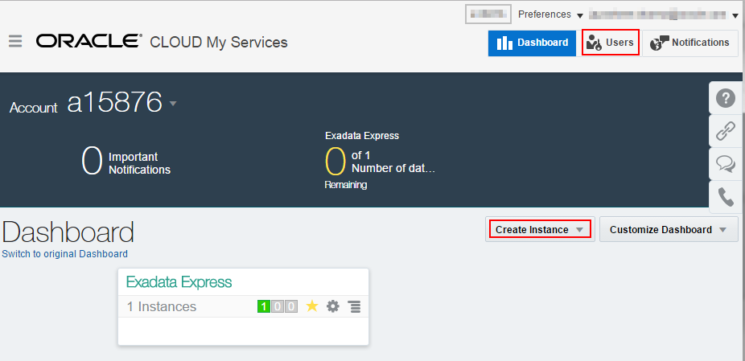
Getting Started with Exadata Express
On signing into the service, you get access to the dashboard.
Dashboard allows you to create database instances and users.
The number of instances you create is limited by the amount of resources you have access to.
Notes:
After successful subscription to the service, you can login to your account and access the dashboard. Based on the type of subscription you can create instances.
The instances would appear on the dashboard. You can see an instance created in the image . To manage the instance, click on the instance.
成功订阅服务后，您可以登录到您的帐户并访问仪表板。 根据订阅类型，您可以创建实例。
实例将显示在仪表板上。 您可以看到在图像中创建的实例。 要管理实例，请单击实例。
登录服务后，您可以访问仪表板。
仪表板允许您创建数据库实例和用户。
您创建的实例数量受到您可以访问的资源数量的限制。

Slide 15
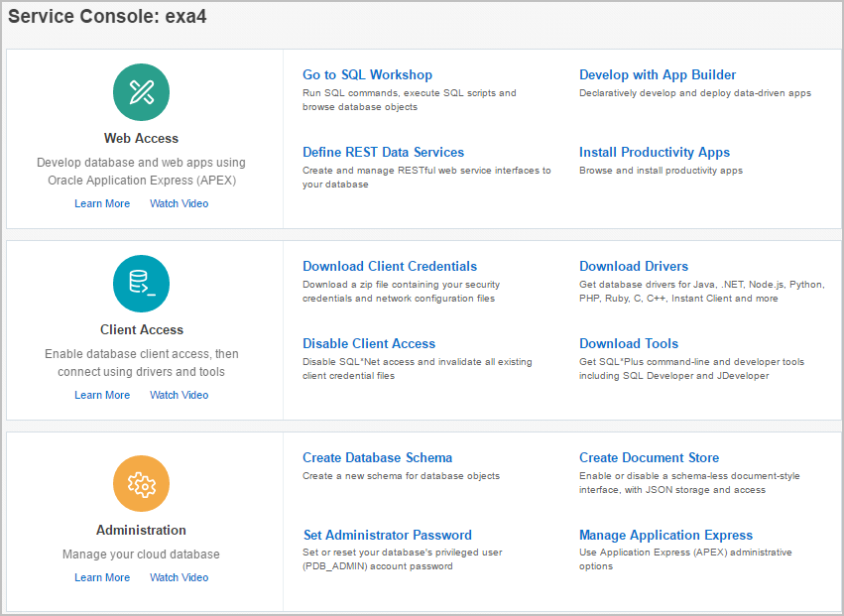
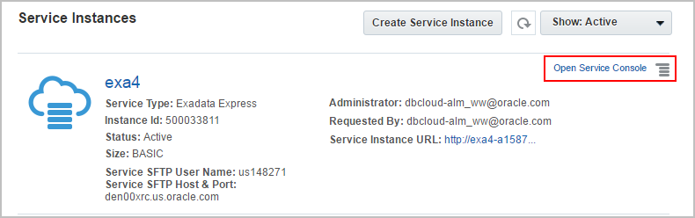
Managing Exadata
Notes:
On clicking the instance on the dashboard, you see various details about the dashboard. You can access the services by clicking on ‘Open Service Console’.
The service console provides you access to tools for Web Access, Client Access and Administration.
点击仪表板上的实例，您将看到有关仪表板的各种详细信息。 您可以通过点击“打开服务控制台”来访问服务。
服务控制台可让您访问Web Access，客户端访问和管理工具。

Slide 16
Service Console
Service Console is the interface to use and manage the Exadata service
It provides three different perspectives of the instance
Web Access
Client Access
Administration
Notes:
Web access provides utilities which enable you to develop database and web applications using Oracle Application Express(APEX).
Database clients can connect to Exadata Express service using SQL *Net Access. Some examples of supported database clients are SQLcl, SQL Developer, SQL *Plus, JDBC Thin client,ODP.NET, OCI and Instant Client. Client Access in the Service Console allows you to configure with the client you use.
Administration in the Service Console provides for performing administration tasks such as create new database schemas for database objects, set or reset administration password, create a schema-less documents and collections interface, and use administrative options to manage Oracle Application Express.
Web访问提供实用程序，使您能够使用Oracle Application Express（APEX）开发数据库和Web应用程序。
数据库客户端可以使用SQL * Net Access连接到Exadata Express服务。 支持的数据库客户端的一些示例是SQLcl，SQL Developer，SQL * Plus，JDBC瘦客户机，ODP.NET，OCI和Instant Client。 服务控制台中的客户端访问允许您使用您使用的客户端进行配置。
服务控制台中的管理提供执行管理任务，例如为数据库对象创建新的数据库模式，设置或重置管理密码，创建无模式文档和集合接口，以及使用管理选项来管理Oracle Application Express。

Slide 17
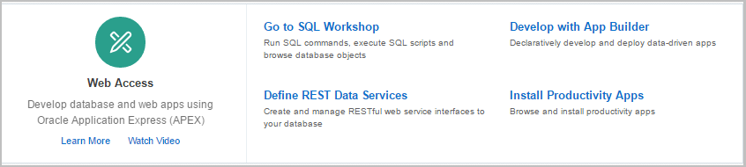
Web Access through Service Console
For quick development of applications
To execute SQL and PL/SQL
To define RESTful services on the database
Reuse apps from pre-built APEX applications

Slide 18
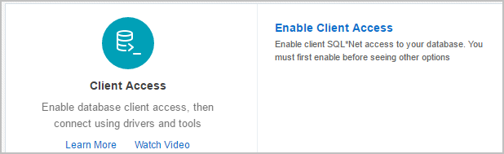
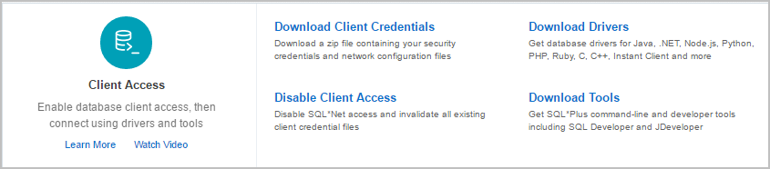
Client Access Configuration through Service Console
Notes:
You have to enable client access to allow SQL*Net Access to your service. Using SQL *Net Access software you can connect the Exadata instance to different clients. This option is only available when client access has not yet been enabled. Once you enable the client access, four options appear in the console:
您必须启用客户端访问才能允许SQL * Net Access访问您的服务。 使用SQL * Net Access软件，您可以将Exadata实例连接到不同的客户端。 此选项仅在客户端访问尚未启用时可用。 启用客户端访问后，控制台中将显示四个选项：

Slide 19
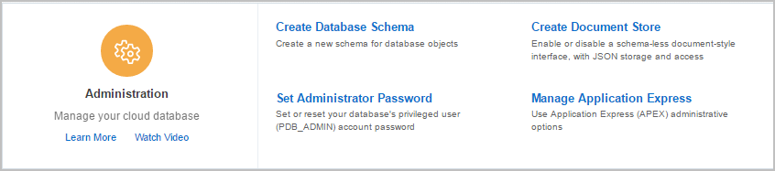
Database Administration through Service Console
Create a new schema for database objects
To create a document store using a schema
Set or reset password for admin
To manage tasks such as archiving APEX schemas and association among APEX schema
Notes:
You can perform various administration tasks through ‘Administration’ in the service console.
您可以通过服务控制台中的“管理”执行各种管理任务。

Slide 20
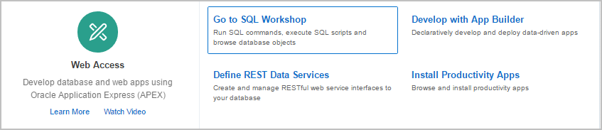
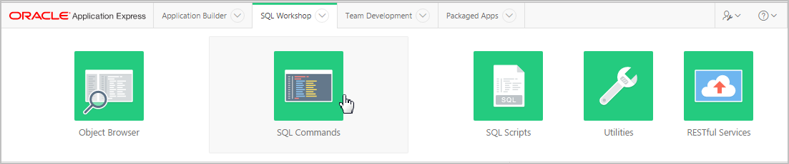
SQL Workshop
1
Clicking on SQL workshop will lead you to APEX interface
2
To run SQL or PL/SQL you can use the SQL commands utility

Slide 21
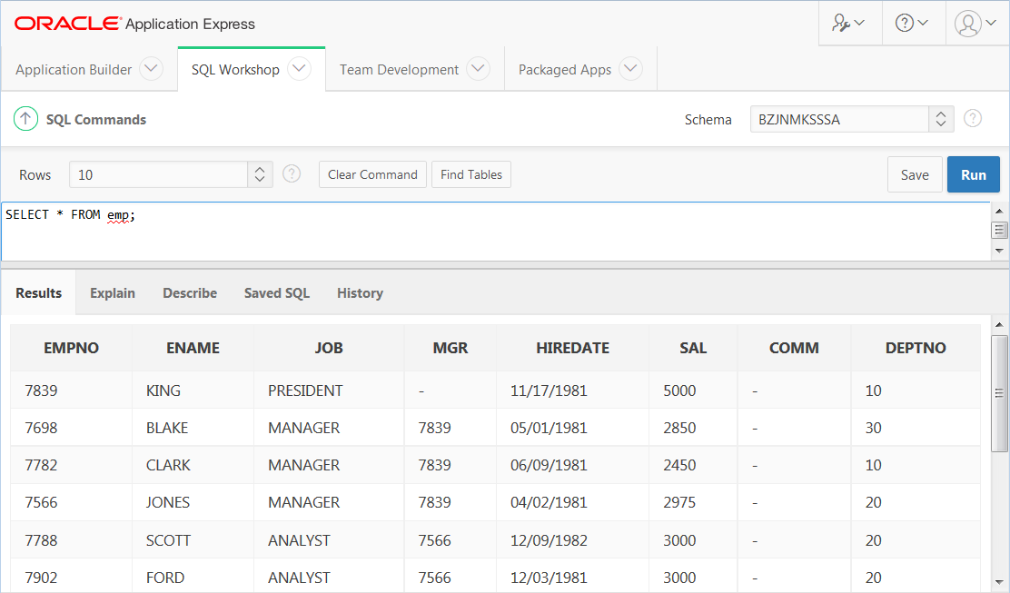
SQL Workshop
You can run SQL statements in the editor.
Notes:
SQL Workshop in APEX allows you to run SQL statements using SQL commands editor. The results of the SQL query entered will be displayed in the tab below.

Slide 22
Connecting through Database Clients
You can connect to Exadata Express through various database clients.
Some of the database clients include:
SQL*Plus
SQLcl
SQL Developer
.Net and Visual Studio
JDBC Thin Client
Notes:
You must first configure database clients and Oracle Database Exadata Express Cloud Service to communicate with each other.
Prerequisite tasks for database client connectivity require you to:
Enable SQL*Net access to your service.
Download client credentials.
Follow set-up instructions for the specific database client you want to connect with.
In the following topics, you will learn how to enable SQL*Net access, download client credentials and make connections using Oracle SQL Developer and SQLcl.

Slide 23
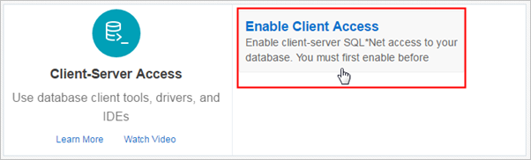
Enabling SQL*Net Access for Client Applications
Enable SQL*Net Access in the Service Console to obtain the various Database Client options.
Notes:
You can connect to your Exadata Express cloud service from diverse database clients over SQL*Net also called as Oracle Database Net Services. Some examples of supported clients include SQL*Plus, SQLcl, SQL Developer, JDBC Thin, ODP.NET, OCI, and Instant Client.
Database drivers for all popular programming and scripting languages such as Python, PHP, Node.js, C/C++, Ruby and Perl are supported. SQL*Net access has to be enabled as a prerequisite for all clients and drivers connecting over SQL*Net.
The Service Administrator must do the following to enable SQL*Net:
Navigate to the Service Console for Exadata Express and open the service console.
Click Enable Client Access.
Download the client credentials.
Now, depending on the client-side application and driver being used, you need to configure the application connection string for that application.

Slide 24
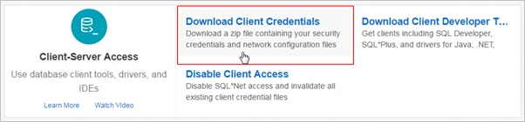
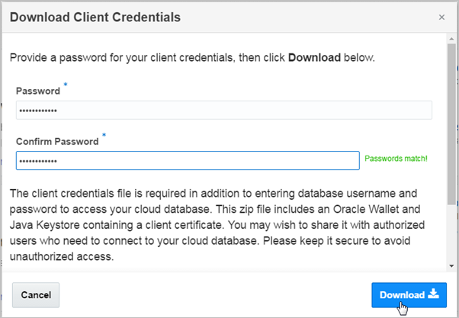
Downloading Client Credentials
1
2
Notes:
You can easily download the zip files for client credentials from service console. Its contents include Oracle Wallet and Java Keystore as well as essential client configuration files. While downloading the zip file, you are prompted to enter a password.
Note that client credential zip files should be carefully managed. Please remember to keep the file secure to avoid unauthorized database access. If you believe the security of this file has been compromised, then immediately disable client access using the cloud service console.
The steps to download the client credentials are as follows.
1. Navigate to Exadata Express and open the service console.
2. Click Download Client Credentials to download a zip file containing your security credentials and network configuration files.
3. Enter a password to create a password-protected Oracle Wallet and Java Keystore files for the service.
4. Click Download and save the downloaded zip file to a secure location that is accessible by your database client(s).
In the following topics, you will learn how to use these credentials to connect to the cloud database.

Slide 25
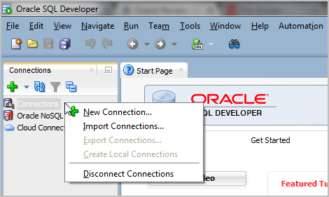
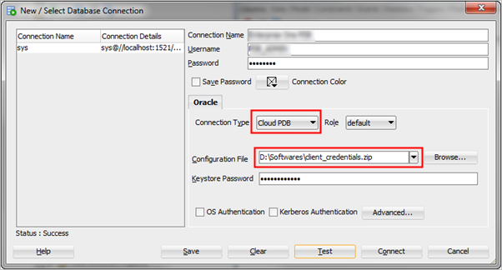
Connecting Oracle SQL Developer
1
Cloud PDB in indicates that connection is made to Exadata Express
2
Keystore Password is the password entered while downloading the client credentials.
Notes:
In order to connect to Oracle Database Exadata Express cloud service, you need to download and install Oracle SQL Developer Release 4.1.5 or later. You should have also downloaded the Client Credentials from Oracle Exadata Express service console. You should then configure an Oracle Cloud connection in the Oracle SQL Developer.
The connection can be created as follows:
Run Oracle SQL Developer locally.
Under Connections, right click Connections and select New Connection.
Enter the following details:
Connection Name – Enter a name for this cloud connection.
Username – Enter username required to sign into Exadata Express.
Password – Enter password required to sign into Exadata Express.
Connection type – Select Cloud PDB.
Configuration File - Click Browse and select the Client Credentials zip file that you previously downloaded from the Exadata Express service console.
Keystore Password – Enter the password provided while downloading the Client Credentials from the Exadata Express service console.
Click Test. If the status is Success, click Connect.
If you have connected successfully, the tables and other objects from Exadata Express display under the new connection.

Slide 26
Connecting Oracle SQLcl
D:\PDB Service\SQL CL\sqlcl-no-jre-latest\sqlcl\bin>sql /nolog
SQLcl: Release 4.2.0.16.160.2007 RC on Thu Sep 08 12:18:07 2016
Copyright (c) 1982, 2016, Oracle. All rights reserved.
SQL>
1
SQL> set cloudconfig client_credentials.zip
Wallet Password: ************
Using temp directory:C:\Users\APOTHU~1.ORA\AppData\Local\Temp\
oracle_cloud_config6707346342028726502
2
SQL> conn pdb_admin/welcome1@dbaccess
Connected.
SQL>
3
Notes:
You can use Oracle SQLcl which is a powerful command-line interface(CLI) to connect to the cloud database. In order to connect, you need to first download and setup Oracle SQLcl locally. You should have also downloaded the Client Credentials from Oracle Exadata Express service console.
To create an Oracle SQLcl cloud connection:
Navigate to the sqlcl/bin directory from where you unzipped the SQLcl installation files, and run sql /nolog, to startup Oracle SQLcl. The Oracle SQLcl starts displaying the date and time, the SQLcl version and copyright information, before the SQLcl prompt appears.
At the SQLcl prompt, type set cloudconfig <name of your wallet zip file>, and press the Enter key.
Enter the Password provided for downloading the Client Credentials from the Exadata Express service console, and press the Enter key.
To connect to the Exadata Express, type conn <username>/<password>@<servicename>, and press the Enter key. The username and password are the credentials of your database account.
You should now be connected to Exadata Express.

Slide 27
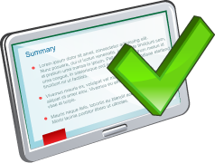
Summary
In this lesson, you should have learned about:
The salient features of Oracle Cloud
Oracle Database Exadata Express Cloud Service
Notes:
Relational database management systems are composed of objects or relations. They are managed by operations and governed by data integrity constraints.
Oracle Corporation produces products and services to meet your RDBMS needs. The main products are the following:
Oracle Database, which you use to store and manage information by using SQL
Oracle Fusion Middleware, which you use to develop, deploy, and manage modular business services that can be integrated and reused
Oracle Enterprise Manager Grid Control, which you use to manage and automate administrative tasks across sets of systems in a grid environment
SQL
The Oracle server supports ANSI-standard SQL and contains extensions. SQL is the language that is used to communicate with the server to access, manipulate, and control data.

