Slide 1
Using SQL Developer

Slide 2
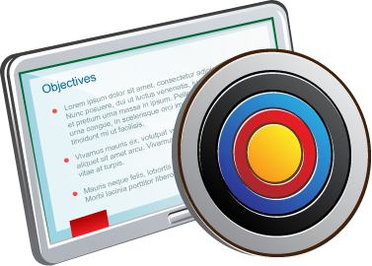
Objectives
After completing this appendix, you should be able to:
List the key features of Oracle SQL Developer
Identify the menu items of Oracle SQL Developer
Create a database connection
Manage database objects
Use SQL Worksheet
Save and run SQL scripts
Create and save reports
Browse the Data Modeling options in SQL Developer
Notes:
In this appendix, you are introduced to the graphical tool called SQL Developer. You learn how to use SQL Developer for your database development tasks. You learn how to use SQL Worksheet to execute SQL statements and SQL scripts.
在本附录中，您将介绍一个名为SQL Developer的图形化工具。 您将学习如何使用SQL Developer进行数据库开发任务。 您将学习如何使用SQL Worksheet来执行SQL语句和SQL脚本。
完成本附录后，您应该能够：
列出Oracle SQL Developer的主要功能
识别Oracle SQL Developer的菜单项
创建数据库连接
管理数据库对象
使用SQL工作表
保存并运行SQL脚本
创建并保存报告
浏览SQL Developer中的数据建模选项

Slide 3

What Is Oracle SQL Developer?
Oracle SQL Developer is a graphical tool that enhances productivity and simplifies database development tasks.
You can connect to any target Oracle database schema by using standard Oracle database authentication.
SQL Developer
Notes:
Oracle SQL Developer is a free graphical tool designed to improve your productivity and simplify the development of everyday database tasks. With just a few clicks, you can easily create and debug stored procedures, test SQL statements, and view optimizer plans.
SQL Developer, which is the visual tool for database development, simplifies the following tasks:
Browsing and managing database objects
Executing SQL statements and scripts
Editing and debugging PL/SQL statements
Creating reports
You can connect to any target Oracle database schema by using standard Oracle database authentication. When connected, you can perform operations on objects in the database.
SQL Developer is the interface to administer the Oracle Application Express Listener. The new interface enables you to specify global settings and multiple database settings with different database connections for the Application Express Listener. SQL Developer provides the option to drag and drop objects by table or column name onto the worksheet. It provides improved DB Diff comparison options, GRANT statement support in the SQL editor, and DB Doc reporting. Additionally, SQL Developer includes support for Oracle Database 12c features.
Oracle SQL Developer是一种免费的图形工具，旨在提高您的生产力并简化日常数据库任务的开发。只需点击几下，就可以轻松创建和调试存储过程，测试SQL语句和查看优化程序计划。
SQL Developer是数据库开发的可视化工具，简化了以下任务：
浏览和管理数据库对象
执行SQL语句和脚本
编辑和调试PL / SQL语句
创建报告
您可以使用标准的Oracle数据库身份验证连接到任何目标Oracle数据库模式。连接时，可以对数据库中的对象执行操作。
SQL Developer是管理Oracle Application Express监听器的界面。新界面使您能够为Application Express侦听器指定不同数据库连接的全局设置和多个数据库设置。 SQL Developer提供了通过表或列名将对象拖放到工作表上的选项。它提供改进的DB差异比较选项，SQL编辑器中的GRANT语句支持和DB Doc报告。另外，SQL Developer包括对Oracle Database 12c功能的支持。

Slide 4

Specifications of SQL Developer
Is shipped along with Oracle Database 12c Release 1
Is developed in Java
Supports Windows, Linux, and Mac OS X platforms
Enables default connectivity using the JDBC Thin driver
Connects to Oracle Database version 9.2.0.1 and later
Notes:
Oracle SQL Developer is shipped along with Oracle Database 12c Release 1 by default. SQL Developer is developed in Java, leveraging the Oracle JDeveloper integrated development environment (IDE). Therefore, it is a cross-platform tool. The tool runs on Windows, Linux, and Mac operating system (OS) X platforms.
The default connectivity to the database is through the Java Database Connectivity (JDBC) Thin driver, and therefore, no Oracle Home is required. SQL Developer does not require an installer and you need to simply unzip the downloaded file. With SQL Developer, users can connect to Oracle Databases 9.2.0.1 and later, and all Oracle database editions, including Express Edition.
Note: For Oracle Database 12c Release 1, you will have to download and install SQL Developer. SQL Developer is freely downloadable from the following link: http://www.oracle.com/technetwork/developer-tools/sql-developer/downloads/index.html
For instructions on how to install SQL Developer, see the website at: http://www.oracle.com/technetwork/developer-tools/sql-developer/overview/index.html
默认情况下，Oracle SQL Developer随Oracle Database 12c Release 1一起提供。 SQL Developer是利用Oracle JDeveloper集成开发环境（IDE）开发的。 因此，它是一个跨平台的工具。 该工具在Windows，Linux和Mac操作系统（OS）X平台上运行。
与数据库的默认连接是通过Java数据库连接（JDBC）瘦驱动程序，因此不需要Oracle Home。 SQL Developer不需要安装程序，您只需解压缩下载的文件即可。 使用SQL Developer，用户可以连接到Oracle数据库9.2.0.1及更高版本，以及所有Oracle数据库版本，包括Express Edition。
注意：对于Oracle Database 12c第1版，您必须下载并安装SQL Developer。 SQL Developer可以从以下方式免费下载
随Oracle Database 12c Release 1一起发货
是在Java开发的
支持Windows，Linux和Mac OS X平台
使用JDBC Thin驱动程序启用默认连接
连接到Oracle数据库版本9.2.0.1及更高版本

Slide 5
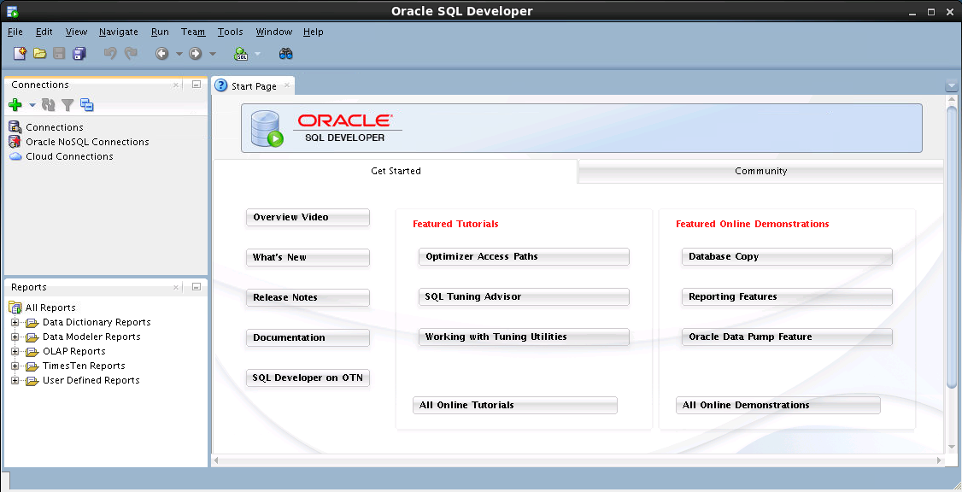
SQL Developer 3.2 Interface
You must define a connection to start using SQL Developer for running SQL queries on a database schema.
Notes:
The SQL Developer interface contains two main navigation tabs:
Connections: By using this tab, you can browse database objects and users to which you have access.
Reports: Identified by the Reports icon, this tab enables you to run predefined reports or create and add your own reports.
General Navigation and Use
SQL Developer uses the left side for navigation to find and select objects, and the right side to display information about selected objects. You can customize many aspects of the appearance and behavior of SQL Developer by setting preferences.
Note: You need to define at least one connection to be able to connect to a database schema and issue SQL queries or run procedures and functions.
SQL Developer界面包含两个主要导航选项卡：
连过“报告接：通过使用此选项卡，您可以浏览可访问的数据库对象和用户。
报告：通”图标标识，此选项卡可用于运行预定义的报告，或创建和添加自己的报告。
一般导航和使用
SQL Developer使用左侧的导航来查找和选择对象，右侧显示有关所选对象的信息。 您可以通过设置首选项来自定义SQL Developer的外观和行为的许多方面。
注意：您需要至少定义一个连接以连接到数据库模式并发出SQL查询或运行过程和函数。

Slide 6
Notes:
Menus
The following menus contain standard entries, plus entries for features that are specific to SQL Developer:
View: Contains options that affect what is displayed in the SQL Developer interface
Navigate: Contains options for navigating to panes and for executing subprograms
Run: Contains the Run File and Execution Profile options that are relevant when a function or procedure is selected, and also debugging options
Versioning: Provides integrated support for the following versioning and source control systems—Concurrent Versions System (CVS) and Subversion
Tools: Invokes SQL Developer tools such as SQL*Plus, Preferences, and SQL Worksheet. It also contains options related to migrating third-party databases to Oracle.
Note: The Run menu also contains options that are relevant when a function or procedure is selected for debugging.
菜单
以下菜单包含标准条目，以及特定于SQL Developer的功能的条目：
视图：包含影响SQL Developer界面中显示内容的选项
导航：包含导航到窗格和执行子程序的选项
运行：包含选择功能或过程时相关的运行文件和执行配置文件选项，以及调试选项
版本控制：为以下版本控制系统和并发版本系统（CVS）和Subversion提供集成支持
工具：调用SQL开发工具，如SQL * Plus，首选项和SQL工作表。 它还包含与将第三方数据库迁移到Oracle相关的选项。
注意：运行菜单还包含选择功能或过程进行调试时相关的选项。

Slide 7

Creating a Database Connection
You must have at least one database connection to use SQL Developer.
You can create and test connections for:
Multiple databases
Multiple schemas
SQL Developer automatically imports any connections defined in the tnsnames.ora file on your system.
You can export connections to an Extensible Markup Language (XML) file.
Each additional database connection created is listed in the Connections Navigator hierarchy.
Notes:
A connection is a SQL Developer object that specifies the necessary information for connecting to a specific database as a specific user of that database. To use SQL Developer, you must have at least one database connection, which may be existing, created, or imported.
You can create and test connections for multiple databases and for multiple schemas.
By default, the tnsnames.ora file is located in the $ORACLE_HOME/network/admin directory, but it can also be in the directory specified by the TNS_ADMIN environment variable or registry value. When you start SQL Developer and open the Database Connections dialog box, SQL Developer automatically imports any connections defined in the tnsnames.ora file on your system.
Note: On Windows, if the tnsnames.ora file exists, but its connections are not being used by SQL Developer, define TNS_ADMIN as a system environment variable.
You can export connections to an XML file so that you can reuse it.
You can create additional connections as different users to the same database or to connect to the different databases.
一个连接是一个SQL Developer对象，它指定了作为数据库的特定用户连接到特定数据库的必要信息。要使用SQL Developer，您必须至少有一个数据库连接，可能是现有的，创建的或导入的。
您可以创建和测试多个数据库和多个模式的连接。
默认情况下，tnsnames.ora文件位于$ ORACLE_HOME / network / admin目录中，但也可以在TNS_ADMIN环境变量或注册表值指定的目录中。当您启动SQL Developer并打开“数据库连接”对话框时，SQL Developer会自动导入系统中tnsnames.ora文件中定义的任何连接。
注意：在Windows上，如果tnsnames.ora文件存在，但其连接未被SQL Developer使用，请将TNS_ADMIN定义为系统环境变量。
您可以将连接导出到XML文件，以便可以重用它。
您可以创建作为不同用户的其他连接到同一数据库或连接到不同的数据库。

Slide 8
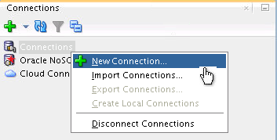
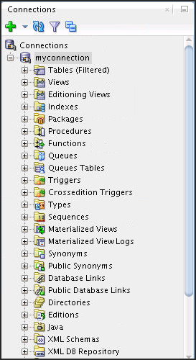
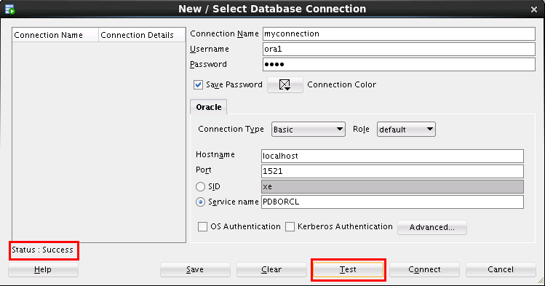
Creating a Database Connection
1
3
2
Notes:
To create a database connection, perform the following steps:
1. On the Connections tabbed page, right-click Connections and select New Connection.
2. In the New / Select Database Connection window, enter the connection name. Enter the username and password of the schema that you want to connect to.
a. From the Role drop-down list, you can select either default or SYSDBA. (You choose SYSDBA for the sys user or any user with database administrator privileges.)
b. You can select the connection type as:
Basic: In this type, enter host name and SID for the database that you want to connect to. Port is already set to 1521. You can also choose to enter the Service name directly if you use a remote database connection.
TNS: You can select any one of the database aliases imported from the tnsnames.ora file.
LDAP: You can look up database services in Oracle Internet Directory, which is a component of Oracle Identity Management.
Advanced: You can define a custom Java Database Connectivity (JDBC) URL to connect to the database.
Local/Bequeath: If the client and database exist on the same computer, a client connection can be passed directly to a dedicated server process without going through the listener.
要创建数据库连接，请执行以下步骤：
1.在“连接”选项卡上，右键单击“连接”，然后选择“新建连接”。
2.在“新建/选择数据库连接”窗口中，输入连接名称。输入要连接到的模式的用户名和密码。
一个。从“角色”下拉列表中，您可以选择默认或SYSDBA。 （您为sys用户或具有数据库管理员权限的任何用户选择SYSDBA。）
湾您可以选择连接类型为：
基本：在此类型中，输入要连接到的数据库的主机名和SID。端口已设置为1521.如果使用远程数据库连接，还可以选择直接输入服务名称。
TNS：您可以选择从tnsnames.ora文件导入的任何一个数据库别名。
LDAP：您可以在Oracle Internet Directory中查找数据库服务，Oracle Internet Directory是Oracle身份管理的组件。
高级：您可以定义一个自定义的Java数据库连接（JDBC）URL来连接数据库。
本地/ Bequeath：如果客户端和数据库存在于同一台计算机上，则可以将客户端连接直接传递到专用服务器进程，而无需通过侦听器。

Slide 9
Notes:
c. Click Test to ensure that the connection has been set correctly.
d. Click Connect.
If you select the Save Password check box, the password is saved to an XML file. So, after you close the SQL Developer connection and open it again, you are not prompted for the password.
3. The connection gets added in the Connections Navigator. You can expand the connection to view the database objects and view object definitions (dependencies, details, statistics, and so on).
Note: From the same New/Select Database Connection window, you can define connections to non-Oracle data sources using the Access, MySQL, and SQL Server tabs. However, these connections are read-only connections that enable you to browse objects and data in that data source.
C。 单击测试以确保连接设置正确。
D。 单击连接。
如果选择保存密码复选框，密码将保存到XML文件。 因此，在关闭SQL Developer连接并重新打开后，不会提示您输入密码。
3.连接被添加到Connections Navigator中。 您可以扩展连接以查看数据库对象并查看对象定义（依赖关系，详细信息，统计信息等）。
注意：在同一个新建/选择数据库连接窗口中，您可以使用Access，MySQL和SQL Server选项卡定义与非Oracle数据源的连接。 但是，这些连接是只读连接，使您能够浏览该数据源中的对象和数据。

Slide 10
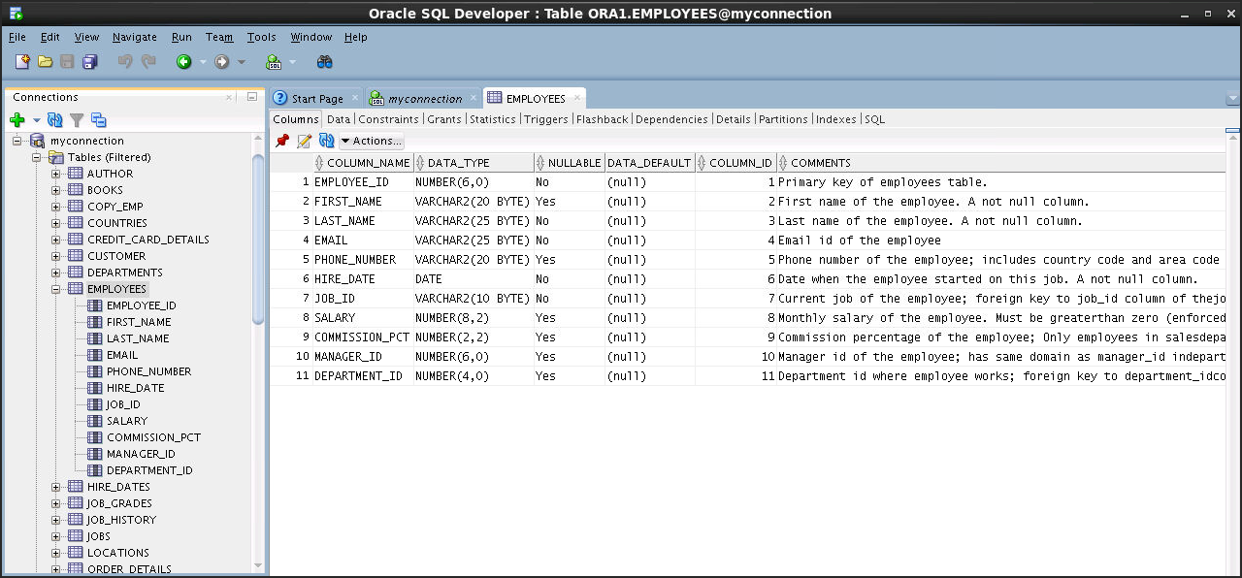
Browsing Database Objects
Use the Connections Navigator to:
Browse through many objects in a database schema
Review the definitions of objects at a glance
Notes:
After you create a database connection, you can use the Connections Navigator to browse through many objects in a database schema, including Tables, Views, Indexes, Packages, Procedures, Triggers, and Types.
SQL Developer uses the left side for navigation to find and select objects, and the right side to display information about the selected objects. You can customize many aspects of the appearance of SQL Developer by setting preferences.
You can see the definition of the objects broken into tabs of information that is pulled out of the data dictionary. For example, if you select a table in the Navigator, details about columns, constraints, grants, statistics, triggers, and so on are displayed on an easy-to-read tabbed page.
If you want to see the definition of the EMPLOYEES table as shown in the slide, perform the following steps:
1. Expand the Connections node in the Connections Navigator.
2. Expand Tables.
Click EMPLOYEES. By default, the Columns tab is selected. It shows the column description of the table. Using the Data tab, you can view the table data and also enter new rows, update data, and commit these changes to the database.
创建数据库连接后，可以使用Connections Navigator浏览数据库模式中的许多对象，包括表，视图，索引，包，过程，触发器和类型。
SQL Developer使用左侧导航来查找和选择对象，右侧显示有关所选对象的信息。您可以通过设置首选项来自定义SQL Developer外观的许多方面。
您可以看到被分解为从数据字典中拉出的信息的标签的对象的定义。例如，如果您在导航器中选择一个表，则有关列，约束，授权，统计信息，触发器等的详细信息将显示在易于阅读的选项卡页面上。
如果要查看幻灯片中所示的EMPLOYEES表的定义，请执行以下步骤：
1.展开Connections Navigator中的Connections节点。
2.展开表。
3.点击雇员。默认情况下，列选项卡被选中。它显示了表的列描述。使用“数据”选项卡，您可以查看表数据，并输入新行，更新数据，并将这些更改提交到数据库。

Slide 11

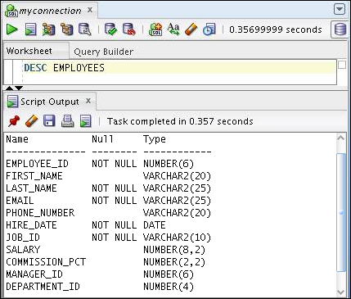

Displaying the Table Structure
Use the DESCRIBE command to display the structure of a table:
Notes:
In SQL Developer, you can also display the structure of a table using the DESCRIBE command. The result of the command is a display of column names and data types, as well as an indication of whether a column must contain data.
在SQL Developer中，还可以使用DESCRIBE命令显示表的结构。 该命令的结果是列名和数据类型的显示，以及列是否必须包含数据的指示。

Slide 12
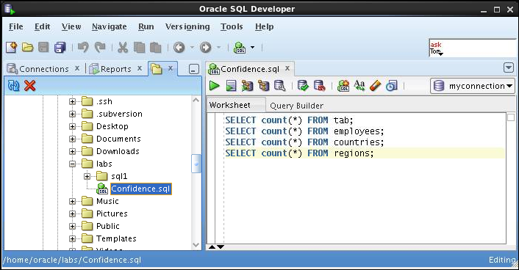

Browsing Files
Use the File Navigator to explore the file system and open system files.
Notes:
Browsing Database Objects
You can use the File Navigator to browse and open system files.
To view the File Navigator, click the View tab and select Files, or select View > Files.
To view the contents of a file, double-click a file name to display its contents in the SQL Worksheet area.
浏览数据库对象
您可以使用文件导航器来浏览和打开系统文件。
要查看文件导航器，请单击视图选项卡，然后选择文件，或选择查看>文件。
要查看文件的内容，请双击文件名以在SQL Worksheet区域中显示其内容。

Slide 13
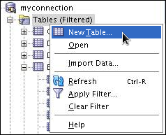

Creating a Schema Object
SQL Developer supports the creation of any schema object by:
Executing a SQL statement in SQL Worksheet
Using the context menu
Edit the objects by using an edit dialog box or one of the many context-sensitive menus.
View the data definition language (DDL) for adjustments such as creating a new object or editing an existing schema object.
Notes:
SQL Developer supports the creation of any schema object by executing a SQL statement in SQL Worksheet. Alternatively, you can create objects by using the context menus. When created, you can edit objects using an edit dialog box or one of the many context-sensitive menus.
As new objects are created or existing objects are edited, the DDL for those adjustments is available for review. An Export DDL option is available if you want to create the full DDL for one or more objects in the schema.
The slide shows how to create a table using the context menu. To open a dialog box for creating a new table, right-click Tables and select New Table. The dialog boxes to create and edit database objects have multiple tabs, each reflecting a logical grouping of properties for that type of object.
SQL Developer支持通过在SQL Worksheet中执行SQL语句来创建任何模式对象。 或者，您可以使用上下文菜单创建对象。 创建时，您可以使用编辑对话框或许多上下文相关菜单之一编辑对象。
当创建新对象或编辑现有对象时，可以对这些调整的DDL进行查看。 如果要为模式中的一个或多个对象创建完整的DDL，则可以使用导出DDL选项。
幻灯片显示如何使用上下文菜单创建表。 要打开一个用于创建新表的对话框，请右键单击“表”，然后选择“新建表”。 创建和编辑数据库对象的对话框有多个选项卡，每个选项卡都反映了该类型对象的属性的逻辑分组。

Slide 14
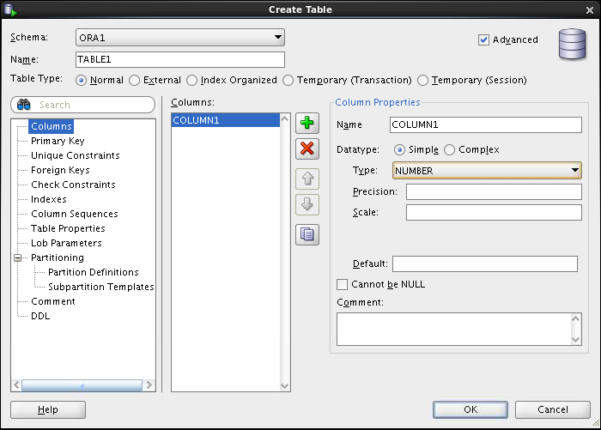

Creating a New Table: Example
Notes:
In the Create Table dialog box, if you do not select the Advanced check box, you can create a table quickly by specifying columns and some frequently used features.
If you select the Advanced check box, the Create Table dialog box changes to one with multiple options, in which you can specify an extended set of features while you create the table.
The example in the slide shows how to create the DEPENDENTS table by selecting the Advanced check box.
To create a new table, perform the following steps:
1. In the Connections Navigator, right-click Tables and select Create TABLE.
2. In the Create Table dialog box, select Advanced.
3. Specify the column information.
4. Click OK.
Although it is not required, you should also specify a primary key by using the Primary Key tab in the dialog box. Sometimes, you may want to edit the table that you have created; to do so, right-click the table in the Connections Navigator and select Edit.
在“创建表”对话框中，如果不选择“高级”复选框，则可以通过指定列和一些常用功能来快速创建表。
如果选择高级复选框，“创建表”对话框将更改为具有多个选项的对话框，您可以在创建表格时指定一组扩展功能。
幻灯片中的示例显示如何通过选择高级复选框创建DEPENDENTS表。
要创建新表，请执行以下步骤：
1.在Connections Navigator中，右键单击Tables并选择Create TABLE。
2.在“创建表”对话框中，选择“高级”。
3.指定列信息。
4.单击“确定”。
虽然不是必需的，但也可以使用对话框中的“主键”选项卡来指定主键。 有时，您可能想编辑您创建的表; 要这样做，右键单击连接导航器中的表，然后选择编辑。

Slide 15
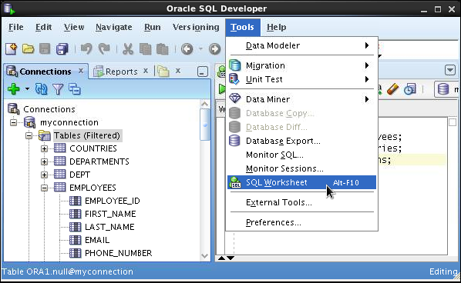
Using the SQL Worksheet
Use the SQL Worksheet to enter and execute SQL, PL/SQL, and SQL*Plus statements.
Specify any actions that can be processed by the database connection associated with the worksheet.
Or, click the Open SQL Worksheet icon.
Select SQL Worksheet from the Tools menu.
Notes:
When you connect to a database, a SQL Worksheet window for that connection automatically opens. You can use the SQL Worksheet to enter and execute SQL, PL/SQL, and SQL*Plus statements. The SQL Worksheet supports SQL*Plus statements to a certain extent. SQL*Plus statements that are not supported by the SQL Worksheet are ignored and not passed to the database.
You can specify the actions that can be processed by the database connection associated with the worksheet, such as:
Creating a table
Inserting data
Creating and editing a trigger
Selecting data from a table
Saving the selected data to a file
You can display a SQL Worksheet by using one of the following:
Select Tools > SQL Worksheet.
Click the Open SQL Worksheet icon.
连接到数据库时，该连接的SQL Worksheet窗口将自动打开。 您可以使用SQL工作表输入并执行SQL，PL / SQL和SQL * Plus语句。 SQL Worksheet在一定程度上支持SQL * Plus语句。 SQL Worksheet不支持的SQL * Plus语句将被忽略，不会传递给数据库。
您可以指定与工作表关联的数据库连接可以处理的操作，例如：
创建表
插入数据
创建和编辑触发器
从表中选择数据
将所选数据保存到文件
您可以使用以下方法之一显示SQL Worksheet：
选择“工具”>“SQL工作表”。
单击Open SQL Worksheet图标。

Slide 16
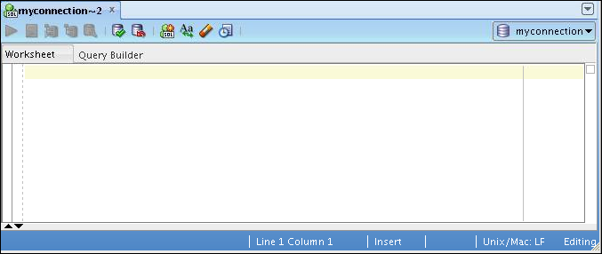
Using the SQL Worksheet
2
4
6
8
10
1
3
5
7
9
11
Notes:
You may want to use the shortcut keys or icons to perform certain tasks such as executing a SQL statement, running a script, and viewing the history of the SQL statements that you have executed. You can use the SQL Worksheet toolbar that contains icons to perform the following tasks:
1. Run Statement: Executes the statement where the cursor is located in the Enter SQL Statement box. You can use bind variables in the SQL statements, but not substitution variables.
2. Run Script: Executes all the statements in the Enter SQL Statement box by using the Script Runner. You can use substitution variables in the SQL statements, but not bind variables.
3. Autotrace: Generates trace information for the statement
4. Explain Plan: Generates the execution plan, which you can see by clicking the Explain tab
5. SQL Tuning Advisory: Analyzes high-volume SQL statements and offers tuning recommendations
6. Commit: Writes any changes to the database and ends the transaction
Rollback: Discards any changes to the database, without writing them to the database, and ends the transaction
您可能希望使用快捷键或图标来执行某些任务，例如执行SQL语句，运行脚本以及查看已执行的SQL语句的历史记录。您可以使用包含图标的SQL Worksheet工具栏来执行以下任务：
1.运行语句：在Enter SQL语句框中执行游标所在的语句。您可以在SQL语句中使用绑定变量，但不能使用替换变量。
2.运行脚本：使用脚本运行程序执行“输入SQL语句”框中的所有语句。您可以在SQL语句中使用替换变量，但不能使用绑定变量。
3.自动跟踪：生成语句的跟踪信息
4.说明计划：生成执行计划，您可以通过单击“解释”选项卡来查看
5. SQL调优咨询：分析大量SQL语句并提供调优建议
6.提交：将更改写入数据库并结束事务
7.回滚：丢弃对数据库的任何更改，而不将其写入数据库，并结束事务

Slide 17
Notes:
8. Unshared SQL Worksheet: Creates a separate unshared SQL Worksheet for a connection
9. To Upper/Lower/InitCap: Changes the selected text to uppercase, lowercase, or initcap, respectively
10. Clear: Erases the statement or statements in the Enter SQL Statement box
SQL History: Displays a dialog box with information about the SQL statements that you have executed
8.未共享的SQL工作表：为连接创建单独的非共享SQL工作表
9.上/下/ InitCap：将所选文本分别更改为大写，小写或initcap
10.清除：删除“输入SQL语句”框中的语句或语句
11. SQL历史：显示一个对话框，其中包含您已执行的SQL语句的信息

Slide 18
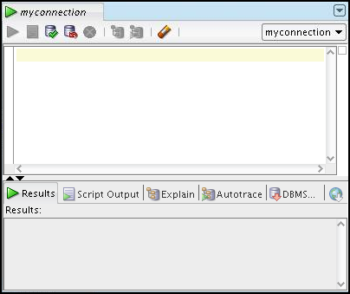
Using the SQL Worksheet
Use the SQL Worksheet to enter and execute SQL, PL/SQL, and SQL*Plus statements.
Specify any actions that can be processed by the database connection associated with the worksheet.
Enter SQL statements.
Results are shown here.
Notes:
When you connect to a database, a SQL Worksheet window for that connection automatically opens. You can use the SQL Worksheet to enter and execute SQL, PL/SQL, and SQL*Plus statements. All SQL and PL/SQL commands are supported as they are passed directly from the SQL Worksheet to the Oracle database. The SQL*Plus commands that are used in SQL Developer must be interpreted by the SQL Worksheet before being passed to the database.
The SQL Worksheet currently supports a number of SQL*Plus commands. Commands that are not supported by the SQL Worksheet are ignored and not sent to the Oracle database. Through the SQL Worksheet, you can execute the SQL statements and some of the SQL*Plus commands.
连接到数据库时，该连接的SQL Worksheet窗口将自动打开。 您可以使用SQL工作表输入并执行SQL，PL / SQL和SQL * Plus语句。 支持所有SQL和PL / SQL命令，因为它们直接从SQL Worksheet传递到Oracle数据库。 在SQL Developer中使用的SQL * Plus命令必须由SQL Worksheet解释，才能传递到数据库。
SQL Worksheet目前支持许多SQL * Plus命令。 SQL Worksheet不支持的命令将被忽略，不会发送到Oracle数据库。 通过SQL工作表，可以执行SQL语句和一些SQL * Plus命令。

Slide 19
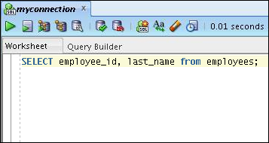
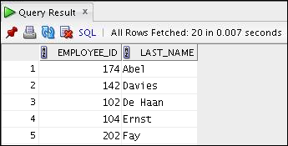
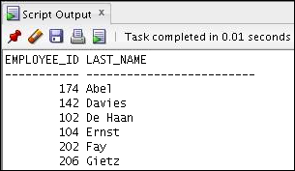
Executing SQL Statements
Use the Enter SQL Statement box to enter single or multiple SQL statements.
F9
F5
F5
F9
Notes:
The example in the slide shows the difference in output for the same query when the F9 key or Execute Statement is used versus the output when F5 or Run Script is used.
幻灯片中的示例显示当使用F9键或执行语句时相同查询的输出差异，而使用F5或运行脚本时输出。

Slide 20

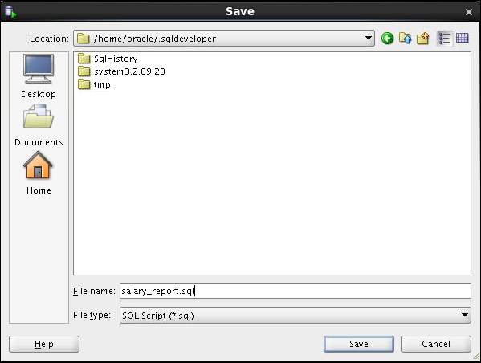
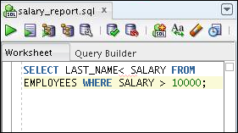
Saving SQL Scripts
Click the Save icon to save your SQL statement to a file.
1
3
The contents of the saved file are visible and editable in your SQL Worksheet window.
Identify a location, enter a file name, and click Save.
2
Notes:
You can save your SQL statements from the SQL Worksheet to a text file. To save the contents of the Enter SQL Statement box, perform the following steps:
1. Click the Save icon or use the File > Save menu item.
2. In the Save dialog box, enter a file name and the location where you want the file saved.
3. Click Save.
After you save the contents to a file, the Enter SQL Statement window displays a tabbed page of your file contents. You can have multiple files open at the same time. Each file is displayed as a tabbed page.
Script Pathing
You can select a default path to look for scripts and to save scripts. Under Tools > Preferences > Database > Worksheet Parameters, enter a value in the “Select default path to look for scripts” field.
您可以将SQL语句从SQL Worksheet保存到文本文件。 要保存“输入SQL语句”框的内容，请执行以下步骤：
1.单击保存图标，或使用文件>保存菜单项。
2.在“保存”对话框中，输入文件名和要保存文件的位置。
3.单击保存。
将内容保存到文件后，“输入SQL语句”窗口将显示文件内容的标签页。 您可以同时打开多个文件。 每个文件显示为标签页。
脚本路径
您可以选择默认路径来查找脚本并保存脚本。 在工具>首选项>数据库>工作表参数下，在“选择默认路径查找脚本”字段中输入一个值。

Slide 21
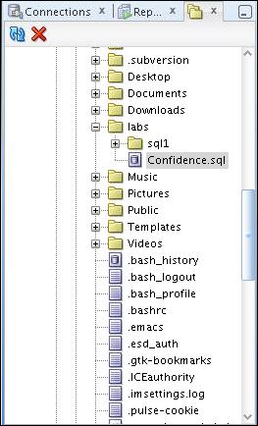
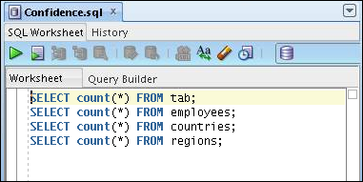
Executing Saved Script Files: Method 1
Use the Files tab to locate the script file that you want to open.
Double-click the script to display the code in the SQL Worksheet.
1
To run the code, click either:
Execute Script (F9), or
Run Script (F5)
Select a connection from the drop-down list.
3
2
Notes:
To open a script file and display the code in the SQL Worksheet area, perform the following steps:
1. In the files navigator, select (or navigate to) the script file that you want to open.
2. Double-click the file to open it. The code of the script file is displayed in the SQL Worksheet area.
3. Select a connection from the connection drop-down list.
4. To run the code, click the Run Script (F5) icon on the SQL Worksheet toolbar. If you have not selected a connection from the connection drop-down list, a connection dialog box will appear. Select the connection that you want to use for the script execution.
Alternatively, you can also do the following:
1. Select File > Open. The Open dialog box is displayed.
2. In the Open dialog box, select (or navigate to) the script file that you want to open.
3. Click Open. The code of the script file is displayed in the SQL Worksheet area.
4. Select a connection from the connection drop-down list.
To run the code, click the Run Script (F5) icon on the SQL Worksheet toolbar. If you have not selected a connection from the connection drop-down list, a connection dialog box will appear. Select the connection that you want to use for the script execution.
要打开脚本文件并在SQL Worksheet区域中显示代码，请执行以下步骤：
1.在文件导航器中，选择（或导航到）要打开的脚本文件。
2.双击文件打开它。脚本文件的代码显示在SQL Worksheet区域中。
3.从连接下拉列表中选择连接。
4.要运行代码，请单击SQL Worksheet工具栏上的运行脚本（F5）图标。如果您没有从连接下拉列表中选择连接，将显示一个连接对话框。选择要用于脚本执行的连接。
或者，您还可以执行以下操作：
1.选择文件>打开。显示打开对话框。
2.在“打开”对话框中，选择（或导航到）要打开的脚本文件。
3.单击打开。脚本文件的代码显示在SQL Worksheet区域中。
4.从连接下拉列表中选择一个连接。
5.要运行代码，请单击SQL Worksheet工具栏上的运行脚本（F5）图标。如果您没有从连接下拉列表中选择连接，将显示一个连接对话框。选择要用于脚本执行的连接。

Slide 22
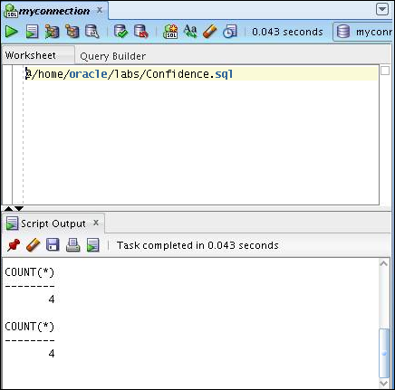
Executing Saved Script Files: Method 2
Use the @ command followed by the location and name of the file that you want to execute and click the Run Script icon.
The output from the script is displayed on the Script Output tabbed page.
Notes:
To run a saved SQL script, perform the following steps:
1. Use the @ command followed by the location and the name of the file that you want to run in the Enter SQL Statement window.
Click the Run Script icon.
The results from running the file are displayed on the Script Output tabbed page. You can also save the script output by clicking the Save icon on the Script Output tabbed page. The File Save dialog box appears and you can identify a name and location for your file.
要运行保存的SQL脚本，请执行以下步骤：
1.使用@命令，后跟要在“输入SQL语句”窗口中运行的文件的位置和名称。
2.单击运行脚本图标。
运行文件的结果显示在“脚本输出”选项卡页面上。 您还可以通过单击“脚本输出”选项卡页面上的“保存”图标来保存脚本输出。 将出现“文件保存”对话框，您可以识别文件的名称和位置。

Slide 23
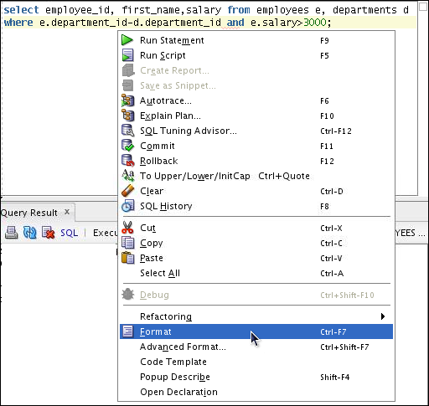
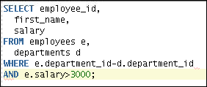
Formatting the SQL Code
__________________________________
____________________
_____
.SQL
Before
formatting
After
formatting
Notes:
You may want to format the indentation, spacing, capitalization, and line separation of the SQL code. SQL Developer has a feature for formatting SQL code.
To format the SQL code, right-click in the statement area and select Format.
In the example in the slide, before formatting, the SQL code has the keywords not capitalized and the statement not properly indented. After formatting, the SQL code is beautified with the keywords capitalized and the statement properly indented.
您可能需要格式化SQL代码的缩进，间距，大小写和行间隔。 SQL Developer具有格式化SQL代码的功能。
要格式化SQL代码，请右键单击语句区域，然后选择“格式”。
在幻灯片中的示例中，在格式化之前，SQL代码的关键字未大写，语句未正确缩进。 格式化后，SQL代码被美化，大写字母和语句正确缩进。

Slide 24
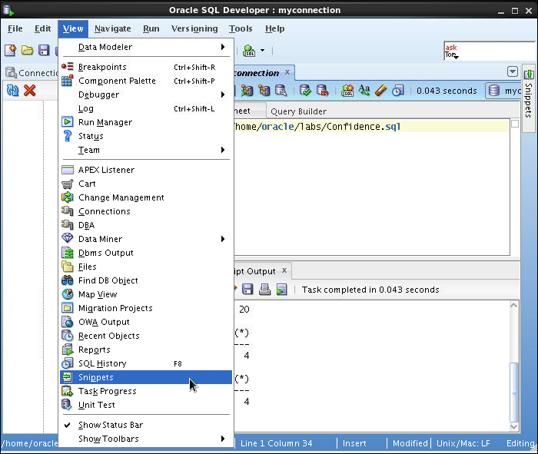
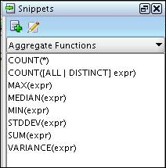
Using Snippets
Snippets are code fragments that may be just syntax or examples.
When you place your cursor here, it shows the Snippets window. From the drop-down list, you can select the functions category that you want.
Notes:
You may want to use certain code fragments when you use the SQL Worksheet or create or edit a PL/SQL function or procedure. SQL Developer has a feature called Snippets. Snippets are code fragments such as SQL functions, optimizer hints, and miscellaneous PL/SQL programming techniques. You can drag snippets to the Editor window.
To display Snippets, select View > Snippets.
The Snippets window is displayed on the right. You can use the drop-down list to select a group. A Snippets button is placed in the right window margin, so that you can display the Snippets window if it becomes hidden.
当您使用SQL工作表或创建或编辑PL / SQL函数或过程时，可能需要使用某些代码片段。 SQL Developer有一个名为Snippets的功能。 代码片段是代码片段，例如SQL函数，优化器提示和各种PL / SQL编程技术。 您可以将片段拖放到编辑器窗口。
要显示Snippets，请选择“视图”>“代码段”。
Snippets窗口显示在右侧。 您可以使用下拉列表来选择一个组。 代码片段按钮放置在右侧窗口边框中，以便您可以在Snippets窗口隐藏时显示该片段。

Slide 25
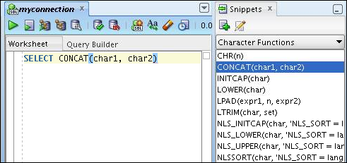
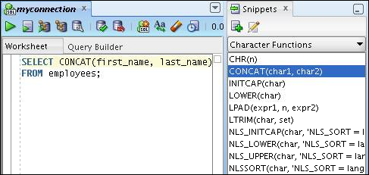
Using Snippets: Example
Inserting a
snippet
Editing the
snippet
Notes:
To insert a Snippet into your code in a SQL Worksheet or in a PL/SQL function or procedure, drag the snippet from the Snippets window to the desired place in your code. Then you can edit the syntax so that the SQL function is valid in the current context. To see a brief description of a SQL function in a tool tip, place the cursor over the function name.
The example in the slide shows that CONCAT(char1, char2)is dragged from the Character Functions group in the Snippets window. Then the CONCAT function syntax is edited and the rest of the statement is added as in the following:
SELECT CONCAT(first_name, last_name)
FROM employees;
要在SQL工作表或PL / SQL函数或过程中将代码段插入到代码中，请将代码段从“代码段”窗口拖动到代码中所需的位置。 然后，您可以编辑语法，以便SQL函数在当前上下文中有效。 要在工具提示中查看SQL函数的简要说明，请将光标放在函数名称上。
幻灯片中的示例显示，在“代码段”窗口中的“字符函数”组中拖动了CONCAT（char1，char2）。 然后，编辑CONCAT函数语法，并添加其余的语句，如下所示：

Slide 26
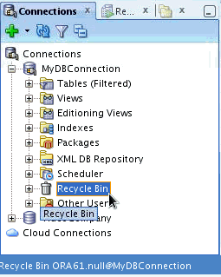
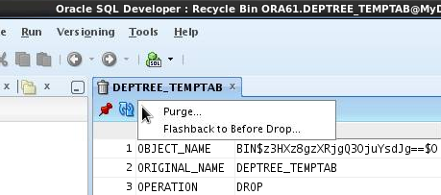
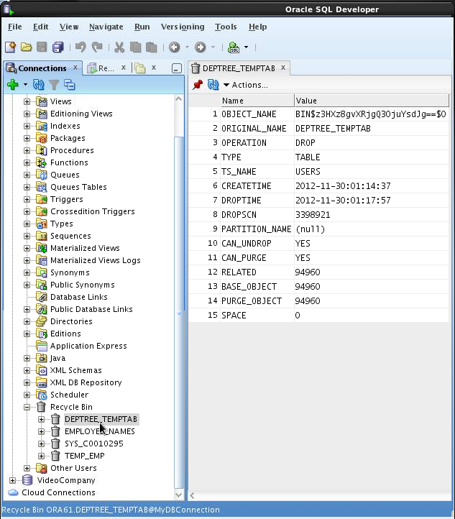
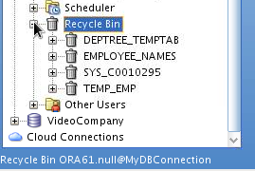
Using the Recycle Bin
The recycle bin holds objects that have been dropped.
4
Select the operations from the drop-down Actions list.
1
3
Purge: Removes the object from the Recycle bin and deletes it
Flashback to Before Drop: Moves the object from the recycle bin back to its appropriate place in the Connections navigator display
2
Notes:
The recycle bin is a data dictionary table containing information about dropped objects. Dropped tables and any associated objects such as indexes, constraints, nested tables, and the likes are not removed and still occupy space. They continue to count against user space quotas, until specifically purged from the recycle bin or the unlikely situation where they must be purged by the database because of tablespace space constraints.
To use the recycle bin, perform the following steps:
1. In the Connections navigator, select (or navigate to) the recycle bin.
2. Expand Recycle Bin and click the object name. The object details are displayed in the SQL Worksheet area.
Click the Actions drop-down list and select the operation that you want to perform on the object.
回收站是包含有关丢弃对象的信息的数据字典表。 丢弃的表和任何关联的对象（如索引，约束，嵌套表等）不会被删除，仍然占用空间。 它们继续计算用户空间配额，直到从回收站特别清除，或者由于表空间空间限制，数据库必须清除它们的不太可能的情况。
要使用回收站，请执行以下步骤：
1.在连接导航器中，选择（或导航到）回收站。
2.展开回收站并单击对象名称。 对象详细信息显示在SQL Worksheet区域中。
3.单击操作下拉列表，然后选择要对对象执行的操作。

Slide 27
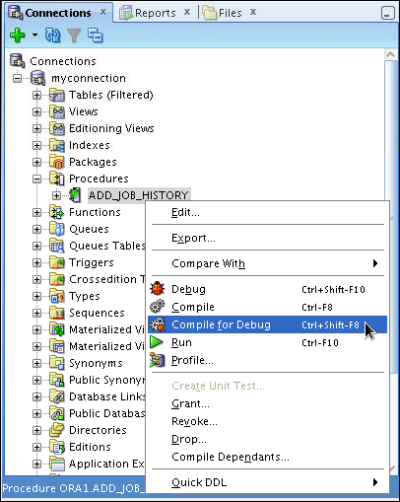
Debugging Procedures and Functions
Use SQL Developer to debug PL/SQL functions and procedures.
Use the Compile for Debug option to perform a PL/SQL compilation so that the procedure can be debugged.
Use the Debug menu options to set breakpoints, and to perform Step Into and Step Over tasks.
Notes:
In SQL Developer, you can debug PL/SQL procedures and functions. Using the Debug menu options, you can perform the following debugging tasks:
Find Execution Point goes to the next execution point.
Resume continues execution.
Step Over bypasses the next method and goes to the next statement after the method.
Step Into goes to the first statement in the next method.
Step Out leaves the current method and goes to the next statement.
Step to End of Method goes to the last statement of the current method.
Pause halts execution, but does not exit, thus allowing you to resume execution.
Terminate halts and exits the execution. You cannot resume execution from this point; instead, to start running or debugging from the beginning of the function or procedure, click the Run or Debug icon on the Source tab toolbar.
Garbage Collection removes invalid objects from the cache in favor of more frequently accessed and more valid objects.
These options are also available as icons on the Debugging tab of the output window.
在SQL Developer中，您可以调试PL / SQL过程和函数。使用调试菜单选项，您可以执行以下调试任务：
查找执行点转到下一个执行点。
恢复继续执行。
Step Over绕过下一个方法，并转到方法之后的下一个语句。
Step Into进入下一个方法的第一个语句。
Step Out离开当前的方法并转到下一个语句。
方法的一步结束将转到当前方法的最后一个语句。
暂停停止执行，但不会退出，从而允许您恢复执行。
终止停止并退出执行。你不能从这一点恢复执行;相反，要从功能或过程的开始开始运行或调试，请单击“源”选项卡工具栏上的“运行”或“调试”图标。
垃圾收集从缓存中移除无效对象，有利于更频繁访问和更有效的对象。
这些选项也可以作为输出窗口的调试选项卡上的图标。

Slide 28
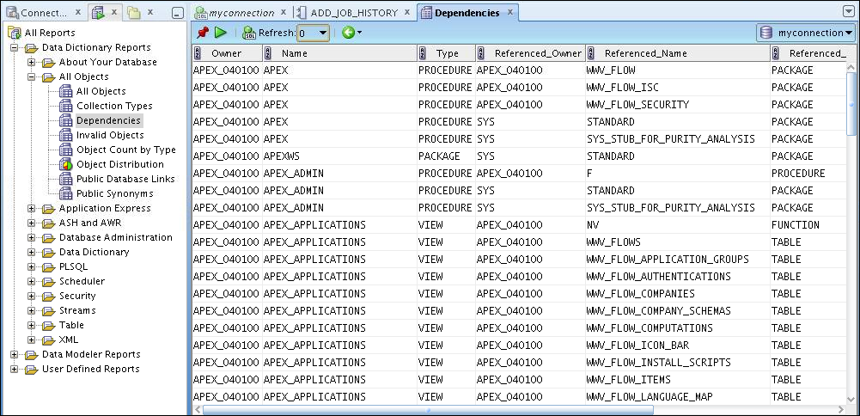
Database Reporting
SQL Developer provides a number of predefined reports about the database and its objects.
Notes:
SQL Developer provides many reports about the database and its objects. These reports can be grouped into the following categories:
About Your Database reports
Database Administration reports
Table reports
PL/SQL reports
Security reports
XML reports
Jobs reports
Streams reports
All Objects reports
Data Dictionary reports
User-Defined reports
To display reports, click the Reports tab on the left of the window. Individual reports are displayed in tabbed panes on the right of the window; for each report, you can select (using a drop-down list) the database connection for which to display the report. For reports about objects, the objects shown are only those visible to the database user associated with the selected database connection, and the rows are usually ordered by Owner. You can also create your own user-defined reports.
SQL Developer提供了许多关于数据库及其对象的报告。 这些报告可分为以下类别：
关于您的数据库报告
数据库管理报告
表格报告
PL / SQL报告
安全报告
XML报告
工作报告
流报告
所有对象报告
数据字典报告
用户定义的报告
要显示报告，请单击窗口左侧的“报告”选项卡。 单个报告显示在窗口右侧的标签窗格中; 对于每个报表，您可以选择（使用下拉列表）显示报表的数据库连接。 对于有关对象的报告，显示的对象只是与所选数据库连接相关联的数据库用户可见的对象，并且行通常由Owner排序。 您还可以创建自己的用户定义的报告。

Slide 29
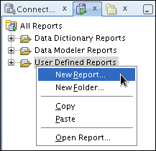
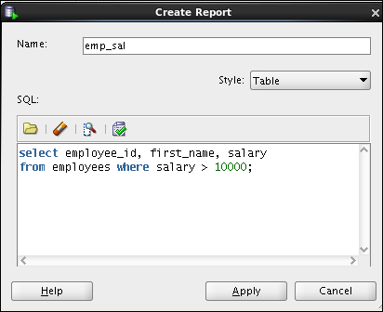
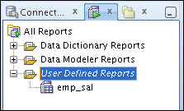
Creating a User-Defined Report
Create and save user-defined reports for repeated use.
Organize reports in folders.
Notes:
User-defined reports are reports created by SQL Developer users. To create a user-defined report, perform the following steps:
1. Right-click the User Defined Reports node under Reports and select Add Report.
2. In the Create Report dialog box, specify the report name and the SQL query to retrieve information for the report. Then click Apply.
In the example in the slide, the report name is specified as emp_sal. An optional description is provided indicating that the report contains details of employees with salary >= 10000. The complete SQL statement for retrieving the information to be displayed in the user-defined report is specified in the SQL box. You can also include an optional tool tip to be displayed when the cursor stays briefly over the report name in the Reports navigator display.
You can organize user-defined reports in folders and you can create a hierarchy of folders and subfolders. To create a folder for user-defined reports, right-click the User Defined Reports node or any folder name under that node and select Add Folder. Information about user-defined reports, including any folders for these reports, is stored in a file named UserReports.xml in the directory for user-specific information.
用户定义的报告是由SQL Developer用户创建的报告。要创建用户定义的报告，请执行以下步骤：
1.右键单击“报告”下的“用户定义报告”节点，然后选择“添加报告”。
2.在“创建报告”对话框中，指定报告名称和SQL查询以检索报告的信息。然后单击应用。
在幻灯片中的示例中，报告名称指定为emp_sal。提供了一个可选描述，指出报告中包含薪资> = 10000的员工的详细信息。用于检索要显示在用户定义报表中的信息的完整SQL语句在SQL框中指定。您还可以在“报告”导航器显示屏中包含一个可选的工具提示，以便在光标停留在报告名称上时显示。
您可以在文件夹中组织用户定义的报告，您可以创建文件夹和子文件夹的层次结构。要为用户定义的报告创建文件夹，请右键单击“用户定义的报告”节点或该节点下的任何文件夹名称，然后选择“添加文件夹”。关于用户定义的报告（包括这些报告的任何文件夹）的信息存储在用户特定信息目录中的名为UserReports.xml的文件中。

Slide 30
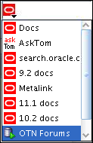
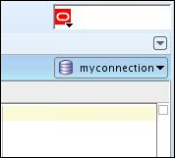
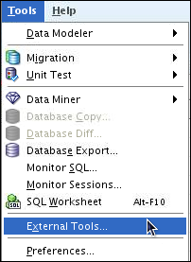
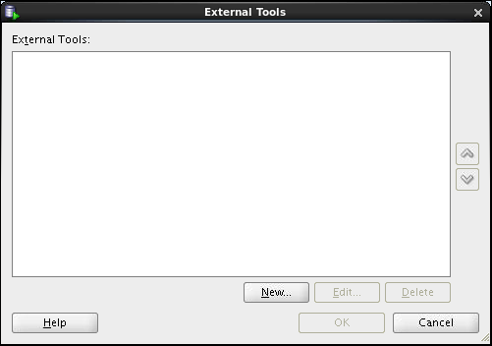
Search Engines and External Tools
1
Links to popular search engines and discussion forums
Shortcut to switch between connections
2
Notes:
To enhance the productivity of developers, SQL Developer has added quick links to popular search engines and discussion forums such as AskTom, Google, and so on. Also, you have shortcut icons to some of the frequently used tools such as Notepad, Microsoft Word, and Dreamweaver, available to you.
You can add external tools to the existing list or even delete shortcuts to the tools that you do not use frequently. To do so, perform the following steps:
1. From the Tools menu, select External Tools.
In the External Tools dialog box, select New to add new tools. Select Delete to remove any tool from the list.
为了提高开发人员的生产力，SQL Developer已经添加到热门搜索引擎和讨论论坛（如AskTom，Google等）的快速链接。 此外，您可以使用一些常用工具（如记事本，Microsoft Word和Dreamweaver）的快捷方式图标。
您可以将外部工具添加到现有列表中，甚至可以删除不经常使用的工具的快捷方式。 为此，请执行以下步骤：
1.从工具菜单中，选择外部工具。
2.在“外部工具”对话框中，选择“新建”以添加新工具。 选择删除以从列表中删除任何工具。

Slide 31


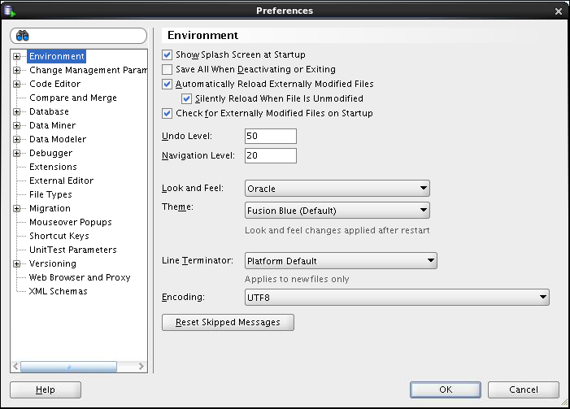
Setting Preferences
Customize the SQL Developer interface and environment.
In the Tools menu, select Preferences.
Notes:
You can customize many aspects of the SQL Developer interface and environment by modifying SQL Developer preferences according to your needs. To modify SQL Developer preferences, select Tools, and then Preferences.
The preferences are grouped into the following categories:
Environment
Change Management Parameter
Code Editors
Compare and Merge
Database
Data Miner
Data Modeler
Debugger
Extensions
External Editor
File Types
您可以通过根据您的需要修改SQL Developer的首选项来自定义SQL Developer界面和环境的许多方面。 要修改SQL Developer首选项，请选择工具，然后选择首选项。
偏好分为以下几类：
环境
变更管理参数
代码编辑器
比较和合并
数据库
数据挖掘机
数据建模器
调试器
扩展
外部编辑
文件类型

Slide 32
Notes:
Migration
Mouseover Popups
Shortcut Keys
Unit Test Parameters
Versioning
Web Browser and Proxy
XML Schemas
移民
鼠标悬停弹出窗口
快捷键
单位测试参数
版本
Web浏览器和代理
XML模式

Slide 33
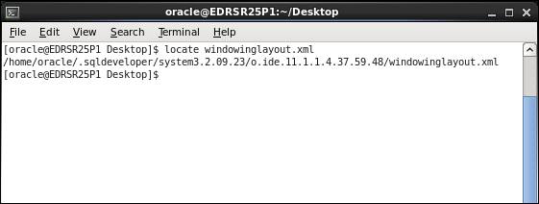

Resetting the SQL Developer Layout
Notes:
While working with SQL Developer, if the Connections Navigator disappears or if you cannot dock the Log window in its original place, perform the following steps to fix the problem:
1. Exit SQL Developer.
2. Open a terminal window and use the locate command to find the location of windowinglayout.xml.
3. Go to the directory that has windowinglayout.xml and delete it.
Restart SQL Developer.
在使用SQL Developer时，如果连接导航器消失，或者无法将日志窗口停放在原始位置，请执行以下步骤来解决问题：
1.退出SQL Developer。
2.打开一个终端窗口，并使用locate命令查找windowinglayout.xml的位置。
3.转到具有windowinglayout.xml的目录并将其删除。
4.重新启动SQL Developer。

Slide 34
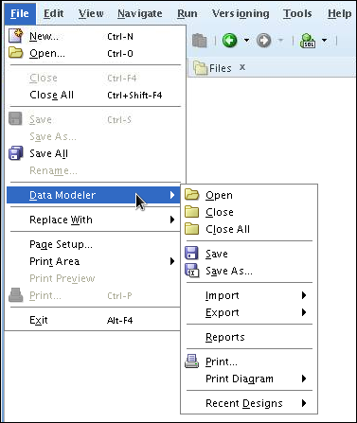
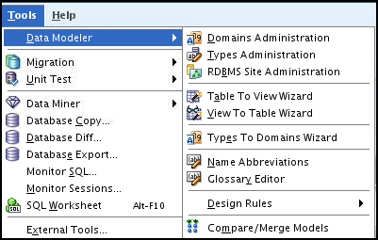
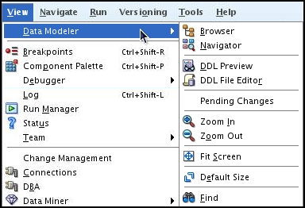
Data Modeler in SQL Developer
SQL Developer includes an integrated version of SQL Developer Data Modeler.
The Tools > Data Modeler menu options provide the administration and wizard options.
The File > Data Modeler menu options allow you to open, save, and print design models.
The View > Data Modeler menu options provide navigation and view options.
Notes:
Using the integrated version of the SQL Developer Data Modeler, you can:
Create, open, import, and save a database design
Create, modify, and delete Data Modeler objects
To display Data Modeler in a pane, click Tools, and then Data Modeler. The Data Modeler menu under Tools includes additional commands, for example, that enable you to specify design rules and preferences.
使用集成版本的SQL Developer Data Modeler，您可以：
创建，打开，导入和保存数据库设计
创建，修改和删除Data Modeler对象
要在窗格中显示Data Modeler，请单击工具，然后单击Data Modeler。 “工具”下的“数据建模器”菜单包括其他命令，例如，可以指定设计规则和首选项。

Slide 35

Summary
In this appendix, you should have learned how to use SQL Developer to do:
Browse, create, and edit database objects
Execute SQL statements and scripts in SQL Worksheet
Create and save custom reports
Browse the Data Modeling options in SQL Developer
Notes:
SQL Developer is a free graphical tool to simplify database development tasks. Using SQL Developer, you can browse, create, and edit database objects. You can use SQL Worksheet to run SQL statements and scripts. SQL Developer enables you to create and save your own special set of reports for repeated use.
SQL Developer是一个免费的图形化工具，用于简化数据库开发任务。 使用SQL Developer可以浏览，创建和编辑数据库对象。 您可以使用SQL Worksheet来运行SQL语句和脚本。 SQL Developer使您能够创建并保存自己的特殊报告集以供重复使用。

