Slide 1
藉由客觀數據
找出影響紅白酒品質之因素
10727122 廖奕銘
10727132 張任宏

Slide 2
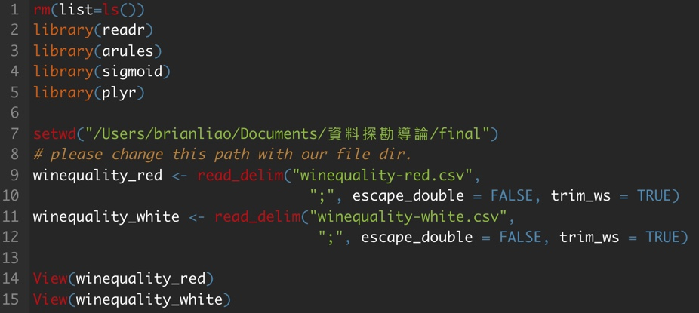
載入Dataset

Slide 3
初始化及載入library
載入Dataset

Slide 4
設置work directory及讀入dataset
載入Dataset

Slide 5
查看讀入結果
載入Dataset

Slide 6
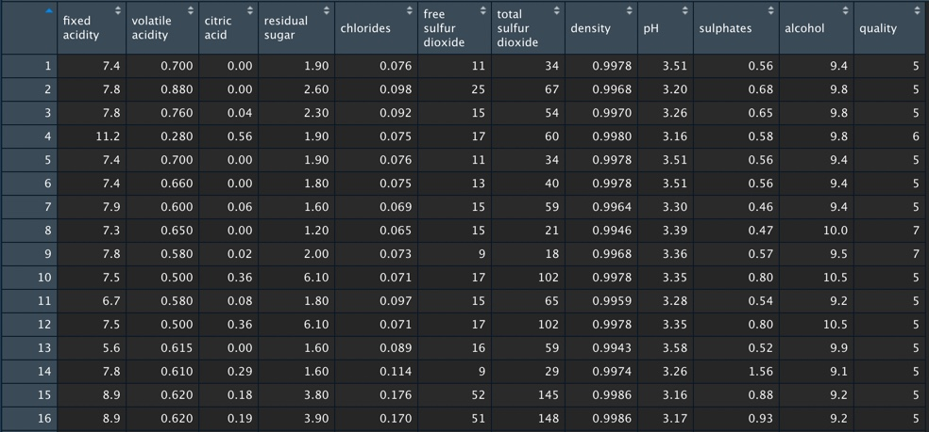
winequality_red
載入Dataset

Slide 7
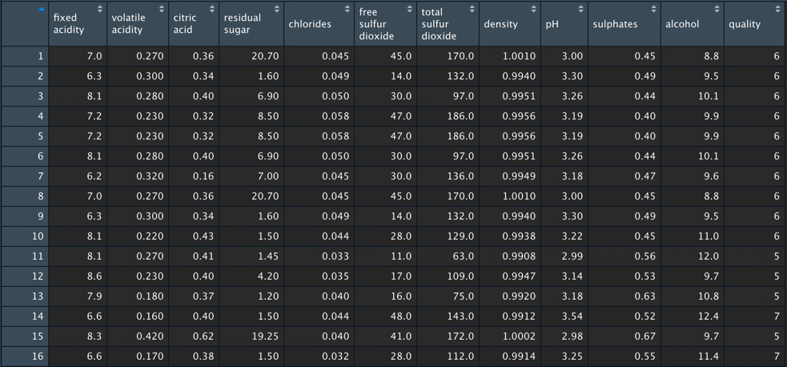
winequality_white
載入Dataset

Slide 8
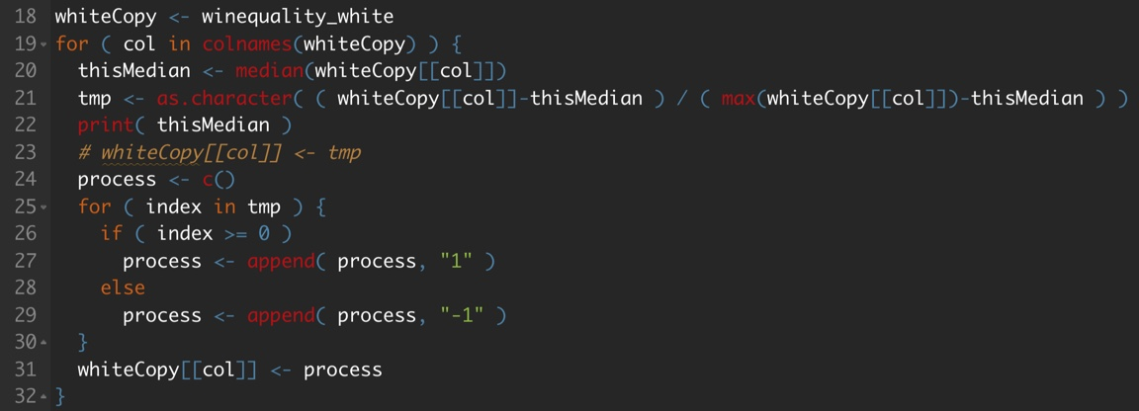
Preprocessing

Slide 9
將winequality_white放到whitecopy，之後以col遍歷colname
Preprocessing

Slide 10
取得各 attribute 的中位數，再以各欄位減去中位數後除最大值與中位數的差
Preprocessing

Slide 11
將正值改成 1，負值改為 -1
Preprocessing

Slide 12
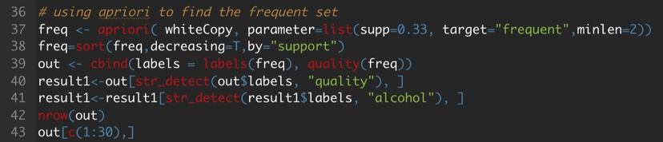
以 apriori 找 frequent，以min sump = 0.33 找 alcohol, quality
Apriori

Slide 13
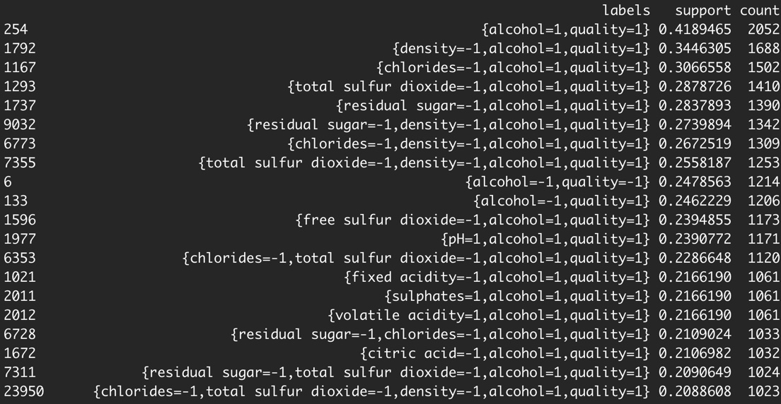
White wine frequent set ( alcohol, quality )
Result

Slide 14
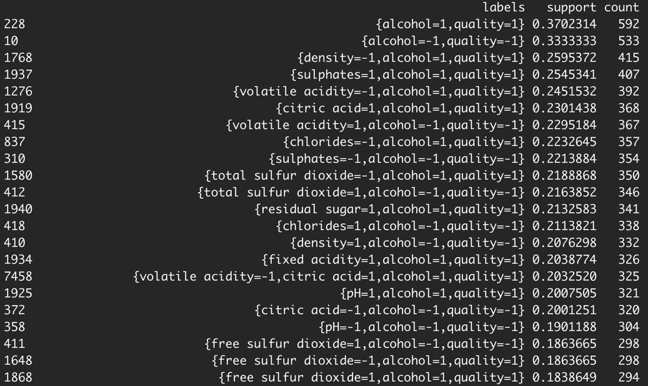
Red wine frequent set ( alcohol, quality )
Result

Slide 15
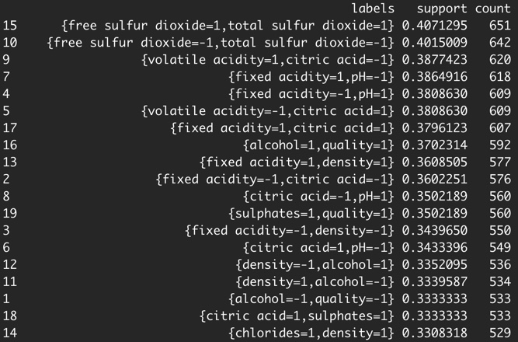
Red wine
frequent set
Result

Slide 16
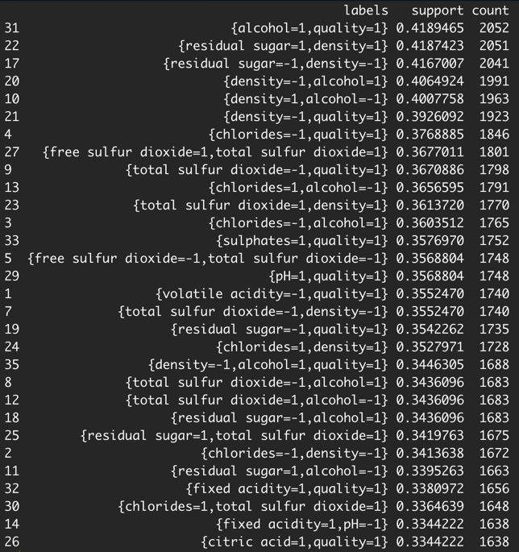
Red wine
frequent set
Result

Slide 17
Thanks for listening

