Slide 1
Irish Enzymes Stock and Customer Management System
Thomas Dowling
(X11107049)
National College of Ireland

Slide 2
Part One
Searching (with Ajax enabled)

Slide 3
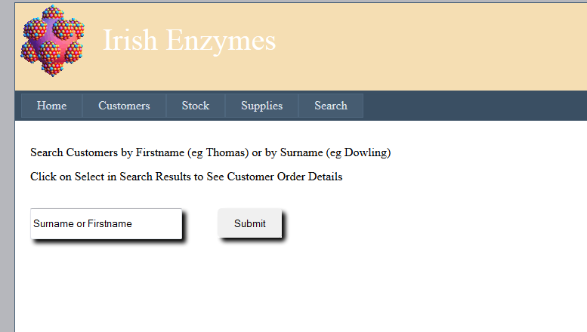
Searching of Customers Table
May Search by Surname or Firstname
Auto-completion configured with both parameters
Drop-Shadow and Rounded Corners done with extenders from the Ajax Control Toolkit

Slide 4
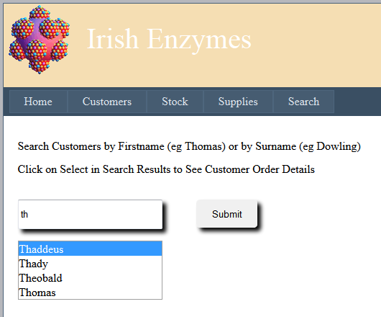
Searching of Customers Table
Ajax (autocompletion) with firstname

Slide 5
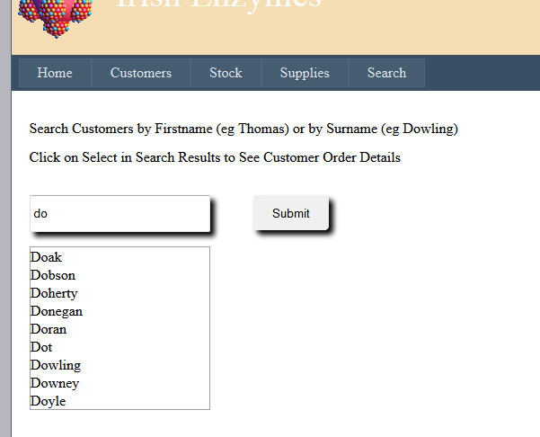
Searching of Customers Table
And with Surname…

Slide 6
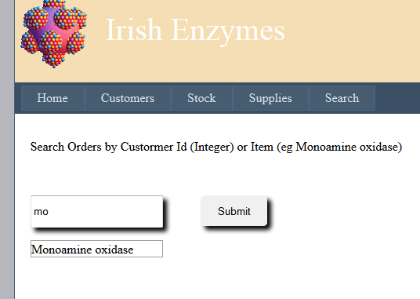
Searching of Orders Table
Autocompletion (Ajax) with either
Customer-id
Item

Slide 7
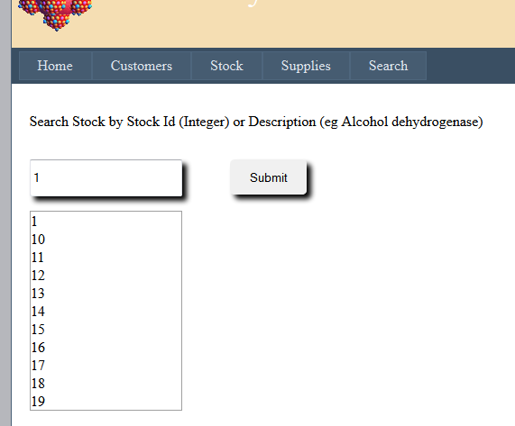
Searching of Stock Table
Autocompletion (Ajax) with either
Stock-ID
Description

Slide 8
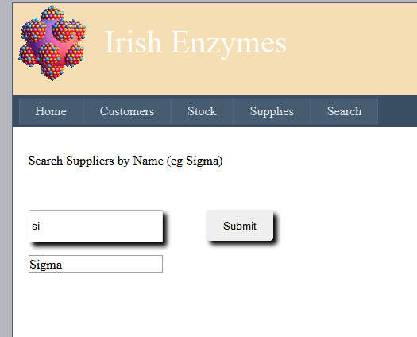
Searching of Suppliers Table
Autocompletion (Ajax) with Suppliers Name

Slide 9
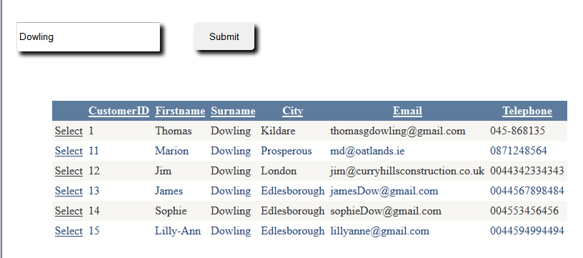
Results of a Typical Customers Search

Slide 10
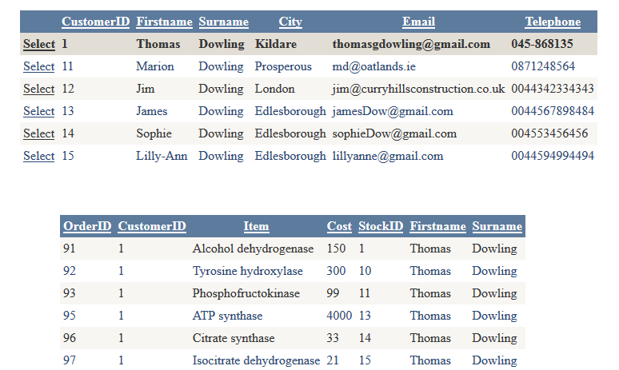
‘Master-Detail’ Effect with Search
Clicking on Select from a Search Result gives
Details of the Orders Placed by that Customer

Slide 11
Part Two
Management of Customer Details

Slide 12
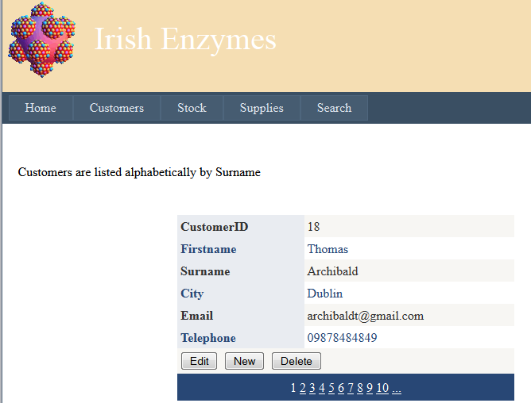
Customer Details
May Create New Customer
May Edit or Delete a Customer’s Details
May Browse Customer Details

Slide 13
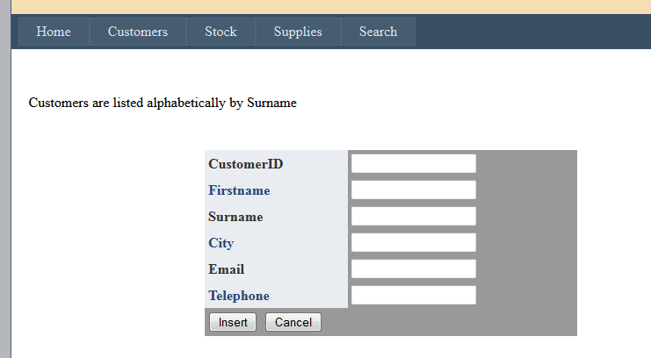
Create a New Customer
May Create New Customer
May Edit or Delete a Customer’s Details
May Browse Customer Details

Slide 14
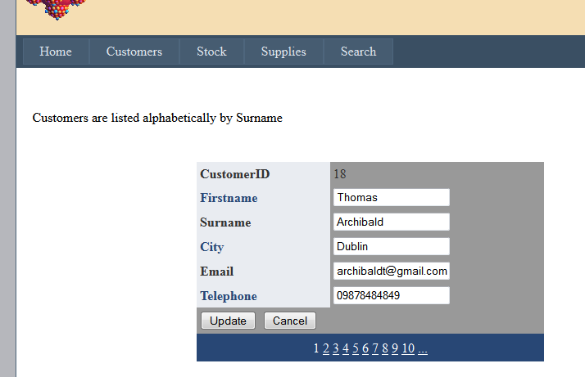
Update a Customer’s Details

Slide 15
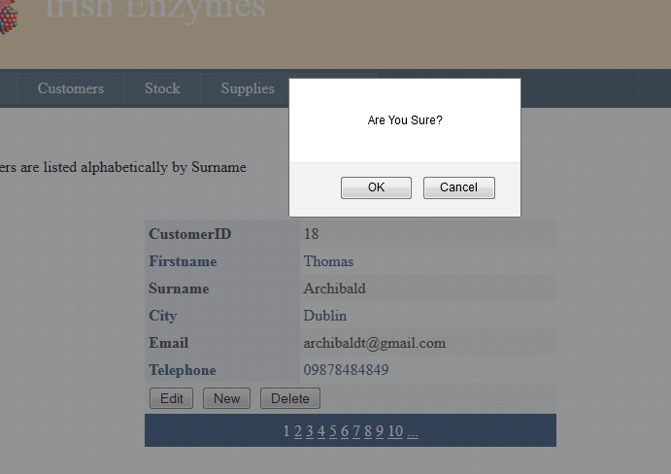
Confirm Before Delete
This effect was achieved with the ConfirmButtonExtender (Ajax Toolbox)

Slide 16
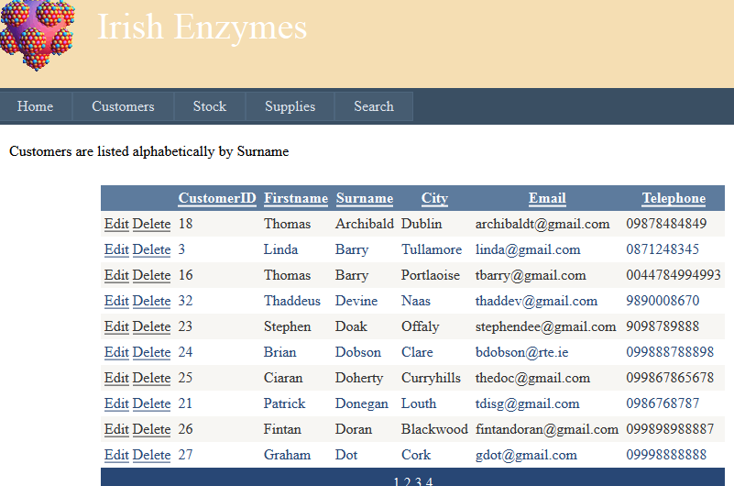
A GridView of Customer Details

Slide 17
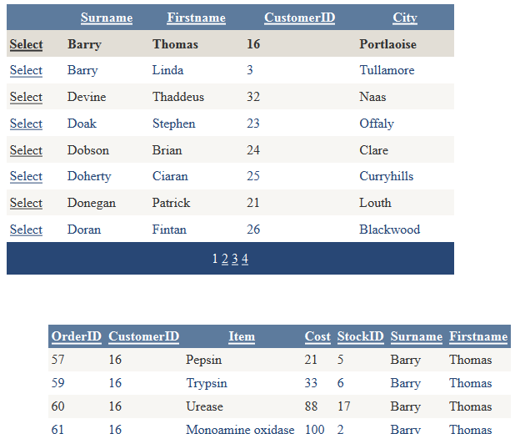
Master-Details with Customers

Slide 18
Part Three
Management of Stock

Slide 19
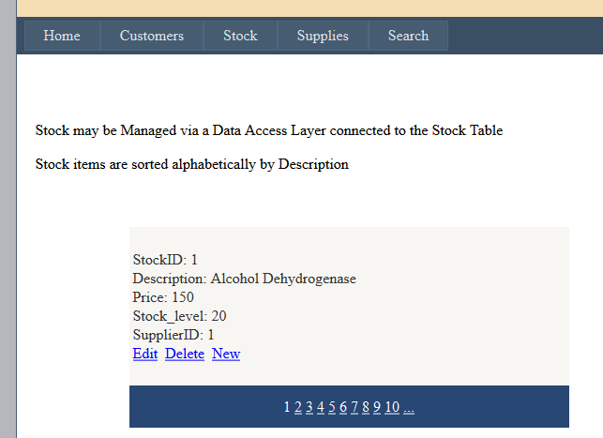
Data Access Layer Connected to the Stock Table

Slide 20
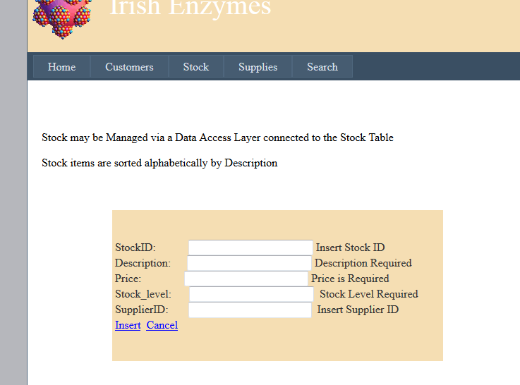
Validation of Update Fields prior to Submission

Slide 21
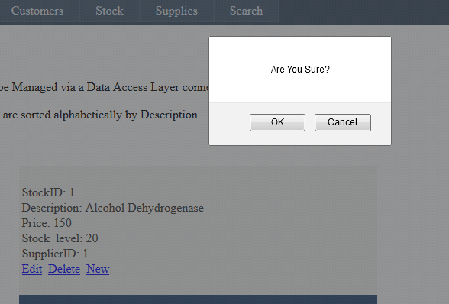
Validation before Delete

Slide 22
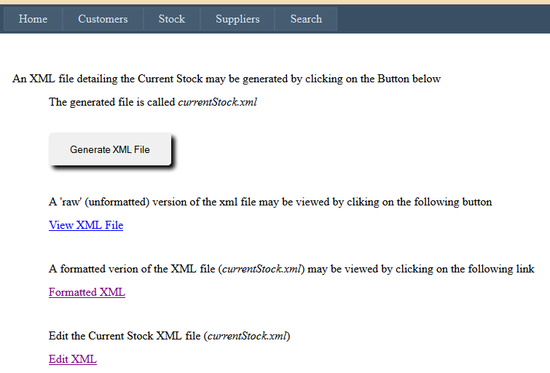
Generate and View XML File detailing Current Stock
(Accounts/Stock/currentStock.xml)

Slide 23
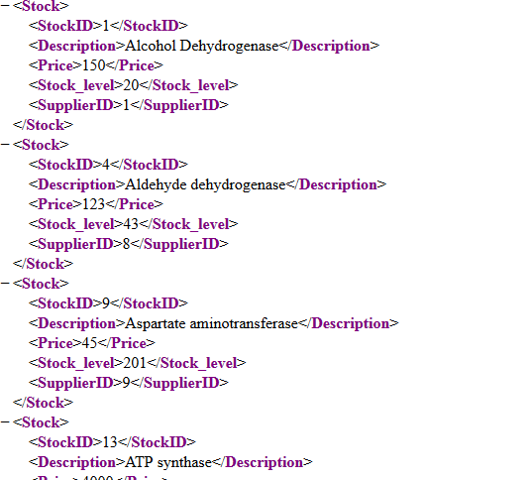
An Example of a Typical XML File Output

Slide 24
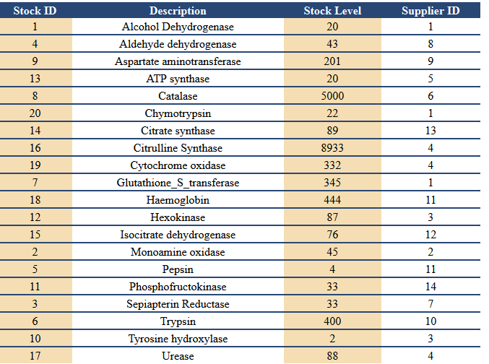
The Formatted Current Stock XML file
(Accounts/Stock/formattedXML.aspx)

Slide 25
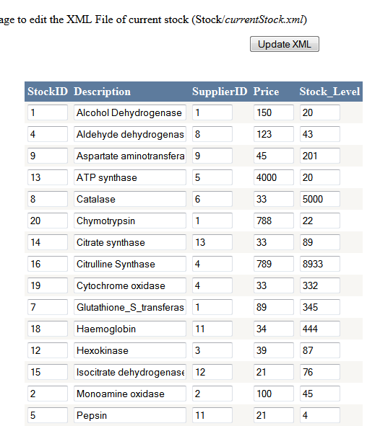
The CurrentStock.xml file may be updated…

Slide 26
Part Four
Management of Suppliers

Slide 27
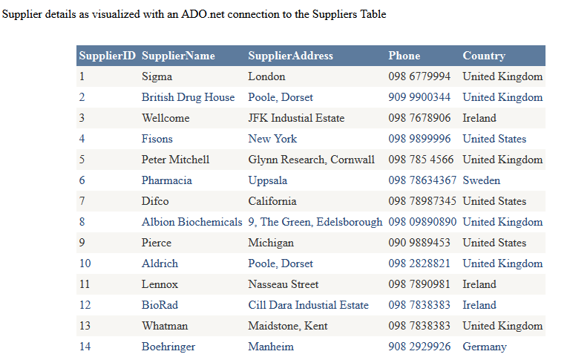
Supplier Details as Visualized with an ADO.net Connection
to the Suppliers Table

Slide 28
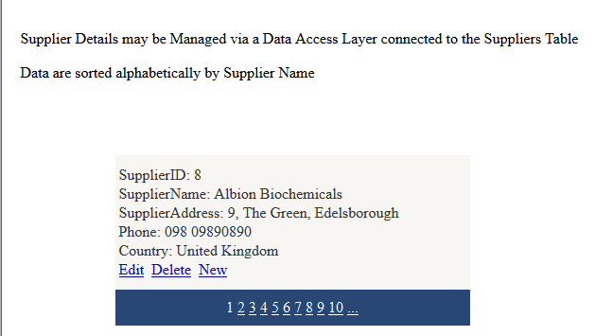
Data Access Layer Connected to the Suppliers Table
The functionality is similar to that of the DAL
Layer connected to the Stock Table (Described Above)

Slide 29
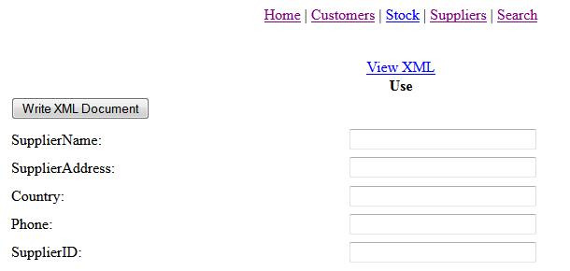
Generate an XML File for a new Supplier
MasterPage did not work (for me) with this one
(Stock/Suppliers/newSupplier.xml)

Slide 30
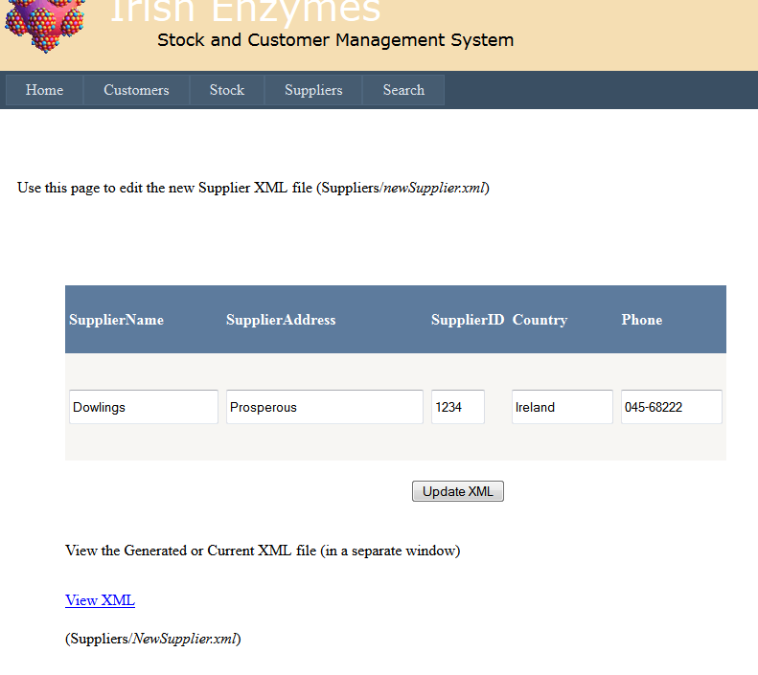
The newSupplier.xml File may be Edited..
(Stock/Suppliers/newSupplier.xml)

Slide 31
Part Five
Login

Slide 32
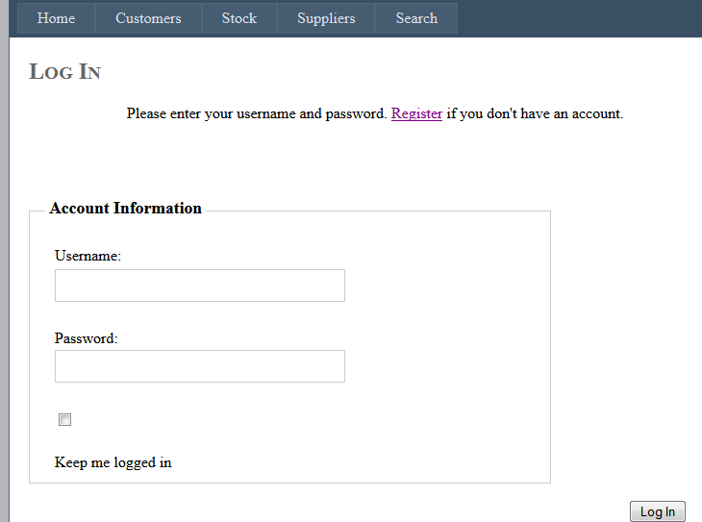
Login Screen

Slide 33
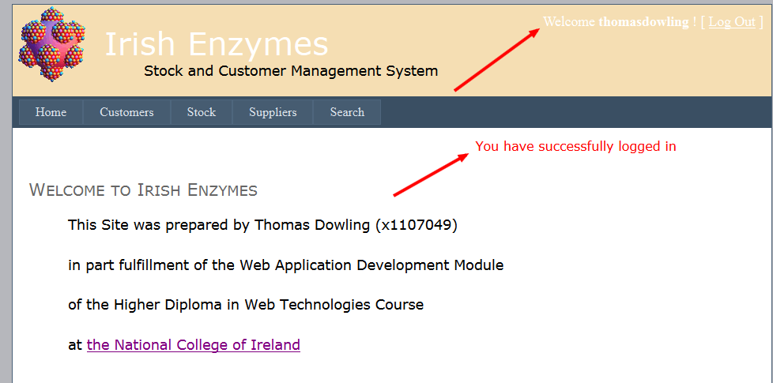
Successful Login
Successful Login redirects to Home Page

Slide 34
A Problem with Login …
"The connection name 'ApplicationServices' was not found in the applications configuration or the connection string is empty.“
The above problem was SOLVED (eventually)
by appropriately modifying the web.config file with the following code
See (from Stack Overflow): http://stackoverflow.com/questions/4645009/how-to-change-asp-net-configuration-tool-connection-string

Slide 35
Stack OverFlow Code (web.config)
<membership> <providers> <clear/> <add name="AspNetSqlMembershipProvider" type="System.Web.Security.SqlMembershipProvider" connectionStringName="LocalSqlServer" enablePasswordRetrieval="false" enablePasswordReset="true" requiresQuestionAndAnswer="false" requiresUniqueEmail="false" maxInvalidPasswordAttempts="5" minRequiredPasswordLength="6" minRequiredNonalphanumericCharacters="0" passwordAttemptWindow="10" applicationName="/"/> </providers> </membership>

Slide 36
Part Six
Custom Error Message

Slide 37

Custom Error Message
When an error occurs the user is directed to a
custom error page.

Slide 38
Part Seven
Flow Diagrams
Each flow diagram describes the functionality on the drop-down menu items in the Website

Slide 39
Search Functionality
Ajax (auto-completion) enabled in all cases

Slide 40
Customers Flowchart

Slide 41
Stock Flowchart

Slide 42
Suppliers Flowchart

