Slide 1
Reading Social State from Respiration
A Switching RNN on the breathing waveform — Valence & Rank

Slide 2
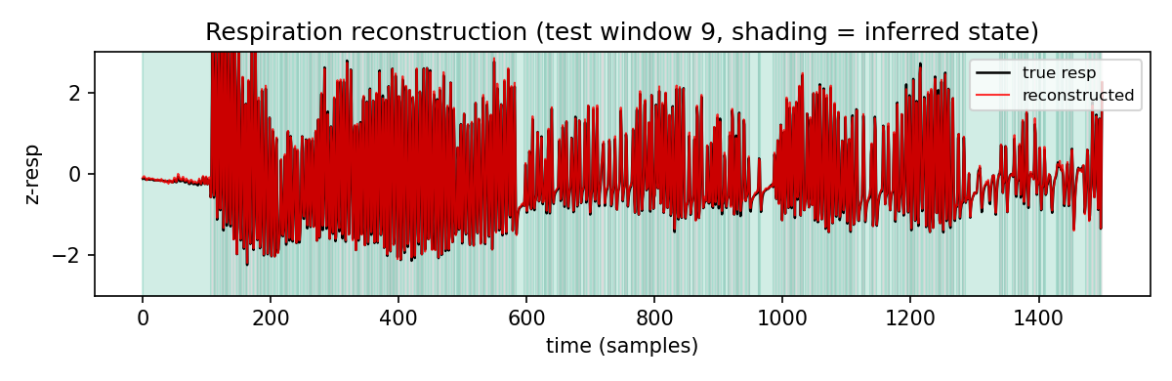
Valence — reconstruction (held-out)
• True vs SRNN-reconstructed breathing,
• held-out windows (leave-one-subject-out).
per-fold held-out MSE
fold0 0.013761
fold1 0.002536
fold2 0.020521
fold3 0.012259
fold4 0.005540
fold5 0.003261
fold6 0.005920
fold7 0.010101
-------------------
MEAN 0.009237
(min .0025 max .0205)
• respiration/plot/resp_recon.png

Slide 3
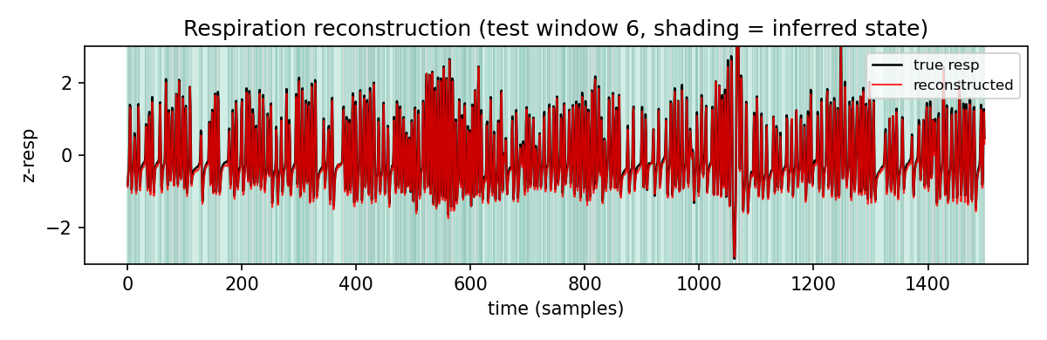
Rank — reconstruction (held-out)
• True vs SRNN-reconstructed breathing,
• held-out windows (leave-one-cage-out).
per-fold held-out MSE
fold0 0.002808
fold1 0.005947
fold2 0.007453
fold3 0.004695
-------------------
MEAN 0.005226
(min .0028 max .0075)
• respiration/plot_rank/resp_recon.png

Slide 4
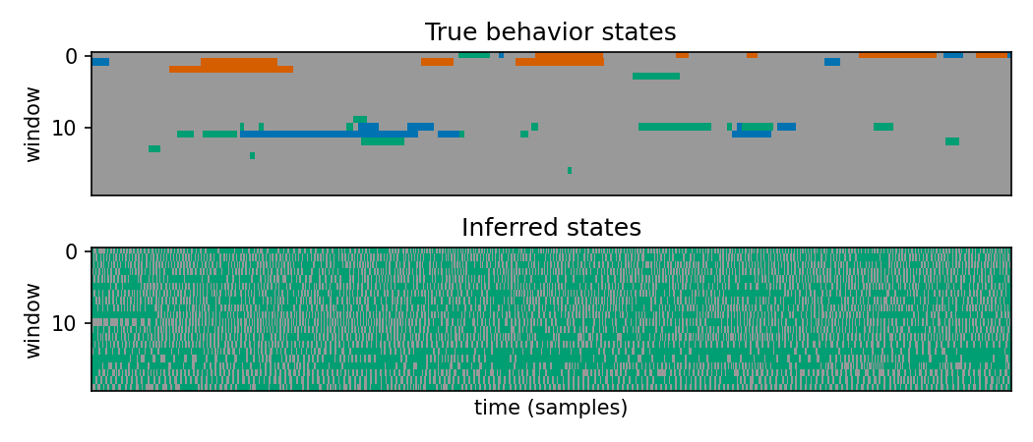
Valence — discovered discrete states
• Discovery mode (coef_cross = 0):
• states learned from the breathing signal,
• not from sniff labels.
• Two dominant states ≈ inhale / exhale.
• respiration/plot/states.png

Slide 5
Switch rate → breathing rate
• Equation: breathing_Hz = switch_rate × fs / 2 (fs = 50 Hz)
• Why it works:
– The two discovered states ≈ inhale and exhale.
– One full breath = inhale → exhale = 2 state switches.
– switch_rate = fraction of timesteps where the state changes (switches per sample).
– switches/sec = switch_rate × fs ; breaths/sec = switches/sec ÷ 2.
• Example recordings:
– RI1_s2_4 switch_rate 0.354 → 8.86 Hz
– RI1_s1_1 switch_rate 0.317 → 7.92 Hz
– RI2_s3_5 switch_rate 0.231 → 5.77 Hz
– RI2_s4_8 switch_rate 0.240 → 6.01 Hz

Slide 6
Valence — breathing rate & latent decode
• Breathing rate → valence: ROC-AUC = 1.00 (n = 15 recordings).
– Positive mean 7.93 Hz | Negative mean 6.51 Hz.
• Leave-one-subject-out decode, balanced accuracy (chance = 0.5):
– rate only ............................. 0.706
– full latent h ......................... 0.762
– latent h, rate regressed out .......... 0.756

Slide 7
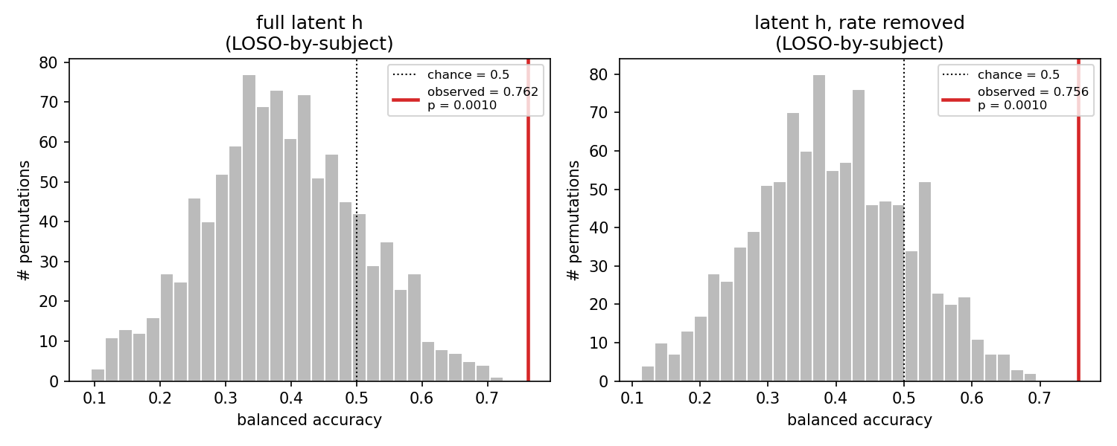
Valence — permutation test (LOSO)
• Null: valence labels shuffled at recording
• level; decode recomputed × 1000.
• full latent: obs 0.762, null 0.387±0.118, p = 0.001
• rate-removed: obs 0.756, null 0.393±0.112, p = 0.001
• respiration/plot/permutation_test_subject.png

Slide 8
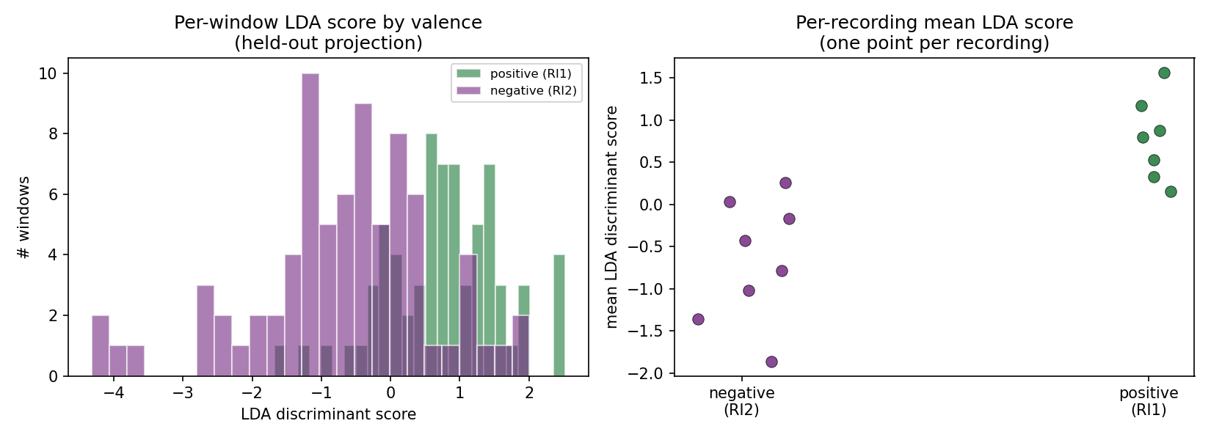
Valence — LDA projection (LOSO)
• Held-out leave-one-subject-out LDA projection.
• Left: per-window score by valence.
• Right: per-recording means.
• respiration/plot/lda_projection_subject.png

Slide 9
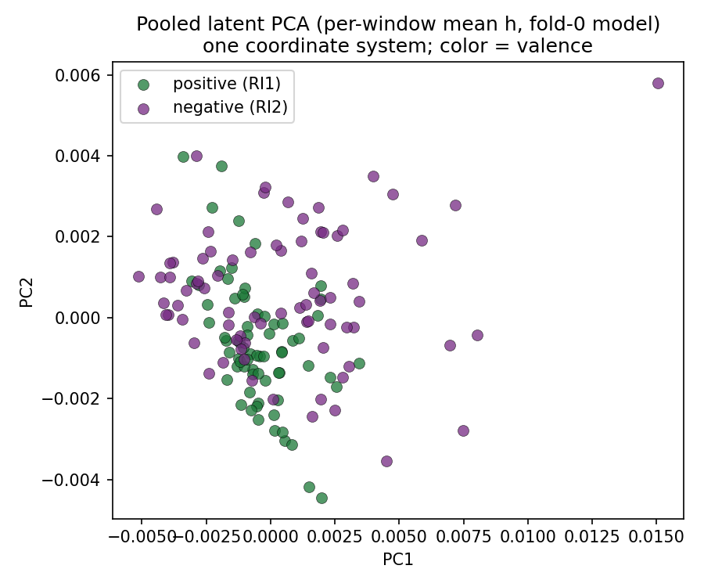
Valence — latent PCA
• All 147 windows through one model (fold 0).
• Per-window mean latent, 2 principal components,
• colored by valence.
• respiration/plot/pooled_latent_pca_by_valence.png

Slide 10
Rank — breathing rate & latent decode
• Data: 70 windows, 7 recordings, 4 cages (leave-one-cage-out).
• Breathing rate → rank: ROC-AUC = 0.333.
– Dominant mean 6.87 Hz | Subordinate mean 7.55 Hz.
• Leave-one-cage-out decode, balanced accuracy (chance = 0.5):
– rate only ............................. 0.604
– full latent h ......................... 0.446
– latent h, rate regressed out .......... 0.550
– decode permutation p: rate-removed 0.18, full latent 0.39.

Slide 11
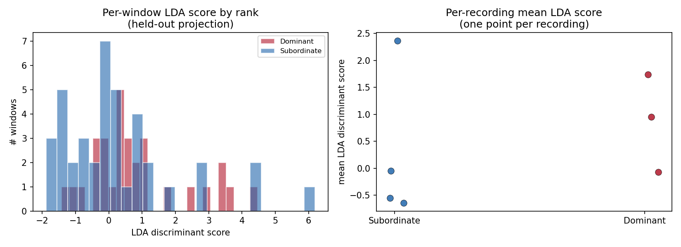
Rank — LDA projection (LOCO)
• Held-out leave-one-cage-out LDA projection.
• Left: per-window score by rank.
• Right: per-recording means.
• respiration/plot_rank/lda_projection_cage.png

Slide 12
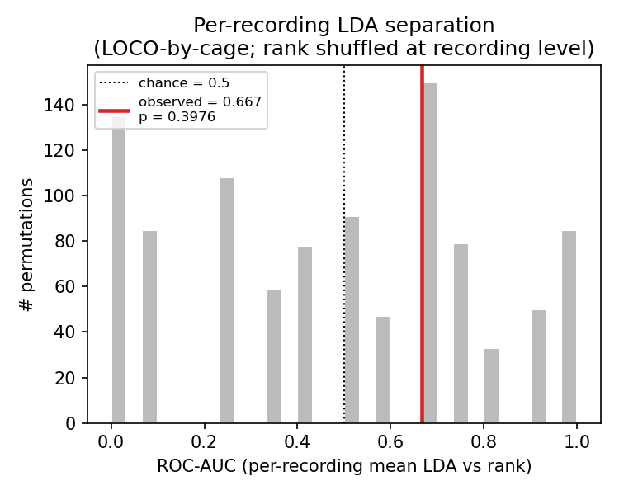
Rank — LDA permutation test (LOCO)
• Statistic = ROC-AUC(per-recording mean LDA
• score → rank), n = 7 recordings.
• Observed AUC = 0.667.
• Null mean 0.477 ± 0.316.
• p = 0.40.
• respiration/plot_rank/lda_permutation_cage.png

Slide 13
Summary — key numbers
• Valence (LOSO, 147 windows, 8 subjects):
– rate → valence AUC 1.00 ; latent decode 0.762 (rate-removed 0.756) ; permutation p = 0.001.
– reconstruction MSE mean 0.0092.
• Rank (LOCO, 70 windows, 4 cages):
– rate → rank AUC 0.333 ; latent decode 0.446 (rate-removed 0.550) ; decode permutation p = 0.18.
– per-recording LDA AUC 0.667, permutation p = 0.40 ; reconstruction MSE mean 0.0052.

