Slide 1



Best Practices & Pitfalls in Applying Machine Learning to Magnetic Resonance Imaging
Thomas Moreau
thomas.moreau@inria.fr

Slide 2
Declaration of
Financial Interests or Relationships
Speaker Name: Thomas Moreau
I have no financial interests or relationships to disclose with regard to the subject matter of this presentation.

Slide 3
Outline
Supervised Learning
Model selection and cross-validation
Weakly supervised learning
Large models computationnal tradeoff

Slide 4
Supervised Learning
Classical machine learning framework
  Google, Facebook, amazon, …
  Computer Vision, Speech processing, …
  Millions/Billions of samples
  Lots of annotations

Slide 5
Supervised Learning
Classical machine learning framework
From annotated data, predict an outcome

Slide 6
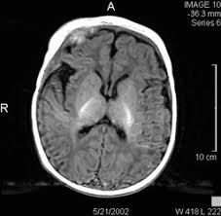
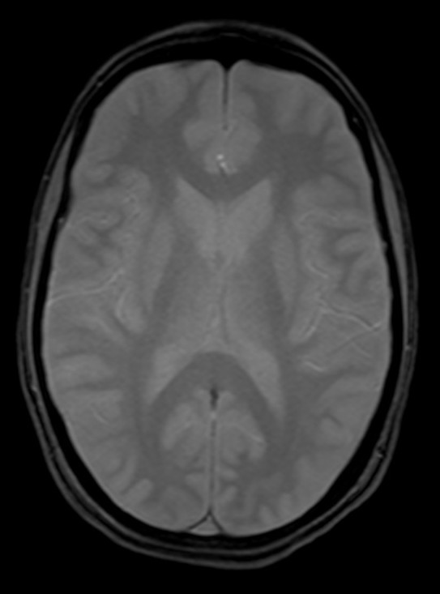
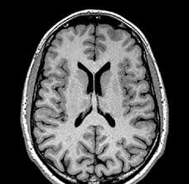
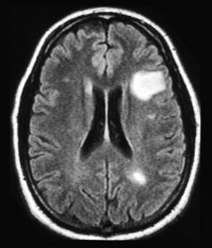
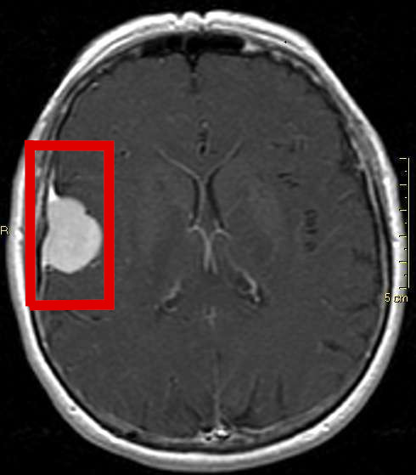
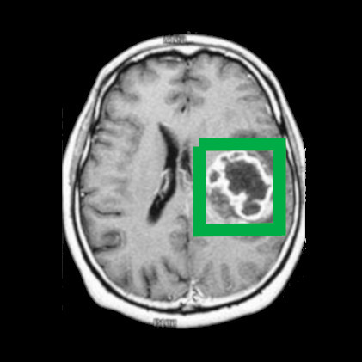
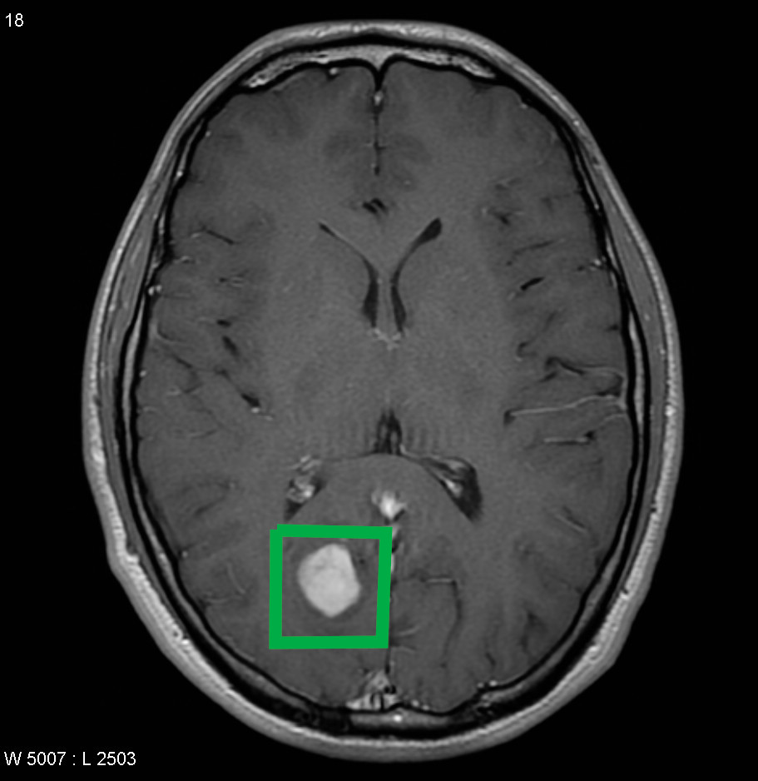
Supervised Learning
From annotated data, predict an outcome
Training
Outcomes
Annotations

Slide 7




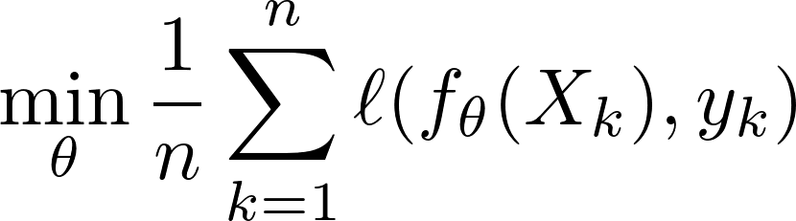
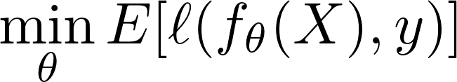
Empirical Risk Minimization
Data distribution: Model:
Training set: Loss:
Risk minimization
Empirical Risk Minimization

Slide 8
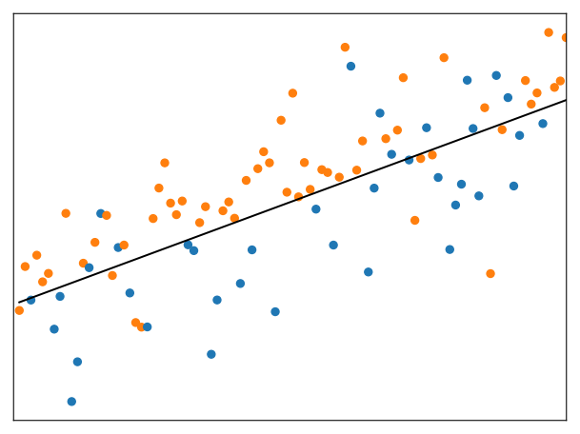
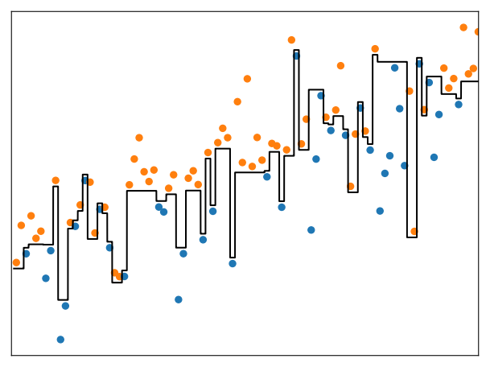
Model Selection
Binary classification:
    Linear model Decision tree

Slide 9

Model Selection: Generalization
Data distribution: Model:
Training set: Loss:
Risk minimization Empirical Risk Minimization
Generalization: measure this discrepancy

Slide 10
Model Selection: Generalization
Measuring the generalization: Test set
Split the data in 2 parts:
  Train the model
  on one part
  Evaluate the model
  on unseen and
  independent data
X
Test
40%
Train
Split
60%

Slide 11
Model Selection
Binary classification:
    Linear model Decision tree
Generalization:
How does the model behave
with new, unlabelled data
Training Error: 10%
Test Error: 10%
Training Error: 0%
Test Error: 40%

Slide 12
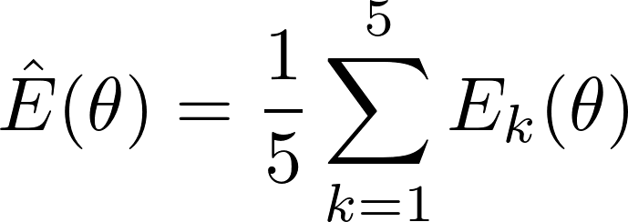

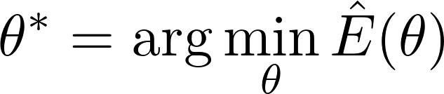


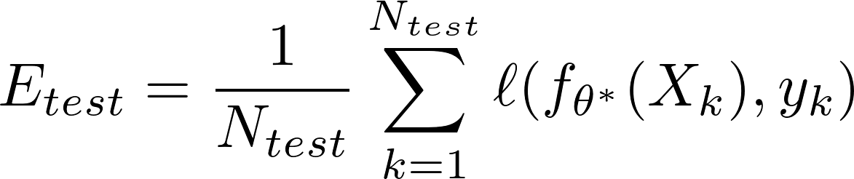


Model Selection: Generalization
Generalization for model selection: Cross validation
Test
Train
Validation
Train
Split 1
Splits
Split 1
Split 1
Train
Split 2
1-2
Splits
Splits
Split 2
Split 3
1-4
Splits
Splits
Split 3
1-3
Split 4
Splits
3-5
2-5
Split 4
Split 5
4-5
Split 5
Split 5

Slide 13
Model Selection: Generalization
Generalization for model selection:
      Cross validation
Evaluate the risk with left out data
Splitting strategies:
  Leave-one-out (LOO)
  Random splits
  Stratified

Slide 14
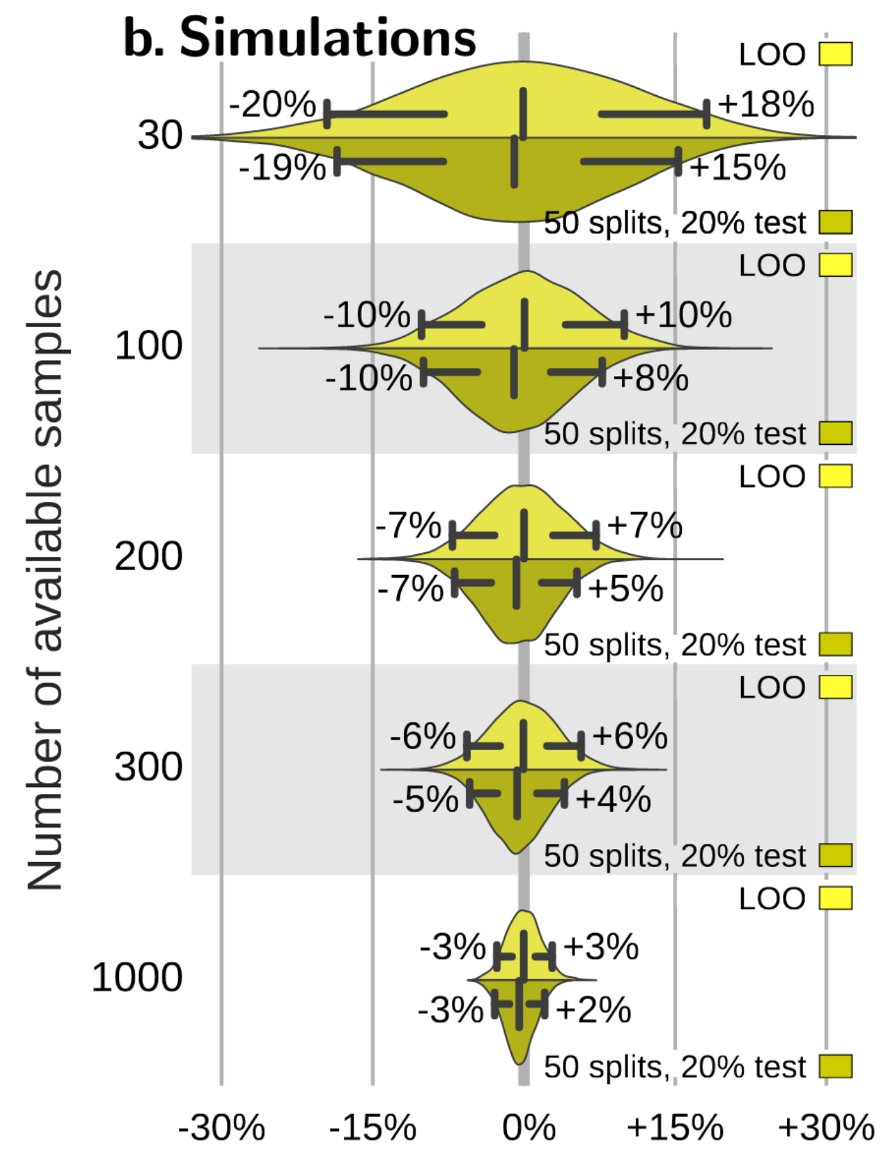


Model Selection: Sample size
Uncertainty of CV
  Sample size
X drawn from 2 Gaussian
Display the difference:
for large =10000
[Varoquaux, 2017]

Slide 15
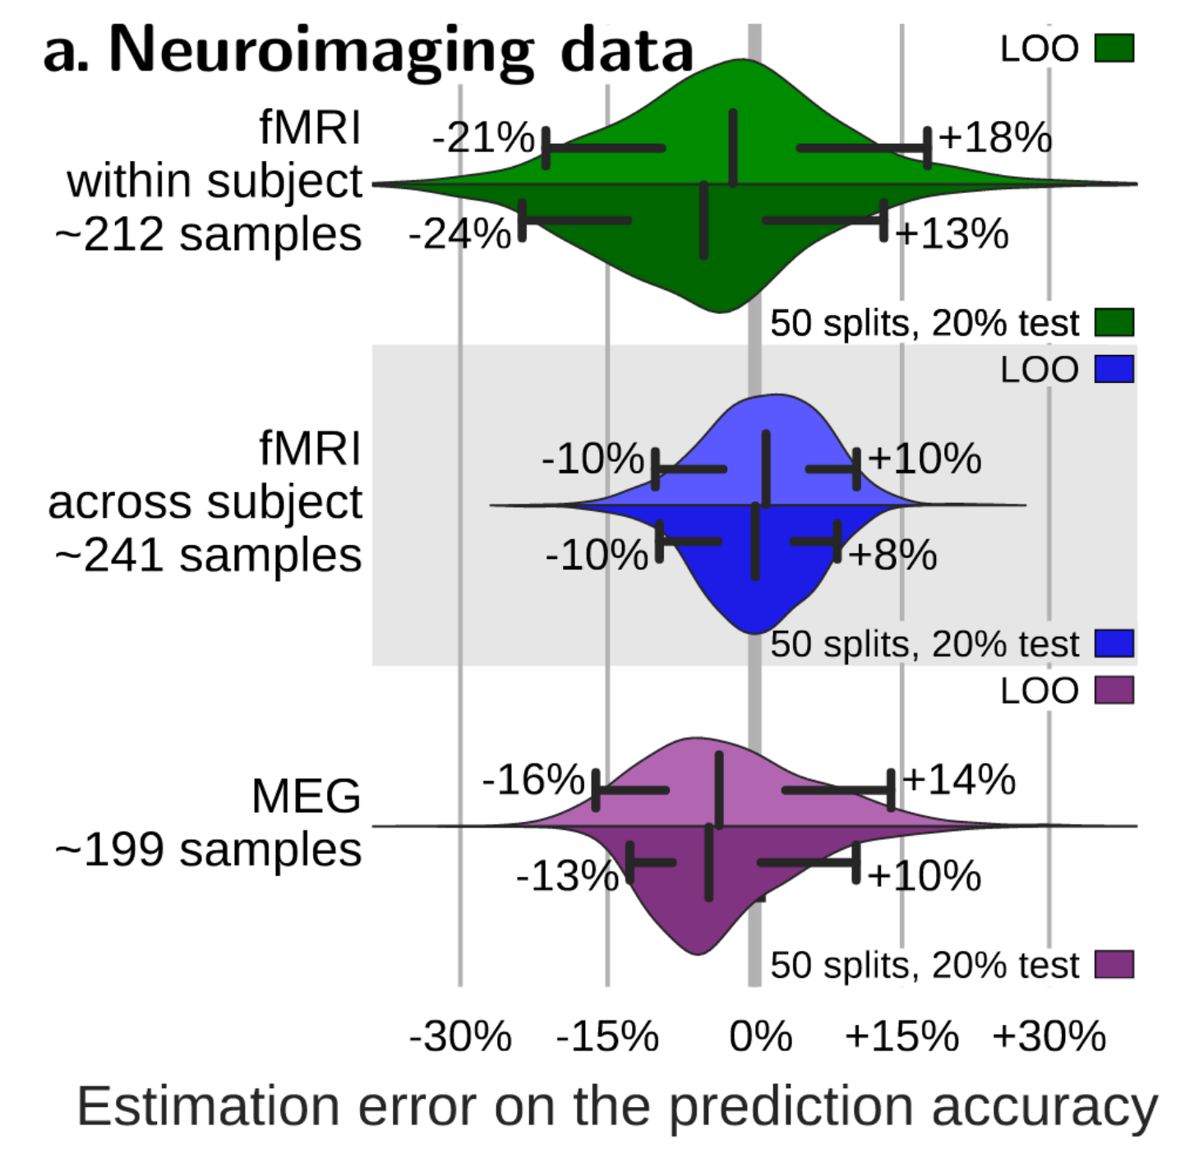
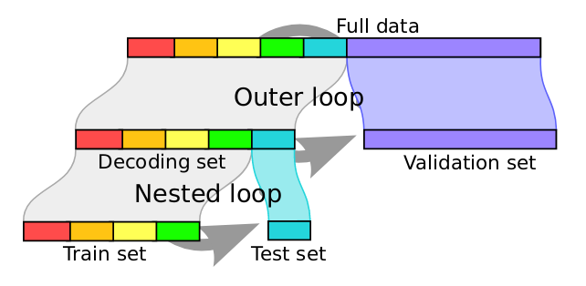
Model Selection: Sample size
CV and test error discrepancy
  fMRI
  MEG
[Varoquaux, 2017]

Slide 16



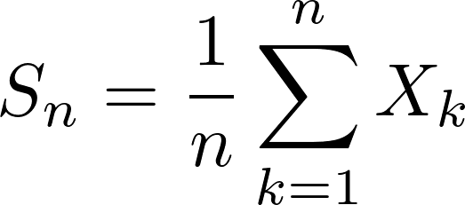
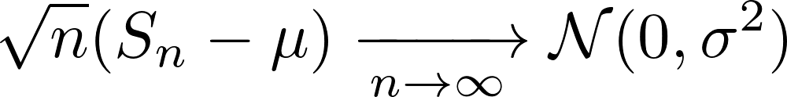
Central Limit Theorem
For i.i.d random variables
If and
Then verifies

Slide 17
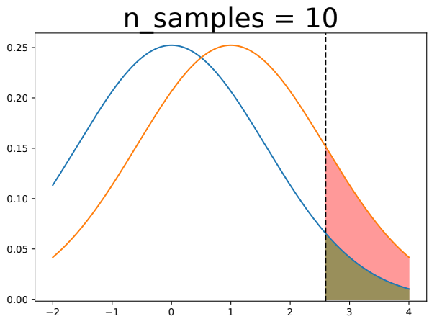
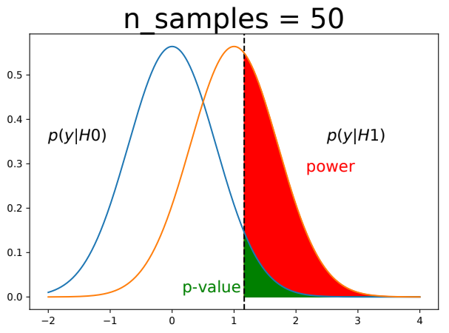
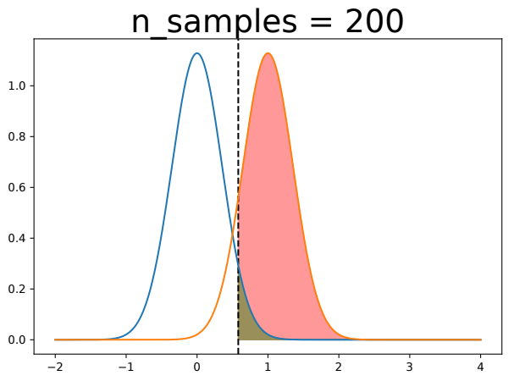
Sample size effect
Less
subjects
More
subjects

Slide 18
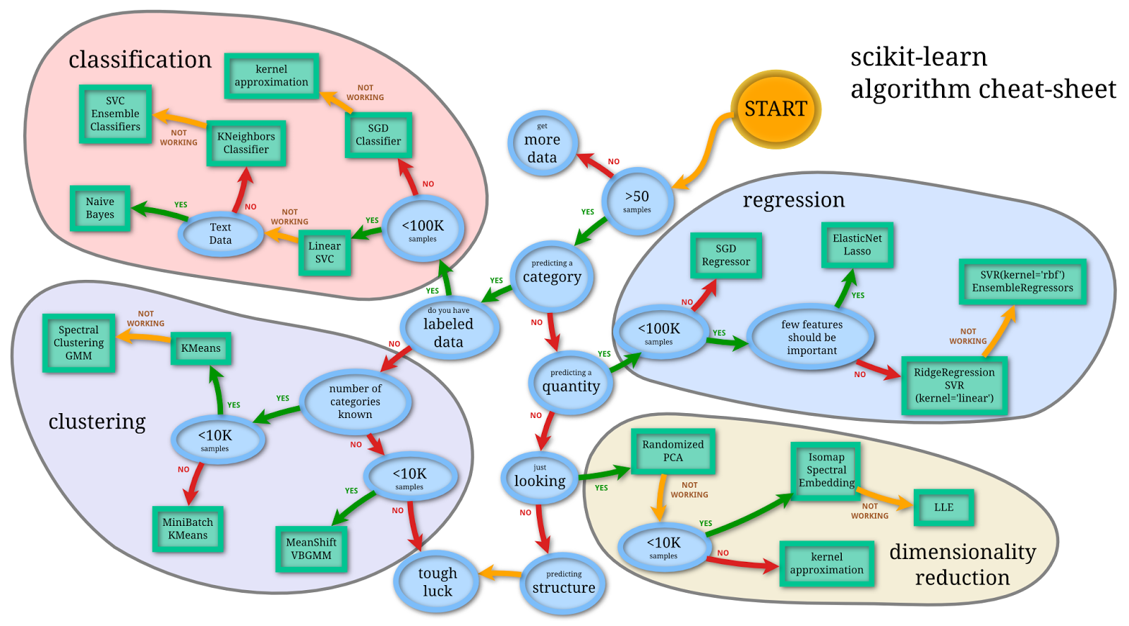
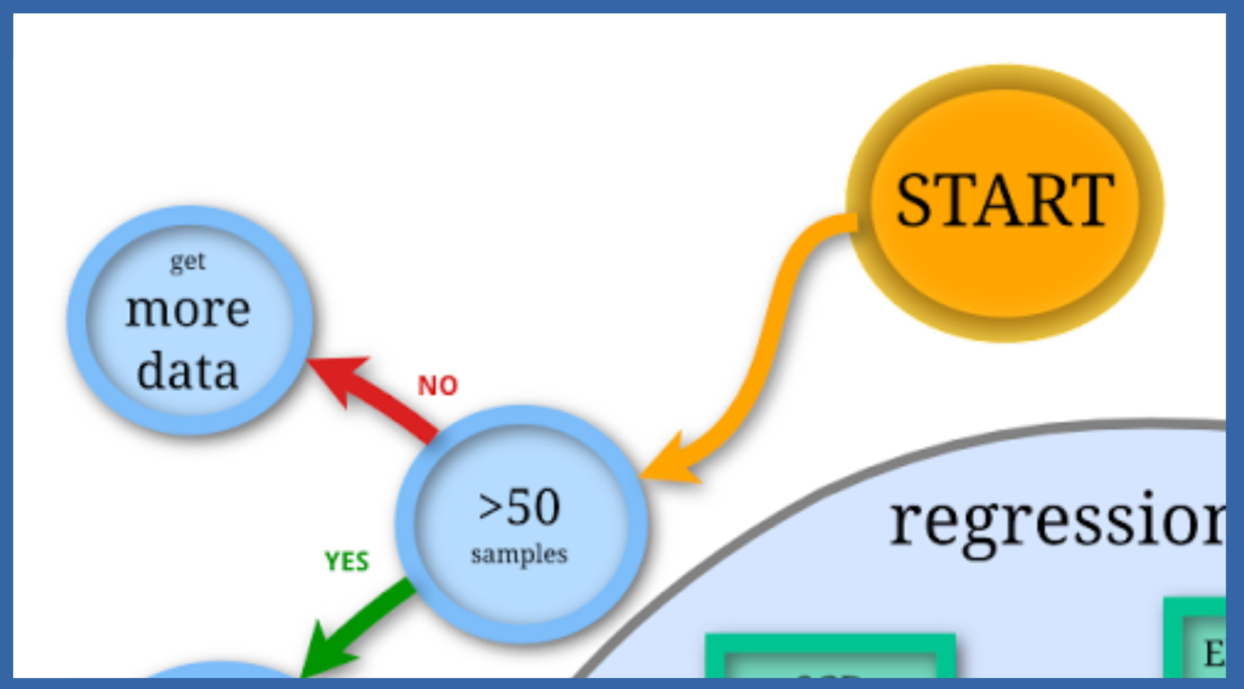
Robust machine learning

Slide 19
Part 1: Take home messages
Test data is necessary
Larger sample size is needed
Validate on independent data
Reliable findings
Reproducibility

Slide 20
Annotated data
Humans are really good at classifying images, sounds...
… but not that good for other data!
  Vectorial data with more than 2D
  fMRI: very high dimensional signals
Not possible to have annotations of the brain functions and structures.

Slide 21
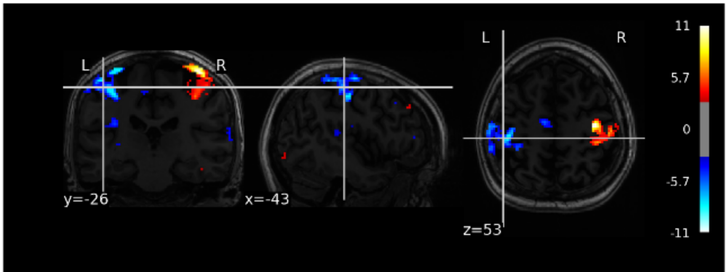
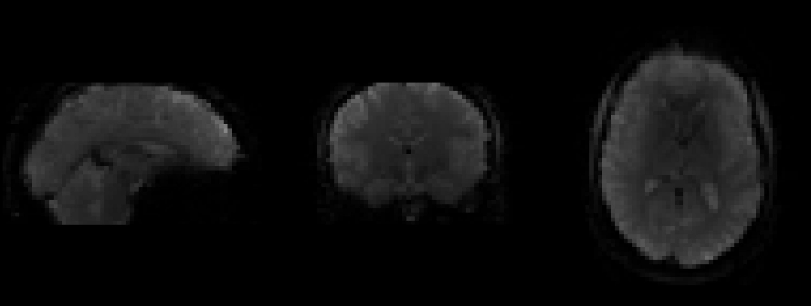
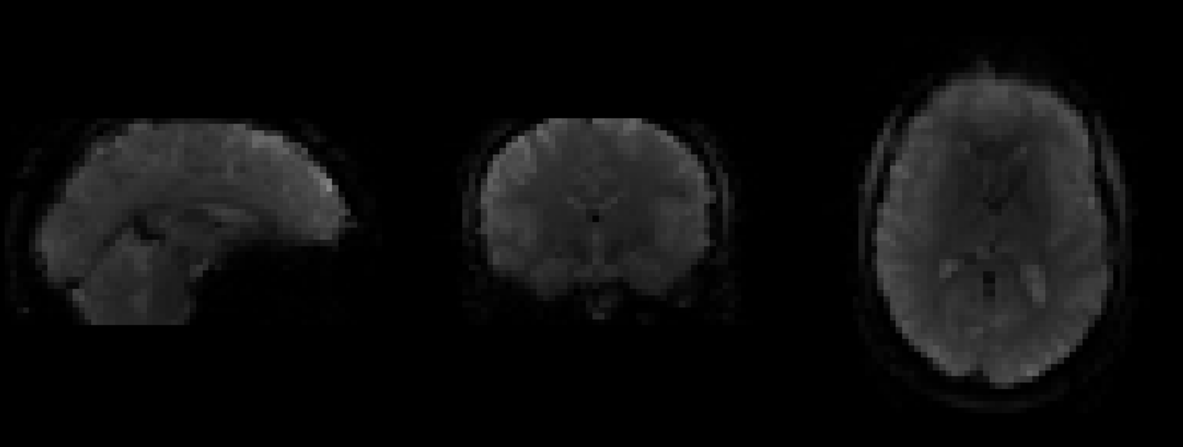
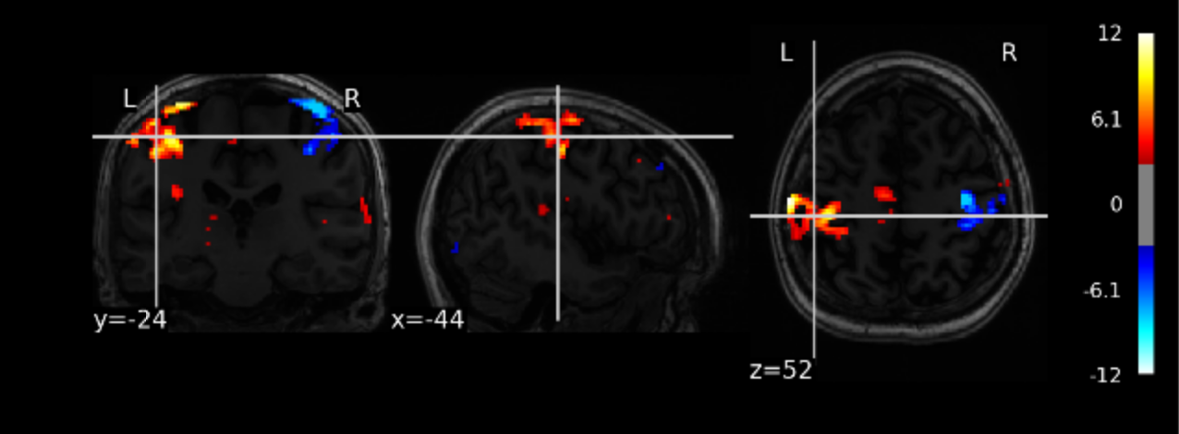

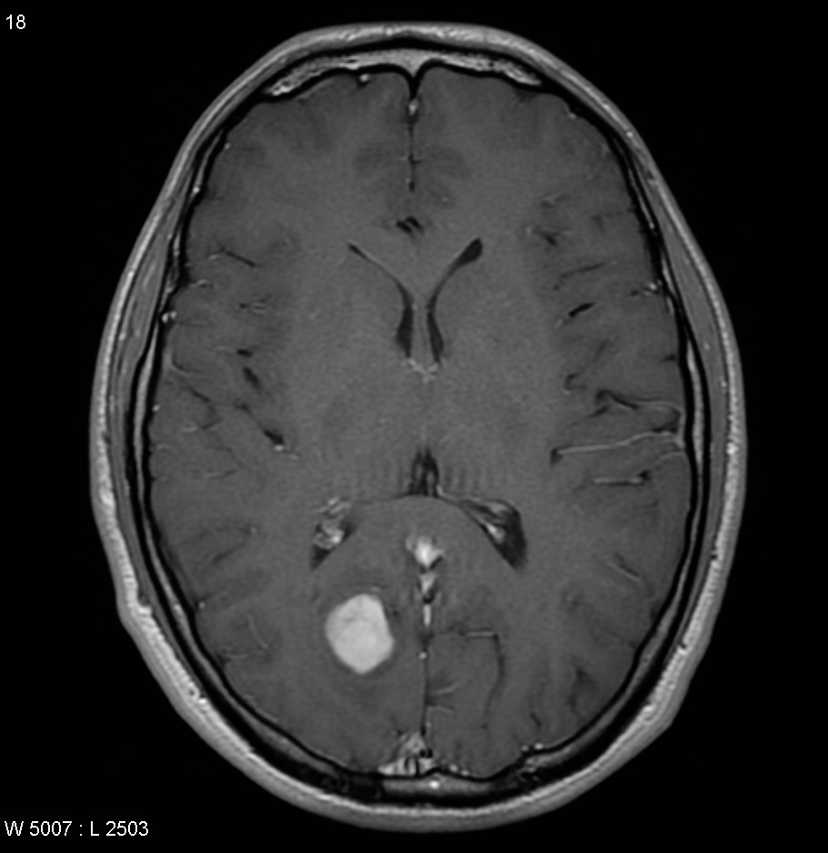
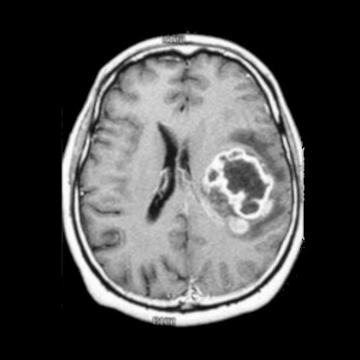

Weakly-supervised learning
Labels are weakly related to the task we want to solve:
Rely on the structure
of the data!
Training
Outcomes
Annotations
Examples
Conditions

Slide 22
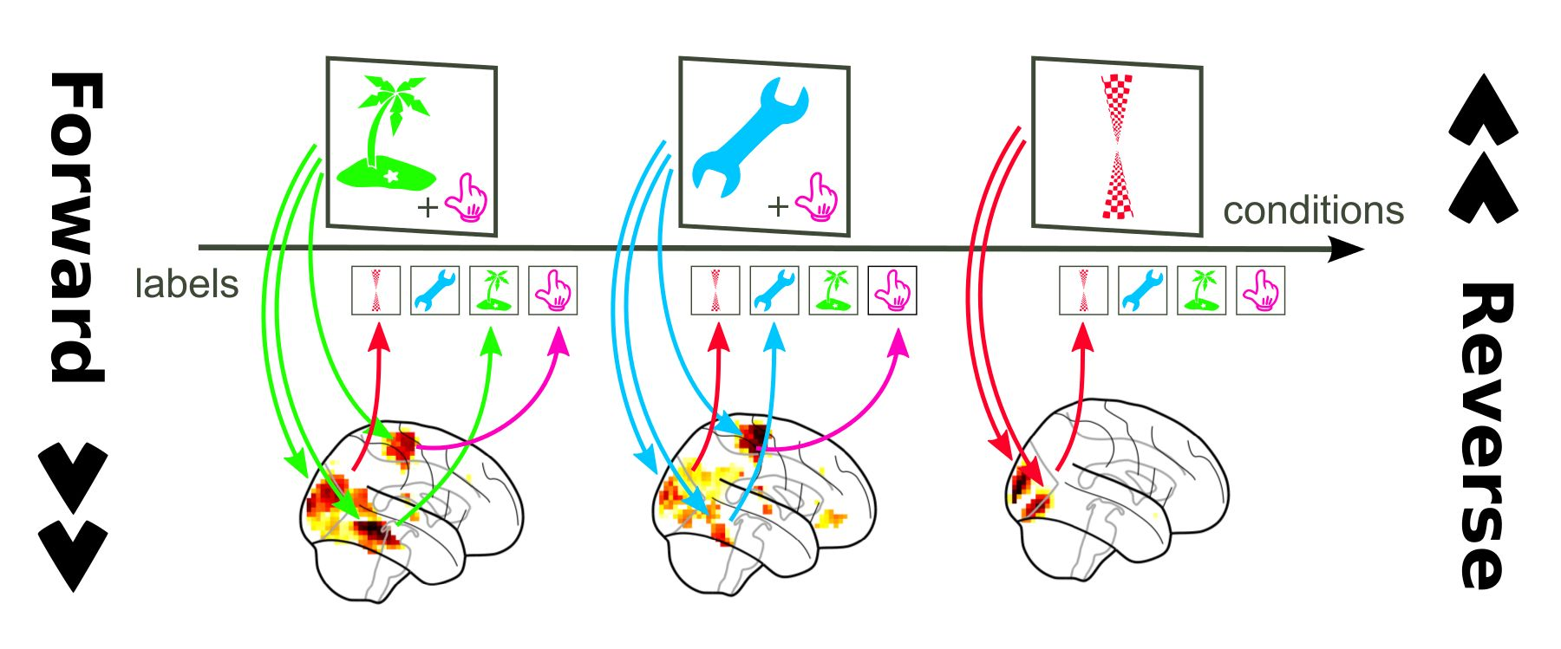
Large Scale Brain Mapping
Predict conditions based on brain scan
Highlight functional maps

Slide 23
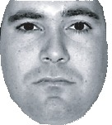
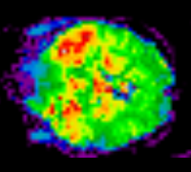
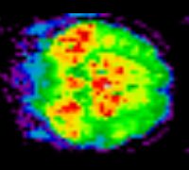

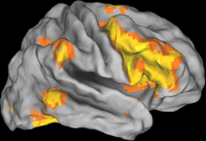
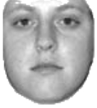
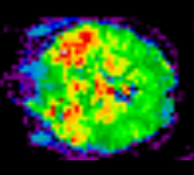
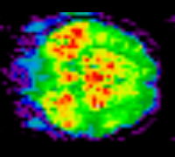

Large Scale Brain Mapping
Brain scans
X
=
Conditions
Linear Model
The linear model is a brain map

Slide 24
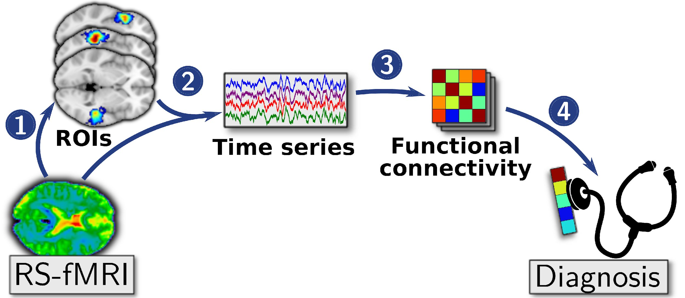
Unsupervised Learning
Resting State recordings
Functional connectivity studies
ROI extraction relies on
the structure of the data!

Slide 25
Big Data: Technical challenge
New datasets provides larger sample size
  Camcam (650subjects), HCP (1,200 subjects),
  UKBB (5,000 subjects), …
Very complex data
  Large images: 10⁵ to 10⁶ voxels
  Low SNR, structured noise, inter-subject variability,...

Slide 26
Dimension Reduction
Large n lead to exploding memory
Computational bottleneck → memory
Need to reduce dimension, i.e. # voxels
Without losing too much info!

Slide 27
Reduce resolution
Spatial averaging
→ averaging activity on regions
Against the trend to go with larger resolution…
Smart selection of related voxels?

Slide 28
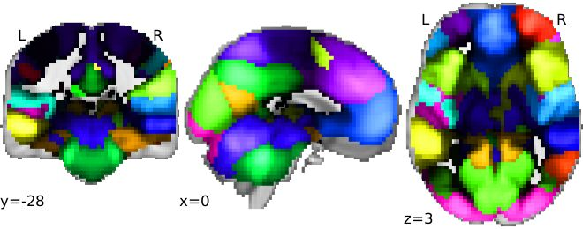
Fixed parcellation: Atlas
Choose an Atlas
  Destrieux 2009
  Yeo 2011
  MSDL (Varoquaux et al 2011)
  Cradock 2012
Average over the parcels

Slide 29
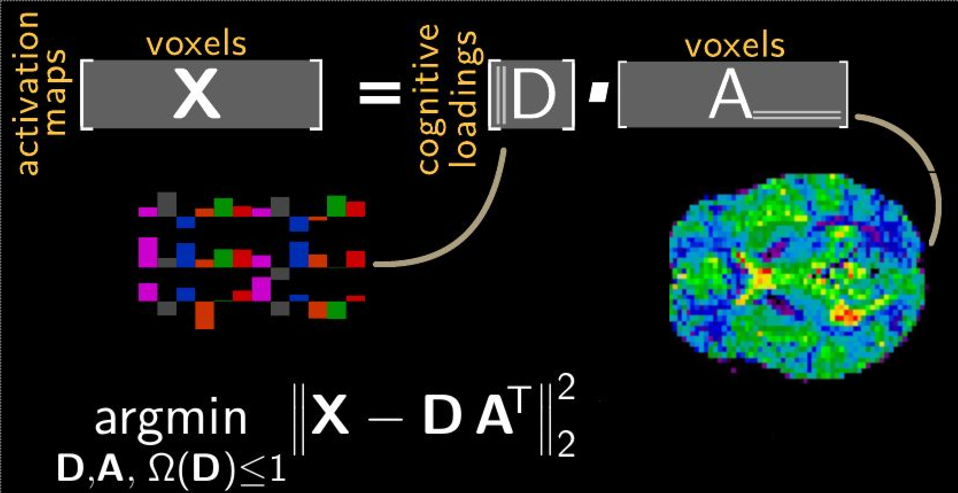
Principal Component Analysis

Slide 30
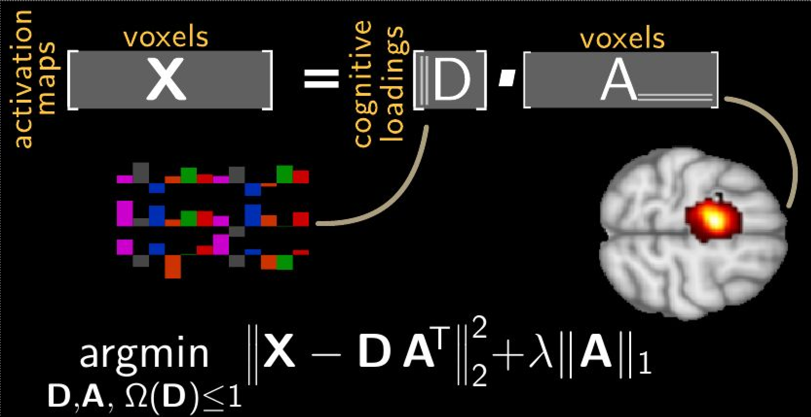
Sparse PCA

Slide 31
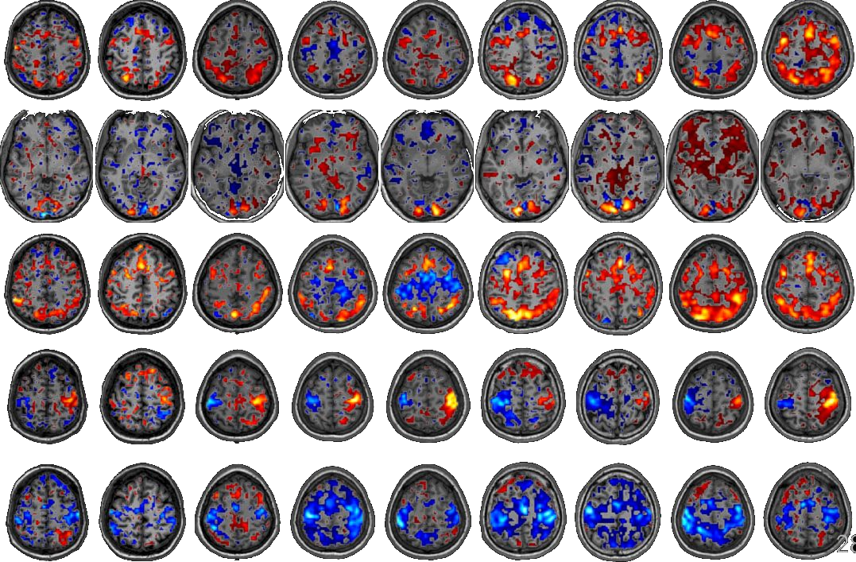
Sparse PCA
[Pinel et al. 2007]

Slide 32
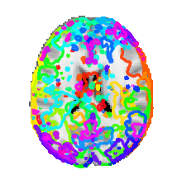
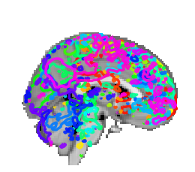
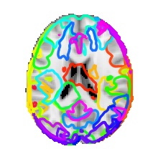
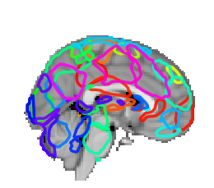
Scaling to large datasets
50Gb data 1Tb data
Use more data to get better parcellation
[Mensch et al 2016]: Use stochastic updates to scale

Slide 33
Part 2: Take home messages
Weakly-learning and unsupervised learning
Reduce dimension of the data
Use data structure
Atlas
Learned Parcellation

Slide 34
Conclusion
Use independent data to evaluate models
Use a large number of samples
Rely on the data structure

Slide 35




Conclusion
Need more public data
Need more open source Software

