Slide 1








Franck Charras
Research Software Engineer
2011 - 2016 Ponts ParisTech & Master MVA
2016 - 2022 Sancare: Co-founder and former CTO
2022 - now Member of team-project SODA at INRIA
EuroScipy 2023, Basel 2023.08.17
Exploring GPU-powered backends for scikit-learn

Slide 2





Intel CoE partnership
develop and distribute computational backends that can leverage Intel hardware using
oneAPI libraries
2 x $ 100000 grant
one full time engineer at INRIA
EuroScipy, Basel 2023.08.17
Exploring GPU-powered Backends
for Scikit-Learn

Slide 3
I – Introduction to GPU computing
II – Adopting the Array API standard
III – Exploring a plugin system
IV – The oneAPI toolchain for portability of low-level code
V – Designing a plugin for k-means with the oneAPI toolchain
EuroScipy, Basel 2023.08.17
Exploring GPU-powered Backends
for Scikit-Learn

Slide 4
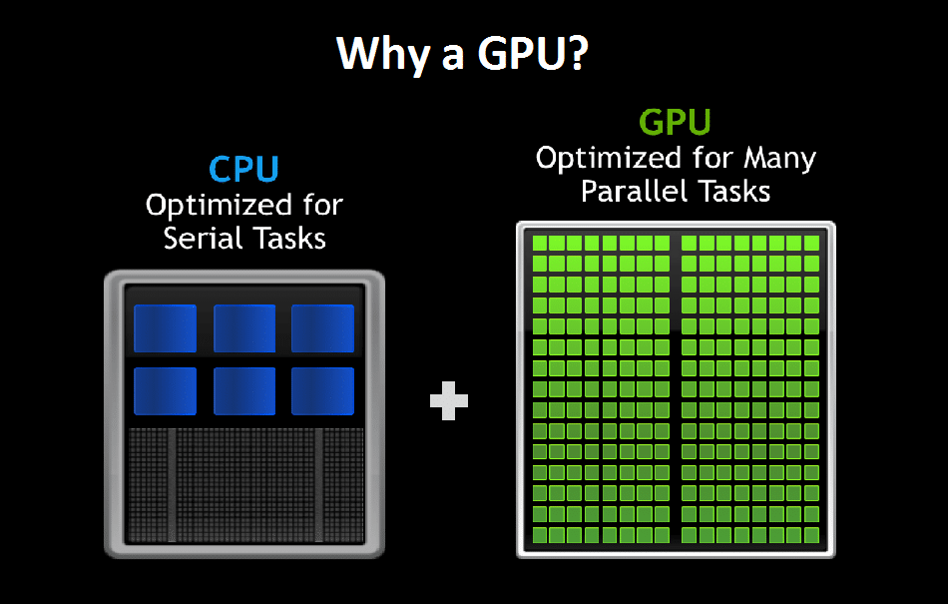
GPU = Graphics Processing Units
GPGPU = General Purpose Computing on GPUs
Credits: https://blogs.nvidia.com/blog/2018/06/11/what-is-a-virtual-gpu/
EuroScipy, Basel 2023.08.17
Exploring GPU-powered Backends
for Scikit-Learn
1/21

Slide 5
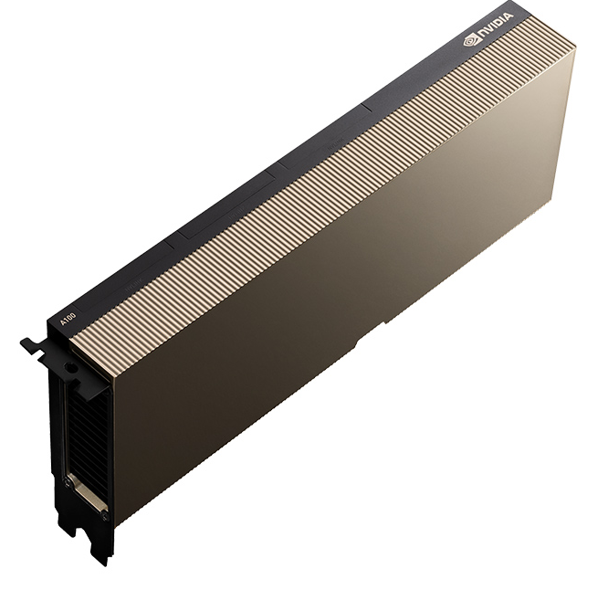
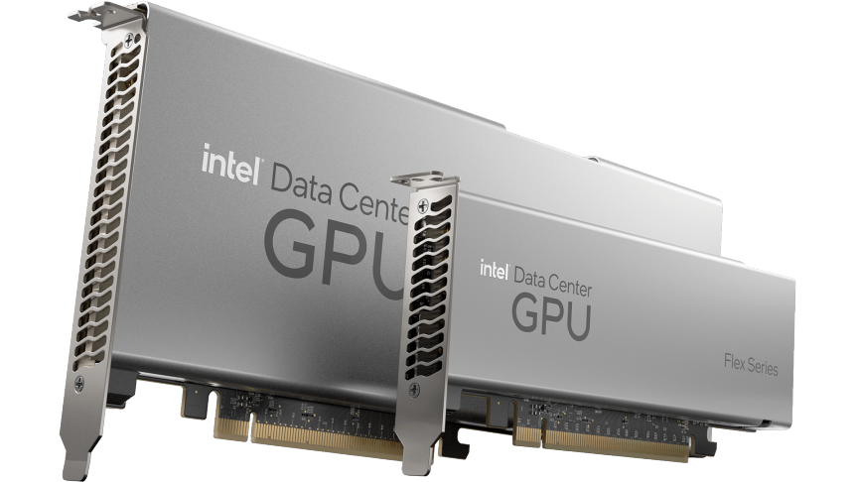
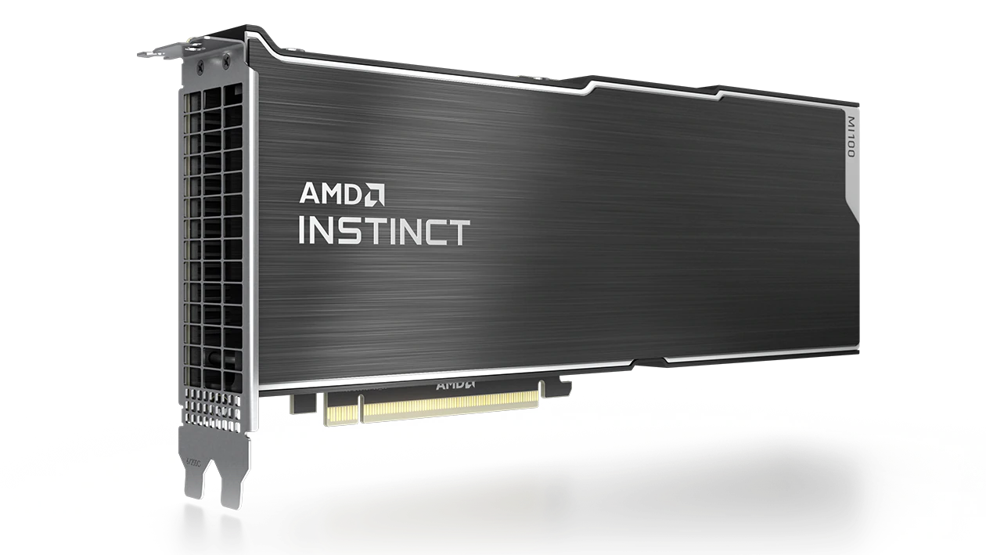
Competing manufacturers
(non exhaustive)
NVIDIA
Credit: nvidia.com
Intel
Credit: intel.com
EuroScipy, Basel 2023.08.17
Exploring GPU-powered Backends
for Scikit-Learn
2/21
AMD
Credit: amd.com

Slide 6
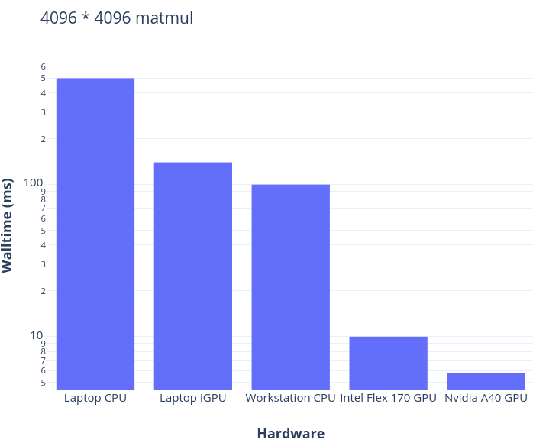
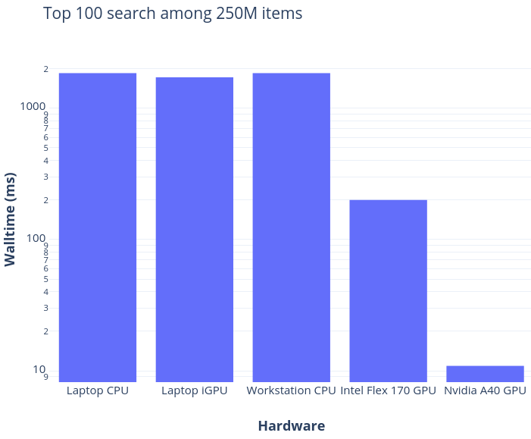
Comparative performance for torch.matmul and torch.topk
EuroScipy, Basel 2023.08.17
Exploring GPU-powered Backends
for Scikit-Learn
3/21

Slide 7
I – Introduction to GPU computing
II – Adopting the Array API standard
III – Exploring a plugin system
IV – The oneAPI toolchain for portability of low-level code
V – Designing a plugin for k-means with the oneAPI toolchain
EuroScipy, Basel 2023.08.17
Exploring GPU-powered Backends
for Scikit-Learn

Slide 8
I – Introduction to GPU computing
II – Adopting the Array API standard
III – Exploring a plugin system
IV – The oneAPI toolchain for portability of low-level code
V – Designing a plugin for k-means with the oneAPI toolchain
EuroScipy, Basel 2023.08.17
Exploring GPU-powered Backends
for Scikit-Learn

Slide 9
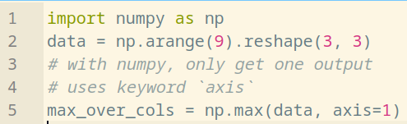
Introduction to the Array API standard
EuroScipy, Basel 2023.08.17
Exploring GPU-powered Backends
for Scikit-Learn
4/21

Slide 10
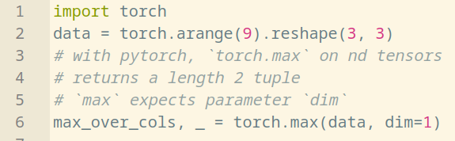
Introduction to the Array API standard
EuroScipy, Basel 2023.08.17
Exploring GPU-powered Backends
for Scikit-Learn
4/21

Slide 11
Introduction to the Array API standard
Different array libraries can have different syntax for the same operation !
EuroScipy, Basel 2023.08.17
Exploring GPU-powered Backends
for Scikit-Learn
4/21

Slide 12
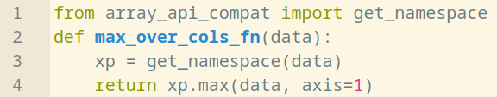
Introduction to the Array API standard
The Array API enables writing agnostic single-source code and interface it with all arrays !
EuroScipy, Basel 2023.08.17
Exploring GPU-powered Backends
for Scikit-Learn
5/21

Slide 13


Introduction to the Array API standard
The Array API enables writing agnostic single-source code and interface it with all arrays !
EuroScipy, Basel 2023.08.17
Exploring GPU-powered Backends
for Scikit-Learn
5/21

Slide 14
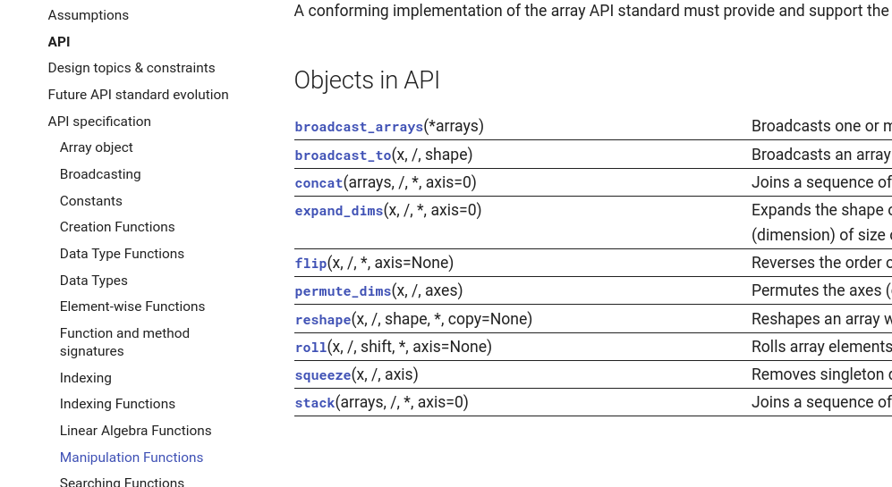
Array API spec excerpt
EuroScipy, Basel 2023.08.17
Exploring GPU-powered Backends
for Scikit-Learn
6/21
https://data-apis.org/array-api/latest/API_specification/index.html

Slide 15




Compatible array libraries
(done or ongoing)
(non exhaustive)
CPU
CPU
GPU AMD/INTEL/NVIDIA
OTHERS
CPU
DISTRIBUTED
Dpctl + DPNP
CPU
GPU INTEL
EuroScipy, Basel 2023.08.17
Exploring GPU-powered Backends
for Scikit-Learn
7/21
GPU NVIDIA

Slide 16
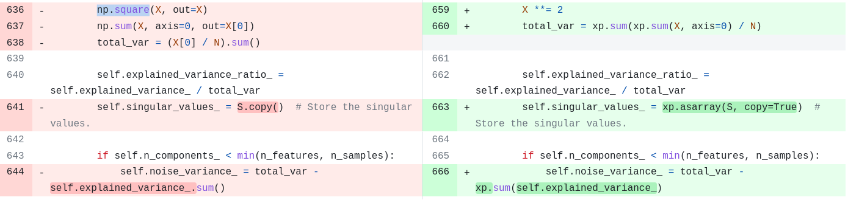

Towards Array API compliancy in scikit-learn
When possible, use the Array Api rather than numpy calls !
Excerpt of https://github.com/scikit-learn/scikit-learn/pull/26315
ENH Array API support for PCA
EuroScipy, Basel 2023.08.17
Exploring GPU-powered Backends
for Scikit-Learn
8/21

Slide 17


Towards Array API compliancy in scikit-learn
sklearn.lda.LDA
sklearn.decomposition.PCA
(next release)
sklearn.preprocessing.MinMaxScaler (ongoing)
Discussions and roadmaps #22352 #26024 #26083
EuroScipy, Basel 2023.08.17
Exploring GPU-powered Backends
for Scikit-Learn
9/21

Slide 18

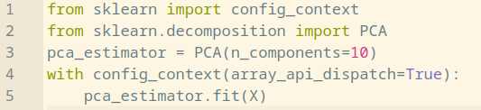

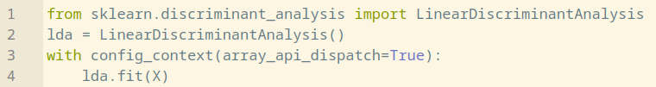
Towards Array API compliancy in scikit-learn
How to use it ?
Experimental features require explicit
activation in scikit-learn config class
EuroScipy, Basel 2023.08.17
Exploring GPU-powered Backends
for Scikit-Learn
10/21

Slide 19
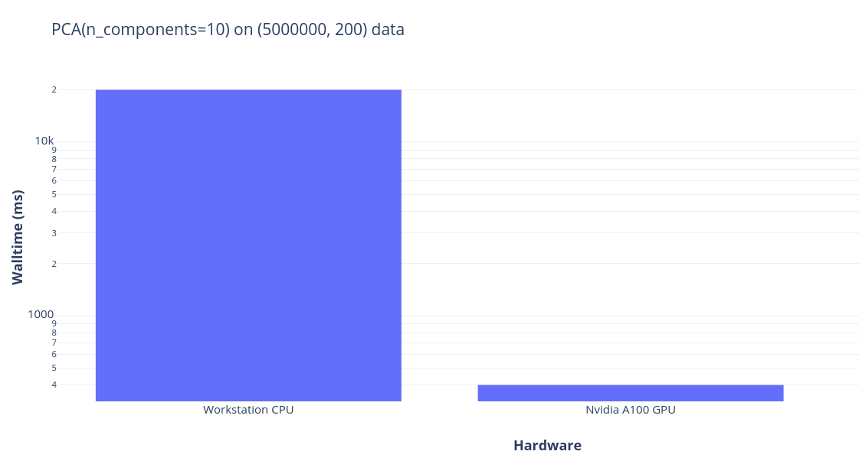
Towards Array API compliancy in scikit-learn
What about performance ?
YES when CPU takes too long
40x speedup with pytorch on GPU
Doesn’t matter
If CPU is already fast enough
(1sc walltime on 10 times
less data)
EuroScipy, Basel 2023.08.17
Exploring GPU-powered Backends
for Scikit-Learn
11/21
NB: pytorch backend for intel GPUs currently lacks optimization for QR factorization, so Intel GPUs are not included in the figure

Slide 20

Towards Array API compliancy in scikit-learn
Will all estimators support all compatible array libraries ?
Likely not :-(
Current limitations of the Array API approach:
    Does not cover all functions for all libraries (torch.topk, torch.cdist, np.argpartition,…)
    Not all algorithms can be implemented (efficiently) with high level array operations !
        (random forest, histogram gradient boosting trees,...)
EuroScipy, Basel 2023.08.17
Exploring GPU-powered Backends
for Scikit-Learn
12/21

Slide 21
I – Introduction to GPU computing
II – Adopting the Array API standard in scikit-learn
III – Exploring a plugin system in scikit-learn
IV – The oneAPI toolchain for interoperability of low-level code
V – Designing a plugin for k-means with the oneAPI toolchain
EuroScipy, Basel 2023.08.17
Exploring GPU-powered Backends
for Scikit-Learn

Slide 22
I – Introduction to GPU computing
II – Adopting the Array API standard in scikit-learn
III – Exploring a plugin system in scikit-learn
IV – The oneAPI toolchain for interoperability of low-level code
V – Designing a plugin for k-means with the oneAPI toolchain
EuroScipy, Basel 2023.08.17
Exploring GPU-powered Backends
for Scikit-Learn

Slide 23
Exploring a plugin system in scikit-learn
> Preview of user workflow:
EuroScipy, Basel 2023.08.17
Exploring GPU-powered Backends
for Scikit-Learn
13/21

Slide 24
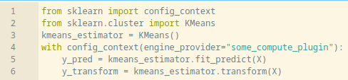
Exploring a plugin system in scikit-learn
> Preview of user workflow:
EuroScipy, Basel 2023.08.17
Exploring GPU-powered Backends
for Scikit-Learn
13/21

Slide 25
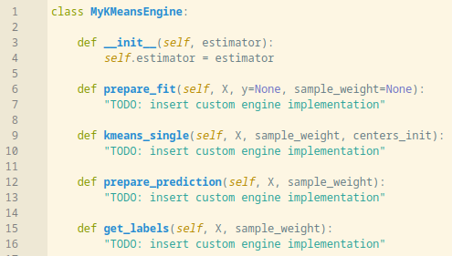
Exploring a plugin system in scikit-learn
> Example for plugin developers: register a custom engine class
> Test against native scikit-learn unit tests
EuroScipy, Basel 2023.08.17
Exploring GPU-powered Backends
for Scikit-Learn
14/21

Slide 26
Exploring a plugin system in scikit-learn
Foundational issue https://github.com/scikit-learn/scikit-learn/issues/22438
Pull request https://github.com/scikit-learn/scikit-learn/pull/25535
Development branch https://github.com/scikit-learn/scikit-learn/tree/feature/engine-api
Example plugin for KMeans on intel GPUs
                https://github.com/soda-inria/sklearn-numba-dpex
EuroScipy, Basel 2023.08.17
Exploring GPU-powered Backends
for Scikit-Learn
15/21

Slide 27
I – Introduction to GPU computing
II – Adopting the Array API standard in scikit-learn
III – Exploring a plugin system in scikit-learn
IV – The oneAPI toolchain for interoperability of low-level code
V – Designing a plugin for k-means with the oneAPI toolchain
EuroScipy, Basel 2023.08.17
Exploring GPU-powered Backends
for Scikit-Learn

Slide 28
I – Introduction to GPU computing
II – Adopting the Array API standard in scikit-learn
III – Exploring a plugin system in scikit-learn
IV – The oneAPI toolchain for interoperability of low-level code
V – Designing a plugin for k-means with the oneAPI toolchain
EuroScipy, Basel 2023.08.17
Exploring GPU-powered Backends
for Scikit-Learn

Slide 29












Open standards for portability of low-level code
Tech corporations
synchronize on
open standards
(non exhaustive list)
Computer graphics
All purpose computing
Computer graphics
EuroScipy, Basel 2023.08.17
Exploring GPU-powered Backends
for Scikit-Learn
16/21

Slide 30

Open standards for portability of low-level code
(non exhaustive list)
Standard C++ Domain Specific Language
to compile binaries for heteregenous computing from single-source code
EuroScipy, Basel 2023.08.17
Exploring GPU-powered Backends
for Scikit-Learn
17/21

Slide 31



SYCL - based toolchains
Open-source compilers:
contribution to LLVM
OpenSYCL
Proprietary compiler:
oneAPI DPC++ (based on LLVM) + codeplay
Python JIT (DPC++ - based):
dpctl
numba_dpex
EuroScipy, Basel 2023.08.17
Exploring GPU-powered Backends
for Scikit-Learn
18/21

Slide 32
I – Introduction to GPU computing
II – Adopting the Array API standard
III – Exploring a plugin system
IV – The oneAPI toolchain for interoperability of low-level code
V – Designing a plugin for k-means with the oneAPI toolchain
EuroScipy, Basel 2023.08.17
Exploring GPU-powered Backends
for Scikit-Learn

Slide 33
I – Introduction to GPU computing
II – Adopting the Array API standard
III – Exploring a plugin system
IV – The oneAPI toolchain for interoperability of low-level code
V – Designing a plugin for k-means with the oneAPI toolchain
EuroScipy, Basel 2023.08.17
Exploring GPU-powered Backends
for Scikit-Learn

Slide 34
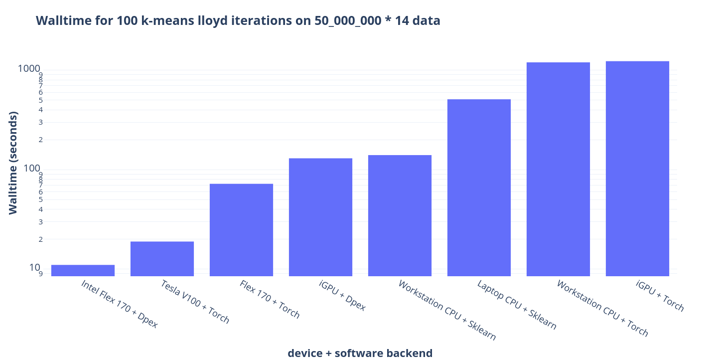

A plugin for k-means with the oneAPI toolchain
k-means is one order of magnitude faster on GPU, more significantly so when optimized with a low-level implementation
NB: cuml implementation of k-means for Nvidia GPUs could not be included in the figure because it could not scale to this amount of data memory-wise.
EuroScipy, Basel 2023.08.17
Exploring GPU-powered Backends
for Scikit-Learn
19/21
sklearn_numba_dpex
https://github.com/soda-inria/sklearn-numba-dpex

Slide 35

A plugin for k-means with the oneAPI toolchain
More comprehensive blogpost:
https://team.inria.fr/soda/exploring-a-oneapi-based-gpu-powered-backend-for-scikit-learn
Current limitations:
    Only works for Intel GPUs
    Installation of the runtime can be challenging
      require separate installation of low-level intel compute runtime
      not pip installable
      conda installable with custom channels
Further work:
    Exploring support for other estimators (KNN next ?)
    Planning plugins for other backends (CUDA with CumL)
EuroScipy, Basel 2023.08.17
Exploring GPU-powered Backends
for Scikit-Learn
20/21

Slide 36
More at EuroScipy 2023 !
Sprint session on Tomorrow: workshop for GPU programming !
https://euroscipy.org/2023/sprint.html
EuroScipy, Basel 2023.08.17
Exploring GPU-powered Backends
for Scikit-Learn
21/21

Slide 37
Thank you for your attention
EuroScipy, Basel 2023.08.17
Exploring GPU-powered Backends
for Scikit-Learn

Slide 38
Towards Array API compliancy in scikit-learn
Will all estimators and all array libraries be supported ?
Likely not :-(
Other inconveniences:
      Lacks support for RNG
      Lacks synchronization functions for libraries that evaluate lazily (dask, jax...)
EuroScipy, Basel 2023.08.17
Exploring GPU-powered Backends
for Scikit-Learn
16/26

Slide 39
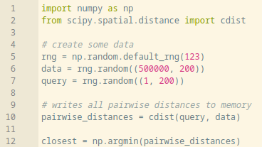
On possible inefficiencies with array libraries
Each call to a high-level array function writes the result into memory.
Example of pairwise_distance + argmin common pattern:
EuroScipy, Basel 2023.08.17
Exploring GPU-powered Backends
for Scikit-Learn
17/26

Slide 40
On possible inefficiencies with array libraries
Each call to a high-level array function writes the result into memory.
Example of pairwise_distance + argmin common pattern:
Writing low-level code can be more
than one order of magnitude faster
EuroScipy, Basel 2023.08.17
Exploring GPU-powered Backends
for Scikit-Learn
17/26

Slide 41
I – Introduction to GPU computing
II – Adopting the Array API standard in scikit-learn
III – Exploring a plugin system in scikit-learn
IV – The oneAPI toolchain for interoperability of low-level code
V – Designing a plugin for k-means with the oneAPI toolchain
EuroScipy, Basel 2023.08.17
Exploring GPU-powered Backends
for Scikit-Learn

Slide 42
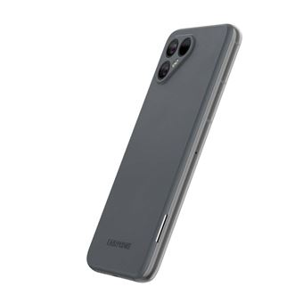
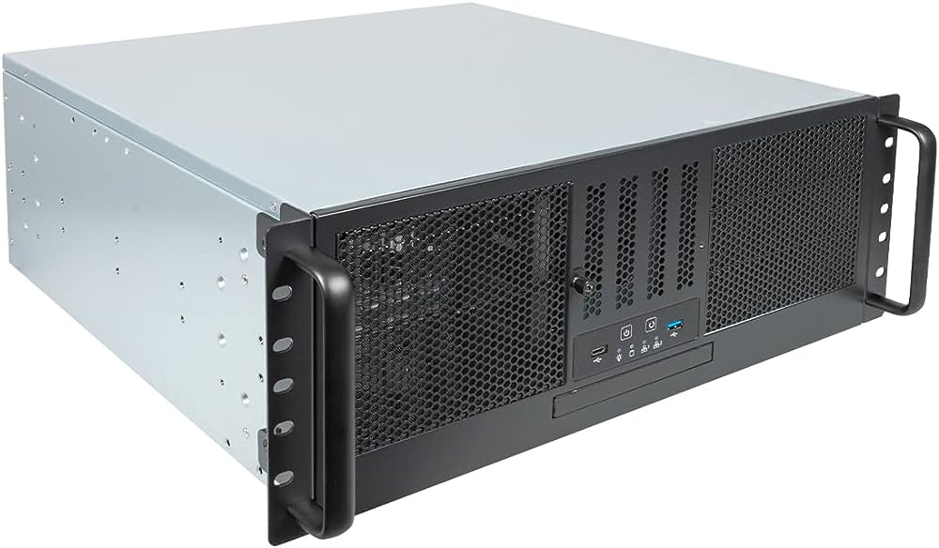
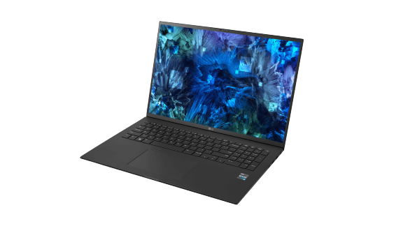
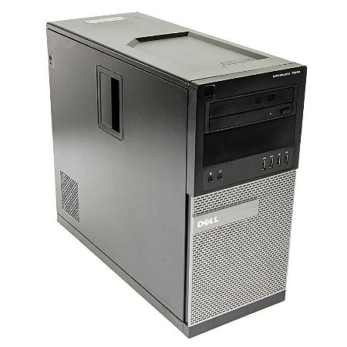
GPUs are everywhere
iGPUs (integrated)
iGPUs or Discrete GPUs
Server grade discrete GPUs
Consumer-grade discrete GPUs
(gaming,...)
EuroScipy, Basel 2023.08.17
Exploring GPU-powered Backends
for Scikit-Learn
2/26

Slide 43
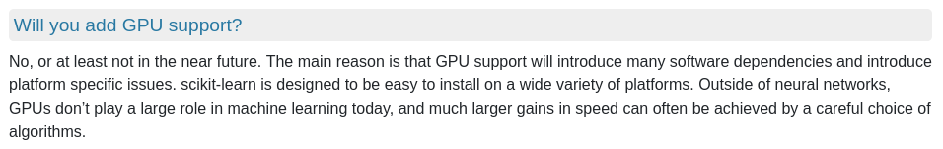
GPUs for scikit-learn ?
https://scikit-learn.org/stable/faq.html#will-you-add-gpu-support
Is now the time of GPU computing in scikit-learn ?
EuroScipy, Basel 2023.08.17
Exploring GPU-powered Backends
for Scikit-Learn
5/26

Slide 44
GPUs for scikit-learn ?
https://scikit-learn.org/stable/faq.html#will-you-add-gpu-support
EuroScipy, Basel 2023.08.17
Exploring GPU-powered Backends
for Scikit-Learn
4/26

Slide 45
GPUs for scikit-learn ?
https://scikit-learn.org/stable/faq.html#will-you-add-gpu-support
EuroScipy, Basel 2023.08.17
Exploring GPU-powered Backends
for Scikit-Learn
4/26

Slide 46
GPUs for scikit-learn ?
https://scikit-learn.org/stable/faq.html#will-you-add-gpu-support
EuroScipy, Basel 2023.08.17
Exploring GPU-powered Backends
for Scikit-Learn
4/26

Slide 47


GPUs for scikit-learn ?
https://scikit-learn.org/stable/faq.html#will-you-add-gpu-support
Reports of emerging implementations using GPUs for common algorithms:
Nearest neighbor search https://github.com/facebookresearch/faiss
XGBoost https://xgboost.readthedocs.io/en/stable/gpu
EuroScipy, Basel 2023.08.17
Exploring GPU-powered Backends
for Scikit-Learn
4/26

