Slide 1
Internet protocol stack
application: supporting network applications
  FTP, SMTP, HTTP
transport: process-process data transfer
  TCP, UDP
network: routing of datagrams from source to destination
  IP, routing protocols
link: data transfer between neighboring network elements
  Ethernet, 802.11 (WiFi), PPP
physical: bits “on the wire”
application
transport
network
link
physical
Introduction
1-<number>

Slide 2






Chapter 2 Application Layer
2: Application Layer
Notes:
In this chapter, we will learn the application layer in details. Thanks to the rapid development of IT technologies, we are very familiar with those applications and their companies are also well known throughout the world.
Pc: disconnected machines.
Internet: web browser
Web 2.0: interaction between users. Web2.0是2003年之后互联网的热门概念之一，不过目前对什么是Web2.0并没有很严格的定义。一般来说Web2.0（也有人称之为互联网2.0）是相对Web1.0的新的一类互联网应用的统称。Web1.0的主要特点在于用户通过浏览器获取信息，Web2.0则更注重用户的交互作用，用户既是网站内容的消费者（浏览者），也是网站内容的制造者。

Slide 3
Some network apps
Web + email
Video + audio
e-mail: Foxmail
Web: Opera
instant messaging:
  QQ, WeChat
remote login
  Remote desktop, LogMeIn
P2P file sharing
  E-mule, BT
multi-user network games
streaming stored video clips
  Youtube, Youku
voice over IP
  Skype
real-time video conferencing
Social network
Mobile computing
Cloud computing
Popular topics
File sharing + gaming
2: Application Layer
Notes:
Pictures of applications
Video
Audio
Game (sanguo sha)

Slide 4
Chapter 2: Application layer
2.1 Principles of network applications
2.2 Web and HTTP
2.3 FTP
2.4 Electronic Mail
  SMTP, POP3, IMAP
2.5 DNS
2: Application Layer

Slide 5
Principles
Architecture and models
Application processes on two machines can communicate w/ each other
Application layer protocols
2: Application Layer

Slide 6
Application architectures
Client-server
  Indirect communication
  too much load on server
Peer-to-peer (P2P)
  Direct communication
Hybrid (mix) of client-server and P2P
  QQ server has your friend list;
  QQ clients can directly communicate.
2: Application Layer
Notes:
Web
E-donkey
QQ, MSN

Slide 7





Client-server architecture (1/2)
What is a server?
  always-on host
  permanent IP address
  server farms for scaling
client/server
2: Application Layer
Notes:
Amazon employee has a BP call
Within 0.5 hour, u should have access to a computer to handle the issue.
Permanent IP

Slide 8
Client-server architecture (2/2)
clients:
  communicate with server
  Not always-on
  may have dynamic IP addresses
    Check your IP?
  do not communicate directly with each other
client/server
2: Application Layer
Notes:
Dynamic IP

Slide 9
Scalability
可扩展性
If too many clients, the server is over-burdened.
  Capacity: Max # of clients that a server can support
  Not scalable
client/server
2: Application Layer
Notes:
可扩展性

Slide 10
Pure P2P architecture (1/2)
No always-on server
end systems directly communicate
peers are intermittently connected and change IP addresses
Pros: highly scalable
  When a new peer joins, it does not affect others
间歇的
peer-peer
2: Application Layer

Slide 11
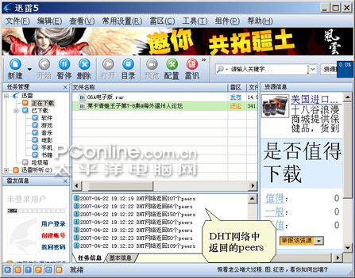
Pure P2P architecture (2/2)
Cons: difficult to manage, and not reliable
  File download stops at 99%!!!
  The 1st seed peer is offline.
小弟下到 99%
跪求哪位大哥做种 T.T
。。。
2: Application Layer
Notes:
When u download p2p w/ BT, it stops at 99%, the seed peer is offline.
What will u do? Send a post

Slide 12
Hybrid of client-server and P2P
Skype
  voice-over-IP P2P application
  centralized server: finding address of remote party:
  client-client connection: direct (not through server)
Instant messaging (QQ)
  chatting between two users is P2P
  centralized service: client presence detection/location
    user registers its IP address with central server when it comes online
    user contacts central server to find IP addresses of buddies
2: Application Layer
Notes:
Remember the typical example, it is useful when being asked a question.

Slide 13
Principles
Architecture and models
Application processes on two machines can communicate w/ each other
Application layer protocols
2: Application Layer

Slide 14
Processes communicating
进程通信
Process: program running within a host.
within same host, two processes communicate using inter-process communication (defined by OS).
processes in different hosts communicate by exchanging messages
Client process: process that initiates communication
Server process: process that waits to be contacted
Note: applications with P2P architectures have client processes & server processes
2: Application Layer
Notes:
OS communication
Host communication
In P2P, one peer is client that starts a process to contact a process at another peer which is in the server role.

Slide 15


Analogous to Door-to-door delivery
sends/receives messages to/from its door
Postal infrastructure for door-to-door delivery.
Postal interface: (1) choice of delivery method; (2) air-delivery; 3-day delivery, standard shipping
Infrastructure
2: Application Layer

Slide 16
Sockets
套接字
process sends/receives messages to/from its socket
socket analogous to door
  sending process shoves message out door
  sending process relies on transport infrastructure on other side of door which brings message to socket at receiving process
host or
server
host or
server
controlled by
app developer
process
process
socket
socket
TCP with
buffers,
variables
TCP with
buffers,
variables
Internet
controlled
by OS
API: (1) choice of transport protocol; (2) ability to set a few parameters
2: Application Layer
Notes:
Socket is like the interface of a process.
Door to door; mail is sent through doors.
Door 1: -------link (transport infrastructure)------Door 2
Send to lower later, transport layer.

Slide 17
Addressing processes (1/2)
to receive messages, process must have identifier
host device has unique 32-bit IP address (like ID)
Q: does IP address of host on which process runs suffice for identifying the process?
  A: No, many processes can be running on same host
2: Application Layer
Notes:
区分 process
Different host processes
Same host, different processes

Slide 18
Addressing processes (2/2)
identifier includes both IP address and port numbers associated with process on host.
Example port numbers:
  HTTP server: 80
  Mail server: 25
to send HTTP message to gaia.cs.umass.edu web server:
  IP address: 128.119.245.12
  Port number: 80
2: Application Layer

Slide 19
Principles
Architecture and models
Application processes on two machines can communicate w/ each other
Application layer protocols
2: Application Layer

Slide 20
App-layer protocol defines
Types of messages exchanged,
  e.g., request, response
Message syntax语法:
  what fields in messages & how fields are delineated
Message semantics语义
  meaning of information in fields
Rules for when and how processes send & respond to messages
Public-domain protocols:
defined in RFCs
allows for interoperability
e.g., HTTP, SMTP
Proprietary (private) protocols:
e.g., Skype
2: Application Layer
Notes:
Request for comments, internet standard. Name is RFC

Slide 21
App layer is dependent on transport layer
App protocol can decide which transport protocol to use.
Data loss
some apps (e.g., audio) can tolerate some loss
other apps (e.g., file transfer, telnet) require 100% reliable data transfer
application
transport
network
link
physical
Timing
some apps (e.g., Internet telephony, interactive games) require low delay to be “effective”
Introduction
1-<number>

Slide 22
What transport service does an app need?
Throughput
some apps (e.g., multimedia) require minimum amount of throughput to be “effective”
other apps (“elastic apps”) make use of whatever throughput they get
Security
Encryption, data integrity, …
2: Application Layer
Notes:
Video, audio has minimum requirement

Slide 23
Transport service requirements of common apps
Application
file transfer
e-mail
Web documents
real-time audio/video
stored audio/video
interactive games
instant messaging
Data loss
no loss
no loss
no loss
loss-tolerant
loss-tolerant
loss-tolerant
no loss
Throughput
elastic
elastic
elastic
audio: 5kbps-1Mbps
video:10kbps-5Mbps
same as above
few kbps up
elastic
Time Sensitive
no
no
no
yes, 100’s msec
yes, few secs
yes, 100’s msec
yes and no
2: Application Layer
Notes:
Burst data
Stream data

Slide 24
Internet transport protocols services
TCP service:
connection-oriented: setup required between client and server processes
reliable transport between sending and receiving process
flow control: sender won’t overwhelm receiver
congestion control: throttle sender when network overloaded
does not provide: timing, minimum throughput guarantees, security
UDP service:
unreliable data transfer between sending and receiving process
does not provide: connection setup, reliability, flow control, congestion control, timing, throughput guarantee, or security
May have data loss
Q: why bother? Why is there a UDP?
Fast!!!
2: Application Layer
Notes:
It is difficult to understand transport layer protocol
UDP can take up all bandwidth

Slide 25
Internet apps: application, transport protocols
Application
layer protocol
SMTP [RFC 2821]
Telnet [RFC 854]
HTTP [RFC 2616]
FTP [RFC 959]
HTTP (eg Youtube),
RTP [RFC 1889]
SIP, RTP, proprietary
(e.g., Skype)
Underlying
transport protocol
TCP
TCP
TCP
TCP
TCP or UDP
typically UDP
Application
e-mail
remote terminal access
Web
file transfer
streaming multimedia
Internet telephony
Loss
tolerant
  People are error-tolerant
  so the app can tolerate data loss
2: Application Layer
Notes:
People are error tolerant
RTP, real time protocol
The Session Initiation Protocol (SIP) is an IETF-defined signaling protocol widely used for controlling communication sessions such as voice and video calls over Internet Protocol (IP).

Slide 26
Chapter 2: Application layer
2.1 Principles of network applications
  app architectures
  app requirements
2.2 Web and HTTP
2.3 FTP
2.4 Electronic Mail
  SMTP, POP3, IMAP
2.5 DNS
2: Application Layer

Slide 27
Web and HTTP
First some jargon (aka terms)
As you read files located on remote machines
Web page consists of objects
Object can be HTML file, JPEG image, Java applet, audio file,…
Web page consists of base HTML-file which includes several referenced objects
Each object is addressable by a URL
Example URL:
www.someschool.edu/someDept/pic.gif
Remote host name
path name
2: Application Layer

Slide 28
HTTP overview
超文本传输协议
HTTP: hypertext transfer protocol
Web’s application layer protocol
client/server model
  client: browser that requests, receives, “displays” Web objects
  server: Web server sends objects in response to requests
HTTP request
PC running
Explorer
HTTP response
HTTP request
Server
running
Apache Web
server
HTTP response
Mac running
Navigator
2: Application Layer
Notes:
As u download the HTML file, the browser will display the content. Then, u can disconnect the internet to view the page.

Slide 29
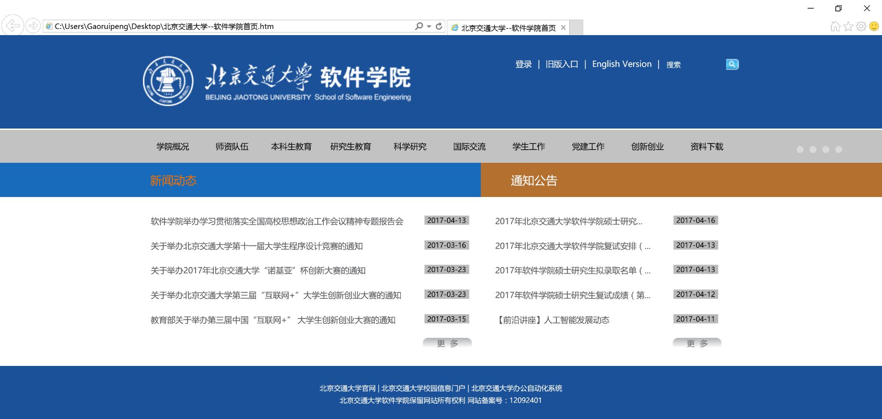
Web page
2: Application Layer
Notes:
As u download the HTML file, the browser will display the content. Then, u can disconnect the internet to view the page.

Slide 30
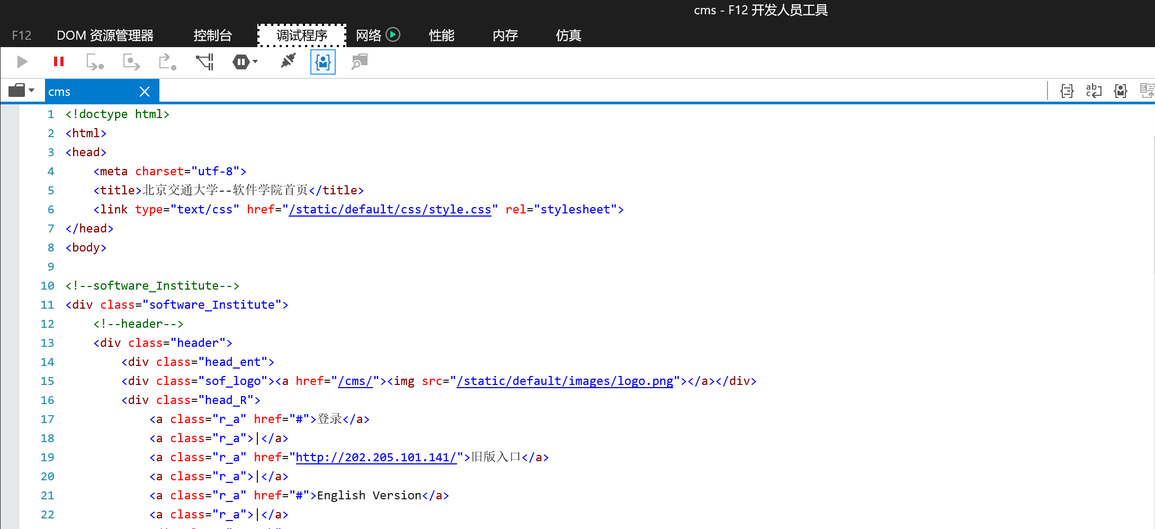
HTML file
2: Application Layer

Slide 31
HTTP overview (continued)
Uses TCP: 4 steps
client initiates TCP connection (creates socket) to server, port 80
server accepts TCP connection from client
HTTP messages (application-layer protocol messages) exchanged between browser (HTTP client) and Web server (HTTP server)
TCP connection closed
HTTP is “stateless”
server maintains no information about past client requests
aside
Protocols that maintain “state” are complex!
past history (state) must be maintained
if server/client crashes, their views of “state” may be inconsistent, must be reconciled (synchronized)
2: Application Layer
Notes:
Status of Client is unknown to server
When u login an app, the server will know ur status. If u have no activity for 15 mins, u will be kicked out by the server.

Slide 32
HTTP connections
Nonpersistent HTTP
At most one object is sent over a TCP connection.
Persistent HTTP
Multiple objects can be sent over single TCP connection between client and server.
非持续的，非持久的
持久的
2: Application Layer
Notes:
一次短连接发一个
一次长连接发多个
根据不同应用需要

Slide 33
Non-persistent HTTP
(contains text,
references to 10
jpeg images)
Suppose user enters URL www.someSchool.edu/someDepartment/home.index
1a. HTTP client initiates TCP connection to HTTP server (process) at www.someSchool.edu on port 80
1b. HTTP server at host www.someSchool.edu waiting for TCP connection at port 80. “accepts” connection, notifying client
2. HTTP client sends HTTP request message (containing URL) into TCP connection socket. Message indicates that client wants object someDepartment/home.index
3. HTTP server receives request message, forms response message containing requested object, and sends message into its socket
time
2: Application Layer

Slide 34
Non-persistent HTTP (cont.)
4. HTTP server closes TCP connection.
5. HTTP client receives response message containing html file, displays html. Parsing html file, finds 10 referenced jpeg objects
time
6. Steps 1-5 repeated for each of 10 jpeg objects
2: Application Layer

Slide 35
Non-Persistent HTTP: Response time
Definition of RTT (round trip time): time for a small packet to travel from client to server and back.
Response time:
one RTT to initiate TCP connection
one RTT for HTTP request and first few bytes of HTTP response to return
file transmission time
total = 2RTT+transmit time
initiate TCP
connection
RTT
request
file
RTT
time to
transmit
file
file
received
time
time
2: Application Layer

Slide 36
Persistent HTTP
Nonpersistent HTTP issues:
Too slow
Too much overhead
requires 2 RTTs per object
OS overhead for each TCP connection
browsers often open parallel TCP connections to fetch referenced objects
Persistent HTTP
Longer connection
More server resource
server leaves connection open after sending response
subsequent HTTP messages between same client/server sent over open connection
client sends requests as soon as it encounters a referenced object
as little as one RTT for all the referenced objects
2: Application Layer

Slide 37
HTTP request message
two types of HTTP messages: request, response
HTTP request message:
  ASCII (human-readable format)
request line
(GET, POST,
HEAD commands)
GET /somedir/page.html HTTP/1.1
Host: www.someschool.edu
User-agent: Mozilla/4.0
Connection: close
Accept-languange:fr
(extra carriage return, line feed)
header
lines
Extra
carriage return,
line feed
indicates end
of message
2: Application Layer
Notes:
ASCII ['æski]
基本释义
abbr. 美国信息交换标准码（American Standard Code for Information Interchange）
关于“回车”（carriage return）"\r"
和“换行”（line feed）"\n"

Slide 38

HTTP request message: general format
2: Application Layer
Notes:
Entity is empty when GET. It is used by POST
CR = carriage return
LF = line feed
SP = space

Slide 39

Uploading form input
Post method:
Web page often includes form input
Input is uploaded to server in entity body
URL method:
Uses GET method
Input is uploaded in URL field of request line:
www.somesite.com/animalsearch?monkeys&banana
2: Application Layer

Slide 40
Method types
HTTP/1.0
GET
POST
HEAD
  Similar to GET
  asks server to leave out the requested object in response
  For debugging
HTTP/1.1
GET, POST, HEAD
PUT
  uploads file in entity body to path on server specified in URL field
DELETE
  deletes file specified in the URL field
2: Application Layer

Slide 41
HTTP response message
status line
(protocol
status code
status phrase)
HTTP/1.1 200 OK
Connection close
Date: Thu, 06 Aug 1998 12:00:15 GMT
Server: Apache/1.3.0 (Unix)
Last-Modified: Mon, 22 Jun 1998 …...
Content-Length: 6821
Content-Type: text/html
data data data data data ...
header
lines
data, e.g.,
requested
HTML file
2: Application Layer

Slide 42
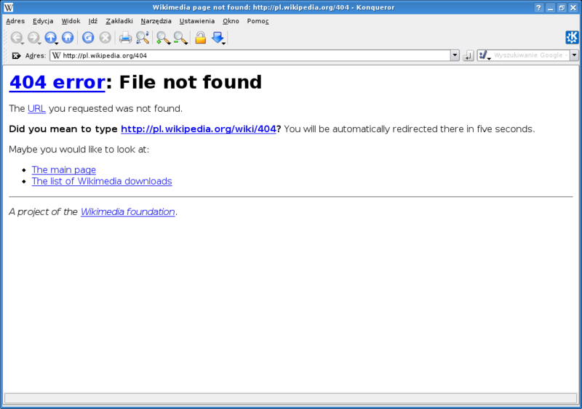
HTTP response status codes
In first line in server->client response message.
A few sample codes:
200 OK
  request succeeded, requested object later in this message
301 Moved Permanently
  requested object moved, new location specified later in this message (Location:)
400 Bad Request
  request message not understood by server
404 Not Found
  requested document not found on this server
505 HTTP Version Not Supported
2: Application Layer

Slide 43
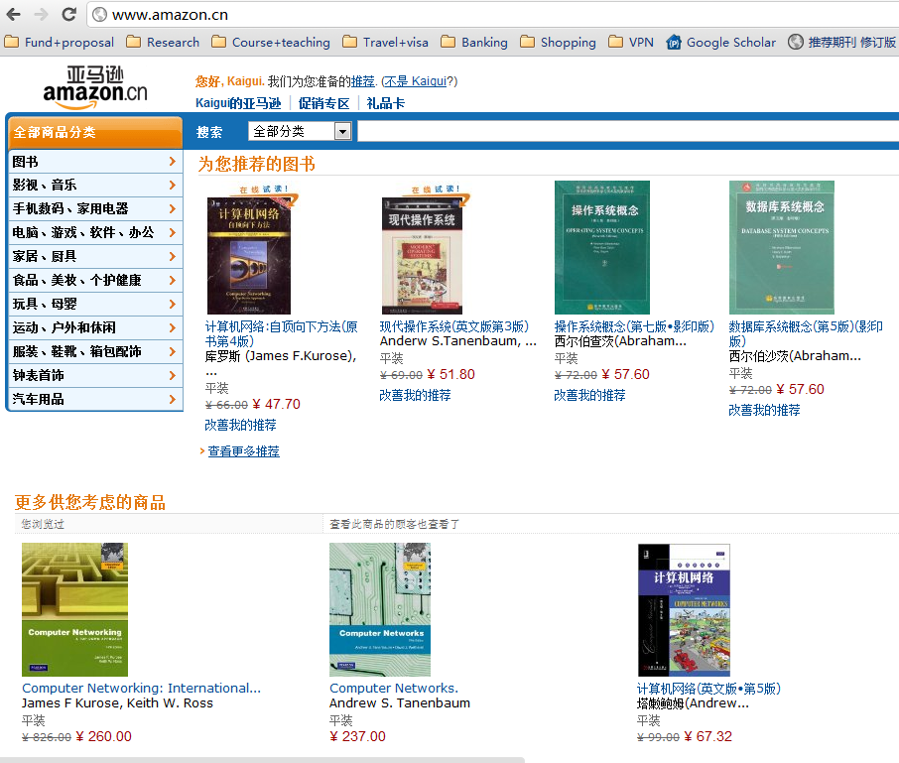
User-specific web page
A purchase
of textbook:
网络+
高教出版社
2: Application Layer
Notes:
telnet???

Slide 44

User-server state: cookies
Example:
Susan always access Internet always from PC
visits specific e-commerce site for first time
when initial HTTP requests arrives at site, site creates:
  unique ID
  entry in backend database for ID
Many major Web sites use cookies
Four components:
  1) cookie header line of HTTP response message
  2) cookie header line in HTTP request message
  3) cookie file kept on user’s host, managed by user’s browser
  4) back-end database at Web site
2: Application Layer
Notes:
Speed up the access to a page
Show ur favorite news, items, deals, etc
Ppl may not be aware of cookies

Slide 45
Cookies: keeping “state” (cont.)
client
server
ebay 8734
usual http request msg
Amazon server
creates ID
1678 for user
cookie file
usual http response
Set-cookie: 1678
create
entry
ebay 8734
amazon 1678
usual http request msg
cookie: 1678
cookie-
specific
action
access
one week later:
usual http response msg
backend
database
access
ebay 8734
amazon 1678
usual http request msg
cookie: 1678
cookie-
spectific
action
usual http response msg
2: Application Layer

Slide 46
Cookies (continued)
aside
What cookies can bring:
authorization
shopping carts
recommendations
user session state (Web e-mail)
Cookies and privacy:
cookies permit sites to learn a lot about you
you may supply name and e-mail to sites
How to keep “state”:
protocol endpoints: maintain state at sender/receiver over multiple transactions
cookies: http messages carry state
2: Application Layer
Notes:
E-transactions use cookies to see the steps and status of a transaction: e.g., purchase on taobao, payment at alipay
Many years ago
Password can be found in cookies

Slide 47

Web caches (proxy server)
Goal: satisfy client request without involving origin server
user sets browser: Web accesses via cache
browser sends all HTTP requests to cache
  object in cache: cache returns object
  else cache requests object from origin server, then returns object to client
origin
server
Proxy
server
HTTP request
HTTP request
client
HTTP response
HTTP response
HTTP request
HTTP response
client
origin
server
2: Application Layer

Slide 48
More about Web caching
cache acts as both client and server
typically cache is installed by ISP (university, company, residential ISP)
Why Web caching?
reduce response time for client request
reduce traffic on an institution’s access link.
Internet dense with (full of) caches: enables “poor” content providers to effectively deliver content
2: Application Layer
Notes:
Reduce the load of remote server

Slide 49
Caching example
Assumptions
average object size = 100,000 bits
avg. request rate from institution’s browsers to origin servers = 15/sec
delay from institutional router to any origin server and back to router = 2 sec
Consequences
utilization on LAN = 15%
utilization on access link (traffic intensity) = 100%
total delay = Internet delay + access delay + LAN delay
= 2 sec + minutes + milliseconds
origin
servers
public
Internet
1.5 Mbps
access link
institutional
network
10 Mbps LAN
institutional
cache
2: Application Layer
Notes:
TI (Traffic intensity) at bottom router is almost. The delay is huge, in order of minutes.
TI<=0.8, then a small delay.
1.5/10 = 15%
100,000 * 15 /1.5M = 1 sec

Slide 50
Caching example (cont)
origin
servers
possible solution
increase bandwidth of access link to, say, 10 Mbps
consequence
utilization on LAN = 15%
utilization on access link = 15%
Total delay = Internet delay + access delay + LAN delay
= 2 sec + msecs + msecs
often a costly upgrade
public
Internet
10 Mbps
access link
institutional
network
10 Mbps LAN
institutional
cache
2: Application Layer

Slide 51
Caching example (cont)
origin
servers
possible solution: install cache
suppose hit rate is 0.4
consequence
40% requests will be satisfied almost immediately
60% requests satisfied by origin server
utilization of access link reduced to 60%, resulting in negligible delays (say 10 msec)
total avg delay = Internet delay + access delay + LAN delay = .6*(2.01) secs + .4*milliseconds < 1.4 secs
public
Internet
1.5 Mbps
access link
institutional
network
10 Mbps LAN
institutional
cache
2: Application Layer
Notes:
2.01 = 2sec + tens of millisec

Slide 52
Chapter 2: Application layer
2.1 Principles of network applications
2.2 Web and HTTP
2.3 FTP
2.4 Electronic Mail
  SMTP, POP3, IMAP
2.5 DNS
2: Application Layer

Slide 53
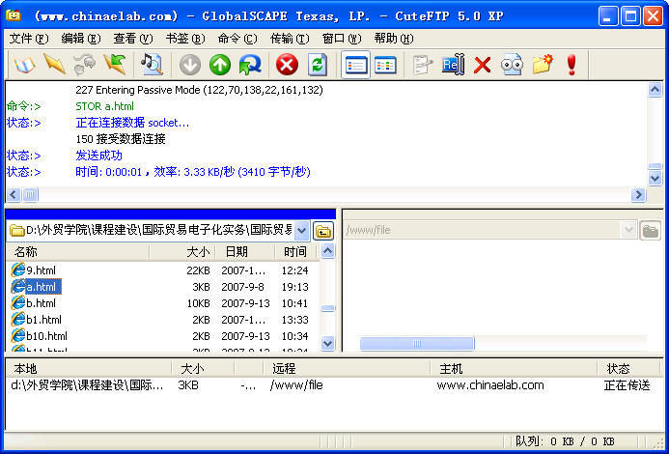
FTP: the file transfer protocol
2: Application Layer

Slide 54

FTP: the file transfer protocol
FTP
user
interface
FTP
client
file transfer
FTP
server
user
at host
remote file
system
local file
system
transfer file to/from remote host
client/server model
  client: side that initiates transfer (either to/from remote)
  server: remote host
ftp: RFC 959
ftp server: port 21 (control) + port 20 (data)
2: Application Layer

Slide 55
FTP: separate control, data connections
TCP control connection
port 21
FTP client contacts FTP server at port 21, TCP is transport protocol
client authorized over control connection
client browses remote directory by sending commands over control connection.
when server receives file transfer command, server opens 2nd TCP connection (for file) to client
after transferring one file, server closes data connection.
FTP
client
TCP data connection
port 20
FTP
server
server opens another TCP data connection to transfer another file.
control connection: “out of band”
FTP server maintains “state”: current directory, earlier authentication
2: Application Layer
Notes:
Out of band; Two TCP connections: one for control, one for data
ftp: State; http: stateless;http+cache = state

Slide 56
FTP commands, responses
Sample commands:
sent as ASCII text over control channel
USER username
PASS password
LIST return list of file in current directory
RETR filename retrieves (gets) file
STOR filename stores (puts) file onto remote host
Sample return codes
status code and phrase (as in HTTP)
331 Username OK, password required
125 data connection already open; transfer starting
425 Can’t open data connection
452 Error writing file
2: Application Layer

