Slide 1

Computer Networking Ruipeng Gao（高睿鹏）
Notes:
Hello everyone, now let’s begin our class. First, welcome to the computer networking course, and I’m the course instructor Ruipeng Gao.

Slide 2


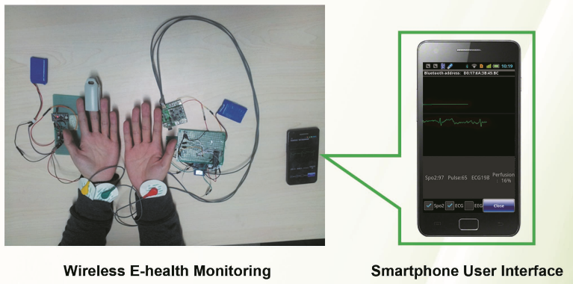
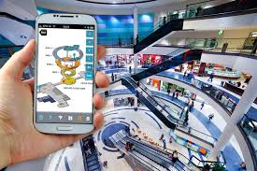
Course instructor
Ph.D. from Peking University
Lecturer in School of Software Engineering, BJTU
Research: wireless networking, mobile computing
Contacts
Room 708, Yifu Building
rpgao@bjtu.edu.cn
Notes:
First, let me introduce myself. I received the Ph.D degree from Peking University, and now I’m a faculty member in School of Software Engineering in Beijing Jiaotong University. My research interests include wireless networking and mobile computing, such as some indoor navigation and mobile health applications. This is my office room and email information; if you are interested in my research or you have any problems in this course, you can come to my office and we talk together.

Slide 3
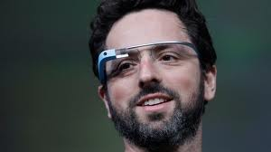

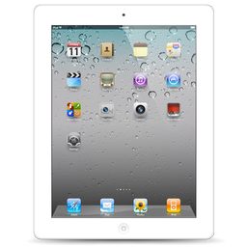
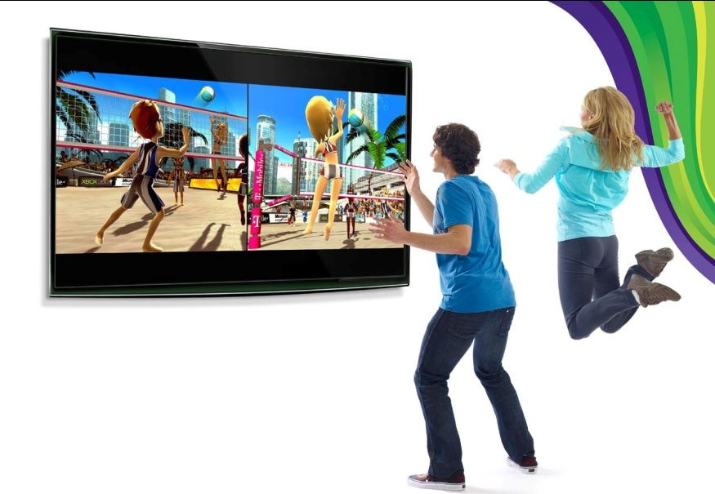

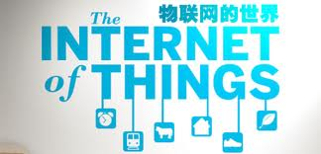
Why computer networks? (1/3)
It’s cool.
→
→
Notes:
Before this course, you may ask why we must learn the computer networks? First of all, it’s really cool. For nearly all modern devices, from a laptop, to Ipad, then to virtual reality devices such as the Google Glass and Leap Motion, they all rely on networks. If you can handle those devices very well, or you present the concept of Big Data and Internet of Things to your girlfriend, she will absolutely admire you.

Slide 4










Why computer networks? (2/3)
It’s promising.
Notes:
In addition, computer networks is promising. When we surf the Internet, we spend most of our time with these apps, and they all require networks. One question, who can open the websites of the last three apps, and do you know why and how they are forbidden in China. After you learn this course, you will find the answer. Attention please, illegal photos and videos are never allowed.

Slide 5
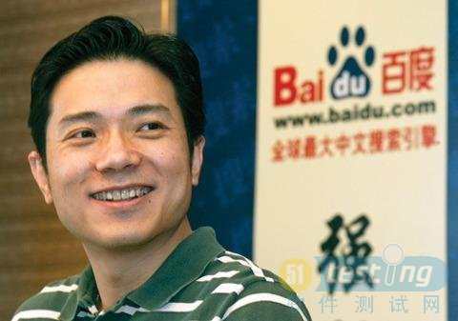

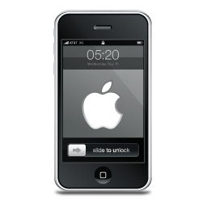




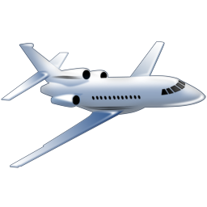
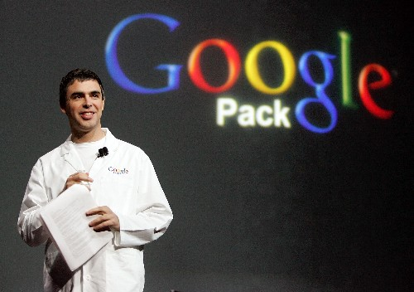
Why computer networks? (3/3)
It’s practical and useful.
Notes:
At last, computer networks is practical and useful. For ordinary students, you can easily find a job after graduation and earn a better life. For those students with passions and a clever mind, you can pursue advanced degrees, or open companies and become CEOs like these three men. Do you know who they are?

Slide 6





Why English?
The goal to be a 1st-tier university in the world
Difference between Chinese and English terms on networking
To write research papers
To study abroad
Work language
Notes:
Then you may ask: why it is an English course, First, we want to be a 1st-tier university in the world, since we already have so many foreign students in our class. Second, The Internet is designed mostly by foreign countries, thus English explains the techniques better than Chinese translations. In addition, if you want to write papers, study abroad, or work for foreign companies, it’s a good opportunity to improve your professional English.

Slide 7
What’s more in the honor-track class?
Fundamental networking theories
Cutting-edge networking researches
Internet of things, mobile Internet, dynamic spectrum access, etc.
Ideas from industry
Ideas on real-world networking applications/startups.
Many other skills
Research skills
Innovation skills
Notes:
From this course, you will learn fundamental networking theories. You will also understand the cutting-edge networking researches, including Internet of Things, mobile Internet, dynamic spectrum access, etc. You can also improve your innovation skills, research skills, and critical thinking skills from ideas on real-world networking applications and startups.

Slide 8
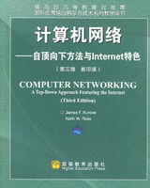
About the textbook
Computer networking:
a top-down approach
J. F. Kurose
www.cs.umass.edu/~kurose/
K. W. Ross cis.poly.edu/~ross/
“It is the most popular textbook on computer networking, both nationally and internationally, and has been translated into fourteen languages.”
Computer Networks
Andrew S. Tanenbaum
Notes:
The textbook we use is called Computer Networking, a top-down approach. It is the most popular textbook on computer networking, both nationally and abroad, and it has been translated into fourteen languages.

Slide 9
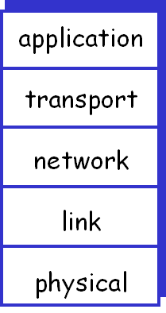
Course arrangement
Chap. 0 Overview
Chap. 1 Introduction
Chap. 2 Application layer
Chap. 3 Transport layer
Chap. 4 Network layer
Chap. 5 Link layer
Chap. 6 Wireless & mobile networks
Chap. 7 Security
传什么样数据？干什么事
从哪里到哪里？
需要确认吗？可靠传输？
途径哪些地方？
下一站是哪？
物理层具体怎么传数据？
（坐车还是坐船？）
Notes:
Our course is arranged the same as the textbook. In the first two classes, we give an overview and introduction of this course, including some key concepts such as the internet protocol stack. It has five layers, and this figure is used throughout our course. Then we use a top-down approach to look into each layer one by one. Application layer tells what data to transmit and what thing to do, transport layer identifies the sender and receiver of the data, and network layer solves the pathway of the data. In link layer, we find the next station of the data along the pathway, and in physical layer, we solve how to transmit the data, by car or by boat. At last we discuss several hot topics such as the security problem in networking.

Slide 10
Grading
32 class hours during 8 weeks
Every Monday and Thursday morning
Attendance, 10%
Homework
Assignments, 15%
Project
Slides and reports, 15%
Exams:
Open-book final exam, 60%
Thanks and enjoy!
Notes:
You may care more about the grading guidelines. Our course has 32 class hours during 8 weeks, on every Monday and Thursday morning, and your attendance account for 10% of your final score. Your homework accounts for 15%, and a project with report accounts for another 15%. At last, an open-book final exam accounts for 60%.

