Slide 1

Who changed
America?
Smartphone?
In future, any software, device, or even surface for generating data/content.

Slide 2



What’s future application like?
Interactive applications

Slide 3
Chapter 2: Application layer
2.1 Principles of network applications
2.2 Web and HTTP
2.3 FTP
2.4 Electronic Mail
  SMTP, POP3, IMAP
2.5 DNS (domain name service)
2: Application Layer

Slide 4

Electronic Mail
outgoing
message queue
user mailbox
Three components:
user agents
mail servers
simple mail transfer protocol: SMTP
user
agent
mail
server
user
agent
SMTP
mail
server
user
agent
SMTP
SMTP
mail
server
user
agent
user
agent
user
agent
2: Application Layer

Slide 5

Electronic Mail: user agent
User Agent
a.k.a. “mail reader”
composing, editing, reading mail messages
Outlook, Eudora, elm, Mozilla Thunderbird
outgoing, incoming messages stored on server
retrieve email from server
2: Application Layer

Slide 6
Electronic Mail: mail servers
Mail Servers
mailbox contains incoming messages for user
message queue of outgoing (to be sent) mail messages
SMTP protocol between mail servers to send email messages
  “client”: sending mail server
  “server”: receiving mail server
user
agent
mail
server
user
agent
SMTP
mail
server
user
agent
SMTP
SMTP
mail
server
user
agent
user
agent
user
agent
2: Application Layer
Notes:
Server = Postal office
Check email, user retrieve email from mailbox
Server’s role: client in quote mark = “client”

Slide 7
Electronic Mail: SMTP [RFC 2821]
uses TCP to reliably transfer email message from client to server, port 25
direct transfer: sending server to receiving server
three phases of transfer
  handshaking (greeting)
  transfer of messages
  closure
command/response interaction
  commands: ASCII text
  response: status code and phrase
messages must be in 7-bit ASCII
2: Application Layer
Notes:
ASCII ['æski] = American Standard Code for Information Interchange

Slide 8


Scenario: Alice sends message to Bob
1) Alice uses UA to compose message and “to” bob@someschool.edu
2) Alice’s UA sends message to her mail server; message placed in message queue
3) Client side of SMTP opens TCP connection with Bob’s mail server
4) SMTP client sends Alice’s message over the TCP connection (queue to mailbox)
5) Bob’s mail server places the message in Bob’s mailbox
6) Bob invokes his user agent to read message
POP3
IMAP
HTTP
SMTP
1
mail
server
mail
server
SMTP
user
agent
user
agent
2
3
6
4
5
2: Application Layer

Slide 9
Try SMTP interaction for yourself:
telnet SMTPservername 25
see 220 reply from server
  220 server name
enter HELO, MAIL FROM, RCPT TO, DATA, QUIT commands
These operations above would let you send email without using email client (reader)
2: Application Layer

Slide 10
SMTP: final words
SMTP uses persistent connections
SMTP requires message (header & body) to be in 7-bit ASCII
SMTP server uses CRLF.CRLF to determine end of message
2: Application Layer
Notes:
One connection, multi message
7-bit ASCII, no multimedia email
End of email: Carriage return （回车）+ line feed （换行）

Slide 11
Comparison with HTTP
HTTP: pull (GET)
SMTP: push (simple transfer)
SMTP requires message format to be 7-bit ASCII; HTTP does not have such restrictions.
HTTP: each object encapsulated (embedded) in its own response msg
SMTP: multiple objects sent in one msg
  HTTP includes each obj. in each response msg
2: Application Layer

Slide 12
Mail access protocols
SMTP
SMTP
access
protocol
user
agent
user
agent
sender’s mail
server
receiver’s mail
server
SMTP: delivery/storage to receiver’s server
Mail access protocol: retrieval from server
  POP: Post Office Protocol [RFC 1939]
    authorization (agent <-->server) and download
  IMAP: Internet Mail Access Protocol [RFC 1730]
    more features (more complex)
    More operations (manipulation) of stored msgs on server
  HTTP: gmail, Hotmail, Yahoo! Mail, etc.
2: Application Layer
Notes:
Check email;
Emails are fetched by users, not automatically delivered.

Slide 13
POP3 protocol
S: +OK POP3 server ready
C: user bob
S: +OK
C: pass hungry
S: +OK user successfully logged on
authorization phase
client commands:
  user: declare username
  pass: password
server responses
  +OK
  -ERR
transaction phase, client:
list: list message numbers
retr: retrieve message by number
dele: delete
quit
C: list
S: 1 498
S: 2 912
S: .
C: retr 1
S: <message 1 contents>
S: .
C: dele 1
C: retr 2
S: <message 1 contents>
S: .
C: dele 2
C: quit
S: +OK POP3 server signing off
2: Application Layer

Slide 14

IMAP
For mobile users, more complex than POP3
  keep all messages in one place: the server
Allows user to organize messages in folders
Users can obtain part of a msg (e..g, a header)
IMAP keeps user state across sessions:
  names of folders
  message IDs associated with which folder name
2: Application Layer

Slide 15
Chapter 2: Application layer
2.1 Principles of network applications
2.2 Web and HTTP
2.3 FTP
2.4 Electronic Mail
  SMTP, POP3, IMAP
2.5 DNS
2: Application Layer

Slide 16
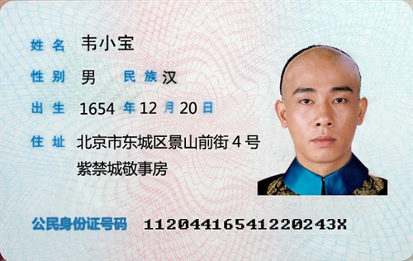
ID-name mapping system
Any people has
  an ID#, a name, and a home address.
Mapping between ID and Name
2: Application Layer
Notes:
SSN = secret, like C-card #
Driver license = = shen fen zheng
Hu-kou

Slide 17
DNS: Domain Name System
IP address from left to right
202.205.101.169
北京交通大学，逸夫西楼，708
People: many identifiers:
  SSN, name, passport #
Internet hosts, routers:
  IP address (32 bit) - used for addressing datagrams
  “name”, e.g., ww.yahoo.com - used by humans
Q: map between IP addresses and name ?
IP address
= ID + home addr. of a host
2: Application Layer
Notes:
SSN = secret, like C-card #
Driver license = = shen fen zheng
Hu-kou

Slide 18
DNS: Domain Name System
Domain Name System:
distributed database implemented in hierarchy of many name servers
application-layer protocol host, routers, name servers to communicate to resolve names (address/name translation)
  note: core Internet function, implemented as application-layer protocol
  complexity at network’s “edge”
不同层次
2: Application Layer

Slide 19
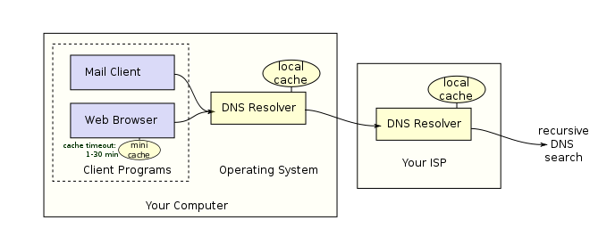
DNS: translation
DNS services
hostname to IP address translation
Host (web server) aliasing: Canonical, alias names 别名
  http://faculty.bjtu.edu.cn/8972/
mail server aliasing
DNS
server
DNS
server
2: Application Layer

Slide 20
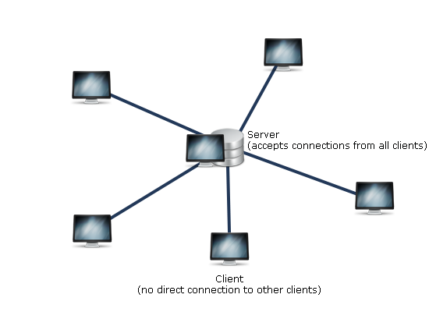
Why not centralized DNS?
Why not centralize DNS?
single point of failure
traffic volume
distant centralized database
maintenance
doesn’t scale!
DNS
server
2: Application Layer

Slide 21
Distributed, Hierarchical Database
Root DNS Servers
com DNS servers
org DNS servers
edu DNS servers
yahoo.com
DNS servers
pbs.org
DNS servers
poly.edu
DNS servers
umass.edu
DNS servers
amazon.com
DNS servers
Client wants IP for www.amazon.com; 1st approx:
client queries a root server to find com DNS server
client queries com DNS server to get amazon.com DNS server
client queries amazon.com DNS server to get IP address for www.amazon.com
2: Application Layer

Slide 22

DNS: Root name servers
contacted by local name server that can not resolve name
root name server:
  contacts authoritative name server if name mapping not known
  gets mapping
  returns mapping to local name server
a Verisign, Dulles, VA
c Cogent, Herndon, VA (also LA)
d U Maryland College Park, MD
g US DoD Vienna, VA
h ARL Aberdeen, MD
j Verisign, ( 21 locations)
k RIPE London (also 16 other locations)
i Autonomica, Stockholm (plus 28 other locations)
e NASA Mt View, CA
f Internet Software C. Palo Alto, CA (and 36 other locations)
m WIDE Tokyo (also Seoul, Paris, SF)
13 root name servers worldwide
b USC-ISI Marina del Rey, CA
l ICANN Los Angeles, CA
2: Application Layer
Notes:
8 in US
2 in euro
1 in tokyo

Slide 23
TLD and Authoritative Servers
Top-level domain (TLD) servers:
  responsible for com, org, net, edu, etc, and all top-level country domains uk, fr, ca, jp.
  Network Solutions maintains servers for com TLD
  Educause for edu TLD
Authoritative DNS servers:
  organization’s DNS servers, providing authoritative hostname to IP mappings for organization’s servers (e.g., Web, mail). mail.bjtu.edu.cn
  can be maintained by organization or service provider
2: Application Layer
Notes:
美国高校教育信息化协会（EDUCAUSE）

Slide 24
TLD and Authoritative Servers
Root DNS Servers
TLD server
com DNS servers
org DNS servers
edu DNS servers
pbs.org
DNS servers
poly.edu
DNS servers
umass.edu
DNS servers
yahoo.com
DNS servers
amazon.com
DNS servers
Authoritative
DNS server
2: Application Layer
Notes:
mail.amazon.com

Slide 25
Local Name Server
does not strictly belong to hierarchy
each ISP (residential ISP, company, university) has one.
  also called “default name server”
when host makes DNS query, query is sent to its local DNS server
  acts as proxy, forwards query into hierarchy
DNS
server
DNS
server
2: Application Layer

Slide 26
Example: DNS name resolution
root DNS server
2
Host at cis.poly.edu wants IP address for gaia.cs.umass.edu
3
TLD DNS server
4
5
iterated query:
contacted server replies with name of server to contact
“I don’t know this name, but ask this server”
local DNS server
dns.poly.edu
7
6
1
8
authoritative DNS server
dns.cs.umass.edu
requesting host
cis.poly.edu
反复查询
gaia.cs.umass.edu
2: Application Layer

Slide 27
Example: DNS name resolution
root DNS server
recursive query:
puts burden of name resolution on contacted name server
heavy load?
  Root or TLD has to wait the response
2
3
7
6
TLD DNS server
local DNS server
dns.poly.edu
5
4
1
8
authoritative DNS server
dns.cs.umass.edu
递归查询
requesting host
cis.poly.edu
gaia.cs.umass.edu
2: Application Layer

Slide 28
DNS: caching and updating records
8 msgs in the previous example!
once (any) name server learns mapping, it caches mapping
  cache entries timeout (disappear) after some time
  TLD servers typically cached in local name servers
    Thus root name servers not often visited
update/notify mechanisms under design by IETF
  RFC 2136
  http://www.ietf.org/html.charters/dnsind-charter.html
2: Application Layer

Slide 29
DNS records and types
DNS: distributed db storing resource records (RR)
RR format: (name, value, type, ttl)
Type=A
  name is hostname
  value is IP address
Type=CNAME
  name is alias name for some “canonical” (the real) name
  www.ibm.com is really
  servereast.backup2.ibm.com
  value is canonical name
Type=NS
  name is domain (e.g. foo.com)
  value is hostname of authoritative name server for this domain
Type=MX
  value is name of mailserver associated with name
    mail.ibm.com
2: Application Layer

Slide 30

DNS protocol, messages
DNS protocol : query and reply messages, both with same message format
msg header
Msg ID: 16 bit # for query, reply to query uses same #
4 flags: 0 or 1
  query or reply?
  reply is authoritative?
  recursion desired ?
  recursion supported?
2: Application Layer

Slide 31
DNS protocol, messages
Name, type fields
for a query:
Ex. ibm, type A
RRs in response
to query:
Ex. Single or multi records
records for
authoritative servers
additional “helpful”
info that may be used:
Ex. canonical name
for mail server
Same for query & reply
2: Application Layer

Slide 32
Inserting records into DNS
example: new startup “Network Utopia”
register name networkuptopia.com at DNS registrar (e.g., Network Solutions)
  provide names, IP addresses of authoritative name server (primary and secondary)
  registrar inserts two RRs into com TLD server:
  (networkutopia.com, dns1.networkutopia.com, NS)
  (dns1.networkutopia.com, 212.212.212.1, A)
Type NS record for networkutopia.com
Type A record for www.networkuptopia.com;
2: Application Layer
Notes:
Home address must be also registered to government.

Slide 33
Same technique, different applications
Caching for web & DNS
Handshake for HTTP, FTP, DNS
  Request + response; query + reply
Hierarchy for ISP, DNS server
  Root, local, etc
Header & body Msg format: http, DNS
Architecture: Central controller (server) + distributed users under control (client)
  Web
  Wireless networks
2: Application Layer
Notes:
Similar approach:
Handshake
Caching
Hierarchy
Mapping+translation
Wireless networks

