Slide 1
Chapter 1: Introduction
Our goal:
get “feel” and terminology 术语
more depth, detail later in course
approach:
  use Internet as example
Overview:
what’s the Internet?
what’s a protocol?
network edge; hosts, access net, physical media
network core: packet/circuit switching, Internet structure
performance: loss, delay, throughput
protocol layers, service models
history
Introduction
1-<number>
Notes:
The first chapter is introduction. In this chapter, our goal is to get a feeling of terminology and professional words, and we explain more depth and details later in each chapter. In this chapter, we first explain what is the Internet, and what is a protocol. Then we introduce the edge and core of networks. In order to evaluate a network, we propose three main metrics, the loss, delay and throughput. The most important part of this chapter is the protocol layers and service models, since they exist through this course. At last we will learn the security issue and history of networking.

Slide 2
Chapter 1: roadmap (agenda, outline)
  1.1 What is the Internet?
  1.2 Network edge
    end systems, access networks, links
  1.3 Network core
    circuit switching, packet switching, network structure
  1.4 Delay, loss and throughput in packet-switched networks
  1.5 Protocol layers, service models
  1.6 Networks under attack: security
  1.7 History
Introduction
1-<number>
Notes:
Def. of internet
Agenda, outline

Slide 3


What’s the Internet
Web surfing ≠ Internet, networking

Slide 4


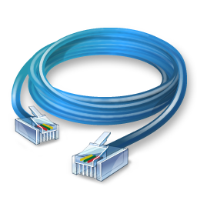



What’s the Internet: computer + cable
Something amazing behind your screen?
Internet?
Introduction
1-<number>
Notes:
What is behind the screen?
You may have many questions How it works
Lets explore this topic chapter by chapter
At the end of this term, you will find the answer.

Slide 5










What’s the Internet: our definition
No one-sentence definition in the book
An analogy: social network → computer network
Implementation of human society in digital world
Communication
…
Introduction
1-<number>
Notes:
What makes a ppl as a social animal?---communication.
Communication between individuals connects people and makes up a society.
When u miss and want to talk to ur girl friend, the answer is Communication
mail, it is painful to wait
Then, phone talk in 1847, still not good
better ways? internet!
Technology evolves, our life gets better n better. U can feel what I feel, see what I see, know what’s happening over my place.

Slide 6


What’s included in the Internet
What’s included in a society?
  People, entities
  Services
  Laws and rules (define the behaviors of the above two parts)
→ internet components
→ internet services
→ protocols, standards
Society
Introduction
1-<number>
Notes:
What makes a Society? Communication between individuals connects people and makes up a society.
Digital version is internet.
1. Component
Computer has ur info n data, it is a representative of you. Ur ID, credit card #, ur address
2. Services: Our goal, internet hopes to replace all services you have in physical world, which is called a virtual world.
newspaper→ web browser
However, partially achieved.
Can help you order food, but cannot eat food when you feel hungry.
3. Laws n rules, you
Cannot cheat
Cannot abuse, or manipulate rules
Protocol can regulate the behavior of component and services

Slide 7







Two views of the Internet
”Nuts and bolts” view
  Components that make up the Internet
A service view
  Web: client + server
  Social networking, game
Mobile network
Global ISP
Home network
Regional ISP
Institutional network
Introduction
1-<number>
Notes:
Two views of understand the Internet
When u focus on computer, router, u r at nuts n bolts view
When u focus on apps such as email, web surfing, u r at service view
Both of them are correct views, covered and used in this course.

Slide 8
Components of the Internet
PC, host, client
Desktop, end system
终端
Access Points
base station
无线基站，发射塔
Server
服务器
Router or switch
路由器或交换机
Mobile device. Laptop
移动终端
Cell phone
手机
Introduction
1-<number>

Slide 9
What’s the Internet: “nuts and bolts” view
millions of connected computing devices:
hosts = end systems
  running network apps
Mobile network
Global ISP
Home network
communication links
  fiber, 光纤
  (twisted-pair) copper wire 双绞线铜线
  radio, 无线电
  satellite, 卫星
Regional ISP
Wired
Institutional network
Wireless
Introduction
1-<number>
Notes:
Apps on ur computer:
Search
Social networks
Link
Wired
Wireless

Slide 10
What’s the Internet: “nuts and bolts” view
Mobile network
transmission rate = bandwidth 带宽
routers: forward packets (chunks of data)
Internet service provider (ISP)
  China mobile中国移动
  China telecom中国电信
Global ISP
Home network
Regional ISP
Intra-net
Institutional network
Inter-net
Introduction
1-<number>
Notes:
Bandwidth: How fast you download a movie
Router: is like a postal office, it knows where to deliver or send data.
Upper-tier ISP; lower=-tier ISP
Intra or inter net

Slide 11



What is a protocol?
Protocol = Pre-agreed rules
Smile = Happy
Nod = yes Shake = no
Human protocols:
What's the time?
Specific msgs sent
Specific actions taken when msgs received, or other events
Cry = Sad

Slide 12
What’s a protocol?
a human protocol and a computer network protocol:
Hi
TCP connection
request
Hi
TCP connection
response
Got the
time?
Get http://www.awl.com/kurose-ross
2:00
<file>
time
Q: Other human protocols?
Introduction
1-<number>
Notes:
Handshake. Other human protocols?
Think about it. A few minutes.
Hint: Time of trip, to and back. No response, congestion, a lot of data traffic. To estimate the traffic over link.

Slide 13
What’s a protocol?
network protocols:
machines rather than humans
all communication activity in Internet governed by protocols
protocols define format, order of msgs sent and received among network entities, and actions taken on msg transmission, receipt
understand
Introduction
1-<number>
Notes:
If we want to implement this on computers and networks
We use machine to communicate. A machine has to understand another machine.
We need a protocol.
Standards = details or guidelines of protocols.
Protocol defines the format, order of msgs.
I teach this course. Cannot be: the course teach me.

Slide 14
Chapter 1: roadmap
  1.1 What is the Internet?
  1.2 Network edge
    end systems, access networks, links
  1.3 Network core
    circuit switching, packet switching, network structure
  1.4 Delay, loss and throughput in packet-switched networks
  1.5 Protocol layers, service models
  1.6 History
Introduction
1-<number>

Slide 15
Edge and core
Edge
Core
Introduction
1-<number>

Slide 16
A closer look at network structure:
network edge: applications and hosts
access networks, physical media: wired, wireless communication links
network core:
  interconnected routers
  network of networks
Introduction
1-<number>

Slide 17
The network edge
end systems (hosts):
  run application programs
  e.g. Web, email
  at “edge of network”
peer-peer
client/server model
  client host requests, receives service from always-on server
  e.g. Web browser/server; email client/server
client/server
peer-peer model:
  minimal (or no) use of dedicated servers
  e.g. Skype, BitTorrent
Introduction
1-<number>
Notes:
P2p= min use of service, download contact book from server
Details in chapter 2

Slide 18
The Network Core
mesh of interconnected routers
the fundamental question: how is data transferred through net? Two ways
  circuit switching: dedicated circuit per call: telephone net
  packet switching: data sent thru net in discrete “chunks”
线路预留
随到随发
Introduction
1-<number>
Notes:
Mesh = network
Circuit = 线路

Slide 19
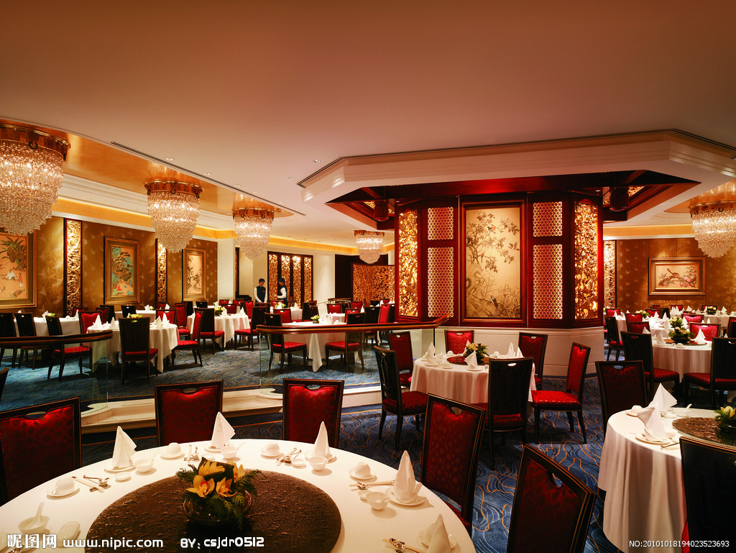
Example: restaurant reservation
A hybrid of two methods
  Reservation in advance for VIP, reliable
  On-demand service for arrived guests, unreliable
Most restaurants take this hybrid approach
Introduction
1-<number>
Notes:
Vip room by reservation
1st come, 1st served

Slide 20
Network Core: Circuit Switching
network resources (e.g., bandwidth) divided into “pieces”
pieces allocated to calls
resource piece idle if not used by owning call (no sharing)
dividing link bandwidth into “pieces”
  frequency division
  time division
Introduction
1-<number>
Notes:
Simultaneously transmit on distinct channels.
Time Round-robin manner

Slide 21
Resource allocation in our life
Example: 4 lanes in a road
Lane-based
Car speed: low
4 type of cars
4 Lanes
4车道
time
Time-based
Car speed: high
Lanes
time
Introduction
1-<number>

Slide 22
Circuit Switching: FDM and TDM
4 freq. bands
4 circuits
Example:
FDM
4 users
frequency
time
TDM
4 slots
4 circuits
frequency
time
Introduction
1-<number>
Notes:
Two simple multiple access control techniques.
Each mobile’s share of the bandwidth is divided into portions for the uplink and the downlink. Also, possibly, out of band signaling.
As we will see, used in AMPS, GSM, IS-54/136

Slide 23
Numerical example
How long does it take to send a file of 640,000 bits from host A to host B over a circuit-switched network?
  All links are 1.536 Mbps
  Each link uses TDM with 24 slots/sec
  500 msec to establish end-to-end circuit
Let’s work it out!
500msec + 640000/ (1.536M/24) = 10.5sec
That is 24 circuits
Introduction
1-<number>

Slide 24
Network Core: Packet Switching
Unsaturated data streams
each end-end data stream divided into packets
user A, B packets share network resources
each packet uses full link bandwidth
resources used as needed
resource contention:
aggregate resource demand can exceed amount available
congestion: packets queue, wait for link use
store and forward: packets move one hop at a time
  Node receives complete packet before forwarding
Bandwidth division into “pieces”
Dedicated allocation
Resource reservation
Introduction
1-<number>
Notes:
Contention = competition
Strong demand may get more resource
Weak demand may get small resource

Slide 25
Packet-switching: store-and-forward
L
R
R
R
takes L/R seconds to transmit (push out) packet of L bits on to link at R bps
store and forward: entire packet must arrive at router before it can be transmitted on next link
delay = 3L/R (assuming zero propagation delay)
Example:
L = 7.5 Mbits
R = 1.5 Mbps
transmission delay = 15 sec
Introduction
1-<number>
Notes:
L is file size, think it as a length

Slide 26
Packet switching versus circuit switching
Packet switching allows more users to use network!
1 Mb/s link
each user:
  100 kb/s when “active”
  active 10% of time
circuit-switching:
  10 users
packet switching:
  with 35 users, probability > 10 active at same time is less than .0004
N users
1 Mbps link
Q: how did we get value 0.0004?
Introduction
1-<number>
Notes:
Circuit: allocate 1Mb to the pieces
Packet switching: by probability, it is possible that 35 users can coexist without problem.
The probability that congestion---more than 10 users---is very low.

Slide 27


Packet switching versus circuit switching
Is packet switching a “slam dunk winner?”
great for bursty data
  resource sharing
  simpler, no call setup
excessive congestion: packet delay and loss
  protocols needed for reliable data transfer, congestion control
Q: How to provide circuit-like behavior?
  bandwidth guarantees needed for audio/video apps
  still an unsolved problem (chapter 7)
Introduction
1-<number>
Notes:
Analogy: restaurant

Slide 28
Summary for Introduction 1
Internet
Components
Client-server
Protocol
Circuit-, packet-switching
Internet
Introduction
1-<number>

